Slide 1
About OMICS Group
OMICS Group International is an amalgamation of Open Access publications and worldwide international science conferences and events. Established in the year 2007 with the sole aim of making the information on Sciences and technology ‘Open Access’, OMICS Group publishes 400 online open access scholarly journals in all aspects of Science, Engineering, Management and Technology journals. OMICS Group has been instrumental in taking the knowledge on Science & technology to the doorsteps of ordinary men and women. Research Scholars, Students, Libraries, Educational Institutions, Research centers and the industry are main stakeholders that benefitted greatly from this knowledge dissemination. OMICS Group also organizes 300 International conferences annually across the globe, where knowledge transfer takes place through debates, round table discussions, poster presentations, workshops, symposia and exhibitions.

Slide 2
About OMICS Group Conferences
OMICS Group International is a pioneer and leading science event organizer, which publishes around 400 open access journals and conducts over 300 Medical, Clinical, Engineering, Life Sciences, Phrama scientific conferences all over the globe annually with the support of more than 1000 scientific associations and 30,000 editorial board members and 3.5 million followers to its credit.
OMICS Group has organized 500 conferences, workshops and national symposiums across the major cities including San Francisco, Las Vegas, San Antonio, Omaha, Orlando, Raleigh, Santa Clara, Chicago, Philadelphia, Baltimore, United Kingdom, Valencia, Dubai, Beijing, Hyderabad, Bengaluru and Mumbai.

Slide 3

PREDICTION AND OPTIMIZATION OF HEAT AFFECTED ZONE WIDTH FOR SUBMERGED ARC WELDING PROCESS
Dr. N K SINGH
Associate Professor
Email: nks_221@yahoo.co.in, Mobile: + 91 9431711359
Indian School of Mines, Dhanbad, INDIA

Slide 4
ABSTRACT
Control of heat affected zone (HAZ) width is very essential for getting required weld bead size and quality. Conditions must be found out that will ensure a predictable and reproducible weld bead that is essential for obtaining repeated, expected cost effective, high quality welded joint. An attempt has been made in present work to find out relation between process control factors i.e. arc voltage, wire feed rate, travel speed, stick out, and heat input and HAZ width. Prediction of HAZ width through analytical solution of heat conduction equation has also been made. Optimum setting of process control variables for minimum HAZ width has been found out through graphical technique.
Key words: HAZ width, Submerged Arc Welding process, transient temperature distribution, regression model, optimization through graphical technique.

Slide 5
INTRODUCTION
Submerged arc welding (SAW) is a high quality, high deposition rate welding process commonly used to join plates of higher thickness in load bearing components. This process of arc welding provides a purer and cleaner high volume weldment that has relatively a higher material deposition rate compared to the traditional welding methods. Submerged Arc Welding Process is one of the important fabrication processes in industry as it has inbred advantage [1, 2]. Use of this technology has huge economic and social implications in the national perspective. A common issue in the application of SAW process raises a concern about the uncertainties involved with the heat affected zone (HAZ) in and around the weldment. The most intriguing issue is about HAZ softening that imparts some uncertainties in the welded quality. It increases the probability of fatigue failures at the weakest zones caused by the heating and cooling cycle of the weld zone. It is observed that a refined microstructure of the HAZ, imparts largely the intended properties of the welded joint [3].

Slide 6
For the case SAW joint, engineers repeatedly face the problem to select the appropriate process control parameters for getting optimum value of HAZ width [4]. In order to bring out an appropriate combination of SAW parameters and a methodology to control such parameters an in depth investigations and characterizations of HAZ softening zone are necessary to enrich this Submerged Arc Welding technology.
In Submerged Arc welding process, major process control parameters are arc voltage and travel speed, wire feed rate, stick out etc. They all affect the bead shape, depth of penetration and chemical composition of the deposited weld metal. Another very critical issue in the understanding of the joint performance obtained from SAW process rests on the analysis of heat affected zone. It is difficult for the operator to observe the weld pool during the process. So, better control comes from SAW process parameter settings than dependence on the operator’s expertise. The HAZ has various regions which influence the ability of the joint to provide crack resistance and uniform strength in both the directions of the weld [3].

Slide 7
The bead width and depth of penetration, measured by infrared thermal imaging technique (IRTI technique), were also found to influence the quality of SAW process [5].
Few details are available in the literature on the aspects of HAZ softening during SAW process. A three-dimensional analysis, aimed at predicting the microstructure in the different zones of a SAW joint, has been proposed in [6].A model to predict HAZ in case of SAW is addressed by [6] attempts to predict HAZ in case of SAW. The combined effect of flux chemical composition and of the welding parameters on the mechanical properties of SAW process has been shown to be of major importance [7-8]. Although the SAW process has drawn much of attention, in recent time [6-10], it is quite clear that a systematic study to bring out a correlation- based performance characterization through identification of control parameters in conjunction with quality assessment, is still missing.

Slide 8
The identification of the contribution of each process parameter on the quality or performance of a SAW joint, poses a challenge to the researchers in this area and demands a very systematic study of the problem. Since the HAZ width is controlled by process parameters and heat input [4], an attempt was made in this paper to correlate the HAZ width with these quantities, in order to optimize the process variables for minimum HAZ width.

Slide 9
EXPERIMENTAL PROCEDURE
MEMCO semi automatic welding machine with constant voltage, retifyer type power source with a 1200-A capacity was used to join C-Mn steel plates 30×15×2cm. An ESAB SA1 (E8), 0.315 cm diameter, copper coated electrode and a basic fluoride type granular flux were used. The experiments were conducted as per the design matrix randomly to avoid errors due to noise factors. Two pieces of C-Mn steel plates were cut and V groove of angle 60º as per the standards were prepared.
The chemical composition of work piece material is described in Table 1. 0.1 cm root opening was selected to join the plates in the flat position keeping electrode positive and perpendicular to the plate. The job was firmly fixed to a base plate and then the submerged arc welding was finally carried out. HAZ width has been measured with the help of optical research microscope(NEOPHOT-32).

Slide 10
DEVELOPMENT OF MATHEMATICAL MODEL
Let HAZ width can be expressed as Y=a₀+a₁V+a₂F+a₃S+a₄N+a₅V²+a₆F²+a₇S²+a₈N²+a₉VF+a₁₀VS+a₁₁VN+a₁₂FS+a₁₃FN+a₁₄SN
Where V, F, S and N denote Arc Voltage, Wire Feed Rate, Travel Speed and Stick Out respectively. From the data of table-2 the a_{i} coefficients (with i=1-14) were calculated by MAT LAB and tabulated in table-3. Calculation of Variance for testing has been made as shown in table 4. It has been found from table-4, this regression model is adequate.

Slide 11
TABLE-3: Regression coefficient of model
SL NO. | Coefficient | Values of Coefficient for prediction of HAZ width
1 | a₀ | 1.04
2 | a₁ | 0.02
3 | a₂ | 0.15
4 | a₃ | -0.16
5 | a₄ | -0.05
6 | a₅ | 0.04
7 | a₆ | 0.07
8 | a₇ | 0.08
9 | a₈ | -0.01
10 | a₉ | 0.03
11 | a₁₀ | 0.01
12 | a₁₁ | 0.03
13 | a₁₂ | -0.06
14 | a₁₃ | 0.04
15 | a₁₄ | 0.01

Slide 12

PARABOLOID HEAT SOURCE:
Heat input is the key parameter for the change of HAZ.So study on heat distribution/transient temperature distribution on welded plate is very essential. For submerged arc welding process heat distribution shape has been assumed as paraboloid.
Let a paraboloid heat source, in which heat is distributed in a Gaussian manner throughout the heat source volume, was initially considered. The heat density q(x, y, z) at a point(x, y, z) is given by the following equation:
q(x, y, z) =A $e^{−(z^{4}−ax^{2}−ay^{2})}$ (1) Where A, a are the maximum heat density and paraboloid heat source parameter respectively.

Slide 13
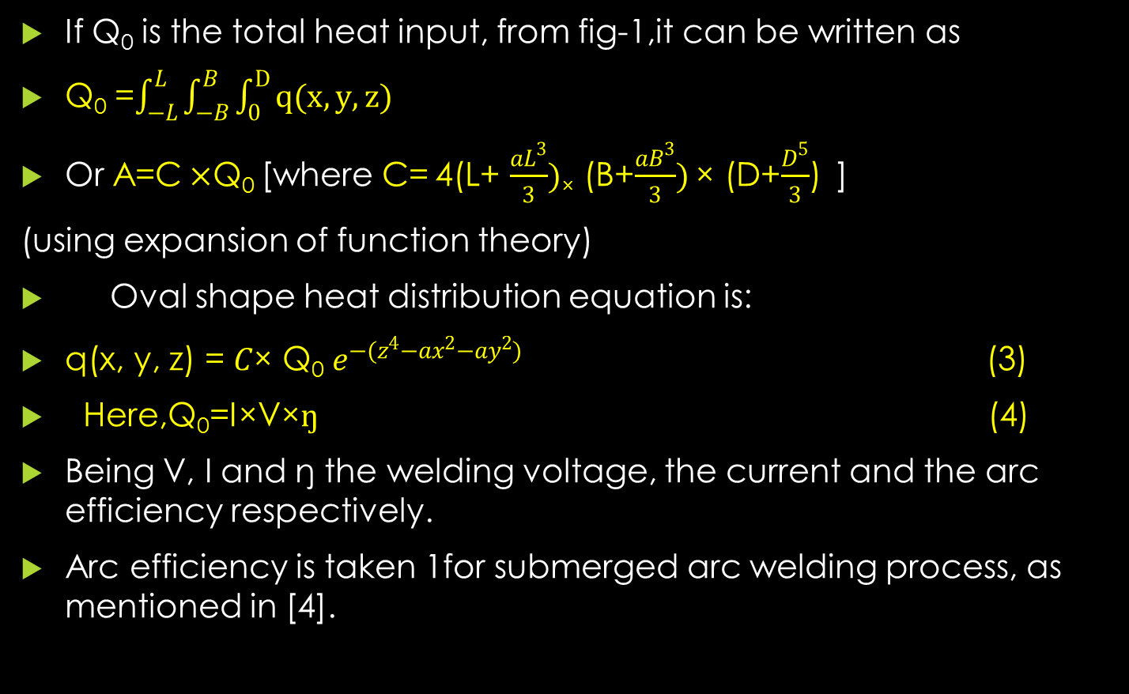
If Q₀ is the total heat input, from fig-1,it can be written as
Q₀ =$\int_{−L}^{L}{\int_{−B}^{B}{\int_{0}^{D}{q(x,y,z)}}}$
Or A=C$×$Q₀ [where C=4(L+ $\frac{aL^{3}}{3})$× (B+$\frac{aB^{3}}{3})$× (D+$\frac{D^{5}}{3}$) ]
(using expansion of function theory)
Oval shape heat distribution equation is:
q(x, y, z) = $C$× Q₀$e^{−(z^{4}−ax^{2}−ay^{2})}$ (3)
Here,Q₀=I×V×$ŋ$ (4)
Being V, I and ŋ the welding voltage, the current and the arc efficiency respectively.
Arc efficiency is taken 1for submerged arc welding process, as mentioned in [4].

Slide 14
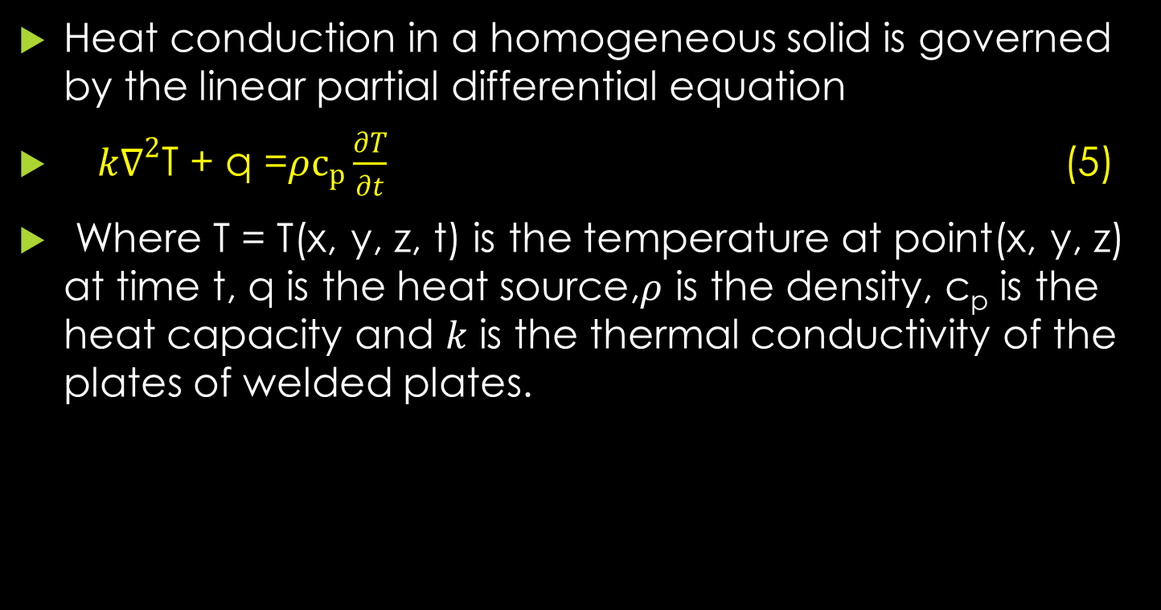
INDUCED TEMPERATURE FIELD
Heat conduction in a homogeneous solid is governed by the linear partial differential equation
$k∇^{2}$T + q =$ρc_{p}\frac{∂T}{∂t}$ (5)
Where T = T(x, y, z, t) is the temperature at point(x, y, z) at time t, q is the heat source,$ρ$ is the density, c_{p} is the heat capacity and $k$ is the thermal conductivity of the plates of welded plates.

Slide 15
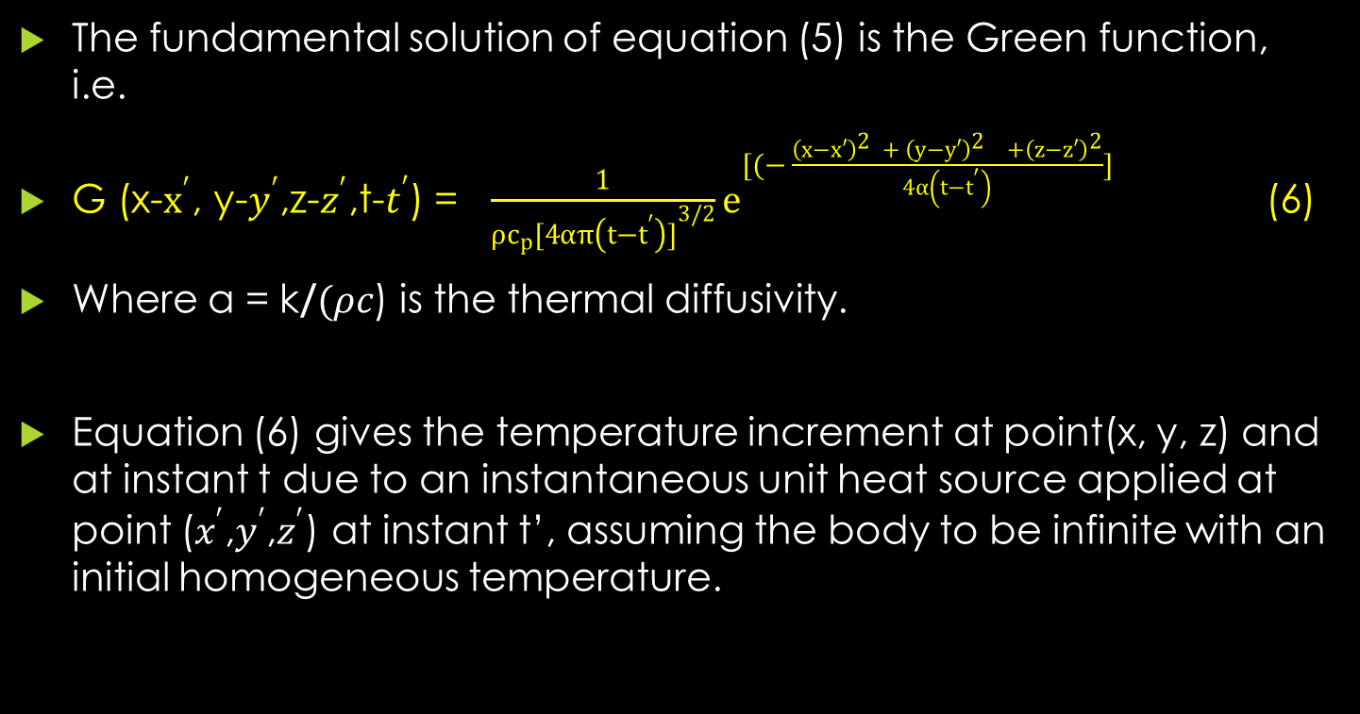
The fundamental solution of equation (5) is the Green function, i.e.
G (x-$x^{′}$, y-$y^{′}$,z-$z^{′}$,t-$t^{′}$) = $\frac{1}{ρc_{p}{[4απ\left(t−t^{′}\right)]}^{3/2}}e^{[(− \frac{{\left(x−x′\right)}^{2 }+ {\left(y−y′\right)}^{2 }+{\left(z−z′\right)}^{2}}{4α\left(t−t^{′}\right)}]}$ (6)
Where α = k/$(ρc$) is the thermal diffusivity.
Equation (6) gives the temperature increment at point(x, y, z) and at instant t due to an instantaneous unit heat source applied at point ($x^{′}$,$y^{′}$,$z^{′}$) at instant t’, assuming the body to be infinite with an initial homogeneous temperature.

Slide 16
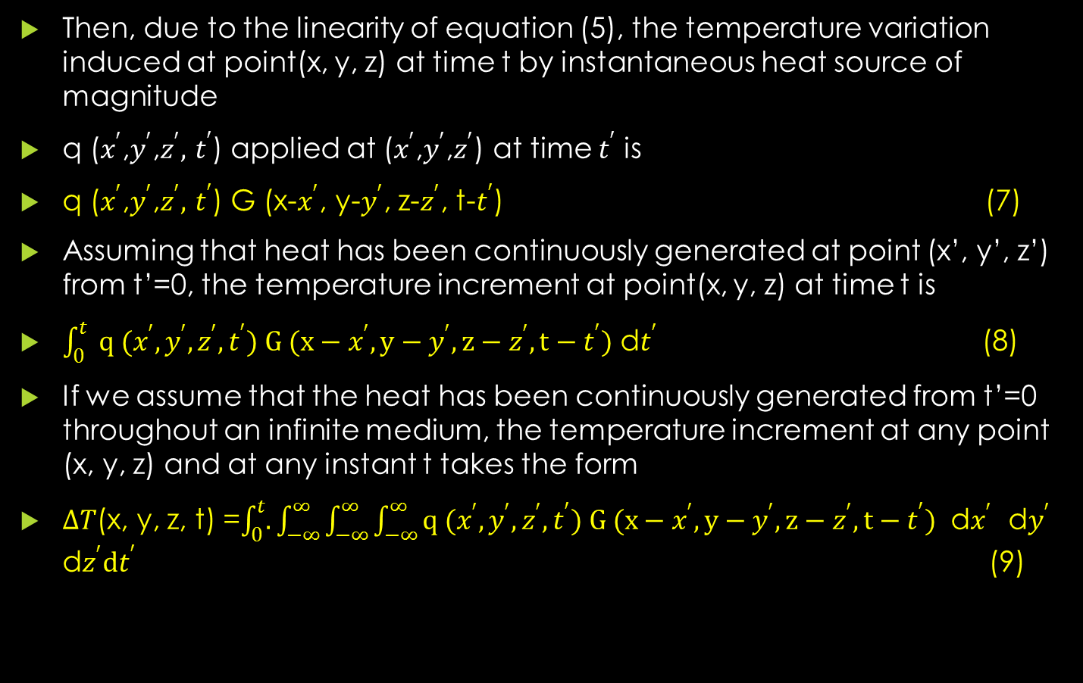
Then, due to the linearity of equation (5), the temperature variation induced at point(x, y, z) at time t by instantaneous heat source of magnitude
q ($x^{′}$,$y^{′}$,$z^{′},$$t^{′}$) applied at ($x^{′}$,$y^{′}$,$z^{′}$) at time $t^{′}$ is
q ($x^{′}$,$y^{′}$,$z^{′},$$t^{′}$) G (x-$x^{′}$, y-$y^{′}$, z-$z^{′}$, t-$t^{′}$) (7)
Assuming that heat has been continuously generated at point (x’, y’, z’) from t’=0, the temperature increment at point(x, y, z) at time t is
$\int_{0}^{t}{ q (x^{′},y^{′},z^{′}, t^{′}) G (x−x^{′}, y−y^{′}, z−z^{′}, t−t^{′})}$ d$t^{′}$ (8)
If we assume that the heat has been continuously generated from t’=0 throughout an infinite medium, the temperature increment at any point (x, y, z) and at any instant t takes the form
$∆T$(x, y, z, t) =$\int_{0}^{t}{.}\int_{−∞}^{∞}{\int_{−∞}^{∞}{\int_{−∞}^{∞}{q (x^{′},y^{′},z^{′}, t^{′}) G (x−x^{′}, y−y^{′}, z−z^{′}, t−t^{′}) }}}$ d$x^{′}$ d$y^{′}$ d$z^{′}dt^{′}$ (9)

Slide 17
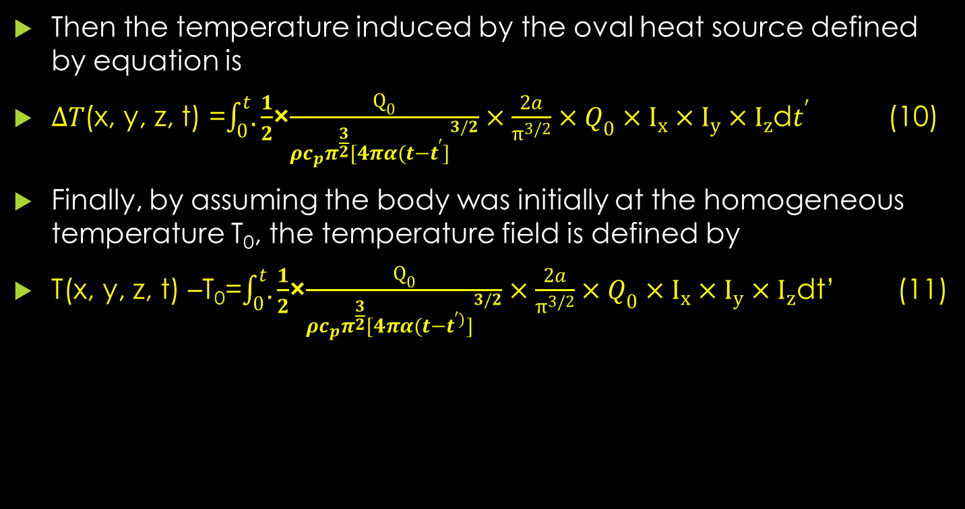
Then the temperature induced by the oval heat source defined by equation is
$∆T$(x, y, z, t) =$\int_{0}^{t}{.}\frac{1}{2}$×$\frac{Q_{0}}{{ρc_{p}π^{\frac{3}{2}}[4πα(t−t^{′}]}^{3/2}}×\frac{2a}{π^{3/2}}×Q_{0}×I_{x}×I_{y}×I_{z}$d$t^{′}$ (10)
Finally, by assuming the body was initially at the homogeneous temperature T₀, the temperature field is defined by
T(x, y, z, t) –T₀=$\int_{0}^{t}{.}\frac{1}{2}$×$\frac{Q_{0}}{{ρc_{p}π^{\frac{3}{2}}[4πα(t−t^{′)}]}^{3/2}}×\frac{2a}{π^{3/2}}×Q_{0}×I_{x}×I_{y}×I_{z}$dt’ (11)

Slide 18
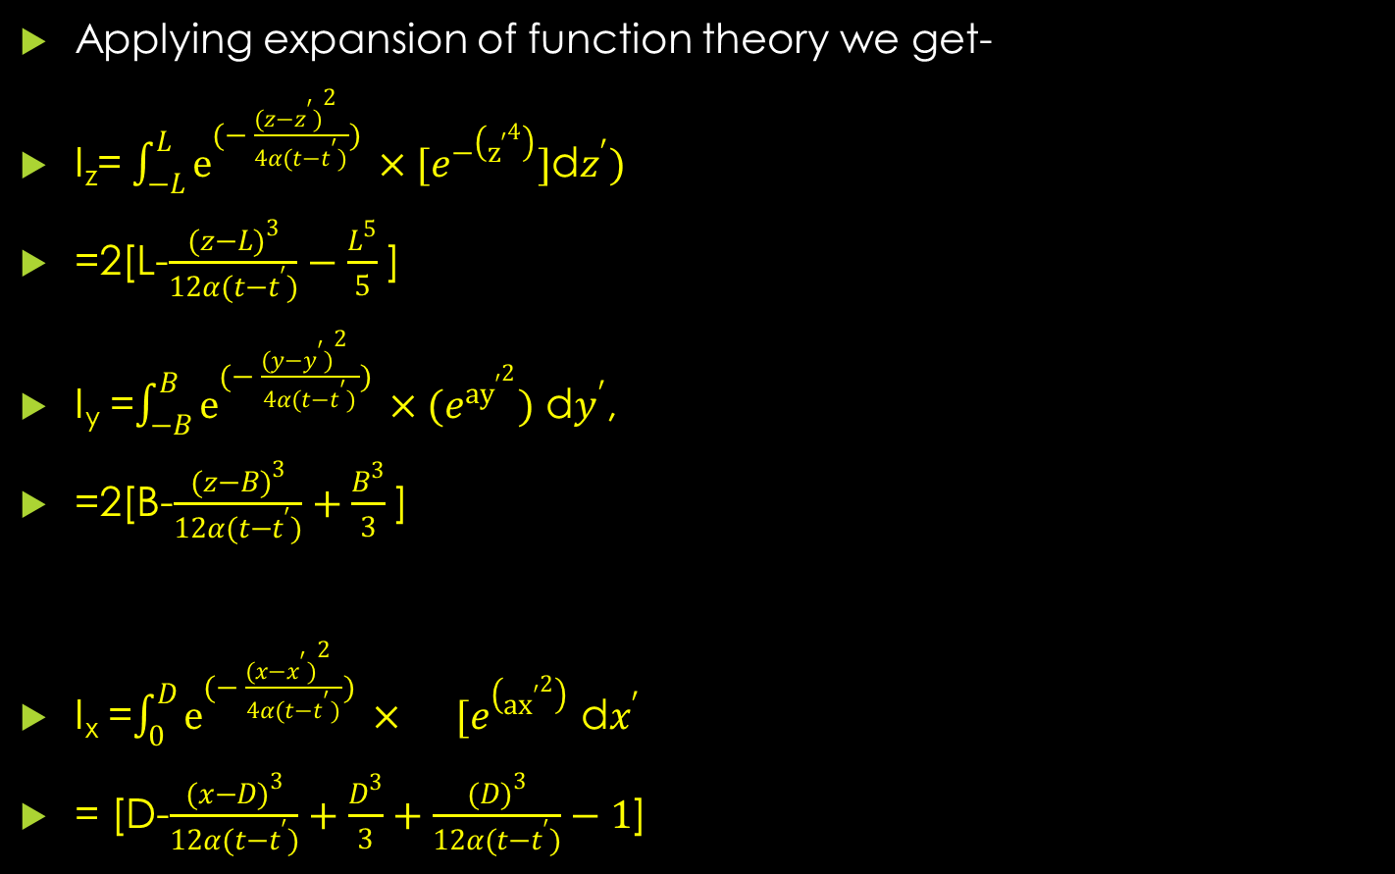
Applying expansion of function theory we get-
I_{z}= $\int_{−L}^{L}{e^{(− \frac{{(z−z^{′})}^{2 }}{4α(t−t^{′})}) }}×[e^{−\left({z^{′}}^{4}\right)}]$d$z^{′})$
=2[L-$\frac{{(z−L)}^{3}}{12α(t−t^{′})}−\frac{L^{5}}{5}$]
I_{y} =$\int_{−B}^{B}{e^{(− \frac{{(y−y^{′})}^{2 }}{4α(t−t^{′})}) }}×(e^{{ay^{′}}^{2}})$ d$y^{′}$,
=2[B-$\frac{{(z−B)}^{3}}{12α(t−t^{′})}+\frac{B^{3}}{3}$]
I_{x} =$\int_{0}^{D}{e^{(− \frac{{(x−x^{′})}^{2 }}{4α(t−t^{′})}) }}× [e^{\left(a{x^{′}}^{2}\right)}$ d$x^{′}$
= [D-$\frac{{(x−D)}^{3}}{12α(t−t^{′})}+\frac{D^{3}}{3}+\frac{{(D)}^{3}}{12α(t−t^{′})}−1$]

Slide 19

Prediction of HAZ width
HAZ width of a C-Mn steel is the region heated from lower critical temperature (i.e., 723$℃$ ) to the temperature just below the melting point temperature of welded materials (i.e. 1464$℃$). Putting these values in the equation (11) HAZ width(s) can be calculated at z=0, x=v$t^{′}$, (where, v=30cm/min), t=$t^{′}$= travel time=60 sec, of electrode. Comparison between computed and experimental data for HAZ width which is described in figure-2

Slide 20
OPTIMIZATION OF HAZ WIDTH
HAZ width is a function of the process parameters of SAW process and these, in turns, depend on the heat input as heat input is the function of voltage, travel speed, wire feed rate, stick out etc. By taking values of HAZ width and heat input from table-2, a relationship between the heat input and HAZ width was find out through regression model, in the form :
y=1.4901x-0.3377x²+0.0207x³, where y=HAZ width and x=heat input .The optimum value of the HAZ width (0.9 mm when heat input =7.76kJ/cm) was obtained from figure 3.

Slide 21
CONCLUSION
A good agreement between the predicted and measured values of HAZ width has been achieved by ignoring convective and radiative heat lost by the welded plate. The considered heat source shape for submerged arc welding in this analysis was a paraboloid. The optimum setting of input variables has been found in order to minimize the HAZ width.

Slide 22
Table 1. Chemical composition of C-Mn steel work piece (in %)
C | Sn | Mn | P | S | Cr | Ni | Mo | Cu | Al
0.18 | 0.36 | 1.58 | 0.023 | 0.027 | 0.06 | 0.03 | 0.01 | 0.04 | 0.05

Slide 23
Table-2: Observed values of HAZ width
Sl.No. | Arc Voltage (volts) | Wire Feed Rate (m/min) | Travel Speed (m/min) | Stick Out (mm) | Heat Input (kJ/cm) | HAZ width (mm)
1 | 27 | 1.0 | 0.6 | 33 | 8.1 | 1.32
2 | 31 | 1.0 | 0.6 | 33 | 9.3 | 1.29
3 | 27 | 1.5 | 0.6 | 33 | 8.1 | 1.65
4 | 31 | 1.5 | 0.6 | 33 | 9.3 | 1.60
5 | 27 | 1.0 | 0.7 | 33 | 6.9 | 1.10
6 | 31 | 1.0 | 0.7 | 33 | 8.0 | 1.15
7 | 27 | 1.5 | 0.7 | 33 | 6.9 | 1.20
8 | 31 | 1.5 | 0.7 | 33 | 8.0 | 1.15
9 | 27 | 1.0 | 0.6 | 38 | 8.1 | 1.14
10 | 31 | 1.0 | 0.6 | 38 | 9.3 | 1.13
11 | 27 | 1.5 | 0.6 | 38 | 8.1 | 1.38
12 | 31 | 1.5 | 0.6 | 38 | 9.3 | 1.70
13 | 27 | 1.0 | 0.7 | 38 | 6.9 | 1.00
14 | 31 | 1.0 | 0.7 | 38 | 8.0 | 0.90
15 | 27 | 1.5 | 0.7 | 38 | 6.9 | 1.00

Slide 24
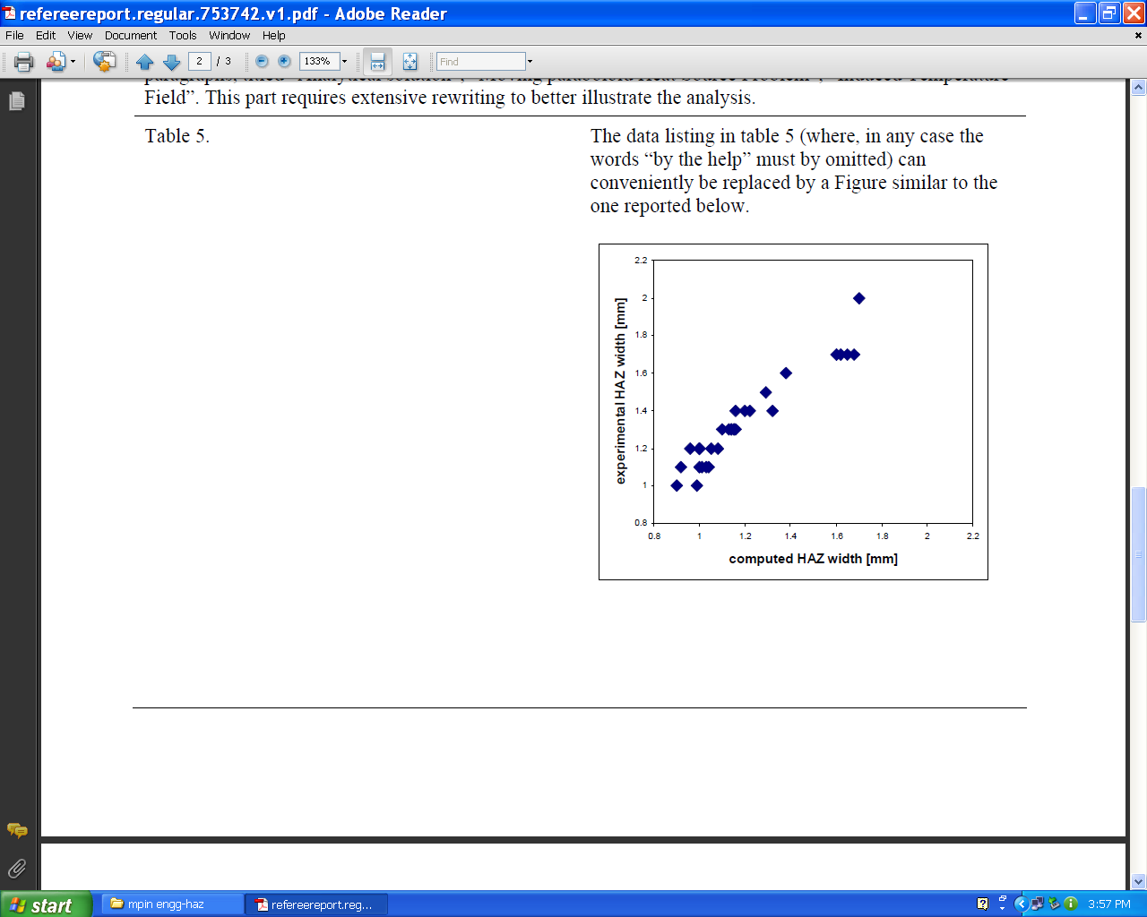
Figure-2: Comparison between computed and Experimental data

Slide 25
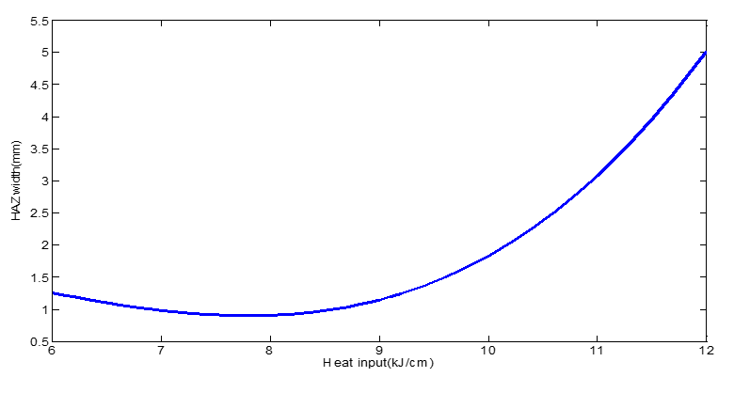
Figure 3: Graphical representation between heat input and HAZ width

Slide 26
Table-4: Calculation of Variance for testing the adequacy of the model
BEAD PARAMETER | FIRST ORDER TERM |  | SECOND ORDER TERM |  | LACK OF FIT |  | ERROR TERM |  |  |  | WHETHER MODEL IS ADEQUATE
 | SS | DF | SS | DF | SS | DF | SS | DF | F RATIO | R RATIO
HAZ width | 1.18 | 4 | 0.4 | 10 | 0.08 | 10 | 0.03 | 6 | 1.9 | 5 | ADEQUATE
Here SS –sum of square, DF-degree of freedom

Slide 27
REFERENCES
[1]Houldcroft, P.T.:Submerged Arc Welding. Abington Publishers, U.K., 1989.
[2]Annon.:Principle of Industrial welding, The James F.Lincoln Arc Welding Foundation, Cleveland, Ohio, 1978.
[3] Murugan,N., and Gunaraj,V.: Prediction and Control of Weld Bead Geometry and Shape Relationships in submerged arc welding of Pipes, J. of Materials Processing Technology, Vol.168, No.3, 2005.
[4]Gunaraj, V., Murugan, N.: Prediction of Heat Affected Zone Characteristics in submerged Arc Welding of Structural Steel Pipes, Welding Research, January 2002.
[5] Menaka,M., Vasudevan,M., Venkatraman,B., Raj,B.: Estimating bead width and depth of penetration during welding by infrared thermal imaging, Non-Destructive Testing and Condition Monitoring , Vol.47, No. 9, 2005.
[6] Pathak,A.K., Dutta,G.L.:Three dimensional Finite Element Analysis to predict the different zones of Microstructure in Submerged Arc Welding, Proc., Institution of Mechanical Engineers, part B, J. of Engineering Manufacture, Vol.218, No. 3 2004.
[7] Kanjilal,P., Majumdar,S.K., Pal,T.K.: Prediction of submerged arc weld-metal composition from flux ingredients with the help of statistical design of mixture experiment, Scandinavian J. of Metallurgy, Vol. 33, No. 3, 2004.
[8] Kanjilal,P., Pal,T.K.:Majumdar,S.K., Combined Effect of Flux and welding Parameters on Chemical Composition and Mechanical Properties of submerged arc Weld Metal, J. of Materials Processing Technology Vol.171, No.2,2006.
[9] Nguyen, N., T., et al. : Analytical Solution for Transient Temperature of Semi-Infinite Body Subjected to 3-D Moving Heat Sources, Welding Research, August, 1999.
[10]Nguyen, N., T., Mai, Y., W., Simpson, S. Ohta, A. :Analytical Approximate Solution for Double Ellipsoidal Heat Source in Finite Thick Plate, Welding Research, 2004.

Slide 28


Slide 29
Let Us Meet Again
We welcome you all to our future conferences of OMICS Group International
Please Visit:
http://materialsscience.conferenceseries.com/
Contact us at
materialsscience.conference@omicsgroup.us
materialsscience@omicsgroup.com

