Slide 1
Novel signaling paradigm regulating TOLL-like receptors in innate immune cells
Samar Abdulkhalek and Myron R. Szewczuk*.
Dept. Biomedical and Molecular Sciences, Queen's University, Kingston, K7L 3N6 Ontario, Canada. *speaker
A novel signaling paradigm for cell surface TLR4 and intracellular TLR-7 and TLR-9
Central to this process is that neuromedin B (NMBR) GPCR-Neu1-MMP9 complex is bound to TLRs in naive and ligand stimulated macrophage cells.

Slide 2
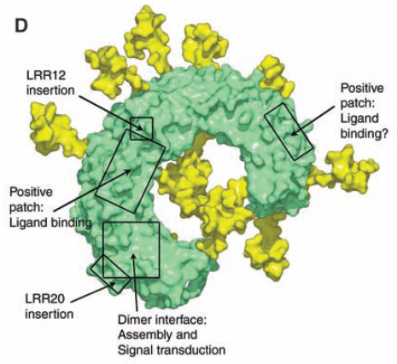
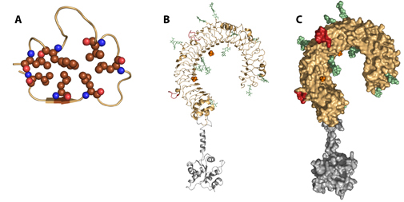
Toll-Like Receptors
Ectodomain
Common Knowledge:
Front-line Pattern Recognition Receptors of the innate immune system
TLRs recognize microbial pathogen-associated molecular patterns (PAMPs)
Crystal structure reveals highly glycosylated ectodomain
  Potential 15 N-glycosylation sites depending on TLR
Still a mystery:
How TLR activation is regulated?
What Is the role for TLR glycosylation in this ligand–induced TLR activation?
TLR3
TIR
Domain
Crystal Structure of TLR3 courtesy of Dr. David Segal, Centre for Cancer Research, NIH
Notes:
TLRs are pattern recognition receptors of the innate immune system that form the front-line antimicrobial defenses of the body. They recognize PAMPs from bacteria, viruses, fungi and parasites. Structurally they comprise a horseshoe-shaped, highly glycosylated exterior domain, a transmembrane region and the intracellular TIR domain (Toll-IL 1 Receptor) which is common to the TLR-IL 1 Receptor superfamily.

Slide 3
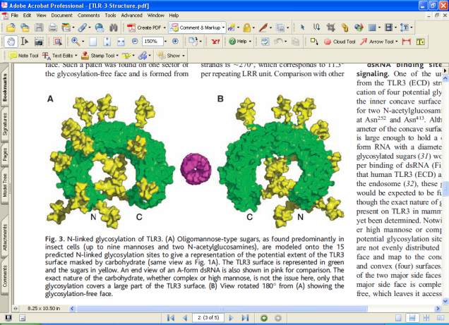

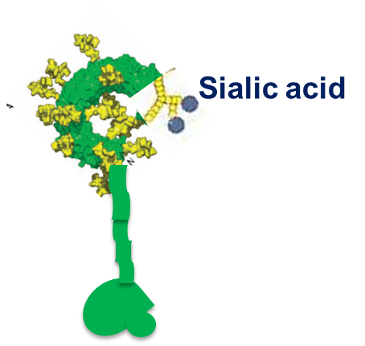
TLR4
Cell surface and intracellular
TOLL-like receptors
highly glycosylated
Sialic acid
MD2
CD14
TLR4
PRAT4A (protein associated with Toll-like receptor 4)
Endoplasmic
Reticulum (ER)
MD-2: 2 N-glycosylation sites
TLR4: 9 N-glycosylation sites at the amino terminal ectodomain
MD2
glycosylation
Gp96

Slide 4


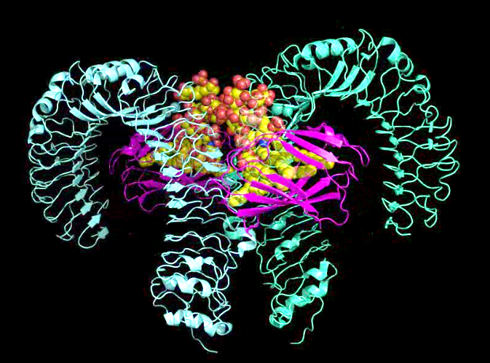

The Nobel Prize in Physiology or Medicine 2011
TLR-4 receptor
"Bruce A. Beutler - Nobel Lecture: How Mammals Sense Infection: From Endotoxin to the Toll-like Receptors".
"Jules A. Hoffmann - Nobel Lecture: The Host Defense of Insects: A Paradigm for Innate Immunity".
"Ralph M. Steinman - Nobel Lecture:
the Discovery of Dendritic Cells".
TLR-4 receptor

Slide 5
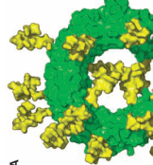
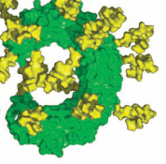

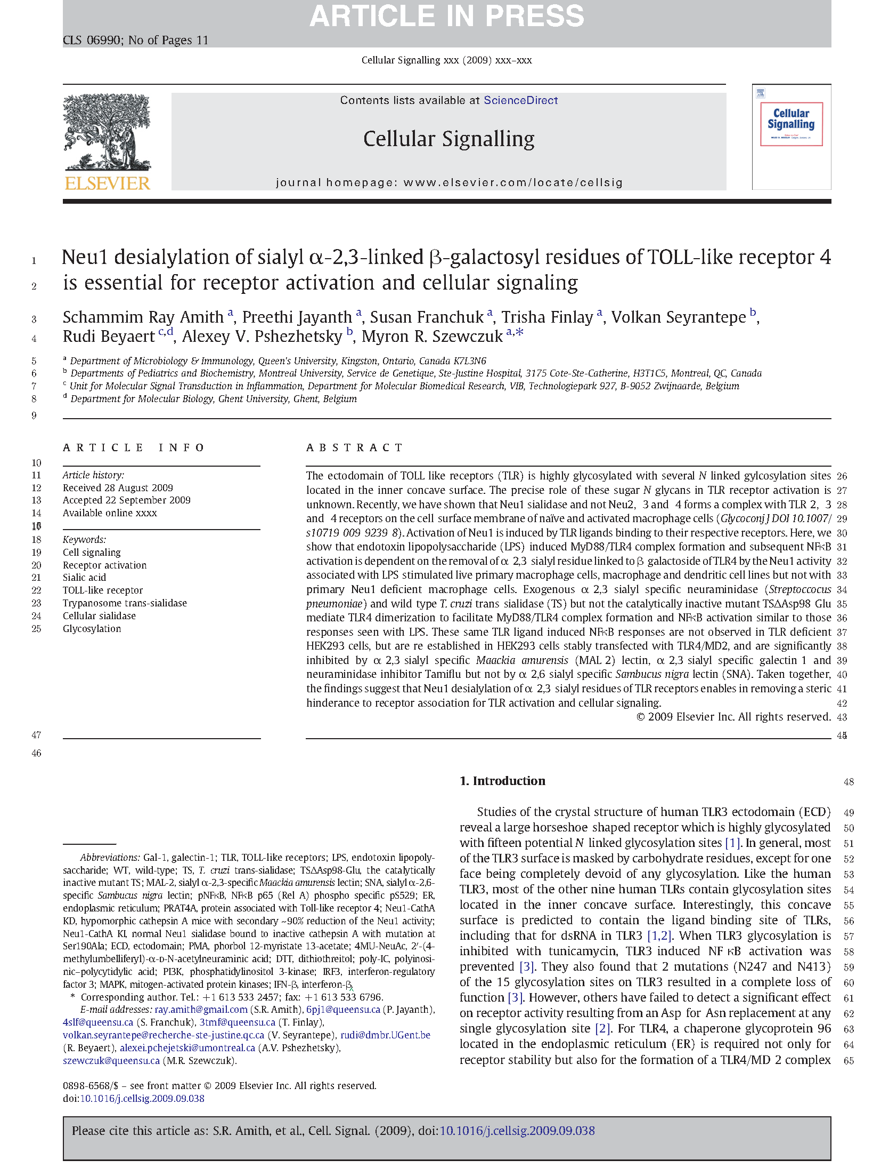
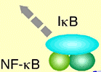
Strept. pneumoniae neuraminidase
T. cruzi Trans-sialidase
Hydrolyzes of
α-2,3 sialyl residue
1
2
3
Ligand
Enables removal of steric hindrance
EBP
TLR
Neu1
Receptor
Dimerization
PPCA
Cellular Signalling 22 (2010) 314–324
MyD88

Slide 6
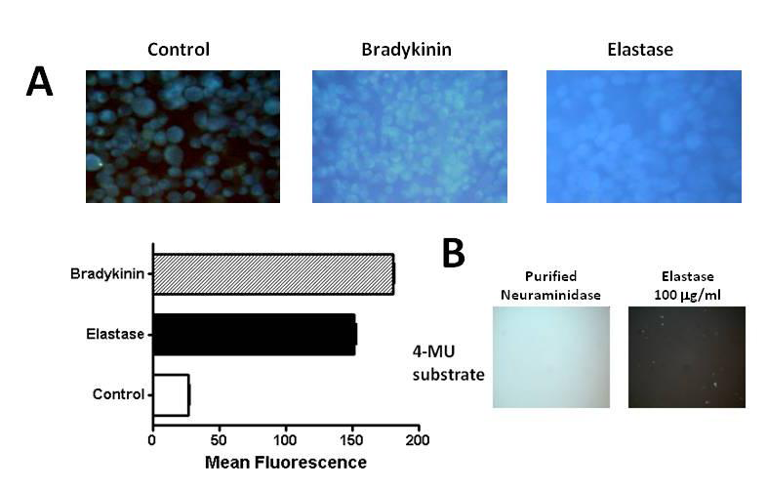
MMP with elastase activity is required to induce NEU1
MMP
Elastase
N
e
u
1
N
e
u
1
E
B
P
Cath A- Cathepsin A
EBP- Elastin binding protein
Cath
A
Cath
A
Control
(4-MUNANA)
Neuraminidase
(C. perfringens)
Elastase
Elastase
Sialidase
activity
4-MUNANA
substrate
Notes:
It is Known that Neu1 exists in a tripartite complex that also includes EBP, CathA. Accordingly we propose that MMP’s with metallo-elastase activity are required to remove EBP complexed to Neu1 and CathA to activate Neu1. Indeed exogenous elastase enzyme was able to induce sialidase activity when added to unstimulated DC2.4 dendritic cells cleaving 4MUNANA substrate.
exogenous sialidase from C.perfringens was able to cleave 4MUNANA While elastase didnot in the absence of cells. Therefore it is the NEU1 that is induced by the elastase.

Slide 7
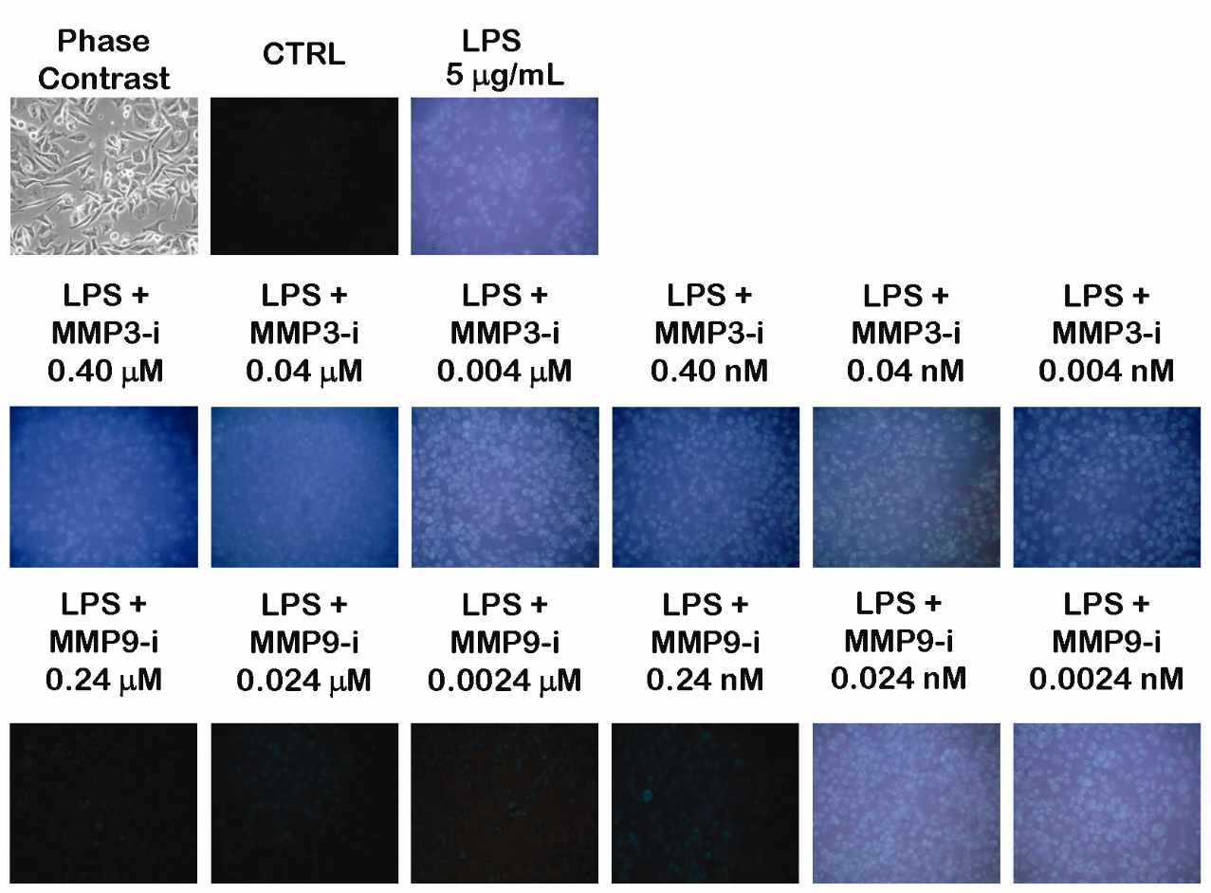
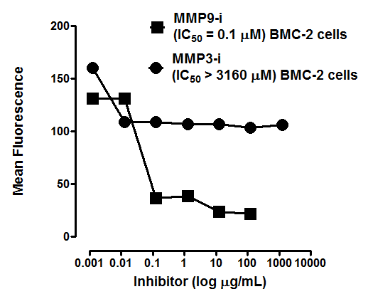
MMP9i inhibits sialidase activity –live cell sialidase assay

Slide 8
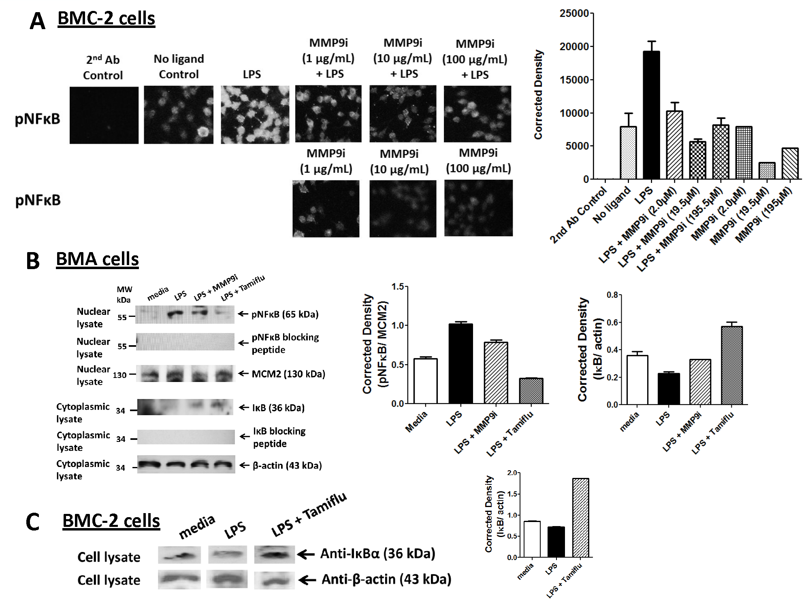
MMP9i inhibits LPS-induced pNFκB

Slide 9

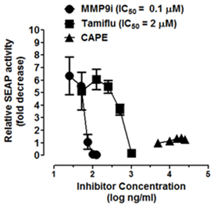

NFκB-dependent SEAP Assay – RAW-blue cells
LPS
Caffeic acid phenethyl ester is a potent and specific inhibitor of activation of nuclear transcription factor NF-kappa B.
MyD88
P
IRAK 1/4
IL-1 receptor-associated kinase-4
TRAF6
IKK
IκB
P
NFκB
SEAP
NFκB

Slide 10
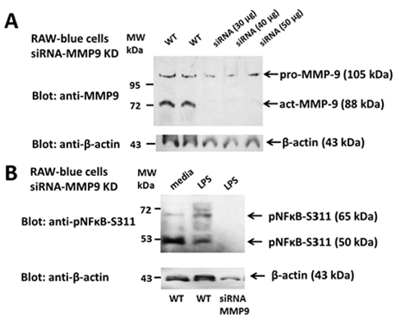
MMP9-siRNA inhibits LPS-induced NFκB in RAW-blue macrophages

Slide 11
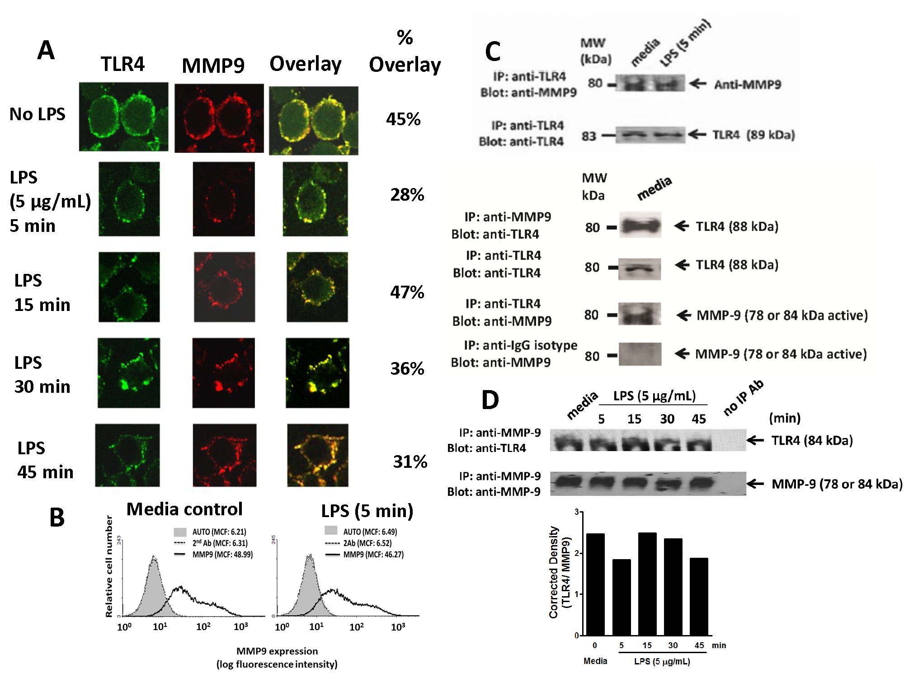
MMP-9 forms a complex with TLR4 in naïve and LPS treated BMA macrophage cells
Notes:
Collectively these data validated the predicted alliance between TLR4 and MMP9 on the cell surface.

Slide 12
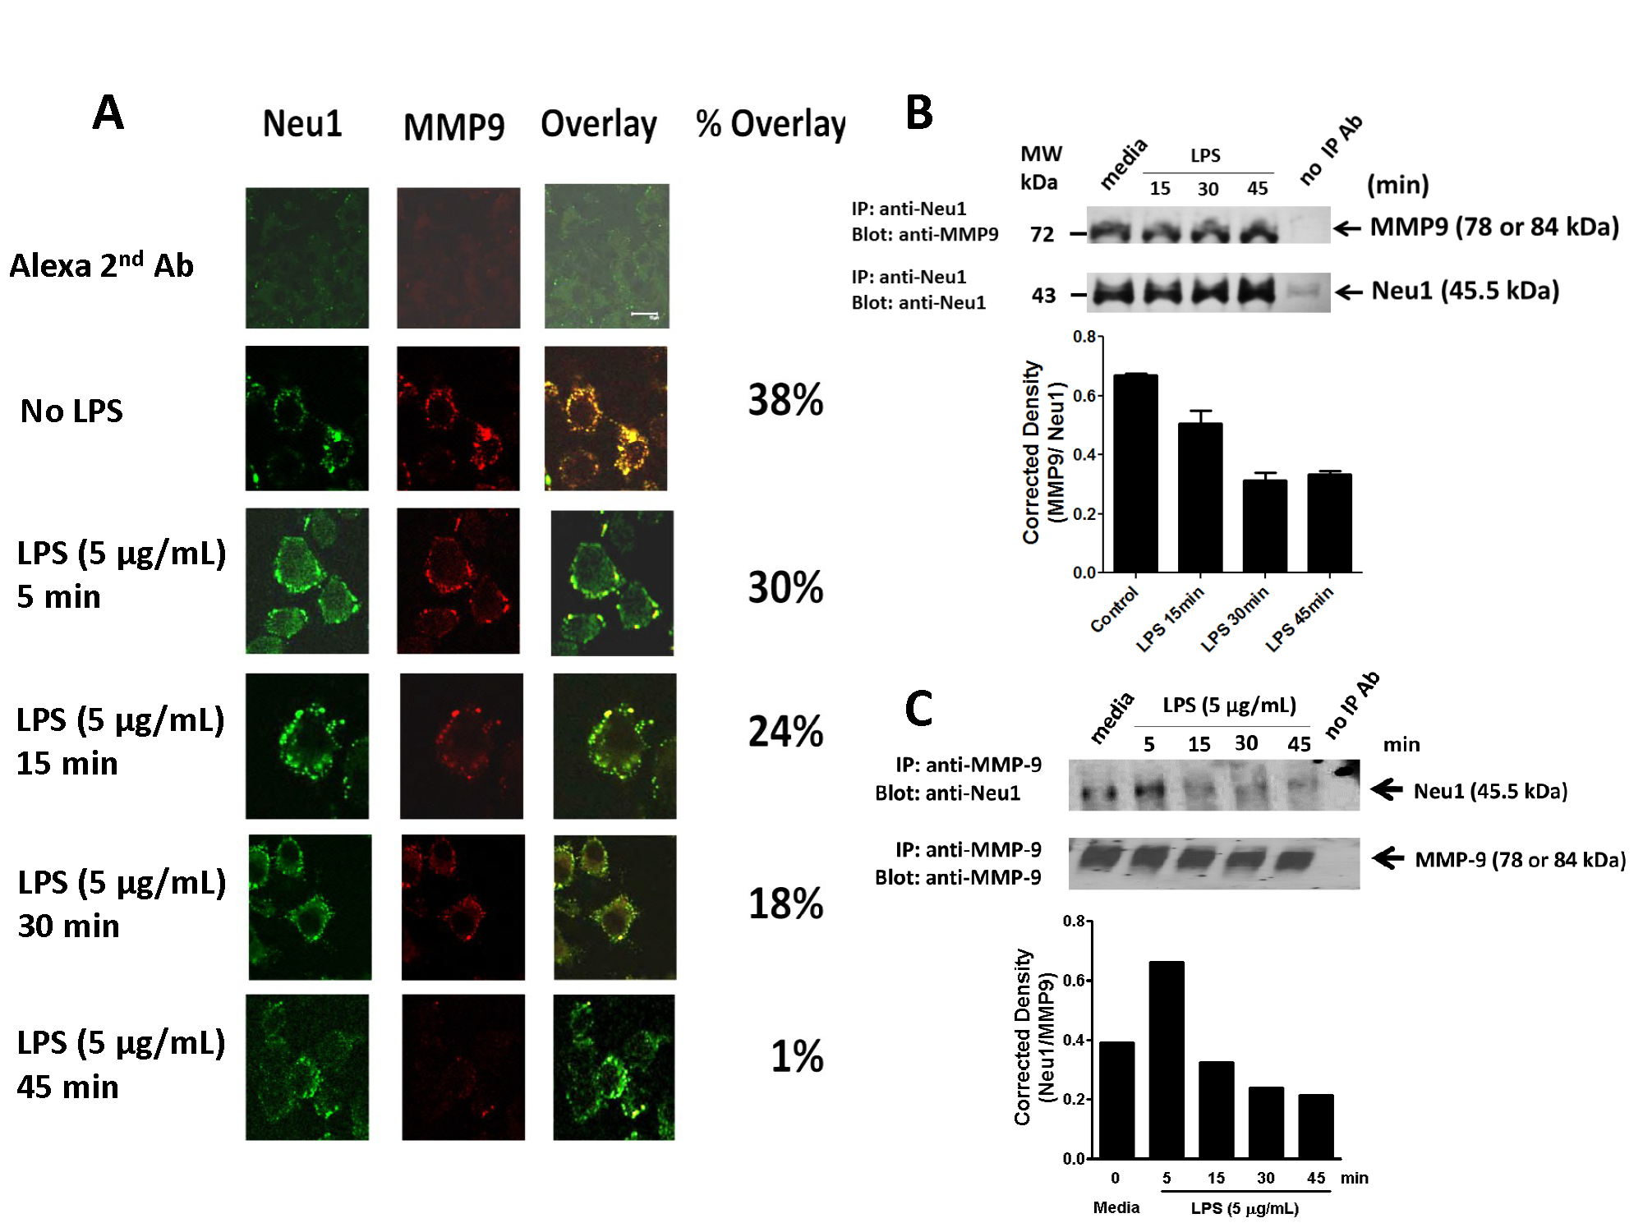
MMP9 forms a Complex with NEU1

Slide 13
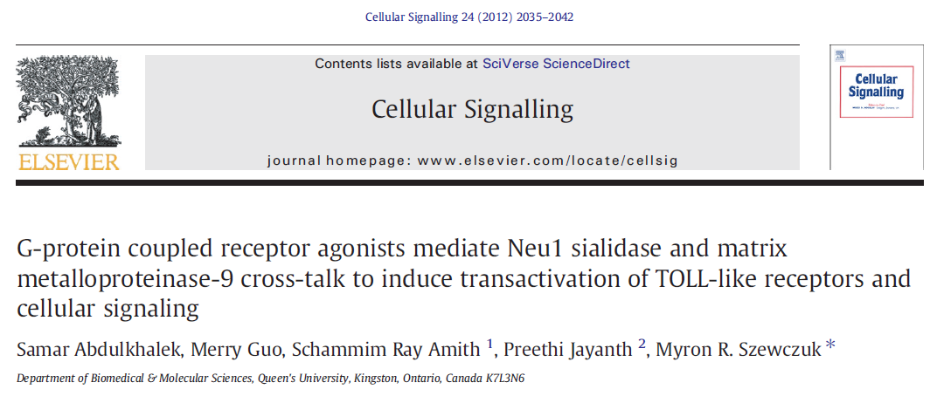
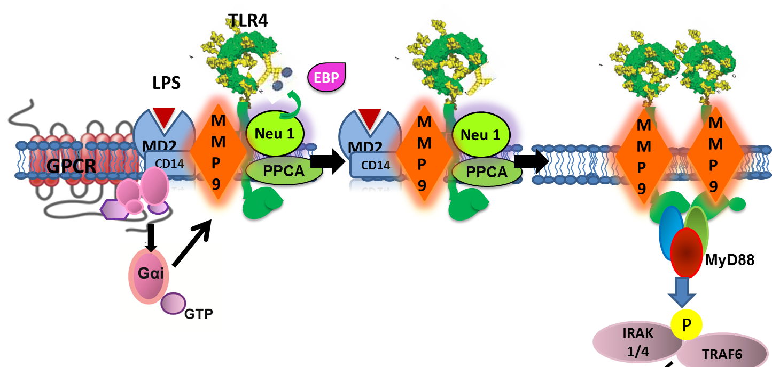

Slide 14
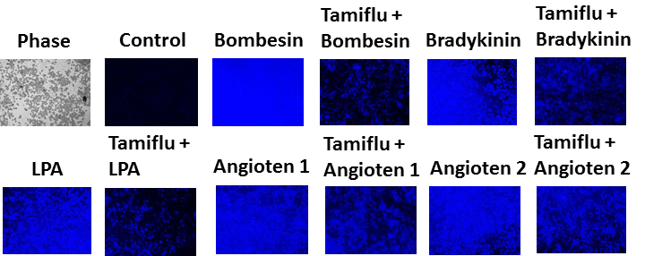
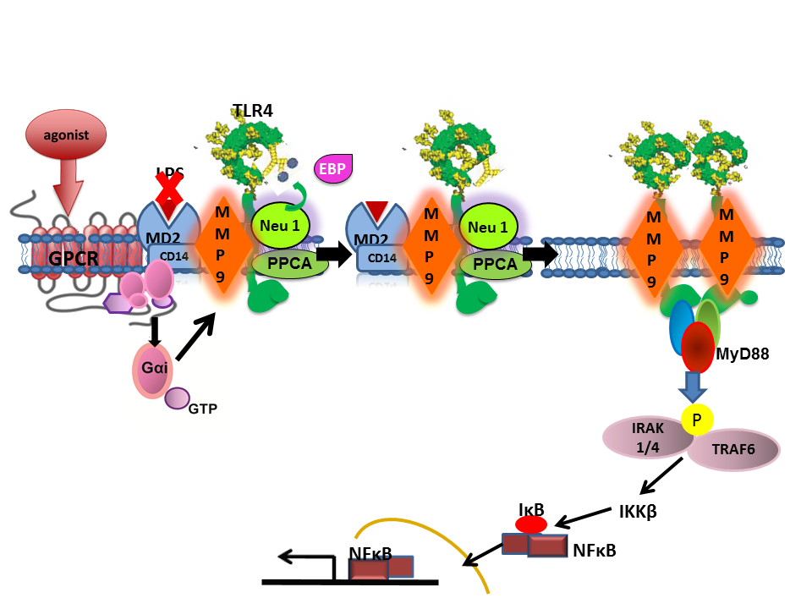
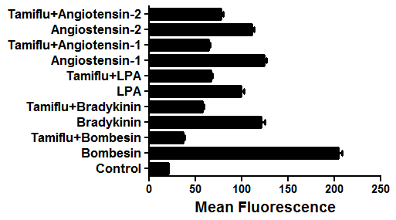
GPCR agonists induced sialidase activity is inhibited by oseltamivir phosphate
a potent endothelium-dependent vasodilator, leading to a drop in blood pressure
RAW-blue
Lysophosphatidic acid (LPA)
Lipid signaling
Angiotensin -vasoconstriction

Slide 15
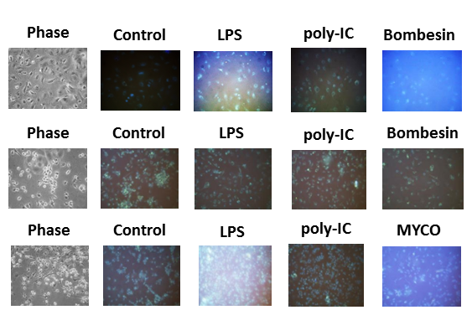
Sialidase activity is abscent in Neu1 deficient primary macrophages derived from genetically engineered mice
TLR4
TLR3
Primary WT
MØ
Neu1-CathA
MØ
Bombesin
CathA KD
MØ

Slide 16
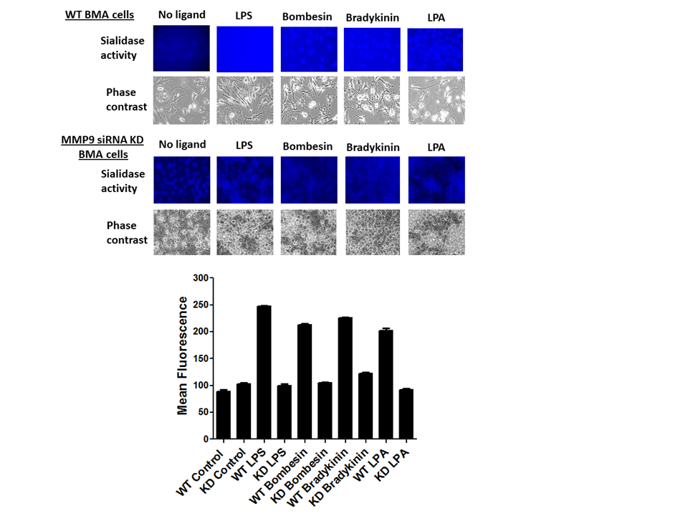

Slide 17
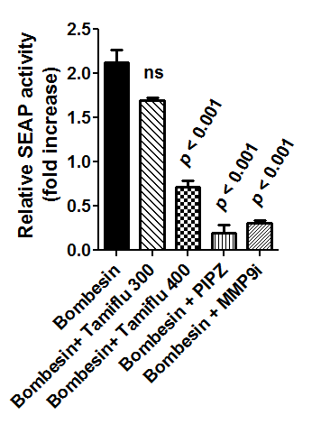
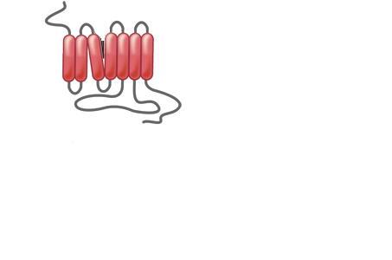

Bombesin induces NFκB activation in Raw-blue cells
MyD88
P
IRAK 1/4
TRAF6
IKK
IκB
P
NFκB
SEAP
NFκB

Slide 18
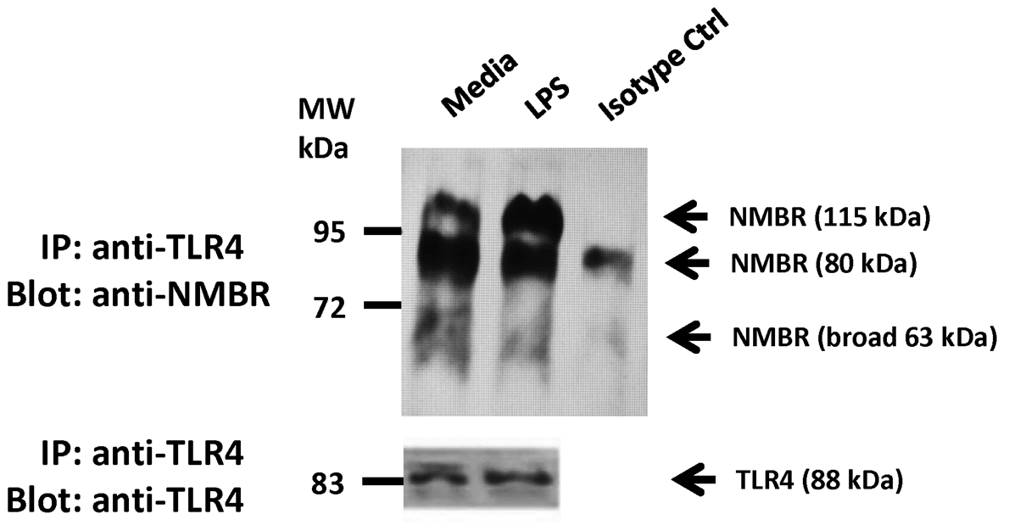
Bombesin receptor neuromedin B (NMBR) co-IP’s with TLR4 in BMA MØ cell lysates

Slide 19
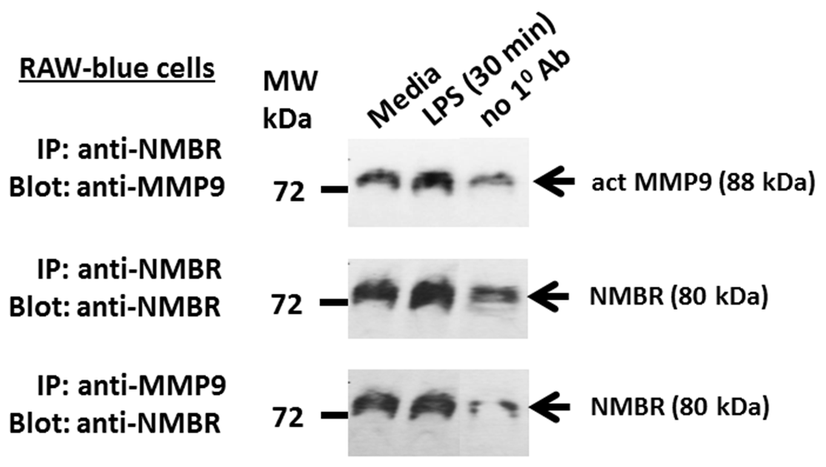
Bombesin receptor NMBR co-IP’s with MMP-9 in RAW-blue MØ cell lysates

Slide 20
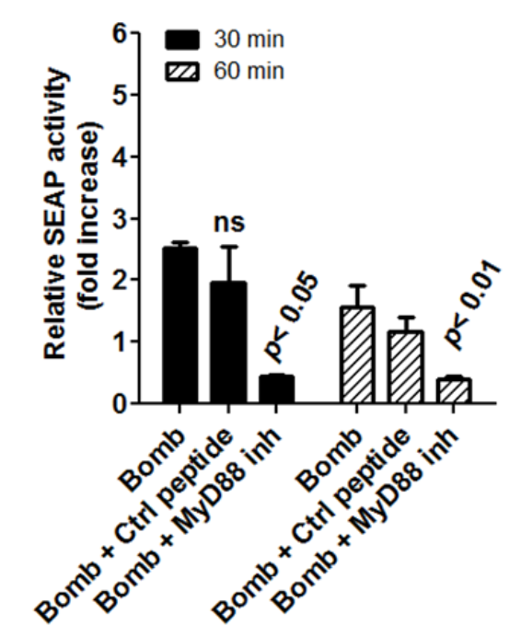
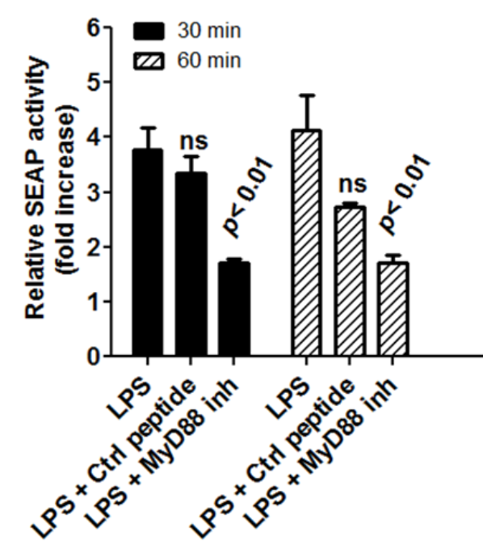
LPS and Bombesin agonists induced SEAP activity in RAW-blue cells is blocked by MyD88 specific inhibitor

Slide 21
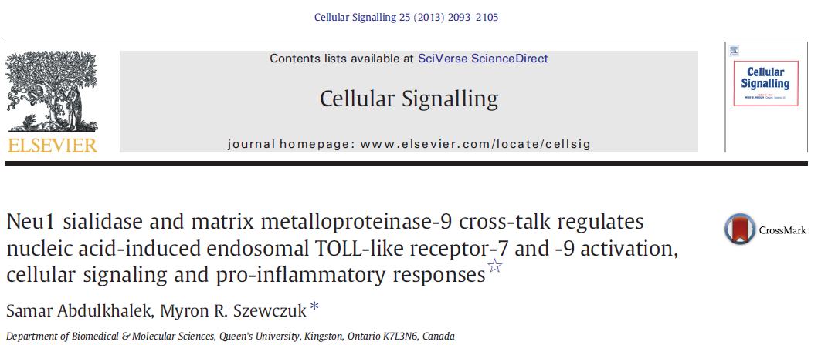
TLR7
Ligand
Endosome
EBP
MMP9
Neu 1
MMP9
Neu 1
MMP9
MMP9
GPCR
PPCA
PPCA

Slide 22
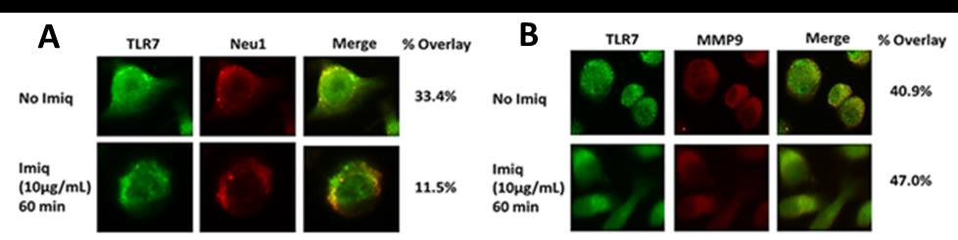
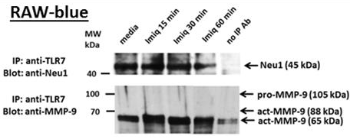
NEU1 and MMP-9 form a complex with TLR7 in naïve and ligand-stimulated macrophage cells

Slide 23
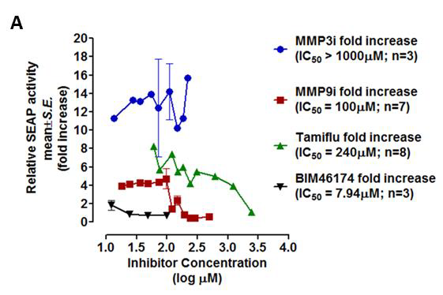
Tamiflu, MMP9i and BIM46174 inhibit TLR7 ligand-induced NFκB activation

Slide 24
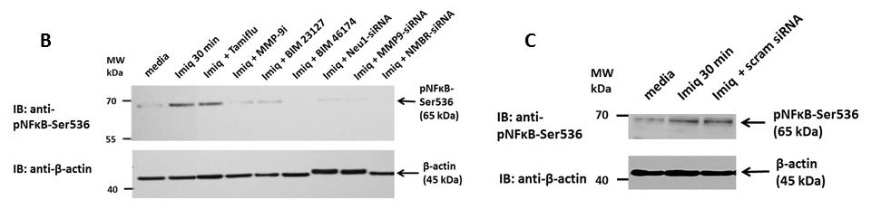
NEU1, MMP-9 and NMBR are essential for TLR7 activation

Slide 25
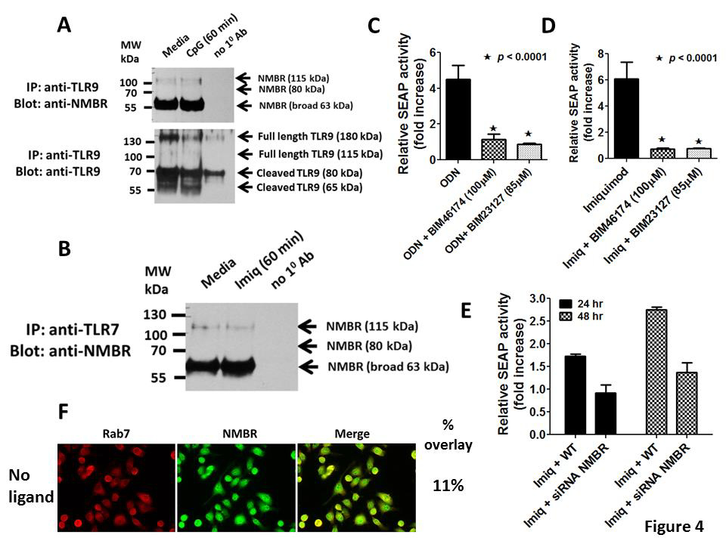
NMBR is involved in intracellular TLRs signaling

Slide 26
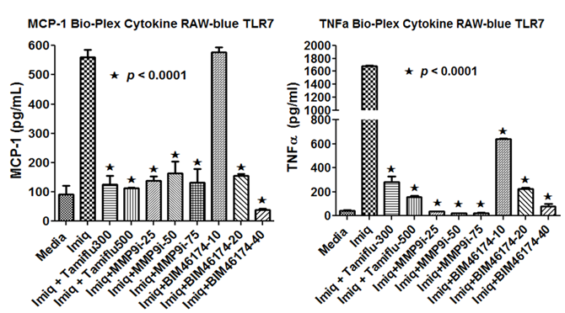
Tamiflu, MMP9i and BIM46174 abrogates TLR7 ligand-induced inflammatory cytokines production

Slide 27
CONCLUSIONS
Neu1 plays a central role in mediating nucleic acid-induced intracellular TLR activation,
GPCR NMBR–MMP9–Neu1 cross-talk constitutes a novel intracellular TLR signaling platform that is essential for NF-κB activation and pro-inﬂammatory responses.

