Slide 1
Therapeutic targeting neuraminidase-1 in multi-stage of tumorigenesis
Myron R. Szewczuk
Dept. Biomedical and Molecular Sciences, Queen's University, Kingston, K7L 3N6 Ontario, Canada
HIGHLIGHTS….
An innovative and promising entirely new targeted therapy for cancer.
Mammalian neuraminidase-1 (Neu1) in complex with matrix metalloproteinase-9 and G-protein coupled receptor tethered to RTKs and TLRs is identified as a major target in the multi-stage of tumorigenesis.
Preclinical studies support an entirely new cancer targeted therapy:
  unaffected by mutations of growth factor receptors,
  blocks tumor neovascularization,
  overcomes chemo-resistance of tumors,
  blocks immune-mediated tumorigenesis,
  blocks tissue invasion and metastasis.

Slide 2
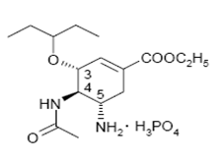
Therapeutic targeting neuraminidase-1 in multi-stage of tumorigenesis
Oseltamivir
phosphate
Therapeutic efficacy of oseltamivir phosphate alone or in combination with chemotherapeutics
tumor growth and metastatic spread, tumour neovascularization and chemo-resistance
pancreatic, breast and ovarian cancers
heterotopic xenograft of tumors growing in RAGxCγ double mutant mice
Published:
TLR-4, -7 & -9
EGFR
Trk
insulin

Slide 3
Cellular Signalling 25 (2013) 2587-2603
Highlights …..
EGFR is fully glycosylated on 8 of the 11 Asn-X-Ser/Thr (X ≠ Pro) canonical N-glycosylation sites; two of the sites are not glycosylated, and one is partially glycosylated.
The mechanism(s) behind epidermal growth factor (EGF)-induced receptors is unknown.
The modification of glycosylation on EGF receptors involves the activation of Neu1.
EGF binding receptor activates neuromedin B receptor (NMBR or BB1) GPCR–Neu1–MMP-9 crosstalk tethered to EGFR at the ectodomain on the cell surface.

Slide 4
EGF
Sialidase Assay on Live Pancreatic Cancer Cells
Fluorogenic sialidase speciﬁc substrate,
4-MUNANA
450 nm
methylumbelliferone
Gilmour, Abdulkhalek et al 2013 Cellular Signalling 25: 2587 (open access)

Slide 5
Gilmour, Abdulkhalek etal. 2013 Cellular Signalling 25 (2013) 2587–2603 (open access)

Slide 6
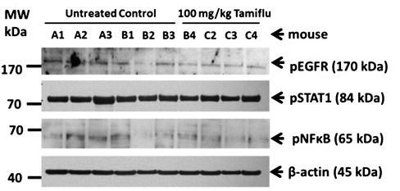
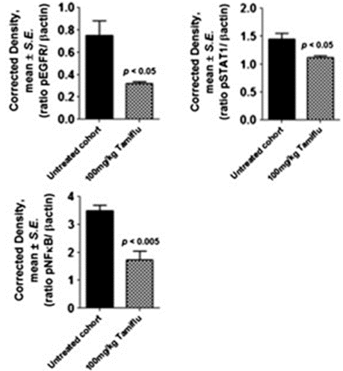
pEGFR
pSTAT1
pNFκB
Highlights
Individual necropsied tumors were taken from untreated and 100 mg/kg OP treated cohorts.
Freshly frozen tumors were thawed on ice, and lysed in lysis buffer containing proteinase and phosphatase inhibitors.
Tamiflu treatment at 100 mg/kg (i.p.) attenuated pEGFR, pSTAT1 and pNFκB activity in heterotopic xenografts of MiaPaCa-2-eGFP tumors growing in RAGxCγ double mutant mice.
Oseltamivir phosphate targets xenografts of MiaPaCa-2 tumors growing in RAGxCγ double mutant mice.

Slide 7
Biophotonic imaging of live necropsy tissues
eGFP-MiaPaCa-2

Slide 8
eGFP-MiaPaCa-2
Gilmour, Abdulkhalek et al Cellular Signalling (open access)

Slide 9
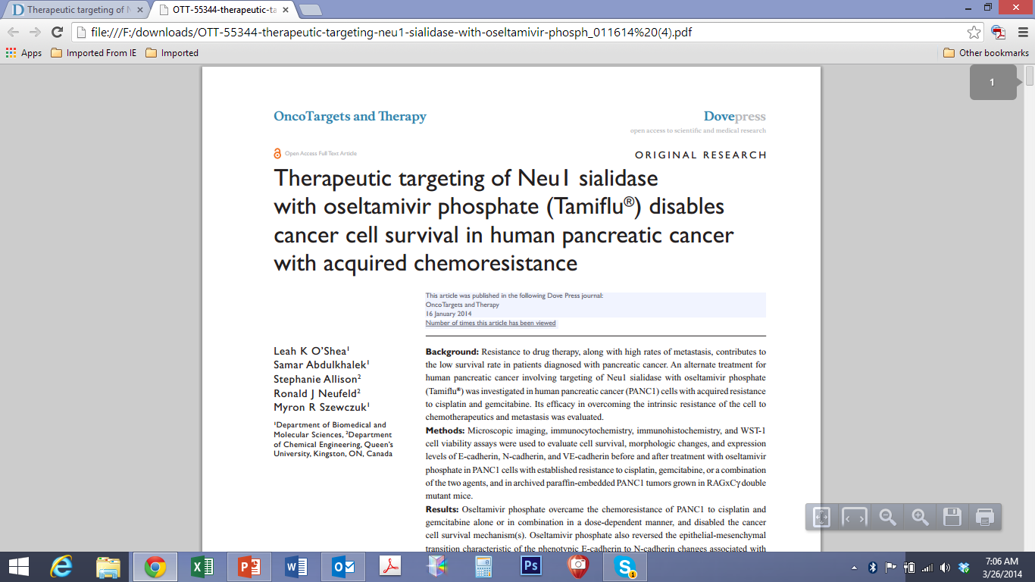
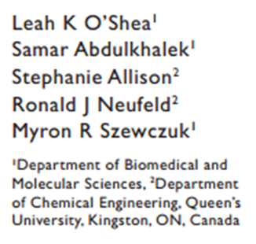
Clinical problem...
Resistance to drug therapy, along with high rates of metastasis, contributes to the low survival rate in patients diagnosed with pancreatic cancer.

Slide 10
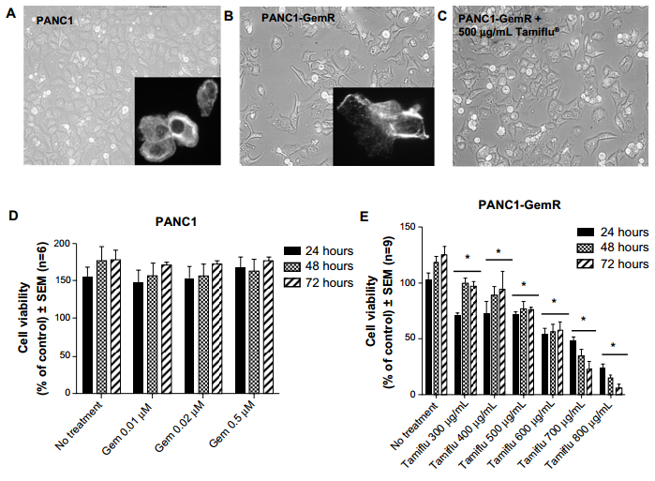
Established chemo-resistant PANC1 against 0.01μM gemcitabine for over 1 yr

Slide 11
Established chemo-resistant PANC1 against 80μM Cisplatin
for over 1 yr

Slide 12
Established chemo-resistant PANC1 against 80μM Cisplatin + 0.01μM Gem for over 1 yr

Slide 13
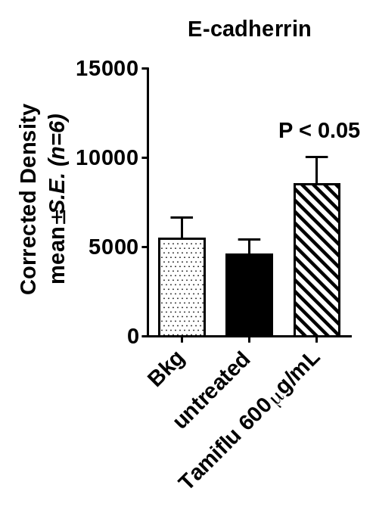
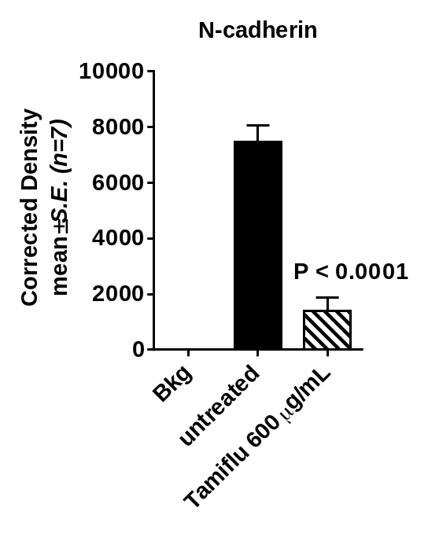
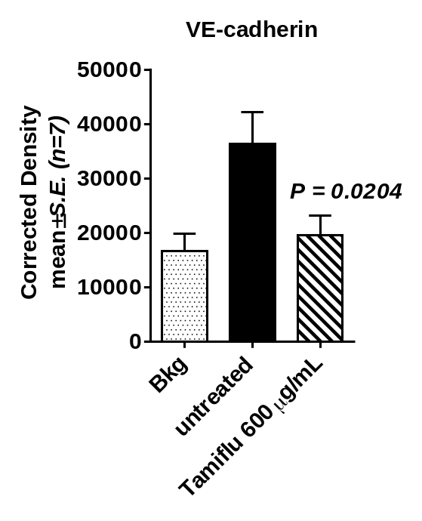
phase
E-cad
phase
N-cad
phase
VE-cad
PANC1
untreated
Tamiflu
24 hrs
no 1⁰ Ab

Slide 14
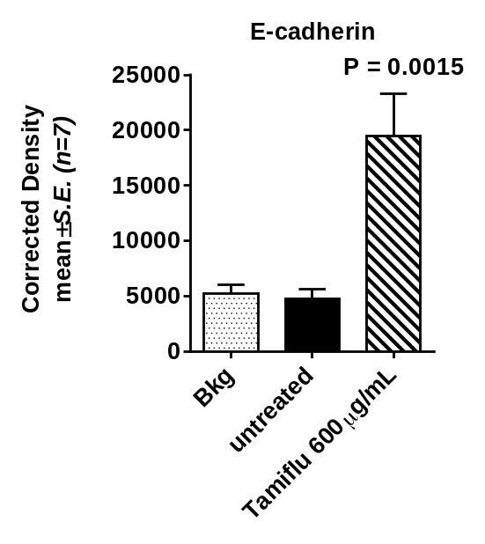
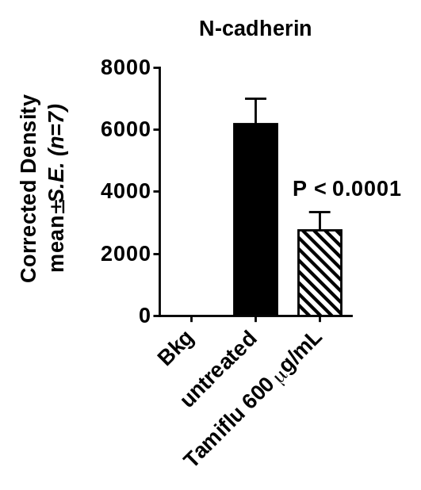
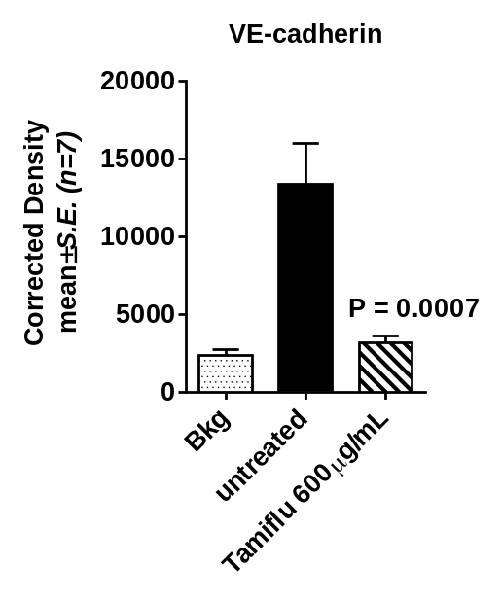
PANC1
GemR 0.01μM
VE-cad
phase
E-cad
phase
N-cad
phase
untreated
Tamiflu
24 hrs
no 1⁰ Ab

Slide 15
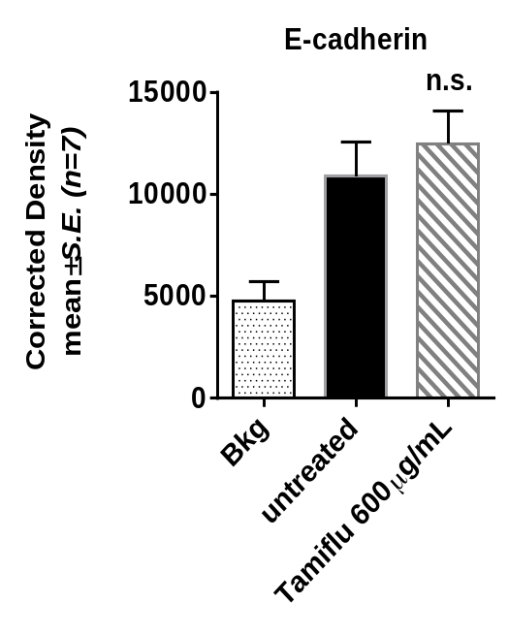
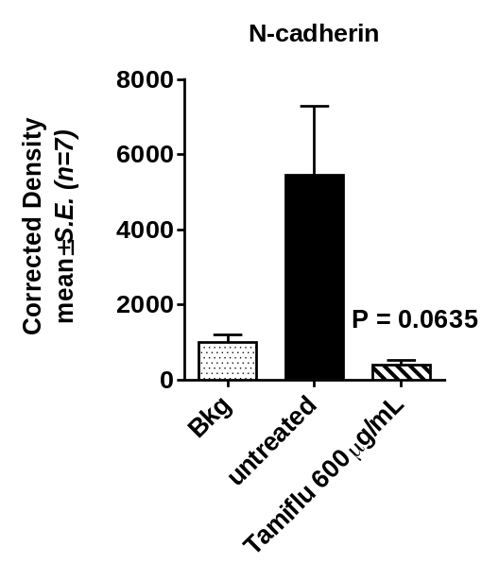
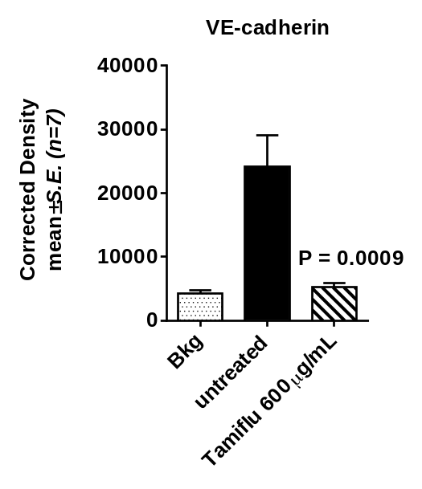
PANC1
CisR 80μM
phase
E-cad
phase
N-cad
phase
VE-cad
untreated
Tamiflu
24 hrs
no 1⁰ Ab

Slide 16
Findings indicate a reversal of EMT following treatment with oseltamivir phosphate, as demonstrated by expression of N-cadherin, VE-cadherin, and E-cadherin as characteristic markers of EMT, and an increase in the sensitivity of chemoresistant pancreatic cancer cells to drug therapy.
Paraffin-embedded tumor staining:
Fluorescence microscopic analyses

Slide 17
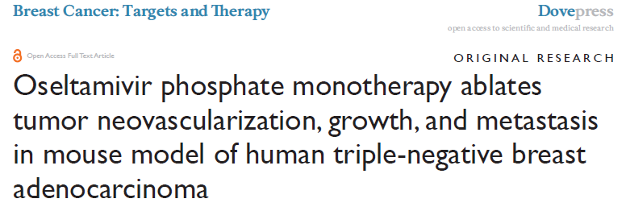
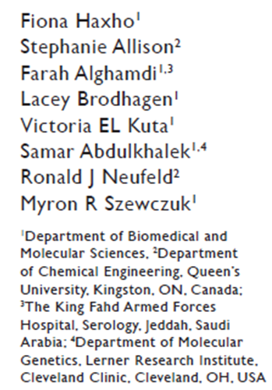
Highlights …..
Triple-negative breast cancers (TNBCs) lack the estrogen, progesterone, and epidermal growth factor (EGF) receptor-2 (HER2/neu) receptors.
Patients with TNBC have typical high grading, more frequent relapses, and exhibit poorer outcomes or prognosis compared with the other subtypes of breast cancers.
Currently, there are no targeted therapies that are effective for TNBC.

Slide 18
A
B

Slide 19
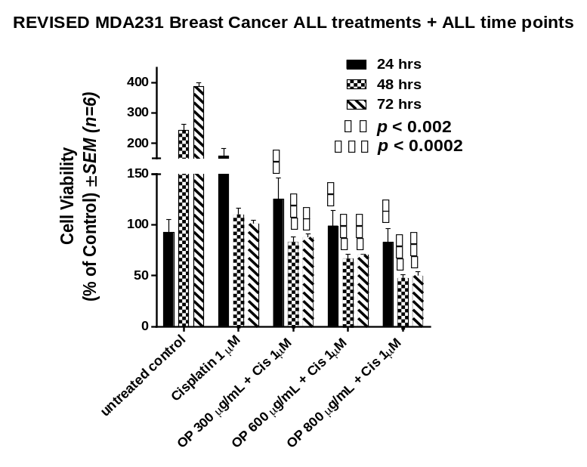
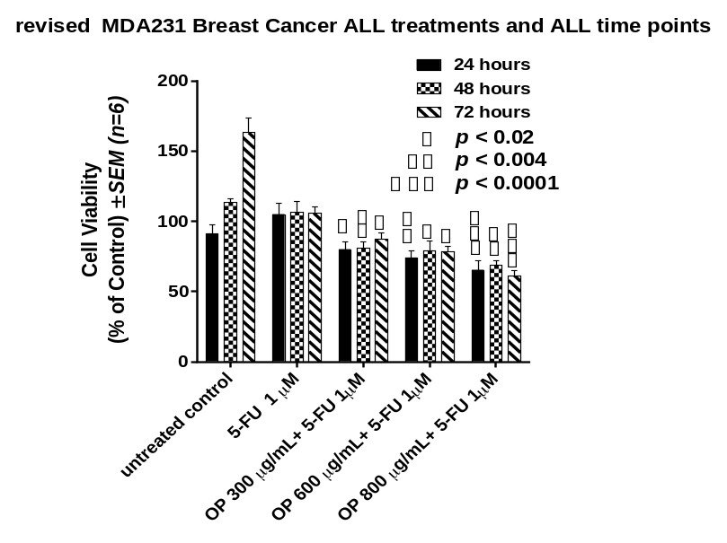
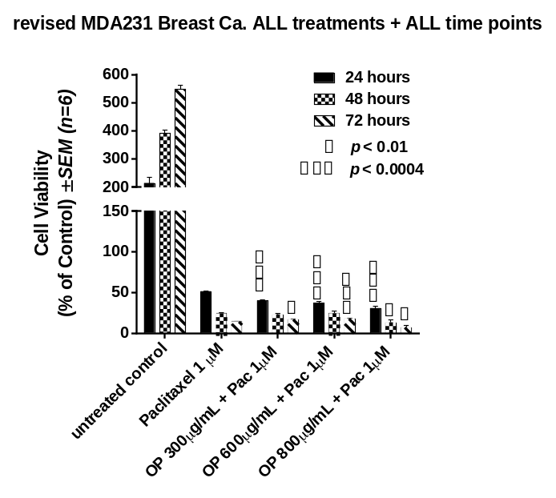
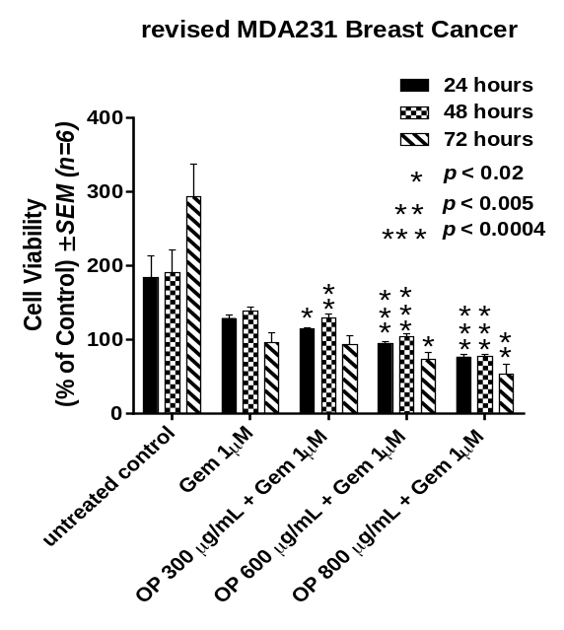
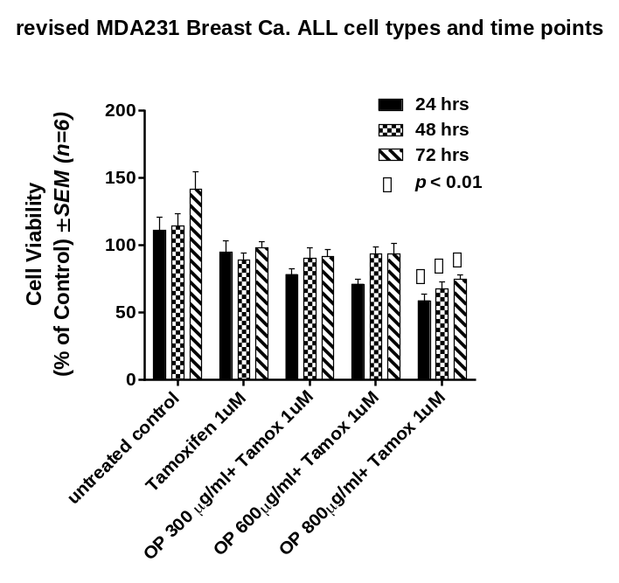
Cisplatin
5-FU
Paclitaxel
MDA-MB-231
Gemcitabine
Tamoxifen

Slide 20
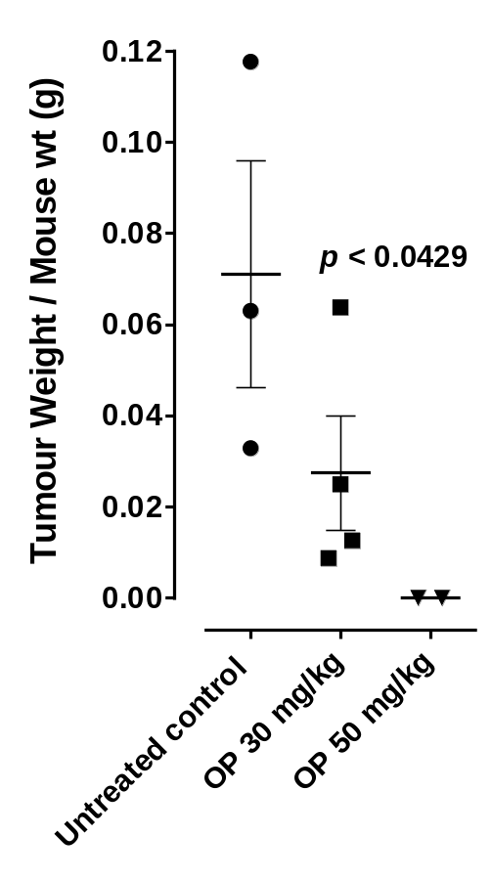
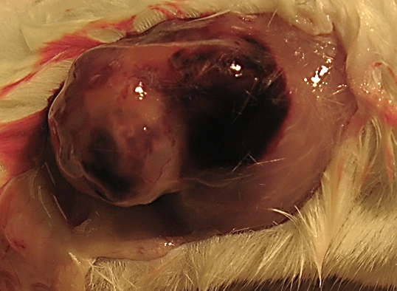
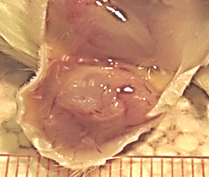
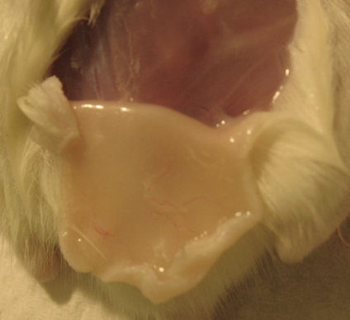
OP 30mg/kg
OP 50mg/kg
untreated
untreated
OP 30mg/kg
OP 50mg/kg

Slide 21
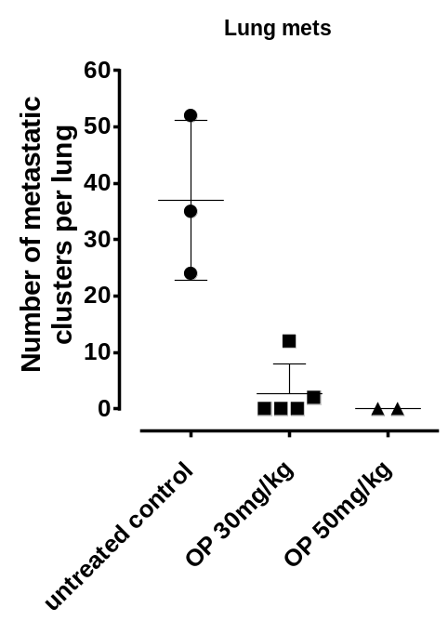
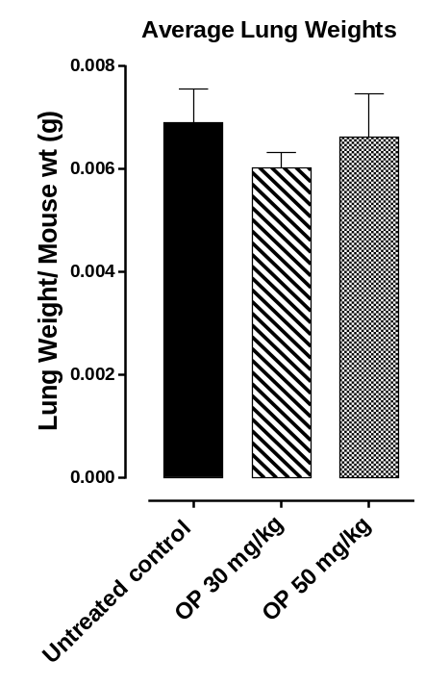
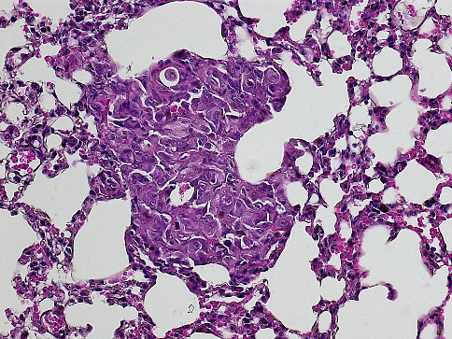
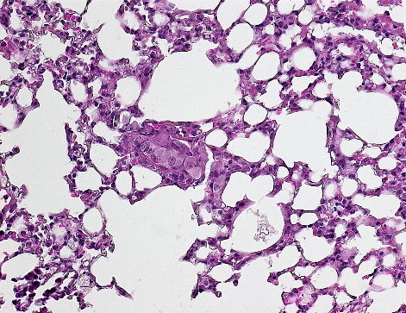
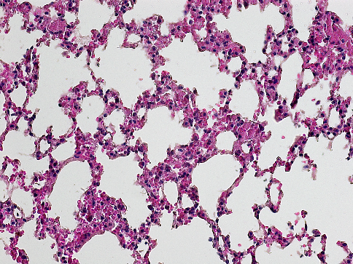
A
B
p < 0.0009
p < 0.002
C
A4
untreated
B2
OP 30mg/kg
C3
OP 50mg/kg

Slide 22
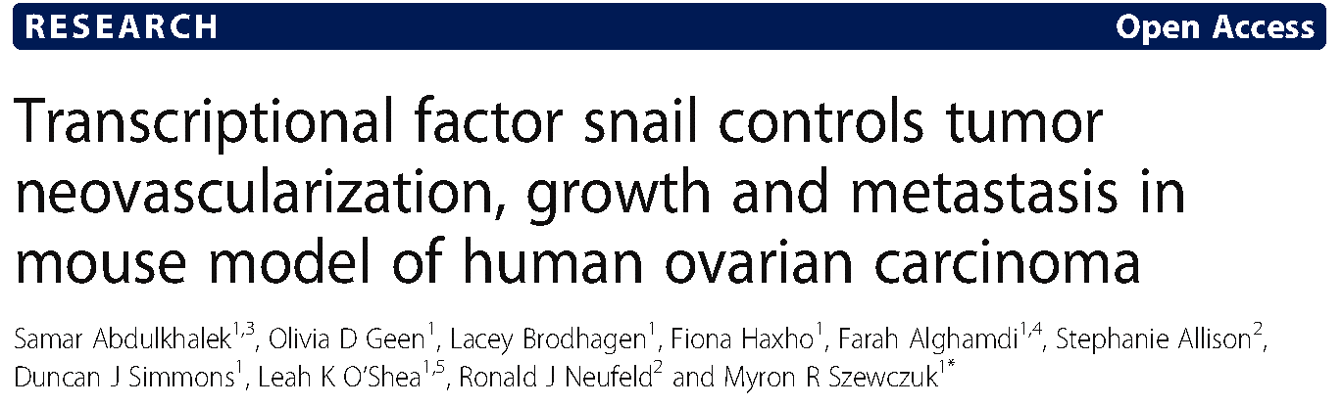
Highlights …..
Snail, a transcriptional factor and repressor of E-cadherin is well known for its role in cellular invasion.
It can regulate epithelial to mesenchymal transition (EMT) during embryonic development and in epithelial cells.
Snail also mediates tumor progression and metastases.
Silencing of Snail and its associate member Slug in human A2780 ovarian epithelial carcinoma cell line was investigated to identify its role in tumor neovascularization.

Slide 23
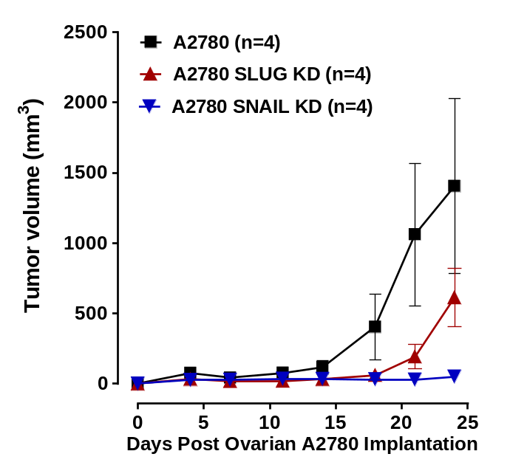
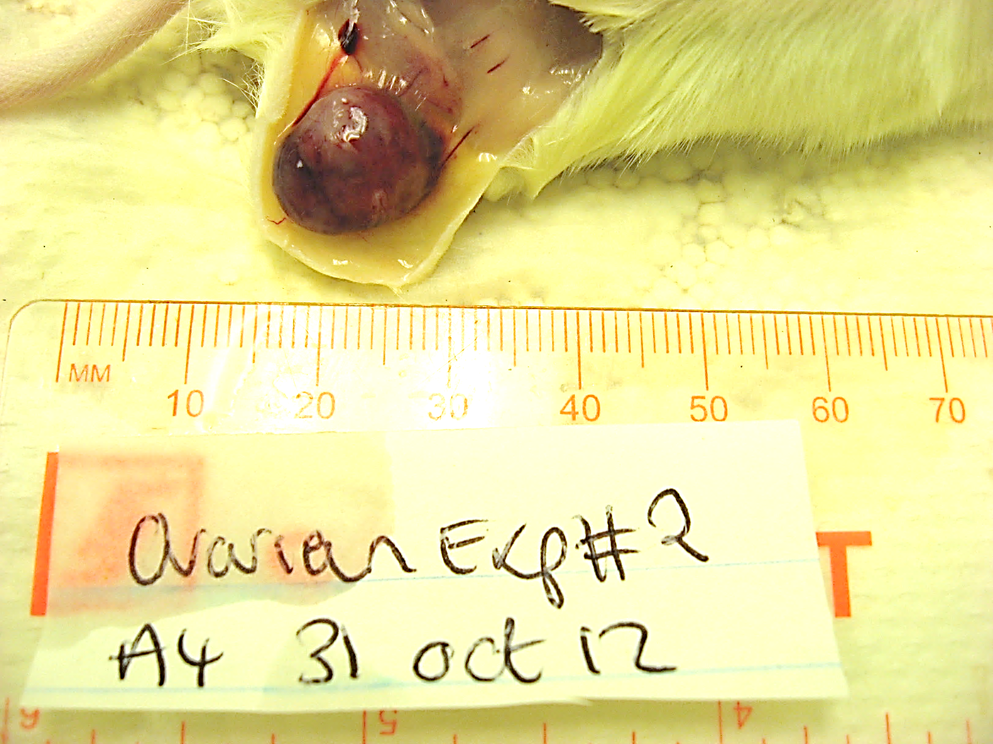
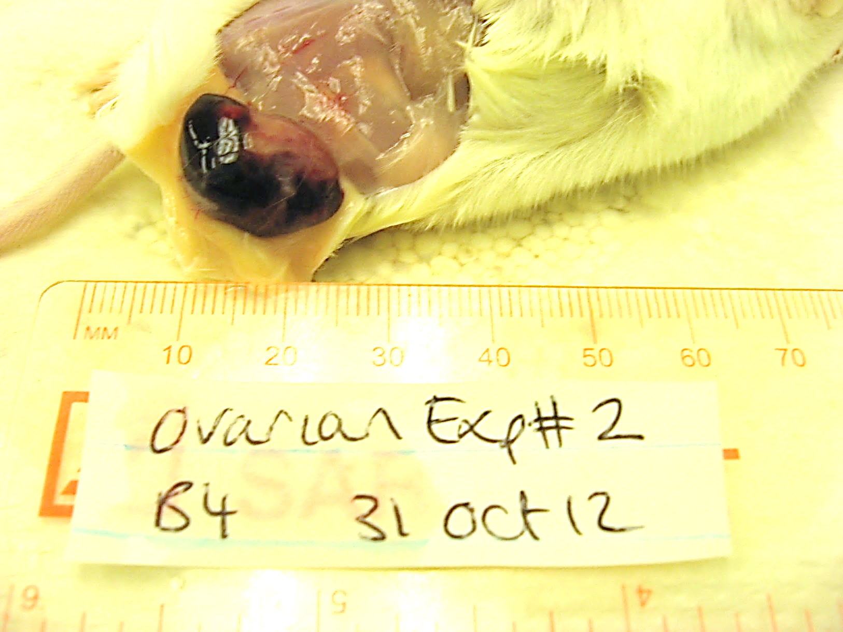
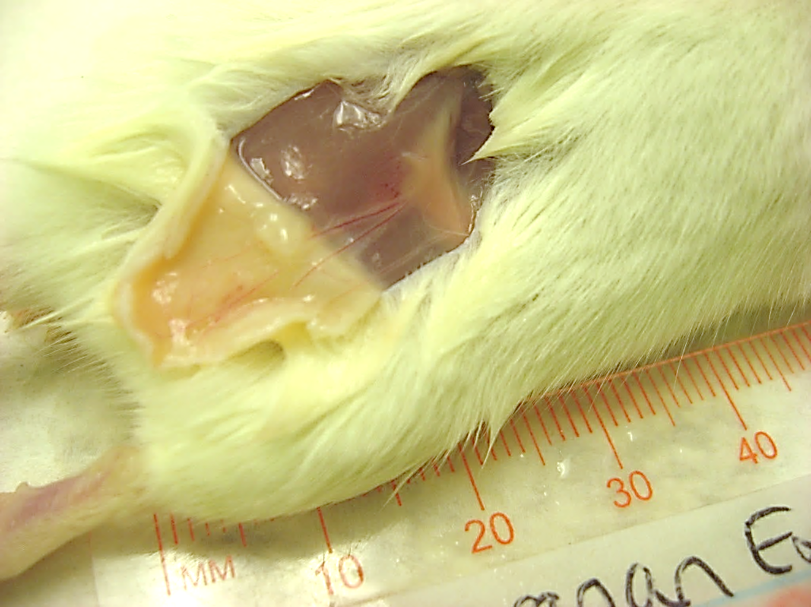
A
B
A4
B4
C4

Slide 24
Novelty
Abdulkhalek et al. Clinical and Translational Medicine 2014, 3:28
SNAIL KD
Signaling cascade
?
SNAIL: a zinc finger transcriptional repressor
SLUG KD
Tumor vasculature
secreted cytokines
Snail genes act primarily as survival factors and inducers of cell movement
Notes:
SNAIL gene may show a role in recurrence of breast cancer by downregulating E-cadherin and inducing an epithelial to mesenchymal transition.^{[3]}
Snail genes act primarily as survival factors and inducers of cell movement, rather than as inducers of EMT or cell fate. One of their best-known functions is to induce epithelial to mesenchymal transitions (EMTs), which convert epithelial cells into migratory mesenchymal cells.

Slide 25
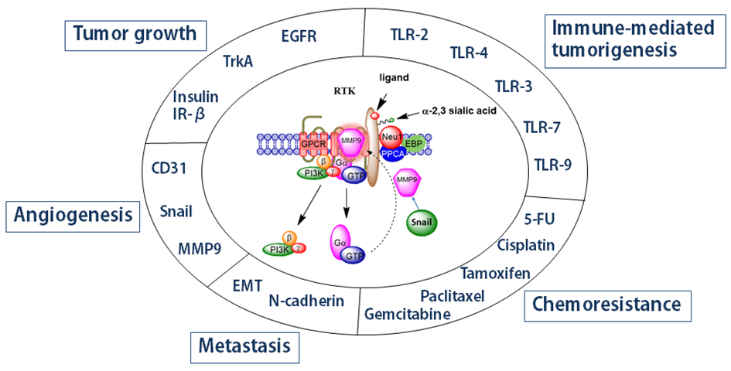
Therapeutic targeting neuraminidase-1 in multi-stage of tumorigenesis

Slide 26
Conclusions
The role of mammalian neuraminidase-1 (Neu1) is identified as a major target in the multi-stage of tumorigenesis.
An innovative and promising entirely new targeted therapy for cancer.

Slide 28

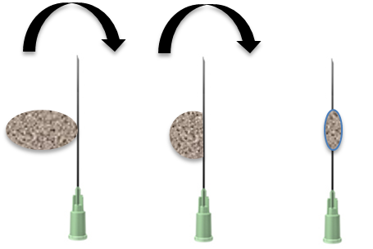
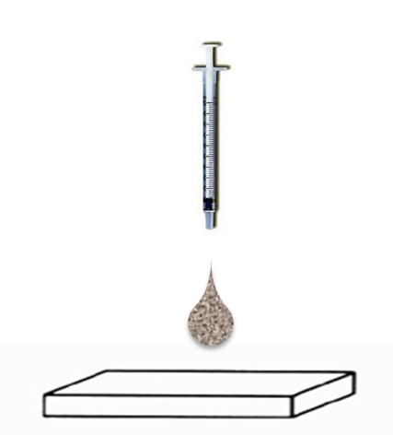


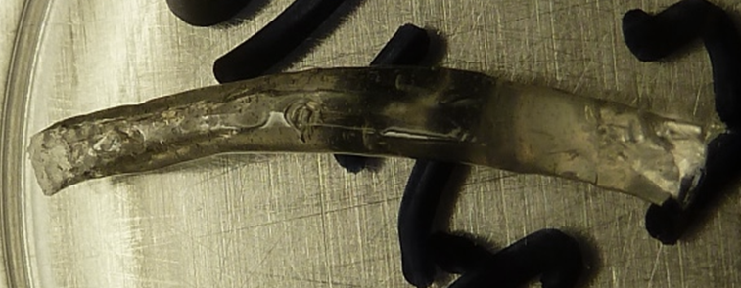
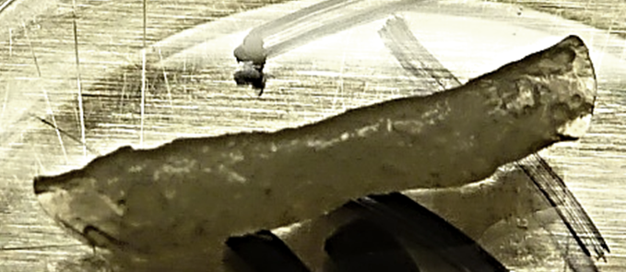
C
A
10G needle
B
PLGA-empty
PLGA-OP 20mg

Slide 29
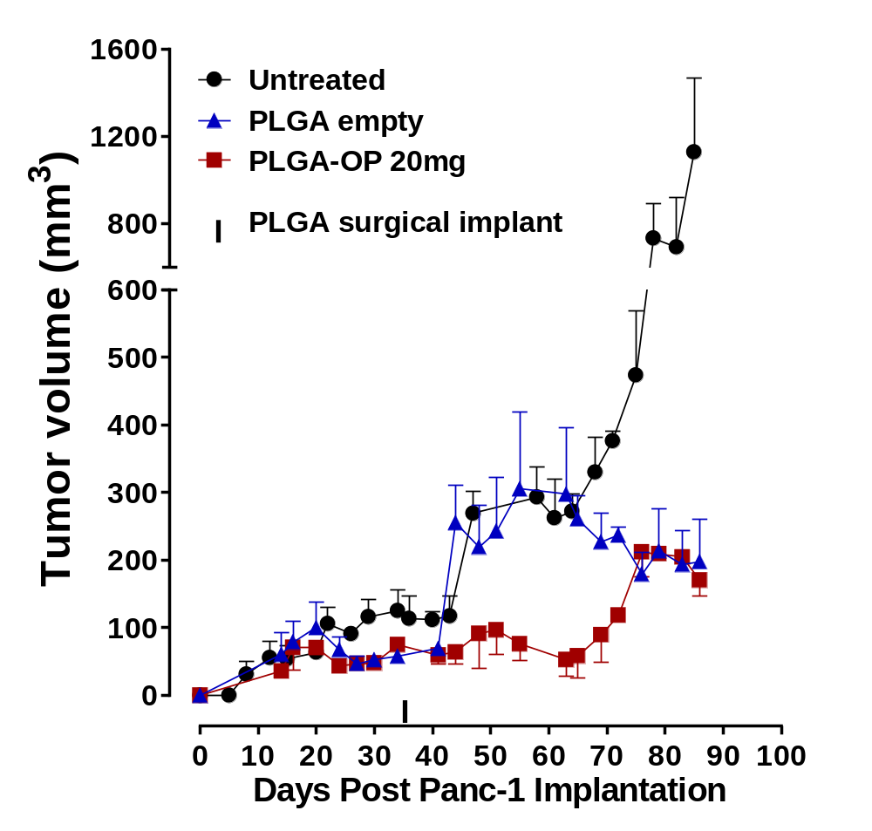
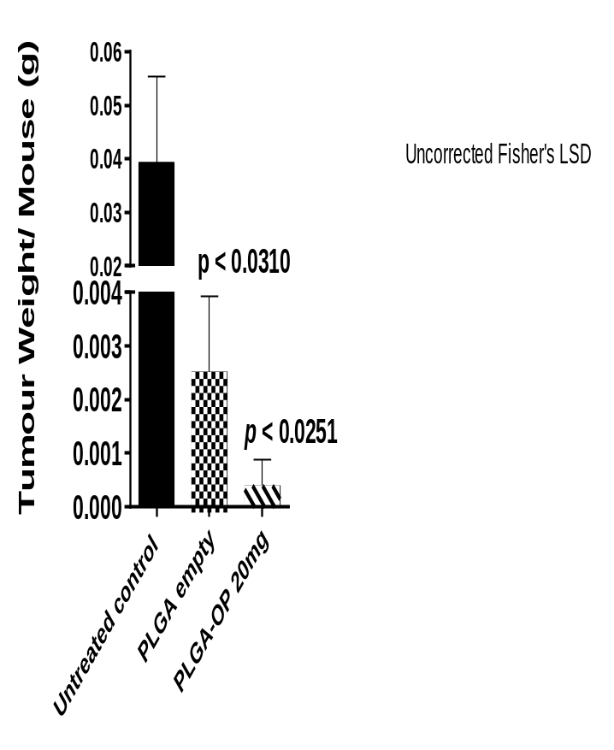

Slide 30
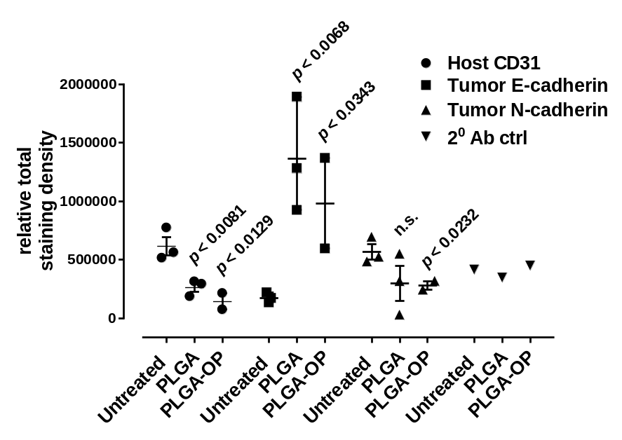
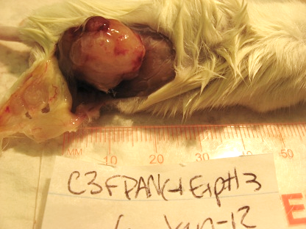
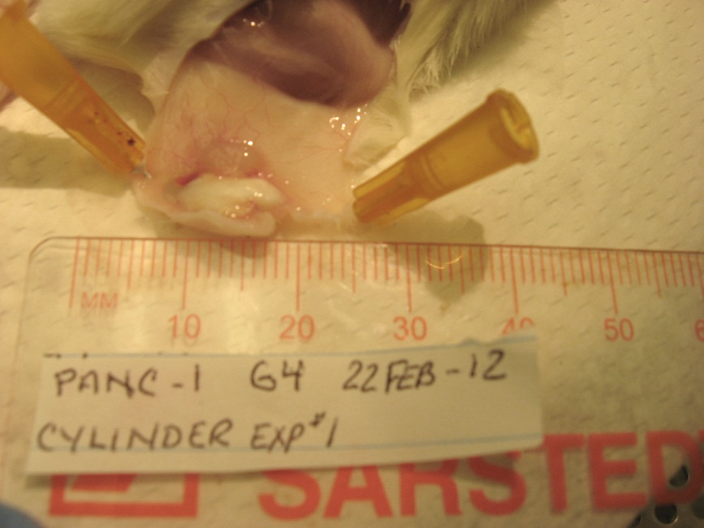
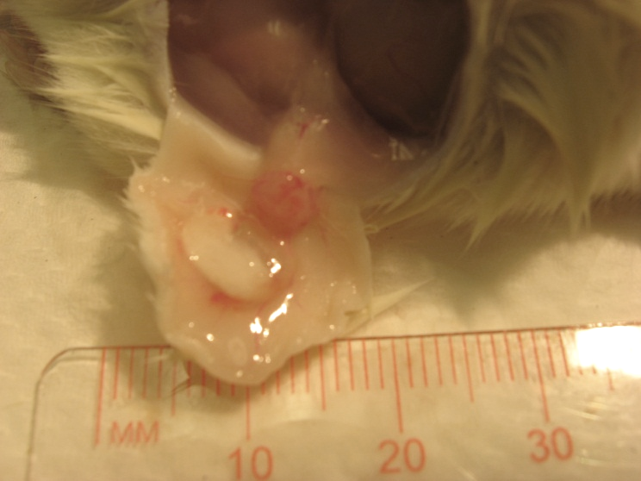
A
C
B
D
Blank PLGA
PLGA 20mg OP

Slide 31
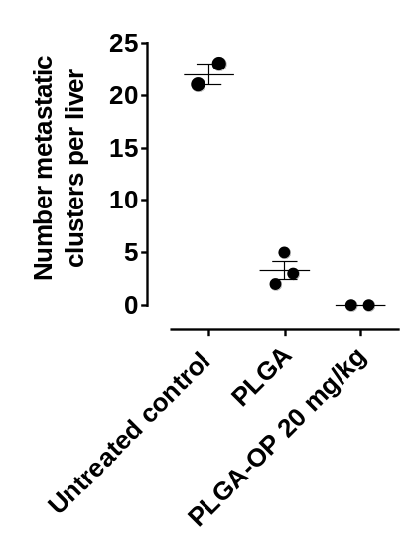
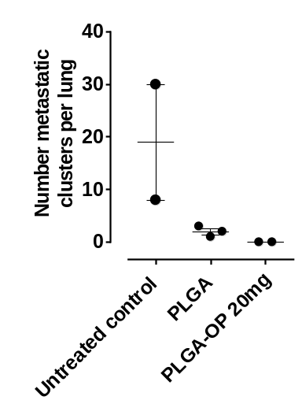
A
B

