Slide 1

Using agriculture wastes and sulfur obtained from the residues of the desulfurization of natural gas and oil as fertilizer for productive purposes.
Muscolo A^{1*}., Mallamaci C¹., Panuccio MR¹., Attinà E¹., Giovenco R²., Lisciandra L²., Calamarà G.².
¹Agriculture Department, Mediterranea University, Feo di Vito, 89124-Reggio Calabria Italy
² SBS Steel Belt Systems s.r.l. – Registered office: Via Roncaglia 14 – 20146 Milan (Italy) – Headquarters and Factory: Via E Mattei, 3 - 21040 Venegono Inf. (VA) Italy

Slide 2
This study started in cooperation with SBS an engineering and production company specialized in the design and manufacturing of steel belt systems for continuous industrial processes, pioneers in developing flaking and pastillating units for a wide range of products.
Our duty was to help SBS in converting harmful wastes (agricultural and elemental sulfur) in resources, identifying the right size and shape of pastilles for agriculture purpose.

Slide 3

Elemental Sulfur (99% S) obtained from the residues of the desulfurization of natural gas and oil is a pollutant for the environment with serious impact on human health. It is, nowadays in a small percentage used in the industrial process to produce sulfuric acid.
Olive wastes and orange residues are recalcitrant biomass, pollutant for the environment.

Slide 4
S is insoluble in water, and to be used for agriculture purpose needs to be mixed with bentonite an inhert clay to form pellet (or pastille). When the clay becomes wet in the soil, it swells and breaks the pellet into many small pieces with a very large reactive surface area releasing sulfur.
Released sulfur requires microbial oxidation to sulfate before plants can take it up. The rate of oxidation is largely governed by the properties of soil and environmental conditions.

Slide 5
The novelty of this study was
to use sulfur-bentonite linked to recalcitrant organic matrices
DUAL AIM
improving the quality and fertility of alkaline soils in a sustainable way.
increasing plant productivity.

Slide 6
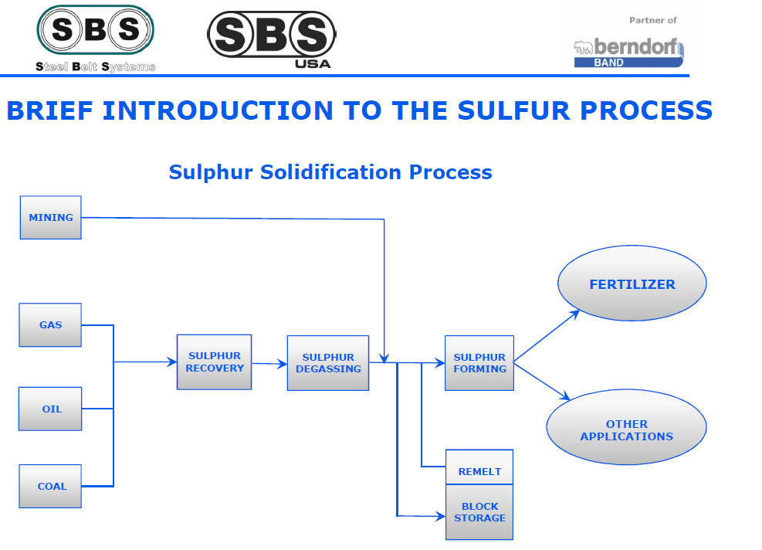

Slide 7
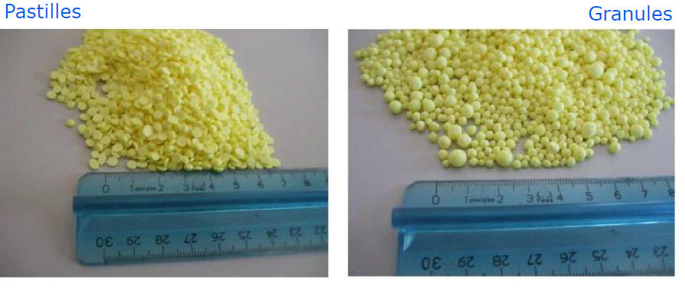
Pastilles were developed from mixtures of 10% sodium bentonite clay with elemental sulfur.
The more suitable shape and size for the pastilles were chosen.

Slide 8
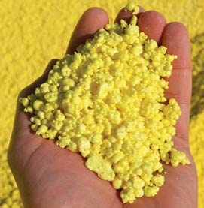
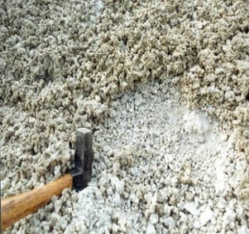
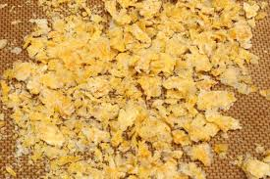

The pastilles of sulfur bentonite were linked with agriculture wastes
Pastilles
+
Elemental S
Bentonite
Dried orange
residues
Dried olive
residues

Slide 9
Experiment with soil
Alkaline sandy-loam soils, in pots, have been amended with sulfur-bentonite + orange waste “A”; sulfur-bentonite + olive waste “B”, sulfur -bentonite “C” at the concentration of 0.88 g l⁻¹. Not amended soil was used as control.
Soil in pots was regularly watered to maintain 70% of field capacity and 2 months after treament, soil chemical and biological parameters were detected.

Slide 10
Soil chemical and biochemical parameters
2 months after treatment
RESULTS
Treatment | Texture | pH | EC ( µS ) | CaCO₃ % | OM % | N ‰ | FDA | MBC
Control | SL | 8.4ª | 200 | 11 | 1.49^{c} | 0.28 ^{d} | 42^{b} | 842^{d}
A | SL | 6.8^{d} | 437 | 10 | 1.68ª | 0.50ª | 46ª | 1245ª
B | SL | 7.2^{c} | 419 | 10 | 1.63^{ab} | 0.33^{b} | 44ª | 1007^{b}
C | SL | 7.6^{b} | 485 | 10 | 1.58ª | 0.30^{c} | 43^{b} | 890^{c}

Slide 11
Experiments with plants:
In vitro: test of phytotoxicity, in petri dishes in growth chamber (red onion and bean)
2) In pots: phenotypic and growth test, in glass house (red onion, bean and cayenne red pepper).
In Vitro experiments
Germination in petri dishes in growth chamber at 25°C and 70% humidity (red onion and bean) with sulfur-bentonite + orange waste “A”; sulfur-bentonite + olive waste “B”; sulfur -bentonite “C” at the concentrations of 1.66; 1.32; 0.88; 0.44; 0.22; 0.11 g l⁻¹ and control “distilled water.”

Slide 12
Red Onion | Treatment | Germination % | Radicle cm | Shoot cm
Control | water | 100 | 1.5^{f} | 3.0e
 | 0.11 | 100 | 3.2^{b} | 4.2^{b}
A | 0.22 | 100 | 4.5ª | 4.3^{b}
 | 0.44 | 100 | 4.6ª | 4.4 ^{b}
 | 0.88 | 100 | 4.7ª | 4.7 ª
 | 1.32 | 80 | 2.0^{c} | 2.9^{d}
 | 1.66 | 68 | 1.4^{d} | 2.9^{d}
B | 0.11 | 90 | 2.2° | 3.7^{c}
 | 0.22 | 100 | 2.5^{d} | 3.7^{c}
 | 0.44 | 100 | 3.0^{c} | 3.7^{c}
 | 0.88 | 100 | 3.5^{b} | 3.8^{c}
 | 1.32 | 76 | 1.9^{c} | 3.5^{d}
 | 1.66 | 61 | 1.5^{f} | 3.0e
C | 0.11 | 100 | 0.9^{h} | 1.6^{f}
 | 0.22 | 100 | 1.2^{g} | 1.6^{f}
 | 0.44 | 100 | 0.8^{i} | 1.6^{f}
 | 0.88 | 100 | 0.8^{i} | 1.6^{f}
 | 1.32 | 50 | 0.8^{i} | 1.2^{g}
 | 1.66 | 35 | 0.8^{i} | 1.0^{h}
In VITRO
RESULTS

Slide 13
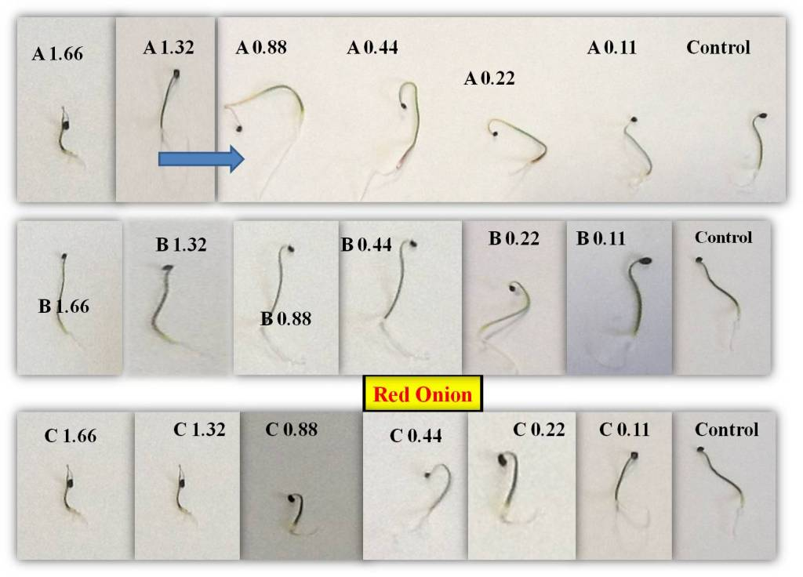

Slide 14
Bean | Treatment | Germination % | Radicle cm | Shoot cm
Control | water | 80 | 8.5^{i} | 2.5^{g}
A | 0.11 | 100 | 16° | 3.8e
 | 0.22 | 100 | 19^{c} | 7^{b}
 | 0.44 | 100 | 22^{b} | 7^{b}
 | 0.88 | 100 | 24ª | 9ª
 | 1.32 | 90 | 22^{b} | 0.8
 | 1.66 | 85 | 18^{d} | 0
B | 0.11 | 100 | 19^{c} | 2.0^{h}
 | 0.22 | 100 | 19^{c} | 2.5^{g}
 | 0.44 | 100 | 19^{c} | 2.5^{g}
 | 0.88 | 100 | 24ª | 4.5^{d}
 | 1.32 | 95 | 24ª | 4.0e
 | 1.66 | 90 | 22^{b} | 3.8e
C | 0.11 | 100 | 14^{f} | 3.5^{f}
 | 0.22 | 100 | 18^{d} | 4.0e
 | 0.44 | 100 | 18^{d} | 4.5^{d}
 | 0.88 | 100 | 21^{b} | 6.5^{c}
 | 1.32 | 70 | 11^{g} | 2.5^{g}
 | 1.66 | 62 | 9.5^{h} | 0

Slide 15
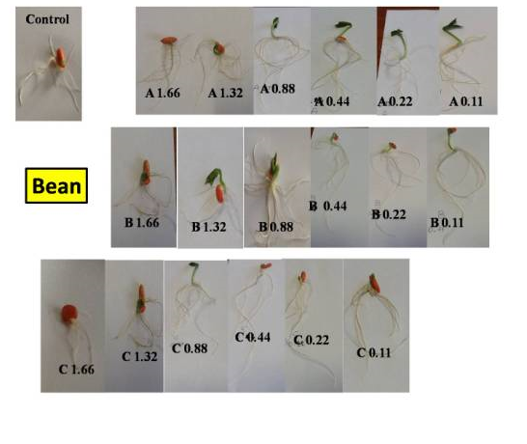

Slide 16
Pot experiments
Phenotypic and growth measurements, in pots with alkaline soil, fertilized with sulfur-bentonite + orange waste “A”; sulfur-bentonite + olive waste “B”; sulfur -bentonite “C” at the concentrations of 0.88 g l⁻¹ and control “not ammended” (red onion, bean and chili pepper). The plants were regularly watered to maintain 70% of field capacity.

Slide 17
Phenotypic and growth parameters of red onion 3 months after treatment (A, B, C) with respect to control (not treated) number in the same column followed by different letters are statistically different p ≤0.05
POT RESULTS
Treatment | Plant height cm | Leaf number | Fruit length cm | Fruit diameter cm
Control | 38^{c} | 5^{b} | 4.6^{d} | 3.1^{c}
A | 46ª | 6ª | 6.3ª | 4.4ª
B | 38^{c} | 5^{b} | 5.6^{b} | 3.5^{b}
C | 41^{b} | 5^{b} | 5.0^{c} | 3.4^{b}

Slide 18
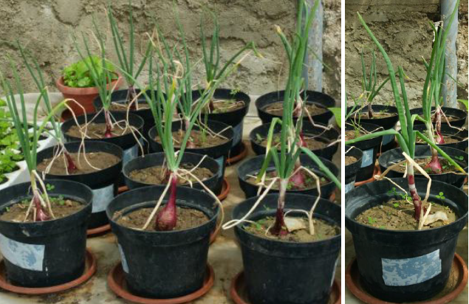
C
B
Control
A

Slide 19
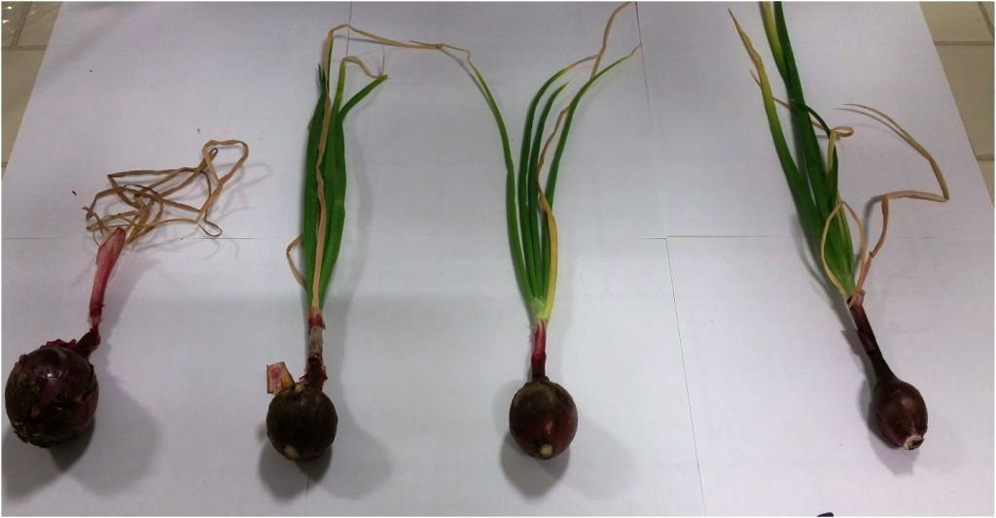
Control
B
C
A

Slide 20
Phenotypic and growth parameters of bean 3 months after treatment (A,B, C) with respect to control (not treated) number in the same column followed by different letters are statistically different p ≤0.05
Treatment | Plant height cm | Leaf number | Flower number | Fruit number
Control | 15^{c} | 5^{d} | 1^{c} | 2^{c}
A | 18^{b} | 10^{b} | 3^{b} | 5^{b}
B | 20ª | 14ª | 8ª | 10ª
C | 16^{c} | 7^{c} | 2^{c} | 5^{b}

Slide 21
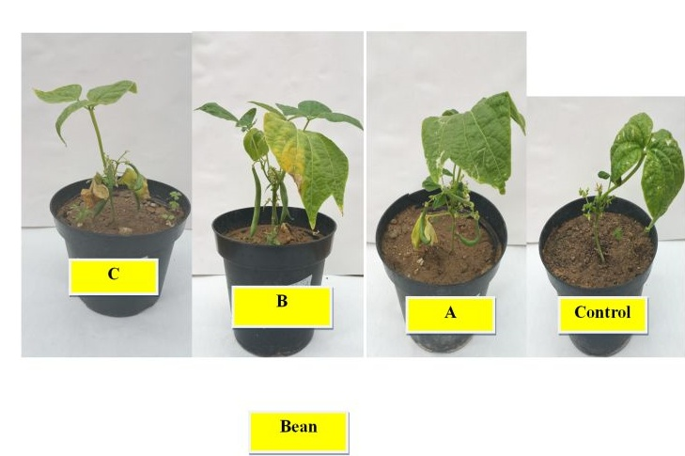

Slide 22
Phenotypic and growth parameters of cayenna red pepper 3 months after treatment (A, B, C) with respect to control (not treated). Number in the same column followed by different letters are statistically different p ≤0.05
Treatment | Plant height cm | Leaf number | Flower number | Fruit number | Fruit length cm
Control | 26^{c*} | 30^{b} | 2^{c} | 1^{d} | 0.3^{d}
A | 32ª | 43ª | 4ª | 4ª | 8ª
B | 30^{b} | 33^{b} | 3^{b} | 3^{b} | 6^{b}
C | 27^{c} | 33^{b} | 3^{b} | 2^{c} | 3^{c}

Slide 23
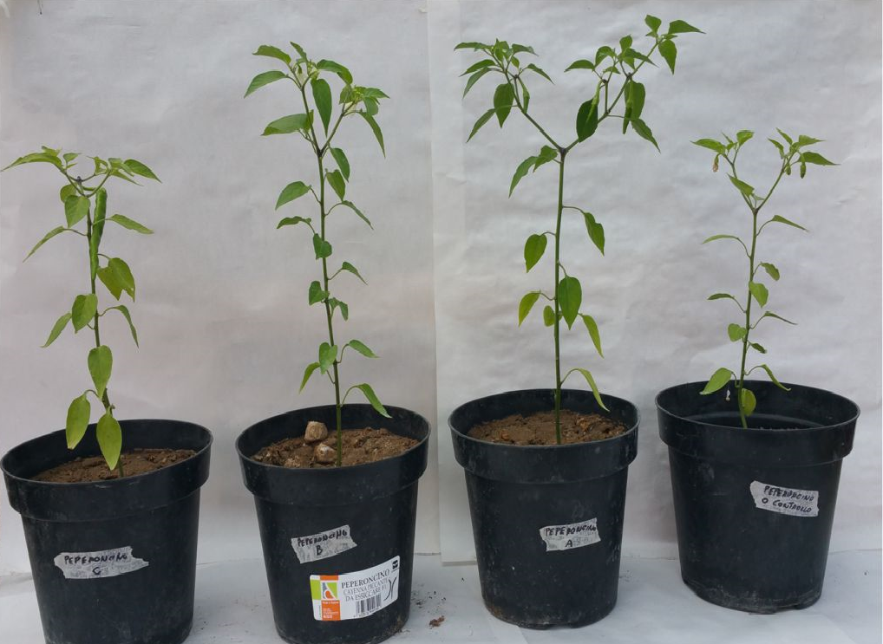
Control
A
C
B

Slide 24
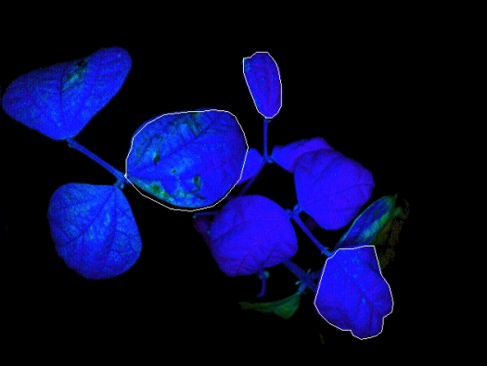
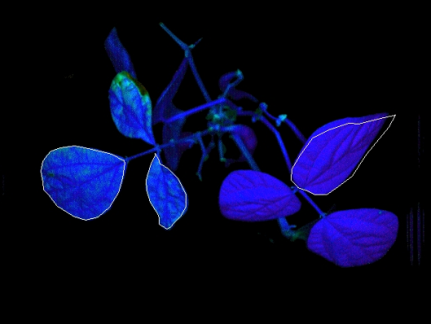
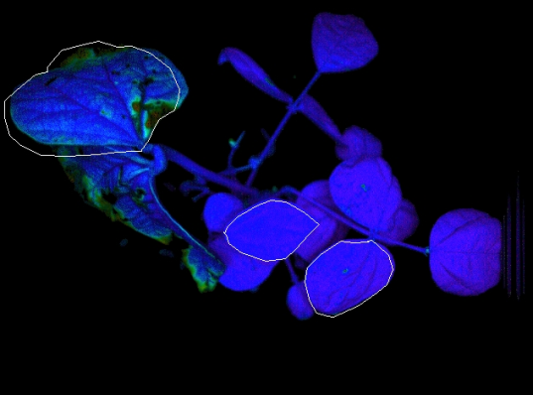
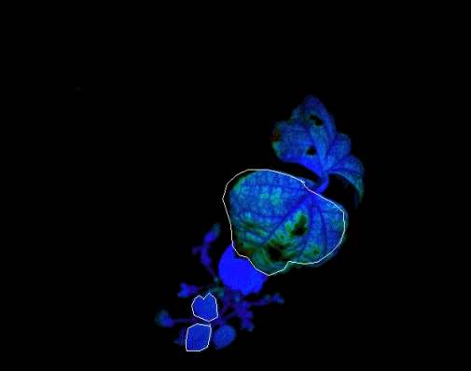
The performance of the fertilized plants was evaluated by assessing the photosynthetic efficiency in respect to control (no treated plants) by using IMAGING-PAM CHLOROPHYLL FLUOROMETER System.
FV/FM = reaction centre acivity in the PSII
C
B
A
Control

Slide 25
Species | Treatment | F | Fm | F0 | YII | Y(NPQ) | NPQ | YNO | qN | qP | qL | ETR | Inh | Fv/Fm
Red pepper | Control | 0.147 | 0.222 | 0.153 | 0.310 | 0.314 | 0.219 | 0.364 | 0.859 | 0.94 | 0.91 | 10 | 0.15 | 0.310
 | A | 0.142 | 0.289 | 0.150 | 0.592 | 0.204 | 0.204 | 0.271 | 0.698 | 1.000 | 0.95 | 15 | 0.17 | 0.680
 | B | 0.127 | 0.226 | 0.120 | 0.546 | 0.180 | 0.219 | 0.321 | 0.769 | 0.94 | 0.93 | 13 | 0.13 | 0.470
 | C | 0.182 | 0.301 | 0.199 | 0.394 | 0.311 | 0.242 | 0.265 | 0.816 | 0.94 | 0.83 | 12 | 0.14 | 0.338
bean | Control | 0.107 | 0.157 | 0.081 | 0.391 | 0.318 | 0.289 | 0.222 | 0.380 | 0.89 | 0.76 | 15 | -0.28 | 0.484
 | A | 0.129 | 0.263 | 0.094 | 0.532 | 0.272 | 0.196 | 0.196 | 0.659 | 0.95 | 0.87 | 16 | -0.22 | 0.640
 | B | 0.078 | 0.190 | 0.067 | 0.553 | 0.298 | 0.182 | 0.149 | 0.804 | 0.91 | 0.85 | 17 | -0.28 | 0.647
 | C | 0.082 | 0.180 | 0.078 | 0.566 | 0.214 | 0.194 | 0.220 | 0.675 | 0.92 | 0.86 | 15 | -0.18 | 0.560
Red onion | Control | 0.075 | 0.182 | 0.099 | 0.588 | 0.358 | 0.251 | 0.255 | 0.663 | 0.95 | 0.90 | 13 | -0.02 | 0.456
 | A | 0.143 | 0.321 | 0.120 | 0.593 | 0.157 | 0.130 | 0.250 | 0.452 | 0.95 | 0.89 | 17 | -0.05 | 0.626
 | B | 0.120 | 0.302 | 0.120 | 0.491 | 0.267 | 0.102 | 0.240 | 0.551 | 0.92 | 0.90 | 16 | -0.05 | 0.602
 | C | 0.601 | 0.246 | 0.130 | 0.502 | 0.304 | 0.095 | 0.194 | 0.314 | 0.69 | 0.65 | 14 | -0.05 | 0.471

Slide 26

Chemical characteristics of sulfur-bentonite + orange waste “A”, sulfur-bentonite + olive waste “B” and sulfur-bentonite “C”
 | pH | EC µS cm⁻¹ | WSP µg tannic acid/l | Na⁺ mg/l | NH4⁺ mg/l | K⁺ mg/l | Mg⁺⁺ mg/l | Ca⁺⁺ mg/l
A | 6.5 | 95 | 1107 | 16 | nd | 3.2 | 4.6 | nd
B | 6.8 | 106 | 738 | 26 | 0.6 | 4.0 | 3.1 | nd
C | 7.5 | 148 | nd | nd | nd | nd | nd | nd

Slide 27

Conclusion
Sulfur bentonite is a corrective-nutritional fertilizer, whose unique formulation in pastilles of 2-4-mm allows the easy distribution and quick disintegration in soil, either in open field or in localized form.
The easy disintegration allows a rapid correction of the soil pH improving the cultivability of alkaline and saline soils in short time.
The lowering of the pH value in the area of ​​root development facilitates mobility and absorption of other nutrients, such as nitrogen, phosphorus and potassium.
The addition of agricultural wastes to sulfur bentonite, particularly of orange waste, improves the fertilizer effects of sulfur-bentonite.
The results evidenced a relationship and a specificity between the species and the type of sulfur-bentonite used.
The effects at seed stage may be different from those at the establishment and growth of the seedling.
Waste material, both agricultural and industrial, represents a resource for the recovery of saline and alkaline soils and an additional incoming for the agricultural sector.

Slide 28

WORK IN PROGRESS
Analysis of nutraceutical properties of:
Red onion (sulphur and phenolic compounds; vitamins)
Bean ( proteins; vitamins; minerals)
Red chili pepper (vitamins, minerals and phyto-nutrients)

Slide 29



