Slide 1


2nd World Congress and Expo on Recycling July 25-27, 2016 Berlin, Germany
Recalcitrant agriculture wastes to produce biogas and amendments.
Muscolo et al.
Department of Agriculture, “Mediterranea” University, Reggio Calabria Italy.
2nd World Congress and Expo on Recycling July 25-27, 2016 Berlin, Germany

Slide 2
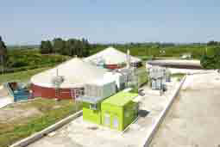
Biogas technology, is a competitive process for reducing the rate of climate change and global warming managing biodegradable waste streams to produce renewable energy in a sustainable way and a nearly stable residue (digestate).
2nd World Congress and Expo on Recycling July 25-27, 2016 Berlin, Germany

Slide 3
This research is in cooperation with Fattoria della Piana owners of two biogas plants each with 998 kW of installed power

Slide 4
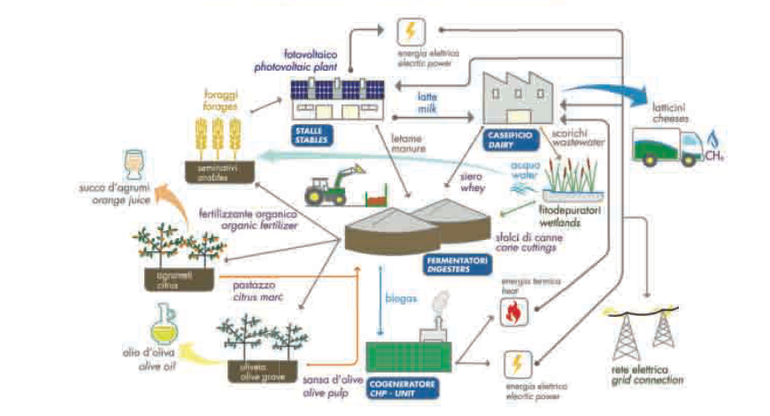

2nd World Congress and Expo on Recycling July 25-27, 2016 Berlin, Germany

Slide 5
While biogas represents an ascertained useful source of renewable energy, the digestate ever-increasing production induces problems related to its sustainable discharge.
Consequently, the production of biogas has to be associated to a sustainable disposal of digestate for being economically and environmentally competitive with the fossil fuels.
2nd World Congress and Expo on Recycling July 25-27, 2016 Berlin, Germany

Slide 6
The two biogas plants were differently supplied:
the first one named Fattoria (F) was powered with animal manures (poultry, cow and sheep), milk serum, maize silage and in minor amount with olive waste and citrus pulp.
The second one named Uliva (U) was mainly powered with olive waste and citrus pulp and in minor amount with animal manure and maize silage.

Slide 7
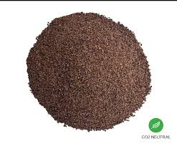
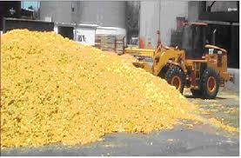


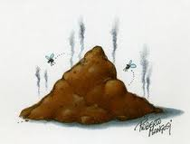
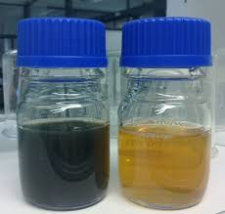
The objectives were :
to evaluate if recalcitrant agriculture wastes (olive wastes and citrus pulps), mixed in different proportions with livestock manures, whey and maize silage produce biogas different in composition
2) to characterize the obtained digestates, each separated in liquid and solid fractions
2nd World Congress and Expo on Recycling July 25-27, 2016 Berlin, Germany

Slide 8
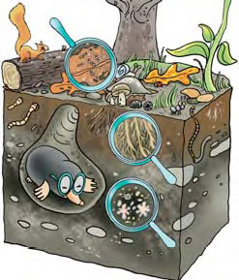
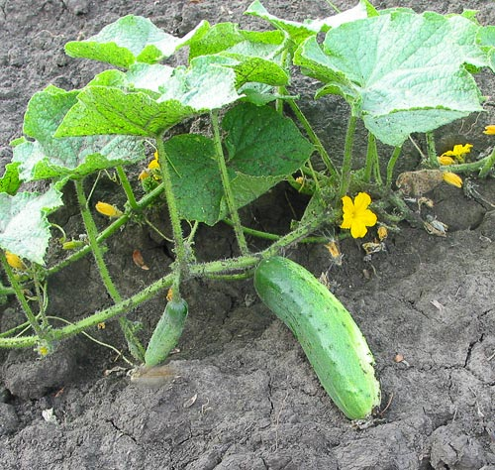
3) to verify the impact of the amendment with liquid (L) and solid fractions (S) of the two digestates on soil fertility
To check cucumis sativus growth and productivity in field amended with liquid (L) and solid fractions (S) of the two digestates
2nd World Congress and Expo on Recycling July 25-27, 2016 Berlin, Germany

Slide 9
Cucumber (Cucumis sativus L.) is an important vegetable, and one of the most popular members of the Cucurbitaceae family. It is one of the oldest vegetables cultivated by man with historical records dating back 5,000 years.
Fertile soils are used for the cultivation of cucumber; infertile soils result in bitter and misshapen fruits which are often rejected by consumers.

Slide 10
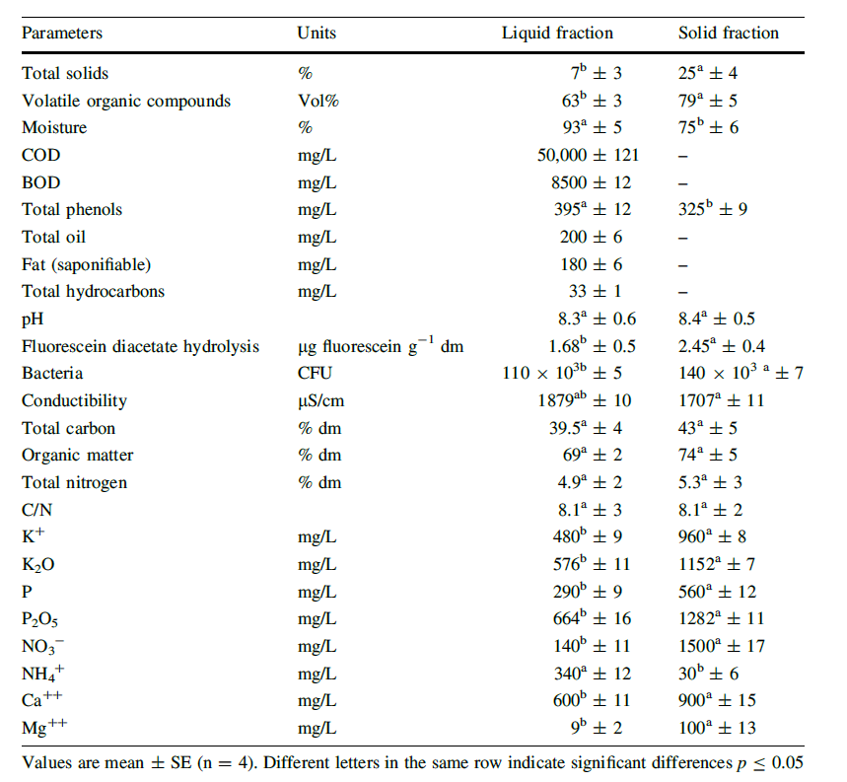
RESULTS
FATTORIA
In both plants, the biogas production reached 440-450 m³/h with a methane content of ~60%
The two biogas digestates were chemically and qualitatively different one from the other.
Waste Biomass Valor 2016, 267-280.

Slide 11
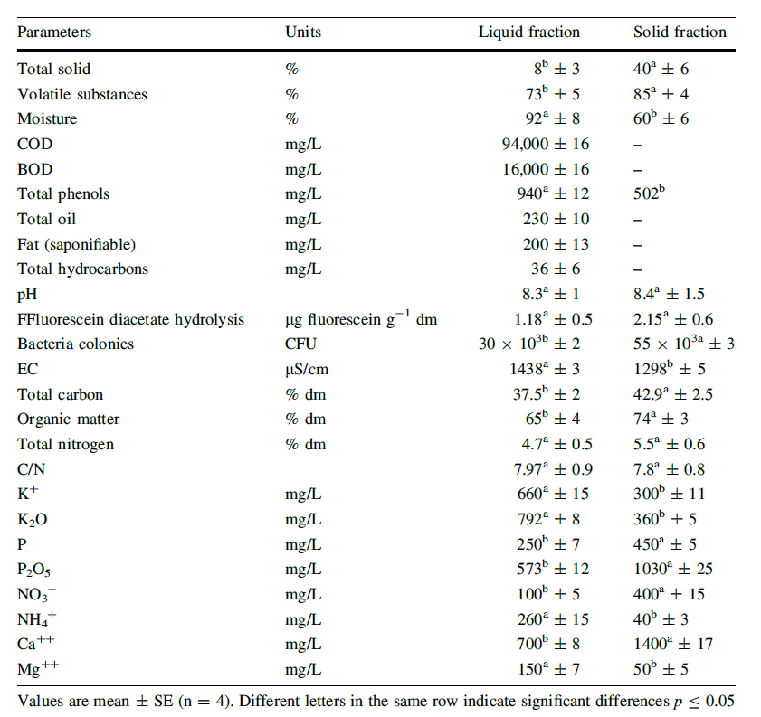
ULIVA

Slide 12
SOIL QUALITY
The observed changes in soil chemical characteristics depended on the source of digestate, the type of fraction, and the concentration used. The improvement of soil chemical and biological properties was greater with both fractions of the digestate Fattoria.

Slide 13
 |  |  | FATTORIA
 |  | OM | WSP | FDA. | MBC | CAT
SOLID
 | F-ratio | 32.598 | 191.81 | 128.99 | 1062.31 | 118.88
 | p value | 0.000 | 0.000 | 0.000 | 0.000 | 0.000
 | R² | 0.924 | 0.986 | 0.980 | 0.997 | 0.978
LIQUID
 | F-ratio | 0.067 | 40.43 | 270.77 | 518.56 | 336.70
 | p value | 0.024 | 0.000 | 0.000 | 0.000 | 0.000
 | R² | 0.976 | 0.969 | 0.990 | 0.995 | 0.992
 |  |  | ULIVA
 |  | OM | WSP | FDA | MBC | CAT
SOLID
 | F-ratio | 12.72 | 1104.33 | 1.33 | 98.97 | 18.42
 | p value | 0.002 | 0.000 | ns | 0.000 | 0.001
 | R² | 0.827 | 0.998 | 0.34 | 0.974 | 0.874
LIQUID
 | F-ratio | 0.067 | 247.79 | 0.82 | 3.13 | 28.73
 | p value | 0.024 | 0.000 | ns | ns | 0.000
 | R² | 0.976 | 0.989 | 0.52 | 0.540 | 0.915
Analysis of variance of fattoria and uliva digestate fractions (solid and liquid) on soil organic matter (SOM), total phenols (WSP), fluorescein diacetate (FDA), microbial biomass C (MBC) and catalase (CAT) indices. F-ratio and R² are shown

Slide 14


CUCUMBER GROWTH

Slide 15
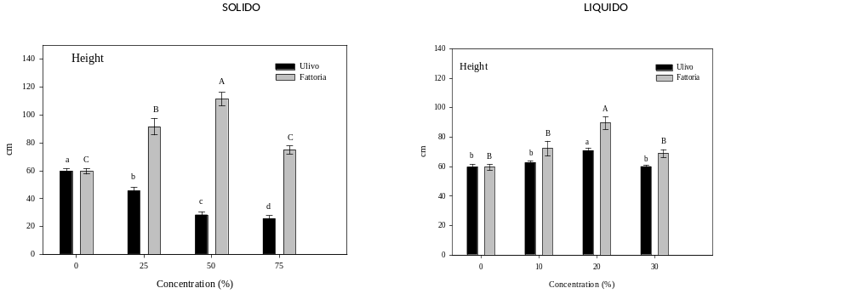
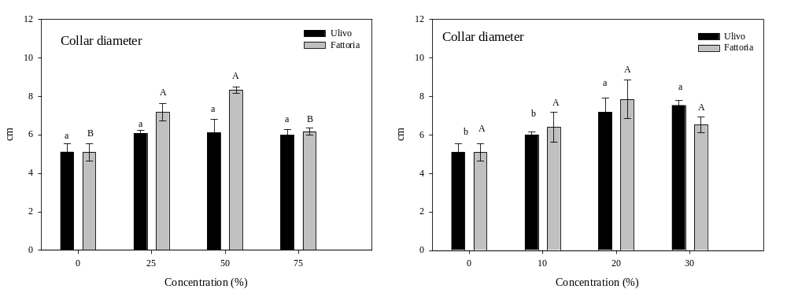
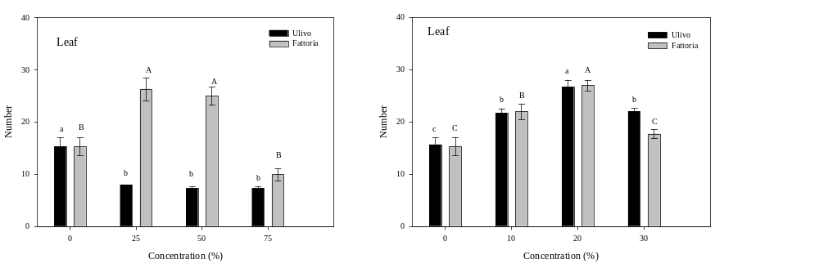
Solid
Liquid

Slide 16
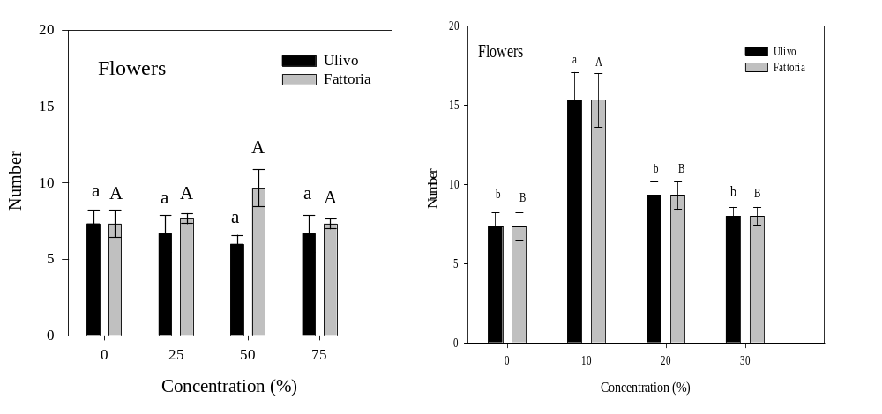
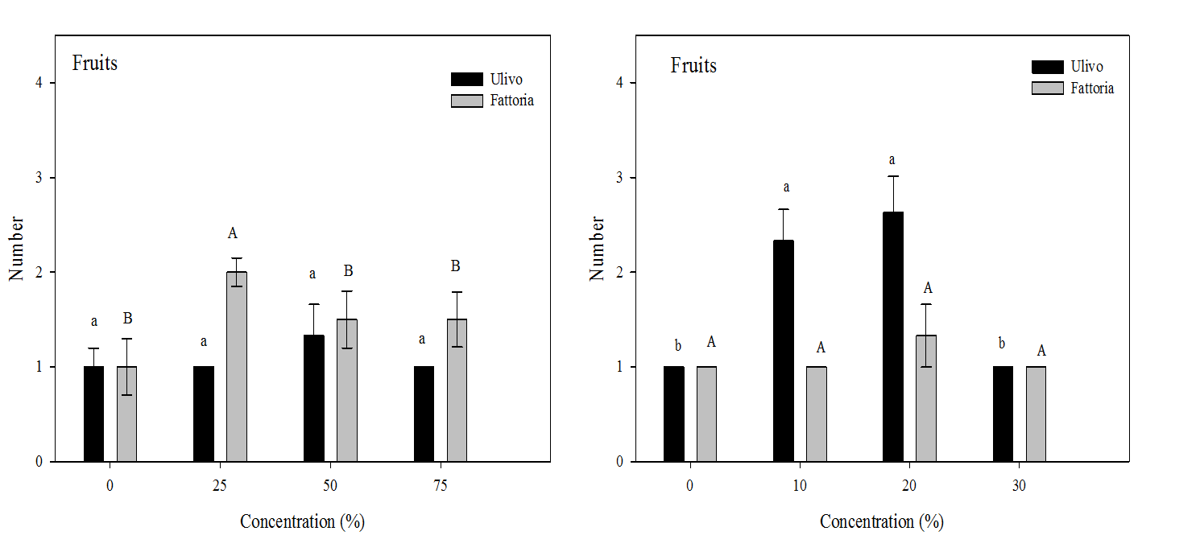
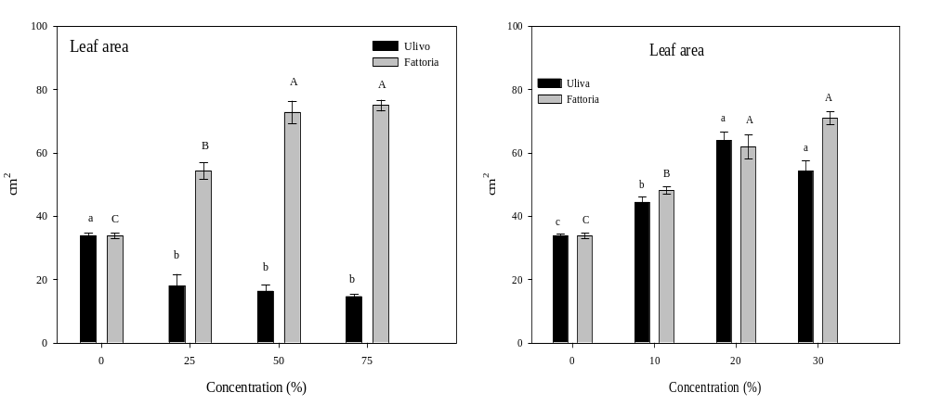
SOLID
LIQUID

Slide 17

Cucumber Nutraceutical Properties

Slide 18
 | Chroma Peel | Chroma Pulp | BRIX | pH | Tritabile acidity |  | Dry matter | DPPH %
Control | 22 ^{c} | 97 ª | 4.05 ª | 6.7^{b} | 0.70^{b} |  | 3.7^{b} | 13.2e
Solid Fattoria
25% | 25^{b} | 99ª | 3.25^{b} | 6.78^{ab} |  | 0.72^{b} | 3.3 ^{b} | 22.5^{c}
50% | 29ª | 101ª | 3.80 ª | 6.70^{b} |  | 0.70^{b} | 3.3 ^{b} | 21.2^{c}
75% | 21^{c} | 99ª | 3.85 ª | 6.81ª |  | 0.50^{c} | 3.4 ^{b} | 13.5e
Liquid Fattoria
10% | 13e | 98ª | 3.70^{ab} | 6.80ª |  | 0.55^{c} | 3.6 ^{b} | 13.1
20% | 16^{d} | 86^{b} | 3.73^{ab} | 6.75^{ab} |  | 0.76^{b} | 3.9 ^{b} | 17.8e
30% | 17^{d} | 85^{b} | 3.81ª | 6.90ª |  | 0.78^{b} | 4.8 ª | 31.2ª
Solid Ulivo
25% | 23^{c} | 97 ª | 3.35^{c} | 6.70^{b} | 0.84^{ab} |  | 3.5 ^{b} | 19.1^{d}
50% | 22^{c} | 96 ª | 3.21^{b} | 6.71^{b} | 0.80^{b} |  | 3.7 ^{b} | 20.3^{d}
75% | 23^{c} | 96 ª | 3.30^{bc} | 6.80ª | 0.89ª |  | 3.8 ^{b} | 13.9e
Liquid Ulivo
10% | 21^{c} | 98 ª | 3.41^{bc} | 6.14e | 0.73^{b} |  | 4.7 ª | 24.5^{b}
20% | 22^{c} | 95 ª | 3.44 ^{bc} | 6.32^{d} | 0.76^{b} |  | 4.9 ª | 14.2e
30% | 23^{c} | 96 ª | 3.55 ^{b} | 6.46^{c} | 0.78^{b} |  | 4.8 ª | 13.8e

Slide 19
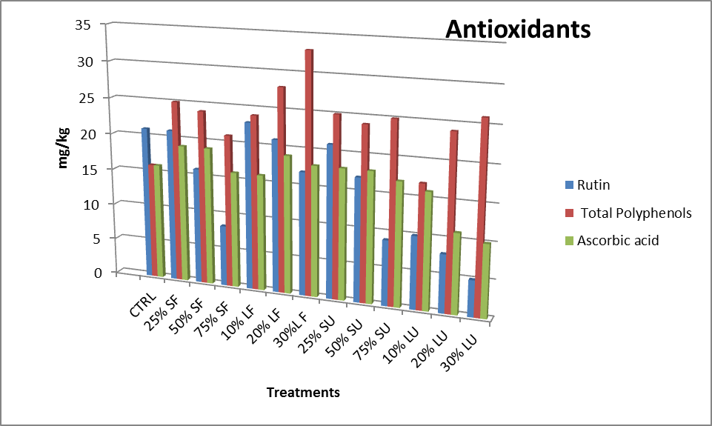
Flavonoids

Slide 20
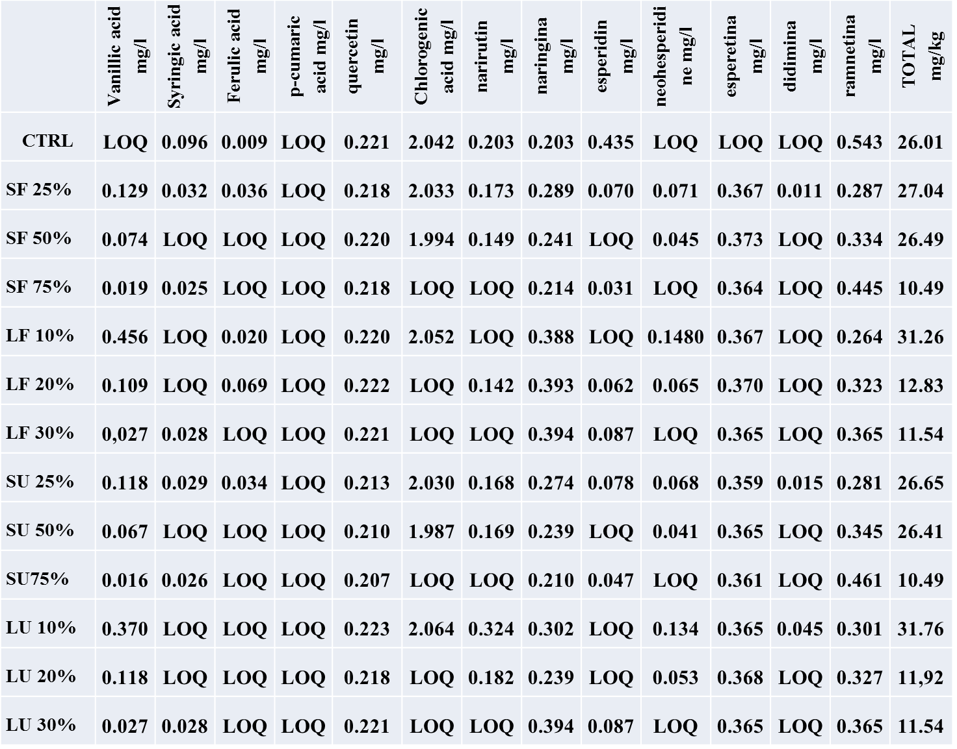
PHENOLS
FLAVONOIDS

Slide 21


CONCLUSIONS
Animal and recalcitrant agriculture wastes produce biogas with high methane percentage.
Digestate composition is strictly dependent on the amount, kind and ratio in which they are mixed.
Digestate, independently from its source, enhanced SOM with positive consequence for long term fertility
Digestate increased phytochemicals, in cucumis sativus, with high medicinal value for human.

Slide 22

Other possible use of solid digestate
Dried and pelletized S.D. is under evaluation as fuel. The maximum energy content is at about 15,0 MJ/kg; however ash and moisture content could reduce the energy potential.
Another developing opportunity for digestate solids is as a renewable construction material. Medium-density fiberboard and wood composite material have emerged as important engineered construction materials.
Composted digestate as an alternative method for animal feeding

Slide 23



