Slide 1
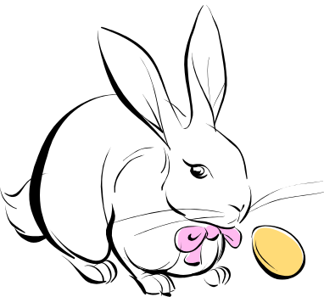
Isolation ,Identification, and Characterization of of Rubber Degradation by a Mixed Microbial Culture
Mr Munzer ullah (PhD student
China University of Petroleum East China

Slide 2
What is rubber
Natural rubber latex is produced by over 2,000 plant species, and its main constituent is poly (cis-1, 4-isoprene), a highly unsaturated hydrocarbon. The present research was conducted to exploit the potential of bacterial strains and fungi for the biodegradation of polyisoprene (Natural Rubber).

Slide 3
Biodegradation
is principle technique in which carbon based materials are largely destroyed by the microorganism. Biodegradation is usually linked to solid waste, environmental pollution, and plastic material. The degradation process is mostly applied for the destruction of several unwanted materials (Leja et al., 2010).

Slide 4
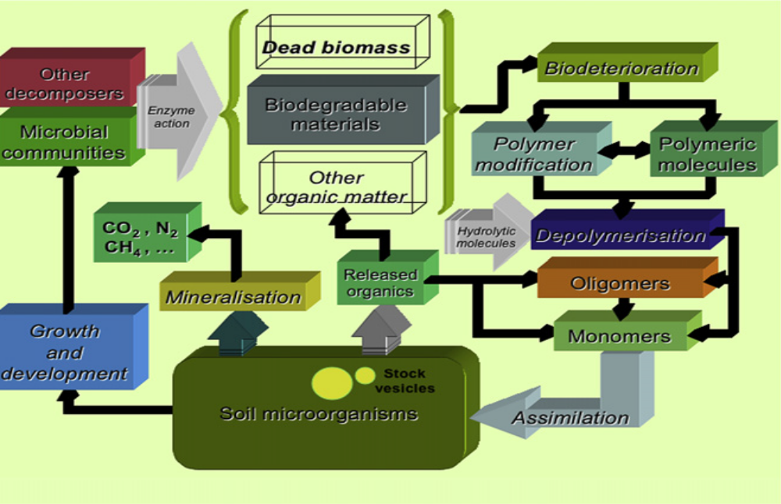
Mechanism of Biodegradation

Slide 5
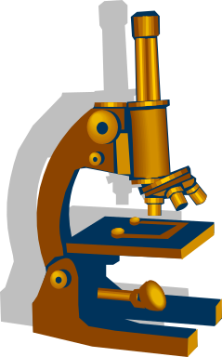
Microbial biodegradation
Microbial degradation of rubber have been investigated for many years. For the biodegradation of bacteria many microorganism are used so for, such as bacteria and fungi. Generally it was assumed that biodegradation is a slow process and special and unique kind of spices are utmost demand for quick degradation (Gallert, 2000).

Slide 6

What is Rubber
Natural rubber latex is produced by over 2,000 plant species, and its main constituent is poly (cis-1, 4-isoprene), a highly unsaturated hydrocarbon. The present research was conducted to exploit the potential of bacterial strains and fungi for the biodegradation of polyisoprene (Natural Rubber).

Slide 7

isolation
identification
Characterization
Bacteria
Fungi

Slide 8
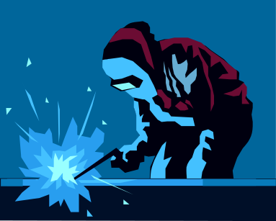
Synthetic Rubber
Synthetic rubber is a type of artificially made polymer which act as elastomer. An elastomer is material whit mechanical property which can under go much more elastic deformation under stress. Synthetic rubber service as a substitute for natural rubber in many cases, epically when improved material properties' are needed

Slide 9
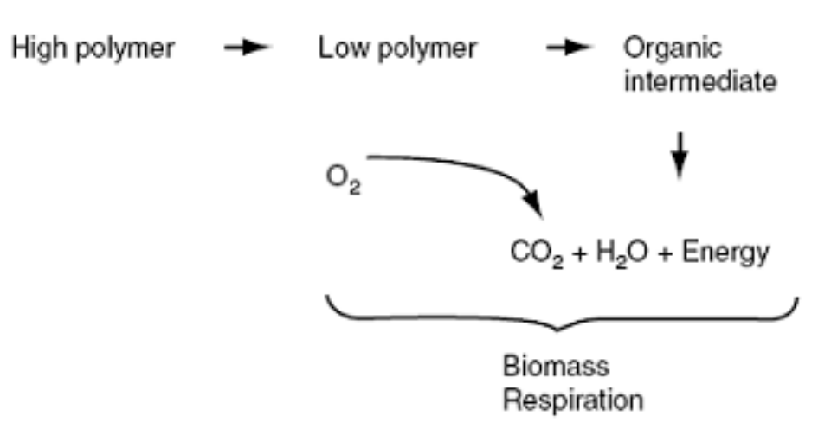


Slide 10

The present research was conducted to exploit the potential of bacterial strains and fungi for the biodegradation of polyisoprene (Natural Rubber). Twelve different bacterial strains were isolated from the sewage sludge contaminated sample by enrichment and sewage burial techniques. These strains were purified, identified and characterized on the basis of morphological and biochemical test according to Bergey’s manual of determinative bacteriology (9th Edition). Among these 7 were Bacillus sp., 3 were Aerococus sp., and 2 were Staphylococcus sp. Two fungal strains were also isolated from the soil and purified on sabourud dextrose and nutrient agar. The fungal strains were identified as Aspergillus sydowii and Aspergillus Candidus

Slide 11

identification
isolation
characterization
Mixed microbial strain

Slide 12

Hazards of Rubber
Hundred of different chemicals are used in the process of making rubber products. Many of these chemical are toxic or poisonous. The highest risks associated with rubber are stomach cancer, gall bladder cancer, lung cancer and many other respiratory disease (Andjelkovic et al., 1977.)

Slide 13

Production of rubber
The international demand for natural rubber has been steadily growing, securing its product identity in various industrial applications. Almost all plantation rubber from south eastern Asia, although rubber trees have been successfully cultivated else where.(National Tire dealer and Retreaters association, 2005)

Slide 14

Identification of degrading microorganism
Among these 7 were Bacillus sp., 3 were Aerococus sp., and 2 were Staphylococcus sp. Two fungal strains were also isolated from the soil and purified on sabourud dextrose and nutrient agar. The fungal strains were identified as Aspergillus sydowii and Aspergillus Candidus

Slide 15

Isolation of degrading microbes
Twelve different bacterial strains were isolated from the sewage sludge contaminated sample by enrichment and sewage burial techniques

Slide 16

The present research was conducted to exploit the potentialbacterial strains and fungi for the biodegradation of polyisoprene (Natural Rubber). Twelve different bacterial strains were isolated from the sewage sludge contaminated sample by enrichment and soil burial techniques. These strains were purified, identified and characterized on the basis of morphological and biochemical test according to Bergey’s manual of determinative bacteriology (9th Edition). Among these 7 were Bacillus sp., 3 were Aerococus sp., and 2 were Staphylococcus sp. Two fungal strains were also isolated from the soil and purified on sabourud dextrose and nutrient agar. The fungal strains were identified as Aspergillus sydowii and Aspergillus Candidus

Slide 17

AIM AND OBJECTIVES
Isolation of rubber degrading microorganisms from soil sewage sludge.
Identification of the rubber degrading microorganisms.
To check the microorganisms for utilization of rubber as a sole source of carbon and energy on solid and liquid media.

Slide 18

Isolation of Rubber (Polyisoprene) Degrading Microorganisms
Rubber degrading microorganisms were isolated from sewage sludge, collected from a Sewage sludge
The microorganisms having the ability to degrade rubber were isolated from sewage sludge by different techniques.
Soil Burial Experiment
Pieces of commonly used rubber gloves were washed and buried in sewage sludge at room temperature for a period of one month. Sewage sludge was taken in a large pot amended with mineral solution (M2) to maintain the availability of mineral salts and moisture. After one month pieces of rubber were taken from sludge, rinsed with sterilized distilled water and placed on nutrient agar plates, at 35ºC for 1 week to observe the microbial growth.

Slide 19
Enrichment technique
Inoculum was prepared from sewage sludge by suspending 10 g of sewage sludge in 90 ml of nutrient broth and incubated at 37ºC at 150 rpm for 24-48 hrs. Pieces of rubber glove were added in a flask containing mineral salt medium (M1) and were inoculated with 10% Inoculum prepared from the sewage sludge by enrichment technique. Cultures were incubated at 37ºC and 150 rpm for 2 weeks. Culturing on agar plates isolated enriched bacteria.
Bacterial and fungal isolates grown on the nutrient agar plates were further purified on nutrient agar and saboraud dextrose agar.

Slide 20
Identification of Bacterial Isolates
Selected bacterial strains were purified and identified on the basis of morphological characteristics and biochemical test according to Bergey’s Manual of Determinative Bacteriology, 8th adition (Buchanan and Gibbons, 1974).
Identification of Fungal isolates
The fungal strains isolated from sewage sludge, attached on rubber pieces, were purified on Saboraud Dextrose agar plates. The fungal strains were identified by both macroscopic and microscopic Saboraud Dextrose agar and microscopic characterization includes shape, color and structure of conidia, hyphae, conidiophores and conidial head.

Slide 21
BIODEGRADATION OF RUBBER
1- Plate assay to study biodegradation of polyisoprene
A solution was prepared by adding polyisoprene (Sigma-Aldrich) in n- hexane. It was poured on the already prepared mineral salt agar plates in sterilized conditions. n-hexane was allowed to evaporate and thin film of rubber was formed on agar plates. Twelve different bacterial strains isolated from sewage sludge were inoculated on mineral salt agar plates. After two to three weeks, growth of bacteria was observed on the plates.
2- Biodegradation in liquid medium
Mineral salt liquid medium was prepared and was taken in two 250 ml flasks each containing rubber pieces and inoculum (10%) containing 12 different bacterial strains isolated from sewage sludge. The flasks were incubated at 37ºC at 150 rpm for a period of one month. The growth of the bacterial consortium was checked by taking OD at 690 nm. After one month of incubation the rubber pieces were taken, washed with sterilized distilled water and analyzed for any changes by FTIR.

Slide 22
Analysis of Biodegradation by CO2 Evolution (Sturm Test)
Sturm Test determined CO2 evolution as a result of rubber biodegradation. The pieces of rubber were added in the culture bottle (Test bottle) containing 300 ml of mineral salts medium without any other performed at room temperature (30C) for 4 weeks. After 4 weeks of culturing the change in biomass and the amount of carbon dioxide produced was calculated in the test and control bottles. CO2 evolved as a result of degradation of polymeric chain was trapped in the absorption bottles containing KOH. Barium chloride solution was added to the CO2 containing KOH bottles and as a result precipitates of barium carbonate (using CO2 released from breakdown of polymer) were formed. CO2 produced was calculated gravimetrically by measuring amount (weight) of CO2 precipitates evolved by addition of BaCl2. Difference in the amount of precipitates in the test and control was carbon source. The test and control bottles were stirred continuously by placing them on the magnetic stirrer. The test was determined (Muller et al., 1992).

Slide 23
Analysis of Biodegradation by CO2 Evolution (Sturm Test)
Sturm Test determined CO2 evolution as a result of rubber biodegradation. The pieces of rubber were added in the culture bottle (Test bottle) containing 300 ml of mineral salts medium without any other performed at room temperature (30C) for 4 weeks. After 4 weeks of culturing the change in biomass and the amount of carbon dioxide produced was calculated in the test and control bottles. CO2 evolved as a result of degradation of polymeric chain was trapped in the absorption bottles containing KOH. Barium chloride solution was added to the CO2 containing KOH bottles and as a result precipitates of barium carbonate (using CO2 released from breakdown of polymer) were formed. CO2 produced was calculated gravimetrically by measuring amount (weight) of CO2 precipitates evolved by addition of BaCl2. Difference in the amount of precipitates in the test and control was carbon source. The test and control bottles were stirred continuously by placing them on the magnetic stirrer. The test was determined (Muller et al., 1992).

Slide 24
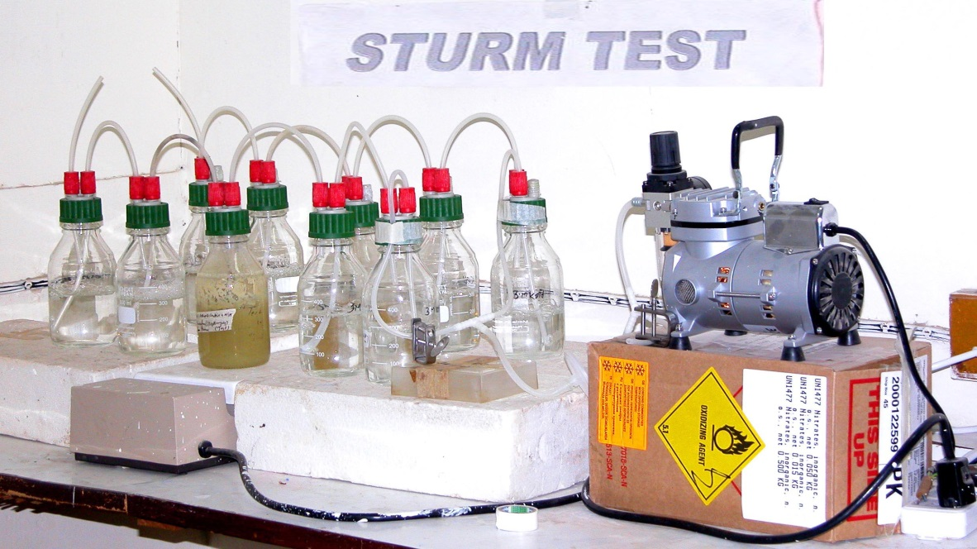
Sturm test for the measurement of carbon dioxide evolution during break down of plastic material. a: CO2 absorbing chambers, b: pretreatment chambers, c: culture vessel, d: 0.2μm air filter, e: pressure air pump, T: Test, C: control.

Slide 25

Results and discussion
Twelve different bacterial strain were isolated by enrichment technique. These strains were further identified on the basis of morphological and biochemical test according to the Bergeys Manual of Determinative Bacteriology , 8th Edition (1974).
Two fungal were also isolated from the sewage sludge and purified on sabourud dextrose agar.

Slide 26
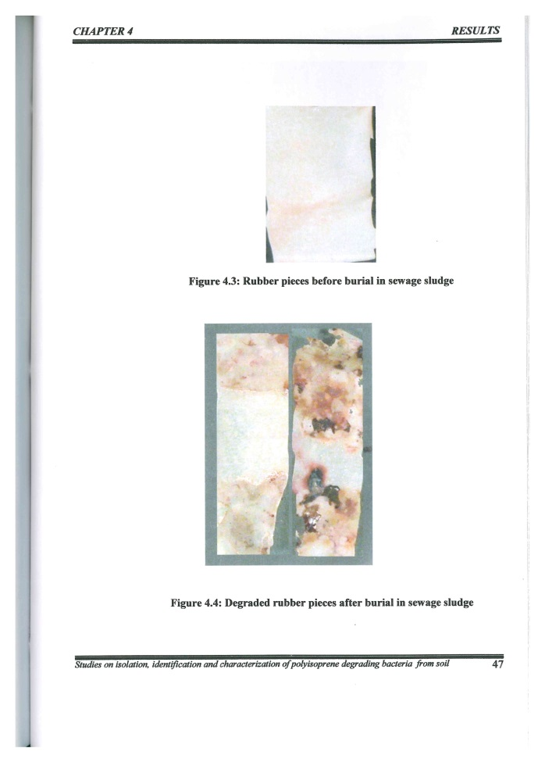
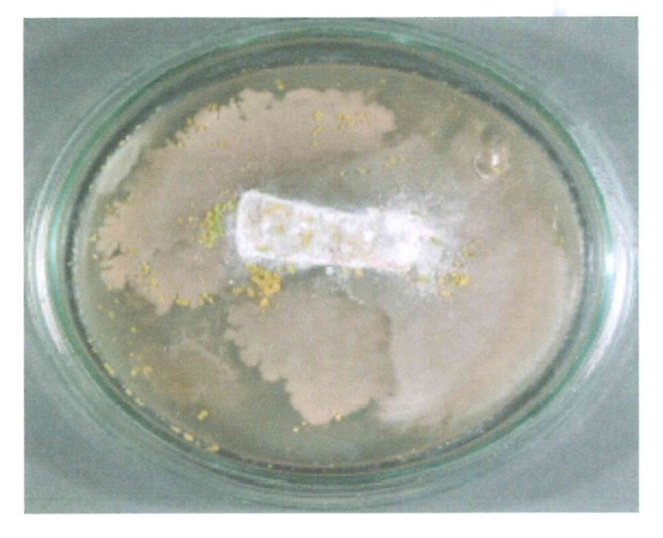

Mixed microbial culture on the surface of rubber

Slide 27
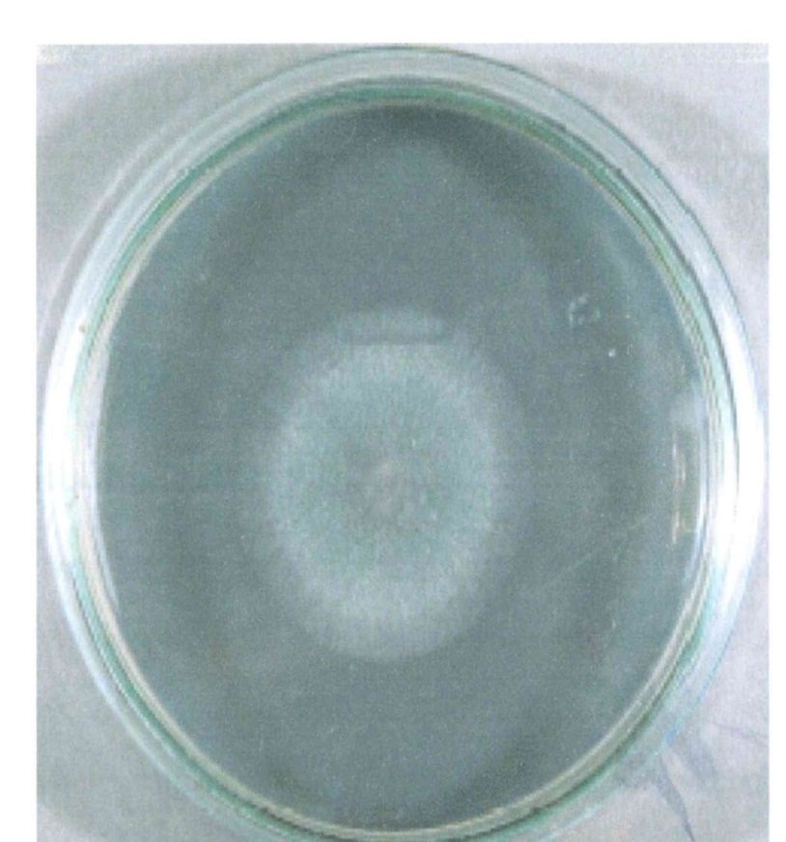
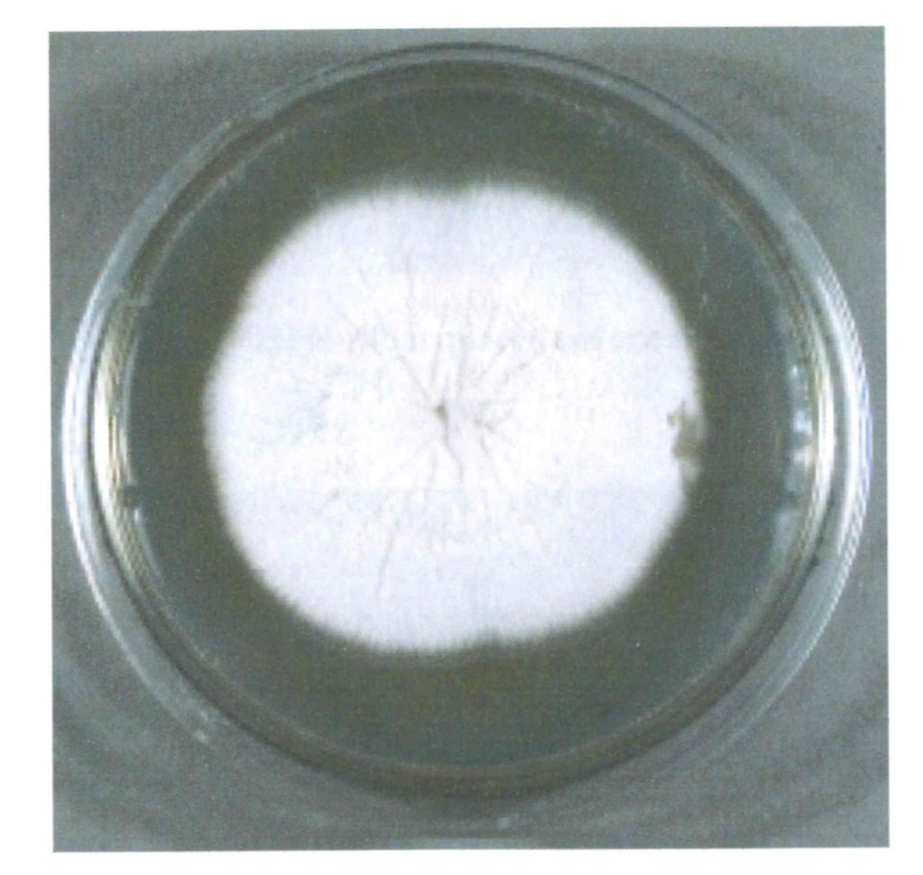

Two fungus spices . Aspergillus sydowi and Aspergillus candidus

Slide 28

FTIR Spectroscopy
Fourier Transform Infrared Spectroscopy
FTIR analysis showed changes in the spectra as compared to untreated rubber pieces. There was decrease of peak in the region of 1200-1400 cm-1 indicating the break down of important functional groups like C=C, carbonyl. Methyl and ester bonds. A peak 3030 cm-1 disappeared after microbial treatment, also correspond to CH2 showed decrease in intensities which correspond to aldehyde formation.

Slide 29
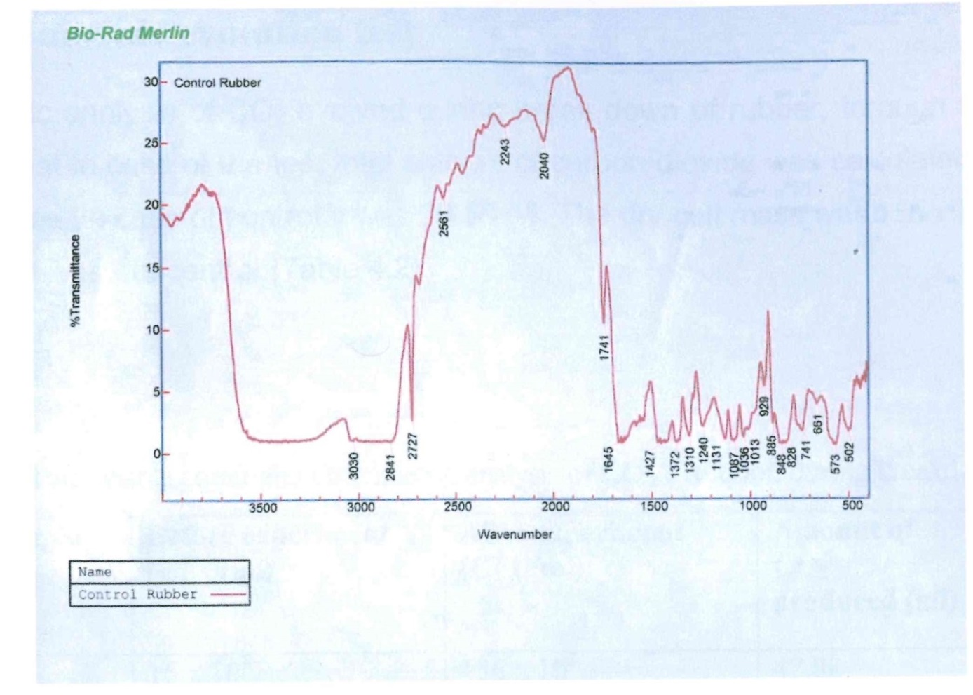
FTIR analysis of untreated rubber

Slide 30
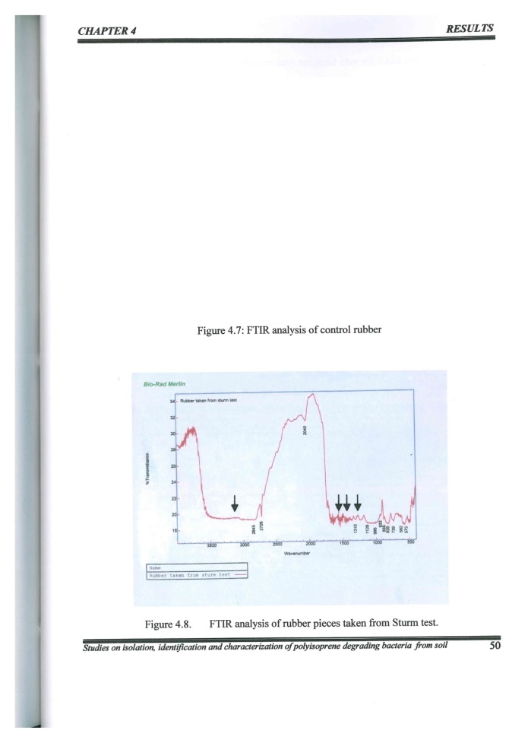

FTIR analysis of rubber pieces treated with mixed microbial culture

Slide 31

Strum test
Strum test
Gravimetric analysis of carbon dioxide during rubber biodegradation was analyze through strum test. The total amount of carbon dioxide was calculated as 42.88 g/l , where in case of control it was 20.58 g/l.

Slide 32

Conclusion
From the present study it can be concluded that:
Soil and sludge contain some bacteria and fungi that are able to bring about some biodegradation of synthetic as well as natural rubber.
The bacterial and fungal isolates found to be attached on the surface of rubber pieces indicates the possibility of their ability to utilize polyisoprene rubber as a source of nutrient.
Production of carbon dioxide during the Sturm test indicated loss of carbon from the molecules of polyisoprene rubber.

Slide 33

4. FTIR study shows some changes in rubber due to degradation.
5. Present study shows that there is a great possibility to find the microorganisms from our environment that can degrade synthetic as well as natural rubber.

Slide 34

FUTURE PROSPECTS
Isolation purification and characterization of enzymes responsible for degradation of Rubber.
Analysis of degradation products and intermediate compounds by GC, HPLC, GPC etc.
Molecular characterization of the microorganism responsible for rubber degradation. .
Effect of various environmental condition on the degradative ability of microorganism.

Slide 35

Detection of Polyisoprene rubber Degradation by Fourier Transform Infrared Spectroscopy
Fourier Transform Infrared Spectroscopy (FTIR) (Bio-Rad Merlin) analysis was done to detect the degradation of Polyisoprene rubber after culturing in liquid media, on the basis of changes in the functional groups. The polymer pieces were mixed with KBr and made into a tablet, which was fixed to the FTIR sample plate. A spectrum was taken at 400 to 4000 wave-numbers cm-1 for each sample.

Slide 36
Analysis of Biodegradation by CO2 Evolution (Sturm Test)
Sturm Test determined CO2 evolution as a result of rubber biodegradation. The pieces of rubber were added in the culture bottle (Test bottle) containing 300 ml of mineral salts medium without any other performed at room temperature (30C) for 4 weeks. After 4 weeks of culturing the change in biomass and the amount of carbon dioxide produced was calculated in the test and control bottles. CO2 evolved as a result of degradation of polymeric chain was trapped in the absorption bottles containing KOH. Barium chloride solution was added to the CO2 containing KOH bottles and as a result precipitates of barium carbonate (using CO2 released from breakdown of polymer) were formed. CO2 produced was calculated gravimetrically by measuring amount (weight) of CO2 precipitates evolved by addition of BaCl2. Difference in the amount of precipitates in the test and control was carbon source. The test and control bottles were stirred continuously by placing them on the magnetic stirrer. The test was determined (Muller et al., 1992).

Slide 37
Conclusions
From the present study it can be concluded that:
Soil and sludge contain some bacteria and fungi that are able to bring about some biodegradation of synthetic as well as natural rubber.
2. The bacterial and fungal isolates found to be attached on the surface of rubber pieces indicates the possibility of their ability to utilize polyisoprene rubber as a source of nutrient.
3. Production of carbon dioxide during the Sturm test indicated loss of carbon from the molecules of polyisoprene rubber.
4. FTIR study shows some changes in rubber due to degradation.
Present study shows that there is a great possibility to find the microorganisms from our environment that can degrade synthetic as well as natural rubber.

Slide 38
FUTURE PROSPECTS
Isolation purification and characterization of enzymes responsible for degradation of Rubber.
Analysis of degradation products and intermediate compounds by GC, HPLC, GPC etc.
Molecular characterization of the microorganism responsible for rubber degradation. .
Effect of various environmental condition on the degradative ability of microorganism.

Slide 39

FUTURE PROSPECTS
Isolation purification and characterization of enzymes responsible for degradation of Rubber.
Analysis of degradation products and intermediate compounds by GC, HPLC, GPC etc.
Molecular characterization of the microorganism responsible for rubber degradation. .
Effect of various environmental condition on the degradative ability of microorganism.

Slide 40

Thank You

