Slide 1

Dr. Munad Jihad Al-Duliamy
College of Dentistry, AL_Iraqia University,

Slide 2
Enhancement of
Orthodontic Anchorage and Retention by
Local Injection of Strontium
(An Experimental Study in Rats)

Slide 3

Contents
Introduction
What is Strontium?
Methodology
Results
Suggestions
Conclusion

Slide 4
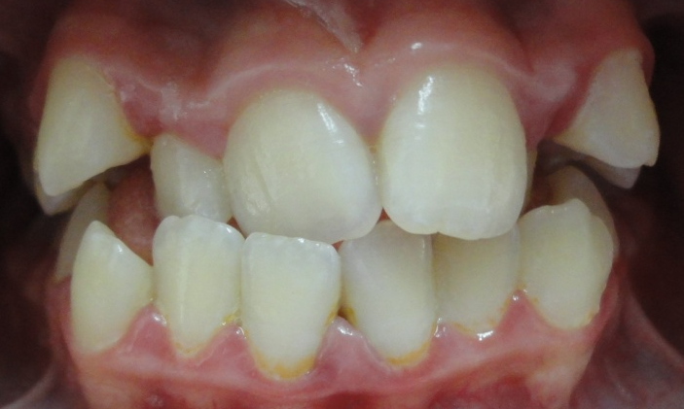
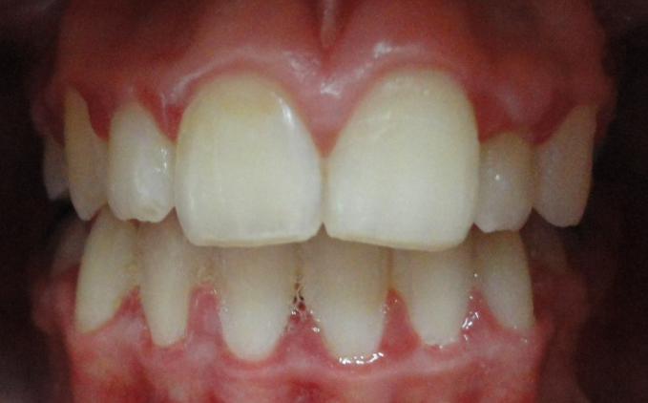
Introduction
Ortho = correct or perfect
Dontic = tooth or teeth
orthodontic
anchorage = The resistance to undesired movements.
retention = prevent the teeth from return to origin,

Slide 5
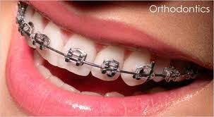
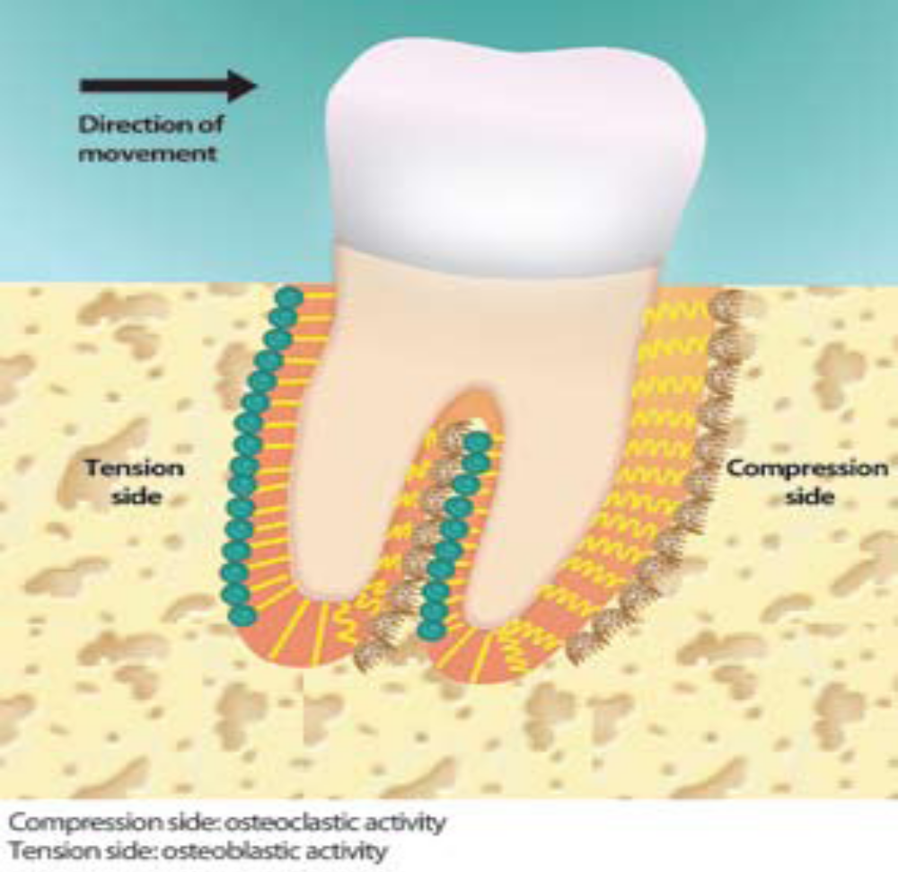
Orthodontic Tooth Movement

Slide 6
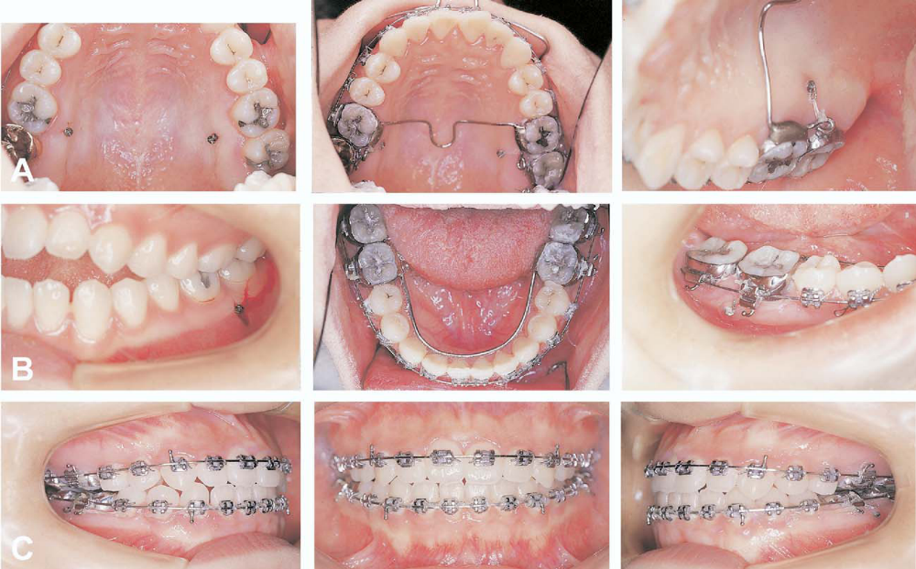
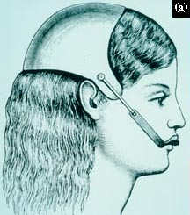
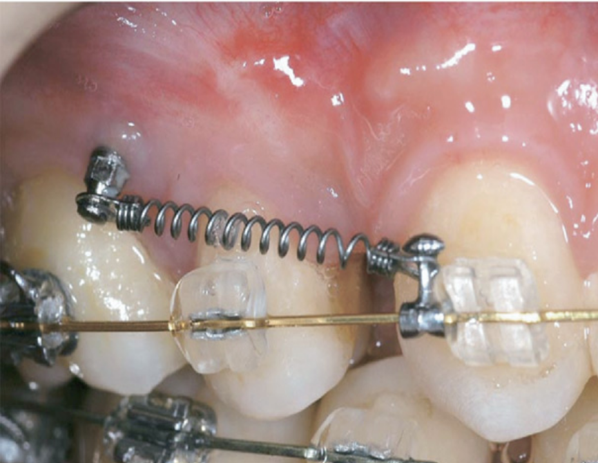
Headgear
Transpalatal bar
Mini screw implant

Slide 7
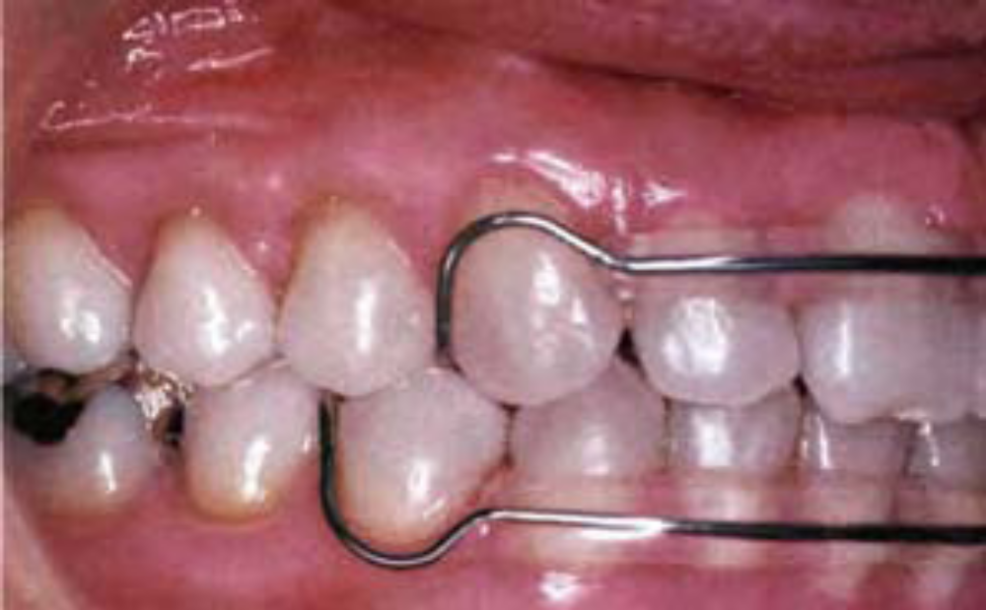
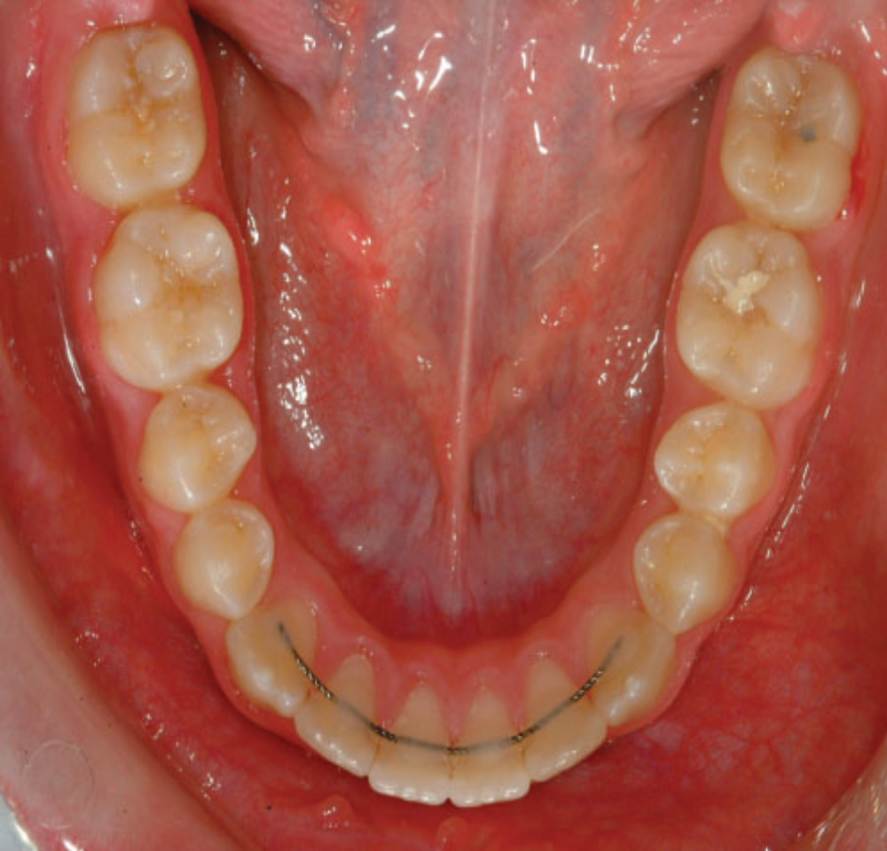
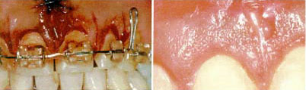
Fixed retainers
Removable acrylic retainer
Supracrestal Fibrotomy

Slide 8
All these anchorage and retentive measures have stood the test of time in providing the best possible treatment outcomes except for some cardinal limitations like difficulties in their:
manufacture,
applications and
patient compliance.

Slide 9

It is the thank to pharmacology to
shed light on the use of drugs as an adjunct for orthodontic treatment either by:
accelerating the speed of tooth movement
or by
retarding the undesired movement of anchor tooth and preventing relapse after orthodontic treatment

Slide 10
Recent research advances suggest that biological modulators which inhibit osteoclasts could be used as new adjunctive approach to orthodontic treatment.
That’s why…. the present experimental study, used for first time one of these modulators which is strontium and aimed to investigate, clinical and histological effects of the local injection of strontium on experimental and relapsed tooth movement in rats.

Slide 11
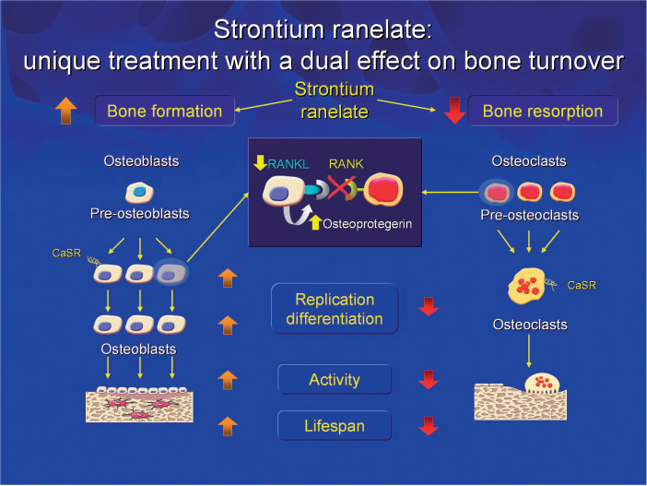
What is Strontium?
Strontium (Sr) is alkaline earth trace metal cation that has a high affinity for hydroxyapatite.
Strontium

Slide 12
Therefore … Strontium
is an active ingredient of drugs used as a first line in treatment of osteoporosis.

Slide 13
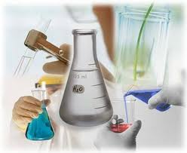


Methodology

Slide 14
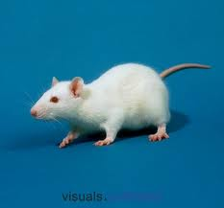
The sample were male wister rats

Slide 15
6 Rats
1st group
T1= one week
Sample
Categorization
6 Rats
1st group
T1= one week
36 Rats
6 Rats
2nd group
T2= two weeks
6 Rats
2nd group
T2= two weeks
Exp.No.1
Exp.No.2
18 RATS
18 RATS
6 Rats
3rd group
T3= three weeks
6 Rats
3rd group
T3= three weeks

Slide 16
Study design
Experiment No.2 clinical and histological effects of local injection of the strontium on relapsed tooth movement.
Experiment No.1
clinical and histological effects of local injection of the strontium on experimental tooth movement

Slide 17
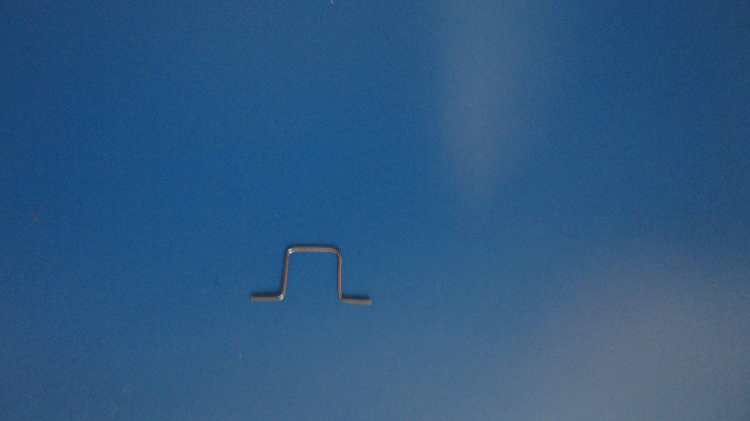
In both Experiments
Uniform standardized expansive springs which manufactured by the Iraqi Ministry of Science and Technology were used for moving the maxillary first molars buccaly.

Slide 18
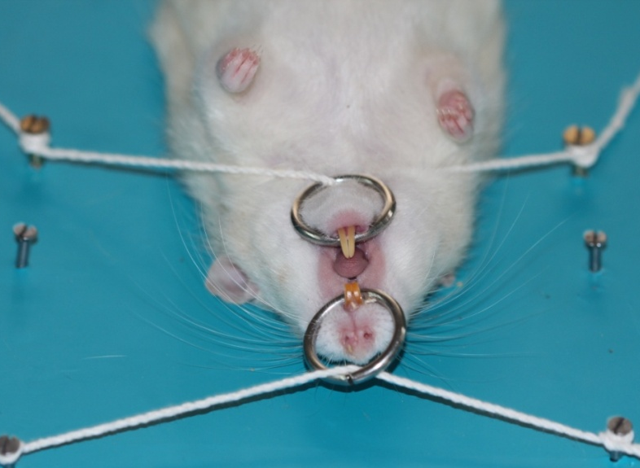
Experiment
No.1

Slide 19
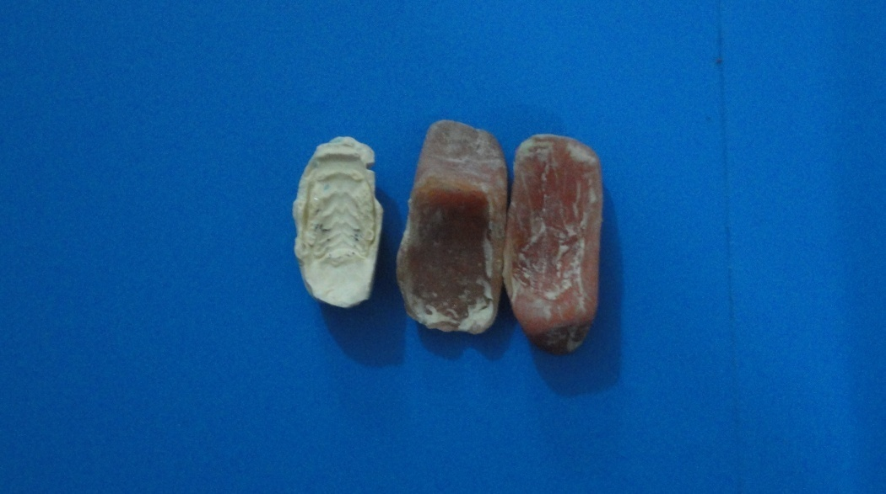
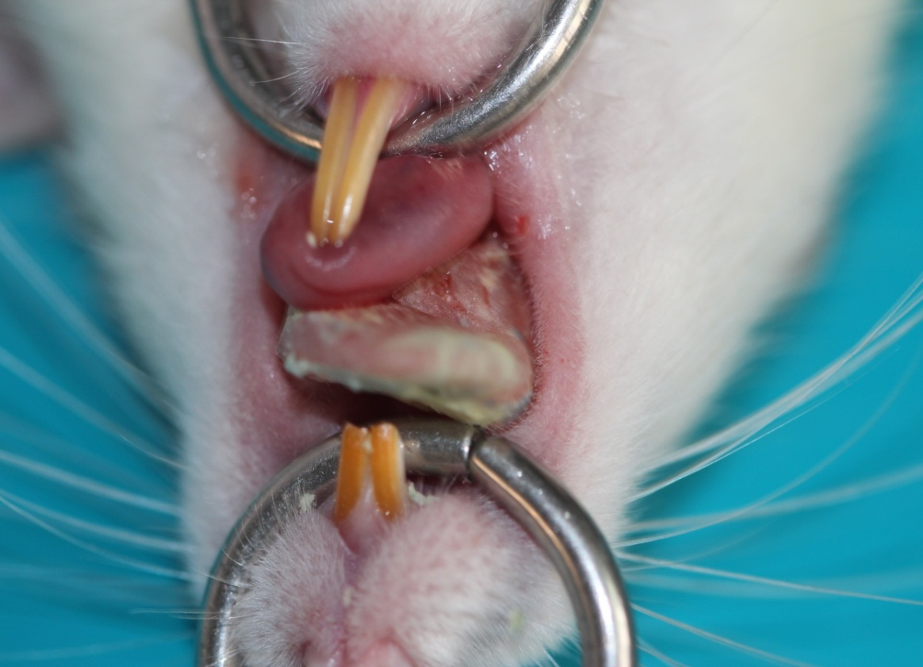
special tray
impression taking
study model

Slide 20
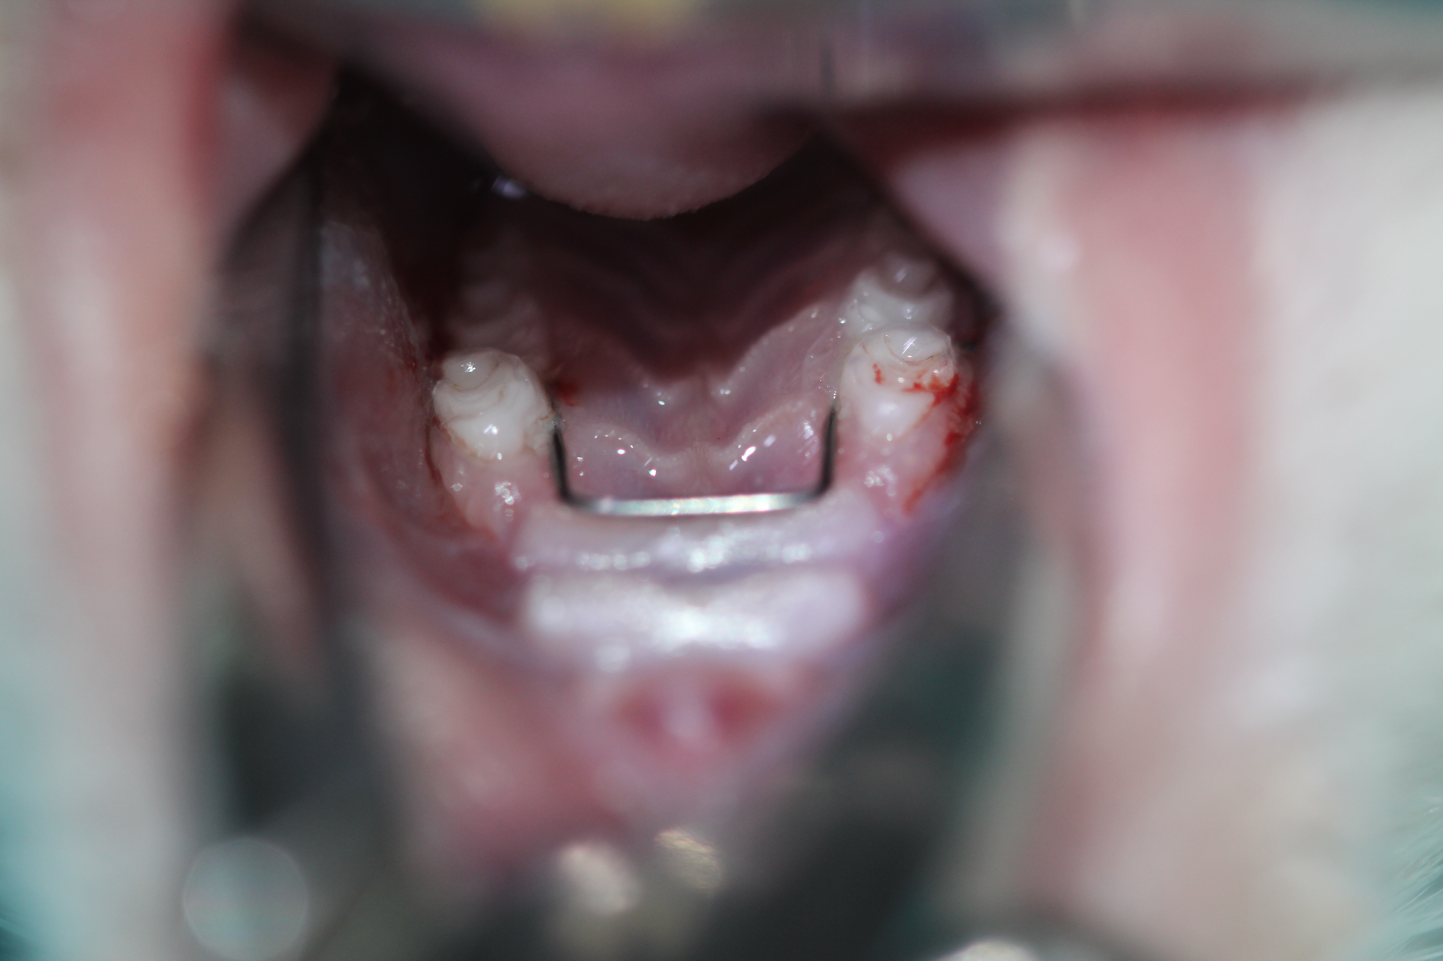
Distilled water
Strontium

Slide 21
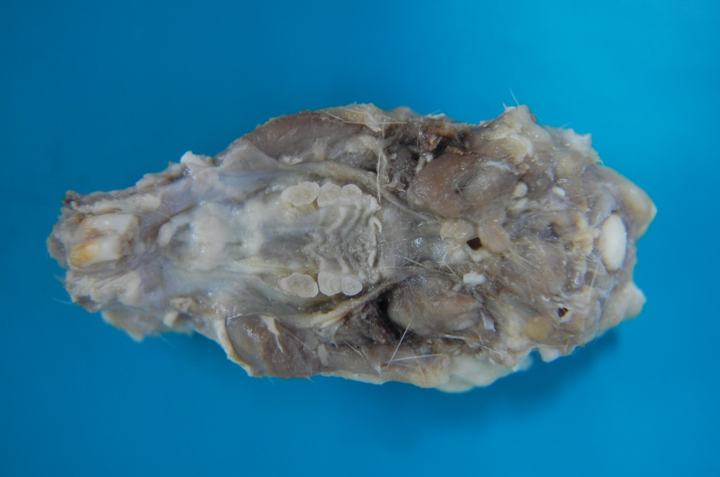

Experiment
No.2
An expansive spring was applied to each animal's maxilla for three weeks to move the maxillary first molars bucully.

Slide 22
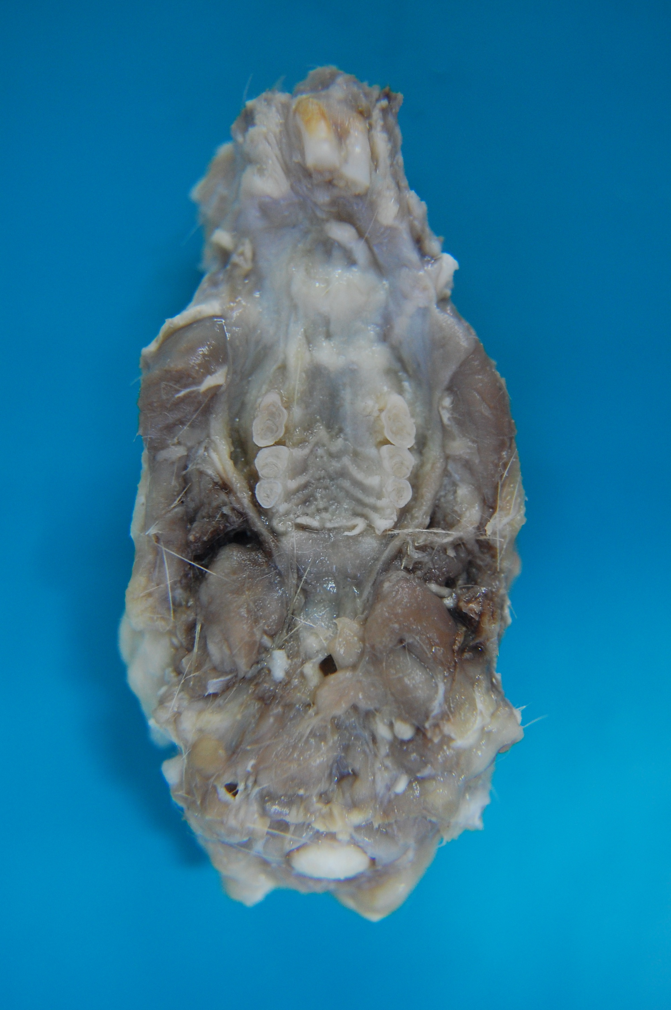
Distilled water
Strontium

Slide 23

Results

Slide 24
After the whole experimental period
Clinically
There were significant inhibition in both experimental and relapsed tooth movement of the left maxillary first molar
Histologicaly
There were significant enhancement in osteoblast NO. and significant reduction in osteoclast NO. at the injection site

Slide 25

Conclusion
The local injection of strontium is a promising approach for enhancing both orthodontic anchorage and retention.

Slide 26

Suggestions
Evaluate the effect of local injection of strontium on the root resorption induced by orthodontic tooth movements.
Further study is needed to evaluate the effect of systemic administration of strontium for enhancement of post orthodontic retention.
Evaluate the ability of strontium in enhancing osseointegration of miniscrew implant.

Slide 27
Evaluate the ability of local application of strontium in ridge augmentation at the site of implant placement.
Investigate the effect of local application of strontium in socket healing after tooth extraction.
Evaluate the ability of local application of strontium in bone regeneration after sever periodontitis.

Slide 28

Bruce Lee said that
“If you always put limits
on everything you do,
It will spread into your work and into your life….

Slide 29

There are no limits

Slide 30
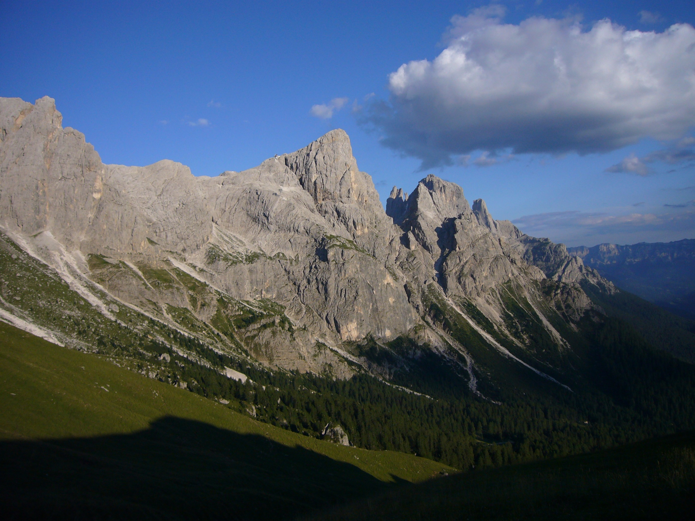
There are only plateaus, and you must not stay there, you must go
Beyond them.”

Slide 31

الحمد
لله

Slide 32

`
Thank you

Slide 33

Any question

