Slide 1



Jeddah Breast Cancer Pilot Screening Program, KSA
7th Global Summit on Cancer Therapy, Oct 5-7, 2015
Dubai, Crown Plaza Hotel
Muna Baslaim, MD
Consultant Surgeon
Head of the Breast Unit,
King Fahd General Hospital
Jeddah, Saudi Arabia

Slide 2
Why patients were passing through difficulties
Different centers with different approaches.
Personal experience.
No standard practice.
Guide-lines are not followed.
No specialized centers.
Unnecessary work-up, unnecessary interventions.

Slide 3
Educational Plan
Treating physician
(Surgeon, Oncologist, Radiologist, Pathologist)
Primary health care physician
Society
Patient, Family, Friends

Slide 4
Physician Education
Multidisciplinary symposia 2003
Regular meeting between different centers with case discussions
Introduction of optimum standard imaging modalities
Improve surgical techniques
Proper pathologic assessment and sample interpretation
Pre-operative oncology counseling and treatment
Proper follow-up of cases
Digital mammography, MRI, Image guided biopsy & stereotactic techniques
Avoid unnecessary & extensive disfiguring procedure, avoid incisional biopsies

Slide 5
Role of primary health care centers
Widely Distributed Accessible
Ladies visit PHC for different reasons
Have records for families
A strong patient physician relation
Transportation
Education
BSE
Screening
Document Data
Reassurance

Slide 6
PHC Education
Repeated courses on Breast Diseases Symptoms and Signs by multidisciplinary team
Workshops on how to perform Clinical Breast Examination
PHC physicians visit the Breast Clinic and Examine Patients
Smooth referral pathway from the PHC to the hospital
Category of Referral: Routine VS Urgent
PHC refer patients for imaging
PHC physician initiate treatment in some cases

Slide 7
Breast Cancer Awareness Campaign 2007
The first multi-institution campaign
Structured educational activities for the physicians and the public
807 ladies screened in main hospitals, 8 cases detected (1.1%)
Outcome:
More women asking for screening
Improved society knowledge
Improved communication between centers
In the periphery, probably same situation

Slide 8
Poor knowledge about the disease and it's mode of presentation
Misconception: Breast feeding is an absolute protection
Cancer is a killing disease regardless of the treatment provided
Lack of the social support
Breast cancer is almost always painless
Lack/inaccessible good medical service

Slide 9
Screening and Educational Activities in the Kingdom
Qasim
Riyadh
30,000 over
5 yrs
168 Ca
60% early
Dammam
8061 over 5 yrs
47 Ca
70% early
Makkah

Slide 10
Breast Cancer Awareness Campaign 2010
Jeddah (2nd largest city) Saudis: 1,729,007, Females: 830,992
27% is the Target age group (≥ 40- 69 year) (224,368).
Screen only 1% of the population (2,244).
Total period of screening 52 working days.

Slide 11
Breast Cancer Awareness Campaign 2010
40 – 69 years
Asymptomatic
Not pregnant nor lactating
Not a breast cancer survivor
No significant morbidity
Eligibility Criteria

Slide 12







Breast Cancer Awareness Campaign 2010
Demographic Data
Risk Factors
National ID Number

Slide 13
Breast Cancer Awareness Campaign 2010
From 2,244
1167 screened
(uptake rate 52%)
154 (BIRAD III-IV) ultrasound
(recall rate 13%)
Higher than the reported 2- 8%.
Radiologist low-volume readers
67.5% pre or peri- menopausal (dense breasts)

Slide 14
Breast Cancer Awareness Campaign 2010
After ultrasound, 32 cases required biopsy
(Biopsy Rate 2.7%)
7 confirmed malignant (0.6 %)
4 IDC, II
2 DCIS
1 ILC

Slide 15
Low risk population
Multi-parity
Early pregnancy and delivery
Breast feeding

Slide 16
Breast Cancer Risk Factors in the History of the Screened Population
Risk Factors | Number (%)
Benign Breast Disease | 51/ 1167 (4.4)
Breast Biopsy | 15/ 1167 (1.3)
Cyst Aspiration | 15/ 1167 (1.3)
Breast Operations | 69/ 1167 (5.9)
Oopherectomy* | 30/ 1167 (2.6)
Hysterectomy† | 48/ 1167 (4.1)
Family History of Breast Cancer‡ | 29/ 1167 (18.8)
Family History of other Malignancies§ | 361/ 1167 (31)
*None was due to malignancies.
† Only 3 had uterine malignancy.
‡ 40.2 % was in 1st degree relatives and 21.5% had ≥ 2 family members with breast cancer.
§ The commonest were uterine, hepatic and lung cancers.

Slide 17
Alarming Risk Factors
↑ Obesity rate (BMI 37.45)
Changes in the lifestyle
Dietary habits (unhealthy food )
Increase smoking habits
↓ Early childbearing and breast feeding

Slide 18
Educational Programs un-wanted effects
Panic state created
PHC physicians fear of responsibility
Hospitals overloaded with worried ladies of all ages
Long waiting list for OPD
OPD overloaded with less time for every patient

Slide 19
% Breast Ca Stages
@ King Fahd Hospital
% | 2004 | 2005 | 2006 | 2007 |  | 2008 | 2009 | 2010 | 2011 | 2012 | 2013 | 2014 | 2015
I | 0 | 7 | 0 | 10 |  | 15 | 14 | 8 | 3 | 17 | 5 | 19 | 5
II | 50 | 10 | 70 | 26 |  | 60 | 48 | 46 | 55 | 34 | 33 | 24 | 44
III | 27 | 70 | 30 | 61 |  | 15 | 35 | 29 | 42 | 44 | 57 | 48 | 50
IV | 23 | 13 | 0 | 3 |  | 10 | 3 | 17 | ? | 5 | 5 | 9 | 1

Slide 20
Screen detected lesions
Fibrocystic Changes
29
Complex F-adenoma
8
DCIS
6
*Blunt Duct Adenosis
*Fat Necrosis
*Inflamm
*Sclerosing Adenosis
4
IDC
10
Epithelial Hyperplasia 15
PASH
IDP
ADH
ALH
2

Slide 21
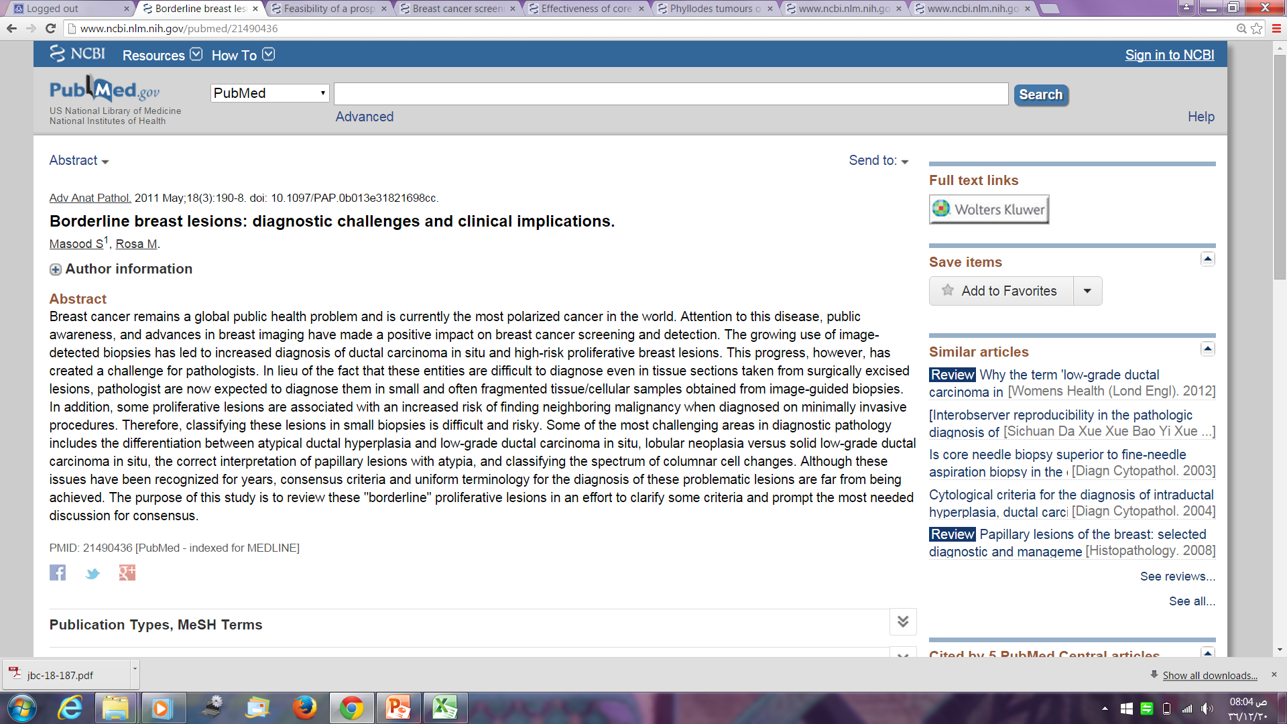
These entities are difficult to diagnose even in tissue sections taken from surgically excised lesions, pathologist are now expected to diagnose them in small and often fragmented tissue/cellular samples obtained from image-guided biopsies.
..differentiation between atypical ductal hyperplasia and low-grade ductal carcinoma in situ, lobular neoplasia versus solid low-grade ductal carcinoma in situ, the correct interpretation of papillary lesions with atypia, and classifying the spectrum of columnar cell changes.

Slide 22
Summary
In every country, mammography screening guidelines should be tailored according to the local parameters like breast cancer incidence, age groups affected and healthcare resources (40s)
Different studies in Asian countries concluded that biennial mammography screening for women aged 40 years is cost-effective.
Saudi women accepted mammographic screening willingly.
Health practitioners of all specialties need to be ready for the increasing work load and the need for higher skills.

Slide 23

Planning
policies
Society
Equipm-ent
Staff
Link
Docum-entation
Centers
Follow-up

