Slide 1
Current Status of Incretin Based Therapies in Type 2 Diabetes
DR.M.Mukhyaprana Prabhu
Professor of Internal Medicine
Kasturba Medical College, Manipal,
Manipal University, India
2nd International Endocrine Conference
Chicago
20th Oct 2014

Slide 2

Greetings from MANIPAL, INDIA

Slide 3
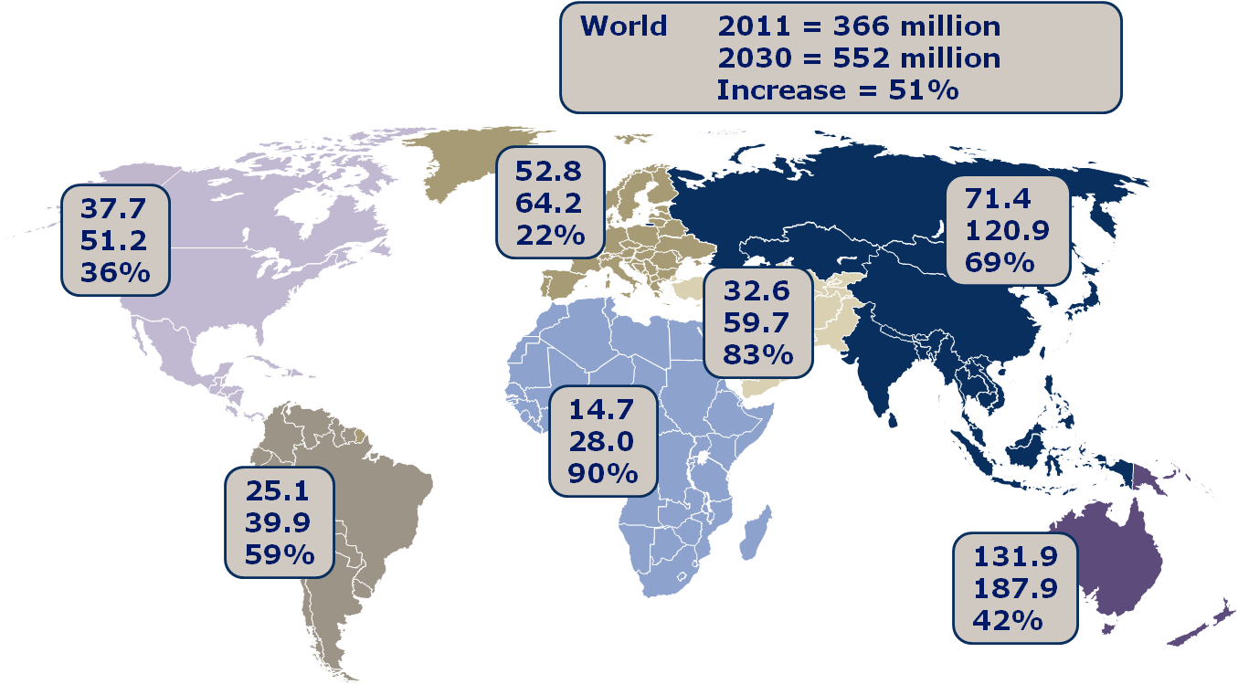

The Diabetes Epidemic: Global Projections, 2010–2030
IDF. Diabetes Atlas 5th Ed. 2011
Notes:
Figures given are: number of people with diabetes in 2011 and predicted number of people that will have diabetes in 2030 according to IDF estimates. Percentage is the increase in diabetes from 2011 to 2030. “World” box acts as the legend.
The burden of diabetes is one of the greatest challenges of the 21st century, as seen in the global incidence and projections of diabetes epidemic worldwide.
366 million people have diabetes in 2011 and this is predicted to rise to 552 million by 2030.
Diabetes caused at least $465 billion in healthcare expenditure in 2011 – 11% of the total expenditure, and is expected to exceed $595 billion by 2030.

Slide 4
Disclosures
Principle investigator from India on multicentre ELIXA trial sponsored by Sanofi Aventis (ongoing)
Co investigator in Saxagliptin (BMP) & Linagliptin (Boehringer Ingelheim) & Liraglutide (Novo) trials
Conflict of interest : None

Slide 5
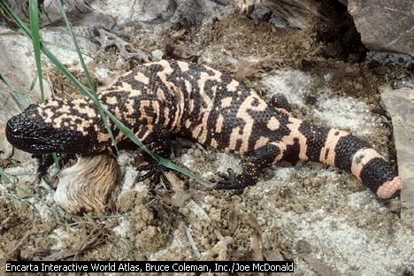

Slide 6
Incretins
Incretins are GI hormones that are released after meals and stimulate insulin secretion
GLP1 and GIP are incretins
GIP is not effective in stimulating insulin
GLP 1 is effective- hence GLP1 signalling system – successful drug target
Goodman & Gilman’s Pharmacological Basis of therapeutics. 12th edition
Notes:
Goodman & Gilman’s Pharmacological Basis of therapeutics. 12th edition

Slide 7
Flow of Presentation
Physiological Effects of Incretins
The Incretin Based Therapies - GLP-1 Analogues
The Incretin Based Therapies - DPP-4 Inhibitors
GLP-1 Analogues vs DPP-4 Inhibitors
The Future of Incretin Based Therapy
Current Status of Incretin Based Therapy
Summary & Conclusion

Slide 8

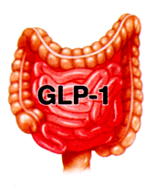
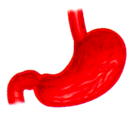
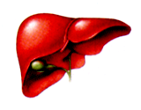

Physiological Effects of GLP-1
β
Pancreas
Brain
α
Satiety
Intestine
Glucose dependent
insulin secretion
Stomach
Insulin synthesis
Glucose dependant Glucagon secretion
Gastric
emptying
Heart
Liver
Glucose production
Cardioprotection
Cardiac function
GLP-1: an incretin hormone with multiple direct effects on human physiology.
Baggio & Drucker. Gastroenterol 2007;132;2131–57
Notes:
GLP-1: effects in humans
GLP-1 is an incretin secreted from enteroendocrine cells in response to nutrient ingestion. GLP-1 is released from gut L-cells, the majority of which are located in the distal ileum and colon. Plasma levels of GLP-1 rise rapidly within minutes of food intake and well before digested nutrients make contact with the distal L-cells; this suggests that nutrient-induced signals from the duodenum and jejunum are relayed to the distal ileum and colon. The release of GLP-1 appears to be biphasic. The first response occurs shortly after food ingestion followed by a second response which is more likely associated with direct contact between nutrients and L-cells [Drucker, 2001].
Starting at the islet cell level, GLP-1 potentiates insulin release from β-cells to promote cellular uptake of glucose; it also inhibits glucagon secretion from α-cells, which, in turn, reduces hepatic glucose output [Drucker, 2001].
Furthermore, GLP-1 acts beyond the pancreas to trigger a cascade of physiological events. By inhibiting gastric emptying (which is postulated to reduce the rate of nutrient absorption), GLP-1 slows the rate of glucose appearance in the blood; this, in turn, appears to reduce insulin secretion requirements. The reduction in appetite observed with GLP-1 treatment may also be associated with inhibited gastric emptying [Drucker, 2001].
GLP-1 may also enhance insulin sensitivity and increase glucose uptake by peripheral tissues, independent of insulin secretion [Drucker, 2006].
In addition to these short-term metabolic effects, GLP-1 may also trigger long-term changes in β-cell mass and function. Studies in rodent models have demonstrated that GLP-1 stimulates β-cell mass by mechanisms that include increased cellular differentiation, islet cell proliferation, and reduced cellular apoptosis [Drucker, 2003].

Slide 9


GLP-1: effects in humans
Stimulates glucose-
dependent insulin secretion
After food ingestion…
Suppresses glucagon
secretion
Slows gastric emptying
Leads to a reduction of
food intake
GLP-1 is secreted from
L-cells of the jejunum
and ileum
Improves insulin sensitivity
Long-term effects
in animal models:
That in turn…
Increase of β-cell mass
and improved β-cell function
Drucker. Curr Pharm Des. 2001
Drucker. Mol Endocrinol. 2003
Notes:
GLP-1: effects in humans
GLP-1 is an incretin secreted from enteroendocrine cells in response to nutrient ingestion. GLP-1 is released from gut L-cells, the majority of which are located in the distal ileum and colon. Plasma levels of GLP-1 rise rapidly within minutes of food intake and well before digested nutrients make contact with the distal L-cells; this suggests that nutrient-induced signals from the duodenum and jejunum are relayed to the distal ileum and colon. The release of GLP-1 appears to be biphasic. The first response occurs shortly after food ingestion followed by a second response which is more likely associated with direct contact between nutrients and L-cells [Drucker, 2001].
Starting at the islet cell level, GLP-1 potentiates insulin release from β-cells to promote cellular uptake of glucose; it also inhibits glucagon secretion from α-cells, which, in turn, reduces hepatic glucose output [Drucker, 2001].
Furthermore, GLP-1 acts beyond the pancreas to trigger a cascade of physiological events. By inhibiting gastric emptying (which is postulated to reduce the rate of nutrient absorption), GLP-1 slows the rate of glucose appearance in the blood; this, in turn, appears to reduce insulin secretion requirements. The reduction in appetite observed with GLP-1 treatment may also be associated with inhibited gastric emptying [Drucker, 2001].
GLP-1 may also enhance insulin sensitivity and increase glucose uptake by peripheral tissues, independent of insulin secretion [Drucker, 2006].
In addition to these short-term metabolic effects, GLP-1 may also trigger long-term changes in β-cell mass and function. Studies in rodent models have demonstrated that GLP-1 stimulates β-cell mass by mechanisms that include increased cellular differentiation, islet cell proliferation, and reduced cellular apoptosis [Drucker, 2003].
REFERENCES
Drucker DJ. Cell Metab. 2006;3:153-165.
Drucker DJ. Curr Pharm Des. 2001;7:1399-1412.
Drucker DJ. Mol Endocrinol. 2003;17:161-171.

Slide 10


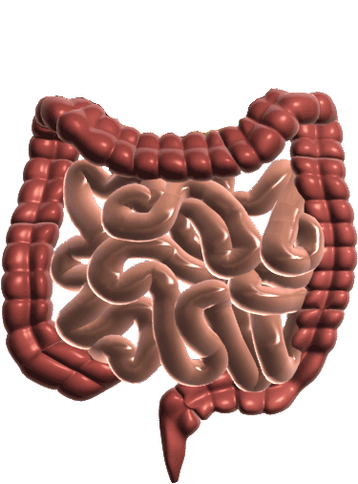
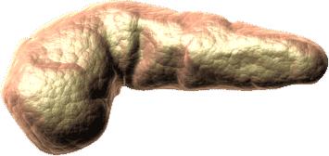
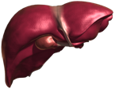
Incretins: Role in Glucose Homeostasis
Food ingestion
↑Glucose
uptake by peripheral tissue^{2,4}
↑ Insulin from beta cells
(GLP-1 and GIP)
Glucose Dependent
Release of gut hormones— Incretins^{1,2}
Pancreas^{2,3}
↓ Blood
glucose
Active
GLP-1 & GIP
Beta cells
Alpha cells
GI tract
↓ Glucagon from
alpha cells
(GLP-1)
Glucose Dependent
DPP-4 enzyme
↓Glucose
production
by liver
Inactive
GLP-1
Inactive
GIP
1. Kieffer TJ, Habener JF. Endocr Rev. 1999;20:876–913.
2. Ahrén B. Curr Diab Rep. 2003;2:365–372.
3. Drucker DJ. Diabetes Care. 2003;26:2929–2940.
4. Holst JJ. Diabetes Metab Res Rev. 2002;18:430–441.
Notes:
Incretins Play an Important Role in Glucose Homeostasis
GLP-1 and GIP are the currently identified incretin hormones. An incretin is a hormone with the following characteristics¹:
It is released from the intestine in response to ingestion of food, particularly glucose.
The circulating concentration of the hormone must be sufficiently high
to stimulate the release of insulin.
The release of insulin in response to physiologic levels of the hormone occurs only when glucose levels are elevated (glucose dependent).
After food is ingested, GIP is released from K cells in the proximal gut (duodenum), and
GLP-1 is released from L cells in the distal gut (ileum and colon).^{2–4} Under normal circumstances, DPP-4 (dipeptidyl peptidase-4) rapidly degrades these incretins to their inactive forms after their release into the circulation.^{2,3}
Actions of GLP-1 and GIP include stimulating insulin response in pancreatic beta cells (GLP-1 and GIP) and suppressing glucagon production (GLP-1) in pancreatic alpha cells when the glucose level is elevated.^{3,4} The subsequent increase in glucose uptake in muscles^{4,5} and reduced glucose output from the liver³ help maintain glucose homeostasis.
Thus, the incretins GLP-1 and GIP are important glucoregulatory hormones that positively affect glucose homeostasis by physiologically helping to regulate insulin in a glucose-dependent manner.^{3,4} GLP-1 also helps to regulate glucagon secretion in a glucose-dependent manner.^{3,6}
References:
1. Creutzfeldt W. The incretin concept today. Diabetologia. 1979;16:75–85.
2. Kieffer TJ, Habener JF. The glucagon-like peptides. Endocr Rev. 1999;20:876–913.
3. Ahrén B. Gut peptides and type 2 diabetes mellitus treatment. Curr Diab Rep. 2003;3:365–372.
4. Drucker DJ. Enhancing incretin action for the treatment of type 2 diabetes. Diabetes Care. 2003;26:2929–2940.
5. Holst JJ. Therapy of type 2 diabetes mellitus based on the actions of glucagon-like peptide-1. Diabetes Metab Res Rev. 2002;18:430–441.
6. Nauck MA, Kleine N, Ørskov C, Holst JJ, Wilms B, Creutzfeldt W. Normalization of fasting hyperglycaemia by exogenous glucagon-like peptide 1 (7-36 amide) in type 2 (non-insulin-dependent) diabetic patients. Diabetologia. 1993;36:741–744.
Purpose:
To demonstrate how the incretin pathway is part of the normal physiology of glucose homeostasis.
Takeaway:
After food ingestion, incretins stimulate insulin release from beta cells and suppress glucagon release from alpha cells in a glucose-dependent manner, resulting in downstream effects that regulate glucose homeostasis.

Slide 11
The Incretin Effect
The “Incretin Effect” describes the phenomenon whereby a glucose load delivered orally produces a much greater insulin secretion than the same glucose load administered intravenously.
Elrick H J Clin Endocrinol Metab 1964;24:1076–82.

Slide 12
The Incretin Effect
Plasma glucose
Insulin response
15
270
80
60
10
180
Plasma glucose (mmol/L)
Insulin (mU/L)
Incretin
effect
40
Plasma glucose (mg/dL)
5
90
20
0
0
0
–10
–5
60
120
180
–10
–5
60
120
180
Time (min)
Time (min)
Oral glucose load (50 g/400 mL)
IV glucose infusion
  Insulin response is greater following oral glucose than IV glucose, despite similar plasma glucose concentration.
Nauck et al. Diabetologia 1986;29:46–52,
Notes:
The incretin hormones play a crucial role in a healthy insulin response
The effect of incretins on insulin secretion is clearly indicated in this study. Healthy volunteers (n=8) fasted overnight before they received an oral glucose load of 50 g/400 ml or an isoglycaemic intravenous glucose infusion for 180 minutes. As can be seen in the left figure, venous plasma glucose concentration was similar with both glucose interventions. However, insulin concentration was greater following oral glucose ingestion than following intravenous glucose infusion, demonstrating the contribution of incretins on insulin secretion.
Reference
Nauck et al. Diabetologia 1986;29:46–52

Slide 13
The Incretin Effect : Diminished in Type 2 Diabetes
Control Subjects
(n=8)
Subjects With Type 2 Diabetes
(n=14)
Normal Incretin Effect
Diminished Incretin Effect
80
80
60
60
IR Insulin, mU/L
IR Insulin, mU/L
40
40
20
20
0
0
0
60
120
180
0
60
120
180
Time, min
Time, min
Oral glucose load
Intravenous (IV) glucose infusion
Nauck M et al. Diabetologia 1986;29:46–52.
Notes:
The Incretin Effect Is Diminished in Subjects With Type 2 Diabetes
In 1964, it was demonstrated that the insulin secretory response was greater when glucose was administered orally through the gastrointestinal tract than when glucose was delivered via IV infusion. The term incretin effect was coined to describe this response involving the stimulatory effect of gut hormones known as incretins on pancreatic secretion.^{1,2}
The incretin effect implies that nutrient ingestion causes the gut to release substances that enhance insulin secretion beyond the release caused by the rise in glucose secondary to absorption of digested nutrients.¹
Studies in humans and animals have shown that the incretin hormones GLP-1 and GIP account for almost all of the incretin effect,³ stimulating insulin release when glucose levels are elevated.^{4,5}
Although the incretin effect is detectable both in healthy subjects and in those with diabetes, it is abnormal in those with diabetes, as demonstrated by the study shown on the slide.⁶
In this study, patients with type 2 diabetes and weight-matched, metabolically healthy control subjects were given glucose either orally or IV to achieve an isoglycemic load.
In those individuals without diabetes (shown on the left), the plasma insulin response to an oral glucose load was far greater than the plasma insulin response to an IV glucose load (incretin effect)—that is, the pancreatic beta cells secreted much more insulin when the glucose load was administered through the gastrointestinal tract.
In patients with type 2 diabetes (shown on the right), the same effect was observed but was diminished in magnitude.
The diminished incretin effect observed in patients with type 2 diabetes may be due to reduced responsiveness of pancreatic beta cells to GLP-1 and GIP or to impaired secretion of the relevant incretin hormone.^{7,8}
Purpose:
To introduce the concept of the incretin effect in healthy individuals and the abnormality in patients with type 2 diabetes.
Takeaway:
Gastrointestinal ingestion of glucose stimulates a greater insulin response than that seen from IV glucose infusion. This effect is significantly decreased in patients with type 2 diabetes. The response is largely attributed to the effect of incretins.
References:
1. Creutzfeldt W. The incretin concept today. Diabetologia. 1979;16:75–85.
2. Creutzfeldt W. The [pre-] history of the incretin concept. Regul Pept. 2005;128:87–91.
3. Brubaker PL, Drucker DJ. Minireview: glucagon-like peptides regulate cell proliferation and apoptosis in the pancreas, gut, and
central nervous system. Endocrinology. 2004;145:2653–2659.
4. Drucker DJ. Biological actions and therapeutic potential of the glucagon-like peptides. Gastroenterology. 2002;122:531–544.
5. Ahrén B. Gut peptides and type 2 diabetes mellitus treatment. Curr Diab Rep. 2003;3:365–372.
6. Nauck M, Stöckmann F, Ebert R, Creutzfeldt W. Reduced incretin effect in type 2 (non-insulin-dependent) diabetes. Diabetologia. 1986;29:46–52.
7. Creutzfeldt W. The entero-insular axis in type 2 diabetes—incretins as therapeutic agents. Exp Clin Endocrinol Diabetes. 2001;
109(suppl 2):S288–S303.
8. Nauck MA, Heimesaat MM, Ørskov C, Holst JJ, Ebert R, Creutzfeldt W. Preserved incretin activity of glucagon-like peptide 1
[7-36 amide] but not of synthetic human gastric inhibitory polypeptide in patients with type-2 diabetes mellitus. J Clin Invest. 1993;91:301–307.

Slide 14
GLP-1 Infusion Has Glucose-dependent Effects
Glucose (mmol/L)
Insulin (pmol/L)
Glucagon (pmol/L)
15
300
20
*
*
10
*
200
*
*
*
*
*
*
*
*
*
10
5
100
*
*
*
*
*
*
*
0
0
0
-30
0
60
120
180
240
-30
0
60
120
180
240
-30
0
60
120
180
240
Time (min)
Time (min)
Time (min)
Placebo (PBO)
Native human GLP-1
Effects of 4-hour GLP-1 infusion (1.2 pmol/kg/min) in 10 patients with type 2 diabetes.
Mean (SE); n=10; *p<0.05.
Nauck et al. Diabetologia 1993;36:741–4
Notes:
Therapeutic effect of GLP-1 in people with Type 2 diabetes
This study evaluated the effect of GLP-1 or saline infusion on plasma glucose, C-peptide (a measure of insulin secretion), and glucagon response in individuals with Type 2 diabetes. The study evaluated 10 individuals whose type 2 diabetes was inadequately controlled using diet and medication. All oral glucose-lowering medications were discontinued prior to the test, which was preceded by an overnight fast [Nauck et al, 1986; Nauck et al, 1993].
These graphs illustrate the improved glucose, C-peptide, and glucagon response to GLP-1 infusion compared with saline placebo. Plasma glucose decreased sharply in response to GLP-1 infusion (P<0.05). As FPG values approached normal, C-peptide, which was higher with GLP-1 compared with saline throughout the infusion (P<0.05), began to decrease as well. Plasma glucagon initially decreased (P<0.05) in response to GLP-1 but returned to baseline levels as plasma glucose returned to normal fasting levels [Nauck et al, 1993].
These results demonstrate that even in individuals with poorly controlled Type 2 diabetes, GLP-1 replacement can reduce FPG to a near-normal state [Nauck et al, 1993].

Slide 15
GLP-1 preserves human islet morphology and function in cultured islets in vitro
Control
+ GLP-1
Day 1
Day 3
Day 5
Farilla et al. Endocrinology. 2003
Notes:
GLP-1 preserves human islet morphology and function in cultured islets in vitro
This study investigated the potential mechanisms of possible longer-term effects of GLP-1 by measuring its influence on the viability and function of freshly isolated human islet cells.
This slide shows the morphology of control and GLP-1-treated islet cultures over time. Islets were cultured in a medium containing 6-mmol/l glucose, and at the end of each 1-, 3- and 5-day period, a glucose-induced secretion test was performed by changing the culture medium from 6- to 15-mmol/l glucose.
Islets cultured for 1 day maintained their spherical 3-dimensional (3-D) structure. As the number of culture days increased, many islets cells lost their 3-D structure; this was attributable to the disappearance of their surrounding acellular membrane. Islets treated with GLP-1 maintained their 3-D structure for longer periods of time. By day 5, control cultures had approximately 45% fewer islets with a preserved 3-D structure compared with an approximately 15% reduction for islets in GLP-1-treated cultures (P<0.01). Although the data are not shown here, GLP-1 cultures also showed higher insulin secretion responses on all 3 days of the test (P<0.05).
These results demonstrate the positive influence of GLP-1 on morphology preservation and insulin secretion of cultured islet cells and suggest a potential mechanism for possible longer-term effects of GLP-1 on islet cell function.
REFERENCE
Farilla L, Bulotta A, Hirshberg B, et al. Endocrinology. 2003;144:5149-5158.

Slide 16
Incretin Based Therapies
GLP-1 secretion is impaired in Type 2 diabetes
Natural GLP-1 has extremely short half-life
Add GLP-1 analogues with longer half-life:
  Exenatide
  Liraglutide
  Lixisenitide
Block DPP- 4, enzyme that degrades GLP-1:
  Sitagliptin
  Saxogliptin
  Vildagliptin
  Saxagliptin
  Linagliptin
Injectables
Oral agents
Drucker. Curr Pharm Des. 2001; Drucker. Mol Endocrinol. 2003
Notes:
GLP-1 enhancement
Postprandial plasma levels of GLP-1 are depressed in Type 2 diabetes, indicating an impaired GLP-1 response to nutrient ingestion. For this reason, continuous GLP-1 infusion therapy has proven useful in short-term studies but is not a practical long-term therapy. The effort to identify effective forms of GLP-1 administration is challenged by its extremely short half-life (the enzyme DPP-4 degrades GLP-1 rapidly following its release from gut cells) [Drucker 2006; Drucker 2001].
Much research has focused on compounds with molecular structures and incretin activity that are similar to GLP-1, but which have longer half-lives because they are not degraded by DPP-4 or are resistant to DPP-4. These compounds include exenatide and liraglutide, which are injectable treatments. Another approach is to identify compounds that inhibit the activity of DPP-4, thus prolonging the half-life of naturally occurring GLP-1. Two oral agents that act as DPP-4 inhibitors are sitagliptin and vildagliptin [Gallwitz, 2006].
REFERENCES
Drucker DJ. Cell Metab. 2006;3:153-165.
Drucker DJ. Curr Pharm Des. 2001;7:1399-1412.
Gallwitz B. Eur Endocr Dis. June 2006:43-46.

Slide 17
GLP1 receptor agonists
Short acting- exenatide and lixisenatide
Lower postprandial glucose levels and insulin concentrations via retardation of gastric emptying
Long acting- albiglutide, dulaglutide, exenatide long-acting release and liraglutide
Lower blood glucose levels through stimulation of insulin secretion and reduction of glucagon levels
Meier J. GLP‑1 receptor agonists for individualized treatment of type 2 diabetes mellitus Nat. Rev. Endocrinol. 8, 728–742 (2012);
Notes:
Meier J.
Nat. Rev. Endocrinol. 8, 728–742 (2012);

Slide 18
Mechanism of action
Activation of the GLP-1 receptor
GLP1 receptors are expressed on beta cells, cells in the peripheral and central nervous system, the heart and vasculature, kidney, lung, and GI mucosa
Binding of agonists to the GLP-1 receptor activates the cAMP-PKA pathway and several GEFs (guanine nucleotide exchange factors)
Goodman & Gilman’s Pharmacological Basis of therapeutics. 12th edition

Slide 19
Mechanism of action
The end result of these actions is increased insulin biosynthesis and exocytosis in a glucose-dependent manner
Goodman & Gilman’s Pharmacological Basis of therapeutics. 12th edition

Slide 20
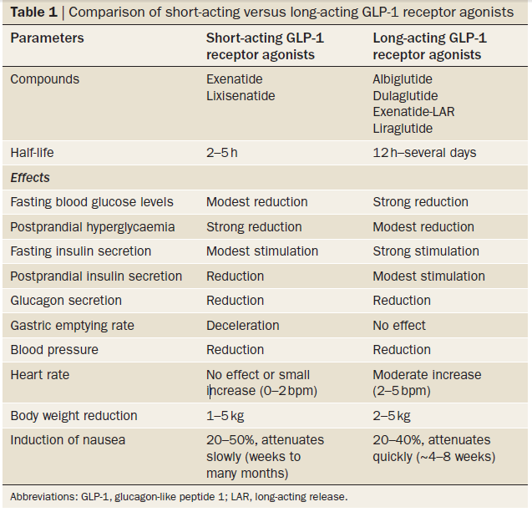

Slide 21
Pharmacokinetics
Exenatide –
  S.C twice daily
  Rapidly absorbed, reaches peak concentrations in ~2 hours
  Little metabolism in circulation
  Vd is 30 L
  Clearance is glomerular filtration
Goodman & Gilman’s Pharmacological Basis of therapeutics. 12th edition

Slide 22
Pharmacokinetics
Liraglutide
  S.C once daily
  Peak in 8-12 hrs
  elimination t_{1/2} is 12-14 hours
  clearance is primarily through the metabolic pathways of large plasma proteins
Goodman & Gilman’s Pharmacological Basis of therapeutics. 12th edition

Slide 23
Advantages of long acting agents
Provide better glycaemic control than the short-acting GLP‑1 receptor agonists, as patients have higher insulin levels in the fasting state (and presumably during the night) following administration of long-acting receptor agonists
Greater reductions in plasma HbA1c levels than those observed with the intermittent activation of the GLP 1 receptor resulting from administration of short-acting compounds
They are also effective during the night and early morning
Meier J. GLP‑1 receptor agonists for individualized treatment of type 2 diabetes mellitus Nat. Rev. Endocrinol. 8, 728–742 (2012);

Slide 24
Adverse effects
Nausea- most frequent- incidence is between 25% and 60%
Occurrence in a specific individual seems to be dependent upon various factors, such as meal size and frequency—and, potentially, BMI
Lower in Asian patients
Meier J. GLP‑1 receptor agonists for individualized treatment of type 2 diabetes mellitus Nat. Rev. Endocrinol. 8, 728–742 (2012);

Slide 25
Adverse effects
Incidence of vomiting 5-15 %
Long-acting GLP‑1 receptor agonists seem to exhibit improved gastrointestinal tolerability, and the incidence of nausea declines over time (tolerance)
Meier J. GLP‑1 receptor agonists for individualized treatment of type 2 diabetes mellitus Nat. Rev. Endocrinol. 8, 728–742 (2012);

Slide 26
Adverse effects
5–10% of patients discontinue treatment owing to nausea & vomiting
Diarrhoea in ~10–20% of patients- more with long acting compounds
Few cases of acute pancreatitis have been reported during treatment with exenatide and other GLP‑1 receptor agonists
An association between treatment with GLP‑1-based drugs and an increased risk of pancreatitis cannot be ruled out
Meier J. GLP‑1 receptor agonists for individualized treatment of type 2 diabetes mellitus Nat. Rev. Endocrinol. 8, 728–742 (2012);

Slide 27
Adverse effects
Liraglutide- increase in mean lipase concentrations of >10 IU, an effect that was reversible after treatment was discontinued.
Cessation of treatment with GLP‑1 receptor agonists in patients with clinical signs of acute pancreatitis is, therefore, advisable, and avoiding these drugs in patients with a history of pancreatitis would be prudent
Should be avoided in patients with a history of thyroid cancer or multiple endocrine neoplasia- increased incidence of C‑cell hyperplasia and medullary thyroid cancer was reported in rats and mice
Meier J. GLP‑1 receptor agonists for individualized treatment of type 2 diabetes mellitus Nat. Rev. Endocrinol. 8, 728–742 (2012);

Slide 28
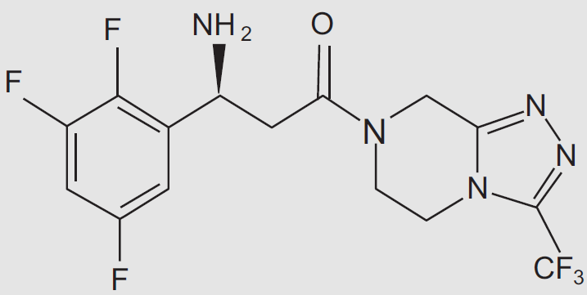
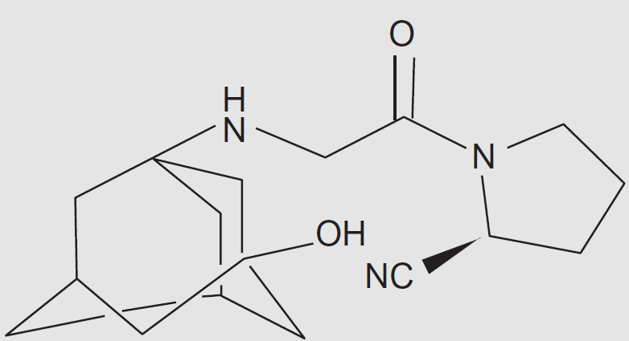
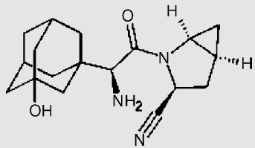
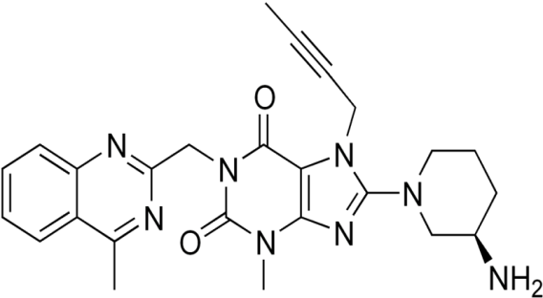
Incretin Based Therapies:
DPP4 Inhibitors
Sitagliptin
Vildagliptin
Saxagliptin
Linagliptin

Slide 29
Overview of Sitagliptin
Sitagliptin is a triazolopiperazine based DPP-4 inhibitor that binds selectively and reversibly to the active site of DPP-4.
The recommended dosage of Sitagliptin is 100 mg once/day.
Sitagliptin is primarily (79%) eliminated unchanged by the kidney. Dosing should be reduced to 50 mg once/day in patients with moderate renal insufficiency and to 25 mg once/day in cases of severe renal impairment or ESRD.
Only about 16% of sitagliptin undergoes hepatic metabolism; hence, its pharmacokinetics have been shown to be unaffected by mild-to-moderate hepatic failure.
Drab SR Pharmacotherapy 2010;30(6):609–624.
Neumiller JJ Clin Ther. 2011;33:528–576

Slide 30
Sitagliptin: Effects on HbA1c
The efficacy and safety of sitagliptin, added to ongoing metformin & pioglitazone therapy for 24 weeks, were assessed in patients with type 2 diabetes who had inadequate glycaemic control.
Add-on to Metformin Study
Add-on to Pioglitazone Study
Δ in HbA_{1c} vs Pbo* = -0.65%
Δ in HbA_{1c} vs Pbo* = -0.70%
8.2
8.2
8.0
8.0
7.8
7.8
(%)
(P<0.001)
(%)
7.6
7.6
(P<0.001)
HbA1c
HbA1c
7.4
7.4
7.2
Placebo (n=224)
Sitagliptin 100 mg (n=453)
7.2
Placebo (n=174)
Sitagliptin 100 mg (n=163)
7.0
7.0
0
6
12
18
24
0
6
12
18
24
Time (weeks)
Time (weeks)
Charbonnel B et al Diabetes Care. 2006;29:2638-2643.
Rosenstock J et al. Clin Ther. 2006;28:1556-1568.
*Compared with placebo.
Notes:
In clinical trials of sitagliptin, the greatest reductions in A1C were seen when it was introduced as combination therapy with metformin to previously oral antidiabetic drug–naive patients, suggesting that these agents have an additive effect.
Sitagliptin once daily lowers HbA_{1c} when added to metformin or pioglitazone
Metformin and pioglitazone improve glycemic control by increasing insulin sensitivity in peripheral tissues [AHFS Drug Information, 2004; Gallwitz, 2006]. These large-scale efficacy trials tested the effect of sitagliptin 100 mg once daily added to metformin or pioglitazone in individuals with a mean HbA_{1c} of ~8.0 % [Charbonnel et al, 2006; Rosenstock et al, 2006].
The first graph illustrates the rapid and progressive HbA_{1c} response to sitagliptin added to metformin. The addition of sitagliptin decreased HbA_{1c} by -0.65% (P<0.001) over the 24-week treatment period [Charbonnel et al, 2006].
Likewise, the response to sitagliptin when added to pioglitazone monotherapy was rapid and progressive, with a net HbA_{1c} reduction of -0.70% (P<0.001) over the 24-week treatment period [Rosenstock et al, 2006].
These results indicate that the addition of sitagliptin improves glycaemic control in individuals whose hyperglycaemia is inadequately controlled by metformin or pioglitazone monotherapy.
REFERENCES
American Hospital Formulary Service Drug Information 2004. Available at http://www.asp.org/ahfs/first_rel/Revised-pioglitazone-may2005.pdf. Accessed December 28, 2006.
Gallwitz B. Eur Endocr Dis. June 2006:43-46.
Charbonnel B, Karasik A, Liu J, Wu M, Meininger G, for the Sitagliptin Study 020 Group. Diabetes Care. 2006;29:2638-2643.
Rosenstock J, Brazg R, Andryuk PJ, Lu K, Stein P, for the Sitagliptin Study 019 Group. Clin Ther. 2006;28:1556-1568.

Slide 31

Sitagliptin: FDA Alert
Eighty-eight post-marketing cases of acute pancreatitis, including two cases of hemorrhagic or necrotizing pancreatitis in patients using sitagliptin, were reported to the Agency between October 16, 2006 and February 9, 2009.
FDA recommended that healthcare professionals should monitor patients carefully for the development of pancreatitis after initiation or dose increases of sitagliptin or sitagliptin/metformin, and to discontinue sitagliptin or sitagliptin/metformin if pancreatitis is suspected while using these products.

Slide 32
Overview of Vildagliptin
Vildagliptin is a cyanopyrrolidine compound.
According to EU labeling, vildagliptin is dosed at 50 mg once or twice daily.
The approval of this drug in the United States has been delayed by a request from the FDA for additional data on the use of vildagliptin in patients with renal impairment, reportedly due to concern about the potential for an elevated risk for skin lesions resulting from increased drug exposure in this patient group.
Drab SR Pharmacotherapy 2010;30(6):609–624.
Neumiller JJ Clin Ther. 2011;33:528–576

Slide 33
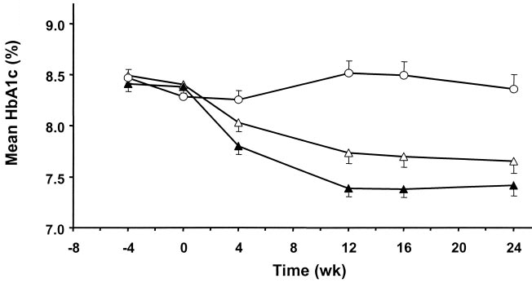
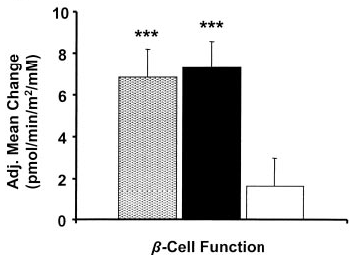
Vildagliptin: Effects on HbA1c & β-Cell function
This was a double-blind, randomized, multicenter, parallel group study of a 24-week treatment with 50 mg vildagliptin daily, 100 mg vildagliptin daily, or placebo in patients continuing a stable metformin dose regimen (≥1,500 mg/day) but achieving inadequate glycaemic control.
50 mg vildagliptin/day
100 mg vildagliptin/day
Placebo
Placebo
50 mg vildagliptin/day
100 mg vildagliptin/day
Vildagliptin produced clinically meaningful, decrease in HbA1c & improvement in measures of β-cell function.
***P <0.001; **P <0.001 vs. placebo.
Bosi E et al. Diabetes Care 2007;30:890–95.
Notes:
Standard breakfast meal tests (500 kcal; 60% carbohydrate, 30% fat, and 10% protein) were performed at weeks 0 and 24 in patients agreeing to participate (30% of patients in each treatment group) for assessment of β-cell function and prandial glucose control. Insulin secretory rate (ISR) was calculated by deconvolution of plasma C-peptide levels. The 2-h area under the curves (AUCs) for ISR and glucose were calculated with the trapezoidal method, and the ratio of ISR AUC to glucose AUC was used as a measure of β-cell function.
While absolute plasma insulin levels were essentially unchanged by vildagliptin treatment , both vildagliptin
dose regimens elicited similar, approximately threefold increases in β–cell function relative to placebo when expressed as ISR relative to glucose.
The between-treatment difference (vildagliptin -placebo) in adjusted mean change ± SE in A1C from baseline to end point was 0.7 ± 0.1% (P <0.001) and 1.1± 0.1% (P<0.001) in patients receiving 50 or 100 mg vildagliptin daily, respectively.

Slide 34
Overview of Saxagliptin
Saxagliptin is a cyanopyrrolidine DPP-4 inhibitor with a high selectivity for DPP-4.
The recommended dosage is 2.5 or 5 mg/day.
Both the Saxagliptin and its metabolite are renally excreted, and accumulation can occur in patients with renal impairment, necessitating a daily dose limit of 2.5 mg.
The 2.5-mg dose is recommended in patients taking strong CYP3A4/5 inhibitors.
Compared with sitagliptin or vildagliptin, saxagliptin is at least 10-fold more potent inhibitor of DPP-4.
Drab SR Pharmacotherapy 2010;30(6):609–624.
Neumiller JJ Clin Ther. 2011;33:528–576

Slide 35
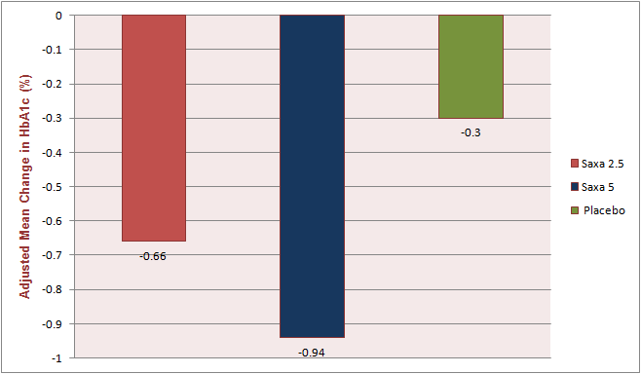
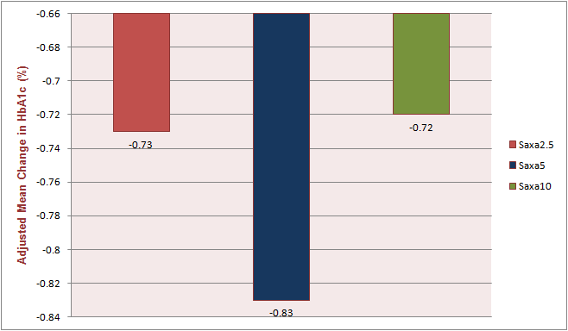
Saxagliptin: Effects on HbA1c
This two 24-weeks trials assessed the efficacy and safety of saxagliptin as add-on therapy in patients with T2 DM with inadequate glycaemic control with TZDs & metformin alone.
Saxagliptin added to TZDs
Saxagliptin added to Metformin
*
*
*
#
*
Adjusted mean change in HbA1c from baseline to wk 24
Adjusted mean change in HbA1c from
baseline versus placebo
*P=0.0007, #p<0.0001 vs Placebo
*p<0.0001
Hollander P et al. J Clin Endocrinol Metab. December 2009, 94(12):4810–19
Defronzo RA et al. Diabetes Care 2009, 32:1649–1655.
Notes:
A total of 565 patients were randomized and treated with saxagliptin (2.5 or 5 mg) or PBO, once daily, plus stable TZD dose for 24 wk. Saxagliptin added to TZD provided statistically significant improvements in key parameters of glycaemic control vs. TZD monotherapy and was generally well tolerated.
Saxagliptin once daily added to metformin therapy was generally well tolerated and led to statistically significant improvements in glycaemic indexes versus placebo added to metformin in patients with type 2 diabetes inadequately controlled with metformin alone. This was a randomized, double-blind, placebo- controlled study of saxagliptin (2.5, 5, or 10 mg once daily) or placebo plus a stable dose of metformin (1,500 –2,500 mg) in 743 patients (A1C ≥7.0 and ≤10.0%).

Slide 36
Linagliptin: The New Prospect
FDA on May 2nd, 2011 approved linagliptin, a dipeptidyl peptidase-4 inhibitor, for the improvement of blood glucose control in adults with type 2 diabetes mellitus.
Linagliptin is predominantly excreted via enterohepatic system, with 84.7% of the drug eliminated in the faeces and only 5% eliminated via urine.
Data to date suggest that linagliptin would not need dose adjustment in patients with type 2 diabetes, regardless of the degree of renal impairment.
www.boehringeringelheim.com/content/dam/.../Linagliptin.pdf
Heise et al Diabetes Obes Metab. 2009 Aug;11(8):786-94.
Edelman SV, Basile J Paper Presented at ADA 2011
Scott LJ. Drugs 2011; 71 (5): 611-624

Slide 37
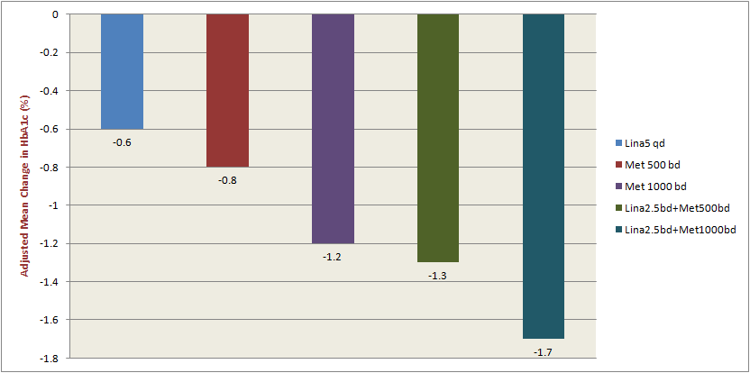
Linagliptin: Effects on HbA1c
This 24-week, double-blind, placebo-controlled study randomized 791 individuals with T2 DM that were drug naïve with an A1c> 7.5% and <11% or that were using one oral antidiabetic drug (metformin) with an A1c >7.0 and <10.5%.
The combination therapy of metformin and linagliptin provided superior improvements in both A1c (p<0.0001) and fasting plasma glucose (p<0.001) than monotherapy comparators.
Thomas Haak,Paper Presented at ADA 2011
Notes:
The treatments arms were: linagliptin 5 mg QD, linagliptin 2.5 BID with metformin 500 mg BID, linagliptin 2.5 mg BID with metformin 1000 mg BID, metformin 500 mg BID, metformin 1000 mg BID, and placebo. Additionally, 66 individuals with type 2 diabetes with an A1c >11% were placed into a separate open-label arm in which they received linagliptin 2.5 mg BID with metformin 1000 mg BID. In the randomized portion of the trial, the arms were largely similar at baseline with an average A1c between 8.5% and 8.7% and a BMI of 29 kg/m2. In the open-label arm, average A1c was 11.8% and BMI was 29 kg/m2.

Slide 38
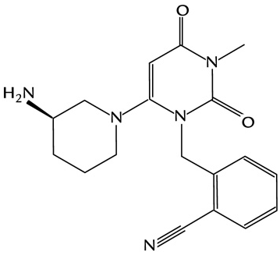
Overview of Alogliptin
Alogliptin is an orally available, quinazolinone based, noncovalent DPP-4 inhibitor.
Alogliptin is primarily excreted unchanged by the kidneys. So, dose adjustment is required in patients with moderate to severe renal impairment.
Chemical Structure of Alogliptin
Drab SR Pharmacotherapy 2010;30(6):609–624.
Neumiller JJ Clin Ther. 2011;33:528–576

Slide 39
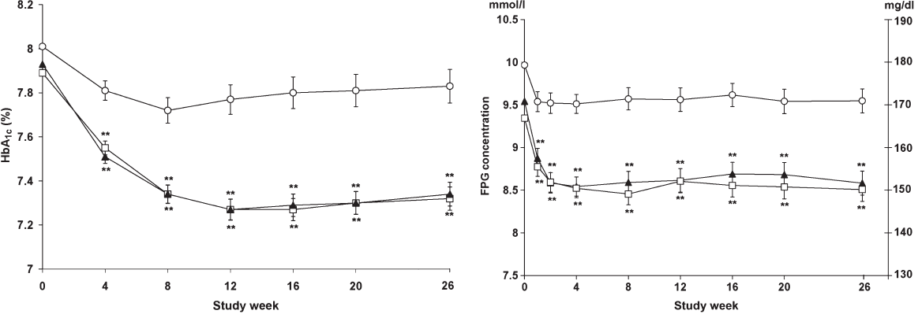
Alogliptin: Effects on Glycaemic Parameters
Evaluation of the efficacy and safety of alogliptin for 26 weeks at once-daily doses of 12.5 and 25 mg in combination with metformin in patients whose HbA1c levels were inadequately controlled on metformin alone.
New drug application for alogliptin has got approval from the Japanese Ministry of Health, Labour and Welfare on April 16th 2010 & it is marketed in Japan.
However, FDA has requested the manufacturer to conduct an additional cardiovascular safety trial before the approval.
Alogliptin 12.5 mg (open squares) and 25.0 mg (filled diamonds) vs. placebo (open circles)
Alogliptin at either dose produced least squares mean (SE) decreases from baseline in HbA1c of - 0.6 (0.1)% and in FPG of -17.0 (2.5) mg ⁄ dl, decreases that were significantly (*p < 0.001) greater than those observed with placebo.
Nauck MA et al. Int J Clin Pract 2009; 63: 46–55
Notes:
Aims: To evaluate the efficacy and safety of alogliptin, a new dipeptidyl peptidase- 4 inhibitor, for 26 weeks at once-daily doses of 12.5 and 25 mg in combination with metformin in patients whose HbA1c levels were inadequately controlled on metformin alone.
Methods and patients: Patients with type 2 diabetes and inadequate glycaemic control (HbA1c 7.0-10.0%) were randomised to continue a stable daily metformin dose regimen (≥1500 mg) plus the addition of placebo (n = 104) or alogliptin at once-daily doses of 12.5 (n = 213) or 25 mg (n = 210). HbA1c, insulin, proinsulin, C-peptide and fasting plasma glucose (FPG) concentrations were determined over a period of 26 weeks.
Results: Alogliptin at either dose produced least squares mean (SE) decreases from baseline in A1c of -0.6 (0.1)% and in FPG of -17.0 (2.5) mg ⁄ dl, decreases that were significantly (p < 0.001) greater than those observed with placebo. The between treatment differences (alogliptin – placebo) in FPG reached statistical significance (p < 0.001) as early as week 1 and persisted for the duration of the study. Overall,
adverse events (AEs) observed with alogliptin were not substantially different from those observed with placebo. This includes low event rates for gastrointestinal side effects and hypoglycaemic episodes. There was no dose-related pattern of AE reporting between alogliptin groups and few serious AEs were reported.
Conclusion: Alogliptin is an effective and safe treatment for type 2 diabetes when added to metformin for patients not sufficiently controlled on metformin monotherapy.

Slide 40
GLP-1 Analogues
vs
DPP-4 Inhibitor

Slide 41
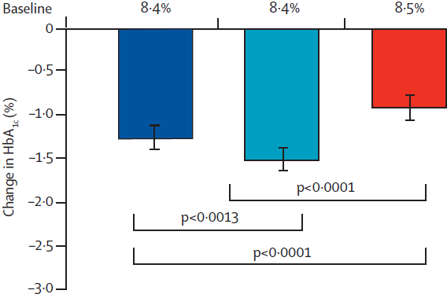
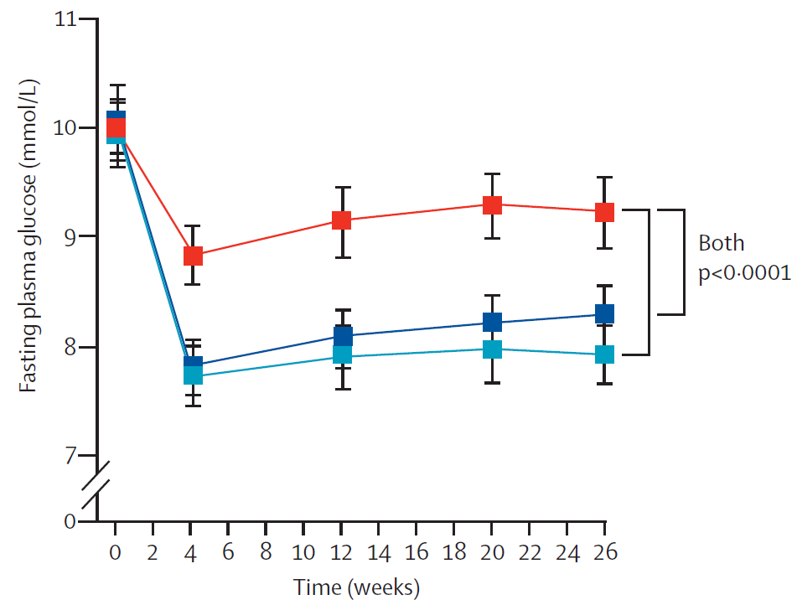

Liraglutide vs Sitagliptin
In this parallel-group, open-label trial, participants with T2 DM who had inadequate glycaemic control on metformin were randomly allocated to receive 26 weeks’ treatment with 1.2 mg or 1.8 mg subcutaneous liraglutide once daily, or 100 mg sitagliptin once daily.
Liraglutide was superior to sitagliptin for reduction of HbA1c & FPG, and was well tolerated with minimum risk of hypoglycaemia.
Pratley RE et al Lancet 2010; 375: 1447–56
Notes:
Background: Agonists of the glucagon-like peptide-1 (GLP-1) receptor provide pharmacological levels of GLP-1 activity, whereas dipeptidyl peptidase-4 (DPP-4) inhibitors increase concentrations of endogenous GLP-1 and glucosedependent insulinotropic polypeptide. We aimed to assess the effi cacy and safety of the human GLP-1 analogue liraglutide versus the DPP-4 inhibitor sitagliptin, as adjunct treatments to metformin, in individuals with type 2 diabetes who did not achieve adequate glycaemic control with metformin alone.
Methods: In this parallel-group, open-label trial, participants (aged 18–80 years) with type 2 diabetes mellitus who had inadequate glycaemic control (glycosylated haemoglobin [HbA1c] 7・5–10・0%) on metformin (≥1500 mg daily for ≥3 months) were enrolled and treated at offi ce-based sites in Europe, the USA, and Canada. Participants were randomly allocated to receive 26 weeks’ treatment with 1・2 mg (n=225) or 1・8 mg (n=221) subcutaneous liraglutide once daily, or 100 mg oral sitagliptin once daily (n=219). The primary endpoint was change in HbA1c from baseline to week 26. The efficacy of liraglutide versus sitagliptin was assessed hierarchically by a non-inferiority comparison, with a margin of 0・4%, followed by a superiority comparison. Analyses were done on the full analysis set with missing values imputed by last observation carried forward; seven patients assigned to liraglutide did not receive treatment and thus did not meet criteria for inclusion in the full analysis set.
Findings: Greater lowering of mean HbA1c (8・5% at baseline) was achieved with 1・8 mg liraglutide (–1・50%, 95% CI–1・63 to –1・37, n=218) and 1・2 mg liraglutide (–1・24%, –1・37 to –1・11, n=221) than with sitagliptin (–0・90%, –1・03 to –0・77, n=219). Estimated mean treatment diff erences for liraglutide versus sitagliptin were –0・60% (95% CI –0・77 to –0・43, p<0・0001) for 1・8 mg and –0・34% (–0・51 to –0・16, p<0・0001) for 1・2 mg liraglutide. Nausea was more common with liraglutide (59 [27%] patients on 1・8 mg; 46 [21%] on 1・2 mg) than with sitagliptin (10 [5%]). Minor hypoglycaemia was recorded in about 5% of participants in each treatment group.
Interpretation: Liraglutide was superior to sitagliptin for reduction of HbA1c, and was well tolerated with minimum risk of hypoglycaemia. These findings support the use of liraglutide as an effective GLP-1 agent to add to metformin.

Slide 42
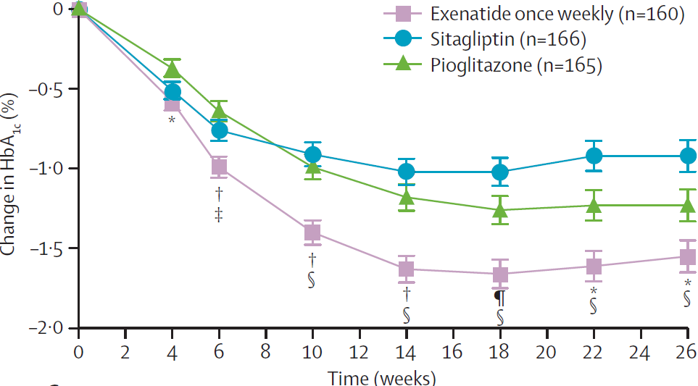
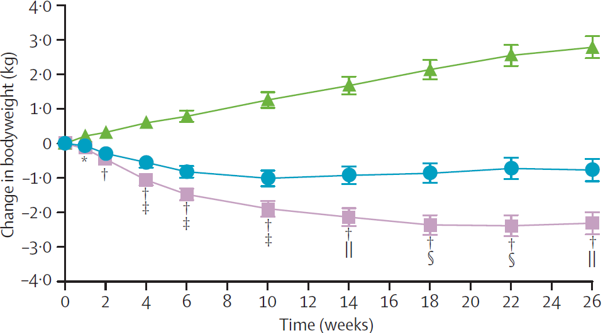
Exenatide LAR vs Sitagliptin (DURATION-2)
In this 26-week randomised, double-blind, double-dummy, superiority trial, patients with T2DM treated with metformin were randomly assigned to receive: 2 mg exenatide once weekly; 100 mg sitagliptin once daily; or 45 mg pioglitazone once daily.
Treatment with once weekly exenatide resulted in a significantly greater reduction in HbA1c & bodyweight as compared to sitagliptin.
‡p<0・05 for exenatide versus sitagliptin. §p<0・0001 for exenatide versus sitagliptin.
||p<0・001 for exenatide versus sitagliptin.
Bergenstal RM et al. Lancet 2010; 376: 431–39
Notes:
Methods: In this 26-week randomised, double-blind, double-dummy, superiority trial, patients with type 2 diabetes who had been treated with metformin, and at baseline had mean glycosylated haemoglobin (HbA1c) of 8·5% (SD 1·1), fasting plasma glucose of 9·1 mmol/L (2·6), and weight of 88·0 kg (20·1), were enrolled and treated at 72 sites in the USA, India, and Mexico. Patients were randomly assigned to receive: 2 mg injected exenatide once weekly plus oral placebo once daily; 100 mg oral sitagliptin once daily plus injected placebo once weekly; or 45 mg oral pioglitazone once daily plus injected placebo once weekly. Primary endpoint was change in HbA1c between baseline and week 26. Analysis was by intention to treat, for all patients who received at least one dose of study drug. This trial is registered with ClinicalTrials.gov, number NCT00637273.
Findings: 170 patients were assigned to receive once weekly exenatide, 172 to receive sitagliptin, and 172 to receive pioglitazone. 491 patients received at least one dose of study drug and were included in the intention-to-treat analysis (160 on exenatide, 166 on sitagliptin, and 165 on pioglitazone). Treatment with exenatide reduced HbA1c (least square mean –1·5%, 95% CI –1·7 to –1·4) significantly more than did sitagliptin (–0·9%, –1·1 to –0·7) or pioglitazone (–1·2%, –1·4 to –1·0). Treatment differences were –0·6% (95% CI –0·9 to –0·4, p<0·0001) for exenatide versus sitagliptin, and –0·3% (–0·6 to –0·1, p=0·0165) for exenatide versus pioglitazone. Weight loss with exenatide (–2·3 kg, 95% CI–2·9 to –1·7) was significantly greater than with sitagliptin (difference –1·5 kg, 95% CI –2·4 to –0·7, p=0·0002) or pioglitazone (difference –5·1 kg, –5·9 to –4·3, p<0·0001). No episodes of major hypoglycaemia occurred. The most frequent adverse events with exenatide and sitagliptin were nausea (n=38, 24%, and n=16, 10%, respectively) and diarrhoea (n=29, 18%, and n=16, 10%, respectively); upper-respiratory-tract infection (n=17, 10%) and peripheral oedema (n=13, 8%) were the most frequent events with pioglitazone.
Interpretation: The goal of many clinicians who manage diabetes is to achieve optimum glucose control alongside weight loss and a minimum number of hypoglycaemic episodes. Addition of exenatide once weekly to metformin achieved this goal more often than did addition of maximum daily doses of either sitagliptin or pioglitazone.

Slide 43
GLP-1 Analogues vs DPP-4 Inhibitors
Properties/Effects | DPP-4 Inhibitors | GLP-1 Analogues
↑ Glucose-dependent insulin secretion | Yes | Yes
↓ Glucagon secretion | Yes | Yes
Effect on incretins | Endogenous incretins enhanced to physiological levels | Exogenous GLP-1: Possible Immune response (antibody formation)
Effect on body weight | Weight neutral | Body weight decreased
Inhibition of gastric emptying | Marginal | Yes
Hypoglycaemia | No | No
Side Effects | No nausea, vomiting | Reported nausea, vomiting
Administration | Oral | Subcutaneous
Barnett A Clinical Endocrinology 2009; 70: 343–53
Notes:
Incretin mimetics and DPP-4 inhibitors: major differences
Incretin mimetics and DPP-4 inhibitors improve glycaemic control in Type 2 diabetes; however, their mechanisms of action and associated side effects are somewhat different [Gallwitz, 2006].
Incretin mimetics are molecular analogues of GLP-1. Their stimulatory influence on glucose-dependent insulin secretion is exclusively a function of their action on GLP-1 receptors. It has been posited that the effect of DPP-4 inhibitors on insulin secretion may be broader because DPP-4 is involved in the degradation of many peptide hormones, including GIP and pituitary adenylate cyclase-activating polypeptide (PACAP), which also potentiate glucose-dependent insulin secretion [Ahren et al, 2005; Drucker, 2006; Gallwitz, 2006; Jamen et al, 2002].
Restoration of first- and second-phase insulin response has been demonstrated with both exenatide and DPP-4 inhibitors. When used as monotherapy, incretin mimetics and DPP-4 inhibitors do not increase the incidence of hypoglycaemia. Counter-regulation of hypoglycaemia by glucagon is maintained with incretin mimetics; however, this has not been adequately tested with DPP-4 inhibitors [Gallwitz, 2006].
Incretin mimetics may exert a portion of their glucoregulatory control through the inhibition of gastric emptying (which slows the rate of nutrient absorption and, thus, the need for insulin secretion). Weight loss has been observed in clinical trials with incretin mimetics, while DPP-4 inhibitors have been weight neutral in clinical trials [Drucker, 2001; Gallwitz, 2006], and some of the effect of incretin mimetics on HbA_{1c} levels may be due to the weight loss.
Like GLP-1, incretin mimetics are peptides and, thus, must be administered by daily injection (although longer-acting formulations are being developed). DPP-4 inhibitors are orally active [Gallwitz, 2006].
Testing of incretin mimetics and DPP-4 inhibitors has been limited to trials that typically lasted 1 year or less. The long term effects of incretin mimetics and DPP-4 inhibitors will need to be followed in clinical practice [Gallwitz, 2006].
REFERENCES
Ahrén B, Hughes TE. Endocrinology. 2005;146:2055-2059.
Drucker DJ. Curr Pharm Des. 2001;7:1399-1412.
Drucker DJ. Cell Metab. 2006;3:153-165.
Gallwitz B. Eur Endocr Dis. June 2006:43-46.
Jamen F, Puech R, Bockaert J, Brabet P, Bertrand G. Endocrinology. 2002;143:1253-1259.

Slide 44
The Future of Incretin Based Therapy

Slide 45
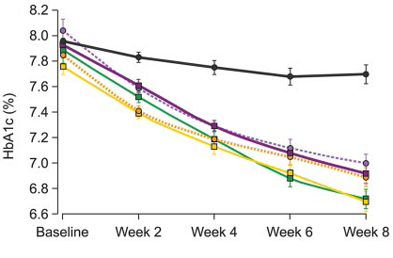
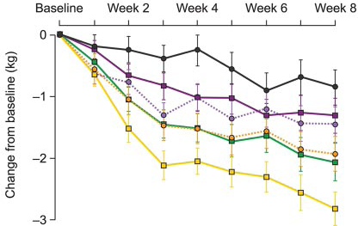
Overview of Taspoglutide
Type 2 diabetic patients who failed to obtain glycaemic control despite 1,500 mg metformin daily were randomly assigned to 8 weeks of double-blind subcutaneous treatment with placebo or taspoglutide.
HbA1c
Body Weight
Roche had suspended the development of taspoglutide, currently in phase 3 trials, because of the high discontinuation rates as a result of gastrointestinal tolerability and serious hypersensitivity reactions.
Black, placebo; magenta, 5 mg once weekly; green, 10 mg once weekly; yellow, 20 mg once weekly; purple, 10 mg once every 2 weeks; orange, 20 mg once every 2 weeks.
Taspoglutide used in combination with metformin significantly improves fasting and postprandial glucose control and induces weight loss.
All taspoglutide doses were statistically significant (P<0.0001)
Nauck MA et al Diabetes Care 2009; 32:1237–43
Notes:
Taspoglutide has 93% homology to endogenous GLP-1.
A long-acting profile was obtained by making 2 amino acid substitutions and using of a sustained-release formulation.
After 8 weeks of treatment, the reductions in A1C from baseline were statistically significant compared with placebo in all groups that received taspoglutide (P < 0.0001). Reductions in A1C were apparent after 1 week of treatment with taspoglutide, with the greatest reductions observed in the 10 and 20 mg once weekly dose groups at the end of treatment.

Slide 46
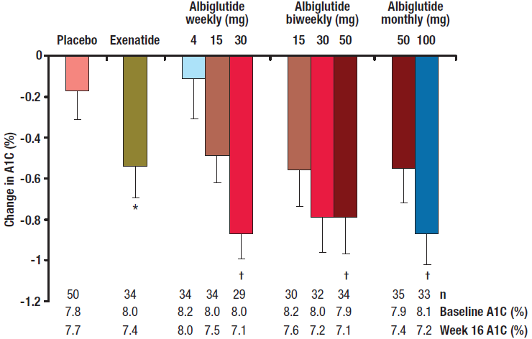
Overview of Albiglutide
(Now in Phase III Trial)
In this 16 weeks, randomized, multicenter double-blind, parallel-group study, 356 type 2 diabetic subjects received subcutaneous placebo or albiglutide (weekly [4, 15, or 30 mg], biweekly [15, 30, or 50 mg], or monthly [50 or 100 mg]) or exenatide twice daily.
Weekly albiglutide administration significantly improved glycaemic control
and elicited weight loss in type 2 diabetic patients, with a favourable safety and tolerability profile.
Rosenstock J et al. Diabetes Care 2009;32:1880–1886
Notes:
OBJECTIVE— To evaluate the efficacy, safety, and tolerability of incremental doses of albiglutide, a long-acting glucagon-like peptide-1 receptor agonist, administered with three dosing schedules in patients with type 2 diabetes inadequately controlled with diet and exercise or metformin monotherapy.
RESEARCH DESIGN AND METHODS— In this randomized multicenter doubleblind parallel-group study, 356 type 2 diabetic subjects with similar mean baseline characteristics (age 54 years, diabetes duration 4.9 years, BMI 32.1 kg/m2, A1C 8.0%) received subcutaneous placebo or albiglutide (weekly [4, 15, or 30 mg], biweekly [15, 30, or 50 mg], or monthly [50 or 100 mg]) or exenatide twice daily as an open-label active reference (per labeling in metformin subjects only) over 16 weeks followed by an 11-week washout period. The main outcome measure was change from baseline A1C of albiglutide groups versus placebo at week 16.
RESULTS— Dose-dependent reductions in A1C were observed within all albiglutide schedules. Mean A1C was similarly reduced from baseline by albiglutide 30 mg weekly, 50 mg biweekly (every 2 weeks), and 100 mg monthly (-0.87, -0.79, and -0.87%, respectively) versus placebo (-0.17%, P <0.004) and exenatide (-0.54%). Weight loss (-1.1 to -1.7 kg) was observed with these three albiglutide doses with no significant between-group effects. The incidence of gastrointestinal adverse events in subjects receiving albiglutide 30 mg weekly was less than that observed for the highest biweekly and monthly doses of albiglutide or exenatide.
CONCLUSIONS— Weekly albiglutide administration significantly improved glycaemic control and elicited weight loss in type 2 diabetic patients, with a favorable safety and tolerability profile.

Slide 47
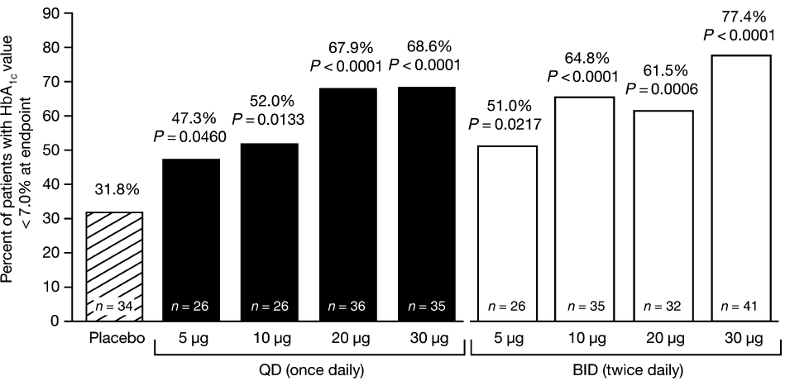
Overview of Lixisenatide
(Now in Phase III Trial)
Randomized, double-blind, placebo-controlled, parallel-group, 13 week study of 542 patients with T 2 DM inadequately controlled on metformin.
Lixisenatide significantly improved glycaemic control in patients with Type 2 diabetes on metformin.
In GETGOAL-L-Asia, a phase 3, 24 week trial, treatment with lixisenatide led to superior reductions in A1c relative to placebo (-0.77% vs. 0.11%, p<0.001) in an Asian population inadequately controlled on basal insulin therapy with or without a sulfonylurea.
Ratner RE et al. Diabet. Med.2010; 27: 1024–32.
Yutaka Seino,Paper Presented at ADA 2011
Notes:
Aims: To evaluate the dose–response relationship of lixisenatide (AVE0010), a glucagon-like peptide-1 (GLP-1) receptor agonist, in metformin-treated patients with Type 2 diabetes.
Methods: Randomized, double-blind, placebo-controlled, parallel-group, 13 week study of 542 patients with Type 2 diabetes inadequately controlled [glycated haemoglobin (HbA1c) ≥ 7.0 and < 9.0% () ≥ 53 and < 75 mmol⁄mol)] on metformin () ≥ 1000 mg ⁄ day) treated with subcutaneous lixisenatide doses of 5, 10, 20 or 30 μg once daily or twice daily or placebo. The primary end-point was change in HbA1c from baseline to 13 weeks in the intent-to-treat population.
Results: Lixisenatide significantly improved mean HbA1c from a baseline of 7.55% (59.0 mmol⁄ mol); respective mean reductions for 5, 10, 20 and 30 lg doses were 0.47, 0.50, 0.69 and 0.76% (5.1, 5.5, 7.5 and 8.3 mmol⁄ mol), on once daily and 0.65, 0.78, 0.75 and 0.87% (7.1, 8.5, 8.2 and 9.5 mmol⁄ mol) on twice-daily administrations vs. 0.18% (2.0 mmol⁄ mol) with placebo (all P < 0.01 vs. placebo). Target HbA1c < 7.0% (53 mmol⁄ mol) at study end was achieved in 68% of patients receiving 20 and 30 μg once-daily lixisenatide vs. 32% receiving placebo (P < 0.0001). Dose-dependent improvements were observed for fasting, postprandial and average self-monitored seven-point blood glucose levels. Weight changes ranged from -2.0 to -3.9 kg with lixisenatide vs. -1.9 kg with placebo. The most frequent adverse event was mild-to-moderate nausea.
Conclusions: Lixisenatide significantly improved glycaemic control in mildly hyperglycaemic patients with Type 2 diabetes on metformin. Dose–response relationships were seen for once- and twice-daily regimens, with similar efficacy levels, with a 20 μg once-daily dose of lixisenatide demonstrating the best efficacy-to-tolerability ratio. This new, oncedaily receptor agonist shows promise in the management of Type 2 diabetes to be defined further by ongoing long-term studies.

Slide 48
Current Status of Incretin Based Therapy

Slide 49
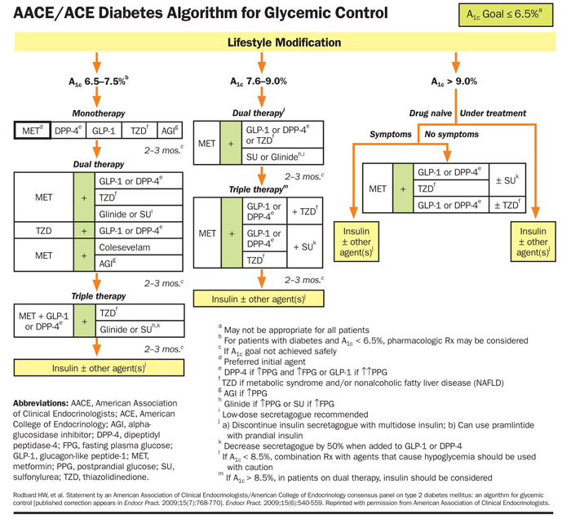

Slide 50
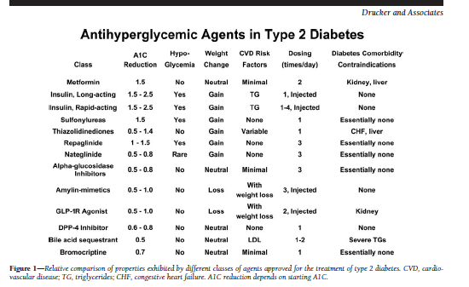

Slide 51
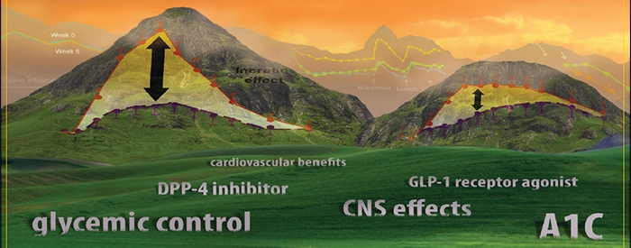
Incretins therapy beyond glycemia
I

Slide 52
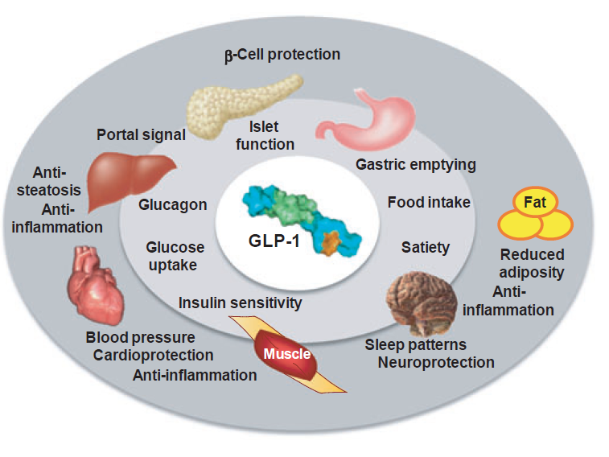

Slide 53
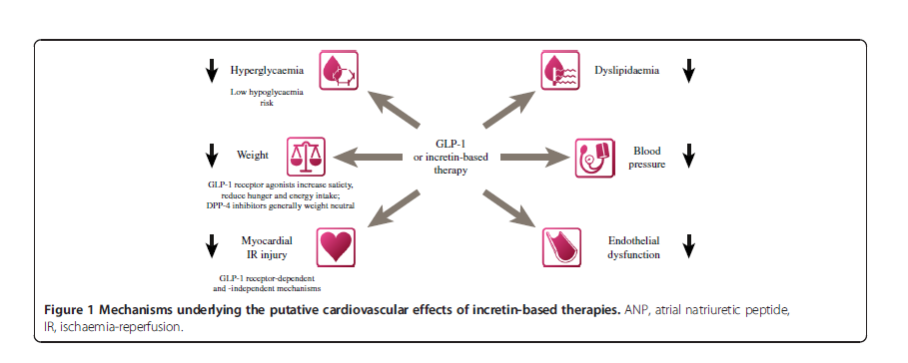
CV Protection

Slide 54
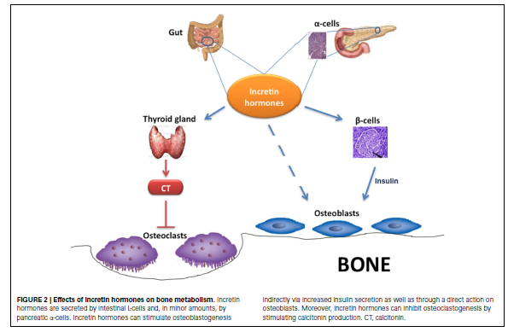
Osteoporosis

Slide 55
Key Points To Remember
The GLP-1 receptor agonists and DPP-4 inhibitors achieve clinically meaningful reductions in HbA1c & improvements in β-cell functions with a low risk of hypoglycaemia.
GLP-1 analogues have been associated with weight loss as an additional clinical benefit.
The results achieved with long-acting GLP-1 receptor agonists appear to be superior to those achieved with short-acting GLP-1 receptor agonists.
Meal-independent dosing (with exception of exenatide) & simple administration & dosage adjustment also make the incretin based therapies an attractive options for treatment of type 2 diabetes.
Incretin therapy beyond glycemia : Cardiovascular protection needs further research & long term safety data needed
`

Slide 56

Today’s physiology is Tomorrow’s medicine
Starling

Slide 57

Questions?
Notes:
Slide Purpose: To ask audience for questions.

Slide 58



