Slide 1

Temperature and precipitation climatology assessment over South Asia using the Regional Climate Model (RegCM4.3): An evaluation of model performance
Mujtaba Hassan
PhD Scholar
Tsinghua University Beijing, P.R. China
3rd International Conference on
Earth Science & Climate Change
July 28-30, 2014 San Francisco, California, USA

Slide 2
Outline
• Introduction
• Materials and methods
Regional Climate model (RegCM4.3)
Experimental design
• Results
• Conclusions

Slide 3
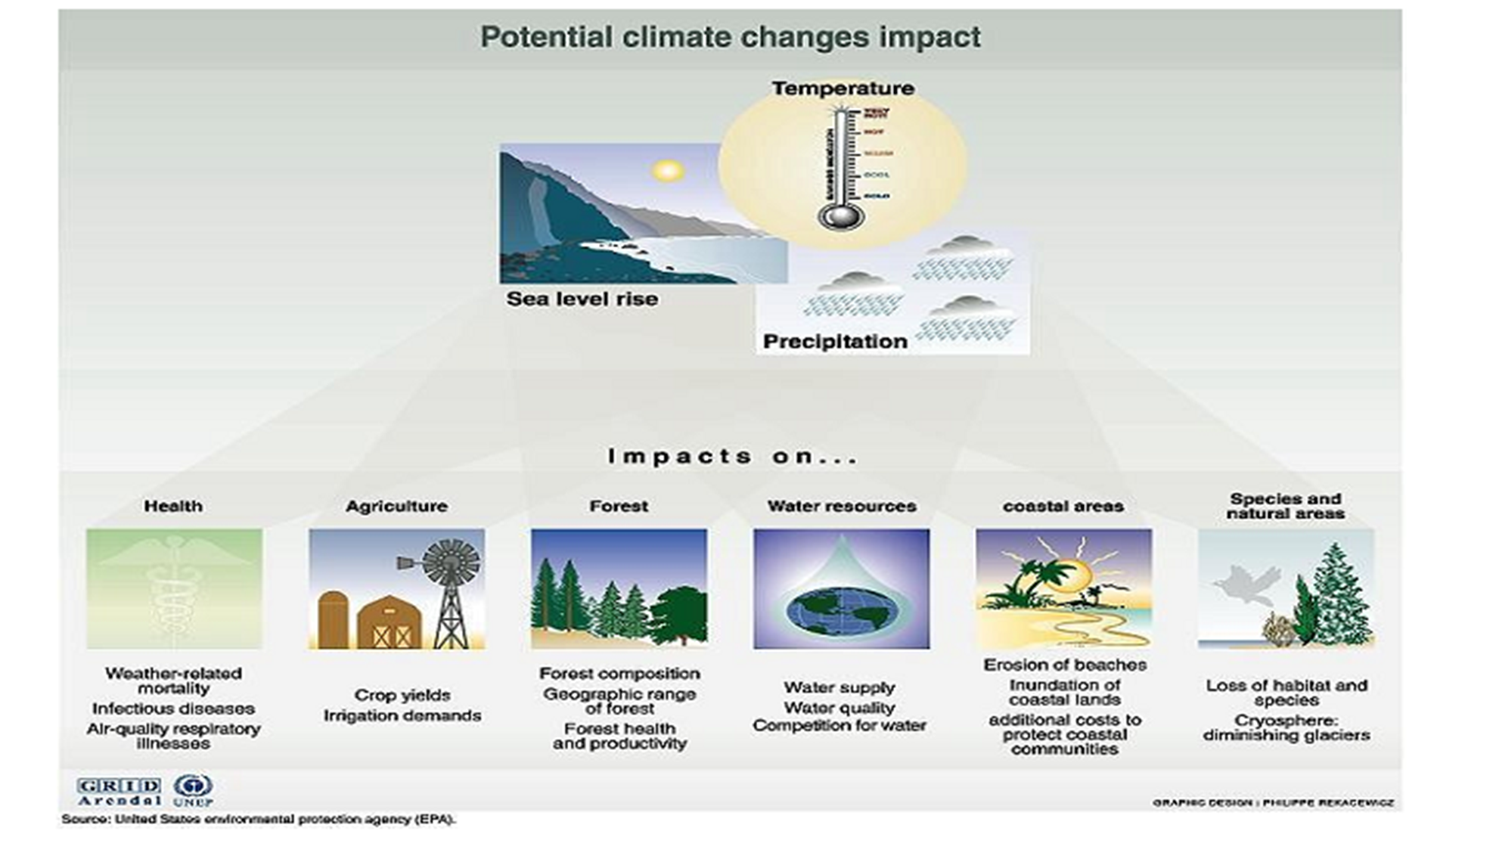
Today Climate is much more complex issue than as it was before the industrial revolution

Slide 4
In order to understand the nature, extent and magnitude of these climate changes usually we used General Circulation Models(GCM)
Global Circulation Model (GCM) do not resolve the topography, land use and clouds features at regional scales because of their coarse resolution
Using Downscaling techniques, high resolution information can be obtained on climate change from comparatively coarse resolution Global Climate Models (GCM)
SO WE NEED DOWNSCALING…………………………

Slide 5
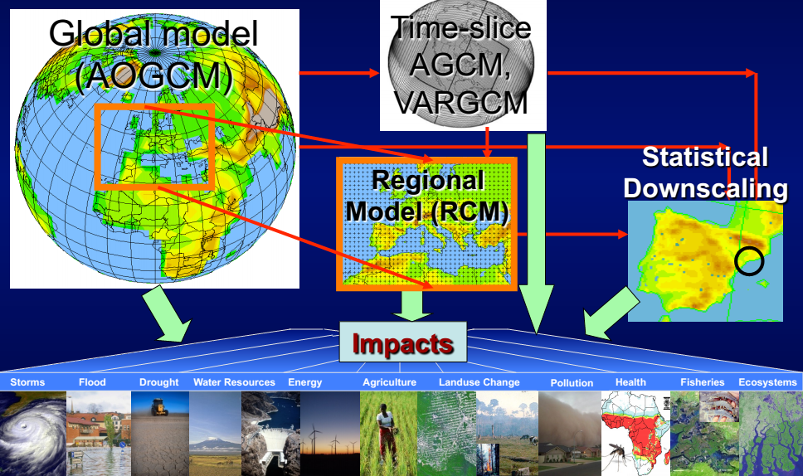
Downscaling regional climate information for impact assessment studies
Dynamical:
It is needed to bridge scaling gap between the climate models and various impact assessment models because the impact assessments are performed at local level
Statistical:
This methods use empirical relationships between GCM outputs and local climate statistics
If statistical relationship changes in the future, this method will not provide the actual real world
Regression analysis, neural network, stochastic weather generator

Slide 6
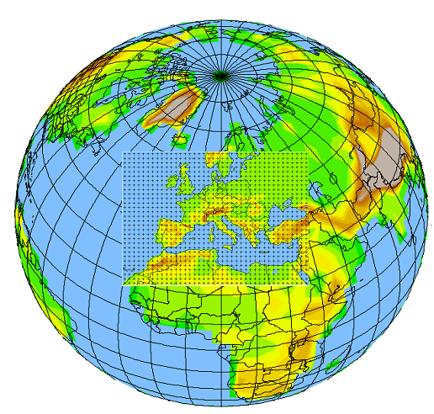
Regional Climate Models
Regional climate models (RCMs) are used to study the regional climate processes, regional climate change impacts and seasonal climate variability
RCM Technique is same like numerical weather prediction (NWP) models, except that it run for a longer time
A RCM is Nested within a GCM in order to locally increase the model resolution
Nested RCMs need Initial and lateral boundary conditions (IC & LBC) from GCMs or reanalysis of observations

Slide 7
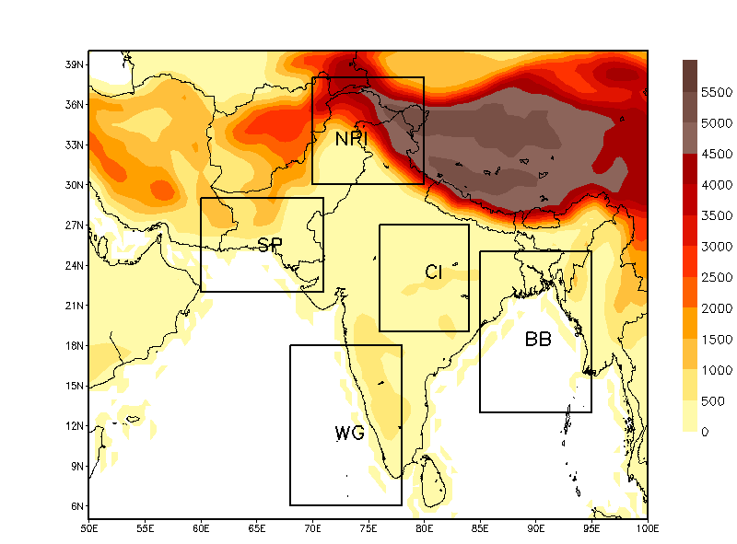
South Asia has diverse climate and characterize by complex topographical features and marked extensive mountain ranges of HKH
Precipitation and temperature regimes of the region are complex due to different weather systems that prevail during the whole year and pose a great challenge to the regional climate models in reproducing the observed climatology

Slide 8
ICTP Regional Climate Model RegCM4.3
International Center for Theoretical Physics (ICTP) regional climate model (RegCM)
• RegCM1 (1989)
– Dickinson et al. (1989), Giorgi and Bates (1989)
• RegCM2 (1993)
– Giorgi et al. (1993a,b)
• RegCM2.5 (1999)
– Giorgi and Mearns (1999)
• RegCM3 (2007)
– Pal et al. (2007)
• RegCM4 (2012)
– Giorgi et al. (2012)

Slide 9
ICTP Regional Climate Model RegCM4.3
The dynamical structure of RegCM includes the hydrostatic version of the mesoscale model, Version 5 (MM5), of the National Center for Atmospheric Research (NCAR) and Pennsylvania State University (Giorge et al. 1993)
RegCM includes the BATS (Dickinson et al. 1993) as well as the community land model (CLM), Version 3.5 (Tawfik and Steiner 2011), as an option in its dynamical core for land surface processes
For radiative transfer, RegCM uses the radiation package of NCAR’s global community climate model, Version CCM3 (kiehl et al. 1996)
Resolved scale precipitation scheme based on SUBEX parameterization of Pal et al. (2000)
The cloud radiation part contains 3 parameters, including cloud fractional cover, cloud liquid water content and cloud effective droplet radius
RegCM uses the planetary boundary layer (PBL) scheme based on a diffusion/relaxation concept (Holtslag et al. 1990)

Slide 10
Convective precipitation (RegCM4.3)
The Kuo scheme (Athens et al. 1987)
The Grell scheme (with two cumulus closure) (Grell et at. 1993)
1. Arakawa & Schubert
2.Fritsch & Chappell
The MIT-Emanuel scheme (Emanuel and Zivkovic Rothman 1999)
Grell over land and Emanuel over ocean
Emanuel over land and Grell over ocean

Slide 11
Experimental Design
Two experiments are conducted for present day simulation (1971-2000)
Initial and lateral boundary conditions
1. European Center for Medium Range Weather Forecast (ECMWF) 40 years reanalysis (ERA40) data with a grid spacing of 2.5º×2.5⁰ (RegCM4.3-ERA40)
2. European Community Hamburg atmospheric general circulation model ECHAM5
(RegCM4.3-ECHAM5)
Sea surface temperature data is prescribed from Global Ice Coverage and Sea Surface Temperature (GISST) with a 1x1 degree resolution.
The model topography and land use data are obtained from Global Land Cover Characterization (GLCC) at 10 min resolution.
The horizontal resolution of RegCM4.3 in these experiments is considered as 50km
The total number of vertical levels are defined as 18 sigma level wit 5hPa at the top of the model

Slide 12

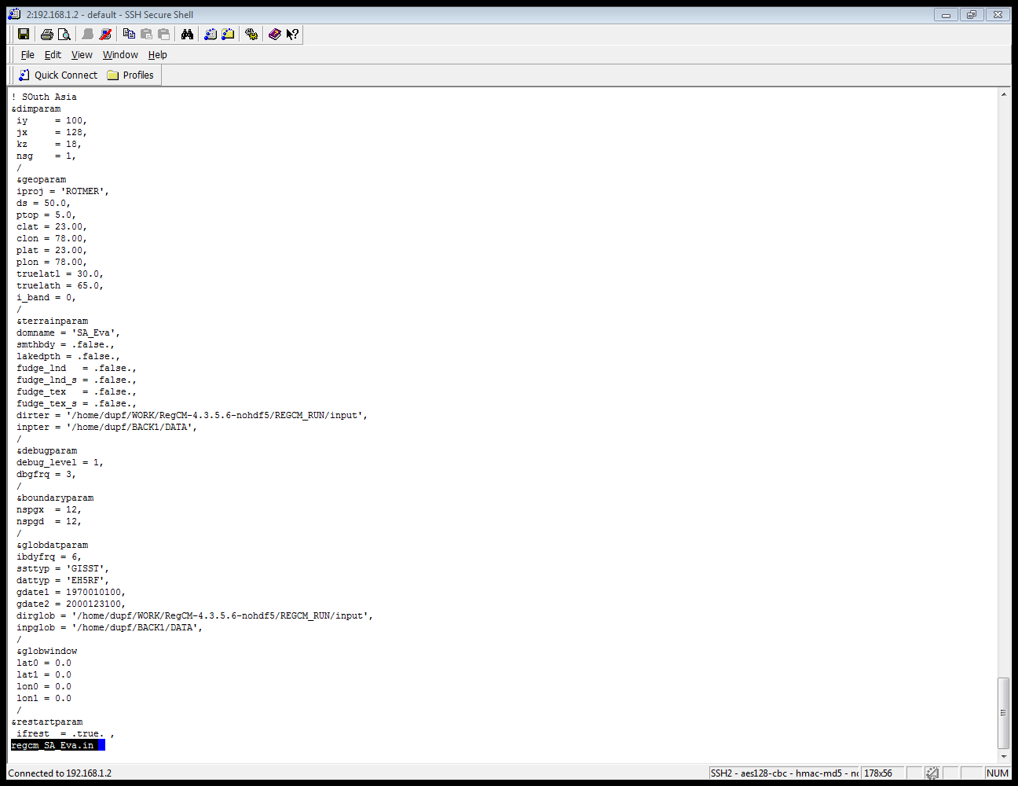
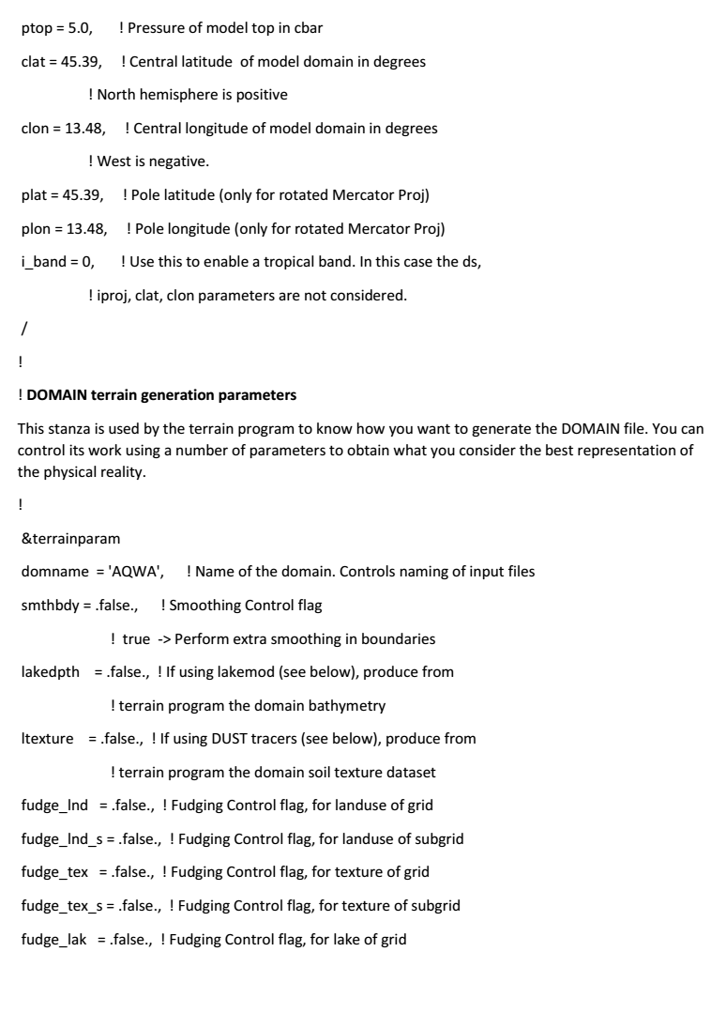
Horizontal resolution
Boundary condition interval (hours)
Type of Sea Surface Temperature
Type of global analysis datasets used

Slide 13
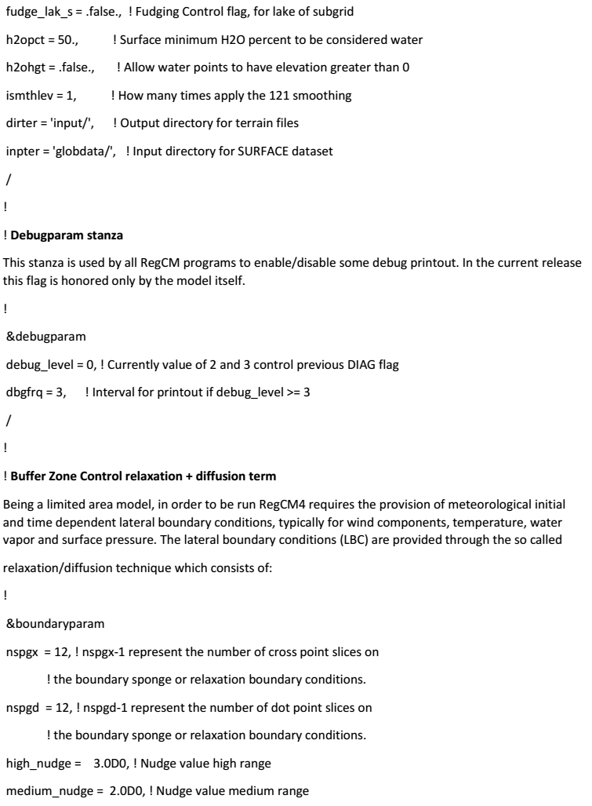
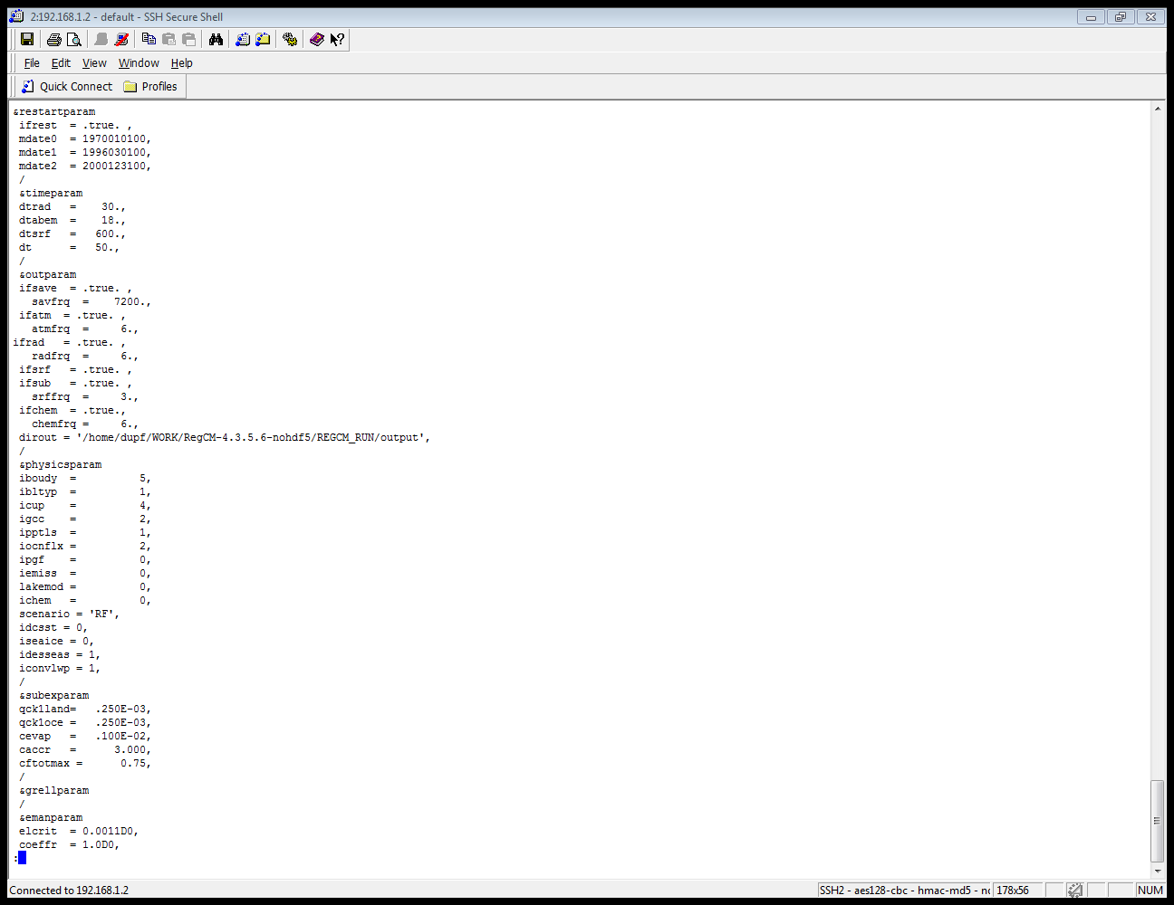
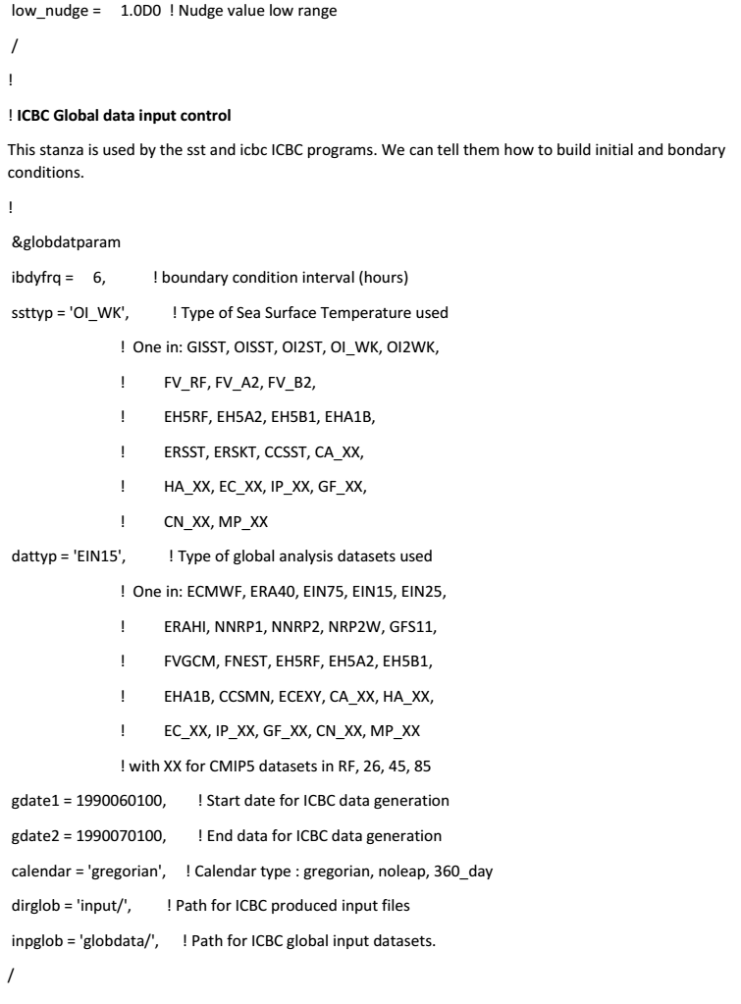
Lateral Boundary conditions scheme (Relaxation Exponential technique)
Boundary layer scheme Holtslag PBL
Cumulus convection (MIT)
IPCC Scenarios

Slide 14
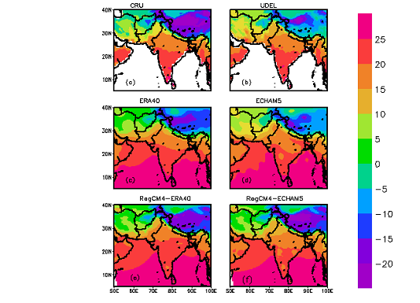
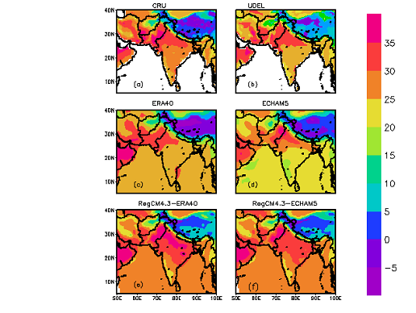
Results
Seasonal mean climatology (Temperature)
OBS
ERA40
ECHAM5
RegCM4.3
Averaged (1971-2000) two meter air temperature (º C) in DJF (left) and JJA (right)

Slide 15
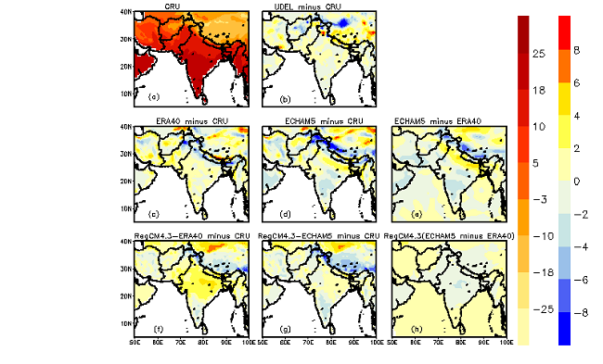
OBS
ERA40-OBS
ECHAM5-OBS
RegCM4.3-OBS
Spatial distribution of temperature bias (^{O}C) for DJF

Slide 16
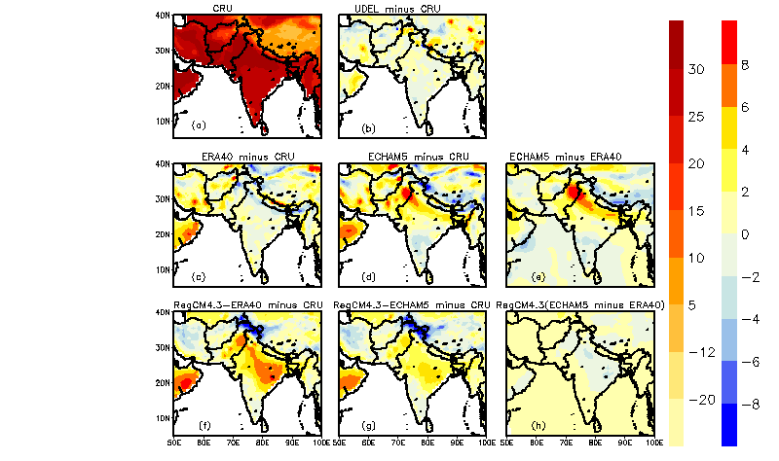
OBS
ERA40-OBS
ECHAM5-OBS
RegCM4.3-OBS
Spatial distribution of temperature bias (^{O}C) for JJA

Slide 17
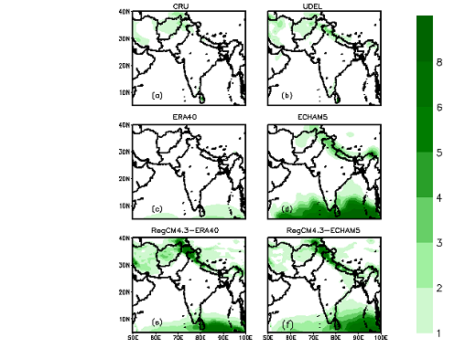
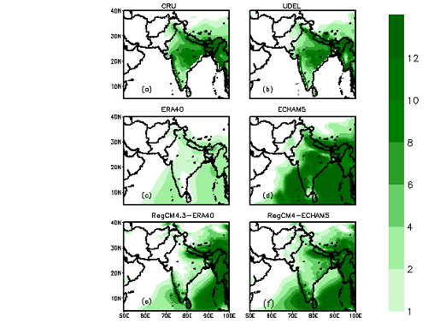
Seasonal mean climatology (Precipitation)
OBS
ERA40
ECHAM5
RegCM4.3
DJF (left) and JJA (right) average (1971-2000) precipitation (in mm/day)

Slide 18
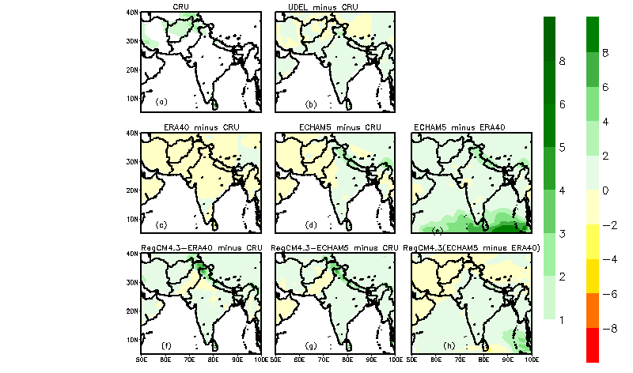
OBS
ERA40-OBS
ECHAM5-OBS
RegCM4.3-OBS
Biases in mean (1971-2000) precipitation (mm/day) for DJF

Slide 19
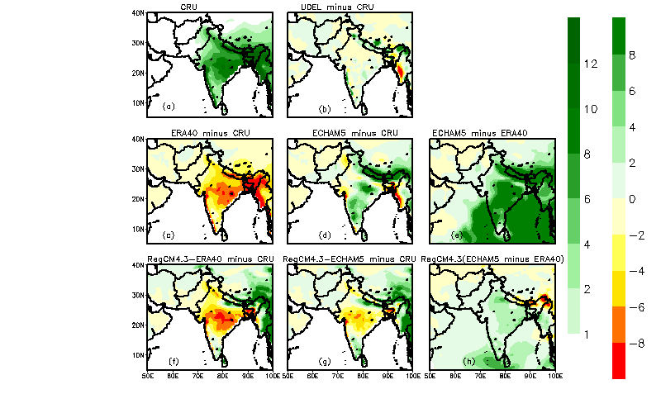
OBS
ERA40-OBS
ECHAM5-OBS
RegCM4.3-OBS
Biases in mean (1971-2000) precipitation (mm/day) for JJA

Slide 20
Annual cycle of monthly area averaged temperature (º C) over 3-sub regions from 1971-2000

Slide 21
Annual cycle of monthly area averaged precipitation (mm/day) over 3-sub from 1971-2000

Slide 22
Conclusion
Evaluation of RegCM4.3 with two experiment (1971-2000)
Main features of Precipitation and Temperature are reproduced well
High precipitation intensity with wet bias in winter over the foothills of HKH
Main characteristics of the summer monsoon precipitation are also captured well
Biases inherited from GCM/Reanalysis, complexities of the domain and internal dynamic of RegCM
Annual cycle of temperature and precipitation analyzed and compare over NPI, WG and BB
Dynamic downscaling improved the output of reanalysis and global GCM in many part of South Asian domain
Further investigation is required to take account the large differences between the driving field and RCM by using other available parameterization and land surface schemes schemes

Slide 23
Thank you !
Comment & Suggestions

