Slide 1



PARTITIONING AND PURIFICATION OF CARBOXYMETHYL CELLULASE IN AQUEOUS BIPHASIC SYSTEM EXTRACTION
MUINAT OLANIKE KAZEEM, UMI KALSOM MD SHAH, AZHARI SAMSU BAHARUDDIN AND NOR’ AINI ABDULRAHMAN
DEPARTMENT OF BIOPROCESS TECHNOLOGY
UNIVERSITI PUTRA MALAYSIA

Slide 2
OUTLINE
Introduction
Overview
Problem statement
Objective
Methodology
Results and Discussion
Conclusion
References
Acknowledgement

Slide 3
Overview
Cellulases enzymes are proteins belonging to the family of glycosyl hydrolases and found wide application in food, textile, animal feed, pulp and paper and biofuel industries.
Commercial cellulase are majorly produced from fungi, however bacterial cellulase in presently gaining recent attention.
Purification of cellulase is required to gain complete understanding of its properties.
The application of conventional protein purification techniques have been useful in the downstream processing of cellulase.

Slide 4
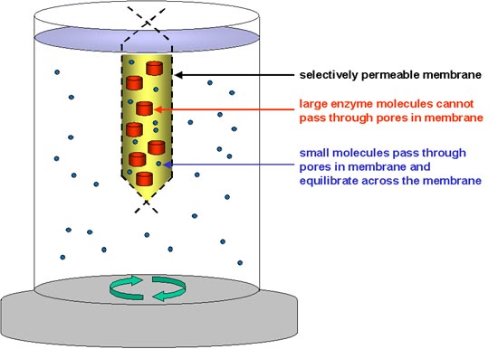
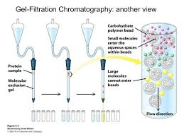
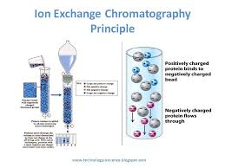
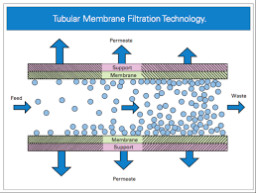
Overview
Ammonium sulphate purification
Ion exchange chromatography
Membrane filtration
Gel filtration

Slide 5
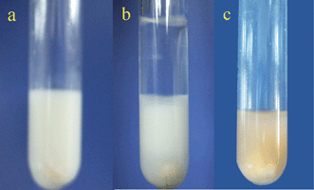
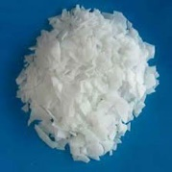
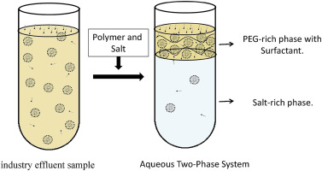
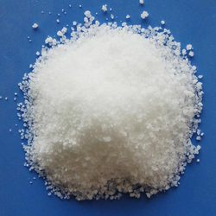
Overview
Aqueous biphasic system is a liquid-liquid fractionation technique that enables selective partitioning by extraction, separation and purification of biomaterials such as proteins, membranes, viruses and enzymes from complex mixtures.
This system is formed by mixing the solutions of two mutually incompatible polymers or polymer/ salt above critical concentrations (Polyethylene glycol).
The basis of separation is the uneven distribution of biomaterials between two phases, both having high water content.
PEG
SALT

Slide 6
Overview
This high water content combined with the low interfacial tension of the system allows non-destructive partitioning of sensitive biomaterials and is often refered as biocompatibility and can also be used in preservation of the enzyme
Partitioning is governed by numerous factors such as molecular weight PEG (hydrophobicity) pH, crude load, temperature, salt concentration.
This can be manipulated to achieve desired separation and purification results, which makes ATPS very flexible for the application.

Slide 7
Comparison between conventional purification and Aqueous biphasic system
Conventional purification | Aqueous biphasic system
Laborious | Simple
Special equipment | 10 ml falcon tube
Sephadex/salt | Polyethylene glycol/salt
Difficult scale up | Easy scalability
Require multiple steps | Can be done in single step
Enzyme loss | Biocompatible
Longer processing time Expensive | Shorter processing time Cheap

Slide 8
Problem Statement
Conventional purification are cumbersome and expensive

Slide 9
OBJECTIVE
To optimize aqueous biphasic system parameters for extraction and purification of carboxymethylcellulase

Slide 10
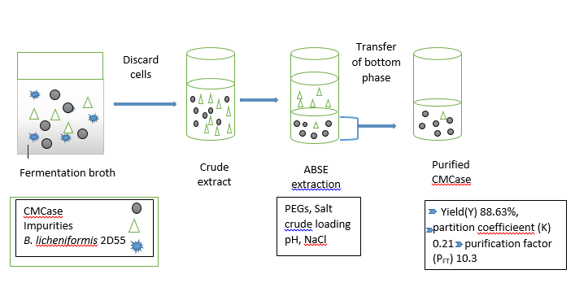
Methodology

Slide 11
Methodology
ABS-carboxymethyl cellulase
Salt selection
Effect of crude
Effect of pH
PEG selection
Effect of NaCl

Slide 12
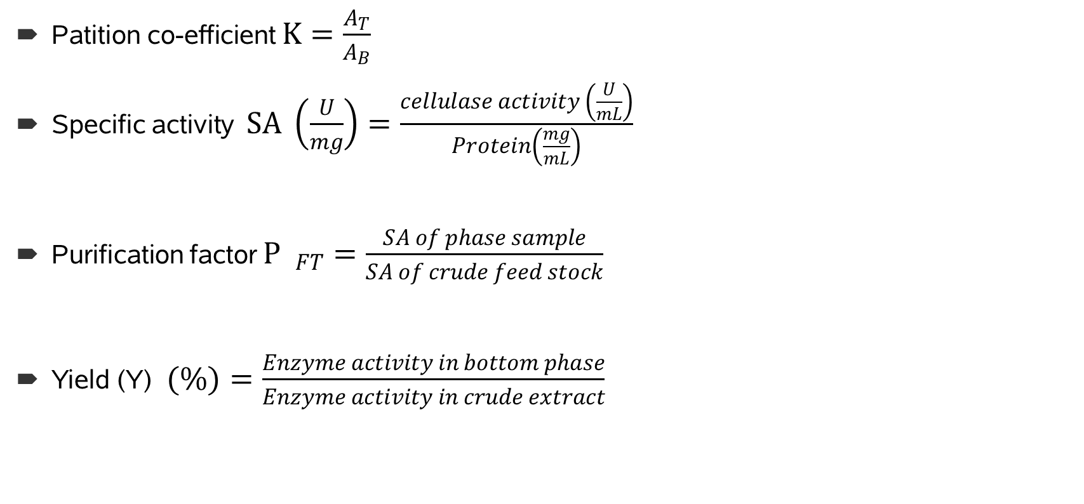
Analysis
Patition co-efficient $K=\frac{A_{T}}{A_{B}}$
Specific activity $SA \left(\frac{U}{mg}\right)=\frac{cellulase activity \left(\frac{U}{mL}\right)}{Protein\left(\frac{mg}{mL}\right)}$
Purification factor $P _{FT}=\frac{SA of phase sample}{SA of crude feed stock}$
Yield (Y) $(\%)=\frac{Enzyme activity in bottom phase}{Enzyme activity in crude extract}$

Slide 13
RESULTS AND DISCUSSION
Table 1: Selection of various bottom phase (salt) for CMCase stability
Type of bottom phase | Concentration (%, w/w) | Cellulase activity (U/mL)
Phosphate | 5 | 26.55 ± 0.62
 | 10 | 25.38 ± 0.56
 | 20 | 22.93 ± 0.21
Magnesium sulphate | 5 | 21.53 ± 0.09
 | 10 | 19.15 ± 0.31
 | 20 | 15.45± 0.18
Ammonium sulphate | 5 | 26.41 ± 0.43
 | 10 | 25.06 ± 0.46
 | 20 | 21.51 ± 0.28
Sodium citrate | 5 | 28.59 ± 0.21
 | 10 | 26.28 ± 0.43
 | 20 | 21.49 ± 0.53
Sodium acetate | 5 | 25.55 ± 0.51
 | 10 | 23.98 ± 0.31
 | 20 | 20.71 ± 0.21

Slide 14
Table 2: Influence of PEG molecular weight on the partitioning behaviour of carboxymethyl cellulasee
PEG MW (g/mol)/ | PEG/Citrate composition (%,w/w) | Partition coefficient (K) | Purification factor (P_{FT}) | Yield (%)
4000 | 20.5/15 | 0.63 | 1.63 | 47.11
6000 | 20.5/15 | 0.52 | 3.32 | 58.89
8000 | 20.5/15 | 0.32 | 6.18 | 68.72
10,000 | 20.5/15 | 0.58 | 1.96 | 50.34

Slide 15
Result and Discussion
Figure 1: Influence of crude load on the partionning behaviour of cellulase

Slide 16
Results and Discussion
In this case, as the pH of ABSE was increased above the pI of cellulase, the cellulase becomes negatively charged which then was attracted to the positively charged PEG to phase there by reducing the yield of cellulase (Ratanapongleka, 2010)
Figure 2: Influence of pH on partitioning behaviour of cellulase

Slide 17
Results and Discussion
Addition of NaCl could cause the disruption of water structure due to greater electrical potential between the PEG and salt phase, thus enhancing the interaction of cellulase with the phase component (Settu et al., 2015).
Figure 3: Inflence of NaCl on the partitioning behaviour of cellulase

Slide 18
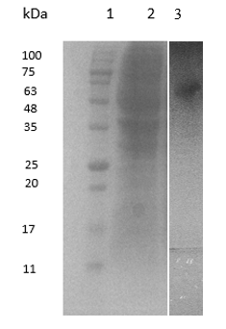
Result and Discussion
Figure 4: SDS-PAGE analysis of cellulase recovery in PEG8000/citrate ABS

Slide 19
CONCLUSION
Aqueous biphsic system parameters at 14 % (w/w) crude load , 1 % NaCl, pH 7.0 produced optimum recovery of CMCase at a yield (Y) of 86.62 %, a partition coefficient (K) of 0.21 and purification factor (P_{FT}) of 10.3 from the bottom phase of PEG 8000/sodium citrate
The results from this study has demonstrated that aqueous biphasis system can be potentially be used to purify carboxymethylcellulase from fermentation broth of B. licheniformis 2D55

Slide 20
Acknowledgments
The author acknowledge the organization for women in science for developing countries (OWSD) for providing scholarship for this research and university of Ilorin Nigeria for granting leave of study

Slide 21
REFERENCES
Azadian, F., Badoei-dalfard, A., Namaki-Shoushtari, A. and Hassanshahian, M. (2016). Purification and biochemical properties of a thermostable, haloalkaline cellulase from Bacillus licheniformis AMF-07 and its application for hydrolysis of different cellulosic substrates to bioethanol production. Molecular Biology Research Communications, 133-145.
Ho, S. L., Lan, J. C.-W., Tan, J. S., Yim, H. S.andNg, H. S. (2017). Aqueous biphasic system for the partial purification of Bacillus subtilis carboxymethyl cellulase. Process Biochemistry.
Kazeem, M. O., Shah, U. K. M. Baharuddin, A. S. and AbdulRahman, N. A. (2016). Enhanced Cellulase Production by a Novel Thermophilic Bacillus licheniformis 2D55: Characterization and Application in Lignocellulosic Saccharification. BioResources, 11(2), 5404-5423
Sofijan, H., Shun, T. J., Abbasiliasi, S., Mustafa, S., Puspaningsih, N. T., Kadkhodaei, S., et al. (2017). Recovery and partial purification of thermophilic β-xylosidase derived from recombinant Bacillus megaterium MS941 by aqueous two-phase system. Separation Science and Technology, 52(5), 834-842.
5. Yin, L. J., Lin, H. H. and Xiao, Z.-R. (2010). Purification and characterization of a cellulase from Bacillus subtilis YJ1. Journal of Marine Science and Technology, 18(3), 466-471

Slide 22


