Slide 1
MUHAMMAD ALAM
Supervisory Team: Dr Amal Ali Elkordy & Dr Timothy paget
Department of PHW, University of Sunderland. UK
TITLE: Local mucoadhesive drug delivery approach for furazolidone against Helicobacter pylori
8th International Conference and Exhibition on Pharmaceutics & Novel Drug Delivery Systems

Slide 2
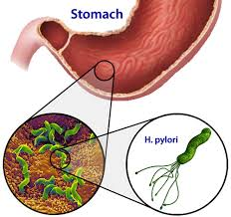
INTROCUTION
Helicobacter pylori is gram-negative bacteria that inhabits in microaerophilic environment.
It is considered as major cause of peptic ulcer as well as chronic gastritis and gastric carcinoma.

Slide 3
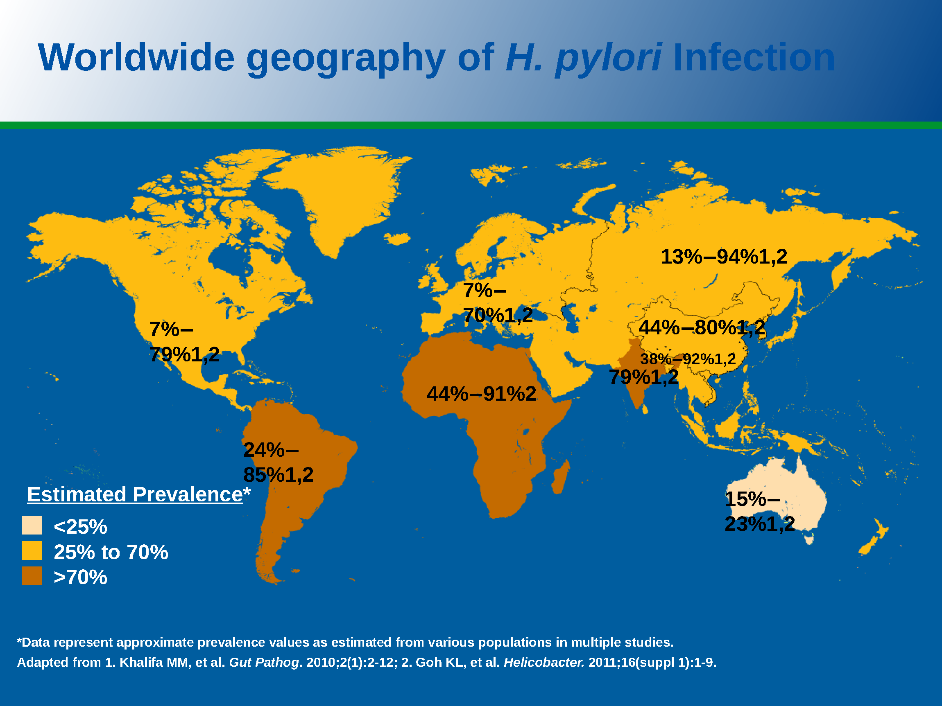

Slide 4
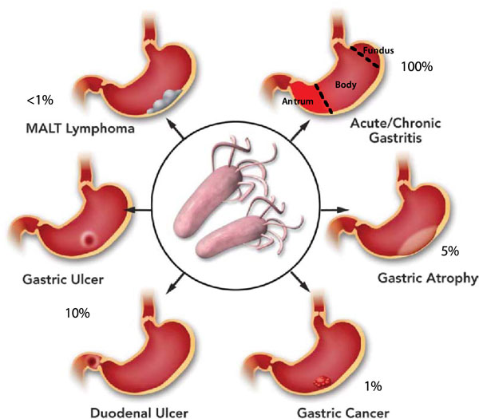
DISEASES

Slide 5
RESISTANCE
Current therapy for eradication of Helicobacter pylori is triple therapeutic regimen involves
2 Antibiotics + 1 proton pump inhibitor
But this presently established therapeutic regimen is not absolutely effective and results in incomplete eradication in most of the cases.
One of the major important issue in treatment of Helicobacter pylori is antibiotic resistance.

Slide 6
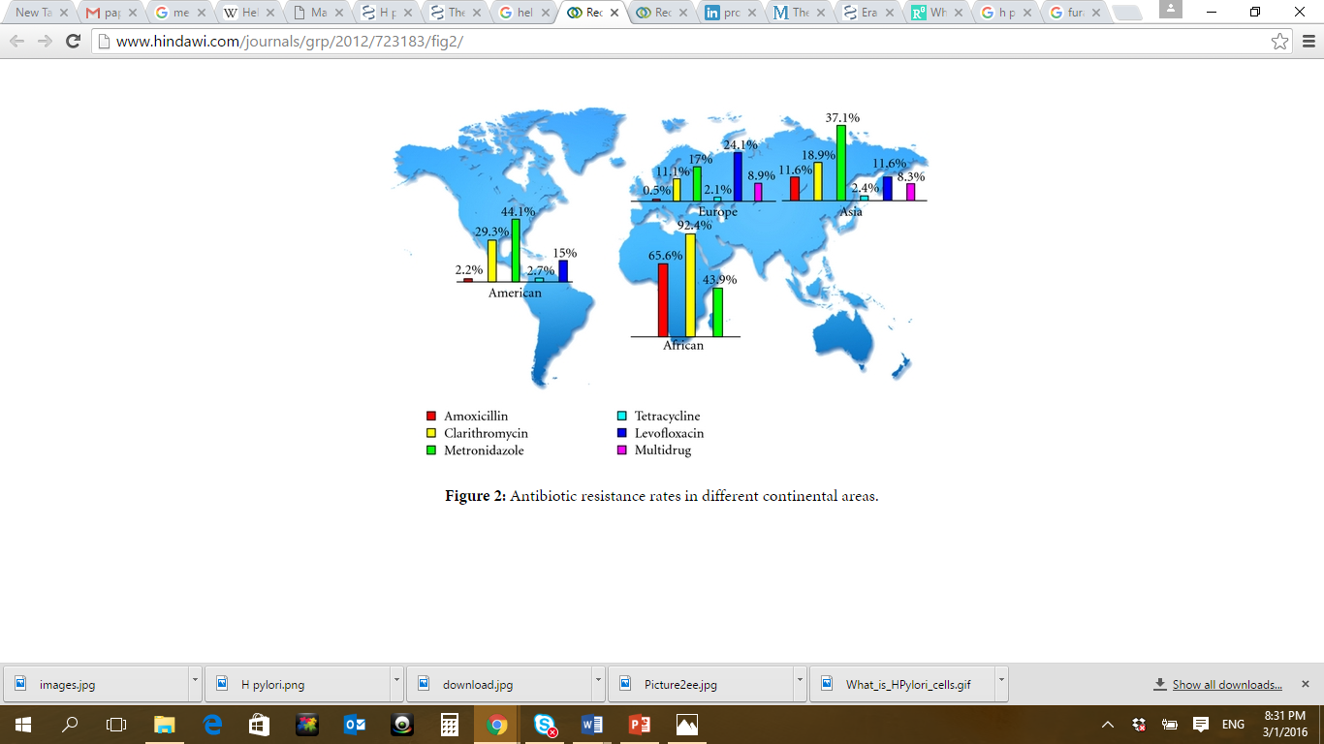
RESISTANCE

Slide 7
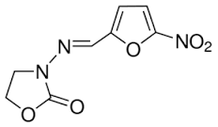
In order to deal with resistance problem different combination of antibiotics in triple therapy are being used
Furazolidone that is monoamine oxidase inhibitor
presents very low resistance for therapeutic
regimen.
But unfortunately the use of
is limited due to potential side effects associated with it because of its high dose of administration
Problem must be addressed in order to unveil the high potential antimicrobial activity of furazolidone against Helicobacter pylori.
FURAZOLIDONE

Slide 8
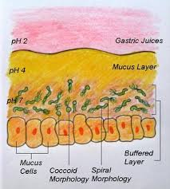
MECHANISM
To avoid the acidic environment of stomach lumen, H. pylori uses its flagella to burrow into the mucus lining of the stomach to reach the epithelial cells underneath, where the pH is more neutral
H. pylori is found in the mucus, on the inner surface of the epithelium, and occasionally inside the epithelial cells themselves.
It adheres to the epithelial cells by producing adhesins, which bind to lipids and carbohydrates in the epithelial cell membrane

Slide 9
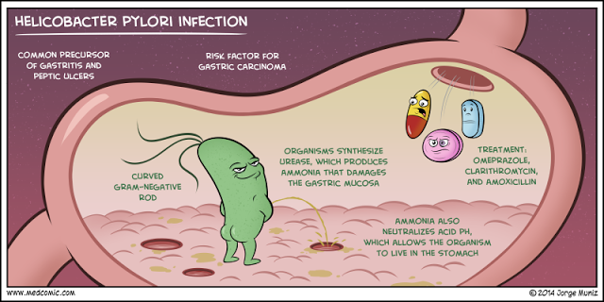
H. pylori also neutralizes the acid in its environment by producing large amounts of urease, which breaks down the urea present in the stomach to carbon dioxide and ammonia.
The ammonia, which is basic, then neutralizes stomach acid is also is toxic to epithelial cells

Slide 10
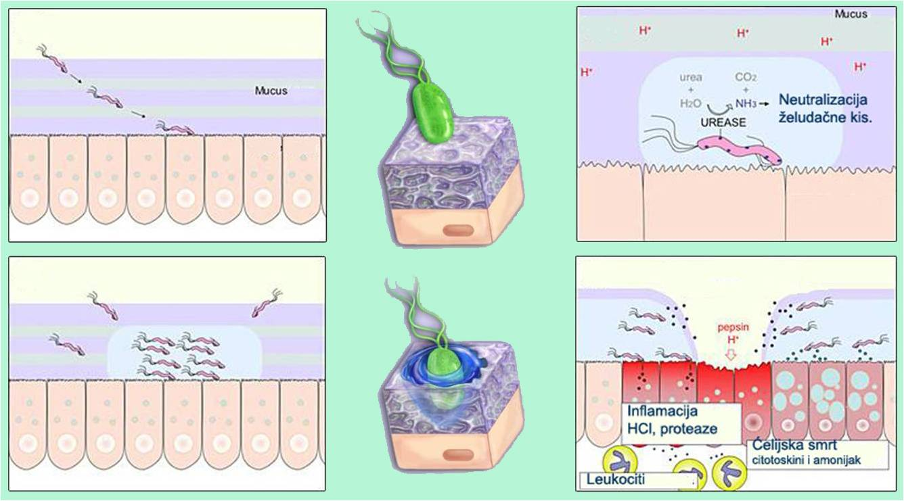

Slide 11
AIMS OF RESEARCH
To optimize furazolidone formulations in order to deliver the minimum amount of drug to the site of inhabitation to reduce the side effect associated with high dose.
To characterize the mucoadhesion of both formulation at two different pH levels .i.e. 1.3 and 4.5
To optimize the retarding effect of glutaraldehyde on mucus adsorption
Why two pH ?
4.5 Post Ppi conditions
1.3 Natural pH inside the lumen

Slide 12
METHODOLOGY
Mucoadhesive liposomal suspension
For liposomal mucoadhesion assay fluorometery was performed by using coumarin-6 and the results were determined by using coumarin calibration curve.
The results were further confirmed by florescence microsco
Mucoadsorption of microparticles
Calorimetric method with Periodic Acid Schiff (PAS) Staining of sigma mucin type I was used for microparticles mucoadhesion analysis.
Details are given in the appendix

Slide 13
KEY RESULTS (MICROPARTICLES FORMULATION)
Effect of Glutaraldehyde
It shows negative effect on adsorption, increase of GTA decrease the mucin adsorption
Hardening effect the adsorption (Kotadiya et al., 2009)

Slide 14
KEY RESULTS (MICROPARTICLES FORMULATION)
Effect of pH
PH shows positive effect on adsorption, decrease in pH decrease the mucin adsorption.
Acidic environment has negative effect on mucin adsorption (P.He et al., 1998)

Slide 15
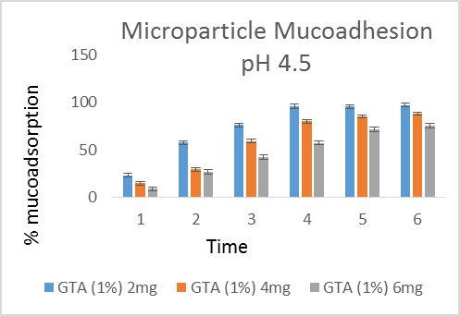

Slide 16
KEY RESULTS (LIPOSOMAL FORMULATION)
Effect of pH on mucoadhesion of liposomes
Positive effect, decrease in pH decrease the mucus adhesion
Amino groups get protonated below pH 4 that causes repulsion between them, subsequently hydrophobic interaction and hydrogen bonding becomes week and makes chitosan soluble (Jayakumar et al., 2010).

Slide 17
KEY RESULTS (LIPOSOMAL FORMULATION)
Effect of pH on mucoadhesion of liposomes

Slide 18
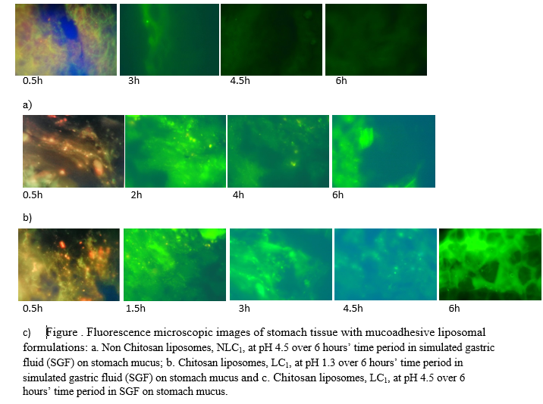
KEY RESULTS (LIPOSOMAL FORMULATION)
Effect of pH on mucoadhesion of liposomes

Slide 19
METHODOLOGY APPENDIX

Slide 20
Mucoadhesion by fluorometry
Freshly excised stomach of sheep was cut into 2x2 cm slices.
The volume of 100 µl of liposomal suspension was spread onto each tissue specimens.
Each tissue specimen was placed in 5ml vial separately containing simulated gastric fluid (SGF).
Vials were put on a shaker incubator (50 rpm) at 37⁰C.
Tissue specimens were taken out at predetermined time intervals (0, 1, 1.5, 3, 4.5, 6 hours) and rinsed with 10ml of phosphate buffer saline (PBS) to remove unadsorbed liposomes.
Mucus was removed carefully and put in 5ml of 5M NaOH solution for 12 hours to dissolve mucus or any traces of tissue completely.
Isopropyl alcohol (IPA) and acetic acid was added to samples to disrupt the lipid membrane and dissolve chitosan followed by centrifugation at 6000rpm for 10 min to extract coumarin-6 from liposomes.
Supernatant was removed and intensity was measured by fluorimeter and percentage of dye recovered from stomach tissue was determined by using calibration curve of coumarine-6.
Non mucoadhesive liposomal suspension (NLC₁, Table 2) was used as a control for comparison and results of both formulations were compared.

Slide 21
Fluorescence Microscopy:
Freshly excised sheep stomach was cut into 0.5 x 0.5 cm slices.
Each slice was coated with 0.5 ml of mucoadhesive liposomal suspension contained coumarin-6 as florescence dye.
Slices were incubated in 5ml SGF at required pH i.e. 1.3 and 4.5.
Vials were put on a shaker incubator (50 rpm) at 37⁰C.
Tissue specimens were taken out at different time intervals over 6 hours.
Then, tissue specimens were immediately snap freeze by using liquid nitrogen and OCT into a block.
Each specimen was cut in 10µm slices by using cryostat (LEICA, Germany) and observed under fluorescence microscope.
The specimens were observed under microscope for the number of liposomal particles attached to the stomach slice after removing from SGF and quantified by comparing at specified time intervals.

Slide 22
MUCUS ADSORPTION OF MICROPARTICLES
Mucin concentration of 1mg/ 2ml was prepared and 2 ml of micro-particle suspension was.
Supernatant was analyzed for free mucin concertation at predetermined time intervals (1.5, 3, 4.5 and 6 hours)
The concentration of free mucin was determined by using standard calibration curve of mucin (Type-I from sigma Aldrich).
Standard solution for calibration curves (0.1, 0.25, 0.5, 0.75 and 1 mg/2) were made and absorbance was measured by UV/visible spectrophotometer at 555nm.
Free mucin was determined by calorimetric methods stated in the link below
http://www.ncbi.nlm.nih.gov/pmc/articles/PMC3304382/

Slide 23
THANKS

