Slide 1

UPGRADING OF BIO-GAS INTO BIO-METHANE BY REGENERATIVE ACTIVATED CARBON SYSTEM
Muhammad Farooq*, John M. Andresen**
* PhD Research Scholar, Institute of Mechanical, Process & Energy Engineering, Heriot-Watt University, Edinburgh United Kingdom.
mf181@hw.ac.uk
** Reader, Institute of Mechanical, Process & Energy Engineering, Heriot-Watt University, Edinburgh United Kingdom.
J.Andresen@hw.ac.uk

Slide 2
Outline:
Introduction
Experimental Set-up
Materials & Methods
Results & Discussion
Conclusions
Acknowledgement
References

Slide 3
1. Introduction
An alternative type of a renewable, carbon-neutral fuel.
Main UK barrier for upgrade of biogas into bio-methane
is a low cost solution to inject in natural gas grid.
Current potential to replace up to 50% of the UK’s natural gas need [1].
Typical biogas composition 50-65% CH₄, 30-45% CO₂, 1000 - 10,000 ppm H₂S [2].
Removal of CO₂ and H₂S is required for biogas upgradation.
Feed in Tariffs (FIT) of Renewable Heat Incentive (RHI) [3].
Strong political drive towards increased bio-gas production.

Slide 4
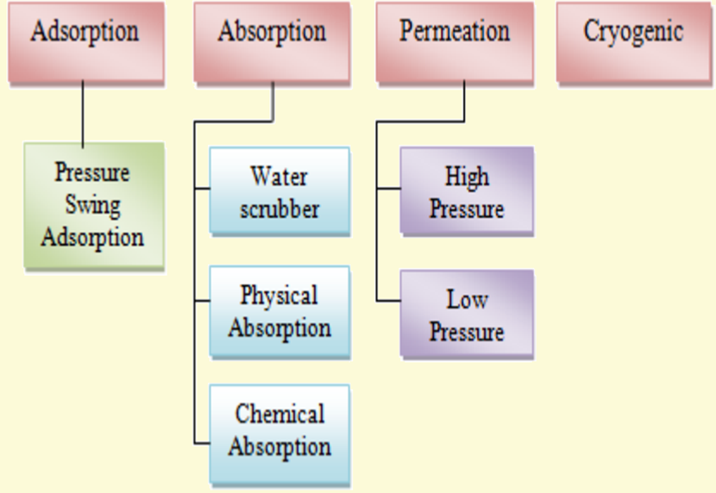
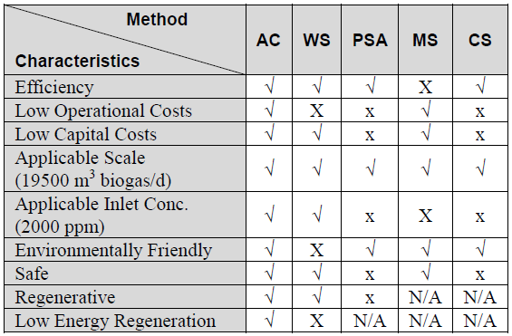
2. Biogas Up-gradation Technologies & Comparison

Slide 5
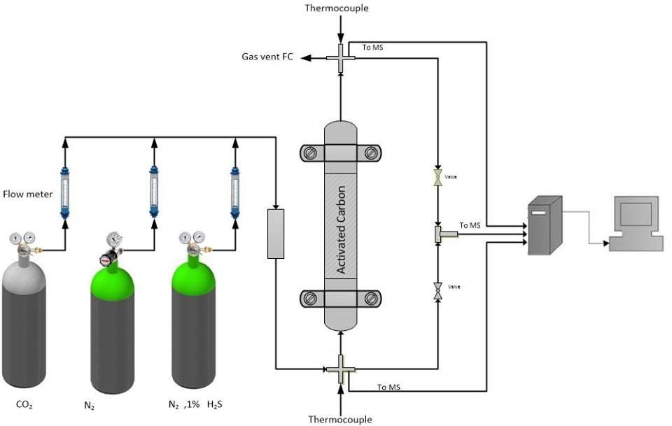
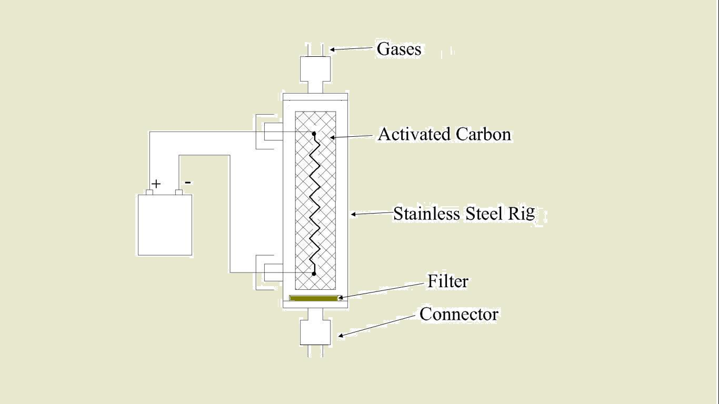
3. Experimental Set-up

Slide 6
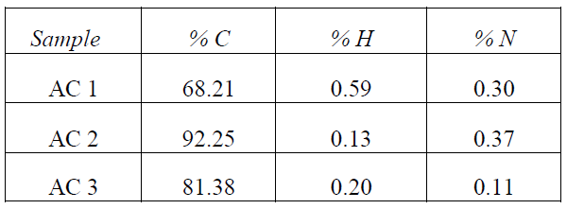
4. Results & Discussion
4.1 Elemental Analysis
CHN analysis : 440 Elemental Analyser
(Control Equipment Cooperation)

Slide 7
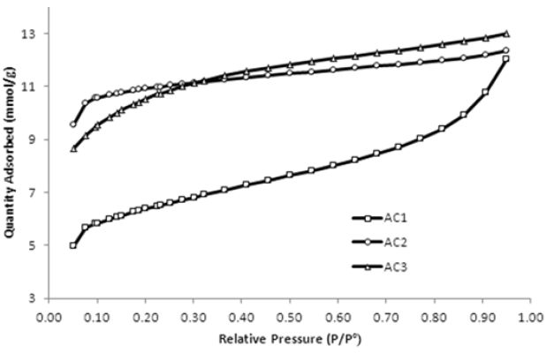
4.2 Surface Area Analysis
BET Surface area calculations : Density Functional Theory (DFT)
(Micrometrics Gemini VII)

Slide 8
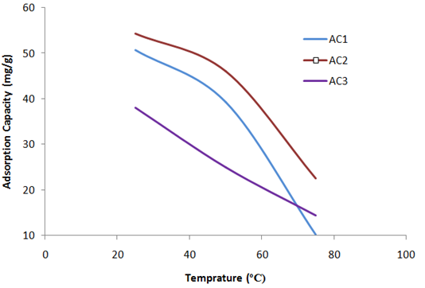
4.3 Adsorption Capacity of Activated Carbons
Adsorption with TGA at different temperatures
Tthermo-Gravimetric Analyser (TGA-Q500)

Slide 9
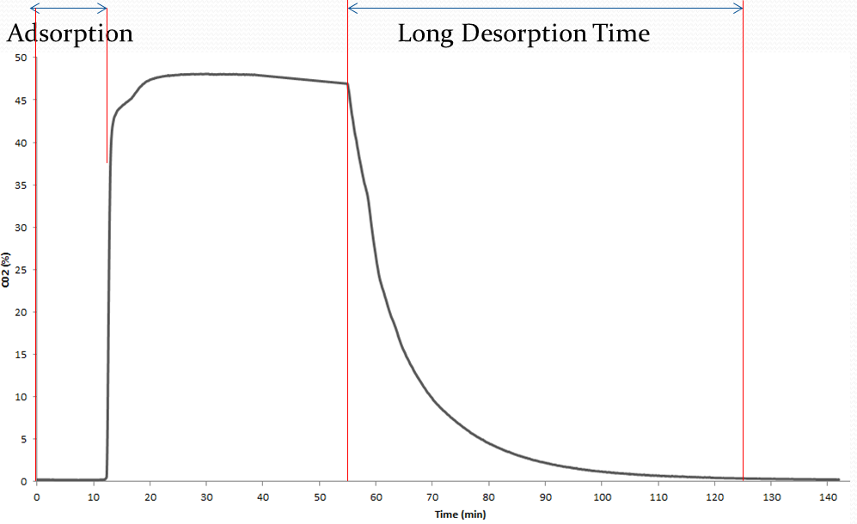
4.4 Breakthrough Capacity of Activated Carbon Adsorption

Slide 10
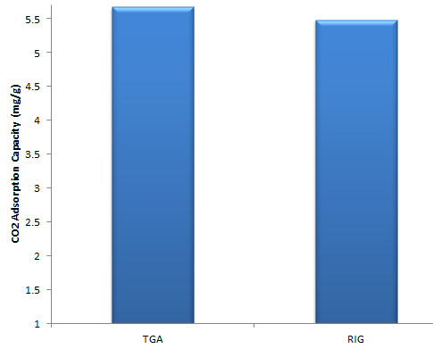
4.5 Comparison of Adsorption Capacity of TGA & Rig

Slide 11
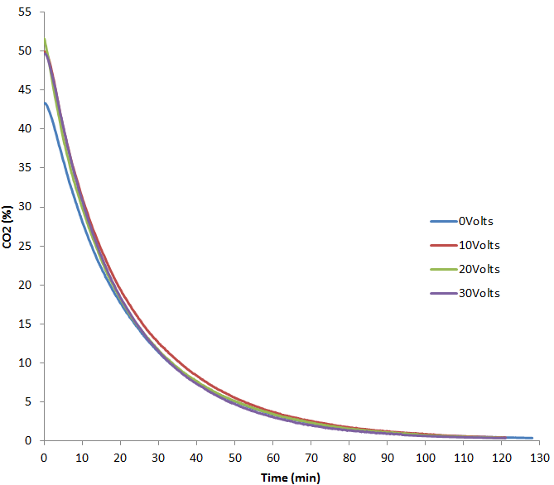
4.6 Desorption of Activated Carbon with Electric Potential

Slide 12
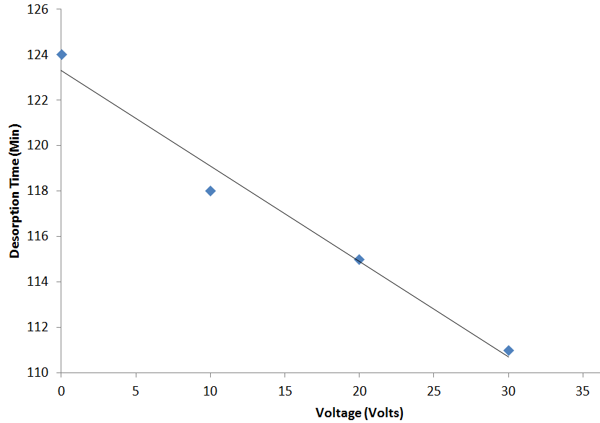
4.6.1 Desorption Time Vs Volts

Slide 13
5. Conclusions
Economically viable bio-methane production from biogas.
Results in lower capital and operating costs and therefore higher overall profits.
Safe, environmentally friendly and results in low methane loss.
Replacement can be up to 20% of the OPEX of a bio-gas to bio-methane plant.
As a guide for the further design and operation of the industrial system.
Next step -Comparison with Dubinin-Astakhov Model

Slide 14
6. Acknowledgement
1st author indebted to the support of University of Engineering & Technology (UET) Lahore, Pakistan, for providing funding for conducting PhD research. I am also Thankful to the Institute of Mechanical Process & Energy Engineering, Heriot-Watt University for providing funding for this conference.

Slide 15
7. References
[1] Roque-Malherbe, R. M. (2007). Adsorption and diffusion
in nonporous materials, CRC press.
[2] Farooq, M., I. Chaudhry, S. Hussain, N. Ramzan and M. Ahmed (2012). “Biogas Up gradation For Power Generation Applications in Pakistan’’ Journal of Quality and Technology Management, VIII (II): 107-118.
[3] DECC (2009). Bio-methane into the Gas Network: A Guide for Producers.
[4] Farooq et al. “Process Viability of Activated Carbon Adsorption for Low Cost Bio-Methane Production using Aspen Process Economic Analyser’’ Proceedings of the ASME 2015 International Mechanical Engineering Congress and Exposition.

Slide 16

Any Questions

