Slide 1


World Congress on Infection Prevention and Control
Salmonella Risk in Poultry Meat
Prof.Dr. Muammer GONCUOGLU
Ankara University, Faculty of Veterinary Medicine, Department of Food Hygiene and Technology

Slide 2
Poultry Meat Safety
In general 3 main points
  Ante-mortem and post-mortem inspection
  Monitoring and surveillance (chemical, microbiologic)
  HACCP, GMP, GHP, GAP etc
Farm to fork
Based on risk analysis
Traceability

Slide 3
Risk Analysis
Risk; probability or threat of danger
The possibility that due to a certain hazard in food there will be an negative effect to a certain magnitude (physical, chemical and microbiological)
Target; poultry meat safety
Protect; public health
Prevent; contamination/exist of hazardous material into food chain
Avoid; economic loss

Slide 4
Why do we need? Necessity?
No guarantee in post-mortem inspection and sampling
May be different contamination steps
Inadequate rules/laws across advanced knowledge
Need of international rules/laws/guide
Common principles in human and animal health approach

Slide 5
Why do we need? Necessity?
Emerging/re-emerging zoonoses
Increase of foodborne illnesses
Rapid changes in food industry
Increase of international transport/trade
Evaluate and power up food control strategy

Slide 6
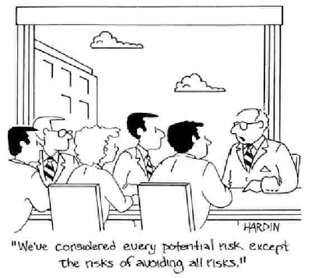
Risk analysis
Risk assessment¹
Risk management²
Risk communication¹⁻²

Slide 7
Risk Analysis (Challenges)
Biological hazards (Salmonella);
  Uncertanities
  Variations
    Dose – response (infectivity, individual sensitivity…)
    Kinetics of Salmonella poultry meat chain (Increase in number, inactivation, stress response…)
    Consumer behaviour

Slide 8
Variables and Uncertanities
Variables (whole chain);
  Dose - response
  Level of consumption – serve degree
  Level of bacteria/contamination ???
  Storage time – degree
  Product and production
  Contamination route and form
  Physiology of bacteria
  History of bacteria
  Genetic differences…….
We can define, determine, specify …. risks limits
Biological risks are heterogenous, variable …

Slide 9
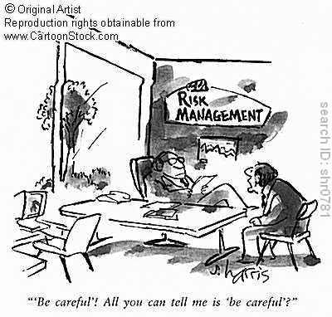
Risk Analysis
Scientific and technological
knowledge
Social and political decisions
Ethic and trade
Decisions;
zero tolerance
minimum risk (if possible)
Main goal; have to classify acceptable from non-acceptable
Food safety goal; protect, influence the frequency and / or concentration of the hazard while food is consuming

Slide 10
Risk Analysis - Production Step
Salmonella
Still one of the most important foodborne bacterial pathogen
Do we still protect public health?
Different risk analysis approach (official monitoring, serotype based, each industry have its’ own, legislation, performance criteria in diff. Laws etc.)
Salmonella can be detected and may be in an increase trend
  Then negative for several weeks
Industry may take regulatory performance standart tests (still many Salmonella + products)

Slide 11
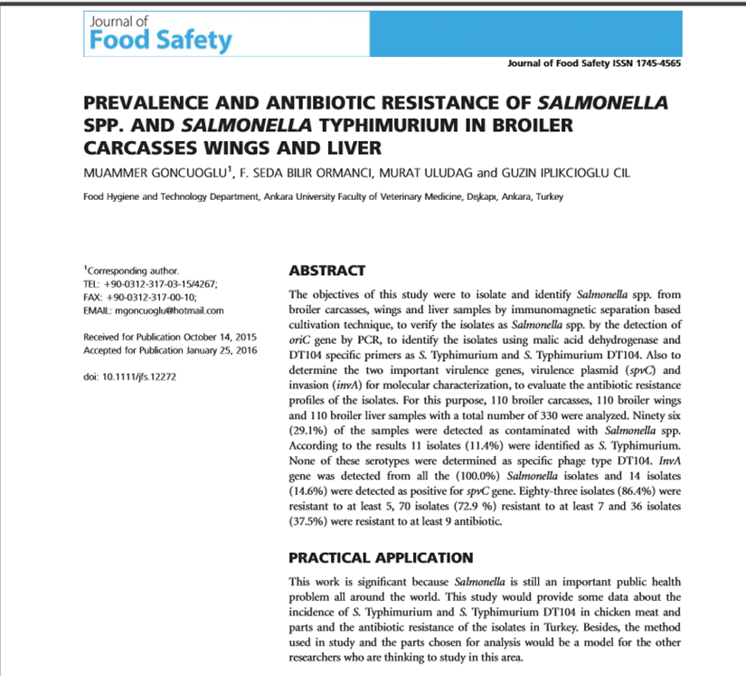
Goncuoglu et al., Journal of Food Safety 36 (2016) 524-531.
All Salmonella isolates were resistant to sulfamethoxazole and susceptible to ceftiofur and imipenem.
Among 96 Salmonella isolates 83 (86.4%) of them were resistant to at least ﬁve,
70 (72.9%) of 96 isolates were resistant to at least seven and
36 (37.5%) of 96 isolate were resistant to at least nine antibiotics

Slide 12
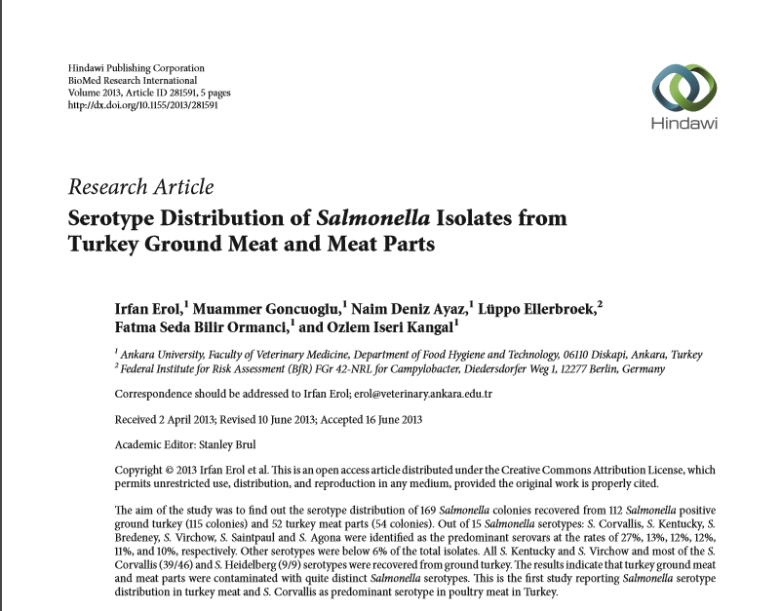
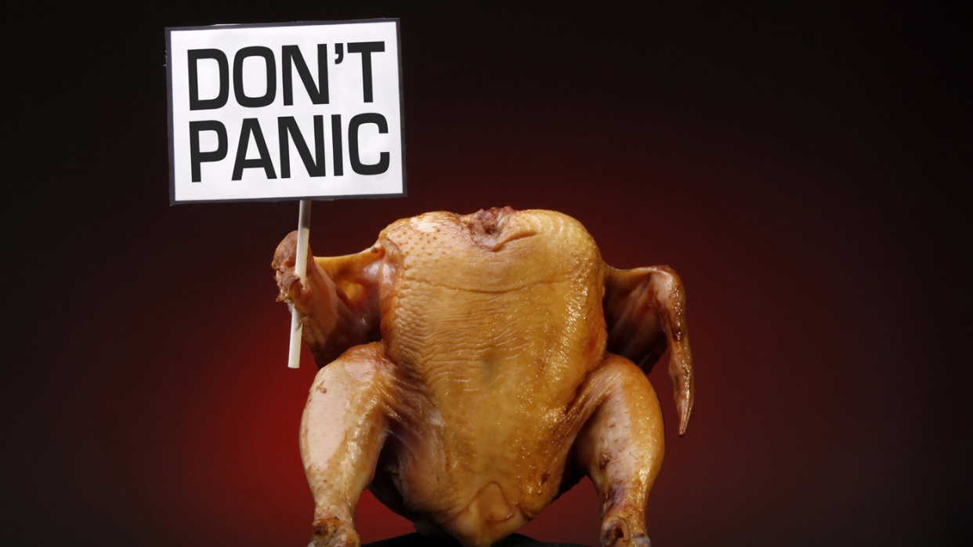
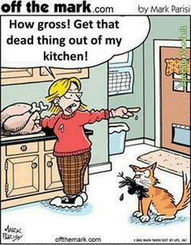
Erol et al. Volume2013,ArticleID281591,5pages http://dx.doi.org/10.1155/2013/281591. BioMed Res. Int.

Slide 13
Serotypes | Percent | Number of isolates |  |  |  | Total
 |  | Ground turkey | Meat cuts | Breasts | Legs
S. Corvallis | 27.2 | 39 | 5 | 1 | 1 | 46
S. Kentucky | 13.0 | 22 | - | - | - | 22
S. Bredeney | 11.8 | 2 | 6 | 2 | 10 | 20
S. Virchow | 11.8 | 20 | - | - | - | 20
S. Saintpaul | 10.7 | 6 | 6 | - | 6 | 18
S. Agona | 10.1 | 9 | 3 | 3 | 2 | 17
S. Heidelberg | 5.3 | 9 | - | - | - | 9
S. Hadar | 3.0 | - | 2 | 2 | 1 | 5
S. Munchen | 1.8 | - | - | 2 | 1 | 3
S. Stanleyville | 1.2 | 2 | - | - | - | 2
S. Montevideo | 1.2 | 2 | - | - | - | 2
S. Subsp. I | 1.2 | 2 | - | - | - | 2
S. Group C | 0.6 | 1 | - | - | - | 1
S. Typhimurium | 0.6 | - | 1 | - | - | 1
S. Newport | 0.6 | 1 | - | - | - | 1
Total | 100 | 115 | 23 | 10 | 21 | 169

Slide 14
Risk Analysis - Production Step
Salmonella
Understand the dynamics of pathogen in birds
  Colonization
  Persistence
  Shedding
Salmonella in systemic tissues may be released and contaminate product
S. Enteritidis, S. Typhimurium, S. Heidelberg, S. Kentucky

Slide 15
Risk Analysis
Salmonella
According to the risk analysis based food hygiene, main goal is to protect «public health»
Salmonella +
  25 g sample 1 Salmonella +
  25 g 10 million Salmonella +
Contamination source - route
Protective measures have to be taken
As production scale is growing hard to maintain zero tolerance

Slide 16
Risk Analizi
Salmonella
2500 > serotype
Different contamination sources (feed, rodent, personel etc.)
Instead of judging positive or not cfu/g/ml???
  Getting knowledge about contamination source?
  PFGE, MLST…
0.9 log CFU 8⁰ C 10 days for
Serotype
  S. Kentucky grow slower than S. Typhimurium

Slide 17
What can we do?
Modelling risk
Statistics
Preventive microbiology
Previous studies
Cost
Scientific data

Slide 18
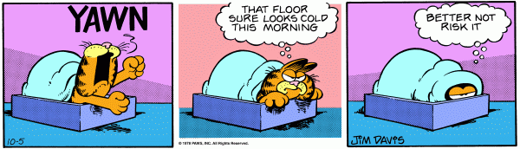
Finally
Modern poultry meat safety approach
  Holistic approach
Correct data
Share knowledge

Slide 19
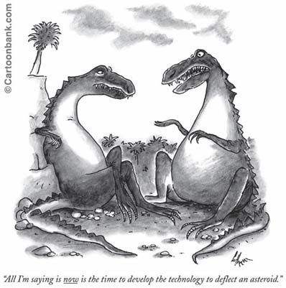
Finally
What is risk for us?
Risk factors - source?
Zero tolerance or
acceptable level?
Cost?

Slide 20
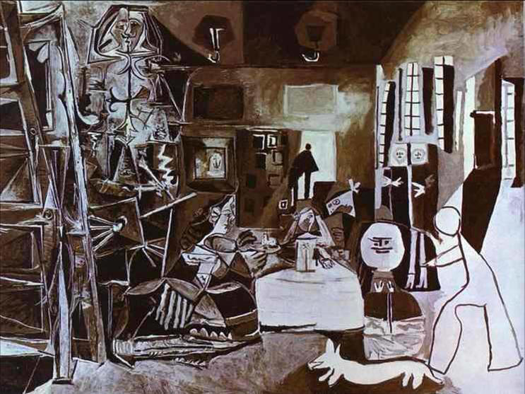

Slide 21


Slide 22
THANK YOU
mgoncuoglu@hotmail.com

