Slide 1


Treatment of Protein Misfolding Diseases with Novel Biologics
Dr. Mourad Tayebi D.V.M (Hons) M.Sc Ph.D
Senior Lecturer; University of Surrey / Founder and CSO; PrioCam LLC (USA)
International Congress on Neuroimmunology and Therapeutics
July 20-22, 2015 San Francisco, California, USA

Slide 2
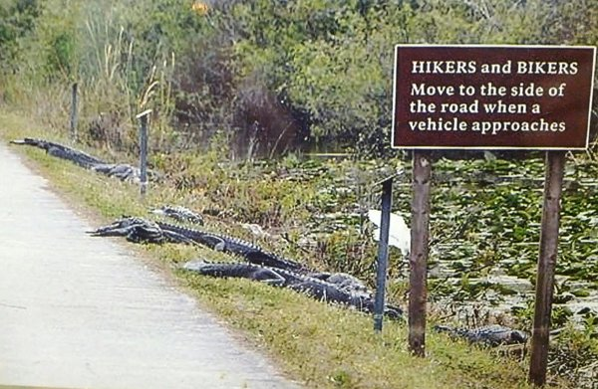
“While current drug therapies only treat the symptoms of Alzheimer's disease, researchers have great hope that in the near future there will be treatments that can stop or slow Alzheimer's” ALZHEIMER’S ASSOCIATION

Slide 3
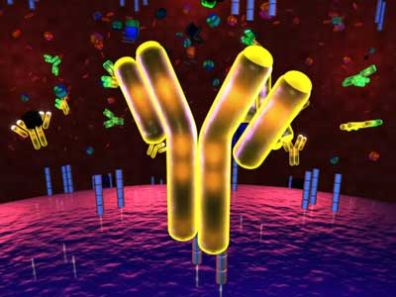
Conventional Antibodies (BCTDI)

Slide 4
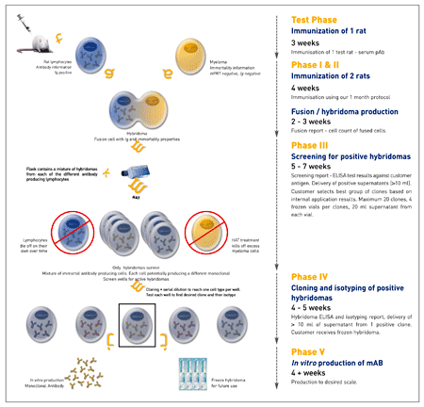

Slide 5
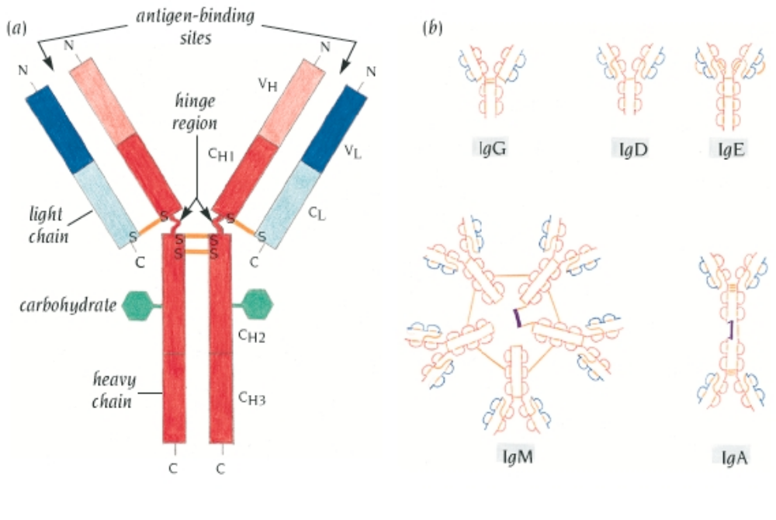
The immunoglobulin molecule, IgG, is built up from two copies each of two different polypeptide chains, heavy (H) and light (L).

Slide 6
Do conventional antibodies inhibit prion replication in vivo ?

Slide 7
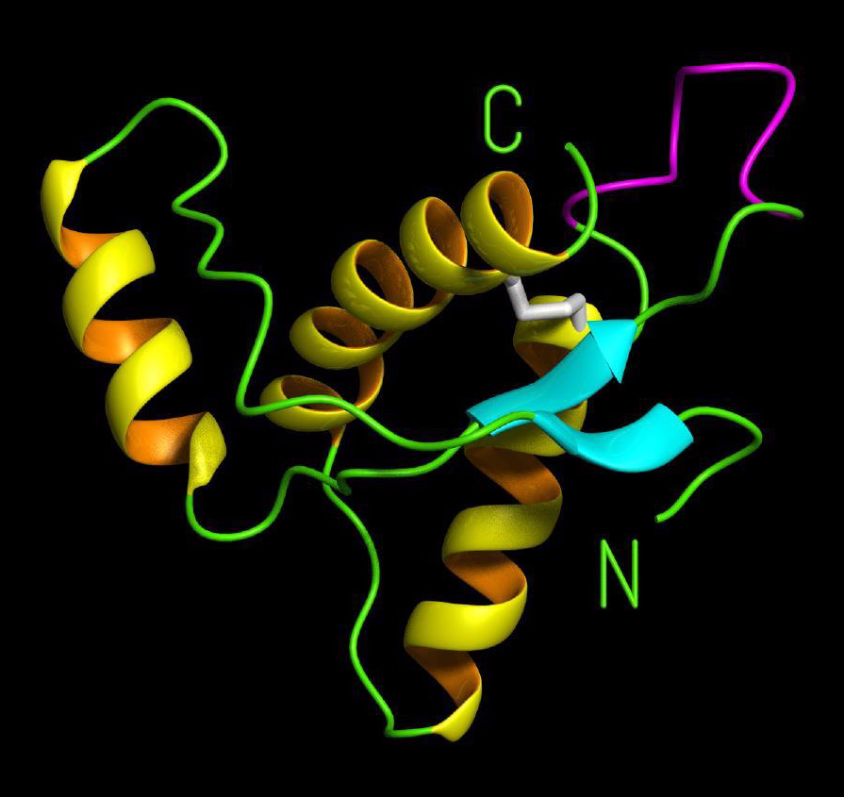
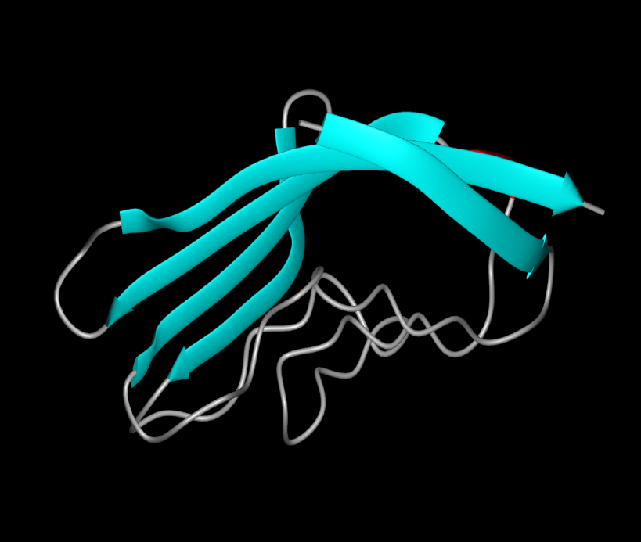
NMR PrP¹²¹⁻²³¹
β-PrP?
C
N
G. Jackson MRC Prion Unit
Riek et al, Nature 1996

Slide 8
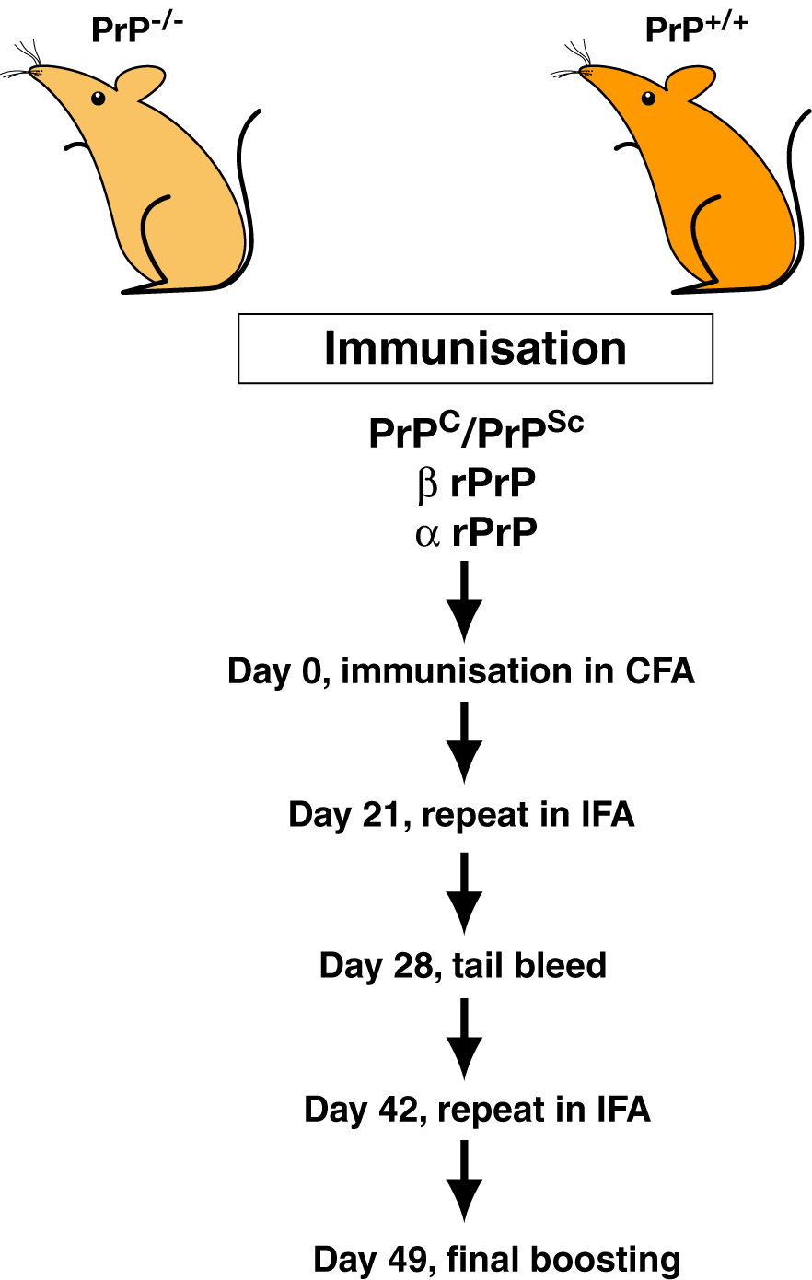
Immunization Protocol

Slide 9
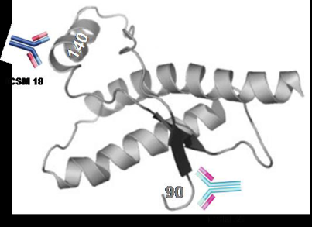
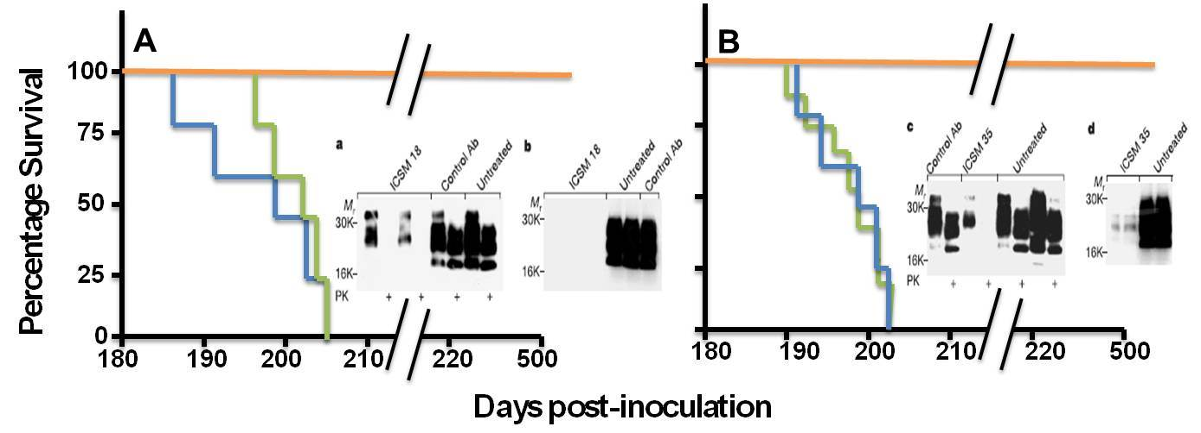
Conventional mAbs inhibit prion replication and delay
the onset of prion disease
White et al. Nature 2003

Slide 10
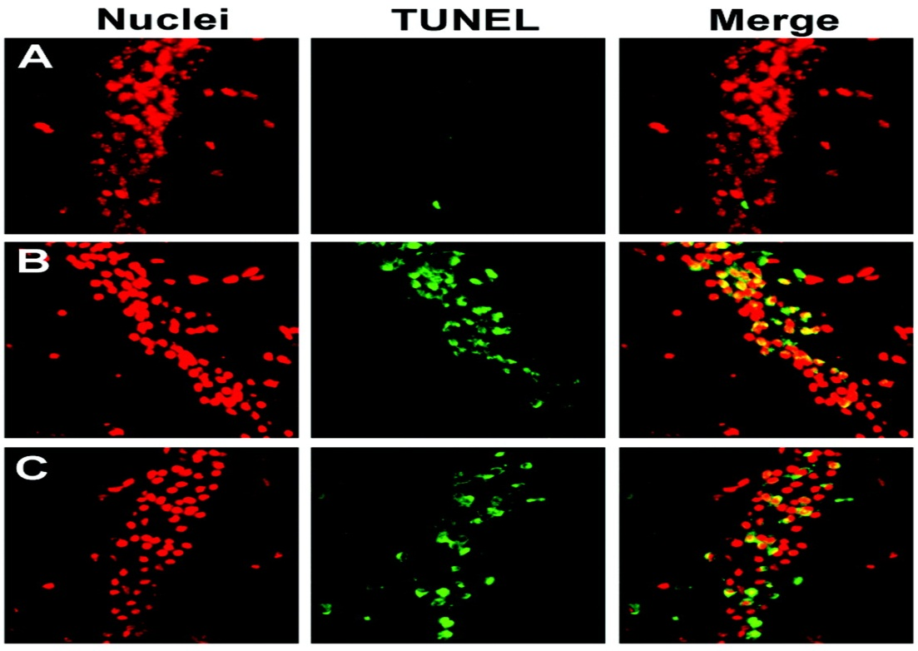
PrP^{C}-specific antibody triggers neuronal apoptosis
IgG b12 (HIV-1)
IgG P (95-105)
IgG D13 (95-105)
Solforosi et al. Science 2004

Slide 11
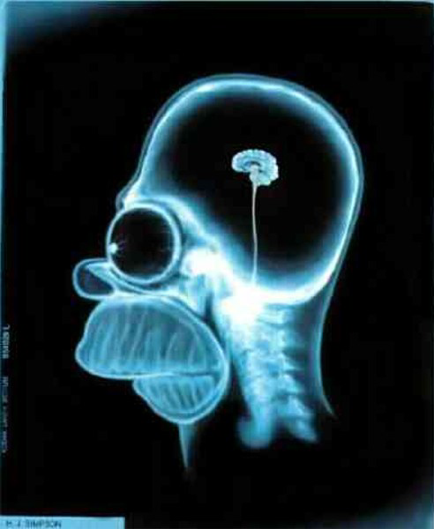
PROBLEMS TO OVERCOME:
BBB crossing
Cell penetration
Brain diffusion
Toxicity
And
Serum half life
Immunogenecity
We knew we needed:
Different type of antibodies
We also needed a way to stabilize the proteins
prior to immunization

Slide 12
Next Generation Antibody Technology
Unconventional Antibody!!

Slide 13
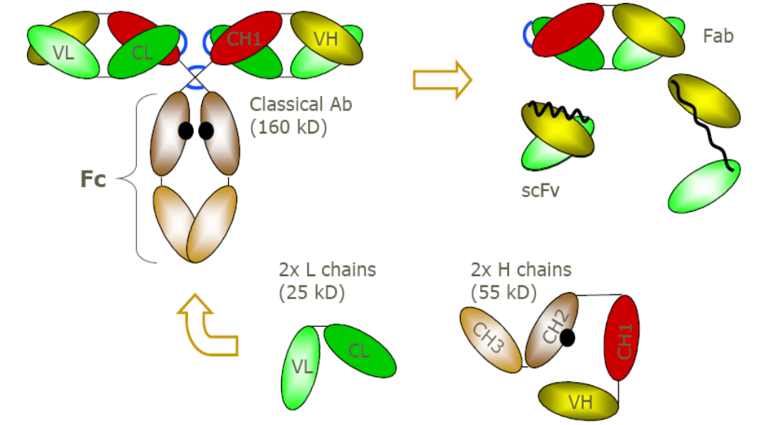
Conventional antibodies and derived fragments

Slide 14
Camelid antibodies – Single-Domain - VHH
Two heavy chains with no light chain.
Lack the CH1 domain
Smaller size,
Greater solubility
Higher stability
Hamers-Casterman et al., 1993
Dumoulin et al., 2002

Slide 15

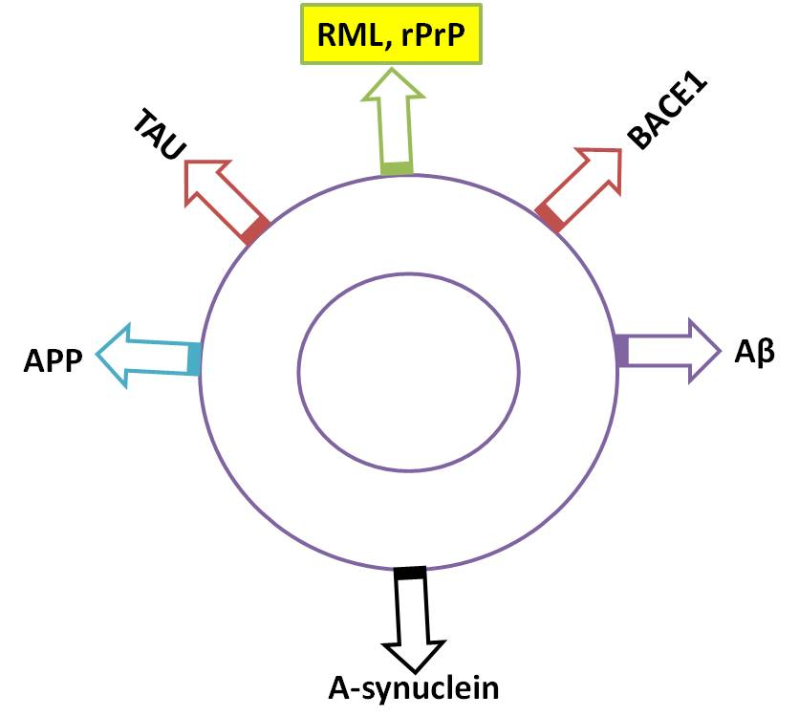
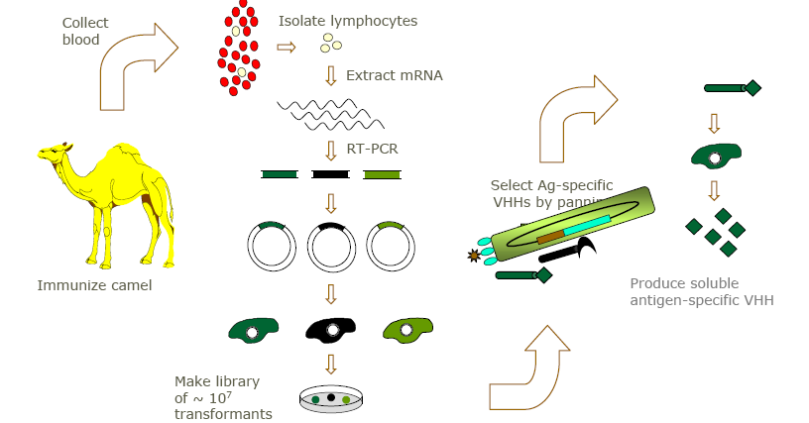
PRIOV ANTIBODIES

Slide 16
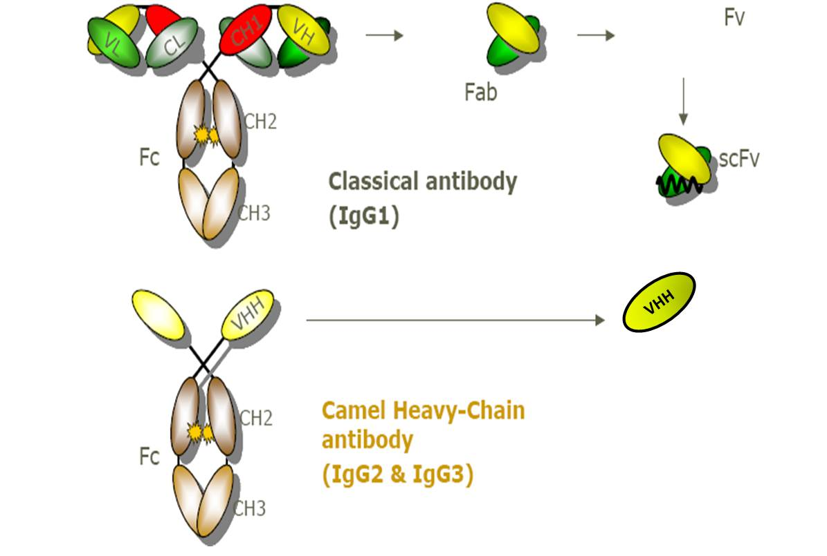
Unconventional antibodies and derived fragments

Slide 17
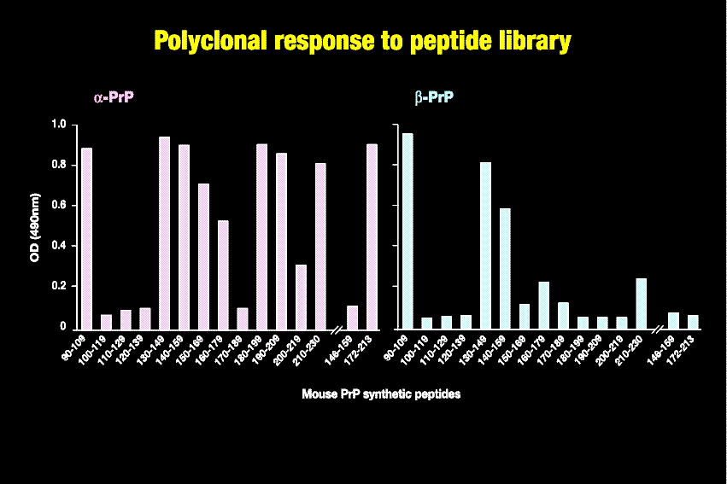
Quality of immune response is time- and
conformation-dependent
Tayebi & Hawke personal communication

Slide 18
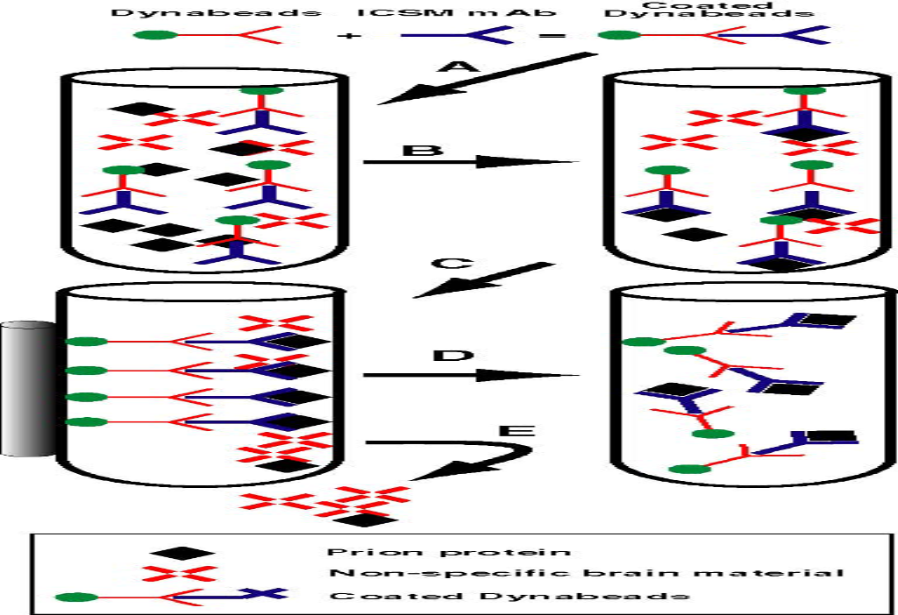
Treatment of prion diseases with conventional antibodies
Tayebi et al. Mol Med 2004 – Patent N

Slide 19
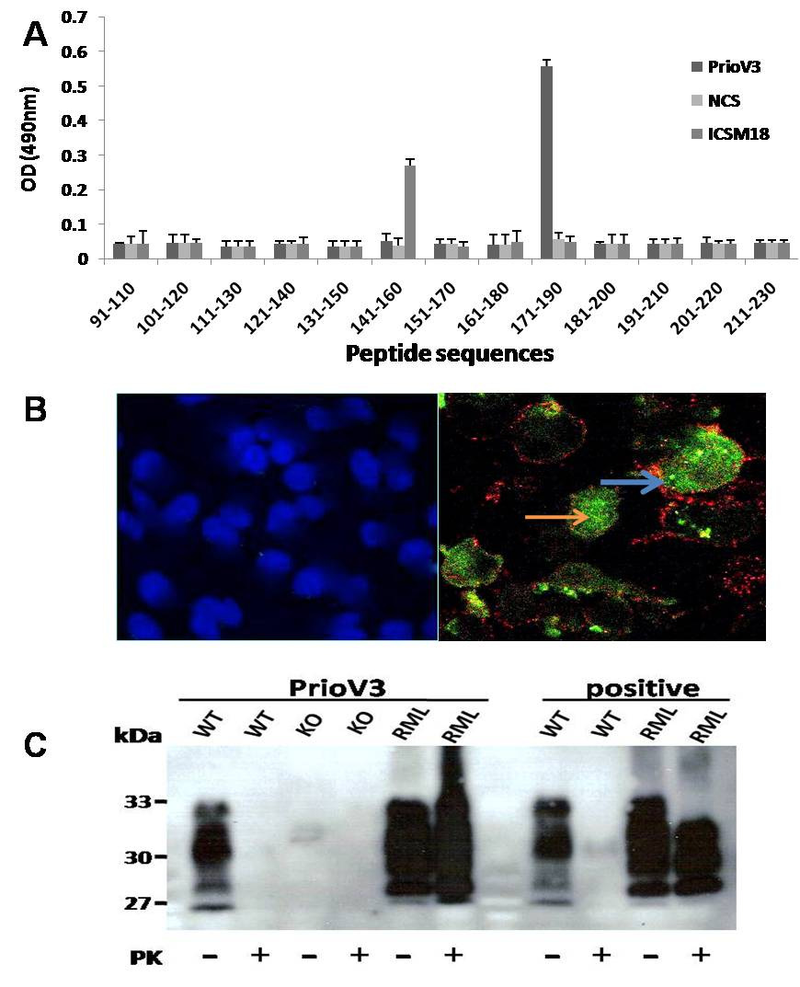
Camelid antibodies enter the cell membrane
Jones al. PLoS ONE 2010 & Patent

Slide 20
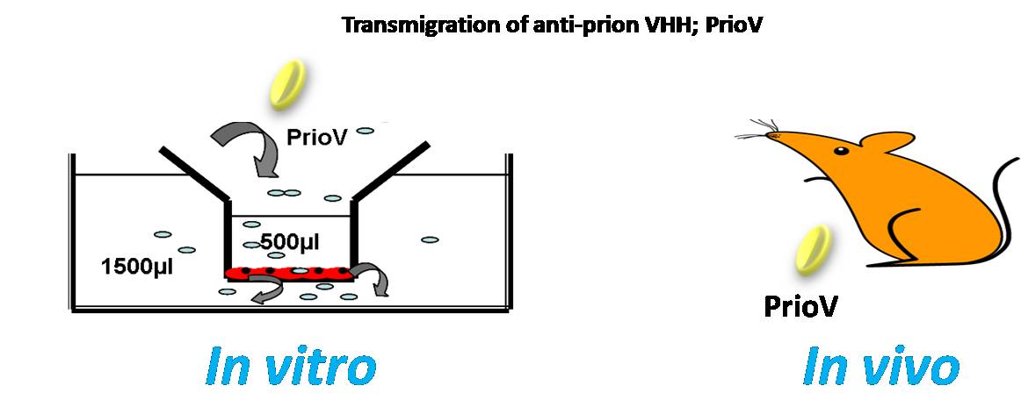
BBB transmigration of camelid antibodies

Slide 21
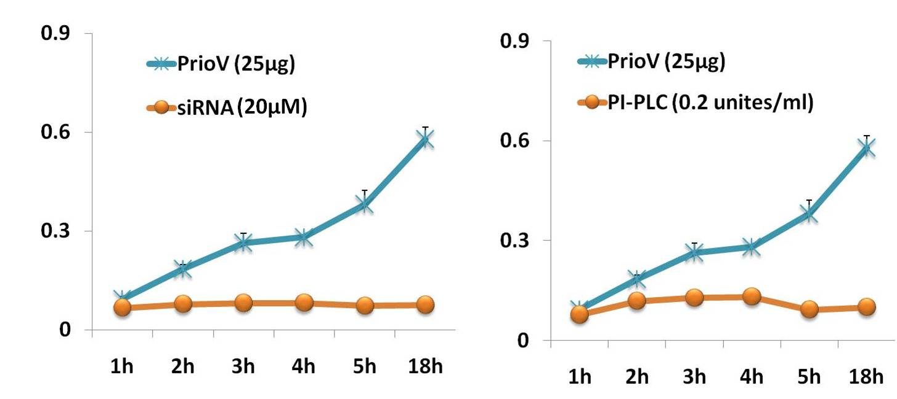
PrP-specific transmigration of camelid antibodies across the BBB in vitro
siRNA
PI-PLC
David et al. J Neuroimmunol 2014

Slide 22
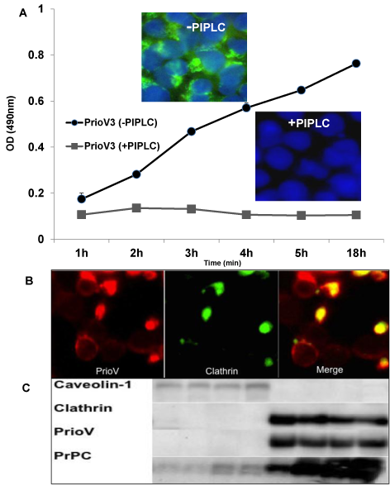
PrP-specific transmigration of camelid
antibodies across the BBB in vitro
David et al. J Neuroimmunol 2014

Slide 23
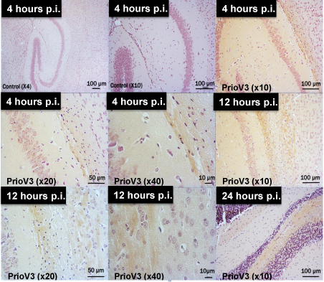
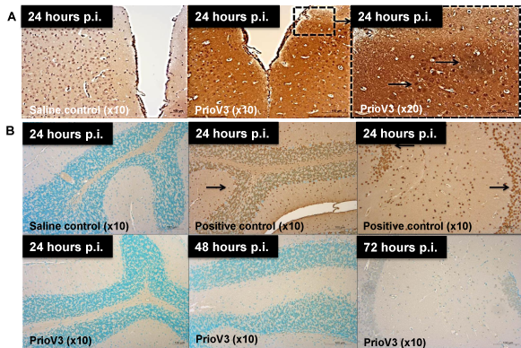
Bio distribution of camelid antibodies
in brain and tissues (i.p.)
David et al. J Neuroimmunol 2014

Slide 24
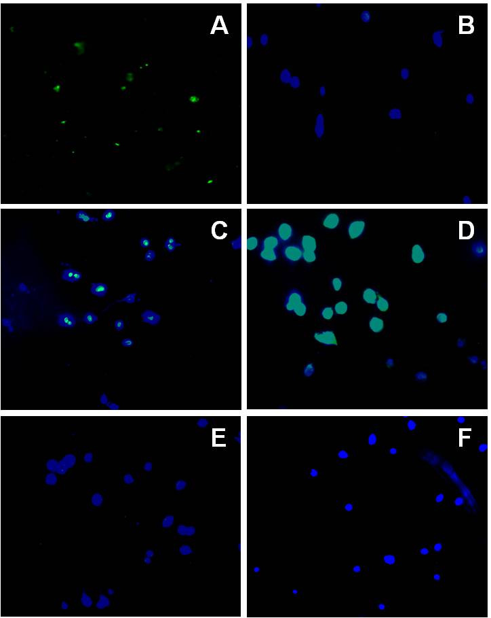
Camelid antibodies are not toxic to N2a
Jones al. PLoS ONE 2010

Slide 25
Do unconventional antibodies inhibit prion replication in vivo ?

Slide 26
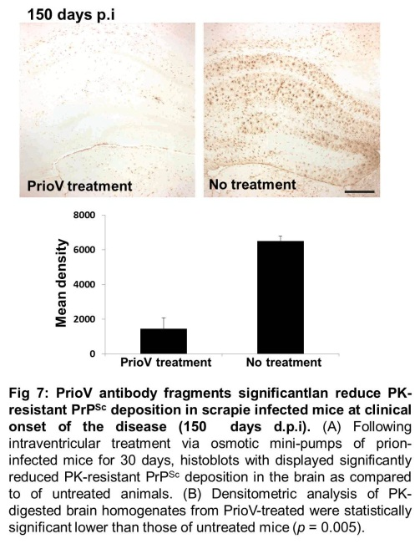
Anti-PrP VHH permanently abrogates prion replication in cell lines, spleen and brain
Jones al. PLoS ONE 2010 & unpublished

Slide 27
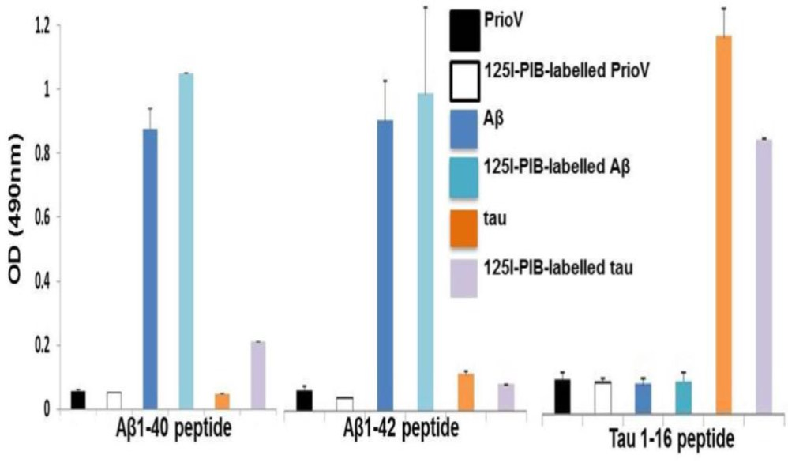
Immunodetection of Aβ1-40, Aβ1-42 & tau1-16
with camelid antibodies
David et al. J Neuroimmunol 2014

Slide 28
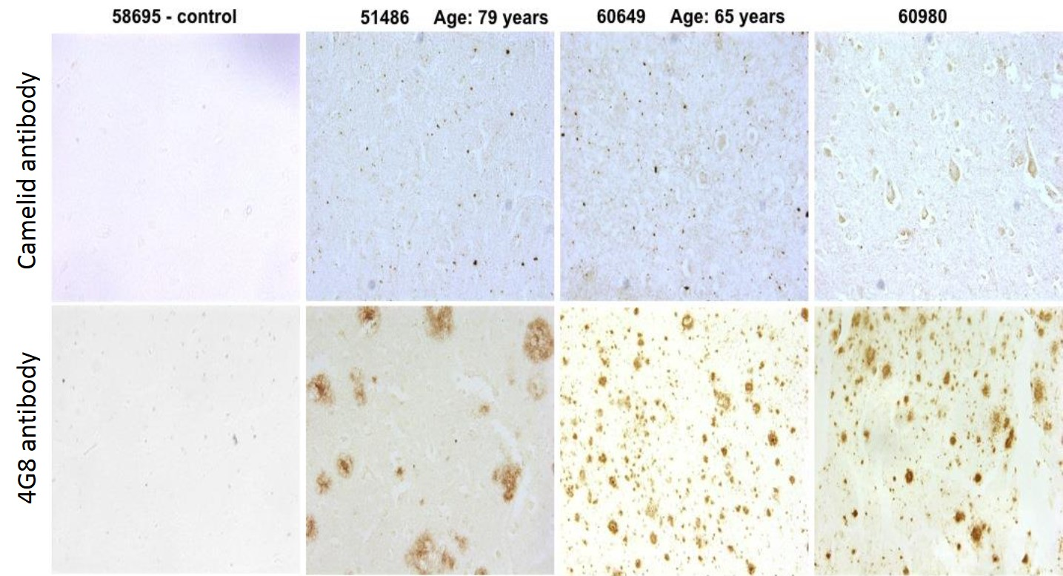
Immunodetection of Aβ and tau oligomers
In brain of AD patients
Tayebi & David unpublished

Slide 29
Do unconventional antibodies inhibit Aβ plaque formation in vivo ?

Slide 30
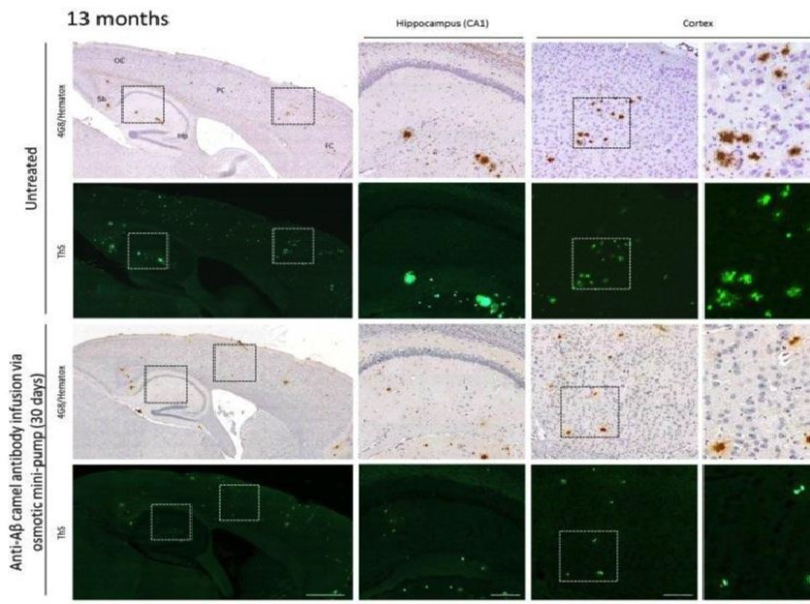
Reduction of Aβ plaque burden following treatment with camelid anti-Aβ1-42 antibody
Tayebi & David unpublished

Slide 31
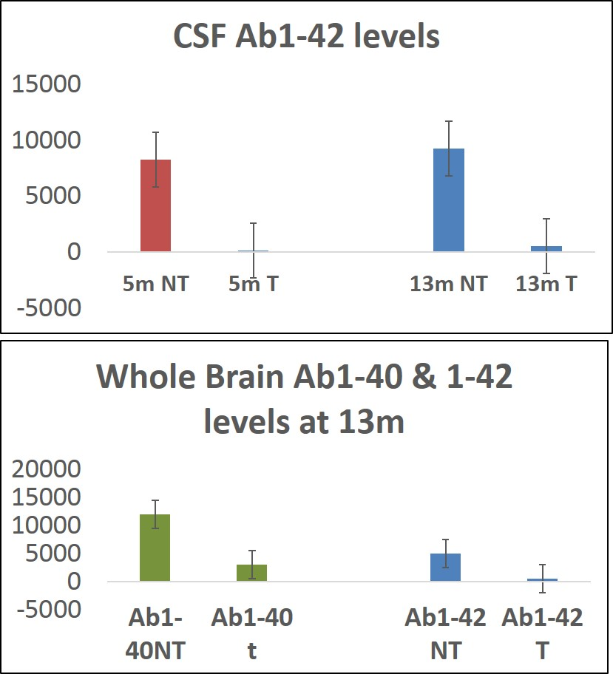
Reduction of Ab soluble oligomer following treatment with camelid antibody
Tayebi & David unpublished

Slide 32
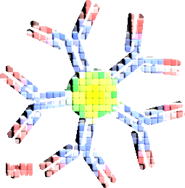
Conventional Antibodies (BCITDI and not BCTDI)

Slide 33
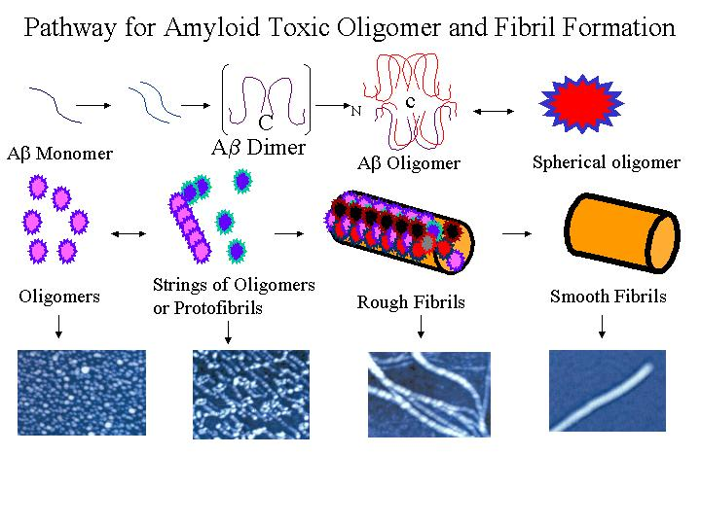
Soluble Amyloid Oligomers are a Common Intermediate in Amyloid Fibril Formation.
Toxic Soluble Oligomers
Glabe &Tayebi & David unpublished

Slide 34
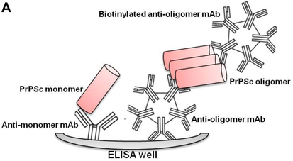
Immunodetection of Soluble Oligomers with
anti-prion-oligomer mAbs
Tayebi al. PLoS ONE 2012

Slide 35
Opportunities for Therapeutic and Diagnostic Development
Diabetes
Type II
Alzheimer’s
Disease
Mad Cow’s
Disease
Parkinson’s
Disease
Huntington’s
Disease
Serum
amyloidosis
Cancer
Vaccine
Drug Discovery
Diagnostic
☻
☻
☻
☻
☻
☻
X?
☻
☻
☻
☻
☻
☻
X?
☻
☻
☻
☻
☻
☻
X?

Slide 36
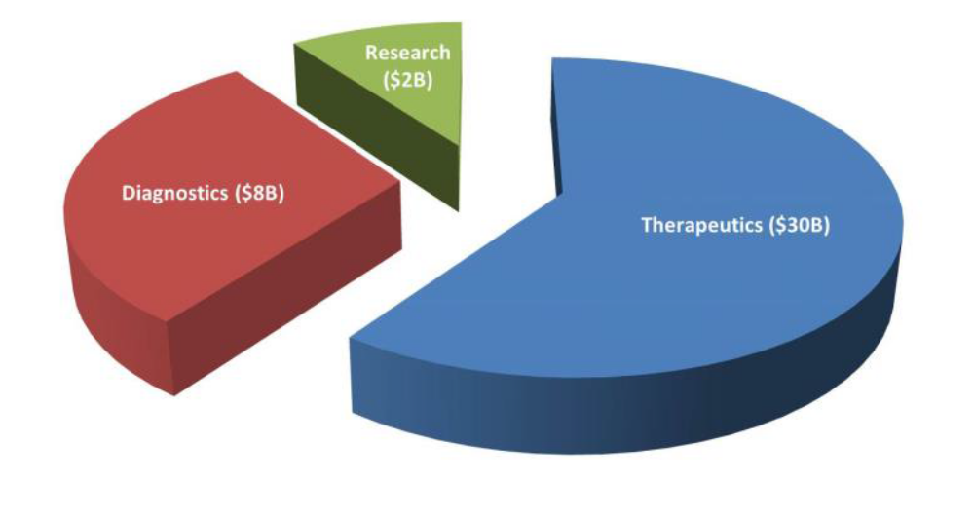
General antibody market
BCC Research Report on Monoclonal Therapeutics and Diagnostic Imaging

Slide 37
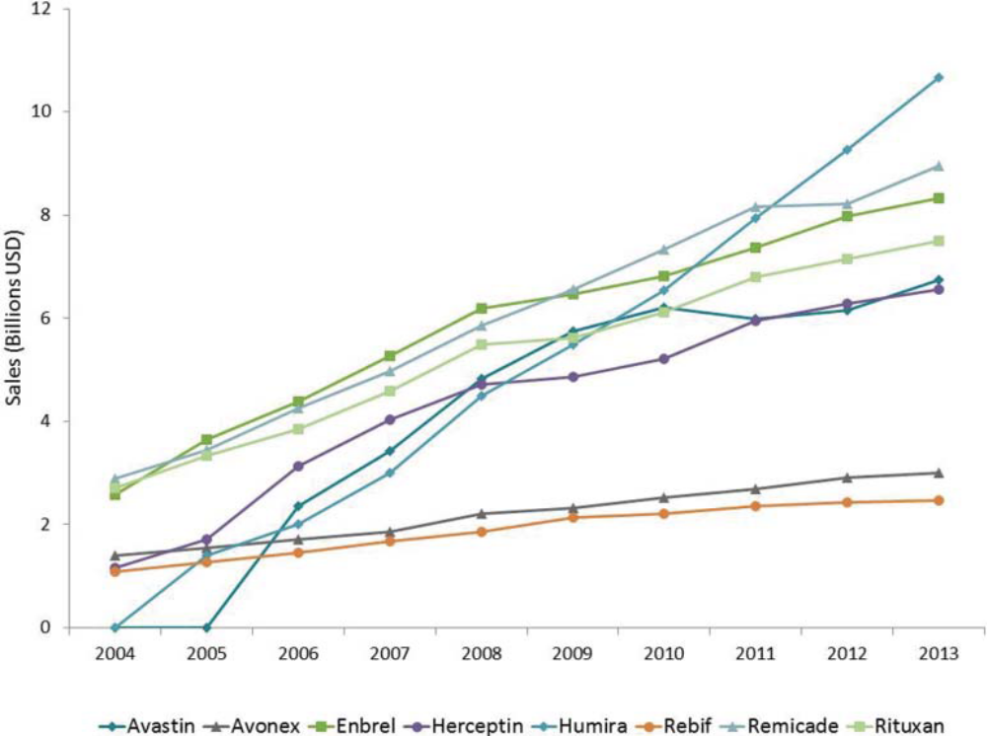
Annual sales of monoclonal antibody products
BCC Research Report on Monoclonal Therapeutics and Diagnostic Imaging

Slide 38
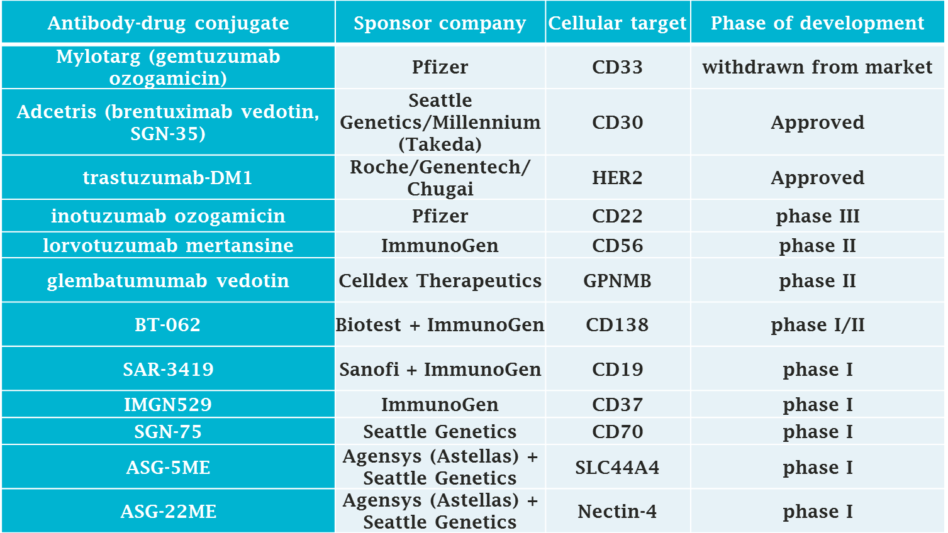
Selected ADCs in clinical development
BCC Research Report on Monoclonal Therapeutics and Diagnostic Imaging

Slide 39
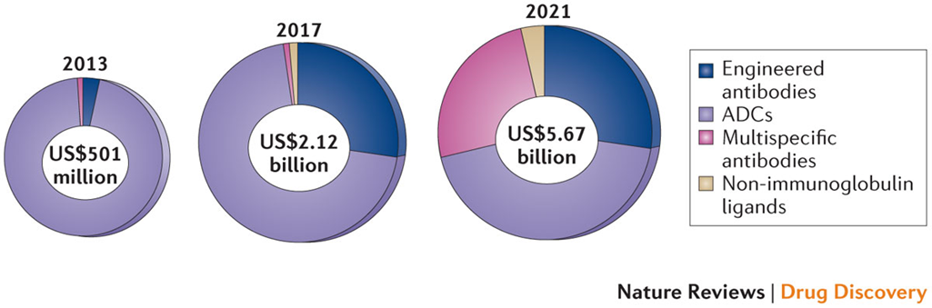
Next Generation Antibodies: Future Market Prospect

Slide 40
Acknowledgments
RVC London
Monique David
Daryl Rhys Jones
William Taylor
Benjamin Stileman
Umaymah Hewitt
Martin Smith
Liam Good
Imperial London
Steve Gentleman
Richards Reynolds
IOO London
John Greenwood
USYD
Simon Hawke

