Slide 1
Influence of Non-Newtonian Behavior of Polymers on their Processing Characteristics
Mosongo Moukwa, PhD
Independent Consultant ^{(*)}
Chapel Hill, NC, USA
11th International Conference on Advanced Materials & Processing. September 07-08, 2017, Edinburgh, Scotland
(*) Former Director of Technology at PolyOne DSS, USA

Slide 2
Outline
Introduction
Rheology of polymer melts
Flow Rheometry
Viscous dissipation
Flow instabilities
Conclusions

Slide 3
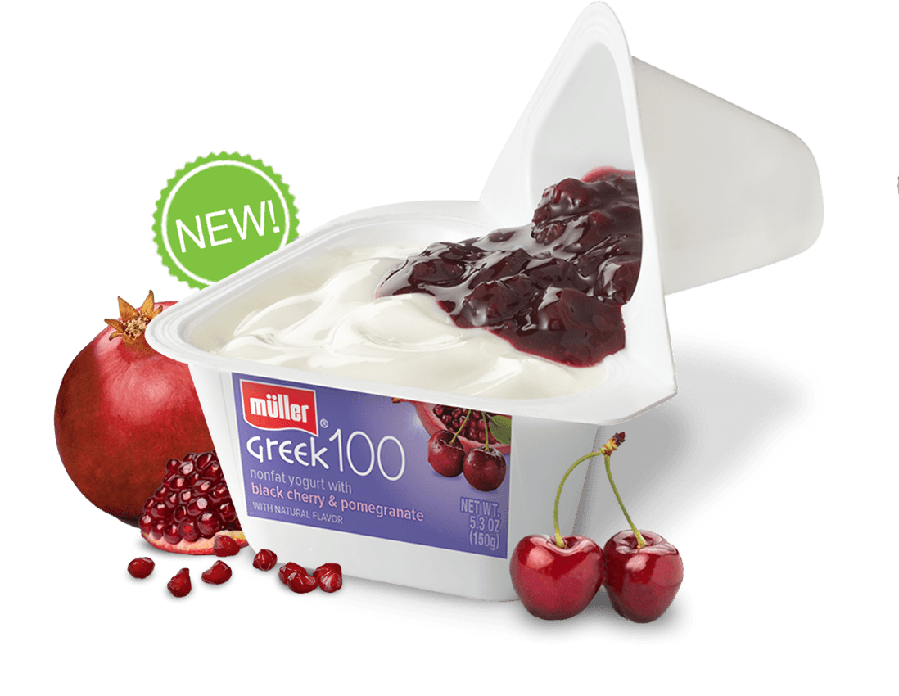

Introduction
A number of companies provides packaging, visual and multi-layers structural sheets and rollstock materials and specialty products for the Food, Medical, Building and Construction, Aerospace, Automotive and other markets.
*Formerly PolyOne Designed Structures and Solutions LLC

Slide 4
Why rheological properties are important
The viscolelastic properties of molten polymers are important to plastic engineers because they govern flow behavior whenever plastics are processed in the molten state
To optimize processing conditions for producing multilayer films and sheets, using more than one extruder
To be able to provide melted polymers that could then be formed

Slide 5
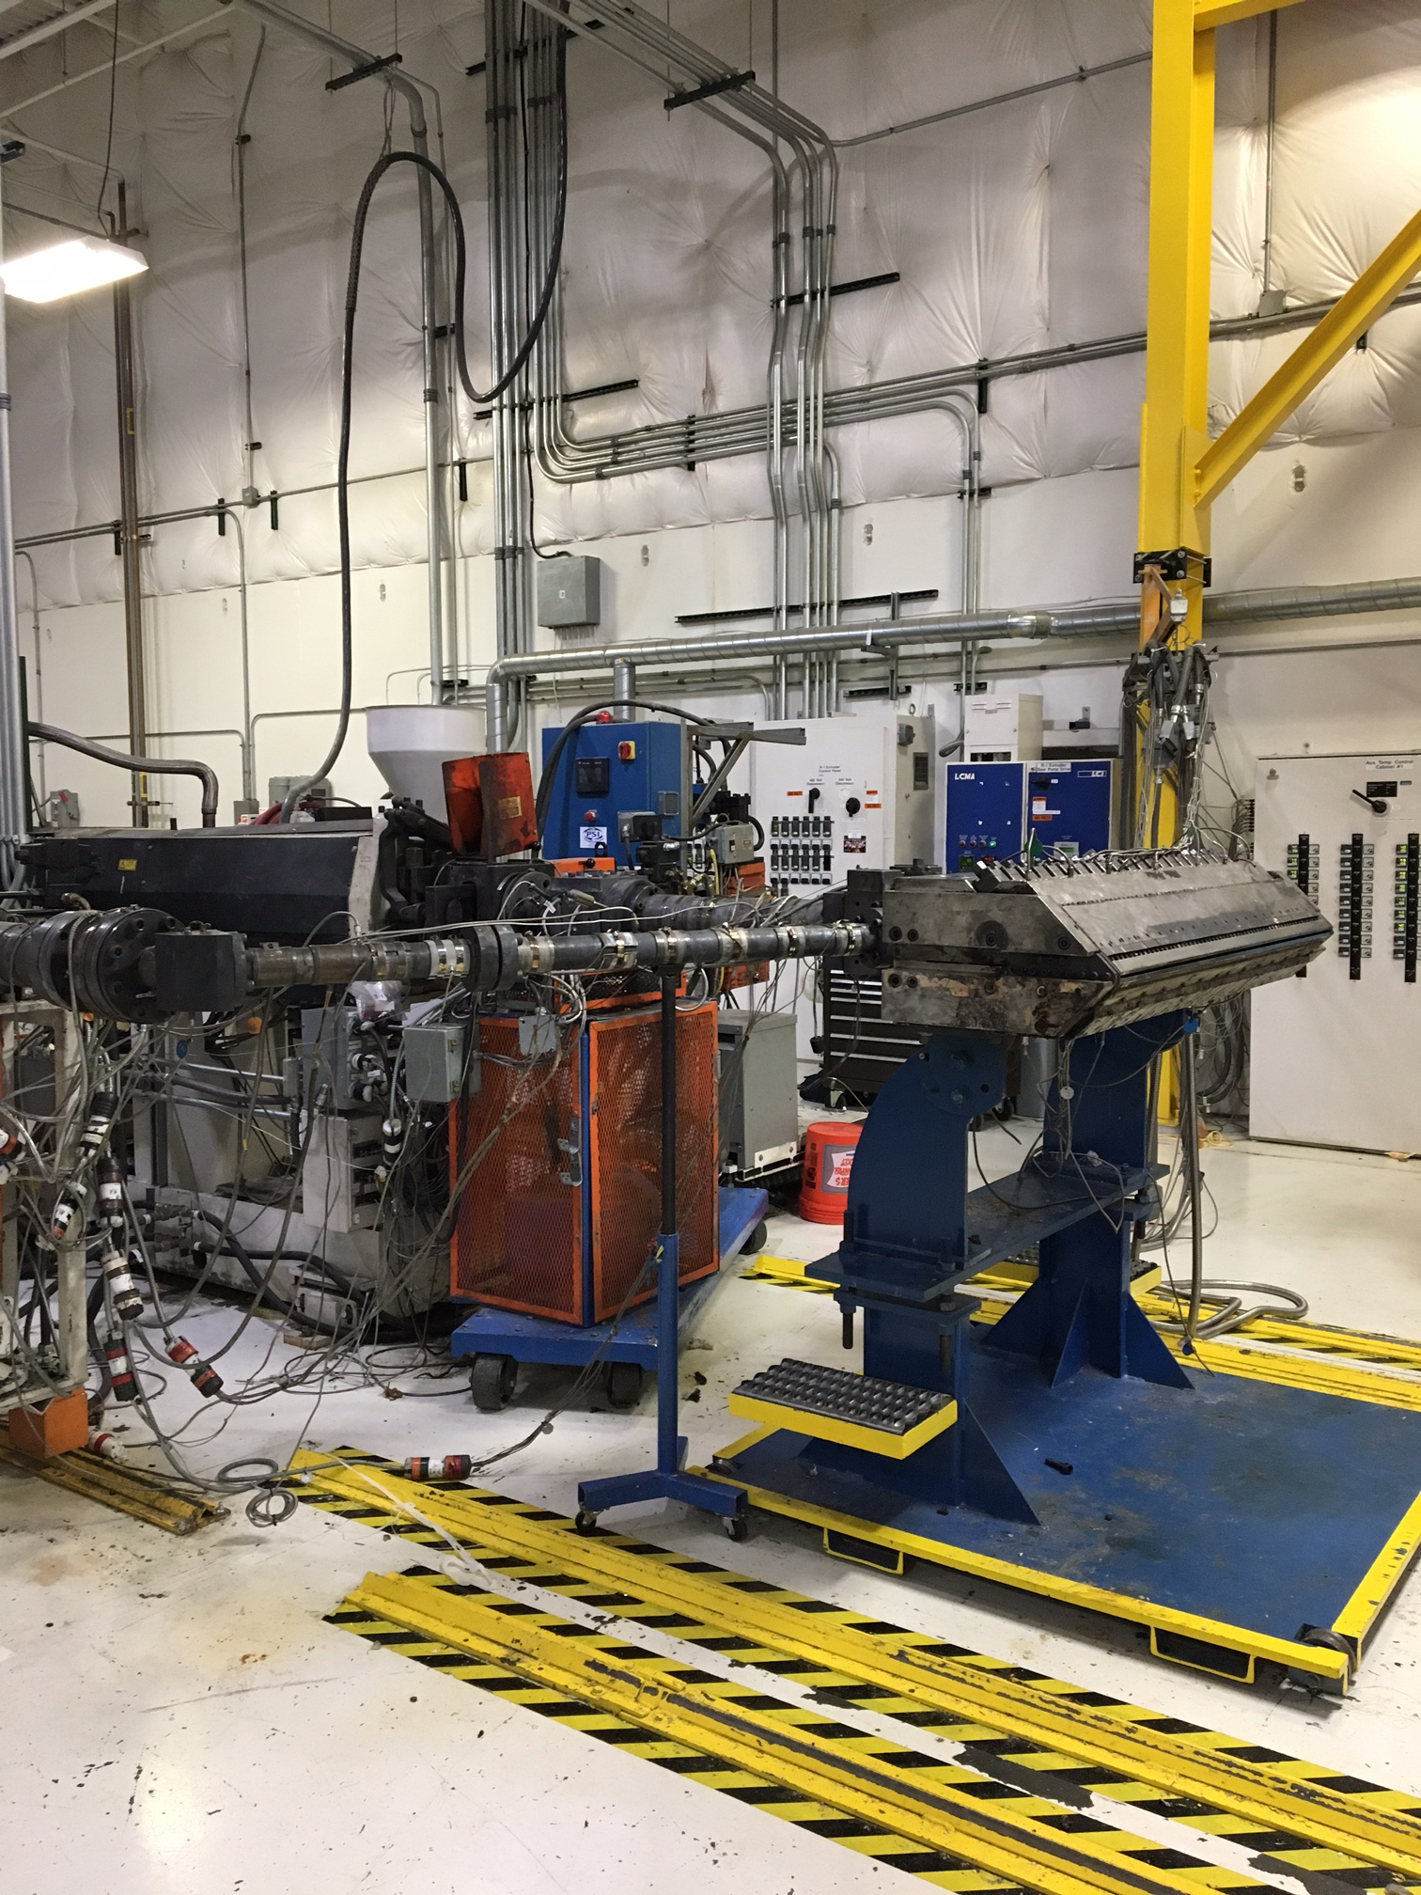
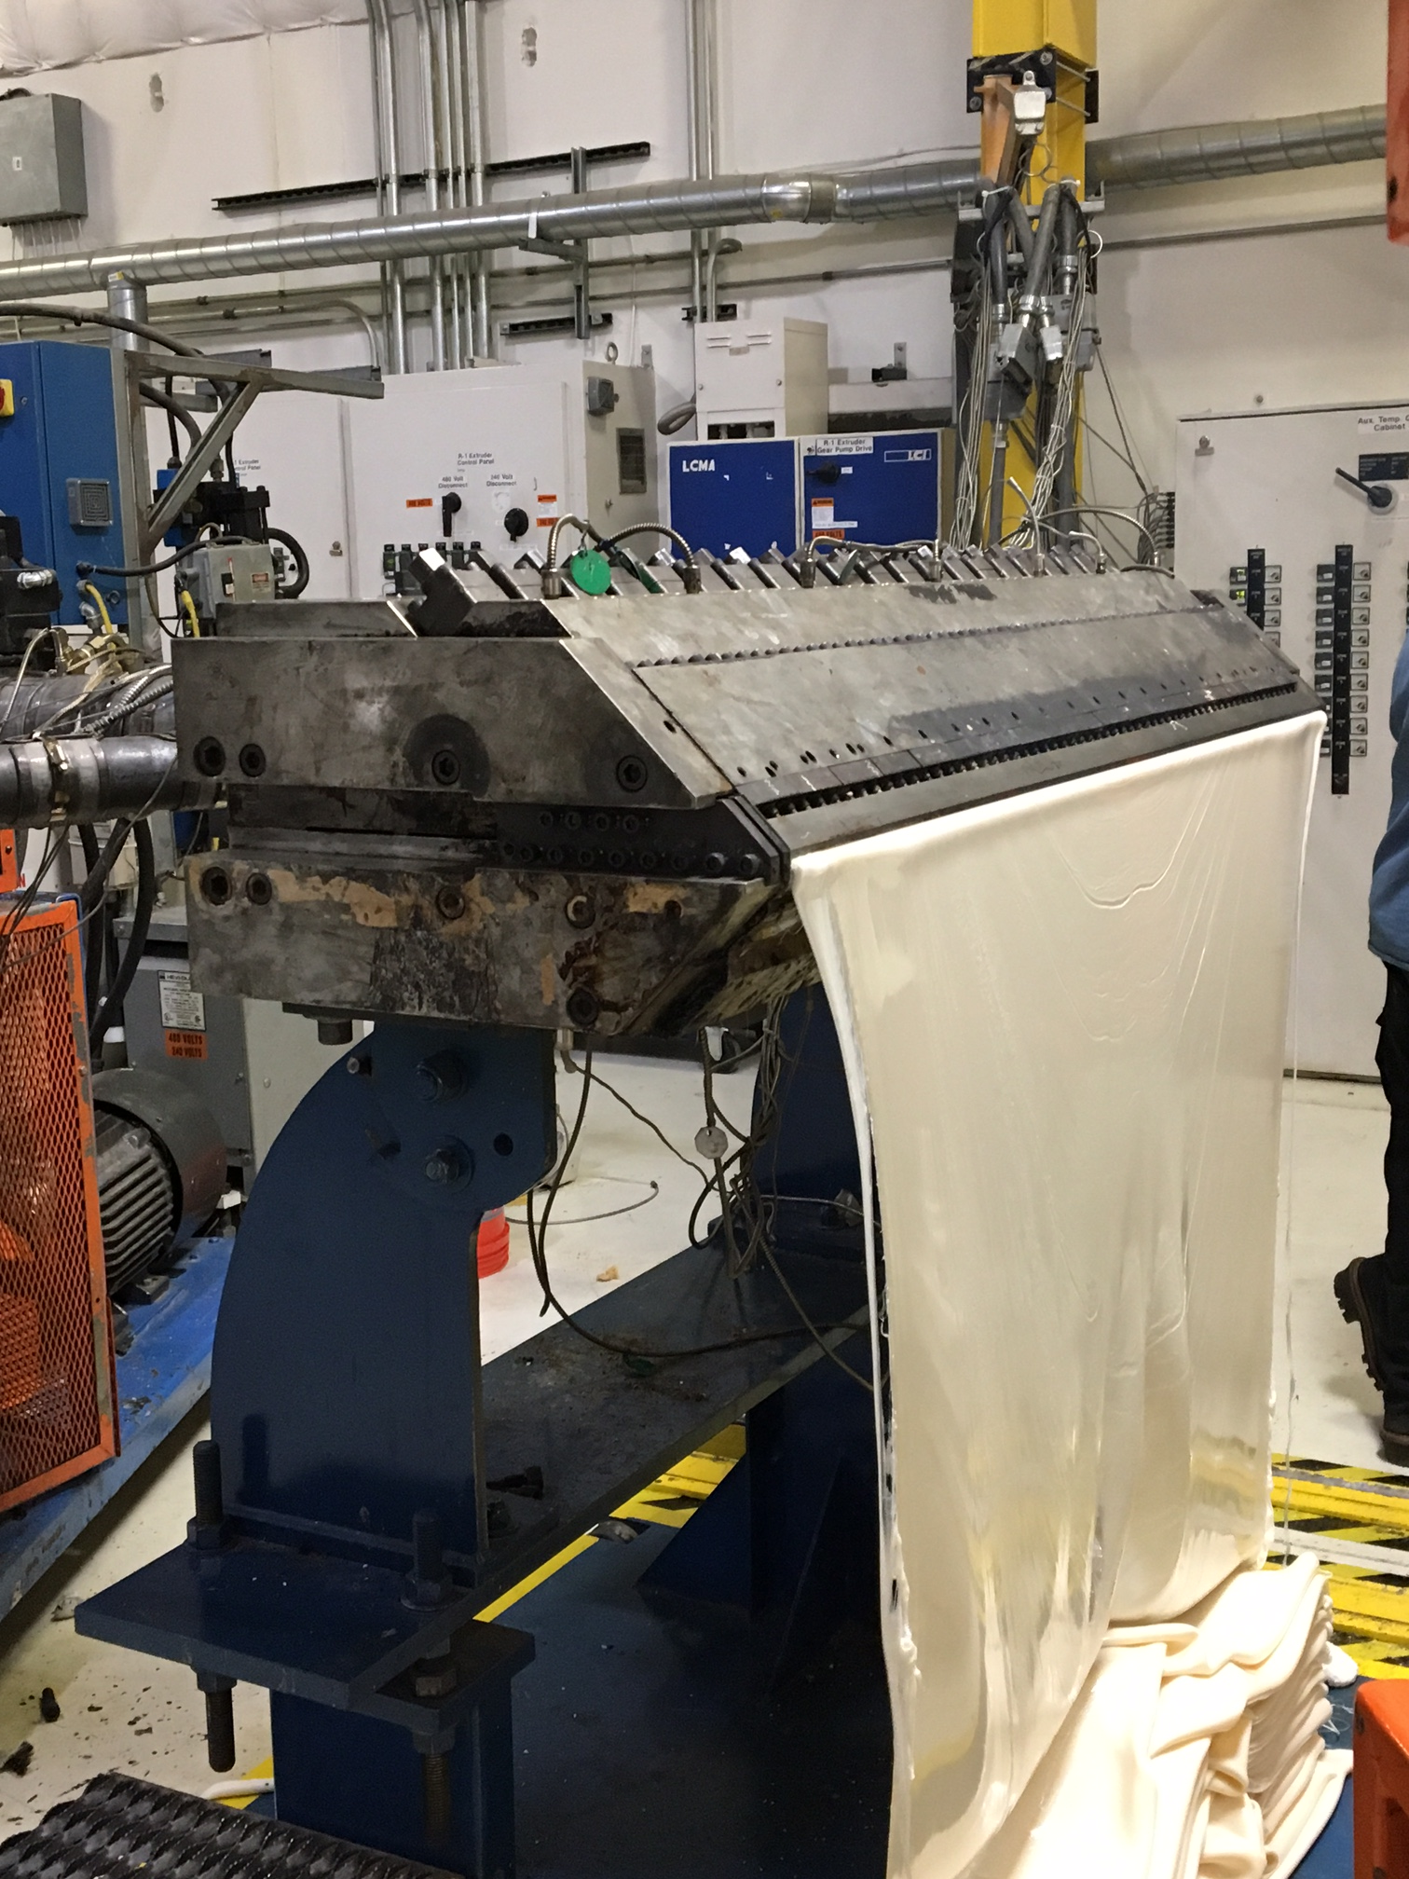
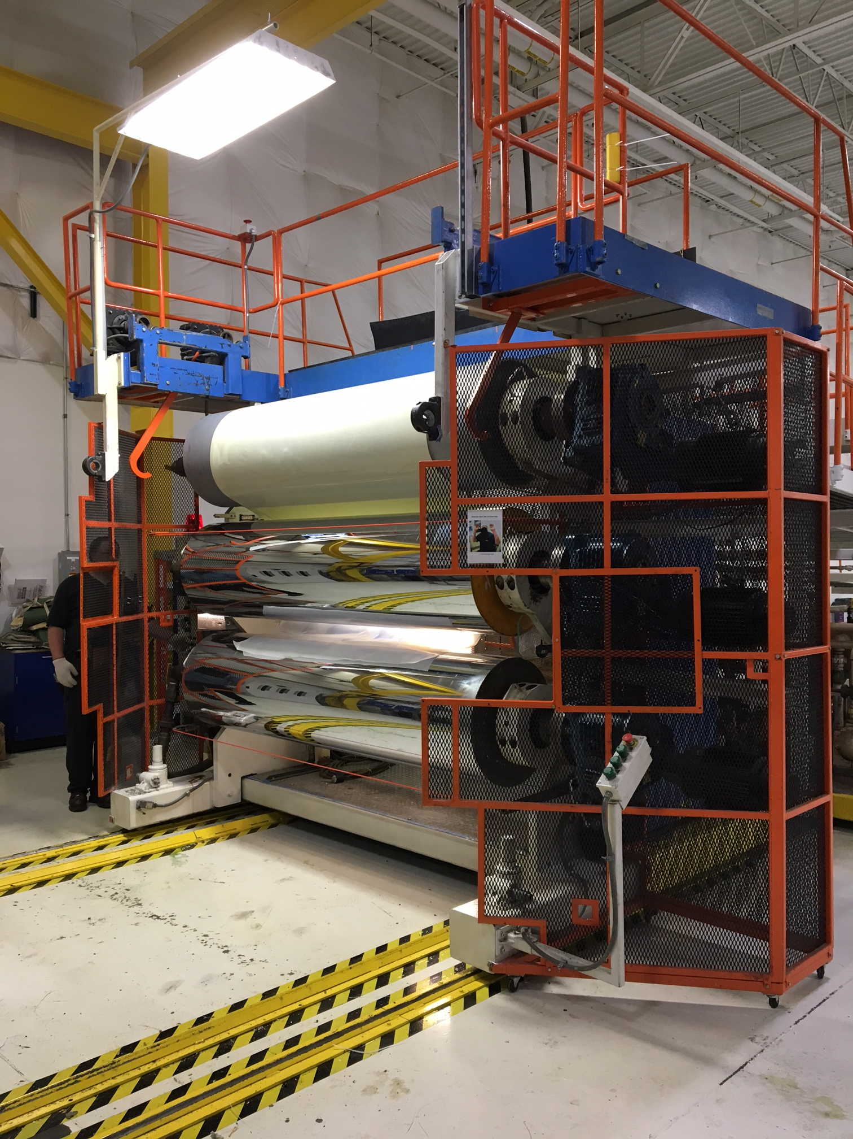
Rheology and extrusion
The main goal is to create flow through equipment and cavities

Slide 6
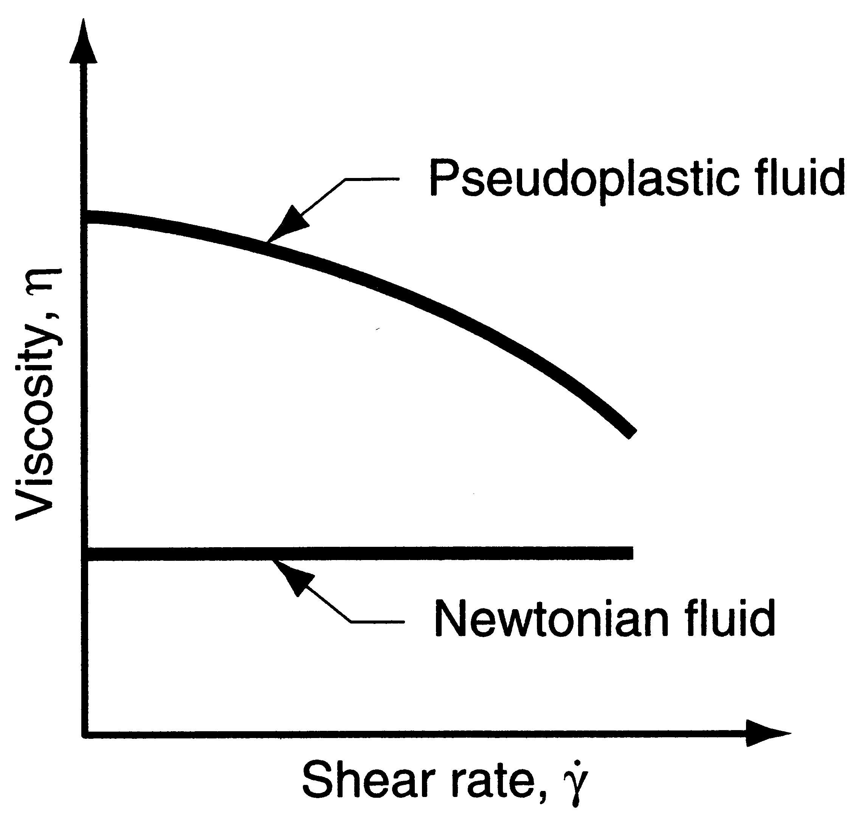

Viscosity of Polymer Melts
Viscosity of a polymer melt decreases with shear rate, thus the fluid becomes thinner at higher shear rates
Shear Thinning
Viscosity
Water: 10⁻³ Pa.sec
Polymer under extrusion: 10² Pa.s to 10⁵ Pa.s

Slide 7
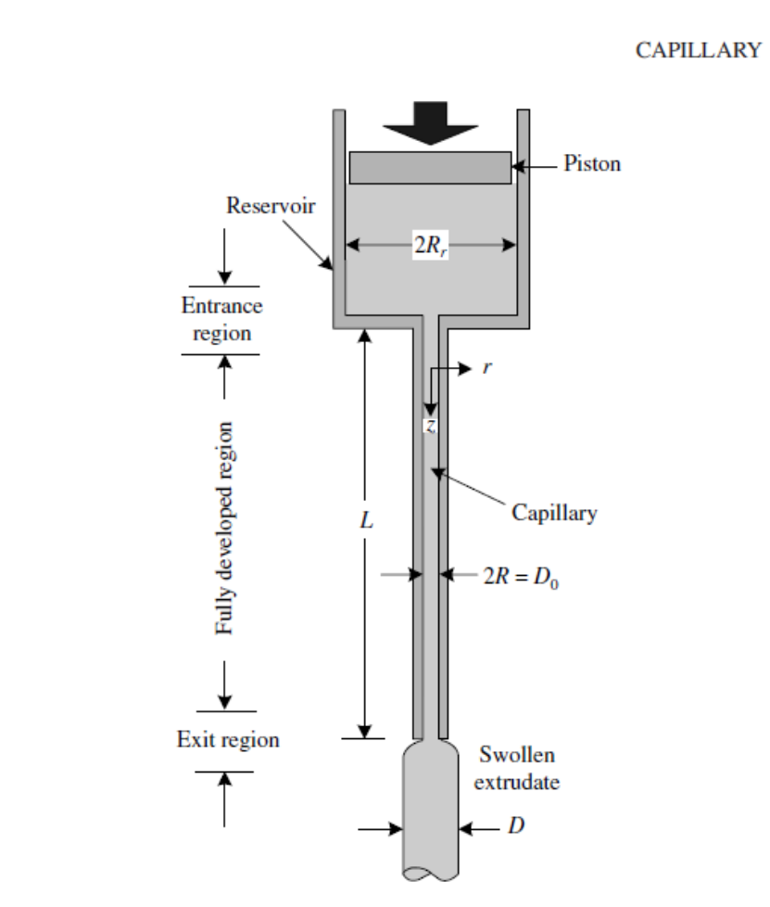

Capillary Flow Rheometry
Results obtained with the capillary flow rheometer are directly relevant to polymer
processing flows, the attainable shear rate values are in the range encountered in
polymer processing.
Rheological function obtained
Apply
Measure
Piston speed
(flow rate: Q )
˙
η ( )
Pressure Drop
γ
For Newtonian fluids
Δ P Q
Linear
relationship
For Polymer melts
Δ P Q^{n}
A nonlinear
relationship
n < 1
The shear stress is determined from the pressure applied by a piston. The shear rate is determined from the flow rate. The shear thinning behavior is frequently expressed by the power-law model
˙
γ
η = m ^{n-1}

Slide 8
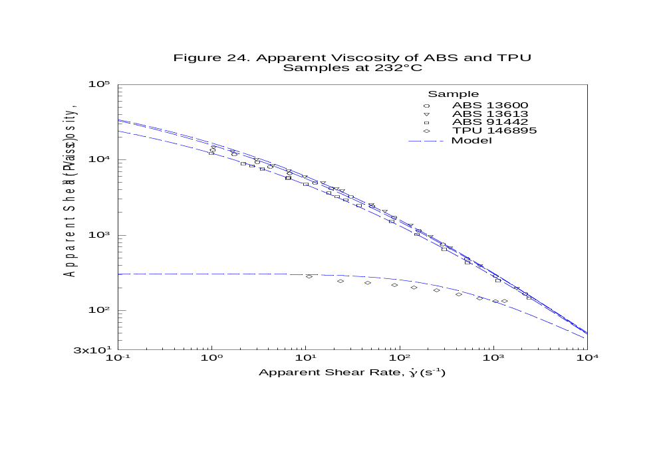
Apparent viscosity for ABS and TPU
Apparent Viscosity of ABS and TPU
Samples at 232° C
Acrylonitrile butadiene styrene (ABS): (C₈H₈)_{x}·​(C₄H₆)_{y}·​(C₃H₃N)_{z})
˙
η = m . ^{n-1}
γ
TPU is a block copolymer consisting of alternating sequences of hard and soft segments
A Sieglaff-McKelvey controlled stress capillary rheometer was used to characterize the shear rate dependent apparent viscosities of the dried ABS and TPU samples over an apparent shear rate range of approximately 1 to 2x103 s-1. The rheometer was equipped with a 0.397 cm radius barrel and a 22.2 L/D die having a 0.5715 mm radius and a 180° entry

Slide 9
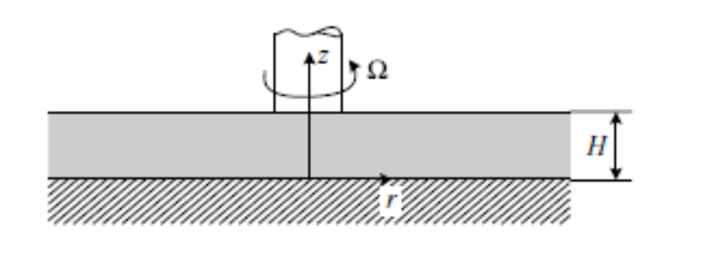
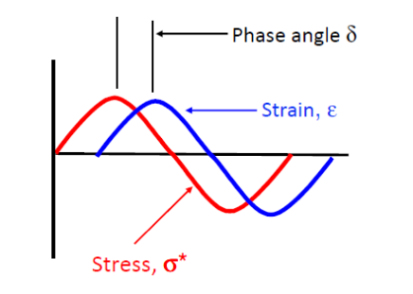
Rheological Response of Polymer Melts to
Small, Sinusoidally Varying Shear Deformations
Rheological function obtained
Apply
Measure
Shear deformation
Dynamic strain
Dynamic Stress
Components of complex viscosity
γ
γ
= _{o} sin ωt
o: small
η* (ω), G’ (ω), G” (ω)
Ω: Angular velocity
γ
Torque = f(ω,t)
complex viscosity
η* (ω) = η’ – iη”
The Elastic (Storage) Modulus
G’(ω) = ωη”
The Viscous (loss) Modulus
G”(ω) = ωη’
Capillary and dynamic simple shear rheometric results are complementary:
At very low or (ω) values they both yield useful macromolecular structure characterization.
η*in the range ω < 10 s⁻¹ forms an extension of η( ) obtained by capillary rheometry at > 10 s⁻¹, a range that is relevant to processing.
˙
γ
˙
γ
˙
γ

Slide 10
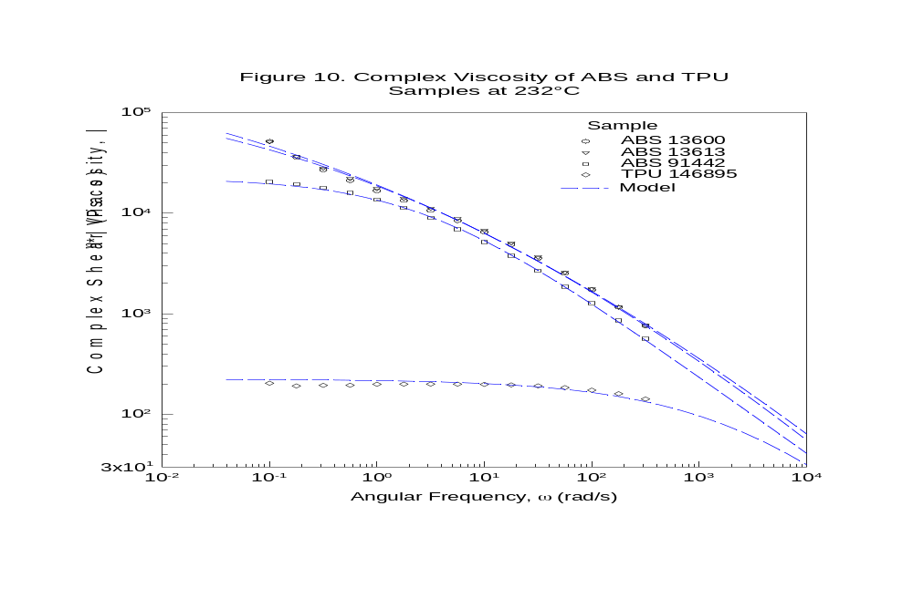
Complex viscosity for ABS and TPU
Complex Viscosity of ABS and TPU
Samples at 232° C
Mw=144,239
Mw/Mn = 2.33
Mw=143,680
Mw/Mn = 2.6
At High frequency: G” < G’
(elastic dominant)
The empirical "Cox-Merz rule" states that shear viscosity at a given shear rate is equal to the dynamic viscosity at the same frequency. =
˙
| η* (ω) |
η ( )
γ
:
A TA Instruments ARES G2 mechanical spectrometer, equipped with 25 mm diameter oscillating parallel plates, was used to measure the viscoelastic properties of the samples over an angular frequency range of 316 to 0.1 radians/s

Slide 11
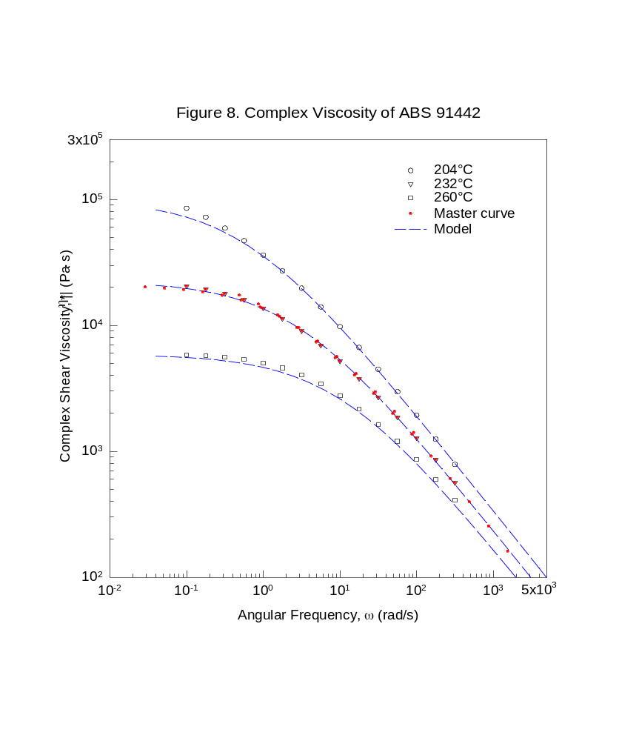
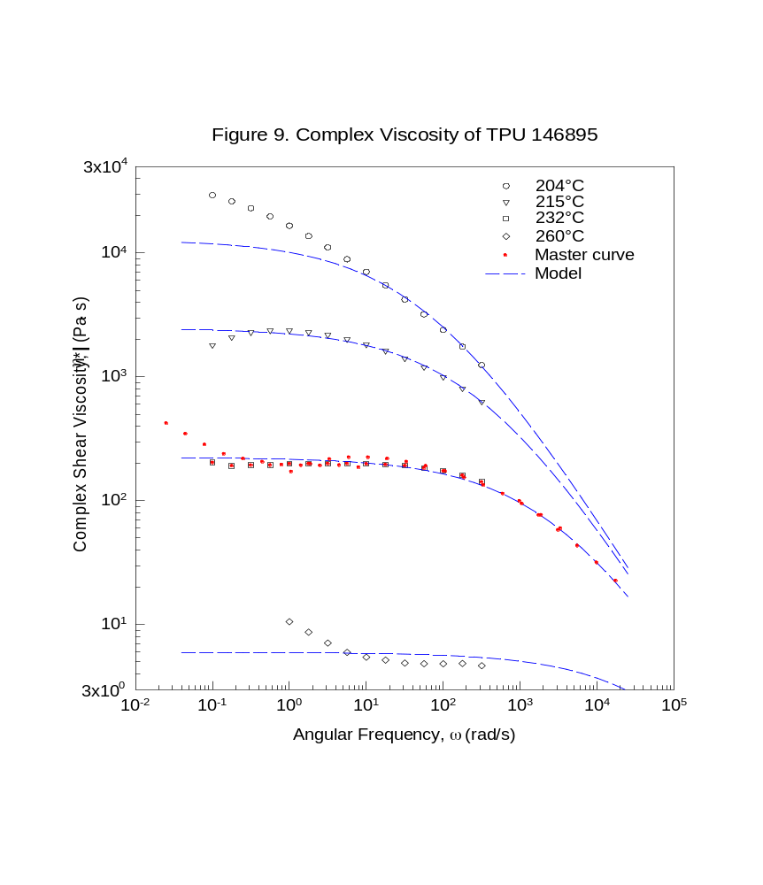
Effect of temperature on complex viscosity
The concept of time-temperature superposition has been found useful for making temperature-independent master curves of viscosity as a function of shear rate
Complex Viscosity of ABS 91442
Complex Viscosity of TPU 146895
Temperature dependent models
Dynamic measurements
η* (ω,T) = a_{T} x η* (ω x a_{T}, T_{o})
Steady Shear measurements
˙
˙
γ
η ( ,T) = a_{T} x η( x a_{T}, T_{o})
γ
Arrhenius or (WLF) model

Slide 12
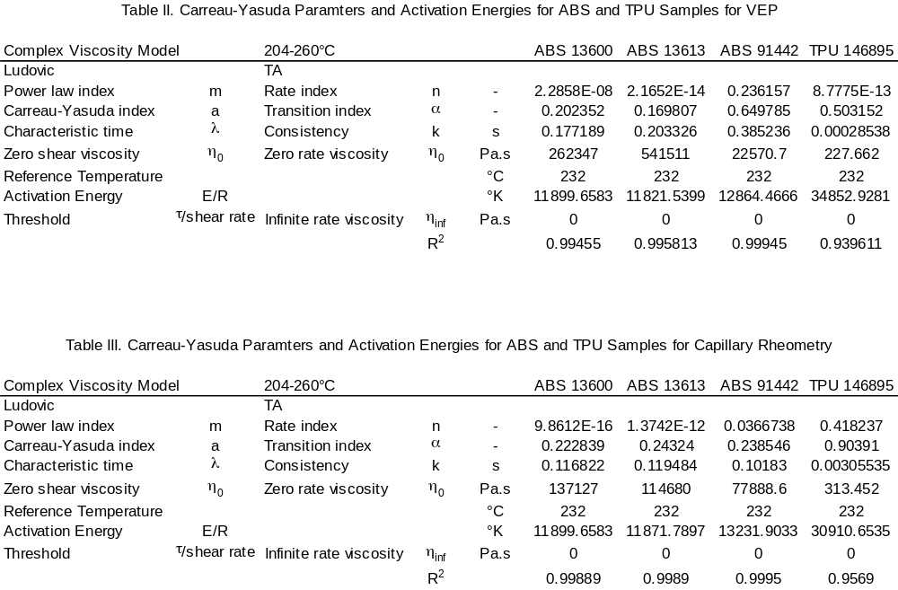
Shear Dependent viscosity model
The Carreau-Yasuda model
The Carreau model is a four-parameter model that accounts for shear thinning, transition and the Newtonian plateau
η_{o} is the zero shear rate viscosity,
λ is a parameter with units of (relaxation) time
n is the pseudoplastic index
a is the Yasuda parameter “transition smoothness”.
Note that the shear-thinning nature of melts is accounted for by the parameter n (n<1), as was the case with the Power Law model. The product λ = De reflects the viscoelastic nature of the melt, which at low De number values De 0 become Newtonian. As De is increased, melts become less viscous and more elastic.
˙
˙
γ
γ
η ( ,T) = η_{o} x a_{T} [1 + (λ x a_{T} )ª] ^{(n-1)/a}

Slide 13
Viscous dissipation in pipe flow
˙
γ
Viscous dissipation φ = τ_{rz} _{rz} in pipe flow is non uniform.
^{n+1}
²
^{1+1/n}
1
˂ν_{z}˃
r
˂ν_{z}˃
_
__
_
__
˙
º
φ (r) = η_{o}
+
3
where
ηº = η
and
γ
|R
=
˂ν_{z}˃
n
R
R
R
φ(r) is zero at the center line and has its maximum value at the wall
Viscosity, Shear rate, Sher stress profile; Power law n = 0.4
Development of temperature profile
˙
r/R
ν_{rz}
γ
τ_{rz}
r/R
_{rz}
1
1
1
2
3
0
2
0
˙
0
0.5
1.0
γ
Viscous dissipation or shear heating
~
η x
~
Large radial temperature fields are generated in a fluid that started out being of uniform temperature. These radial temperature differences give rise to conduction of heat towards the wall. A fully developed temperature is reached when the heat flow into the wall balances the viscous heat generation.

Slide 14
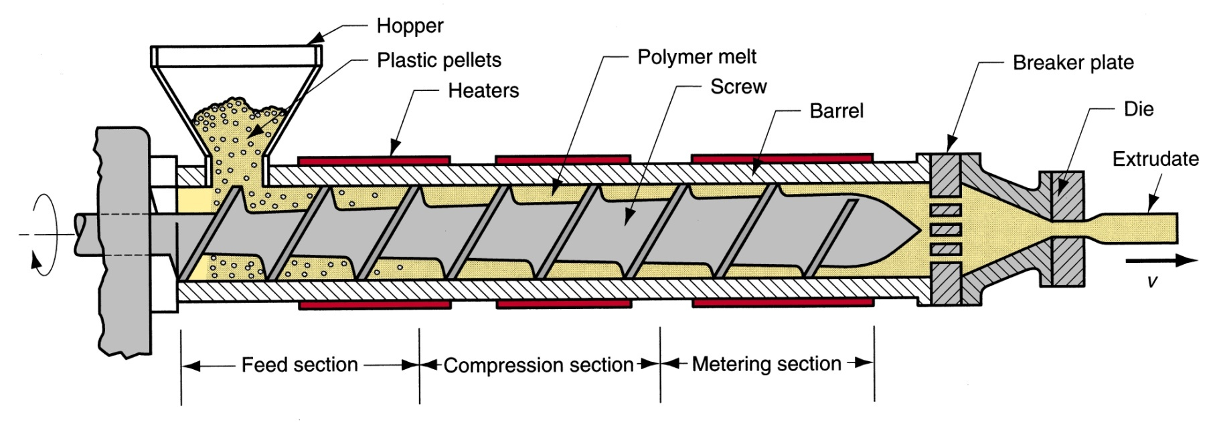
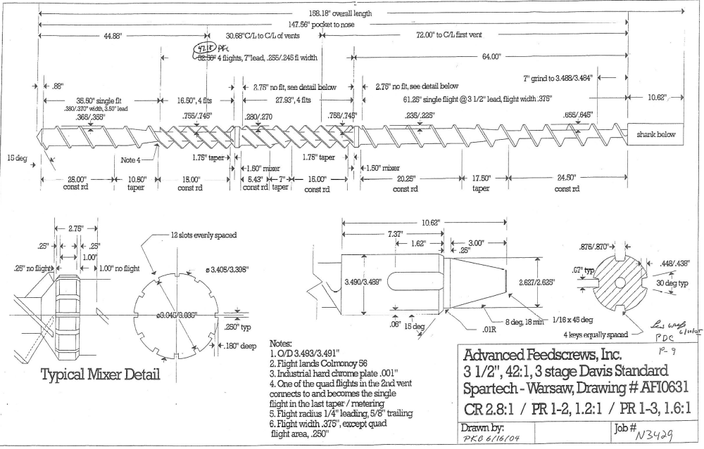
Extrusion
Near the barrel wall, shear rate can be >200/s
At the lip of the die, the shear rate can be as high as 1,000/s
˙
˙
γ
γ
4.5” (368 mm) diameter
Screw speed 55 rpm
Barrel diameter: 369.3 mmm
Metering zone: Channel depth: 0.755 in (19.1 mm); Gap between flight and barrel: 0.025 in (0.64 mm)

Slide 15
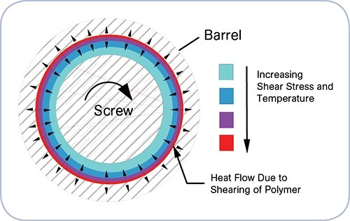
Viscous dissipation in extrusion operation
Barrel
Viscous dissipation or shear heating
˙
2
Increasing shear stress and temperature
γ
~
η x
~
Heat flow due to shearing of polymer
S, screw speed in rpm
˙
˙
 | Depth (mm) | Apparent Shear rate (1/s) | Viscosity ABS (Pa.s) | Viscosity TPU (Pa.s) | η ( )² ABS (Pa.s) | η ( )² TPU (Pa.s)
Metering channel | 18.8 | 55 | 1,100 | 20 | 3.3 * 10 ⁶ | 6.0 * 10 ⁴
Flight clearance | 0.63 | 1650 | 100 | 10 | 2.72 * 10 ⁸ | 2.7 * 10 ⁷
γ
γ
TPU at 330 F (165 C)
ABS at 550 F (288 C)

Slide 16
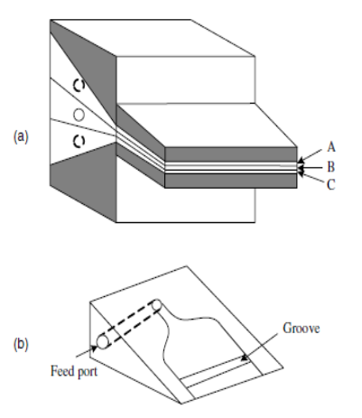
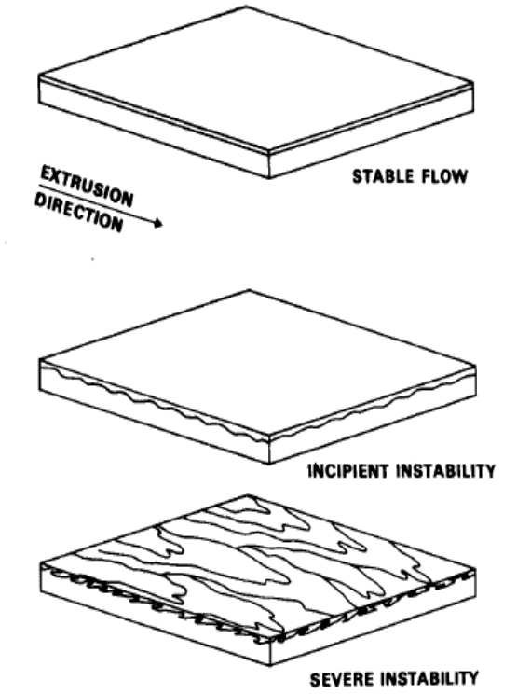
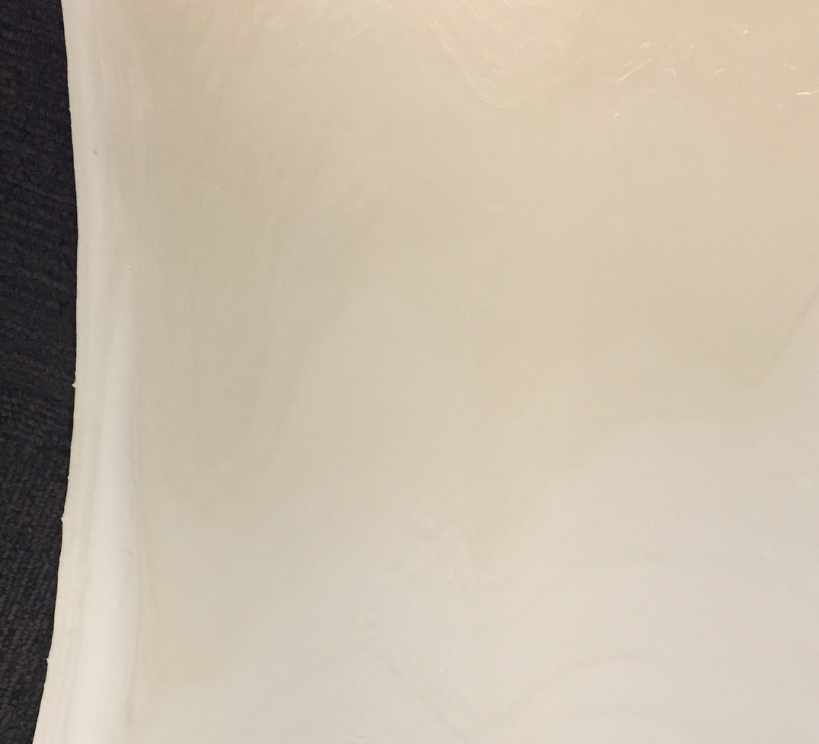
Interfacial instability in multilayer co extrusion
Interfacial instability in multilayer co extrusion
Interfacial instabilities: regular waviness which appears in through a three-layer TPU/ABS/TPU sheet made unstable co-extrusion conditions..
TPU
ABS
TPU
A small single manifold flat film die with a three-layer feedblock was used to coextrude an TPU/ABS/TPU sheet. The combined melt stream then flows to the die where the layers are spread and thinned to the final die land dimensions

Slide 17
Flow analysis of non Newtonian multilayer co-extrusion
Non-Newtonian multilayer flow in the die land region.
l₁
Q_{i} =ʃ
ν_{z} dy
i= 1, …, N
Qn
Layer N
Interface N-1
l_{i-1}
Interface 2
∂P
τ_{zy} =
_
__
(y-y_{max})
h
Layer 2
∂z
Q2
Interface 1
∂P
∂²T
2
Layer 1
__
__
˙
ϱC_{p}ν_{z}
γ
y
Q1
=
k
+
η x
z
∂z
∂y²
These equations are solved numerically under the assumptions of velocity, shear stress, and temperature continuity at all interfaces.
The solution requires a trial-and-error procedure, using some kind of successive iteration scheme.
H. Mavridis and R. N. Shroff, ‘‘Multilayer Extrusion: Experiments and Computer Simulation,’’ Polym. Eng. Sci., 34, 559 (1994).]

Slide 18
Reduction in velocity and interfacial shear stress
Calculations predict that the interfacial shear stress between layers nearest the die walls is reduced most effectively by:
Velocity
Shear stress
Velocity
Shear stress
Increase cap layer thickness
0
+ τ
Decrease total rate
0
+ τ
(d)
(a)
(b)
(a)
(a)
(b)
Δ τ
(a)
(b)
(d)
(a)
0
0
Δ τ
Decrease cap layer viscosity
Increase gap
0
+ τ
0
+ τ
(c)
(a)
(c)
(a)
(e)
(a)
0
Δ τ
(a)
(b)
Δ τ
0
W. J. Schrenk, N. L. Bradley, T. Alfrey, and H. Maack, ‘‘Interfacial Flow Instability in Multilayer Coextrusion,’’ Polym. Eng. Sci., 18, 620–623 (1978); also, W. J. Schrenk and T. Alfrey, ‘‘Co-extruded Multilayer Films and Sheets,’’ in Polymer Blends Vol. 2, D. R. Paul and
N. Seymour, Eds., Academic Press, New York, 1978.

Slide 19
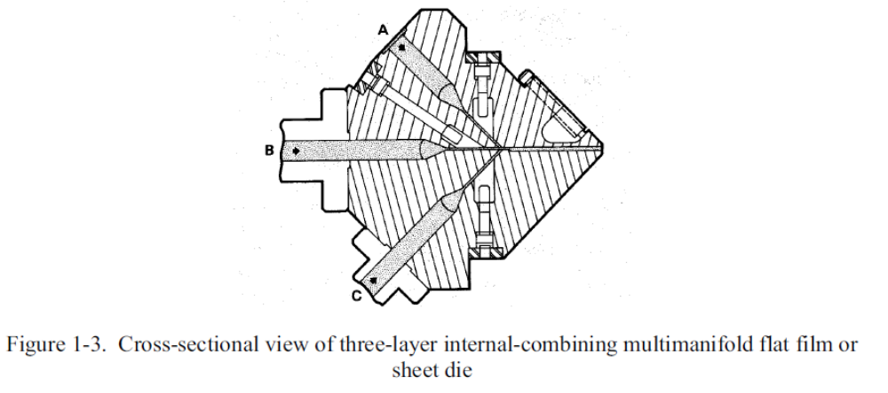
Multi-manifold dies
The principal advantage of multimanifold dies is the ability to coextrude polymers with very different viscosities since each layer is spread independently prior to combining.
Using a multi-manifold die, where the different layers are separately distributed along the full width before being merged to form the multilayer just upstream from the die lips;
Although expensive, such co-extrusion systems can accommodate polymers with very different rheological behaviors.
With these dies, it is possible to regulate flow across the width by profiling an adjustable restrictor bar in each manifold to help obtain uniform distribution.

Slide 20
Conclusions
The non-Newtonian behavior affects processing of polymers in order to provide multi layers structures of consistent quality that can be formed
One remarkable property of polymeric liquids is their shear-thinning behavior (also known as pseudo-plastic behavior). This reduction of viscosity is due to molecular alignments and disentanglements of the long polymer chains. The higher the shear rate, the easier it is to force polymers to flow through dies and process equipment.
Power law exponent and Carreau-Yasuda frequently used for better fitting of data over the entire shear rate range
Interfacial instability in co-extrusion consisting of highly irregular or sometimes regular waviness can occur in coextruded structures at the polymer/polymer interface. The effect is to significantly reduce the optical quality of coextruded film. It is an internal defect
These instabilities can be solved through various strategies

Slide 21
Thank You
www.mosongomoukwa.com

