Slide 1

Brief history of plastics and how they conquered the world
Mosongo Moukwa, PhD
PolyOne Corporation
USA
International Conference on Polymer Science and Engineering August 22-24 2016 New Orleans, Louisiana, USA

Slide 2
Contents
Introduction
History
Applications
Plastics Market
Summary

Slide 3
introduction

Slide 4
“Just remember one word… Plastics.”
- From the motion picture The Graduate (1967)

Slide 5
We have always lived in a polymer age
The word “Polymer” is derived from the Greek poly and meros, meaning many and parts, respectively. There has always been an abundance of natural fibers and elastomers, but few plastics

Slide 6
The Baruch Committee Report to the
President 1942
“Of all critical and strategic materials, rubber is the one which presents the greatest threat to the safety of our nation and the success of the Allied cause. If we fail to secure quickly a large new rubber supply our war effort and our domestic economy will collapse…. The rubber situation gives rise to our most critical problem.”
- From the Baruch Committee Report to the
President 1942

Slide 7
Polymer based materials
Polymers arguably represent the most important class of materials today.
Their multiple and tunable attributes explain their expanding use across most advanced technology platforms

Slide 8
Plastics
In energy, sustainability, health care, security
and informatics, defense and protection. In
fact, more than any other class of materials,
polymers, have the ability to serve in many
different capacities, from major structural
components (e.g. the Boeing 787
“Dreamliner” is 80% by volume carbon fiber
reinforced thermoset) to high value-added
ingredients on the scale of grams (e.g.
lithography, drug delivery)

Slide 9
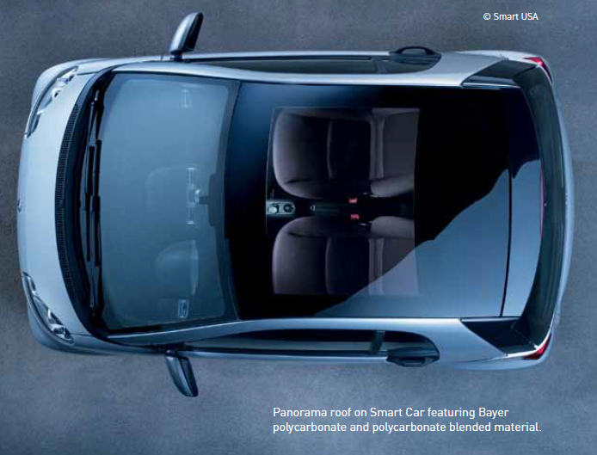

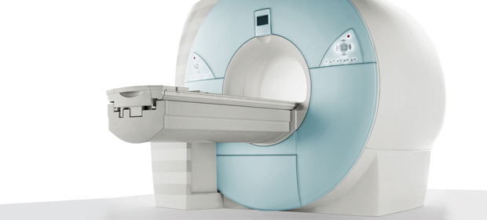
Plastics are everywhere
PolyOne Replacing Lead with Radiation Shielding Technology
In a world first, a bio-based engineering plastic is being used in the front panel of a smartphone (Source: Sharp)

Slide 10
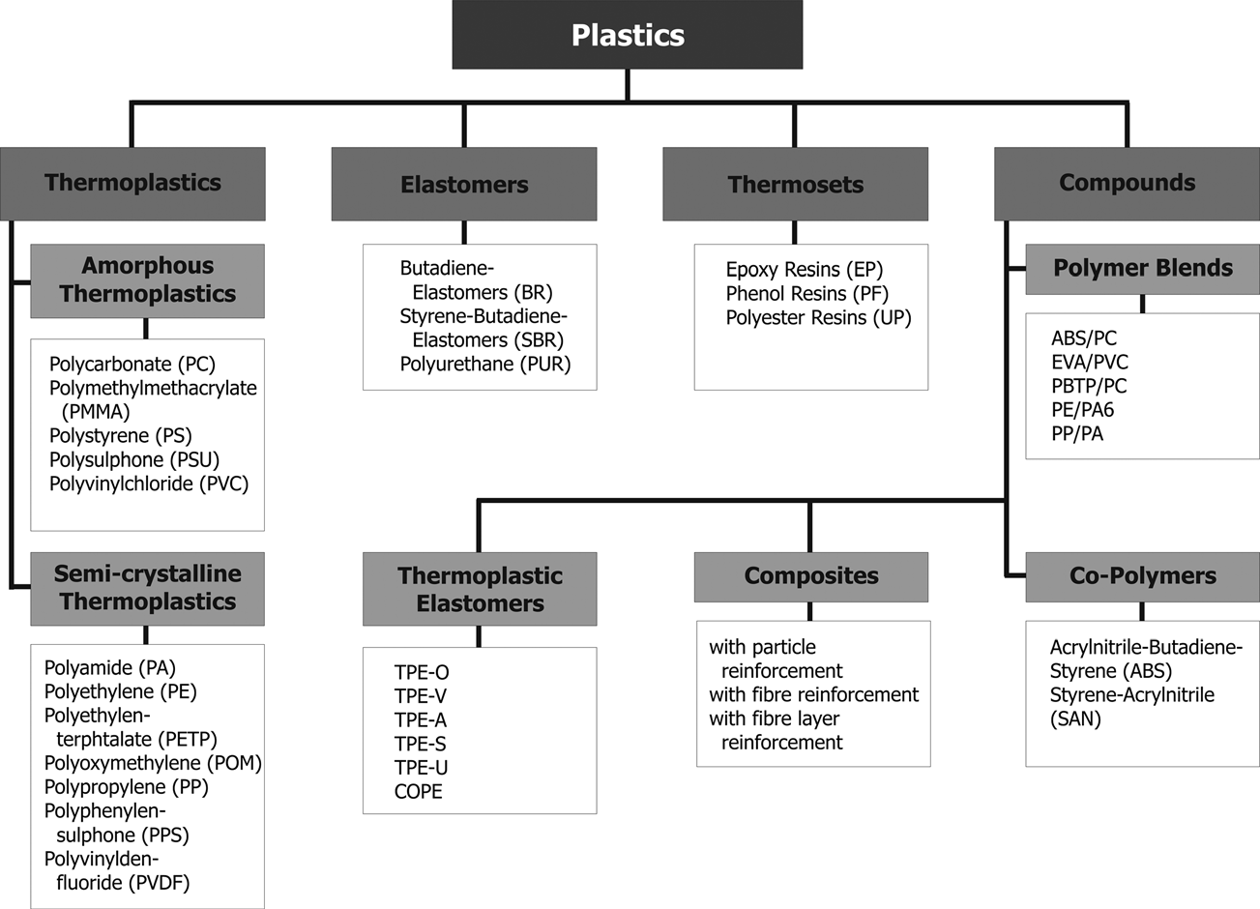
Classification of plastics

Slide 11
History

Slide 12
History of Plastics-timeline
Cellophane causes plastic craze
Polyethylene is discovered
Nylon stockings hit the market
First man made plastics
Rayon is discovered
1862
1880
1891
1900
1913
1920
1933
1939
1940
1866
1907
1926
1938
1957
Celluloid
Bakelite is invented
PVC is invented
Teflon is discovered
Here comes Velcro

Slide 13
Timeline -
Precursors
1839: Natural rubber –method of processing by Charles Goodyear
1843: Vulcanite –Thomas Hancock
1843: Gutta-Percha – William Montgomerie
1856: Shellac – Alfred Critchlow, Samuel Peck
1856: Bois durci – Francois Charles Lepag
Start of the plastic era with semi synthetic
1839: Polystyrene discovered – Eduard Simon
1862: Parkesine – Alexander Parkes
1863: Cellulose Nitrate or Celluloid – John Wesley Hyatt
1872: Polyvinyl Chloride or PVC – Eugene Bauman
1894: Viscose Rayon – Charles Frederick Cross, Edward John Bevan
The first man made Plastics

Slide 14
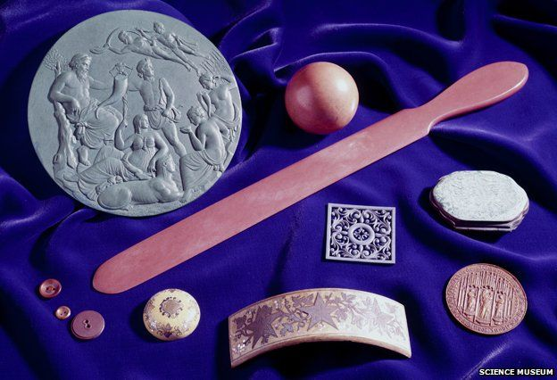
Parkesine
Collection of objects made from Parkesine, held by the Science Museum

Slide 15
Timeline -
Thermosetting and thermoplastics
1908: Cellophane ® -Jacques Brandenberger
1909: First true modern plastic pheno-Formaldehyde trade named
Bakelite
1926: Plasticized PVC – Walter Semon
1927: Cellulose Acetate
1933: PVDC –Polyvinylidene chloride or Saran- Ralph Wiley of Dow
1935: Low density polyethylene or LDPE – Reginald Gibson and Eric
Fawcett
1936: Acrylic or poly methyl methacrylate
1937: Polyurethane – discovered by Otto Bayer and co workers
1938: Polystyrene made practical
1938: Polytetrafluoroethylene or PTFE tradenamed Teflon – Roy
Plunkett
1939: Nylon and Neoprene- replacement for silk and a synthetic
rubber- Wallace Hume and Carothers

Slide 16
Bakelite: birth of of modern plastics era
Leo Baekeland in 1907 announced in an American Chemical Society meeting the synthesis of the first truly synthetic polymeric material, later dubbed Bakelite. Was looking for a replacement for shellac used in electrical insulation
Bakelite, not only a superb insulator. But good materila for consumer goods, …even better than celluloid
Phenol + Formaldehyde → P-F resin + water
Bayer (Germany) and Luft (Austria) had already
made similar resins, but failed to commercialise them.

Slide 17
Timeline -
Thermosetting and thermoplastics
1941: Polyethylene Terephthalate or PET – Whinfield and Dickson
1942 Low density polyethylene
1942: Unsaturated polyester also called PET –John Rex Whinfield and
James Tennant Dickson
1951: High density polyethylene or HDPE – Paul Hogan and Robert
Banks
1951: Polypropylene or PP - Paul Hogan and Robert Banks
1953: Saran Wrap introduced by Dow Chemicals
1954: Styrofoam, foamed PS – Ray McIntire of Dow Chemicals
1964: Polyimide
1970: Thermoplastic polyester- trademarked Dacron, Melinex, Teijin
and Tetoron

Slide 18
Plastics industry came of age during the war
Americans searched for alternative materials that would substitute for and improve the performance of scarce natural resources like rubber, metal, wool, wood, and cotton.
Advances in polymer science provided the needed materials, and plastics proved invaluable to the war effort.
  For example, nylon, invented in 1935, was used for parachutes, ropes, body armor, and more. Plexiglas provided a light, durable alternative to glass for aircraft windows, and nonstick Teflon was used in the atomic bomb.
When the war ended, the American economy shifted from producing tanks and planes to making consumer goods. , with new products such as Tupperware, launcehd in 1948

Slide 19
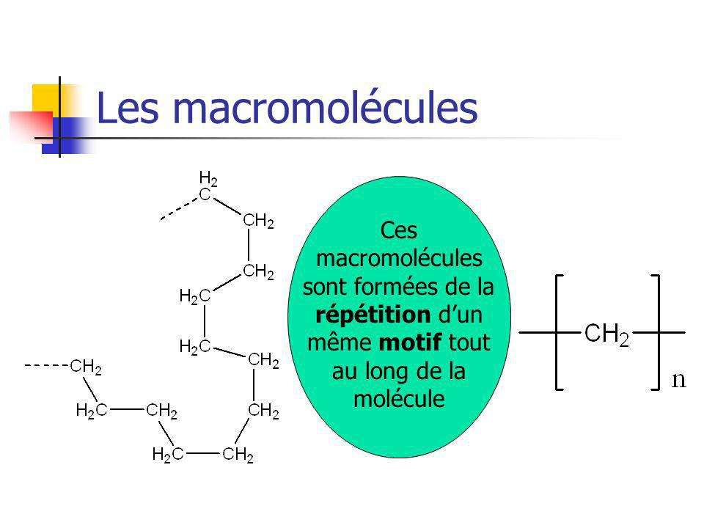
Macromolecules
The broad field of macromolecules science has never been more vibrant since 1919, when Staudinger proposed the concept of macromolecules composed of atoms repetitions and published the theories of polyaddition
Macromolecules are a repetition of the same template
…None years later, he published the polymerization of polystyrene

Slide 20
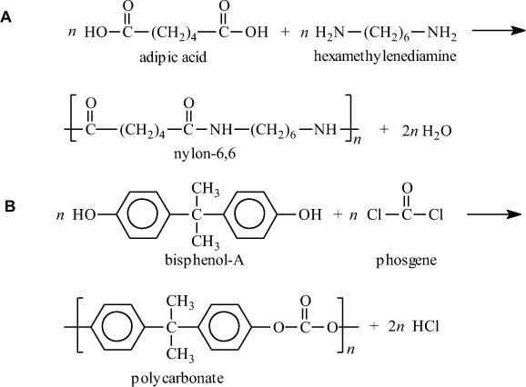
Theory of poly condensation
1930’s research on Chemical Chains at Dupont published theory of poly condensation
Invented Neoprene and Nylon
A. Polyamidation of nylon-6,6
B. Polymerization of bisphenol-A polycarbonate
Condensation polymers are obtained by the random reaction of two molecules

Slide 21
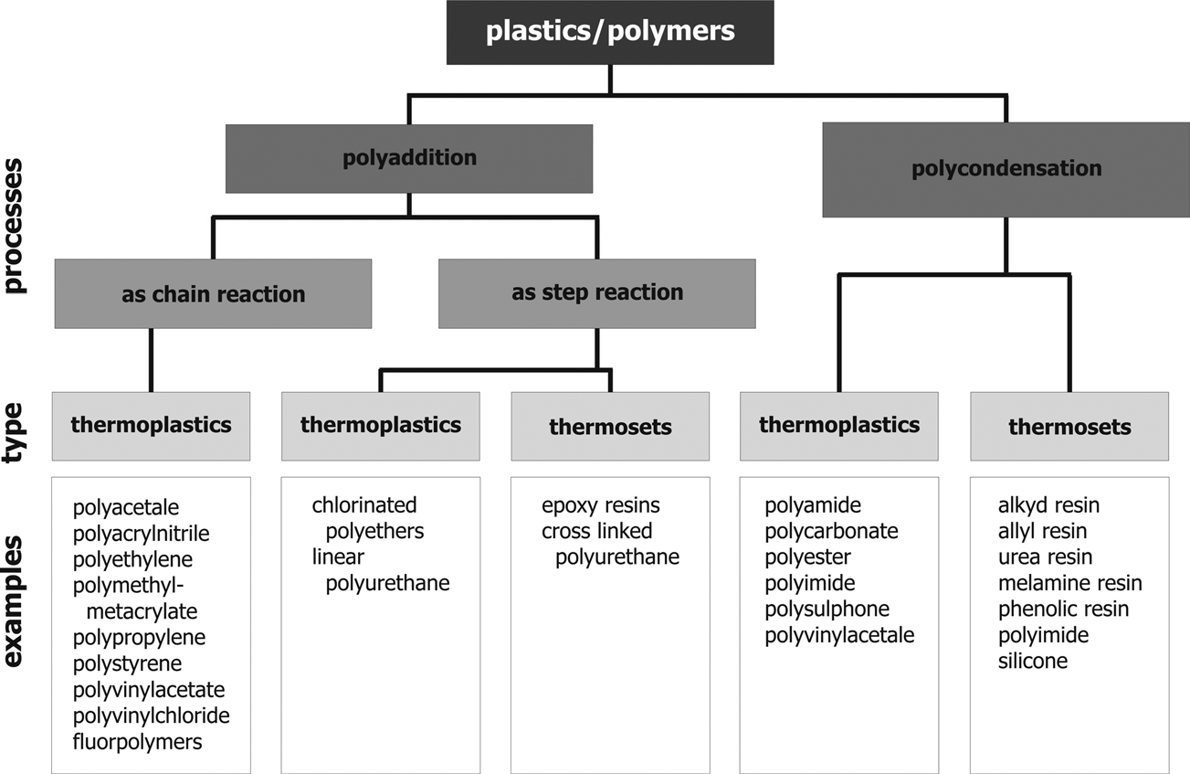
The basic structure of plastics (or polymers) is given by macromolecule chain

Slide 22
Nobel Prize Winners for Their Work with Synthetic Polymers
Scientist(s) | Year | Area
Hermann Staudinger | 1953 | Polymer hypothesis
Karl Ziegler and Giulio Natta | 1963 | Stereo-regulation of polymer structure
Paul Flory | 1974 | Organization of polymer chains
Bruce Merrifield | 1984 | Synthesis on a solid matrix
Pierre de Gennes | 1991 | Polymer structure and control at interface
A. J. Heeger, Alan Mac Diarmid, and H. Shirakawa | 2000 | Conductive Polymers

Slide 23
Commercialization of Selected Polymers
Polymer | Year | Company
Bakelite | 1909 | General Bakelite Corp.
Rayon | 1910 | American Viscose Company
Poly(vinyl chloride) | 1927 | Goodrich
Styrene-butadiene copolymer | 1929 | I. G. Farben
Polystyrene | 1929/1930 | I. G. Farben and Dow
Neoprene | 1931 | DuPont
Poly(methyl methacrylate) (PMMA) | 1936 | Rhom & Haas

Slide 24
Conti….
Polymer | Year | Company
Nylon 6, 6 | 1939/1940 | DuPont
Polyethylene (LDPE) | 1939 | ICI
Poly(dimethyl Siloxane) | 1943 | Dow Corning
Acrylic fiber | 1950 | DuPont
Poly(ethylene terephthalate) | 1953/1954 | DuPont / ICI
Polyurethane block copolymers (Spandex) | 1959 | DuPont
Poly(phenylene terephthalate) | 1960 | DuPont

Slide 25
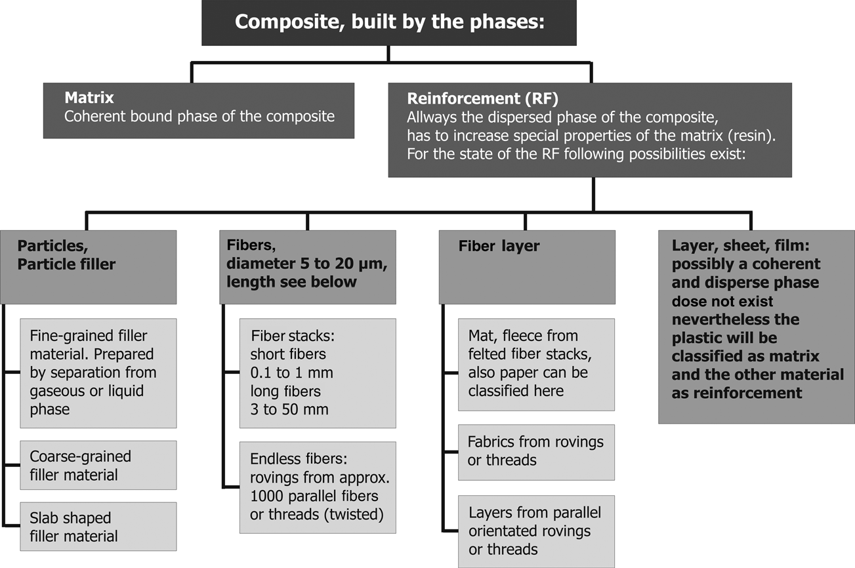
Classification of polymer composites

Slide 26
applications

Slide 27
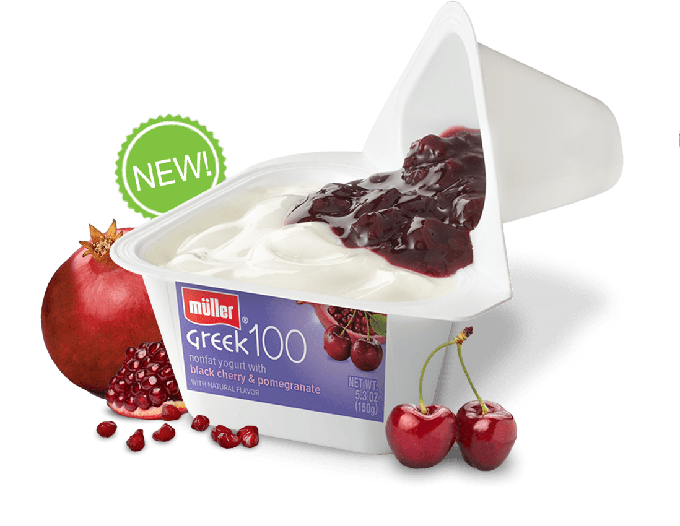
Food packaging

Slide 28
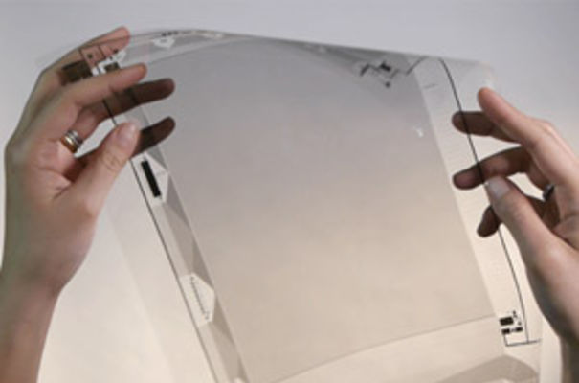
Flexible displays
Flexible displays have progressed so much that companies such as Polymer Vision and Plastic Logic have developed electronic-paper-type applications based on electrophoretic displays driven by organic active-matrix backplanes
Figure 6: flexible display technology by Plastic Logic.
Source: http://www.businessweekly.co.uk/killer-50/50-insider/17764-oled-innovation-award-plastic-logic

Slide 29

Our latest airplanes
Two of the most technologically advanced passenger jets- Boeing Dreamliner and Airbus A350 ZWB -are made with composites of plastics that are reinforced with other materials, such as carbon fibers. So the planes are really tough, lighter weight, and more fuel-efficient. The composite wing tips on the Airbus bend during flight to improve efficiency

Slide 30

Modern cars
Today’s modern car is approximately 50 percent plastics by volume. But it’s only approximately 10 percent plastics by weight. Lightweight yet tough plastics—including those advanced composites—allow carmakers to “lightweight” their vehicles to help significantly improve gas mileage (plus, enhance safety and design features, too).

Slide 31
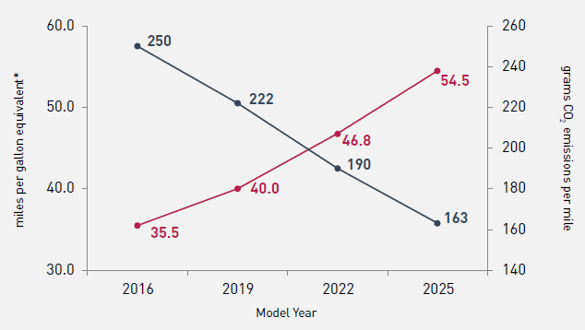
Fuel economy improvements
Ducker Worldwide estimates that 400 pounds—about 10 percent—needs to be removed from the average car to meet the proposed EPA emissions standards that are equivalent to 54.5 mpg.
Data source: U.S. Environmental Protection Agency, “EPA and NHTSA Set Standards to Reduce Greenhouse Gases and Improve Fuel Economy for Model Years 2017-2025 Cars and Light Trucks,” http://www.epa.gov/otaq/climate/documents/420f12051.pdf.

Slide 32
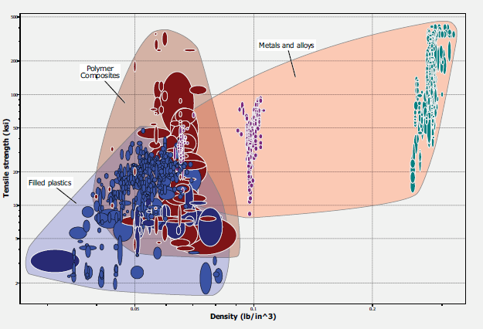
Plastics and composites vs metals
Source: American Chemistry Council

Slide 33

Sporting goods
Nylon, polyester, acrylic, lycra, spandex … all plastic fibers that make up today’s modern stretchy, comfy, sweat-wicking fabrics. Helmets, shin guards, mouth guards … pretty much all plastics.)

Slide 34

Tennis racquets
Most modern racquets are made with composites, such as plastics and carbon fiber, typically called carbon fiber-reinforced plastics. They are lighter weight, stiffer, and stronger than many of the previous materials used for racquets.

Slide 35
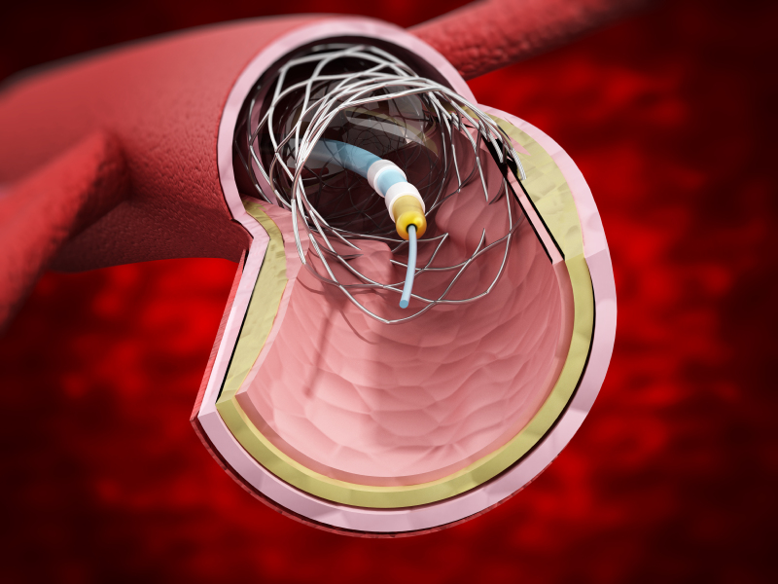
Stents to open blocked heart arteries
Life-saving “stents” are typically are small metal mesh devices covered in plastics. And get this: the FDA has approved a plastic heart stent that doesn’t need the metal mesh. It does its job and then just dissolves completely over time.

Slide 36

Modern eyeglasses
Nearly all modern eye glasses are made with tough, shatter-resistant plastics, such as polycarbonate. These plastic lenses can be crafted into myriad prescriptions and shapes—and then attached to plastic frames to make us look professional, hipster, nerdy, younger

Slide 37
Plastics market

Slide 38
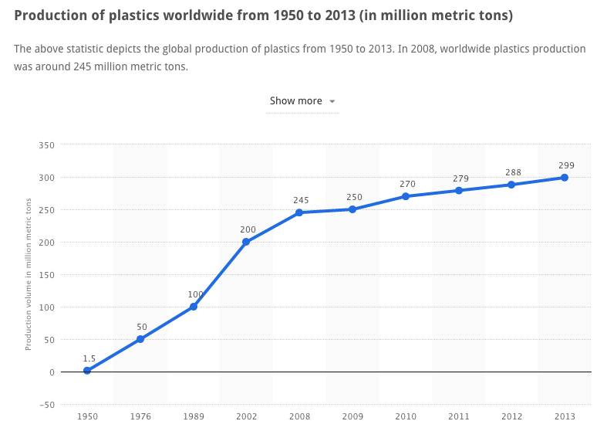
Global plastics production
315 million tons in 2015, growing at 5.3% CAGR and driven by demand for lighter, flexible and durable materials into automotive and transportation; consumer and appliances; electrical and electronics; and others
Source: Plastic Europe
315
315
Million tons
2015
2016

Slide 39
Plastics provide for a variety of markets
In Europe, packaging applications are
the largest application sector for the
plastics industry and represent 39.0%
of the total plastics demand.
Building and construction is the second
largest application sector with 20.6%
of the total European demand.
Automotive is the third sector with a
share of 7.5% of the total demand.
Electrical and electronic applications
represent 5.6% of the plastics demand
Other application sectors such as
appliances, household and consumer
products, furniture and medical
products comprise a total of 21.7%
of the European plastics demand.
Source: Plastics Europe

Slide 40
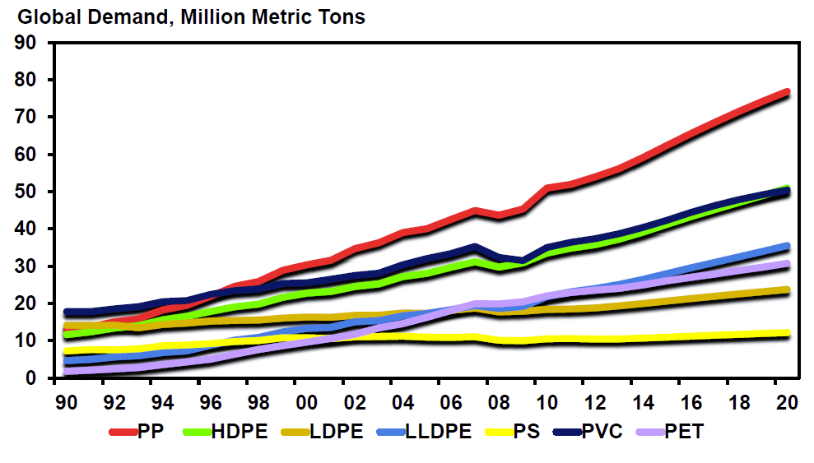
Global production
Polyethylene (PE) accounts for 37%
Propylene (PP) growth outpaced other polymers
Polyethylene (PE), High Density Polyethylene (HDPE), Low density Polyethylene (LDPE), Polyvinyl (PVC), Polyethylene terephthalate (PET); Polystyrene (PS); Acrylonitrile-Butadiene-Styrene (ABS); Polycarbonate (PC); Polypropylene (PP)
Source: PlasticsEurope (PEMRG) and IHS

Slide 41
summary

Slide 42
Impact of Plastics on the economy
Plastics have been a source of jobs, growth, innovation and sustainability
The growth of the plastics industry has a multiplier effect on numerous important sectors of the economy.
A key enabler of innovation of many products and technologies in other sectors of the economy like healthcare, energy generation, aerospace, automotive, maritime, construction, electronics, packaging or textile.
None of these sector would innovate and grow as much as they do without plastic materials and solutions.

Slide 43
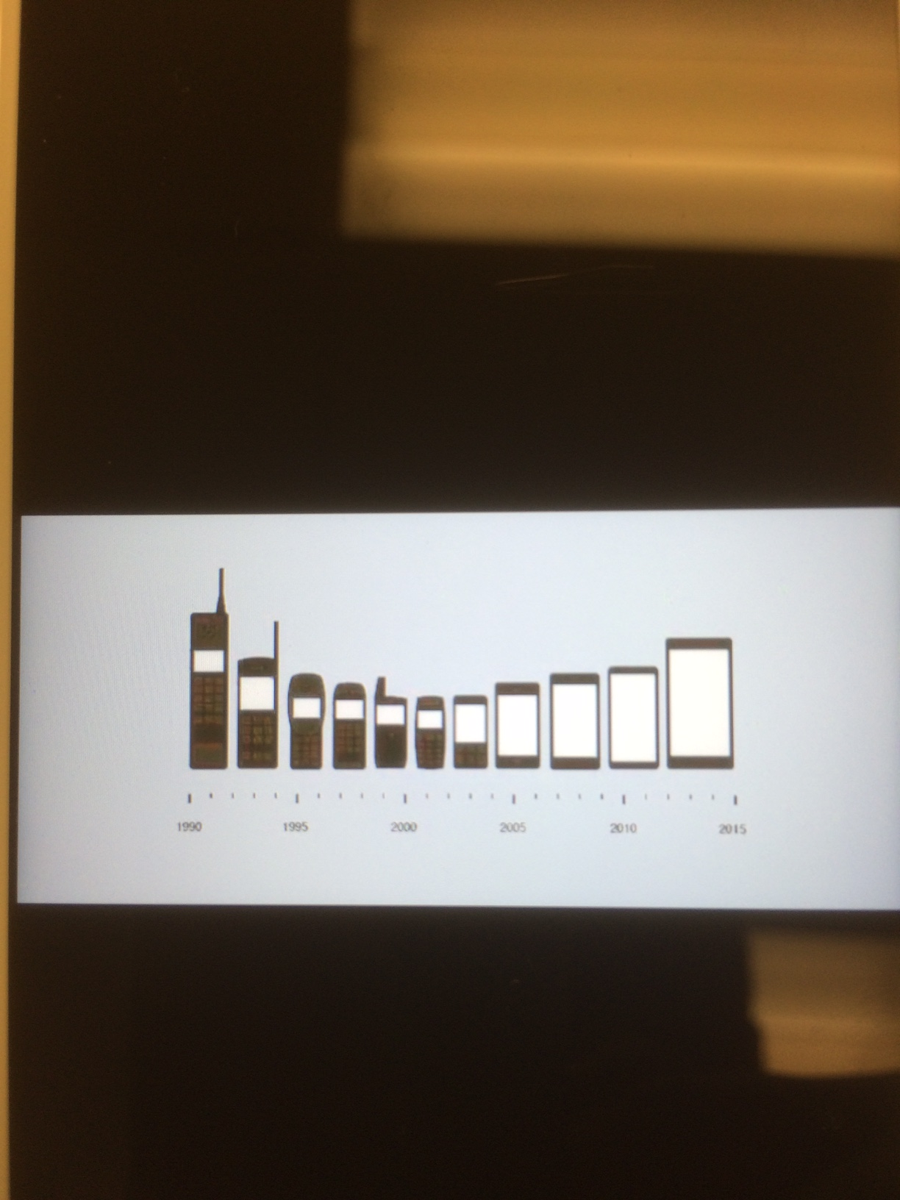

Slide 44
The multiplier effect of the plastics industry
A study led in 2013 by leading Italian think tank “The European House Ambrosetti” reveals the “multiplier effect” of the plastics industry:
It is in one of the sectors that provides the greatest contribution to manufacturing in Europe
  A 10% increase in the value added of the European plastics sector could lead to a 4.4% increase in the value added to the overall EU manufacturing sector.
  For every job created in the plastics sector, almost 3 jobs are created in the wider economy
  A 100€ increase in GDP in the national plastics supplychain generates 238€ of GDP in the national

Slide 45
Plastics unique characteristics
Unique characteristics of plastics also make a strong contribution to a more environmentally sustainable and resource efficient Countries.
Lightweight, versatile and durable plastics contribute to energy and resource savings in strategic sectors like retail, construction, healthcare, automotive or renewable energies.
In addition, significant advances are also being made in the environmental performance of plastics in their production and end-of-life phases, hence contributing to the sustainability of European industries and societies.

Slide 46
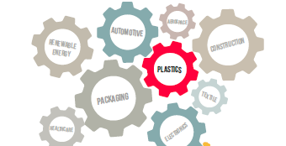
Thank you

