Slide 1
Tumor Treating Fields (TTFields) induced cancer cell death may be immunogenic resulting in enhanced antitumor efficacy when combined with immune-modulating therapy
Moshe Giladi
Head of Preclinical Studies
Novocure Ltd.
(C) 2016 Novocure. All rights reserved. Novocure is a trademark of Novocure. SRC-046
Confidential - For internal training purposes only. Not to be distributed or used in the field

Slide 2
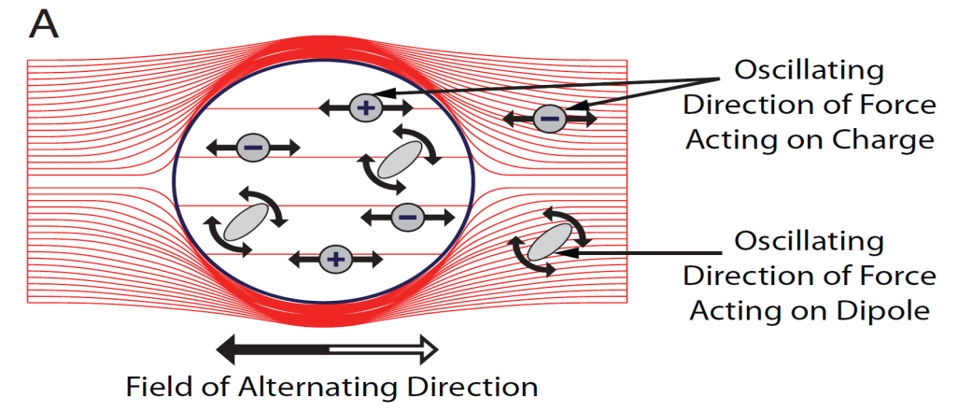
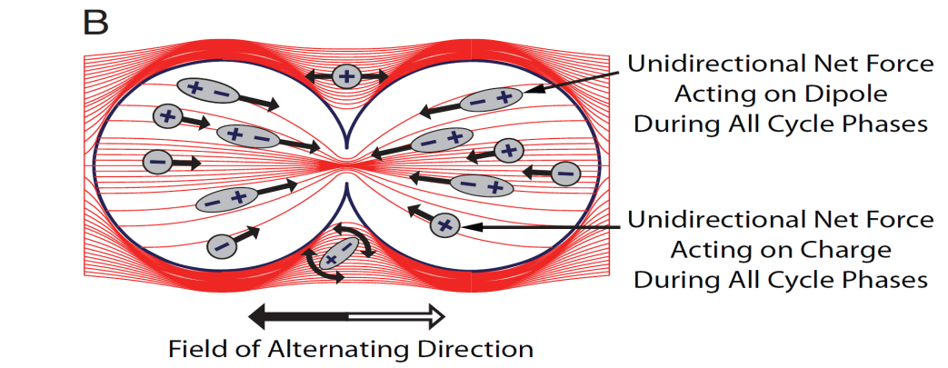
TTFields Distribution in and Around Quiescent and Dividing Cells
A
B
Oscillating
direction of force acting on charge
Unidirectional net force acting on
dipole during all
cycle phases
Unidirectional net force acting on charge during all cycle phases
Oscillating
direction of force acting on dipole
Field of alternating direction
Field of alternating direction
uniform electric field leading to dipoles alignment
nonuniform electric field leading to dielectrophoresis
Kirson ED, Dbalý V, Tovarys F, et al. PNAS. 2007;104(24):10151-10157.
Confidential - For internal training purposes only. Not to be distributed or used in the field

Slide 3
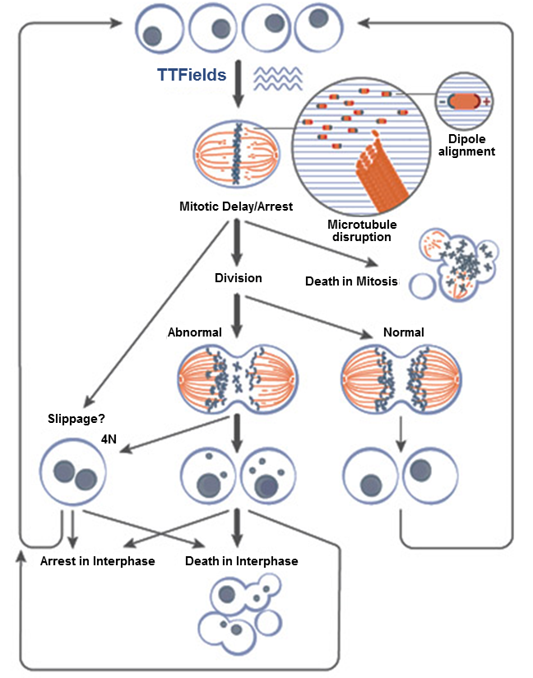
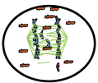
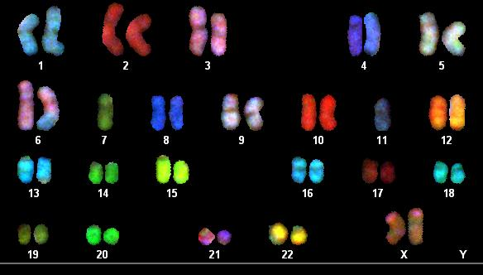
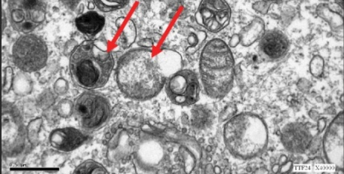
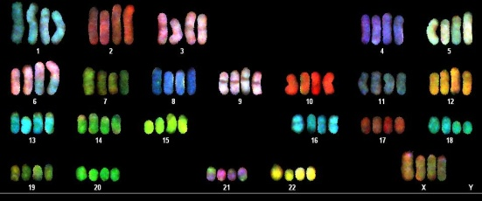
TTFields MOA Summary
NSCLC
NSCLC
Contractile ring
mislocalization
Ovarian
Ovarian
TTFields 48h TTFields 24h
Glioma
Modified from Giladi M, Schneiderman RS, Scientific Reports, 2015 and Gera et al., PLoS One. 2015
Confidential - For internal training purposes only. Not to be distributed or used in the field
Notes:
TTFields exert directional forces on polar microtubules and interfere with the assembly of the normal mitotic spindle. Such interference with microtubule dynamics results in abnormal spindle formation and subsequent mitotic arrest or delay, possibly due to improper attachment of chromosomes to the spindle fibers. Cells can die while in mitotic arrest, however, a more common outcome (highlighted by bold arrow) is progression to cell division. This can lead to the formation of either normal or abnormal aneuploid progeny. The formation of the tetraploid cells can occur either due to mitotic exit through slippage or can occur during improper cell division. Abnormal daughter cells can die in the subsequent interphase, can undergo a permanent arrest, or can proliferate through additional mitosis where they will be subjected to further TTFields assault.

Slide 4


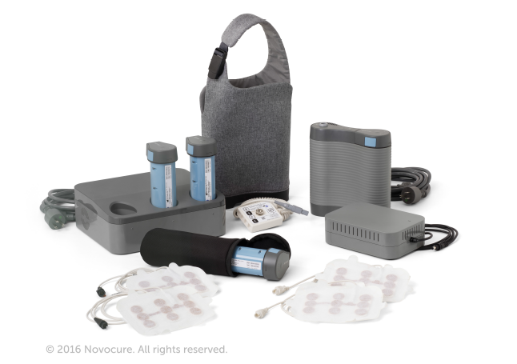
TTFields Are Delivered by Optune
Single-use transducer arrays deliver TTFields through the scalp¹
  Arrays deliver TTFields at a low intensity (1-3 V/cm) and intermediate frequency (200 kHz)²
1. Optune Patient Information and Operation Manual. Novocure Inc. Document number QSD-QR-331. November 1, 2014. 2. Optune Instructions for Use. Novocure Inc. Document number QSD-QR-330. November 2014.
Confidential - For internal training purposes only. Not to be distributed or used in the field
Notes:
TTFields, or Optune, uses principles of physics and electricity to interrupt cancer cell division^{1,2}:
Optune is FDA approved for treatment of adult patients with recurrent glioblastoma
Frequency-tuned to specifically target malignant glioma cells (200 kHz)
Provides portable, noninvasive regional therapy
Sterile, single-use transducer arrays are connected to the electric field generator to deliver TTFields through the scalp³
Each transducer array comprises:
9 ceramic discs covered by hydrogel
Flexible circuit board
Plastic coated wire that plugs the connection cable into the device
The transducer arrays are placed directly on the scalp in a way that targets the tumor and covers the head
Transducer arrays deliver TTFields at a low intensity (1–3 V/cm) and intermediate frequency (200 kHz)⁴
Optune includes³:
Electric field generator
Transducer arrays
Power cords
Portable batteries
Battery charger and rack
Connection cable
Carrying case
References:
Kirson ED, Dbalý V, Tovarys F, et al. Proc Natl Acad Sci USA. 2007;104(24):10152-10157.
Gutin PH, Wong ET. Am Soc Clin Oncol Educ Book. 2012;32:126-131.
Optune Patient Information and Operation Manual. Novocure Inc. Document number QSD-QR-331. November 1, 2014.
Optune Instructions for Use. Novocure Inc. Document number QSD-QR-330. November 2014.

Slide 5
EF-14: Secondary Endpoint, OS¹
Interim Analysis, Per Protocol Population
1.0
4 | TTFields + TMZ (n=196) | TMZ Alone (n=84)
Median OS from randomization, months¹ | 20.5 | 15.6
95% CI, months¹ | 16.6-24.9 | 12.9-18.5
Stratified log-rank¹ | P=0.0042
HR (95% CI)¹ | 0.666 (0.495-0.898)
Median OS from diagnosis, months² | 24.4 | 19.4
2-year OS¹ | 48% | 32%
0.9
TTFields + TMZ
0.8
TMZ alone
0.7
0.6
0.5
Fraction Survival
0.4
0.3
0.2
0.1
0.0
+ Censored
0
6
12
18
24
30
36
42
48
54
60
Overall Survival (months)
    In the final analysis (n=609), TTFields + TMZ extended median OS by 4.4 months, consistent with the interim analysis (n=280)¹
TMZ, temozolomide; CI, confidence interval; HR, hazard ratio; OS, overall survival.
References: 1. Optune Instructions for Use. Novocure. Document number QSD-QR-330. 2015. 2. Novocure Data on File OPT-103.
Confidential - For internal training purposes only. Not to be distributed or used in the field
Notes:
Overall survival (OS) was a powered secondary end point in the trial and was to be tested in the per protocol population. TTFields + temozolomide (TMZ) demonstrated significantly longer median OS compared with TMZ alone in the interim analysis (PP).
Median OS was significantly increased by almost 5 months in the TTFields + TMZ group (20.5 months; 95% confidence interval [CI], 16.6-24.9) compared with TMZ alone (15.6 months in the TMZ group; 95% CI, 12.9-18.5). (P = 0.0042; hazard ratio=0.666).
1-year survival was 75% in the TTFields + TMZ group and 70% in the TMZ alone group (P =0.162) at the interim analysis¹
2-year survival was significantly higher in the TTFields + TMZ group compared with the TMZ alone group (48% vs 32 %, respectively; P=0.0058).
The 1-year survival rates at the final analysis are shown in the table below:
Endpoint Optune/TMZ TMZ Alone P-Value
1-year Survival (PP) 69% 63% 0.131
1-year Survival (ITT) 69% 66% 0.265
The final analysis includes all patients randomized to EF-14 who had CRF information available at the database cutoff of December 3, 2014. This included 695/700 patients randomized at that time: 466 in the TTFields + TMZ arm and 229 in the TMZ alone arm.
References
Optune Instructions for Use. Novocure. Document number QSD-QR-330. 2015.

Slide 6
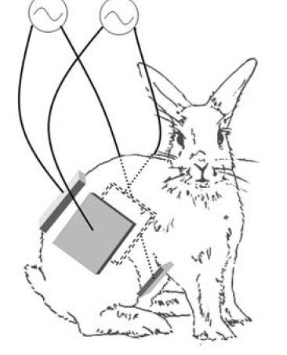
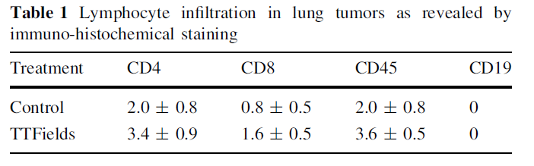
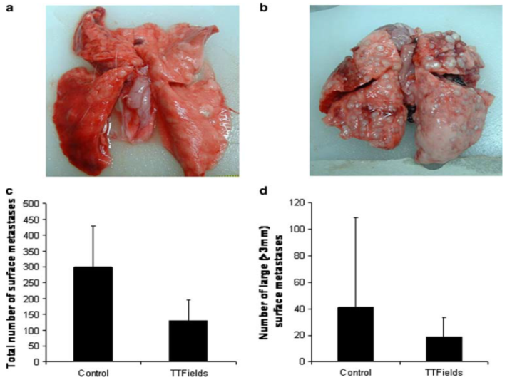
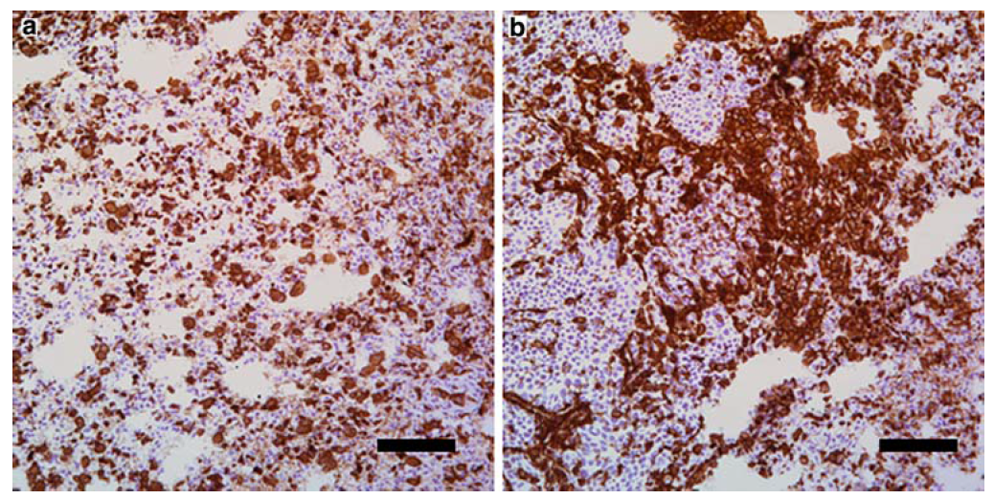
In Vivo Evidence of Immune Stimulation in Response to TTFields Application
Control TTFields
TTFields
Control
Kirson ED, Giladi M, Gurvich Z.et al. Clin Exp Met. 2009;26:633-640.
Confidential - For internal training purposes only. Not to be distributed or used in the field
Notes:
Placement of electrodes on rabbits. The four insulated electrodes were attached to the skin using hydrogel after depilation. The electrodes were wrapped with leucoplast and
electrodes wires were connected to the TTFields generating system or to the sham control system. The four electrodes were functionally divided into two pairs each generating one field direction through the animal. The electrode pairs were placed so as to create two perpendicular field directions at the center of body. Sham electrodes
were placed in the same configuration
Exemplary photos of surface lung metastases in TTFields treated versus sham control rabbits. Treatment was initiated on day 12 from implantation of the kidney tumor. The average total number (±SD) of surface metastases and the average number of large metastases (±SD) in control versus treated rabbits.
Discrete intra-tumoral infiltration of CD45 positive T cells in control tumours and abundant intra-tumoral CD45 positive T cells in TTFields treated tumours. Scale bar 100 lm

Slide 7
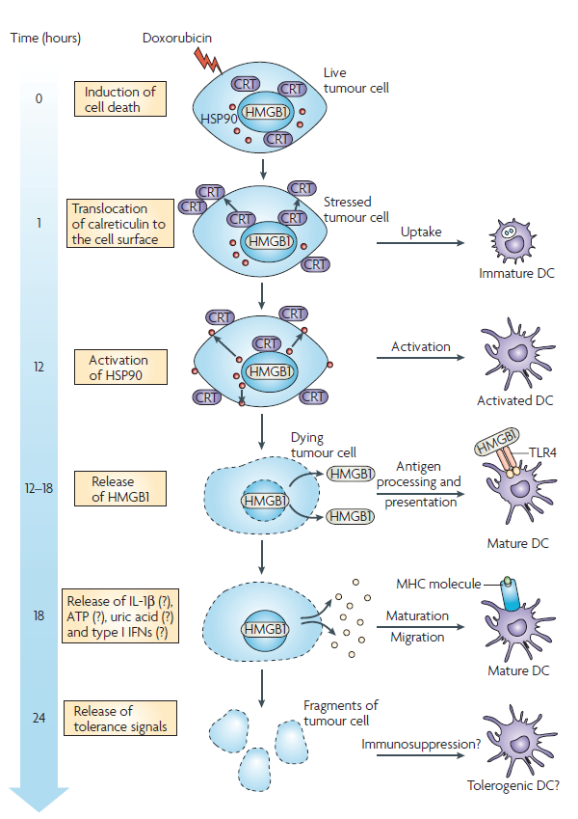
Immunogenic Cell Death - Sequential Events that Link Tumor-Cell Stress with Activation of Antigen-Presenting Cells
Calreticulin acts on the scavenger receptor (Eat me signal)
Toll-like receptor 4 is responsible for activating the innate immune system.
Zitvogel et.al , Nature reviews Immunology 2008
Confidential - For internal training purposes only. Not to be distributed or used in the field

Slide 8
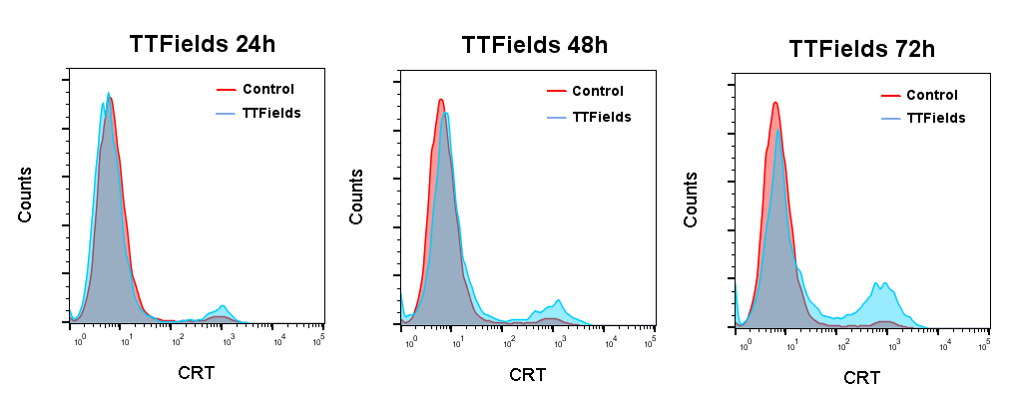
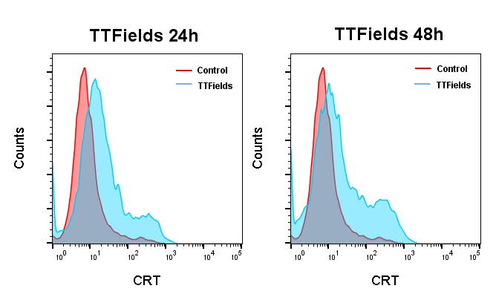
TTFields Application Mediate Cell Surface Exposure of Calreticulin
LLC-1
Mouse lung cancer
MOSE-L
Mouse ovarian cancer
Giladi et al., AAI 2016
Confidential - For internal training purposes only. Not to be distributed or used in the field

Slide 9
TTFields Induce an Increase in HMGB1 Release and a Reduction in Intracellular ATP Levels
LLC-1
Mouse lung cancer
MOSE-L
Mouse ovarian cancer
Giladi et al., AAI 2016
Confidential - For internal training purposes only. Not to be distributed or used in the field

Slide 10
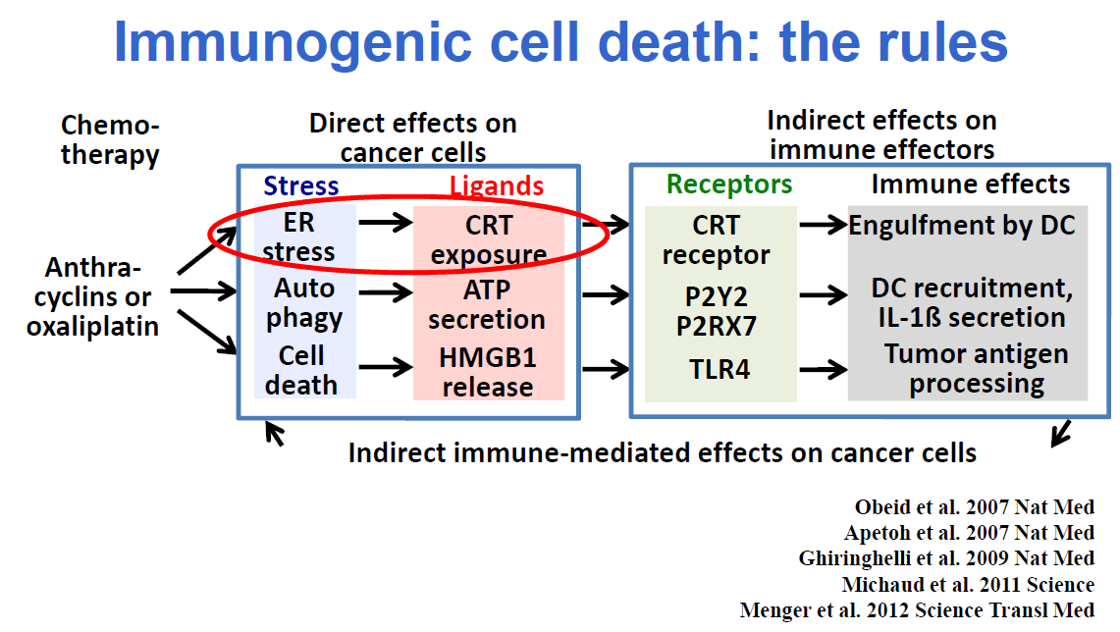
Sequential Events that Link Tumor-Cell Stress with Activation of Antigen-Presenting Cells
TTFields
Confidential - For internal training purposes only. Not to be distributed or used in the field

Slide 11
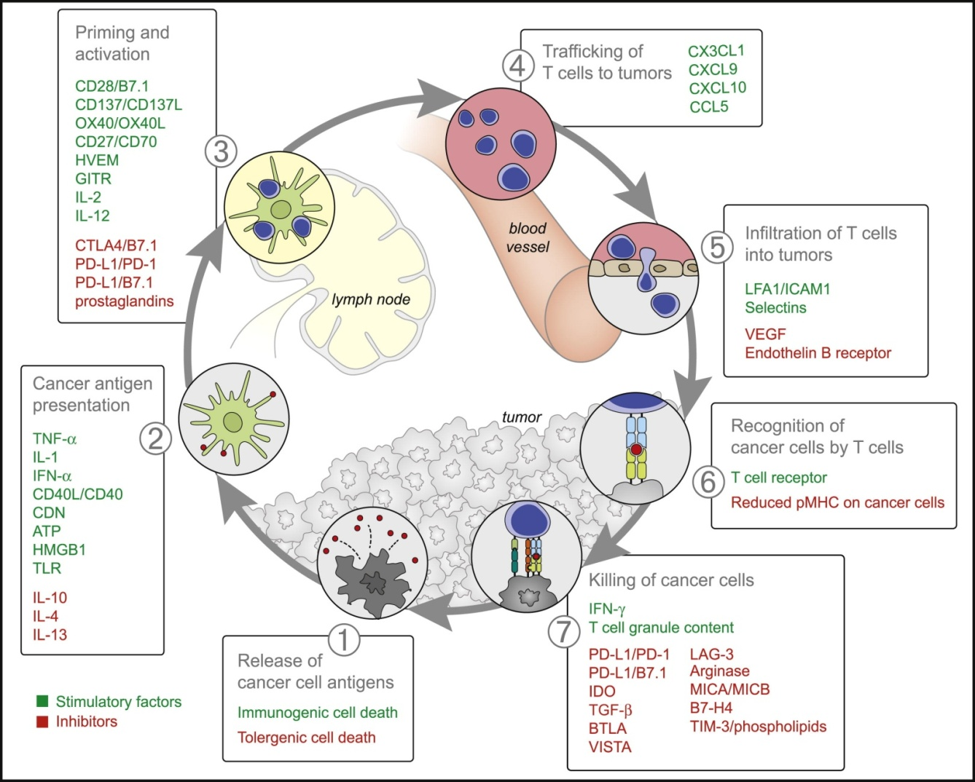
Cancer Immunity Cycle
Anti-PD1
Anti-PD-L1
TTFields
Image from Chen DS, et al. Immunity. 39:1-10. Copyright © 2013 Elsevier Inc.
Confidential - For internal training purposes only. Not to be distributed or used in the field

Slide 12
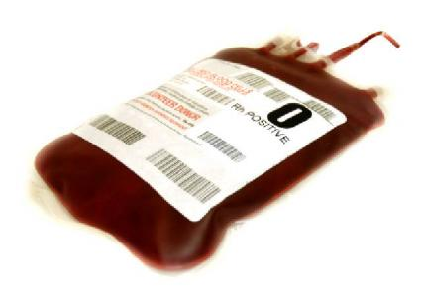
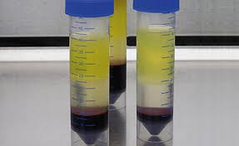

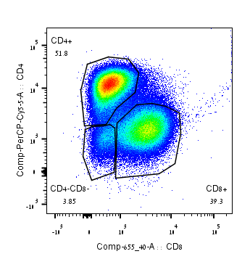
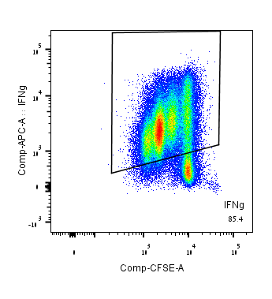
Assay design
Leukocyte fraction of
blood donation
acquired from MADA: ample supply of cells from multiple donors (5)
PBMC production
&
preservation
CFSE staining to detect proliferation
Activate cells with PHA Superantigen
Stain to:
Isolate T-cells
Detect immune activity:
Cytokine Secretion
Cytotoxic Degranulation
Activation/ Exhaustion Marker
Incubate in normal conditions / inovitro for 3.5 days
Flow
cytometry
analysis
Diamant et al., ISCR 2016
Confidential - For internal training purposes only. Not to be distributed or used in the field

Slide 13
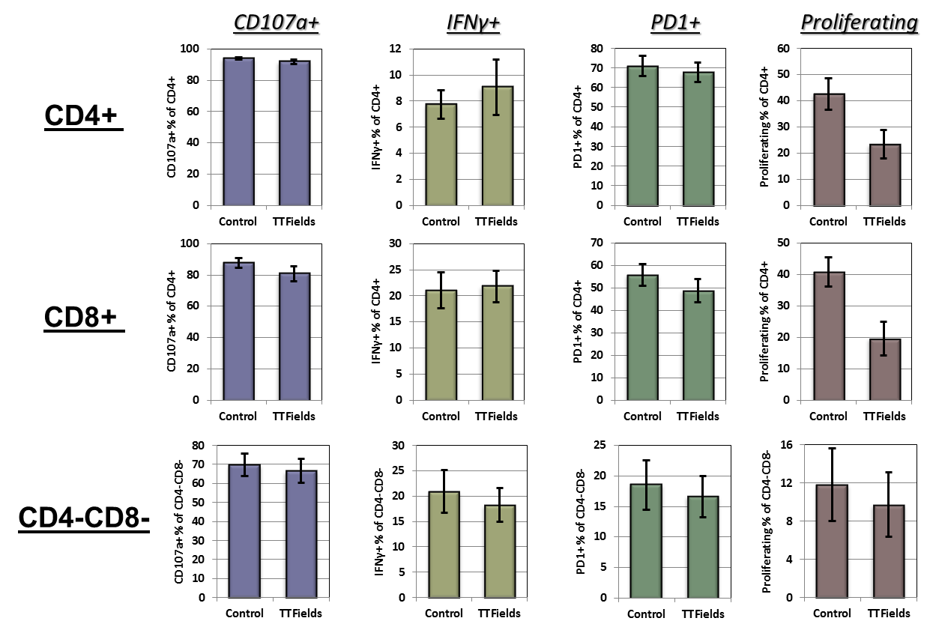
Effect of TTFields on T-cell activation in PBMC culture
Results indicate activated T cells treated with TTFields exhibit slight /no decrease (sometimes even increase) in IFNγ secretion, PD1 up-regulation, and cD107a surface presentation.
Live CD3+ T cells
CD4+
CD8+
CD8-
CD4-
Diamant et al., ISCR 2016
Confidential - For internal training purposes only. Not to be distributed or used in the field

Slide 14
Cancer Immunity Cycle
?
Chen DS, et al. Immunity. 39:1-10, 2013.
Confidential - For internal training purposes only. Not to be distributed or used in the field
Notes:
Over the years our understanding of the tumor immunology vastly increased and the now well known cancer immunity cycle provides the framework for how we can manipulate the immune system to attack and destroy tumor cells. There are 7 steps

Slide 15
TTFields in Combination with Anti-PD-1 Lead to an Increase in Antigen Presenting Cells Infiltration to the Tumor
Giladi et al., AAI 2016
Confidential - For internal training purposes only. Not to be distributed or used in the field

Slide 16
TTFields in Combination with Anti-PD-1 Lead to Elevated PD-L1 Expression and Reduced Tumor Volume
Giladi et al., AAI 2016
Confidential - For internal training purposes only. Not to be distributed or used in the field

Slide 17
Summary of TTFields effects
Disrupt normal mitotic spindle assembly leading to mitotic catastrophe
Lead to abnormal chromosomal segregation
Induce autophagy
Activate immunogenic cell death
Demonstrate enhanced antitumor efficacy when combined with immune-modulating therapy
Confidential - For internal training purposes only. Not to be distributed or used in the field

Slide 18
Cancer Immunity Cycle
TTFields
Image from Chen DS, et al. Immunity. 39:1-10. Copyright © 2013 Elsevier Inc.
Confidential - For internal training purposes only. Not to be distributed or used in the field

Slide 19
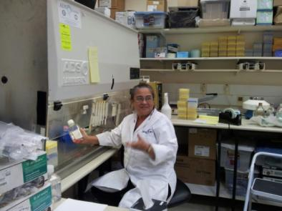

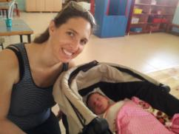
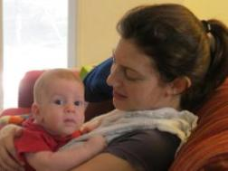
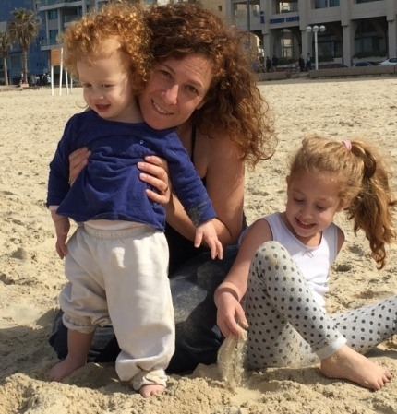
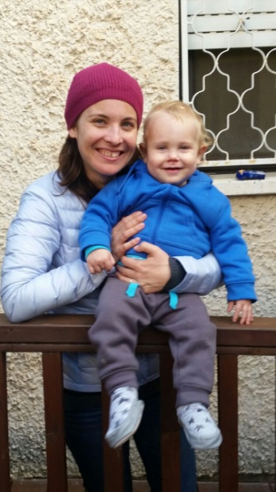
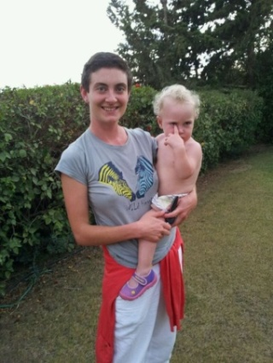
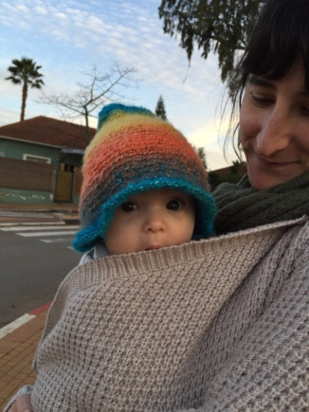
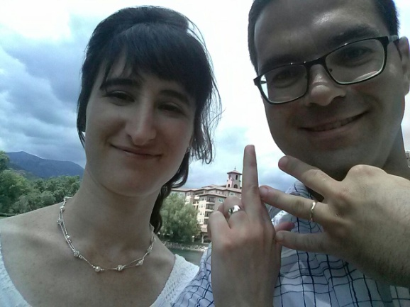
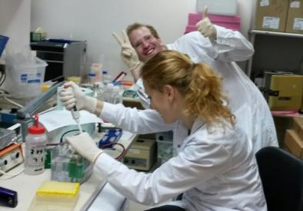

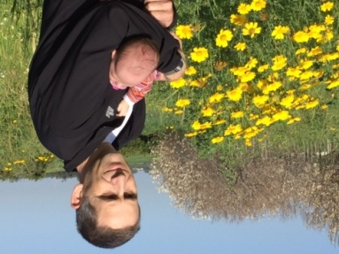
Novocure preclinical studies
Confidential - For internal training purposes only. Not to be distributed or used in the field

