Slide 1
Impact of sludge properties on solid-liquid separation of activated sludge
Morten Lykkegaard Christensen
Department of Chemistry and BioScience
Aalborg University, Denmark

Slide 2
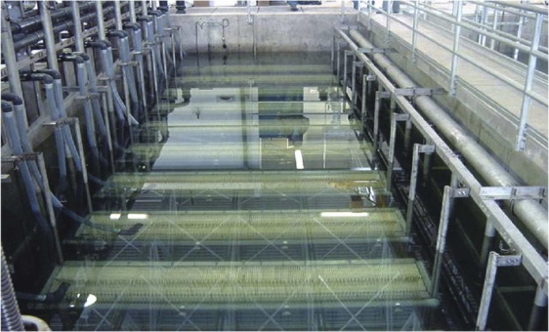
Institut for Kemi og Biovidenskab
Urban
wastewater
Mechanical
treatment
Treated
wastewater
CAS/MBR
Excess sludge
Sludge
Dewatering
Post treatment
Agriculture (fertilizer)
Incineration
Landfilling

Slide 3
Outline
What is sludge?
Filtration of sludge
Cake compressibility (inorganic and organic particles)
Sludge characteristic
  Hardness and conductivity
  Floc strength

Slide 4
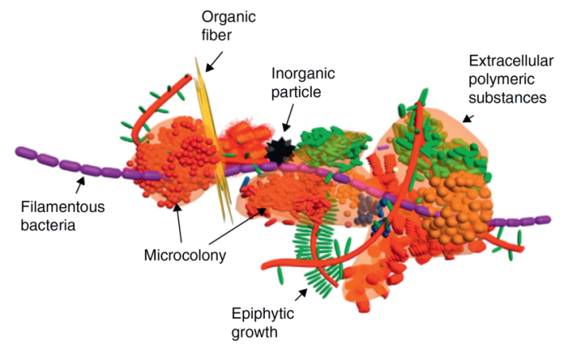
Activated sludge
Sludge flocs (30-170 µm)
Filaments
Single cells (1-10 µm)
Extracellular polymer substances EPS (0.02-0.03 µm)
Divalent ions (Calcium and Iron)
Monovalent ions

Slide 5
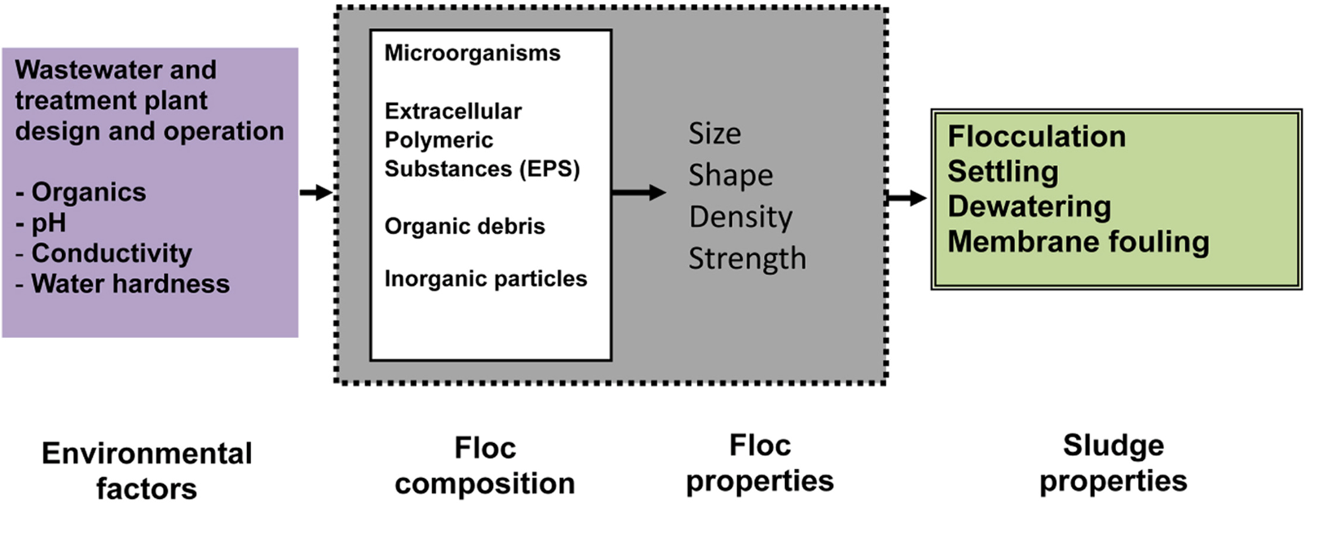
Properties of activated sludge

Slide 6
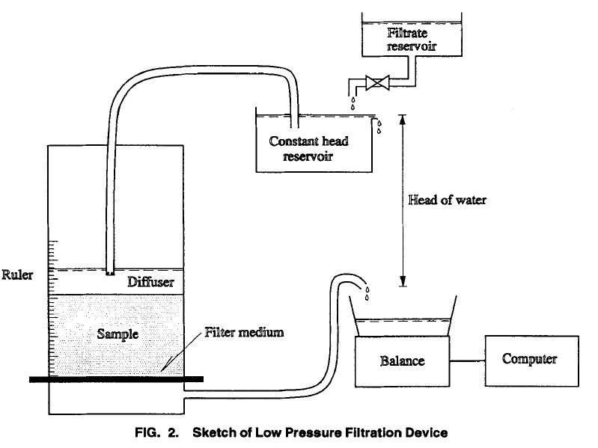
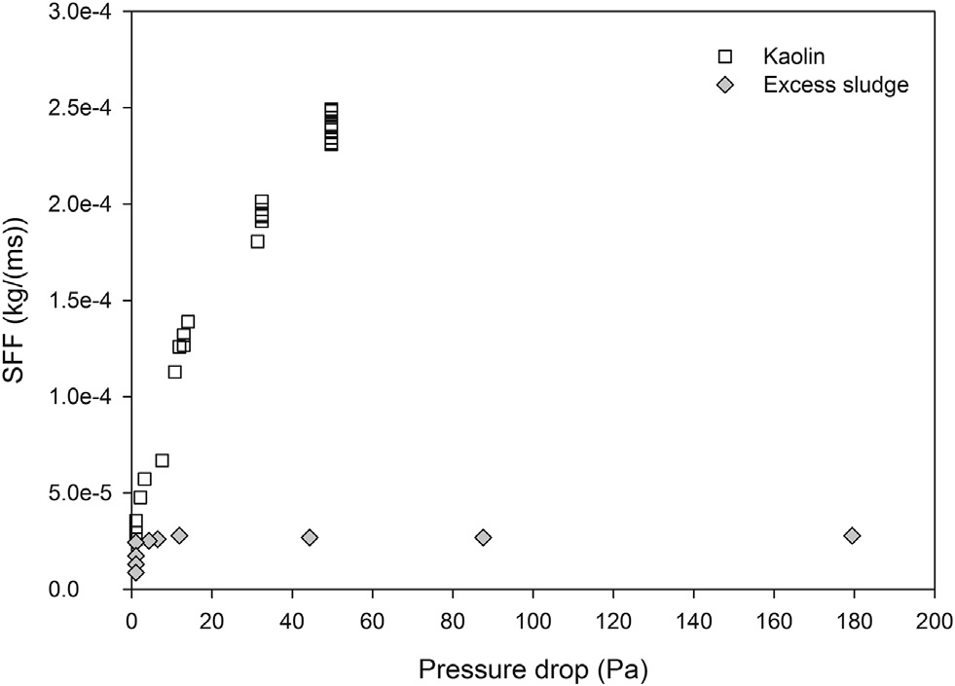
Highly compressible
10 cm

Slide 7
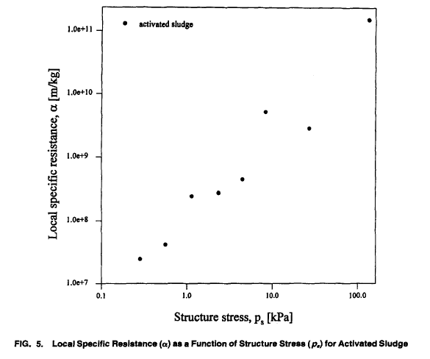
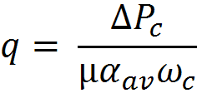
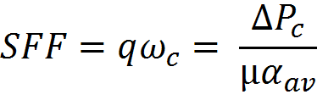
Specific flux constant with pressure not specific resistance
Specific filtrate flow rate (SFF)

Slide 8
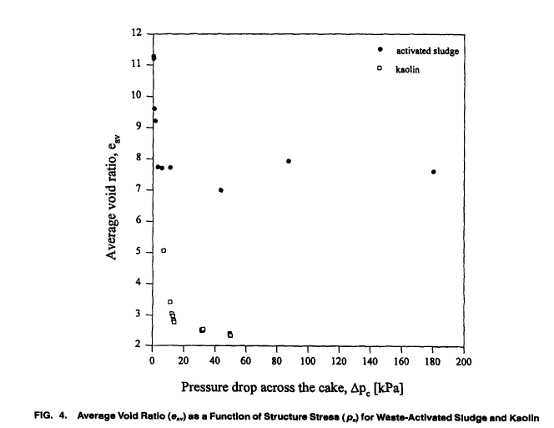
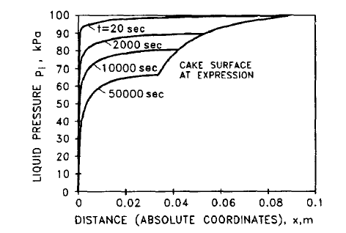
Dry matter content of the cake (skin layer formation)

Slide 9
Why are cakes compressible?

Slide 10
Cake compression (consolidation stage)
Chang and Lee. Wat. Res. 32, 3, 905-914,1998
Primary consolidation
Collapse of global structure, dissipation of excess pore water
Secondary consolidation
Constituent particles readjust into stable configuration
Highly viscous film of adsorbed water surrounding the surface
Ternary consolidation
Deformation and compression of constituent biological particles

Slide 11
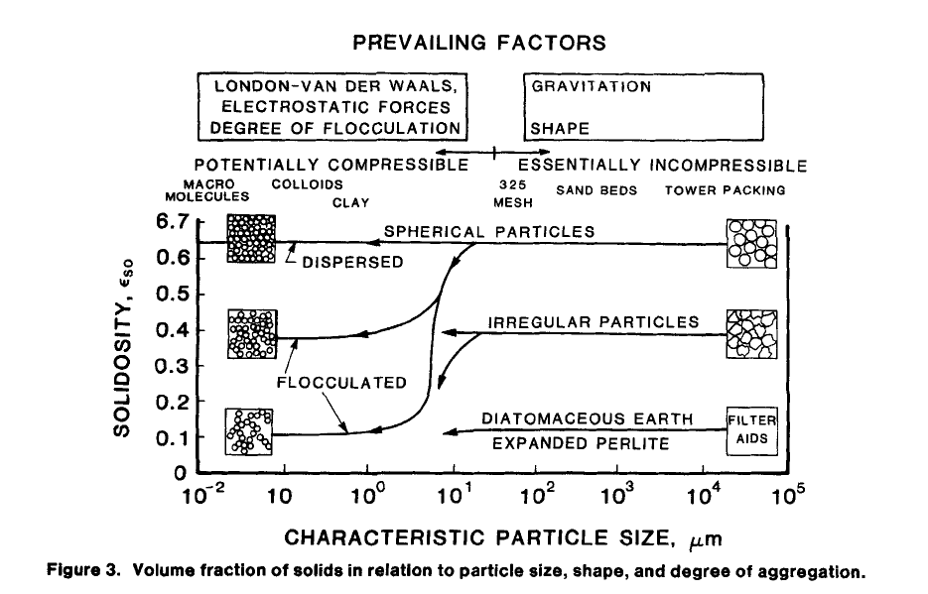
In-organic particles
Tiller and Yeh AIChE J 1987, 33, 8

Slide 12
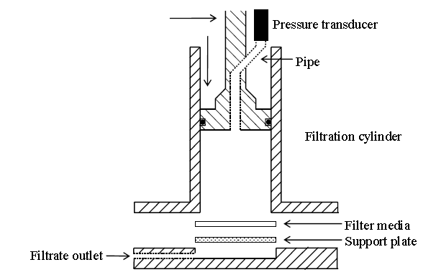
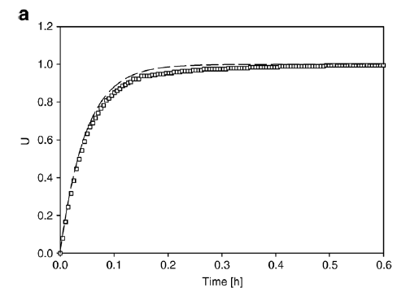
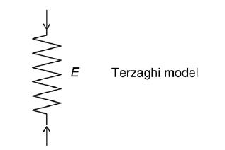
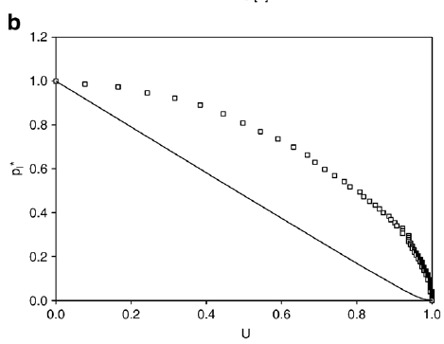
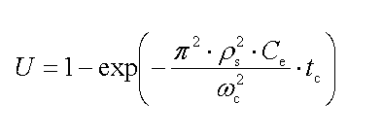
Consolidation anatase

Slide 13
What about organic materials?

Slide 14
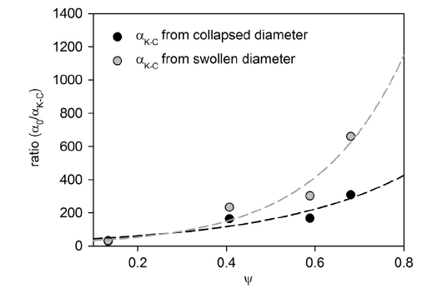
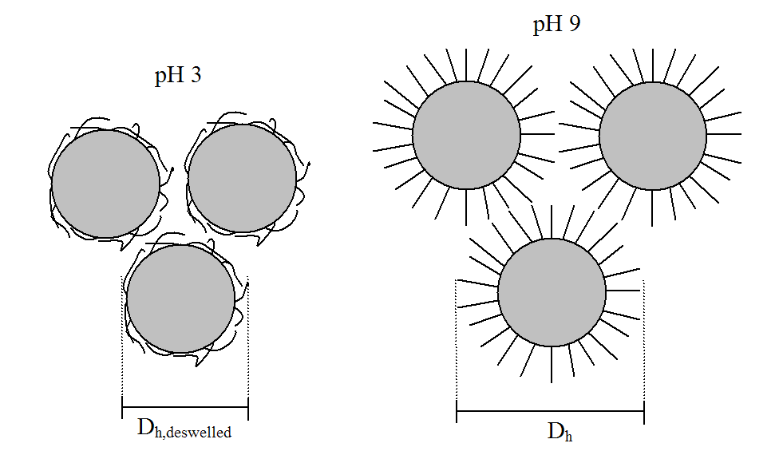
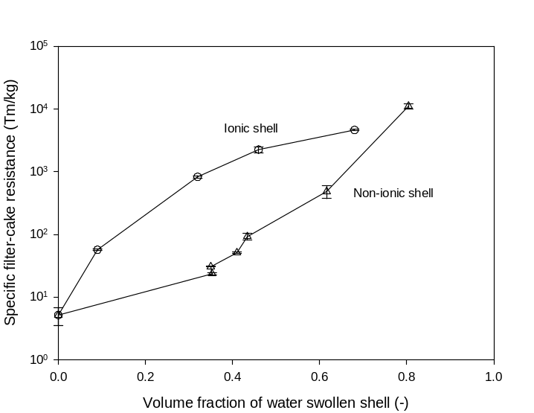
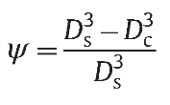
Deformation and compression
Organic particles

Slide 15
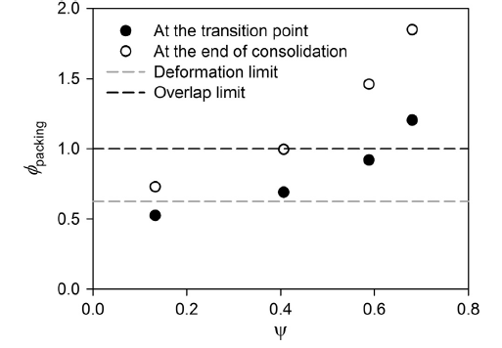
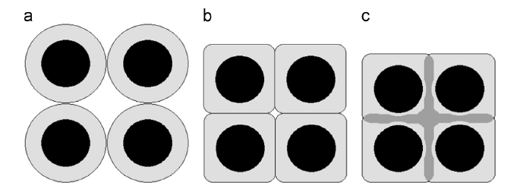
Deformation and compression
Organic particles

Slide 16
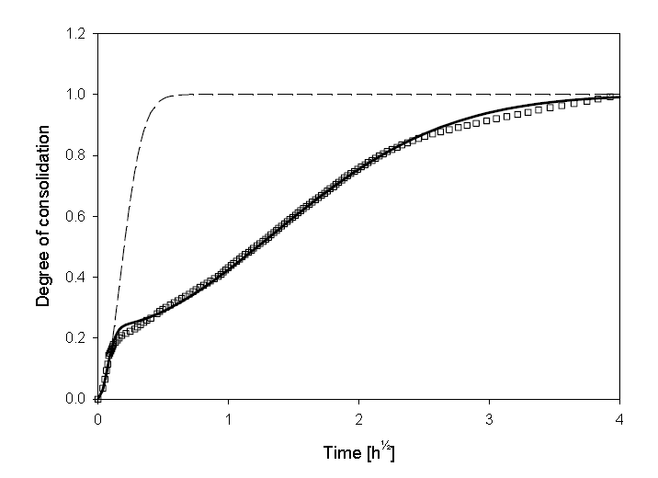
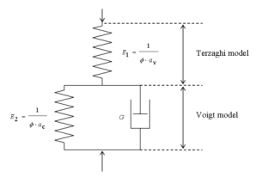
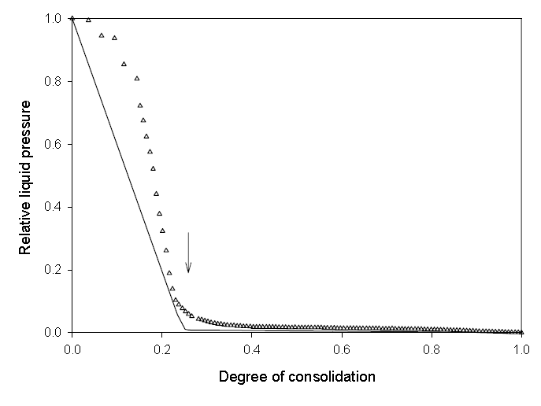
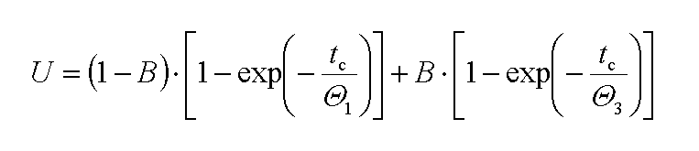
Consolidation poly(styrene-acrylic acid)

Slide 17
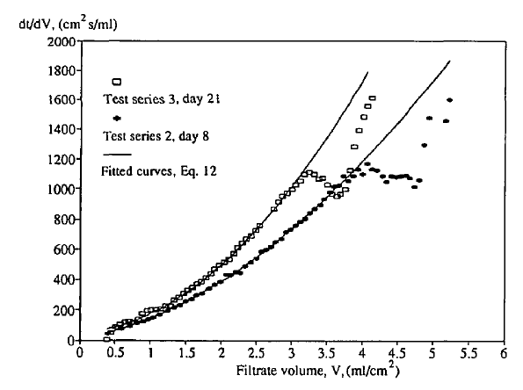
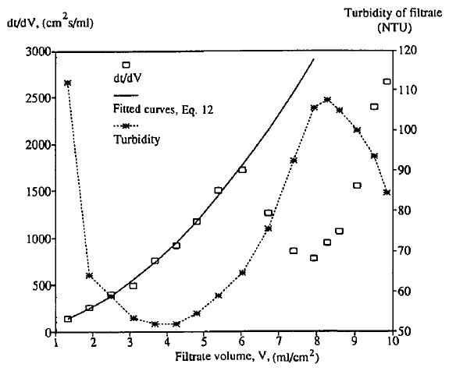
Blinding and floc erosion

Slide 18
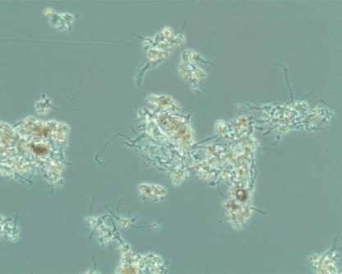
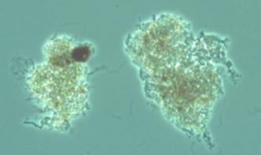
Biological sludge filterability
Not only function of size and structure
Water content and floc strength important as well
Bramming syd (easy to dewater)
Aalborg Øst (difficult to dewater)

Slide 19
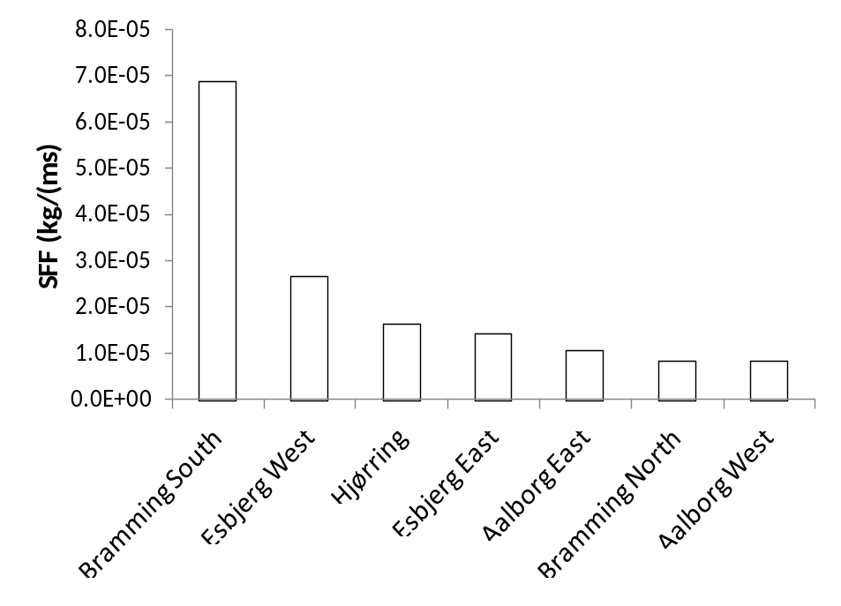
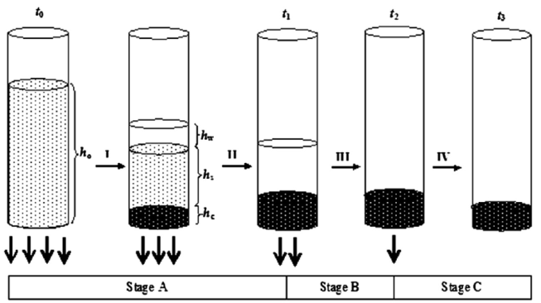
Large difference between plants

Slide 20
Which properties affects sludge dewaterability?
Water hardness
Conductivity

Slide 21
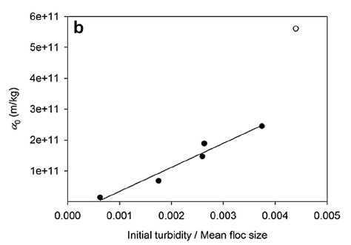
Specific cake resistance for MBR sludge in Europe
Initial turbidity important
Single cells
Filaments
Mean floc size important

Slide 22
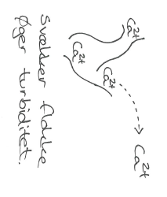
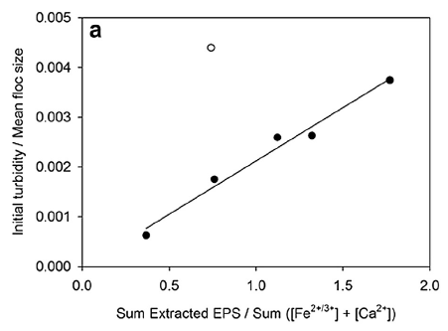
Divalent ions important (Ca²⁺, Fe^{2+/3+})
Component | Unit | Median | Minimum | Maximum
Iron | mg/g SS | 17.5 | 2.04 | 48
Calcium | mg/g SS | 22.2 | 12.1 | 51.0
Sum | mg/g SS | 43.8 | 14.2 | 67.8

Slide 23
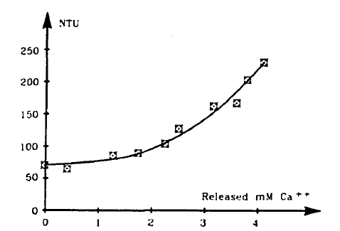
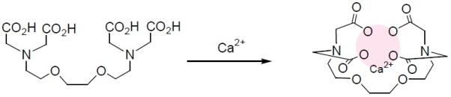
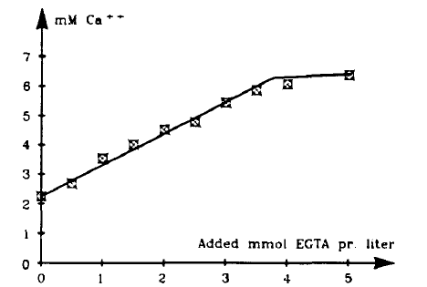
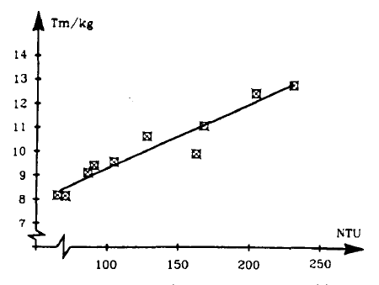
Calcium flocs

Slide 24
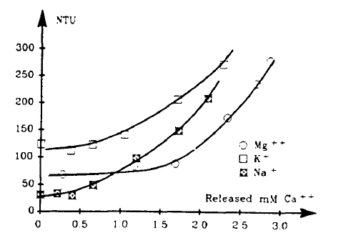
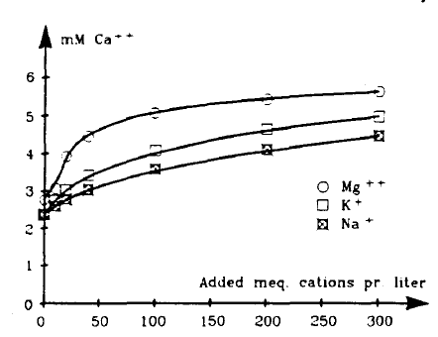
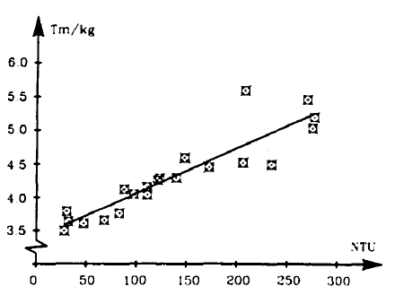
Other cations
 | Unit | Median | Minimum | Maximum
pH | - | 7.07 | 6.42 | 7.53
Conductivity | µS/cm | 750 | 407 | 4350

Slide 25
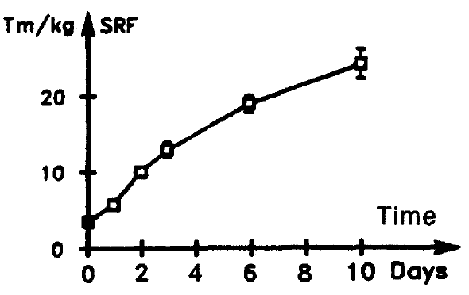
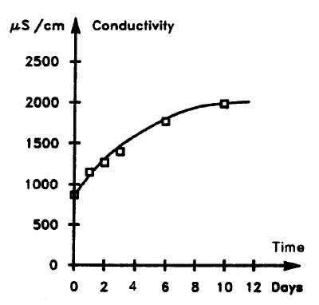
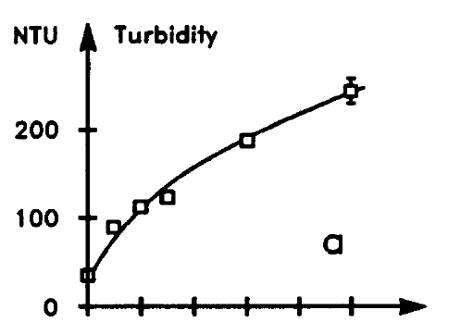

Anaerobic storage of sludge

Slide 26
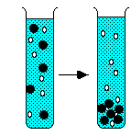
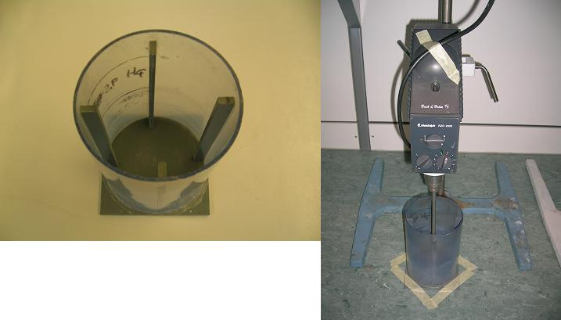
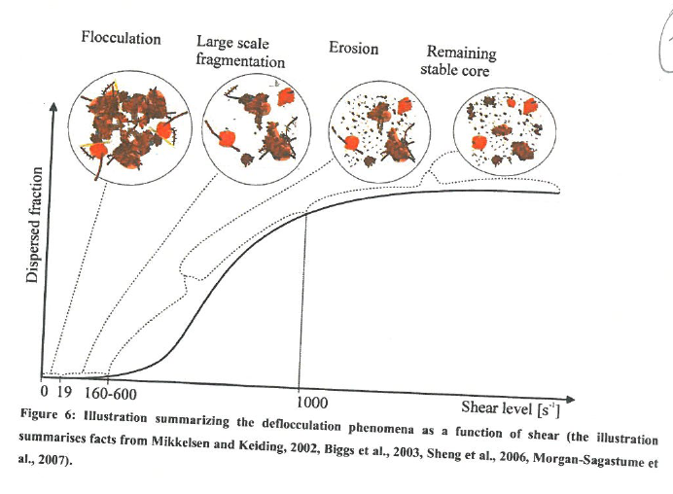
Shear sensitivity
Step 2
Step 3
Step 1

Slide 27
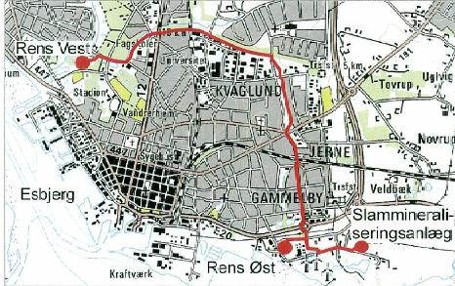

Slide 28
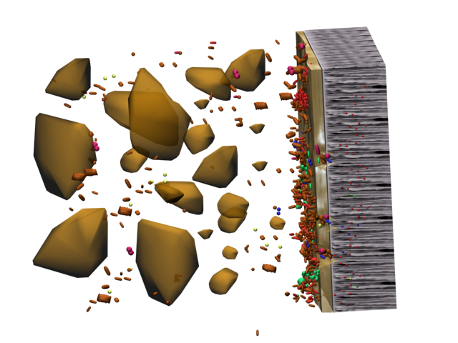


Sludge fragmentation
Fractionation
Sludge flocs (50-100µm)
Soluble microbial products (SMP) (<1000 kDa)
Single cells (1-10 µm)

Slide 29



Filtration test
Constant pressure
Air scoured
Flat sheet membranes (0.2 µm PVDF, Alfalaval)
Area 84 cm²

Slide 30


Filtration at 13 kPa
Filtration at 13 kPa

Slide 31

Reversibility of fouling layer
Gel layer
(protecting the membrane)
Irreversible fouling
Scouring and less fouling
(the reversible fouling is reduced)
Adsorption + pore blocking

Slide 32

Floc scouring

Slide 33
Conclusion
Biological sludge highly compressible (specific filtrate flow rate)
Deformation, compression and disrupture individual sludge flocs
Good properties of sludge
Compact and strong flocs, few single cells and low concentration of dissolved EPS
(clarifier, centrifugation, MBR, pre-treatment before separation)
Shear lowers dewaterability
Pumping, pipes.
Salts important
Calcium and iron improve dewaterability (hard water)
High conductivity lower dewaterability (road salt, sea water, industry)
Storage lowers dewaterability
Anaerobic < Anoxic < Aerobic

