Slide 1
ASSESSING PHARMACEUTICAL
CONTAINMENT EQUIPMENT USING SURROGATE MONITORING
Mootaz El Halawany
Corporate QA, PBI International
Pharmaceutical Quality Expert, Pharmaceutical Industries.
Alex. University School of Pharmaceutical sciences, Egypt
Phone Number (002) 01005220200
http://eg.linkedin.com/pub/mootaz-el-halawany/23/681/881/
mhalawani@gmail.com

Slide 2
PREFACE
When talking today about solid dosage form production, often containment
immediately becomes one of the issues. Why? Regulatory situation states:
“It is the first duty of the employer to protect (the health of) his employees.”
(taken from the UK COSHH rules) should be seen as general guidance when handling potent substances.
In fact, approximately 30 percent of all people in western societies will develop some form of cancer during their lifetime. If one of these had been exposed to a carcinogenic substance, whilst working for a pharmaceutical company, there is the potential for a legal claim against the company. This could result in high cost compensation and in very bad publicity, unless the company can prove that the employee had been protected using best available technology.
Equipment containment is the WORD, and to prove this efficient healthy containment “Protection of employee”, we need to TEST.
This testing is called Surrogate testing.
In my article, I will focus on how to assess pharmaceutical equipment containment via surrogate testing, methodology, and some explanatory illustrations from three famous contained equipment manufactures in Europe, that I used to deal projects design with them. In addition to other important highlights concerning dealing with highly toxic APIs.

Slide 3
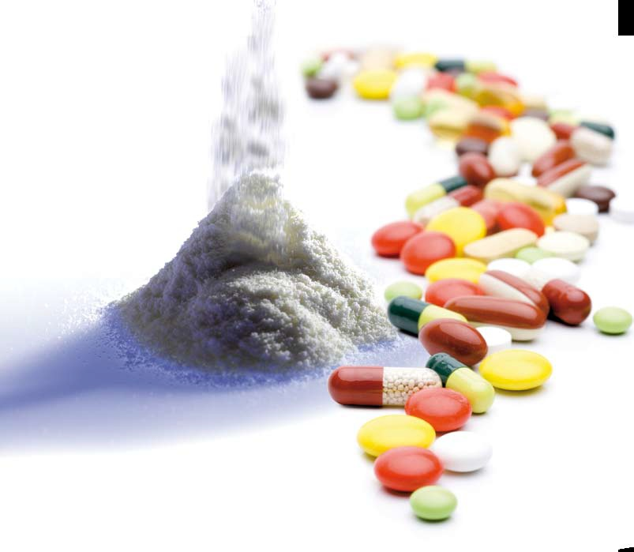

Slide 4
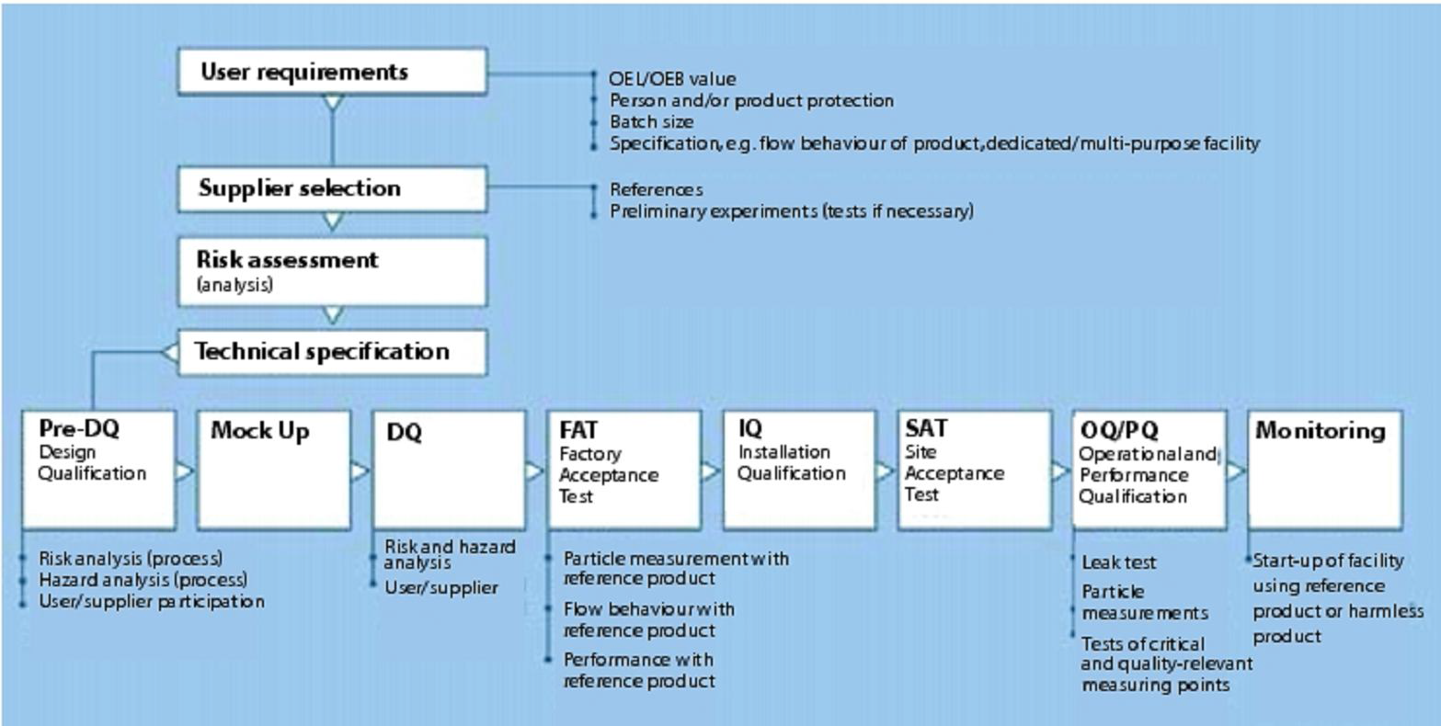

Slide 5
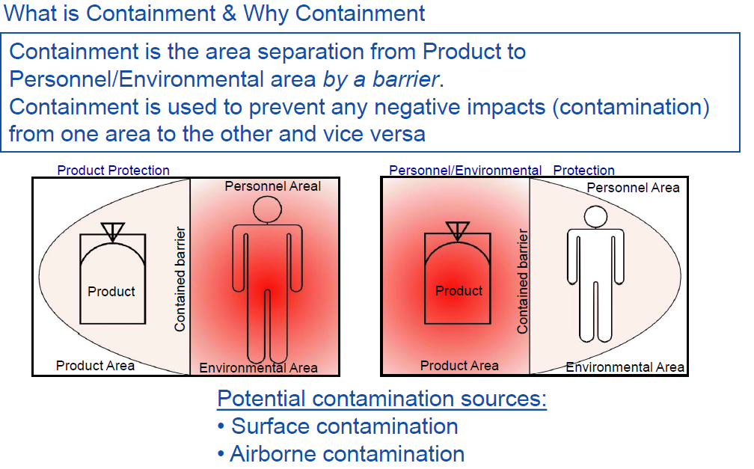
PART 1: MANUFACTURING PROCESS
GENERAL CONTAINMENT CONSIDERATION

Slide 6
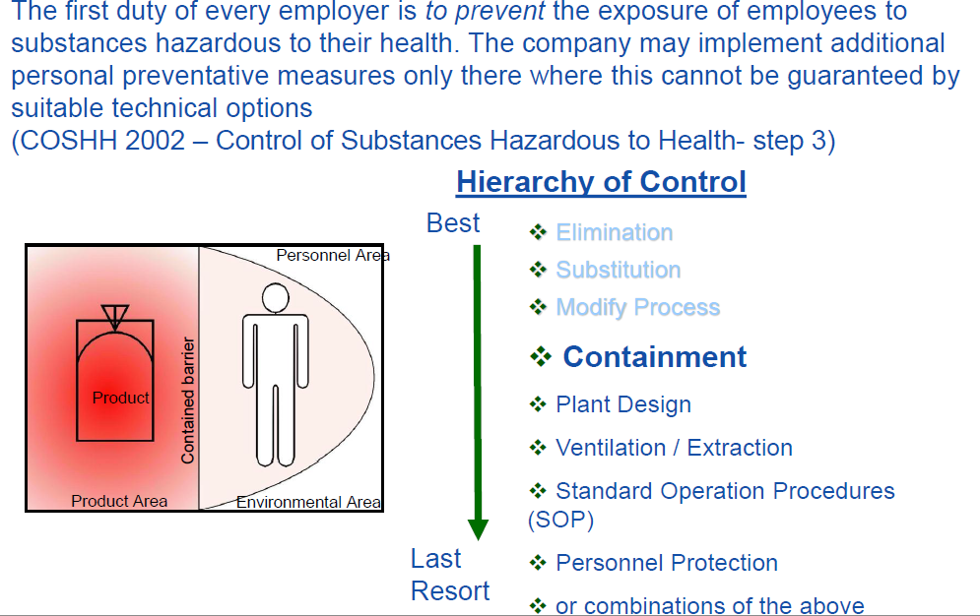
GENERAL REGULATION

Slide 7
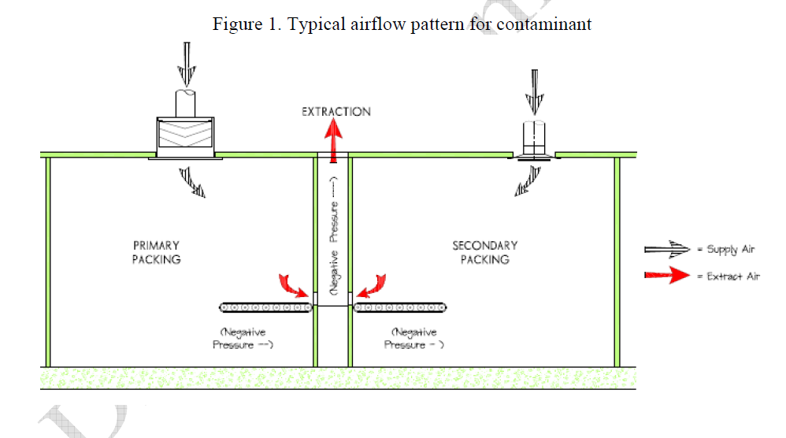

Slide 8
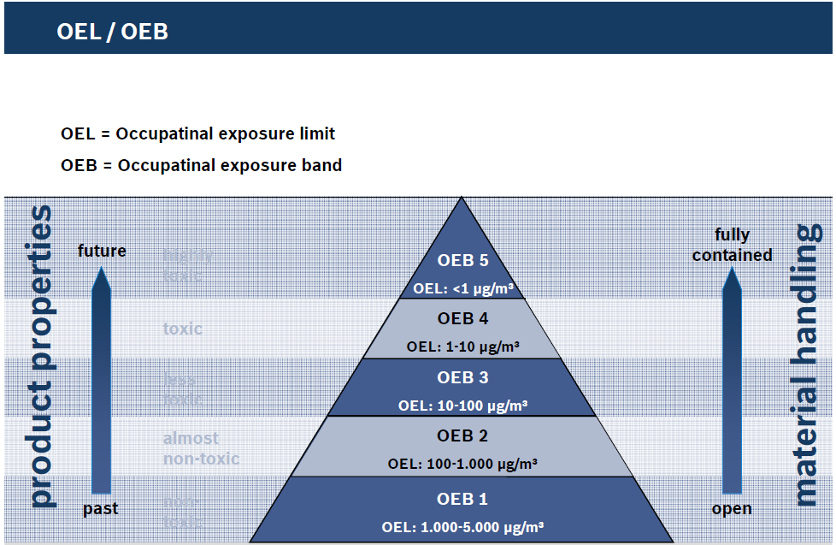

Slide 9
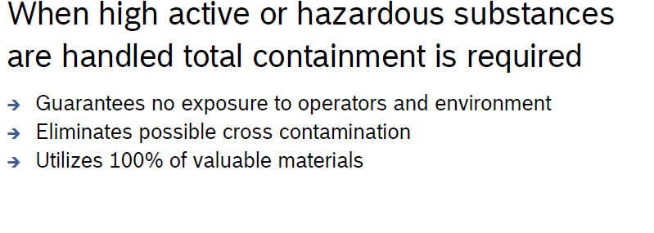
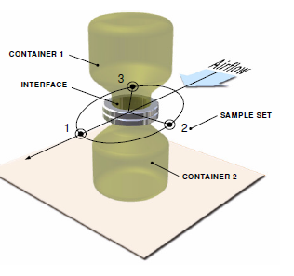

Slide 10
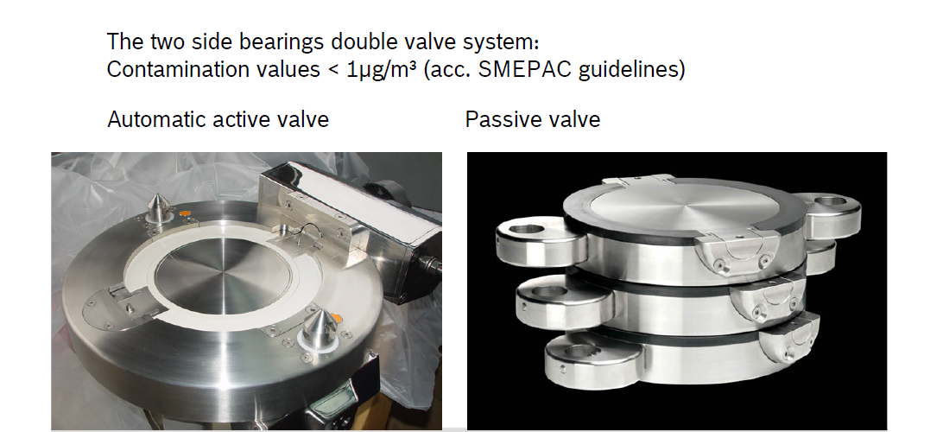

Slide 11
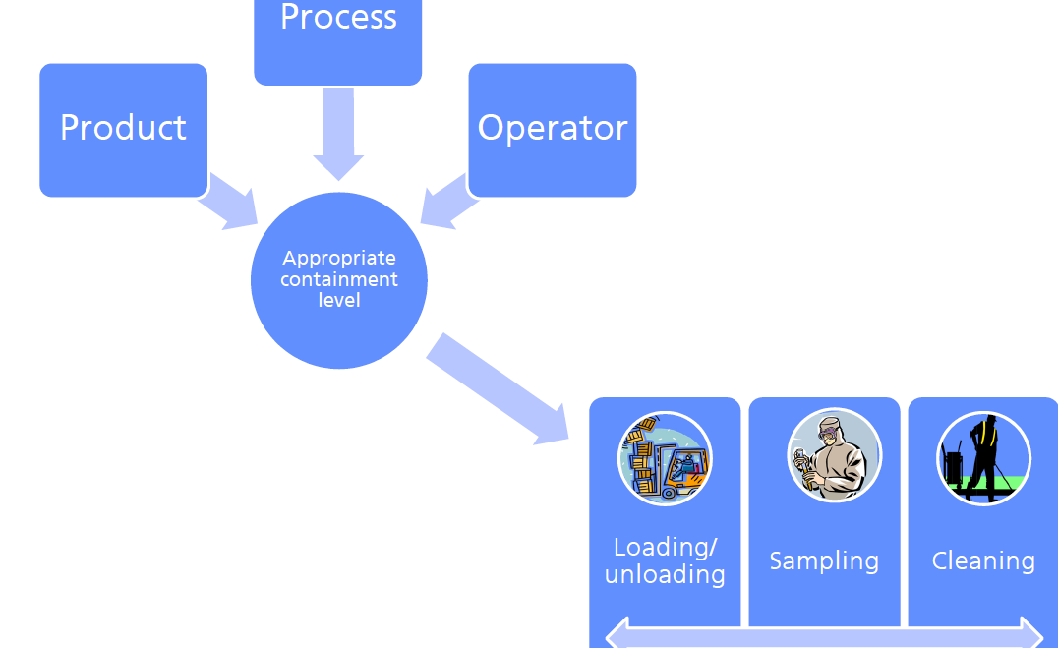

Slide 12
PART 2: SURROGATE TEST
 Handling or processing lactose or another surrogate
material in containment equipment such as an isolator, material transfer valve or other equipment intended to contain active pharmaceutical ingredients (APIs).
 Conducting air sampling and surface sampling to
determine how much dust escapes from the Containment.
 The sampling results provide a means of estimating how effectively the equipment will contain the API under similar conditions of use.

Slide 13
Purpose
and
Benefits
 Evaluate containment performance without
potential exposures to potent Active
Pharmaceutical Ingredients (APIs)
 Evaluate containment performance in
situations where an analytical method been developed for the API of interest
has not

Slide 14
Purpose
and
Benefits
(continued)
 Evaluate equipment/devices before
Purchase (or during FAT)
¾ Obtain baseline data to compare equipment models from different suppliers
¾ Obtain baseline data to compare different
Technologies (Examples: GEA, IMA, & Bosch-Hutlein)

Slide 15
Purpose
and
Benefits
(continued)
 Evaluate performance of new equipment before initial production begins using potent API (Commissioning, SAT, IQ, & OQ)
 Retest to determine if performance of existing equipment has degraded over time versus the
Baseline (Qualification, and Re-Qualification)

Slide 16
SOME
LIMITATIONS
OF
SURROGATE
 Does not evaluate vapors which may
MONITORING
exposures to gases or escape the containment
 Results not directly comparable to materials
with different physical properties
 Results do not guarantee compliance with
OELs established for specific APIs (Unless retested using the real life API)

Slide 17
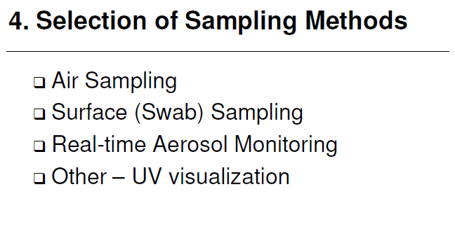

Slide 18
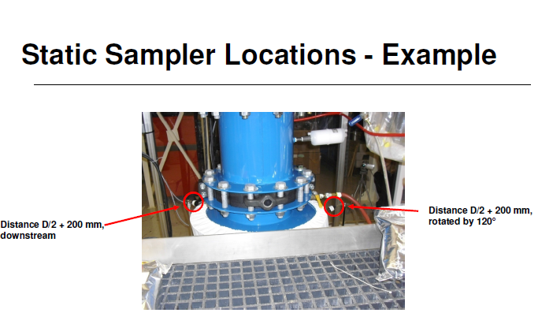

Slide 19
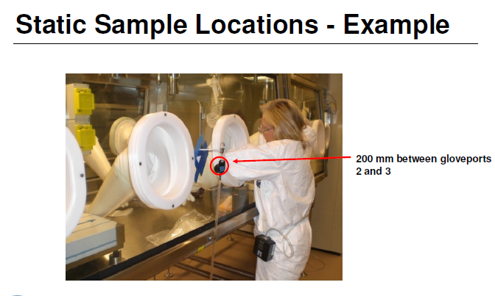

Slide 20
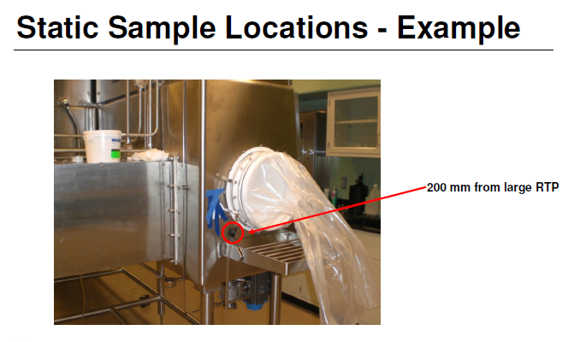

Slide 21
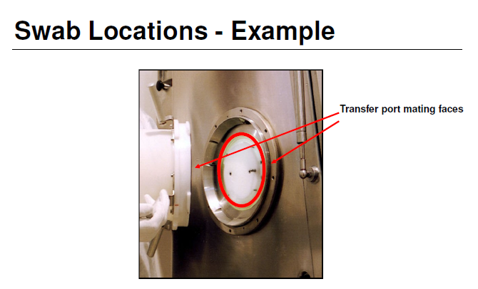

Slide 22
EXAMPLES OF EQUIPMENT TO BE
TESTED VIA SURROGATE
MONITORING
 Isolators
> Airlock Chambers
> Rapid Transfer Ports (RTP)
> Glove Ports
> QA Sampling Ports
> Bag-in/Bag-Out Ports (BIBO)
 Material Discharge/Transfer Valves (Active/Passive valves)

Slide 23
EXAMPLES OF EQUIPMENT TO BE
TESTED VIA SURROGATE MONITORING
 Enclosed equipment such as Tablet Presses
 Open-Faced Flow Hoods
 Dust Collection Units

Slide 24
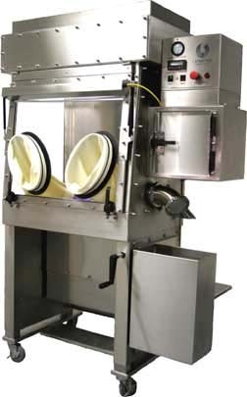
EXAMPLES OF EQUIPMENT TO BE
TESTED
VIA
SURROGATE
MONITORING
Glove Box Isolator
with airlock chamber and glove ports

Slide 25
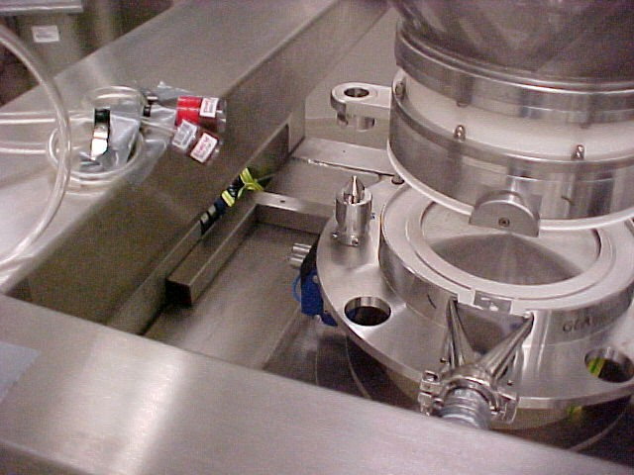
EXAMPLES OF EQUIPMENT TO BE
TESTED
VIA
SURROGATE
MONITORING
Split Butterfly Valve

Slide 26
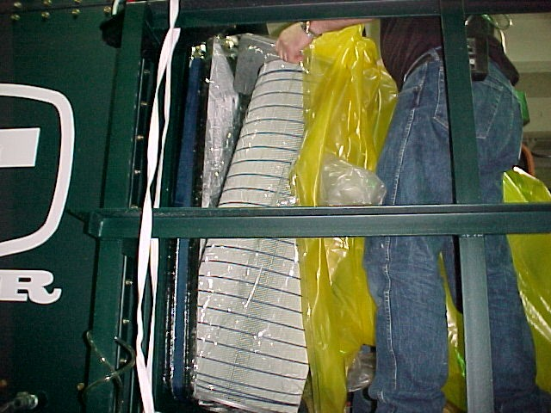
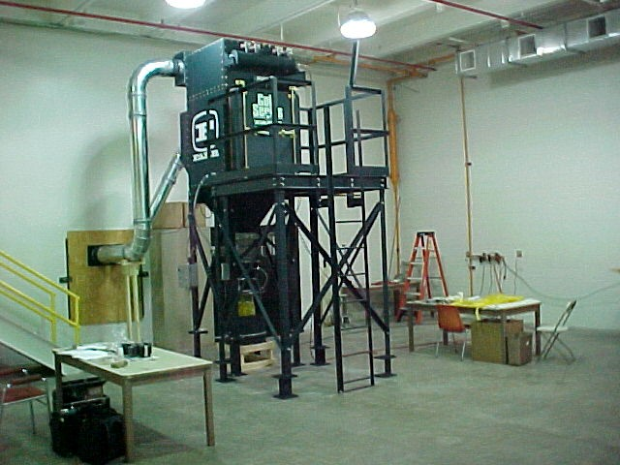
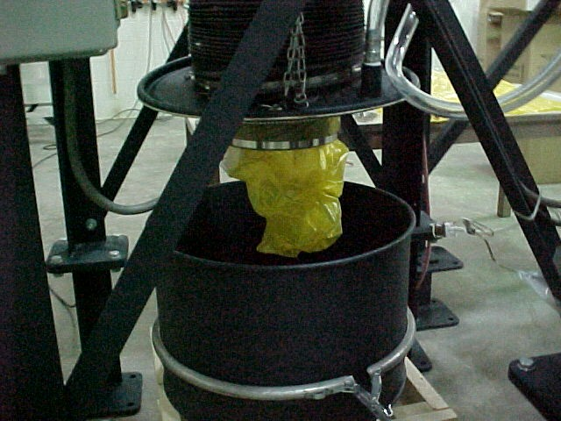
EXAMPLES OF EQUIPMENT TO BE
TESTED
VIA
SURROGATE
MONITORING
Dust Collection System designed
for bag-in/bag-out filter changing and collection drum liner removal

Slide 27
LACTOSE
AS
SURROGATE
 Flow characteristics
 Analytical limit of detection
 Low toxicity
 Availability
 Cost of surrogate
 Cost of sample analysis
 Solubility

Slide 28
OTHER SURROGATE MATERIALS
 Naproxen Sodium
 Riboflavin (vitamin B2)
 Mannitol
 Sucrose
 Acetaminophen (paracetamol)

Slide 29
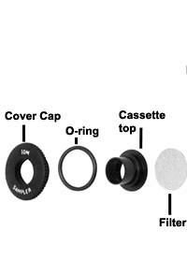
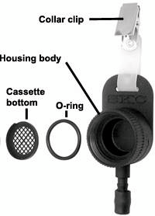
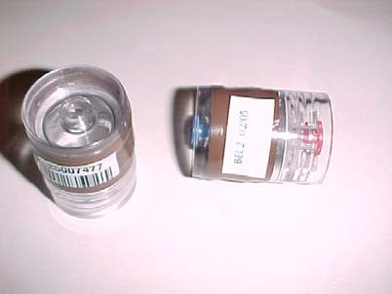
IOM
SAMPLER
vs.
STANDARD
FILTER
CASSETTE
The Institute of Occupational Medicine (IOM) in Scotland
IOM Personal Inhalable Dust Sampler
(exploded
view)
Standard 25 mm filter cassette

Slide 30
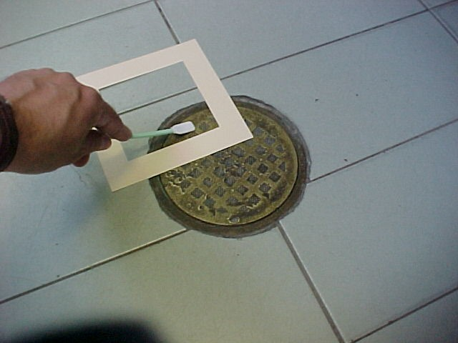
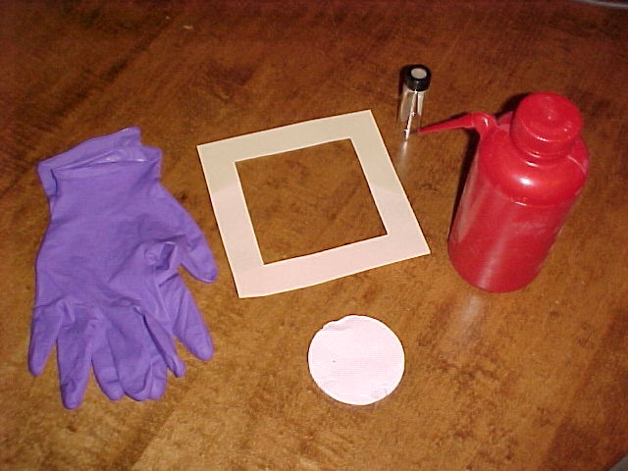
SURFACE WIPE AND SWAB SAMPLES
(Coupons to size the sampling area)

Slide 31
SAMPLING
STRATEGY
 Background air and surface
samples
 Breathing zone samples
 General area air samples
 Surface wipe or swab samples

Slide 32
BACKGROUND
SAMPLES
 Typically 2-3 background air samples
the test room or enclosure
in
 Background swab samples on multiple
surfaces

Slide 33
OPERATOR BREATHING ZONE SAMPLES
 Long-term breathing zone samples on
operator(s) for entire duration of operations
 Short-term breathing zone samples
during individual steps or tasks

Slide 34
GENERAL
AREA
AIR
SAMPLES
 Long and short-term
 Collect near points of potential leakage

Slide 35
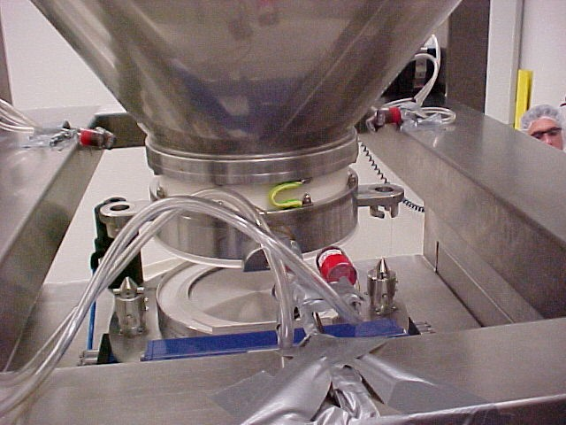
GENERAL
AREA (STATIC)
AIR
SAMPLES
Three samples 120º apart around the
separation point of a split butterfly valve

Slide 36
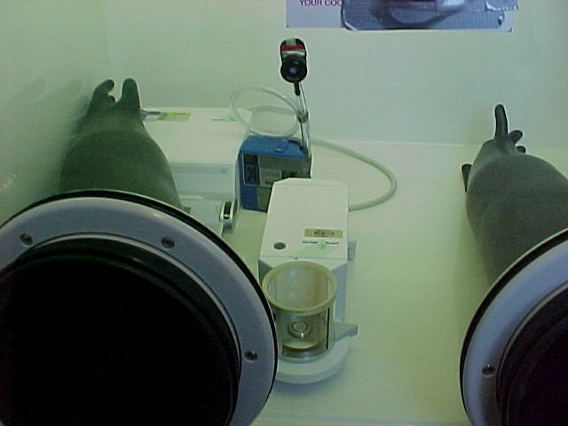
GENERAL
AREA
(STATIC)
AIR
SAMPLES
SAMPLE COLLECTED INSIDE OF ISOLATOR CHAMBER

Slide 37
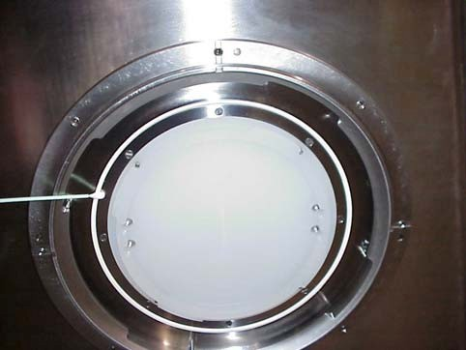
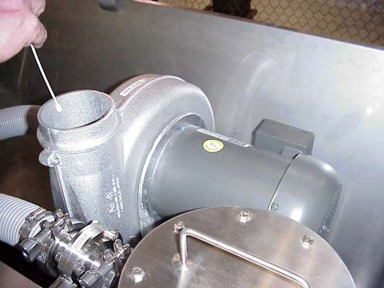
SURFACE
SAMPLES
 Collect after individual cycles or step
 Collect at end of overall operation

Slide 38
SURFACE SWAB OR WIPE SAMPLE RESULTS
 Pharmaceutical companies may or may not have established limit for surface contamination for specific APIs.
 Often detect contamination where air samples were below detection.
 May show need for additional cleaning before removing objects from containment or to other areas (e.g. clean contaminated RTP seal when container is
undocked).

Slide 39
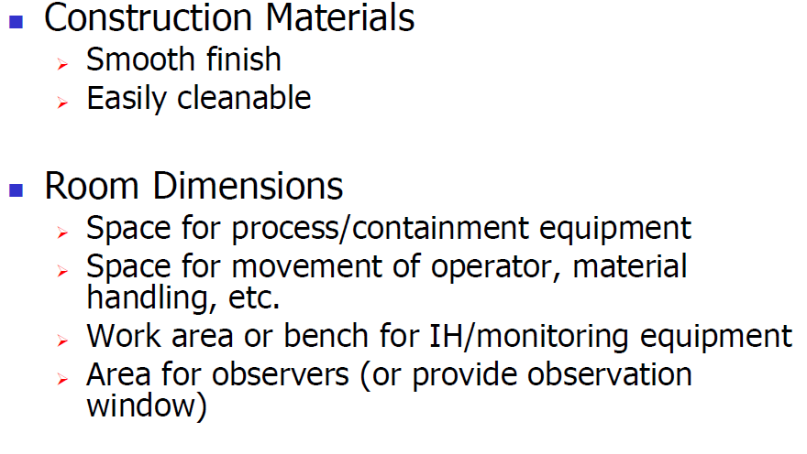
TEST ROOM CONSIDERATIONS



Slide 40
GENERAL
VENTILATION
 Test room should have positive pressure to keep
contamination from adjacent spaces from entering.
 ISPE Guidelines recommend 3 to 5 air changes per
hour for test room and enclosures.
 Supply and return air should be filtered
(HEPA filters typically used)

Slide 41
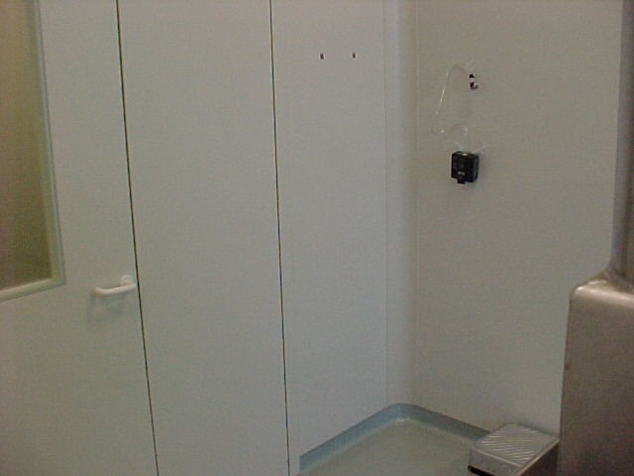
PERMANENT
ROOM
Smooth wall surfaces, seamless floor, rounded edges

Slide 42
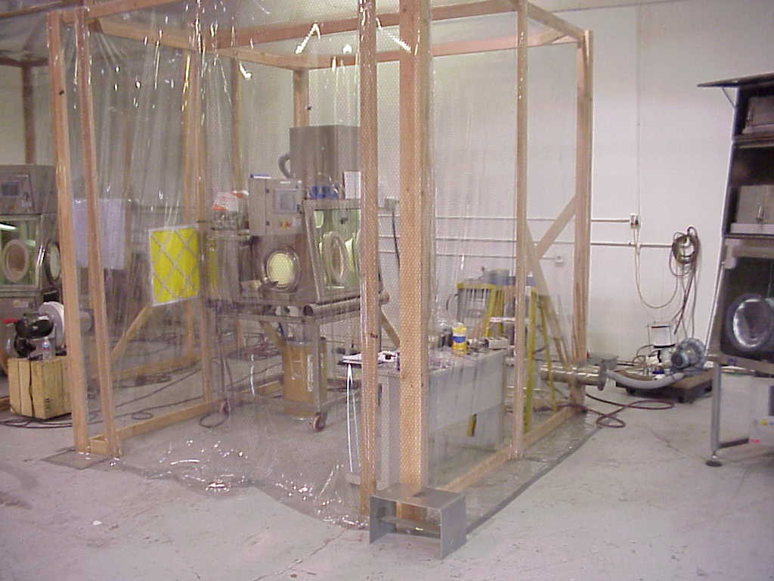
TEMPORARY
ENCLOSURE

Slide 43
SURROGATE HANDLING AND STORAGE
 Do not expose to temperature or humidity
extremes
 Do not store surrogate in the test area
 Any handling, sub-dividing or blending
required before the surrogate monitoring
should be conducted by persons who will not
otherwise be involved in the monitoring and
will not enter the test area.

Slide 44
OTHER
TEST
PARAMETERS
 Air temperature and relative humidity
(Measure in test area during evaluation)
 Ventilation/airflow observations and measurements
 Photographs or video recording
 Diagrams

Slide 45
SUMMARY

Surrogate monitoring evaluates the effectiveness of
containment equipment using materials having low toxicity.
Lactose is the recommended surrogate material, but others may
also be used.
The sampling strategy includes both air samples and surface
samples.
The results can be helpful in selecting containment equipment
that will be appropriate for specific applications.
There are limitations. Therefore, employee exposures to the
actual API should also be evaluated once the containment
becomes operational in the lab or production setting.





Slide 46
QUESTIONS?
Mootaz El Halawany
Phone Number (002) 01005220200
http://eg.linkedin.com/pub/mootaz-el-halawany/23/681/881/
mhalawani@gmail.com

Slide 47
Refrences:
ISPE Guidelines
WHO, Working document QAS/08.256
ASHRAE
GMP Manual (Maas & Peither)
GEA Pharma Systems
BOSCH Packaging GmbH
IMA Life

