Slide 1


World Conference on climate Change
October 24-26, 2016 Valencia, Spain
Susceptibility assessment of climate change-induced geo-disasters in Korea
2016. 10. 25
Moonhyeon Hong
Yonsei University
Sangseom Jeong
Junghwan Kim
Kwangwoo Lee
Notes:
Hello, I’m Moonhyun Hong from Yonsei University, Korea
Today I will present the “susceptibility assessment of climate change-induced geo-disasters in South Korea”
This study covers a framework for assessing the expected damage costs of infrastructure for geo-disasters such as landslide and debris flow.

Slide 2
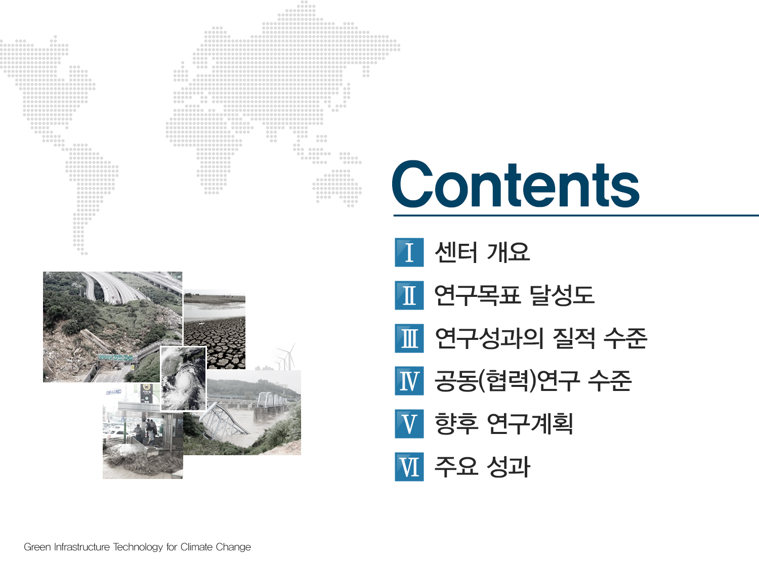
Introduction
A case study on landslides
Susceptibility assessment of landslide
Conclusions
I
II
III
IV
Notes:
The presentation will be progressed following these contents

Slide 3


Ⅰ
Introduction
1 .
Climate change
2 .
Climate change-induced geo-disaster
3.
Schematic diagram of study procedure

Slide 4
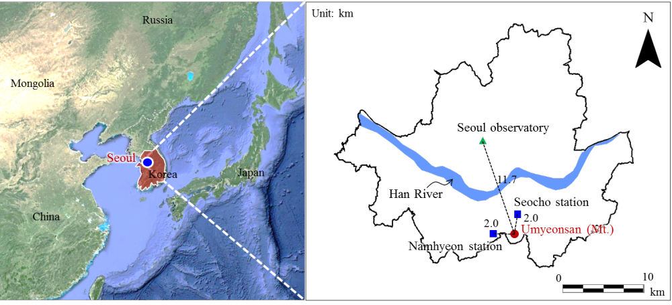
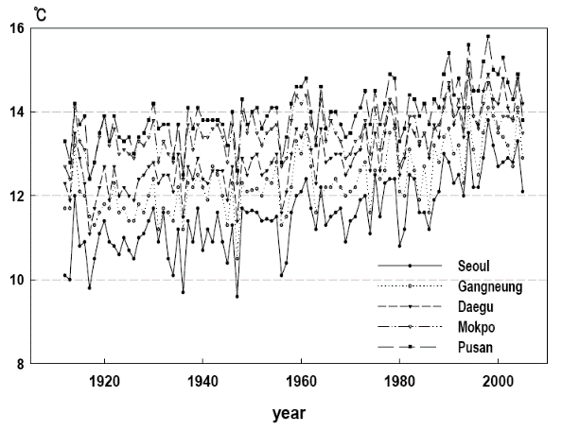
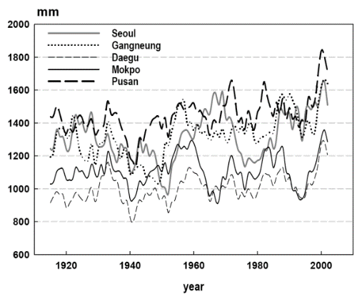
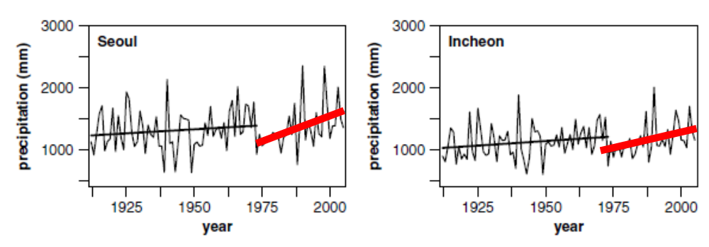
1
Climate change
Warming
Rainfall increase
                Climate change
                More severe fluctuation in rainfall patterns
                (Rainfall intensity, frequency and quantity)
                Triggering the geo-disaster (landslide)
Notes:
In the Asia-Pacific region, there is an evidence of prominent increases in the intensity and frequency of extreme events
under intense rainfall and severe storms, which trigger more geo-disasters.

Slide 5
2
Climate change-induced geo-disaster
Backgrounds
Global climate change is affecting regional weather patterns, rainfall trends, and their variability
Extreme events like landslides related to geotechnical engineering are caused by climate change, particularly in Asia-Pacific Regions
Subject of analysis: landslides
One of the most critical disaster related geotechnical engineering
Extreme rainfall is main factor of landslides

Slide 6
3
Schematic diagram of study procedure
Climate change scenario
Landslide analysis
(GIS based landslide prediction model)
Regional climate model
Estimation of the initial volume of debris flow (from landslide analysis)
Frequency analysis
Debris flow simulation
(apply the initial volume)
Changes of probabilistic rainfall
Impact assessment of urban infrastructure
(from the result of debris flow simulation)
Estimation of future design rainfall
(Lee et al., 2015)
Expected damage cost of infrastructure due to landslide and debris flow under climate change

Slide 7
Ⅱ
A case study on landslides
1 .
Study area: Umyeonsan (MT.)
2 .
Prediction model for landslide analysis
3.
Analytical model for the debris flow

Slide 8
1
Study area
Umyeonsan (Mt.) landslide in July 2011
Seoul metropolitan
Umyeonsan(Mt.) is located in south-east of Seoul
151 landslides and 33 debris flows occurred in 20 watersheds
The accumulated rainfall of 24-h was 424.5 mm.
(Jeong et al., 2015)

Slide 9
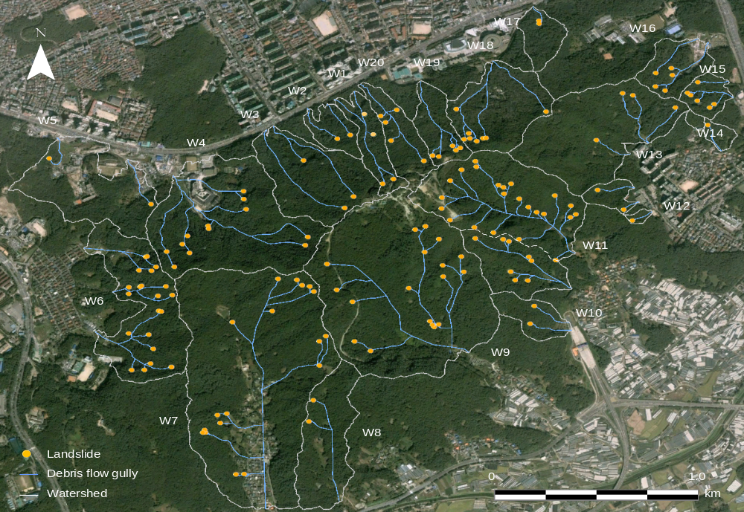
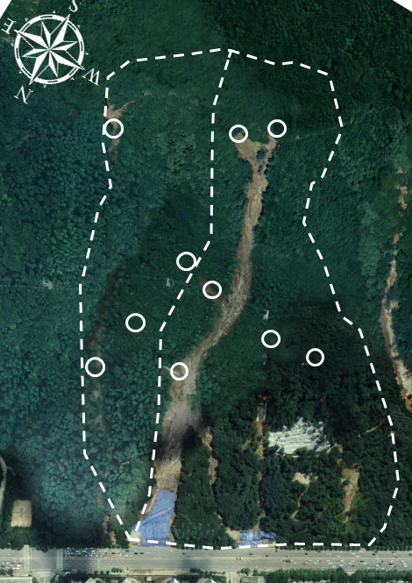
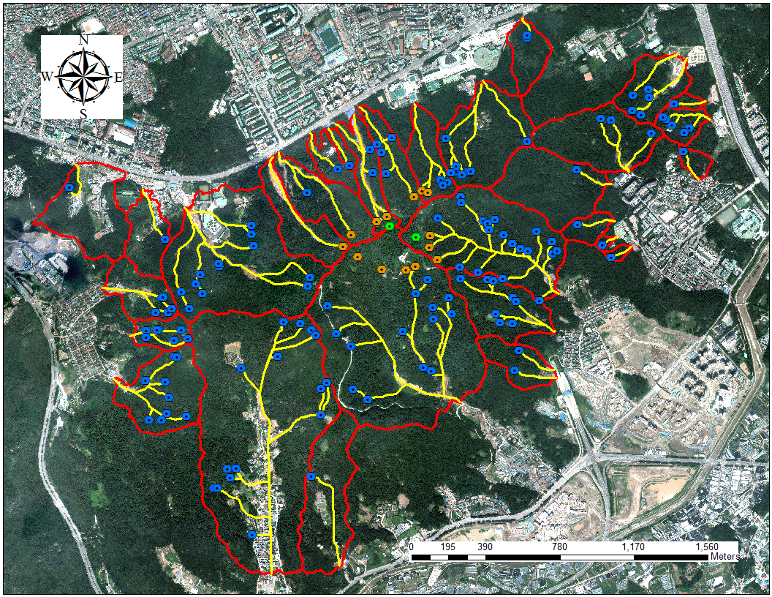
1
Study area
Study area: Raemian watershed, Umyeonsan (Mt.)
Umyeonsan (Mt.)
Raemian
watershed
(Jeong et al., 2015)

Slide 10

2
Prediction model for landslide analysis
“Prediction model for rainfall-induced landslide
based on 3D spatial data”
Considering rainfall intensity, duration and real-time rainfall
Predicting the rainfall infiltration-groundwater flow from
landslide mechanism
Reflecting topography, hydrology, spatial characteristics
Initial volume of debris flow based on regional scale hazard map
(by applying future design rainfall)
Background

Slide 11
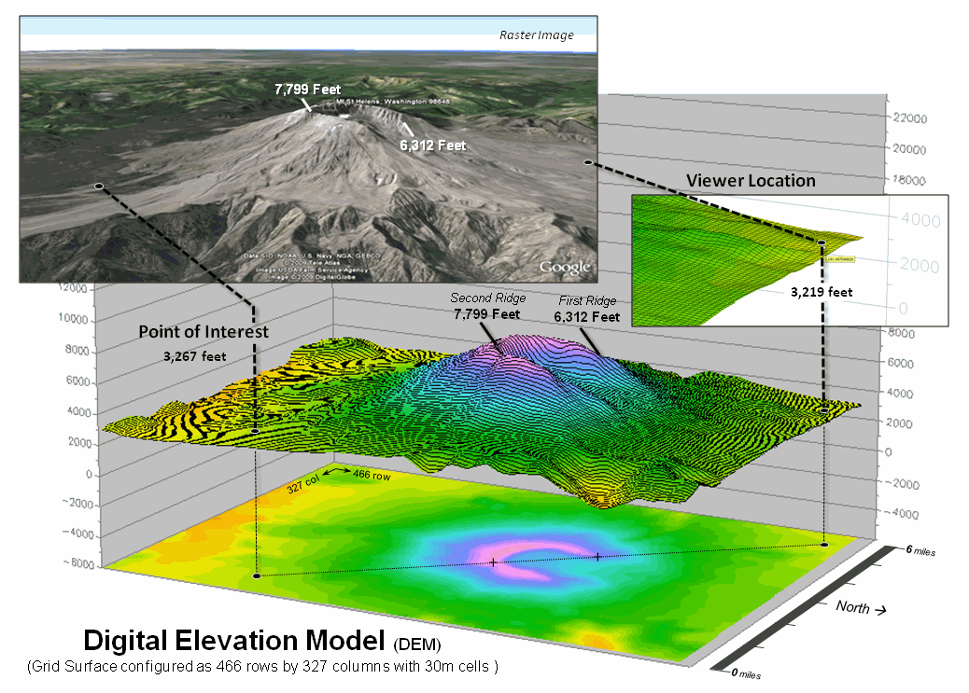
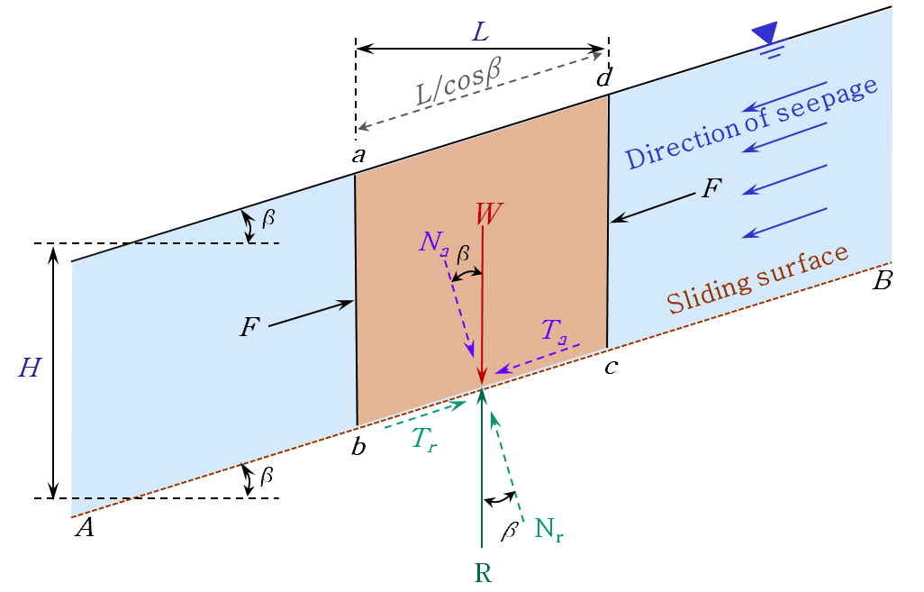
2
Prediction model for landslide analysis
3D GIS data
Physical Model
Topography: Slope, slope direction
Hydrology : Precipitation data
Spatial data : Soil and forestry
Geotechnology: Unsaturated soil
Infiltration : Modified G-A Model
Failure model : Infinite slope model
(Kim et al., 2014)
Notes:
등

Slide 12
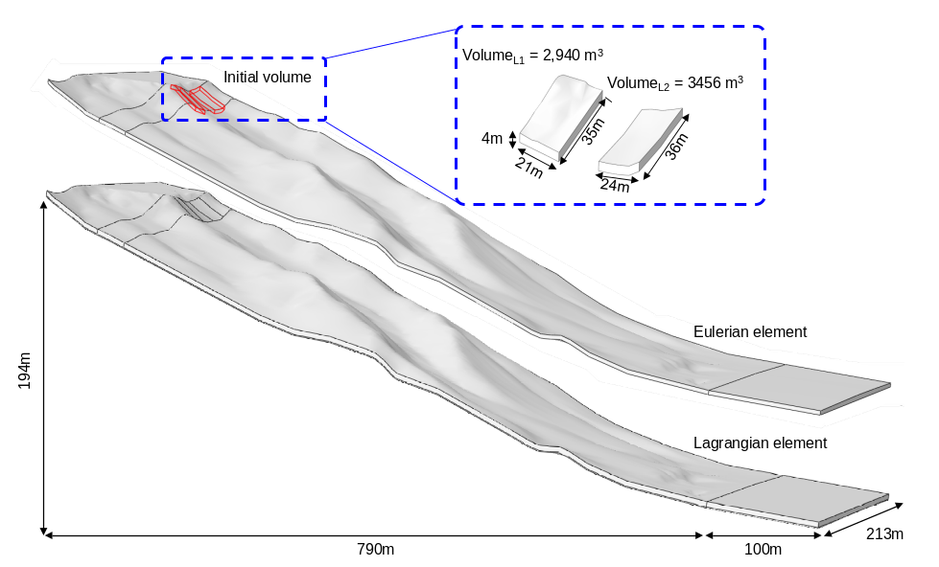
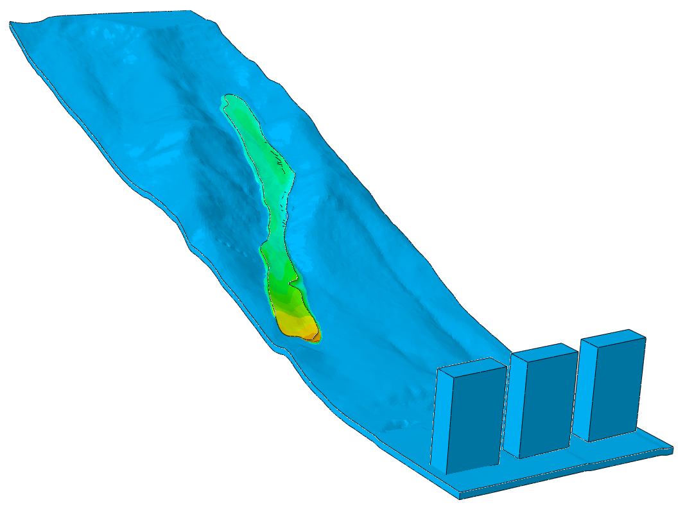
3
Analytical model for the debris flow
Debris flow model with erosion and entrainment of soil
Simulation of debris flow based on Coupled Eulerian-Lagrangian (CEL) method
Considering the erosion and entrainment of soil layer by debris flow
(Lee et al., 2016)
Initial volume of debris flow
Debris flow
Structures

Slide 13
Ⅲ
Susceptibility assessment of landslide
1 .
Site investigation and input parameters
2 .
Applied future design rainfall
3.
Result of landslide analysis
4.
Debris flow simulation

Slide 14
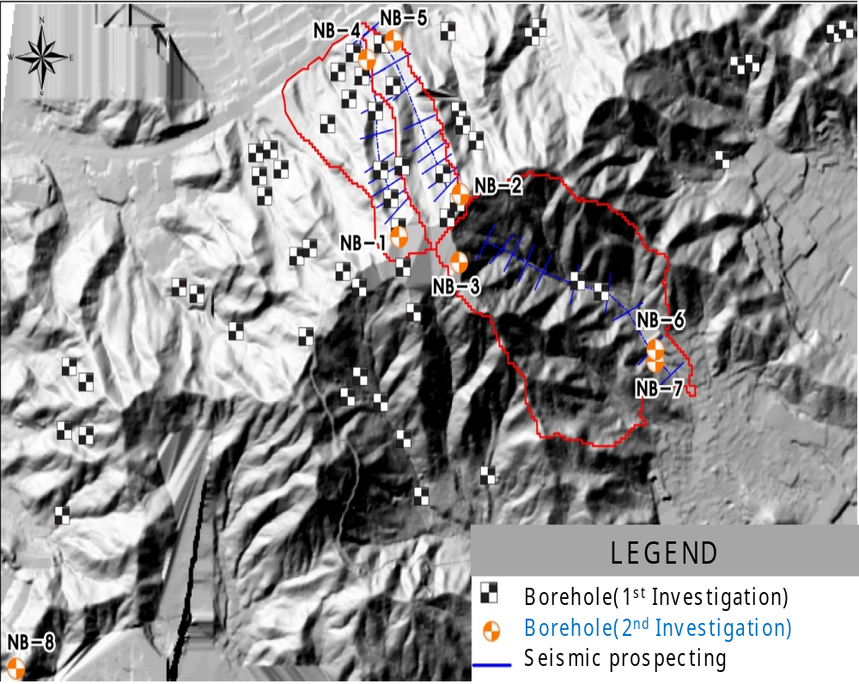
1
Site investigation and input parameters
Site investigation
Seismic Prospecting
In-Situ Permeability
SWCC
Borehole Shear Test
Direct Shear Test
SPT

Slide 15
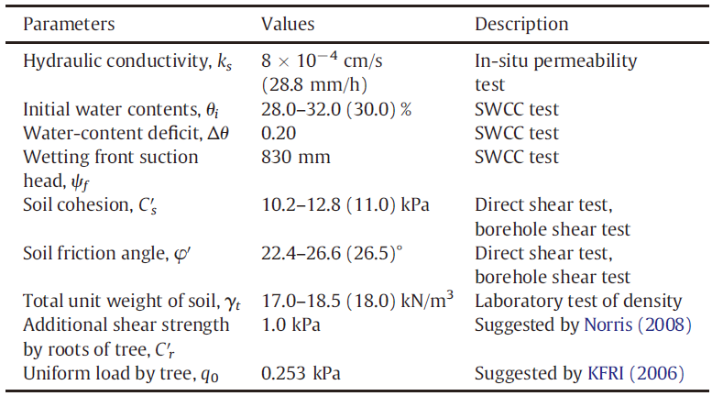
1
Site investigation and input parameters
Input parameters: soil properties and depth
Soil Property
(Kim et al., 2014)
Soil Depth
Raemian watershed : 4.0~10.0 m

Slide 16
2
Applied future design rainfall
Future design rainfall based on climate change scenario
Future period: S0 (1971-2000), S1 (2011-2040), S2 (2041-2070), S3 (2071-2100)
Applied rainfall: 100-year return periods, 24-hour duration
Applied rainfall intensity
S0 (1971-2000): 18.16 mm/hr
S1 (2011-2040): 24.71 mm/hr
S2 (2041-2070): 26.65 mm/hr
S3 (2071-2100): 32.53 mm/hr
(Lee et al., 2015)

Slide 17

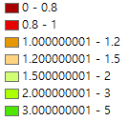
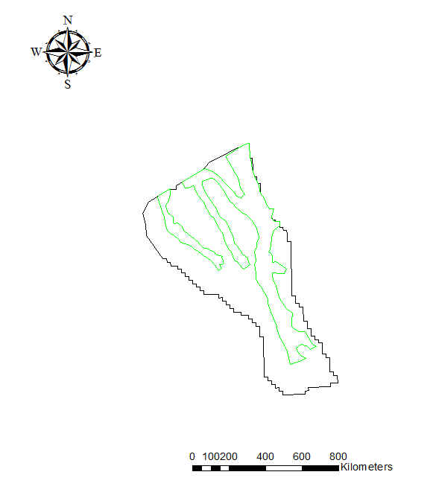
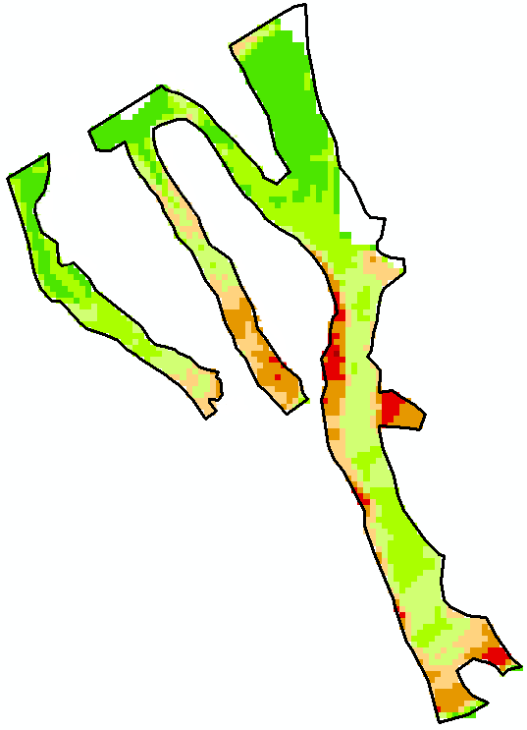
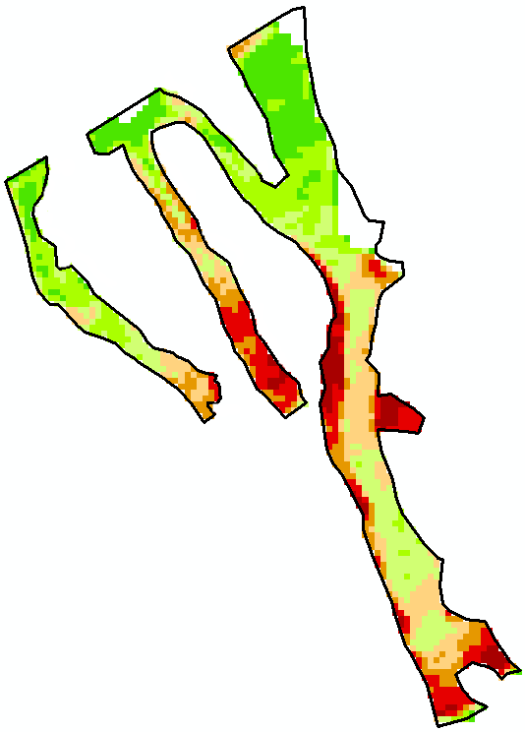
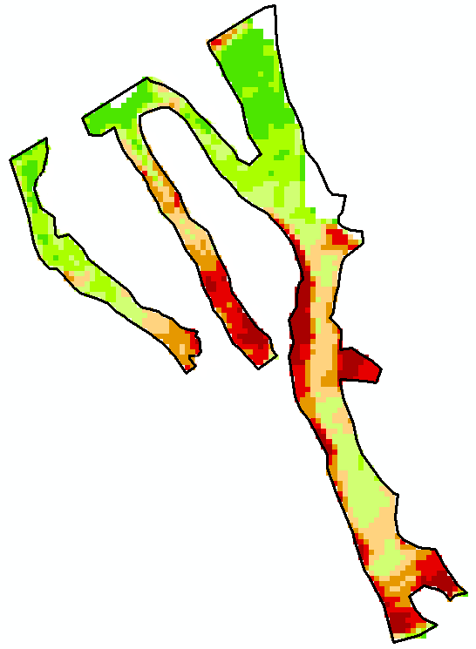
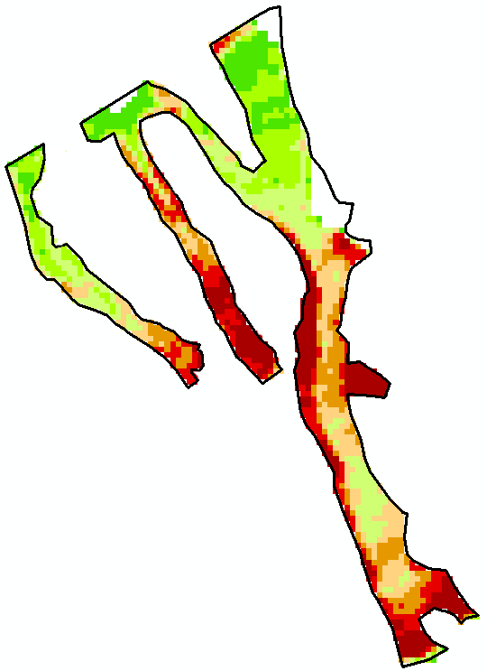
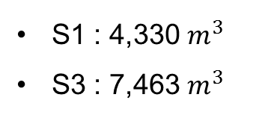
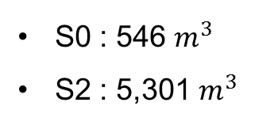
3
Result of landslide analysis
Safety factor
Initial volume of debris flow
0 – 0.8
0.8 – 1.0
1.0 – 1.2
1.2 – 1.5
1.5 – 2.0
2.0 – 3.0
3.0 – 5.0
S0 : 546 $m^{3}$
S2 : 5,301 $m^{3}$
S1 : 4,330 $m^{3}$
S3 : 7,463 $m^{3}$
0
0.1
0.2
0.4
0.6
0.8
km
S0 (1971-2000)
S1 (2011-2040)
S2 (2041-2070)
S3 (2071-2100)

Slide 18
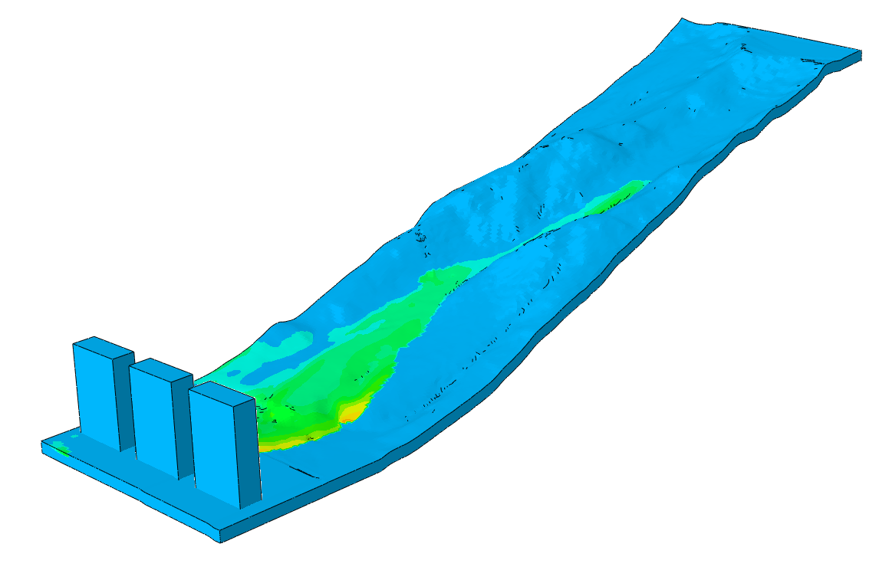
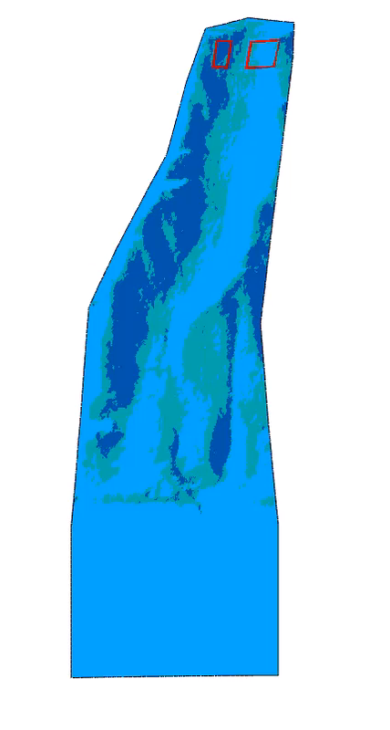
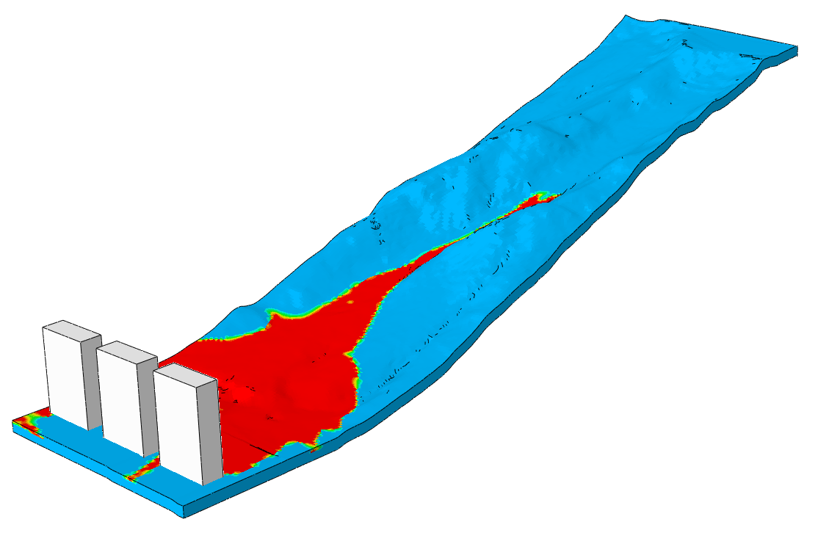
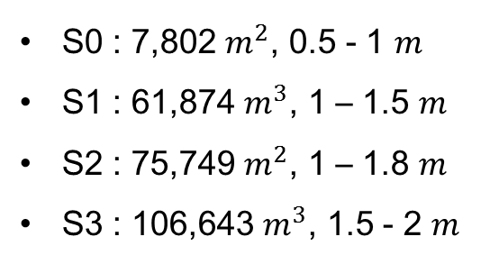
4
Debris flow simulation
Impact assessment of urban infrastructure
(from the result of debris flow simulation)
S0 (1971-2000)
Damaged area and height
S0 : 7,802 $m^{2}$, 0.5 - 1 $m$
S1 : 61,874 $m^{3}$, 1 – 1.5 $m$
S2 : 75,749 $m^{2}$, 1 – 1.8 $m$
S3 : 106,643 $m^{3}$, 1.5 - 2 $m$
S3 (2071-2100)
Expected damage cost
S0 : € 395,672.5
S1 : € 4,465,180.91
S2 : € 6,549,371.71
S3 : € 10,227,664.08

Slide 19
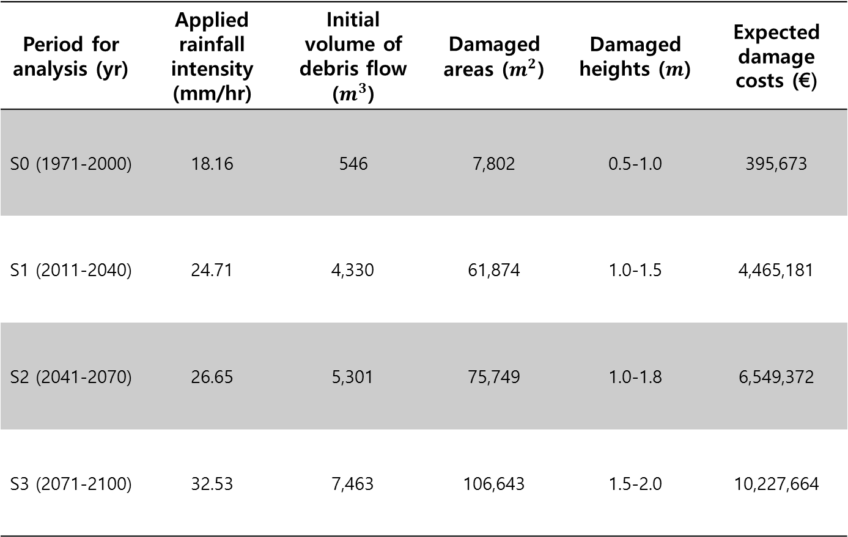
Summary
Period for analysis (yr) | Applied rainfall intensity (mm/hr) | Initial volume of debris flow ($m^{3}$) | Damaged areas ($m^{2}$) | Damaged heights ($m$) | Expected damage costs (€)
S0 (1971-2000) | 18.16 | 546 | 7,802 | 0.5-1.0 | 395,673
S1 (2011-2040) | 24.71 | 4,330 | 61,874 | 1.0-1.5 | 4,465,181
S2 (2041-2070) | 26.65 | 5,301 | 75,749 | 1.0-1.8 | 6,549,372
S3 (2071-2100) | 32.53 | 7,463 | 106,643 | 1.5-2.0 | 10,227,664

Slide 20
Ⅳ
Conclusions

Slide 21
Conclusions
By using some ewll=designed model and climate scenario, we conducted the susceptibility assessment of landslides for a case study of mountain Umyeonsan, estimating the impacts and the expected costs of infrasturctures due to landslides and debris flow under climate change.
From the results of this study, we can conclude that the climate change-induced geo-disasters like landslides or debris flow will be increased, and the damage of infrastructures due to the geo-disasters will be increased.
The result of these study can be useful information for early warning system of landslides and debris flows.

Slide 22


