Slide 1
World Conference on Climate Change 2016
Development of Uncertainty Reduction Method for Climate Change Impact Assessment on High Dam Inflow
October, 24, 2016
Moon-Hwan Lee, Deg-Hyo Bae
Dept. of Civil & Environmental Engineering, Sejong Univ., Seoul, Korea
Notes:
My name is Moon-Hwan Lee. I’m a Ph.D researcher in Sejong university, South Korea
Today I’d like to talk about the “Development of uncertainty reduction method~

Slide 2
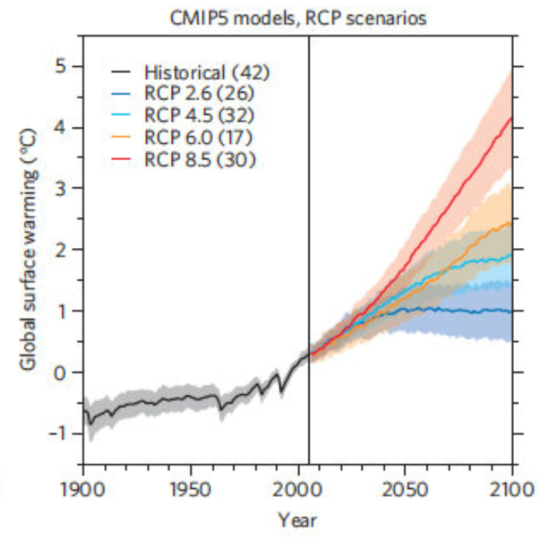
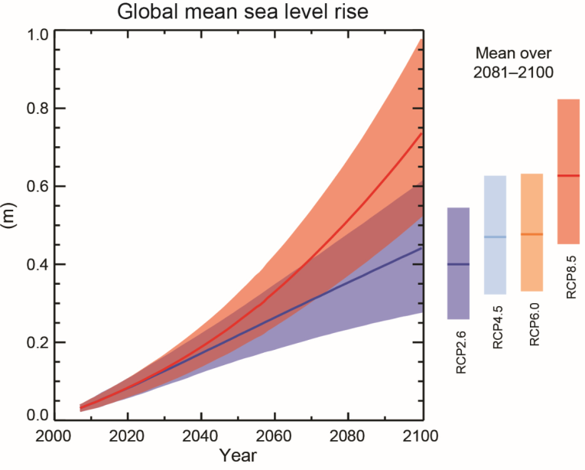
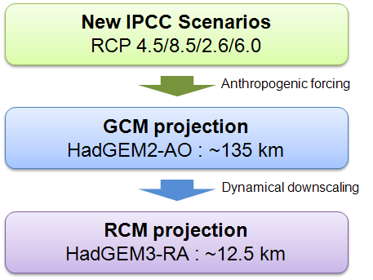
Introduction
Background of this study
  Global mean temperature and sea level rise 3.7℃ and 63mm for end of the century (IPCC AR5)
  Water disasters will be exacerbated due to water resources variation
  Water resources management plan have to consider climate change impact and vulnerability
  Climate change assessment results have lots of uncertainty because of several sources
Greenhouse gas emission scenario
Choice of greenhouse gas emission scenario
GCMs
Choice of GCMs
Downscaling method
Choice of Downscaling method
Hydrological model
Choice of Impact assessment model
Parameterization of model
Notes:
IPCC AR5 presented that global mean temperature and sea level were expected to rise about 3.7℃ and 63mm for the end of the century (2081∼2100)
And also the water disasters will be exacerbated due to water resources variation spatially and temporally on climate change effects
Water resources management plan have to consider climate change impact and vulnerability assessment results
These results have lots of uncertainty because of the several sources such as greenhouse gas emission scenario, global and regional climate simulation and hydrological modeling

Slide 3
Literature Reviews
Kay et al. (2009)
The changes in flood frequency for future period in England, and suggested that GCM is dominant uncertainty source
Xu et al. (2011)
The uncertainty of high and low flow according to selection of GCM and scenario
Chen et al. (2011)
The stream flows using 2 scenarios, 6 GCM, 4 downscaling methods, and 3 hydrological models. Their results showed that the uncertainty of GCM is higher than the other steps
Bae et al. (2011)
GCM is dominant uncertainty source for the runoff projection, however hydrologic model is highest uncertainty source for the dry season
- Previous studies were focused on range estimation of projection results using ensemble GCMs
Uncertainty analysis was done by using simple comparison of result range for each step
Development of uncertainty quantification method and reduction technique are required
Purpose of this Study
  To develop the uncertainty reduction method for climate change impact assessment
  To assess the uncertainties of future projection for 1-day maximum dam inflow
Notes:
There are some previous studies related to climate change uncertainty assessment on water resources.
However, they were focused on range estimation of projection results using ensemble GCMs and uncertainty analysis was done by using simple comparison of result range for each step.
For considering in climate change adaptation, development of uncertainty quantification methodology should be developed and evaluated.
Therefore, the purpose of this study are to develop~ and to assess~

Slide 4
Methodology
Overview of this study
Emission Scenario
Global Climate Model
Downscaling methods
RCM 1
Regional Climate Model
SPP 1
RCM 2
SPP 2
RCM 3
SPP 3
RCM 4
Statistical post-processing
RCM 5
SPP 4
SPP 5
Hydrological analysis
HYM 1
HYM 2
Projections of 1-day maximum dam inflow
Quantification uncertainty
Find the combined DS method
to minimize the uncertainty
Notes:
The overview of this study is as this figure. We used 1 GCM results for focusing on Downscaling method and used numerous RCM, Statistical post-processing method, and hydrological models for projecting 1-day maximum dam flow.
And then we quantified the total uncertainty using all the ensemble member. And also find the combined downscaling method to minimize the uncertainty.

Slide 5
Uncertainty quantification analysis
  Future projection
  Uncertainty assessment based on variance analysis
Uncertainty (Sum of Squares)
Contribution
Notes:
For this study the future projection derived the difference between future dam inflow and historical dam inflow
And, we used the uncertainty assessment method based on variance analysis.
As you can see this equation, total uncertainty consist of all individual step such as RCM, SPP, HYM and interaction effect.
The total uncertainty defined the variance of future projection results
It can be divided by total uncertainty to uncertainty for each step.
The equation of uncertainty analysis is as below.

Slide 6
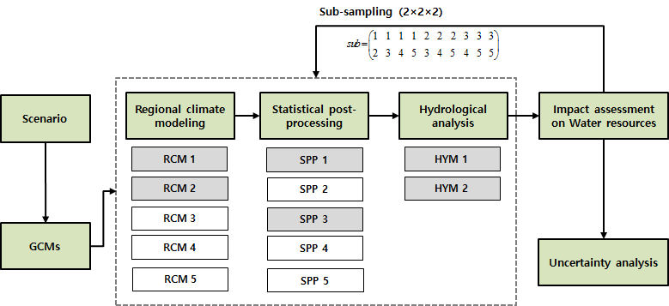
  Experimental design for uncertainty analysis
    5 RCMs, 5 SPPs, 2 HYMs were used
    Using 100 times iterated based on sub-sampling method (2Ⅹ2Ⅹ2)
Notes:
For this study, to quantify the uncertainty for each step, the 5 RCMs, 5 SPPs, 2 hydrological model were used. And also used sub-sampling method because of different number of sample.
And then impact and uncertainty evaluated caused by downscaling and hydrological models focused on 1-day maximum dam inflow
Actually, In this study, We show total uncertainty, and uncertainty of each step.

Slide 7
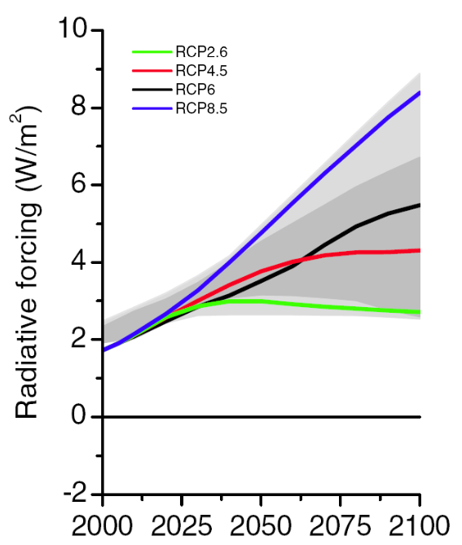
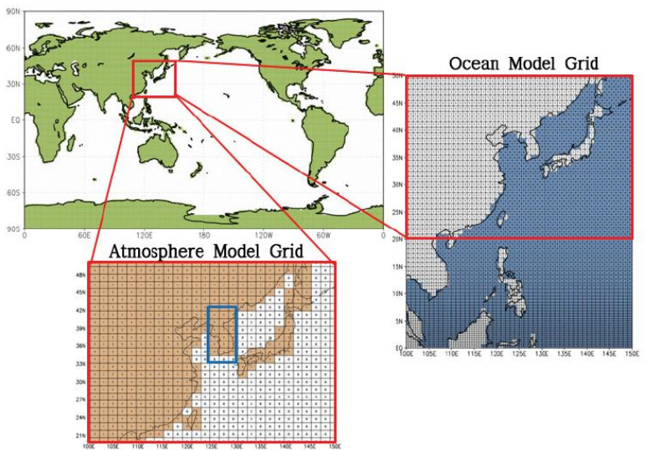
Global climate change scenario
  GCM : HadGEM2-AO simulated by NIMR (National Institute of Meteorological Research)
  Emission Scenario : RCP8.5
  RCP scenario (AR5)
  HadGEM2-AO
RCP8.5
Notes:
For global climate change scenario, we used climate change scenario based on HadGEM2-AO with RCP8.5 scenario simulated by National Institute of Meteorological research, South Korea

Slide 8
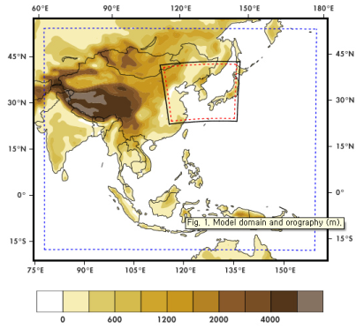
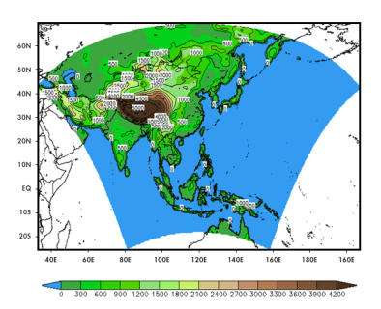
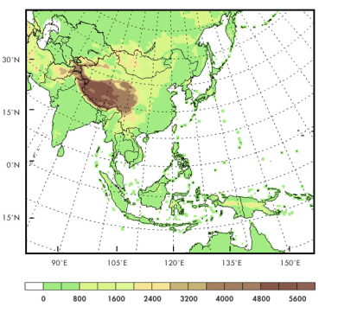
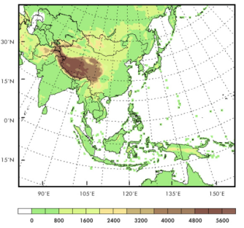
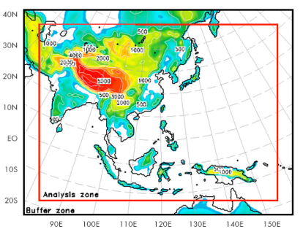
Regional Climate Model (RCM)
  CORDEX-East Asia
    Experiments of comparison and validation of regional climate change scenario
    RCM : HadGEM3-RA, RegCM4, SNU-MM5, SNU-WRF, YSU-RSM
    Data period : Historical period (1981~2005), Future period (2011-2035)
Model | Historical | RCP 8.5
HadGEM3-RA | 1950∼2005 | 2006∼2100
RegCM4 | 1979∼2005 | 2006∼2050
SNU-MM5 | 1979∼2005 | 2006∼2035
SNU-WRF | 1979∼2005 | 2006∼2050
YSU-RSM | 1980∼2005 | 2006∼2050
  RegCM4
  HadGEM3-RA
  SNU-MM5
  SNU-WRF
  YSU-RSM
Notes:
The regional climate model used the CORDEX (COordinated Regional climate Downscaling EXperiment) - East Asia project results.
The CORDEX is experimental projects to compare and validate of regional climate change scenario.
At this time, they provide 5 RCM results such as HadGEM3-RA, RegCM4, MM5, WRF, RSM.
Their data periods are different, So we divide historical period and future period like this.

Slide 9
Statistical post-processing method
  To use climate simulation data is necessary due to climate modeling limitation
    Linear scaling method (Lenerink et al., 2007)
    Variance scaling method (Teutschbein and Seibert, 2012)
    Quantile mapping method (Sennikovs and Bethers, 2009)
    Change factor method (Lettenmaier et al., 1999, Andreasson et al., 2004)
    Step-Wise Scaling Method (Lee and Bae, 2013)
Emission
Scenario
GCM
RCM
Statistical post processing
Impact
Assessment
Model
Climate change factor
Scenario run
Historical run
Spatial downscaling
(Interpolation)
Observation
Bias
Notes:
The statistical post-processing method is necessary to use climate simulation data. There are lots of SPP methods, however, in this study the linear scaling method (LS), Variance scaling method (VS), Quantile mapping method (QM), Change factor method (CF), and Step-Wise scaling method (SWS) are used.

Slide 10
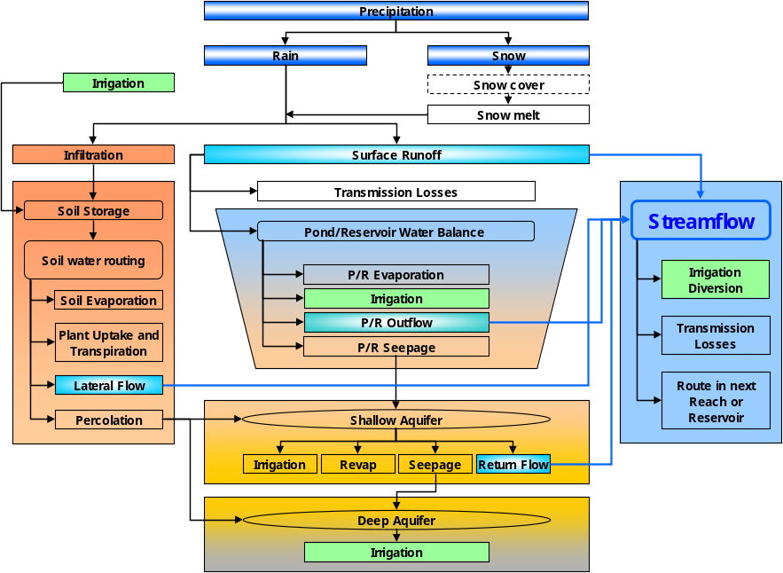
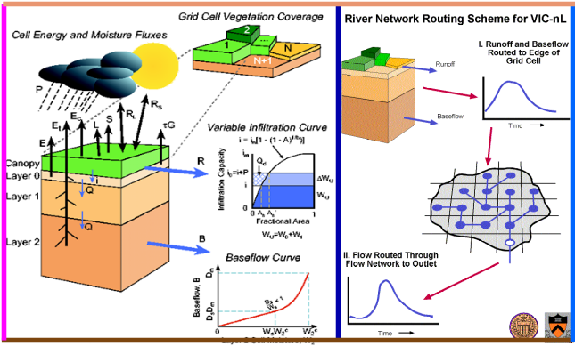
Hydrologic models
  SWAT : Semi-distributed model developed by USDA
  VIC : Distributed model for simulating water and energy flux developed by Univ. Washington
SWAT
VIC
Parameter | Input Data
Basin | DEM
Forcing | Precipitation Maximum Temperature Minimum Temperature Wind Speed
Soil | Soil Properties
Vegetation | Land use
  Indices : 1 day maximum dam inflow
Notes:
In this study, two hydrological models, namely SWAT and VIC were used for simulating past and future dam inflow.
SWAT is a semi-distributed hydrological model developed by Agricultural Research Service in USDA. The VIC model is distributed model developed by Dr. Dennis Lettenmaier research group in University of Washington. These 2 models widely used for climate change impact assessment on water resources.
And also 1-day maximum dam inflow is used for uncertainty analysis.

Slide 11
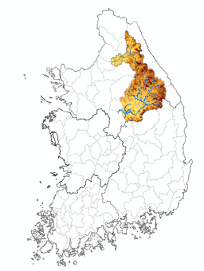
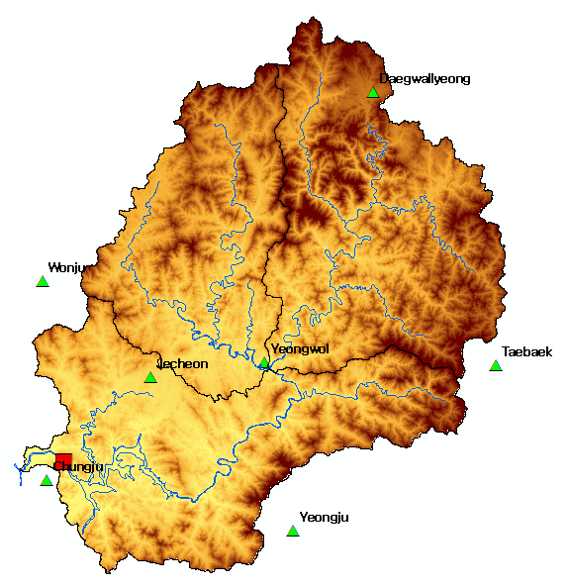
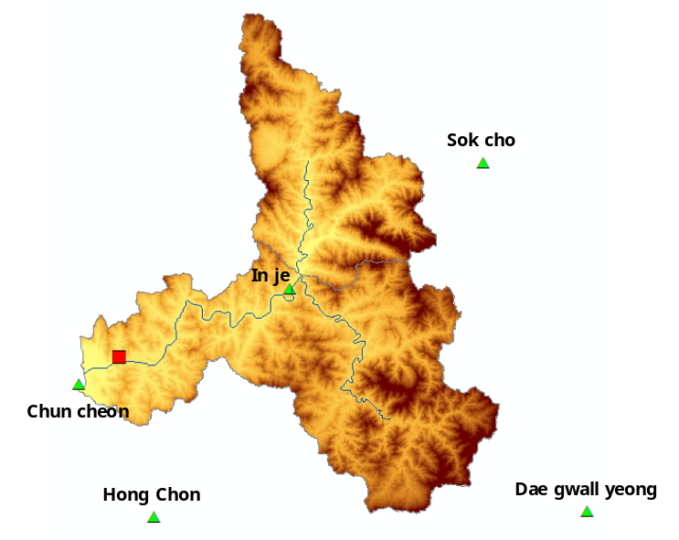

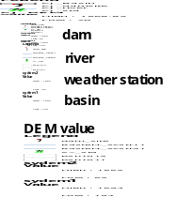
Study Area & Data
Study area
Data collection
  Chungju dam and Soyang river dam basin
  Weather data : 9 stations (KMA)
  DEM : NGII (100ⅹ100m)
  Soil : NAS (100ⅹ100m)
  Land use : ME (100ⅹ100m)
    Area : 6,648 km² (CJ), 2,703 km² (SY)
    Elevation : 70~1,569m (CJ), 194~1,694m (SY)
    Annual precipitation : 1,100~1,200 mm
Notes:
The study area are the Chungju-dam basin and Soyang river dam basin which is an upstream basin in South Han-river, South Korea.
The area, elevation, annual precipitation are about that.
For construction of hydrological model, the required weather and precipitation data of the study area was extracted from KMA’s weather stations.
Also, the digital elevation map (DEM) was prepared from National Geographic Information Institute, land use from WAMIS website, and detailed soil map from National Institute of Agricultural Sciences
국토지리정보원 (National Geographic Information Institute, NGII)
국립농업과학원 (National Institute of Agricultural Sciences, NAS)
환경부(Ministry of Environment)

Slide 12
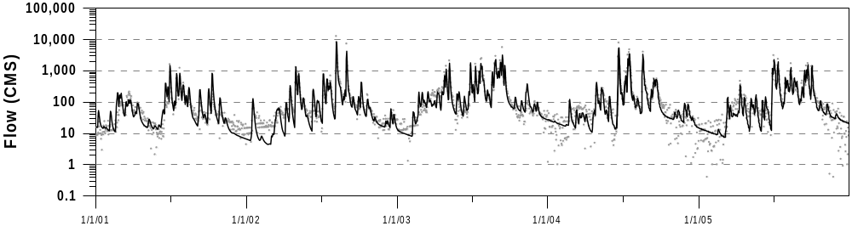

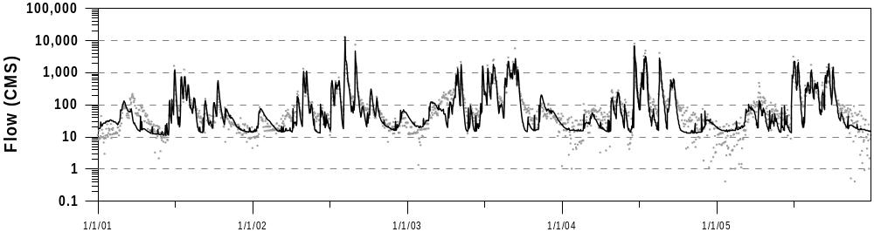
Set up the hydrological model
Parameterization
Model | Basin | Statistic value
 |  | r | RMSE | NSE | VE
SWAT | Chungju | 0.89 | 3.05 | 0.80 | -0.07
 | Soyang | 0.92 | 3.04 | 0.82 | -19.12
VIC | Chungju | 0.83 | 3.90 | 0.69 | 3.31
 | Soyang | 0.89 | 3.36 | 0.79 | -6.65
Verification period: 1996 – 2005
Calibration period: 1986 – 1995
Graphical and statistical assessment
Chungju dam basin
Observation
Simulation
Flow (CMS)
SWAT
2001.1.1
2002.1.1
2003.1.1
2004.1.1
2005.1.1
2006.1.1
Chungju dam basin
Observation
Simulation
Flow (CMS)
VIC
2001.1.1
2002.1.1
2003.1.1
2004.1.1
2005.1.1
2006.1.1
Notes:
The parameters of each hydrological models were estimated manually. The calibration and verification periods were divided like this.
And the figures and table show the graphical and statistical assessment results.
These results showed that the performance of the model is quite satisfactory for analyzing the dam inflow data.
Statistical assessments such as correlation coefficient (CC), root mean square error (RMSE), model efficiency (ME), volume error (VE) were performed using these models.
The results of SWAT and VIC model were about 0.89, 0.83 (CC), 3.05, 3.90 (RMSE), 0.80, 0.69 (ME), -0.1, 3.3% (VE), respectively.

Slide 13
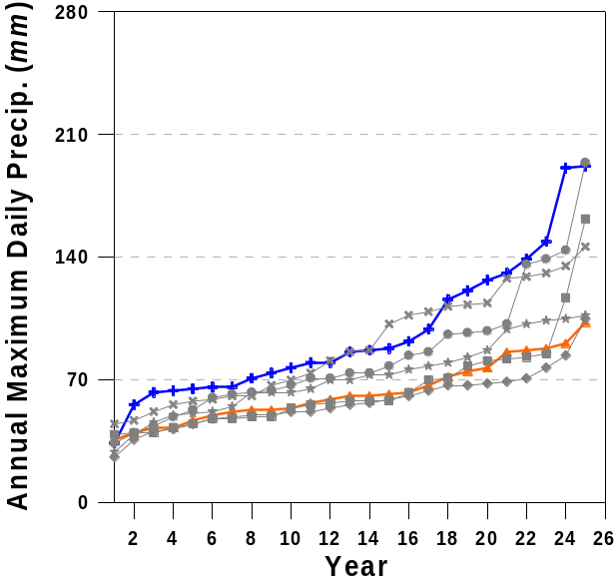
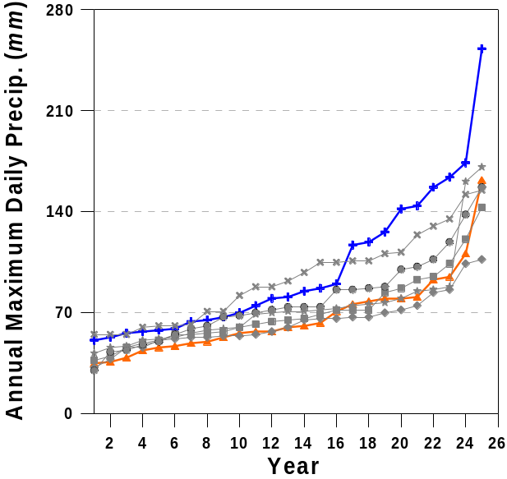
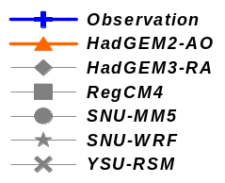
Results and Analysis
Bias of 1-day maximum precipitation for historical period
  All GCM and RCMs tend to underestimate
  Max and min (Obs): 196mm, 48mm, Max (GCM): 100mm
  Bias of average: 20∼30mm, Bias of standard deviation: 3~20mm
Chungju dam basin
Soyang river dam basin
  The SPP is necessary for applying the climate change impact assessment on high dam inflow
Notes:
This slide shows the bias of 1-day maximum precipitation for historical period
As you can see these figure, the 1day maximum precipitation tend to underestimate compared observation one.
The range of observation 1-day maximum precipitation are 50~200mm, however max of GCM is about 100mm
The bias of average value is about 20∼30mm, bias of standard deviation is about 3~20mm
The statistical post processing method is necessary for applying the climate change impact assessment on high dam inflow

Slide 14
Analysis of 1-dam maximum dam inflow for historic periods
  Average bias : 5.5mm (CJ), 4.6mm (SY)
  RCM : –2.4∼10.3mm (CJ, SWAT), -0.2∼10.9mm (CJ, VIC)
  SPP : -1.1∼21.3mm (CJ, SWAT), -4.1∼24.2mm (CJ, VIC)
  SPP is more main source of accuracy for the historical period than RCM, HYM
RCM | CJ basin |  | SY basin |  | SPP | CJ basin |  | SY basin
 | SWAT | VIC | SWAT | VIC |  | SWAT | VIC | SWAT | VIC
HadGEM3-RA | -2.4 | -0.2 | 2.6 | -4.1 | LSM | 6.3 | 2.1 | 5.0 | 0.1
RegCM4 | 8.2 | 6.5 | 7.8 | 6.0 | VSM | 2.1 | 4.5 | 5.8 | 2.0
SNU-MM5 | 6.9 | 4.3 | 4.8 | 2.9 | QM | 21.3 | 24.2 | 19.3 | 23.4
SNU-WRF | 5.6 | 5.1 | 7.4 | 4.3 | SWS | -1.1 | -4.1 | 1.6 | -4.1
YSU-RSM | 10.3 | 10.9 | 9.0 | 12.1 | CFM | 0.0 | 0.0 | 0.0 | 0.0
AVE. | 5.7 | 5.3 | 6.3 | 4.2 | AVE. | 5.7 | 5.3 | 6.3 | 4.2
Notes:
After performing the SPP, we run the hydrological analysis and calculate 1 day maximum dam inflow.
This table show the bias of 1-day maximum dam inflow.
For the annual 1-day maximum dam inflow, the average bias are about 5.5mm for CJ, 4.6mm for SY.
The range of bias according to RCM is about -2.4~10.3mm for CJ basin using SWAT model, however range of bias according to SPP is about -1.1~21.3mm for the same model and basin.
This results means that SPP is more main source of uncertainty than RCM for the accuracy of historical periods
Hydrological model is lowest range than RCM, and SPP

Slide 15
Future projection of 1-day maximum dam inflow
  Average increase : 6.8mm (CJ), 7.6mm (SY)
  RCM: -1.1∼27.1mm (CJ, SWAT), -6.5∼14.0mm (CJ, VIC)
  SPP: 9.8∼14.2mm (CJ, SWAT), -2.8~6.4mm(CJ, VIC)
  RCM is more main source of uncertainty than SPP , HYM is also main factor of uncertainty
RCM | CJ basin |  | SY basin |  | SPP | CJ basin |  | SY basin
 | SWAT | VIC | SWAT | VIC |  | SWAT | VIC | SWAT | VIC
HadGEM3-RA | 4.6 | -4.6 | -3.4 | 4.8 | LSM | 11.6 | 2.9 | 2.0 | 12.3
RegCM4 | 27.1 | 14.0 | 7.4 | 34.5 | VSM | 12.0 | 1.2 | 0.5 | 18.6
SNU-MM5 | 8.7 | 6.7 | 7.6 | 8.4 | QM | 14.2 | 6.4 | 2.4 | 18.2
SNU-WRF | 19.5 | -0.3 | -1.1 | 22.5 | SWS | 13.1 | -2.8 | -2.3 | 15.2
YSU-RSM | -1.1 | -6.5 | -5.5 | 3.4 | CFM | 9.8 | 5.4 | 4.6 | 11.4
AVE. | 11.7 | 1.8 | 1.0 | 14.7 | AVE. | 12.1 | 2.6 | 1.4 | 15.1
Notes:
The future projection of 1-day maximum dam inflow were analyzed for the future period.
The 1-day maximum dam inflow increased 6.8mm/day, 7.6mm/day for the CJ and SY dam basin, respectively.
The range of future projection to RCM is about -1.1~27.1 for CJ basin using SWAT model, however range of future projection according to SPP is about 9.8~14.2mm for the same model and basin.
This results means that RCM is more main source of uncertainty than SPP for the future projection
In contrast the historical period, Hydrological model has also high uncertainty is similar to RCM.

Slide 16
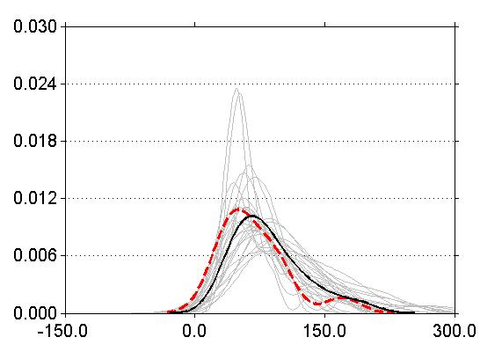
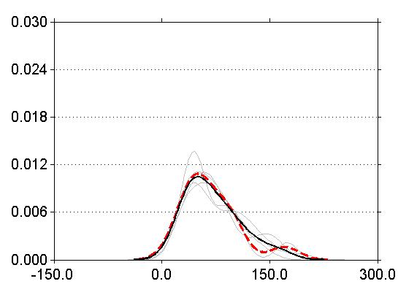
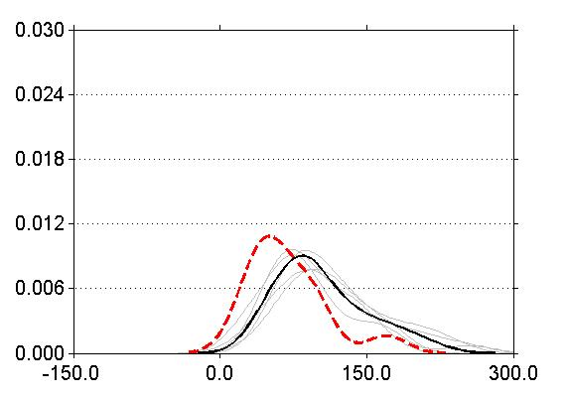
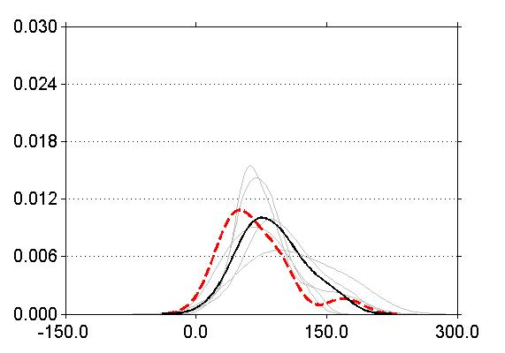
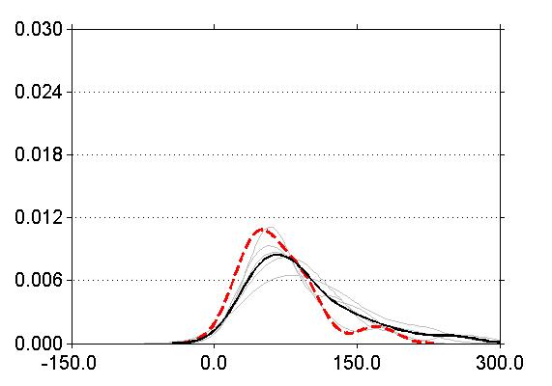
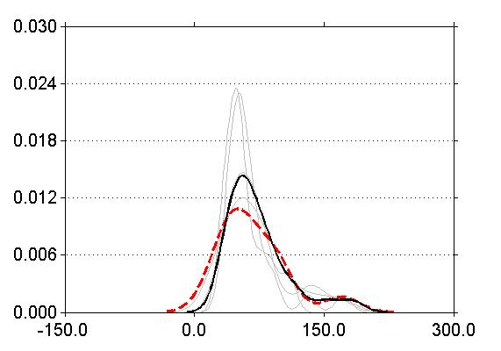
  Analysis and comparison of future projection according to RCM
    RegCM4, SNU-WRF has high increasing trend than the other RCM
    SNU-MM5 is similar to average projection results
Dynamic downscaling
SWAT_OBS
HadGEM3-RA
SWAT_OBS
RegCM4
SWAT_OBS
CJ dam Basin
SWAT_FUT_AVE
CJ dam Basin
SWAT_FUT_AVE
CJ dam Basin
SWAT_FUT_AVE
SWAT_FUT
SWAT_FUT_SPP
SWAT_FUT_SPP
f(x)
f(x)
f(x)
1-day max dam inflow (mm/day)
1-day max dam inflow (mm/day)
1-day max dam inflow (mm/day)
SNU-MM5
SWAT_OBS
SNU-WRF
SWAT_OBS
YSU-RSM
SWAT_OBS
CJ dam Basin
SWAT_FUT_AVE
CJ dam Basin
SWAT_FUT_AVE
CJ dam Basin
SWAT_FUT_AVE
SWAT_FUT_SPP
SWAT_FUT_SPP
SWAT_FUT_SPP
f(x)
f(x)
1-day max dam inflow (mm/day)
1-day max dam inflow (mm/day)
1-day max dam inflow (mm/day)
Notes:
These figures show the future projection results according to SPP method.
RegCM4, SNU-WRF has high increasing trend than the other RCM. SNU-MM5 is similar to average projection results

Slide 17

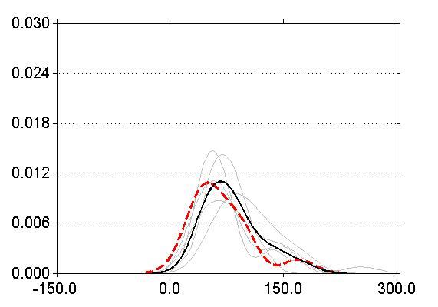
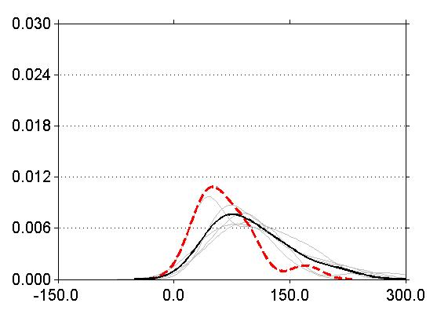
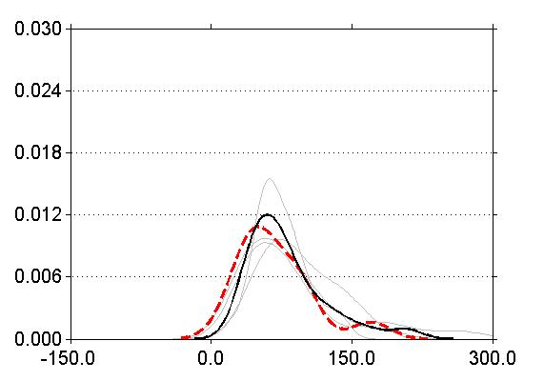
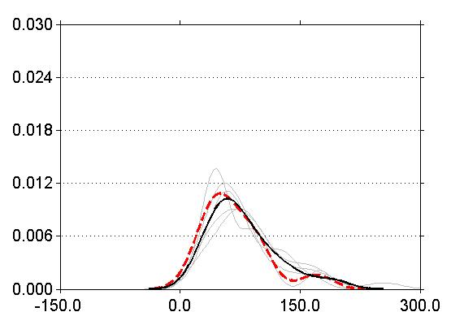
  Analysis and comparison of future projection according to SPP method
    LSM, VSM, SWS are similar to all ensemble member average
    QM has highest increase, CF has lowest increase
Dynamic downscaling
SWAT_OBS
Linear Scaling method
SWAT_OBS
Variance Scaling method
SWAT_OBS
CJ dam Basin
SWAT_FUT_AVE
CJ dam Basin
SWAT_FUT_AVE
CJ dam Basin
SWAT_FUT_AVE
SWAT_FUT
SWAT_FUT_RCM
SWAT_FUT_RCM
f(x)
f(x)
f(x)
1-day max dam inflow (mm/day)
1-day max dam inflow (mm/day)
1-day max dam inflow (mm/day)
Quantile mapping method
SWAT_OBS
Step-Wise Scaling method
SWAT_OBS
Change Factor Method
SWAT_OBS
CJ dam Basin
SWAT_FUT_AVE
CJ dam Basin
SWAT_FUT_AVE
CJ dam Basin
SWAT_FUT_AVE
SWAT_FUT_RCM
SWAT_FUT_RCM
SWAT_FUT_RCM
f(x)
f(x)
f(x)
1-day max dam inflow (mm/day)
1-day max dam inflow (mm/day)
1-day max dam inflow (mm/day)
Notes:
These figures show the future projection results according to SPP method.
The LSM, VSM, SWS are similar to all ensemble member average.
However, QM has highest increase, CF has lowest increase
This results means that the QM and CF methods distort the original than the other method.
It is necessary for eliminate the those of SPP method.

Slide 18
Uncertainty analysis of future projection
  Historical period : SPP(54%), RCM(20%), HYM(2%)
  Future period : RCM(41%), HYM(36%), SPP (2%)
Historical period
Future period
RCM
19.9%
RCM
40.7%
RCM-SPP
RCM-HYM
RCM-SPP
RCM-HYM
19.5%
RCM-SPP-HYM
1.4%
2.7%
RCM-SPP-HYM
11.1%
1.2%
3.2%
SPP
53.9%
2.1%
HYM
2.0%
SPP
2.2%
4.2%
HYM
35.9
SPP-HYM
SPP-HYM
  It is dependent to SPP (directly affected by the precipitation accuracy) for historical period, and RCM (directly affected by the precipitation changes) for future period
Notes:
The uncertainty contributions of future projection on 1-day maximum dam inflow were analyzed.
As you can see these figure, The SPP is the largest sources of uncertainty for the historical period For future period, RCM is the largest sources of uncertainty in MXDI01 about 40.7%.
It is dependent to SPP (directly affected by the precipitation accuracy) for historical period, and RCM (directly affected by the precipitation changes) for future period.

Slide 19
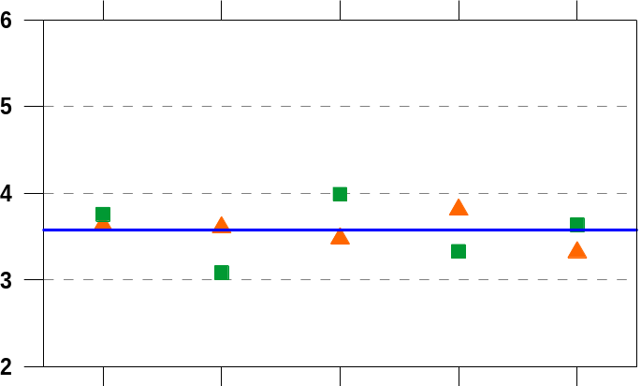


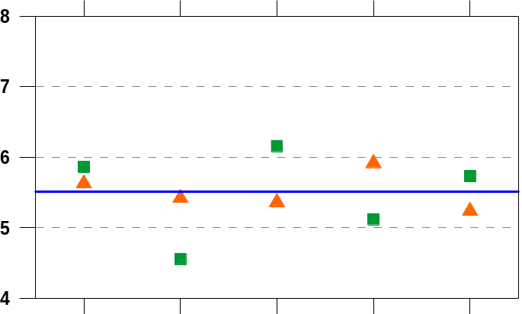


Uncertainty reduction analysis of future projection
  RCM : Total uncertainty increased in the experiments except for HadGEM3-RA, SNU-MM5, YSU-RSM
  SPP : Total uncertainty increased in the experiments except for LS, VS, SWS
SPP
LS
VS
QM
SWS
CF
CJ dam Basin
SPP
Future Projection
RCM
Reference
Type | Chungju dam |  | Soyang river dam
 | (mm) | Reduction rate (%) | (mm) | Reduction rate (%)
5×5×2 | 3.571 | - | 5.515 | -
3×5×2 | 2.891 | 19.0% | 4.155 | 24.7%
5×3×2 | 3.125 | 12.5% | 4.458 | 19.2%
3×3×2 | 2.655 | 25.7% | 3.899 | 29.3%
$$\sqrt{SST}$$
$$\sqrt{SST}$$
HadGEM3-RA
RegCM4
SNU-MM5
SNU-WRF
YSU-RSM
RCM
SPP
LS
VS
QM
SWS
CF
SY dam Basin
SPP
Future Projection
RCM
Reference
  Total uncertainty reduced
    RCM : 19.0∼24.7%
    SPP : 12.5∼19.2%
    RCM, SPP : 25.7∼29.3%
HadGEM3-RA
RegCM4
SNU-MM5
SNU-WRF
YSU-RSM
RCM
Notes:
And also we performed the uncertainty reduction analysis of future projection.
These 2 figures show that the total uncertainty of ensemble member except for just each RCM, SPP
For example, this green square represented the total uncertainty of ensemble member except for HadGEM3-RA
The estimated total uncertainty is larger than original total uncertainty, HadGEM3-RA has uncertainty decrease
Therefore HadGEM3-RA, SNU-MM5, YSU-RSM is appropriate RCMs, and also LS, VS, SWS are also appropriate SPP method for reduction total uncertainty.
And also we analyzed the reduction rate. The total uncertainty has reduced 25% (RCM selection), 19% (SPP selection), 29.3% for both steps selection.

Slide 20
Conclusions and Remark
Conclusions
  The purpose of this study are to develop the uncertainty reduction method and to access the future projection for 1-day maximum dam inflow
  The 1-day maximum dam inflow will be increased about 6.8mm (CJ), 7.6mm (SY), total uncertainty is about 3.6mm, 5.5mm
  SPP (directly affected by the precipitation accuracy) for historical period, and RCM (directly affected by the precipitation changes) are main factor of uncertainty
  The total uncertainty has reduced 19.0∼24.7% (RCM selection), 12.5∼19.2% (SPP selection) 25.7∼29.3% (RCM, SPP selection)
Remarks
  The statistical post-processing methods that cause higher uncertainty should be excluded because these methods distort the original climate change information
  Through this research, the guidelines for constituting the modules for GCM downscaling and hydrologic model are supplied for the reliable climate change impact assessment and the study results in the application area are provided in this study
Notes:
The purpose of this study are to develop the uncertainty reduction method and to access the future projection for 1-day maximum dam inflow
The 1-day maximum dam inflow will be increased about 6.8mm (CJ), 7.6mm (SY), total uncertainty is about 3.6mm, 5.5mm
SPP (directly affected by the precipitation accuracy) for historical period, and RCM (directly affected by the precipitation changes) are main factor of uncertainty
The total uncertainty has reduced 19.0∼24.7% (RCM selection), 12.5∼19.2% (SPP selection) 25.7∼29.3% (RCM, SPP selection)

Slide 21
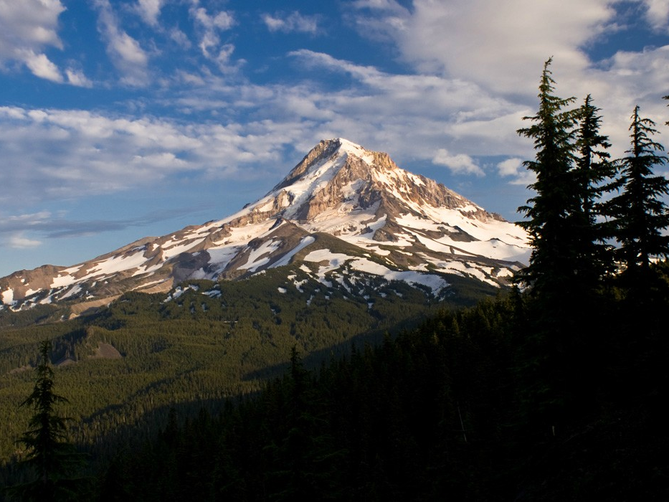
Thank you for your attention!

