Slide 1
EVALUATION OF COLOR CHANGE IN WHITE SPOT LESIONS OF ENAMEL FLUOROSIS USING A RESIN INFILTRATE
Monisha Singhal
PG STUDENT
DEPARTMENT OF PEDODONTICS & PREVENTIVE DENTISTRY
CHANDRA DENTAL COLLEGE & HOSPITAL
BARABANKI, LUCKNOW
INDIA

Slide 2
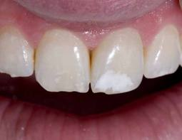
Dental fluorosis
Dental fluorosis is a condition of enamel hypomineralization because of the effects of excessive fluoride on ameloblasts during enamel formation resulting in surface and subsurface porosities and subsequent optical and physical changes

Slide 3
CONVENTIONAL APPROACHES FOR TREATMENT OF
WHITE SPOT LESIONS OF ENAMEL
Remineralizing Therapy
Bleaching Therapy
Micro-abrasion
Conventional
Bonding
Techniques
Veneers

Slide 4
Remineralizing Agents
CPP-ACP ( CASEIN PHOSPHOPEPTIDE
AMORPHOUS CALCIUM PHOSPHATE )
Fluoride Therapy
Limitations
Takes Considerable time
Needs to be implemented early
Results rely on Patient’s Compliance
Fluoride varnishes might be untolerable
among smaller children

Slide 5
“Bleaching Therapy”
Limitations
Limited Esthetic effect
Post-treatment Sensitivity
Reduced Micro-hardness of Enamel

Slide 6

Micro-Abrasion
Limitations
Aggressive Reduction of Enamel
Effective in Shallow lesions only
Require multiple sittings
Sample text here

Slide 7

conventional bonding and various types of veneers- Limitations
Invasive Procedure
Excessive sacrifice of tooth material

Slide 8
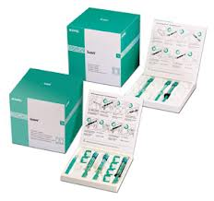
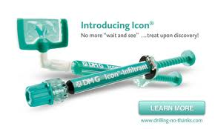
DMG-ICON
A new minimally invasive technique, DMG Icon, occlude the micro porosities within the lesion body with low-viscosity light-curing resins that have been optimized for rapid penetration into the porous enamel.

Slide 9
Mode of Action
The resin infiltrated enamel has been reported to loose its whitish opaque color and recover the healthy enamel color and translucency.
Paris S., Quint Int. 2009; 40: 7133-718

Slide 10



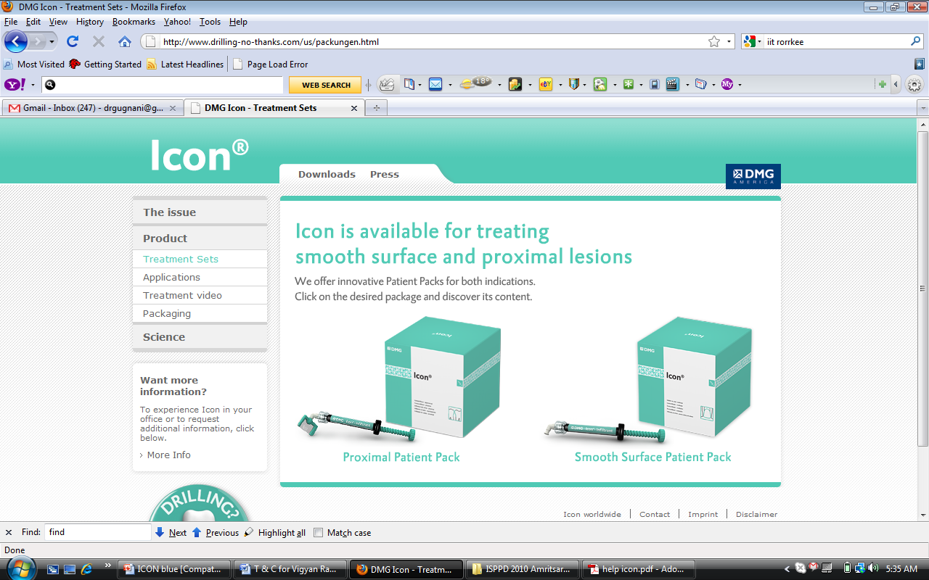
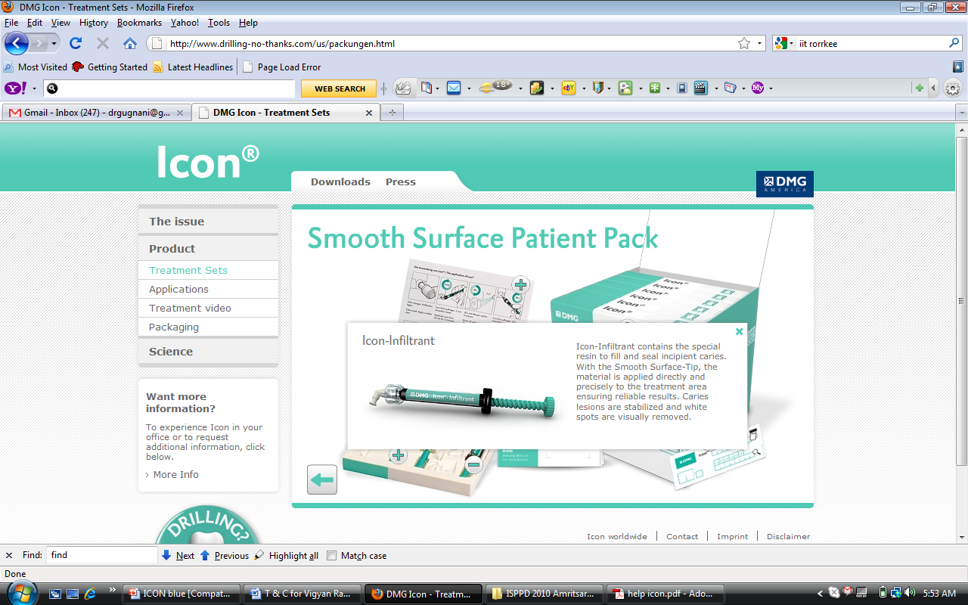
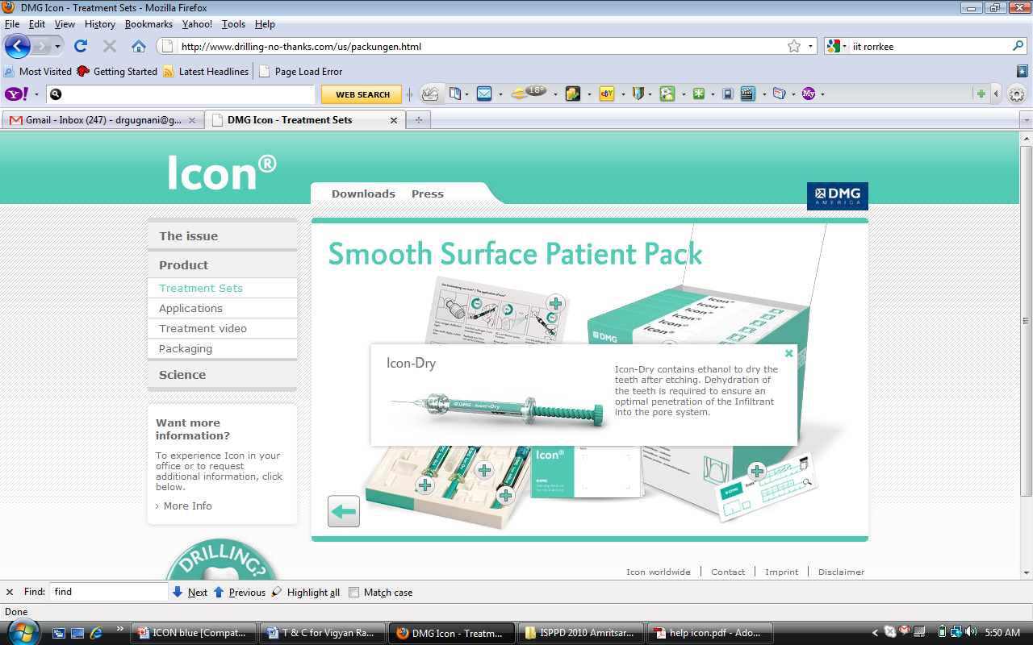
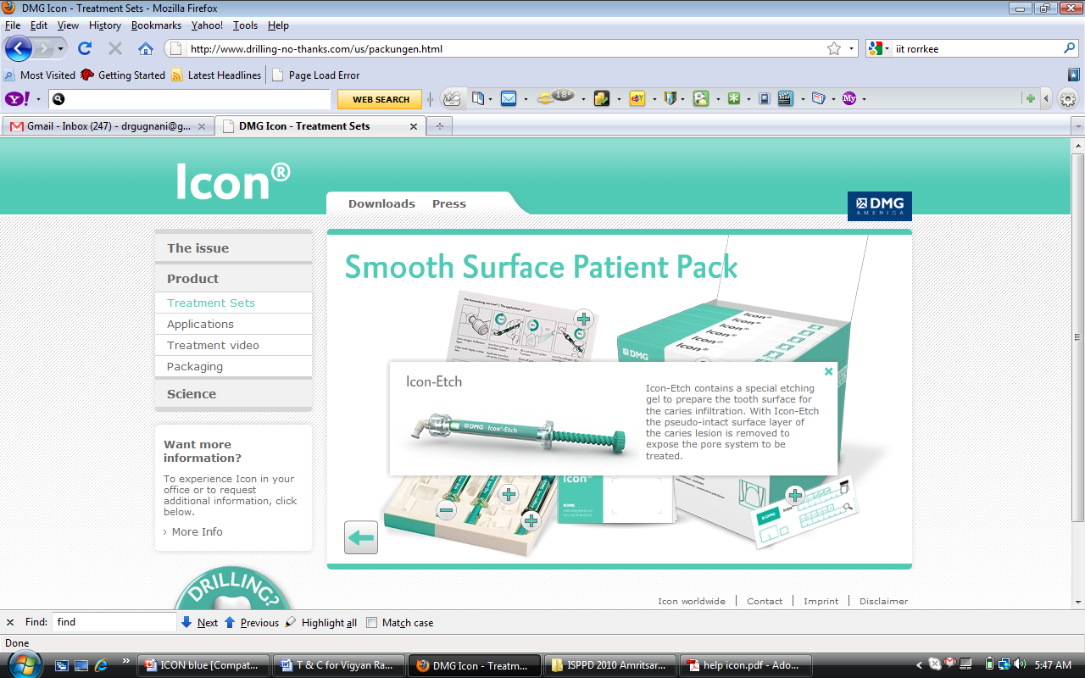
Armamentarium
Etchant
Infiltrate
Alcohol

Slide 11
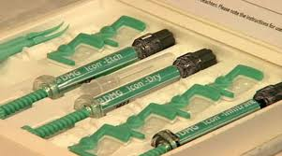
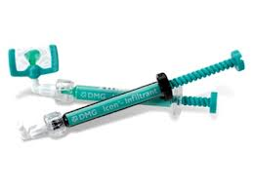
COMPOSITION
Icon-Etch: 15 %Hydrochloric acid, pyrogenic silicic acid, water, additives.
Icon-Dry: 99% ethanol
Icon-Infiltrant: Methacrylate-based resin matrix, initiators, additives

Slide 12

Caries Infiltration System : ICON- Advantages
Stops Caries Progression
Masks the opacity immediately
‘Refractive Index’ equal to Enamel

Slide 13
AIMS AND OBJECTIVES

Slide 14
Aims & Objectives
To clinically assess the masking of white spot lesions of fluorosis using resin infiltration technique.
Assess the pre-treatment and post-treatment l*A*B values of fluorosed Enamel

Slide 15
INCLUSION CRITERIA
6-12 years age
Non pitted mild white spot lesions of fluorosis on maxillary and mandibular permanent anterior teeth.
0.5 - 2 classification of Dean’s index.

Slide 16
MATERIALS
AND METHODS

Slide 17
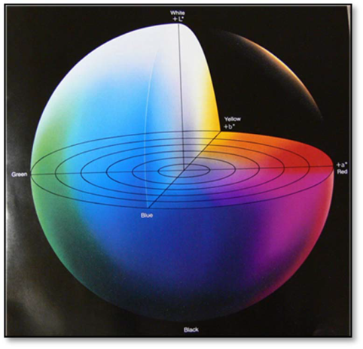
“Methodology”
30 samples of maxillary and mandibular permanent
anterior teeth as per inclusion criteria were treated for resin infiltration with DMG-Icon.
The CIELAB space was
applied in this study, which
is an international system
for color measurement.

Slide 18
“Methodology”
Pretreatment l*a*b values of tooth and white spot lesion were noticed with image analyzing software of standardized clinical photographs (EOS 500 D Canon Camera, Macro-lens Tamron 90mm F/2.8 Di 1:1, with camera settings 1/200, F29, ISO 400, Auto white balance)

Slide 19
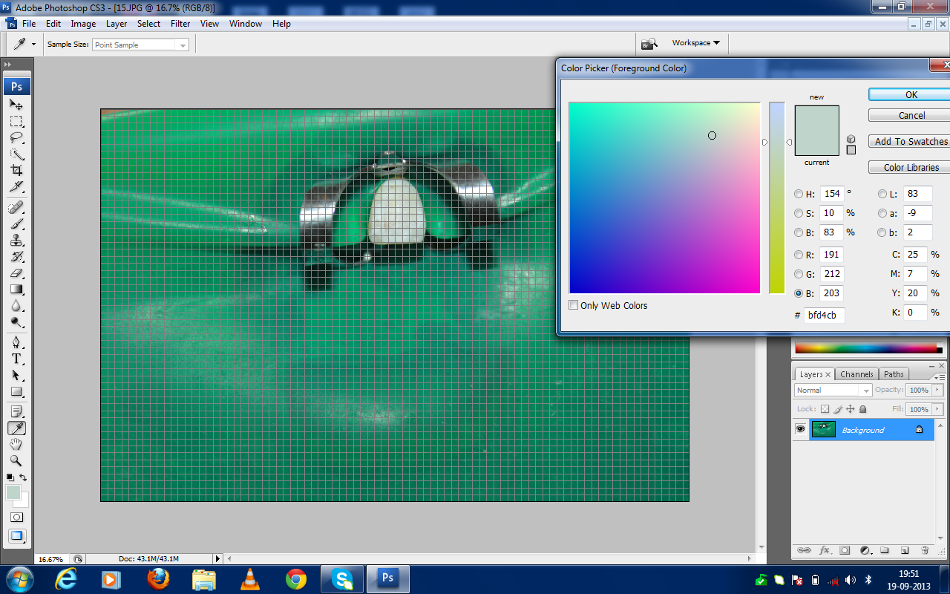

Slide 20
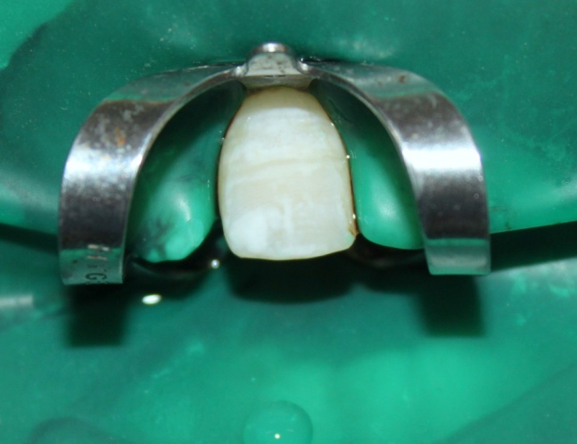
TECHNIQUE OF APPLICATION OF DMG-ICON
Affected tooth was
cleaned and isolated
with rubber dam.

Slide 21
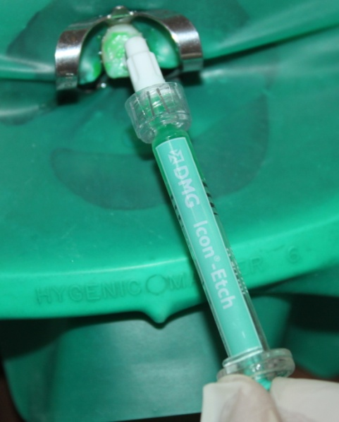
“Procedure”
2. Ample amount of Icon-Etch was applied onto the lesion site for 2 minutes.
Rinsed Icon-Etch with water for at least 30 seconds.
Dried with water-free air

Slide 22
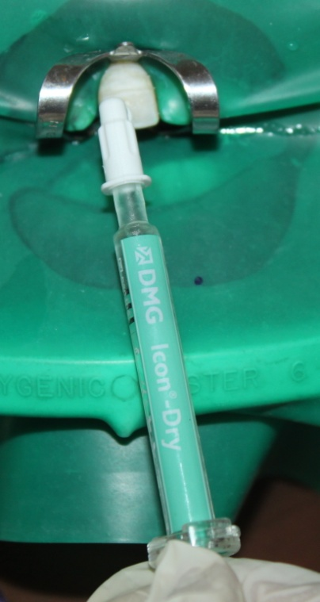
“Procedure”
3. Icon Dry was applied onto the lesion site for 30 seconds.
Dried with water free air.

Slide 23
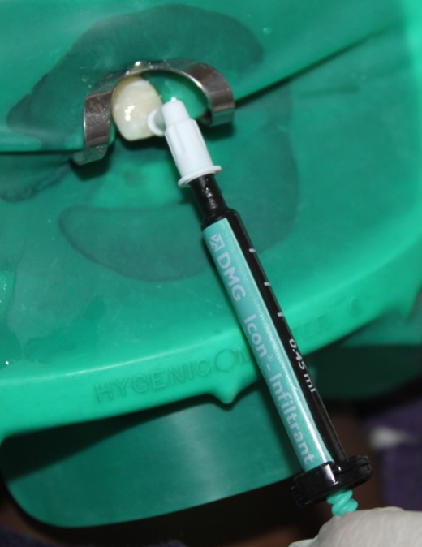
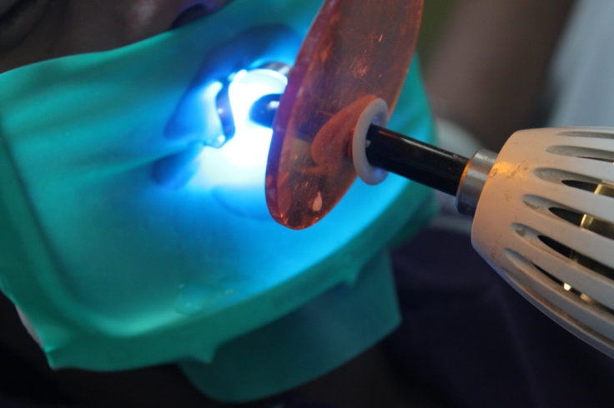
“Procedure”
4. Icon-Infiltrant was applied on the etched surface and left for 3 minutes .
Light-cure Icon-Infiltrant for 40 seconds.
After curing the application was repeated once for 1 minute and cured for 40 seconds
Remove the rubber dam.

Slide 24

PRE-TREATMENT

Slide 25
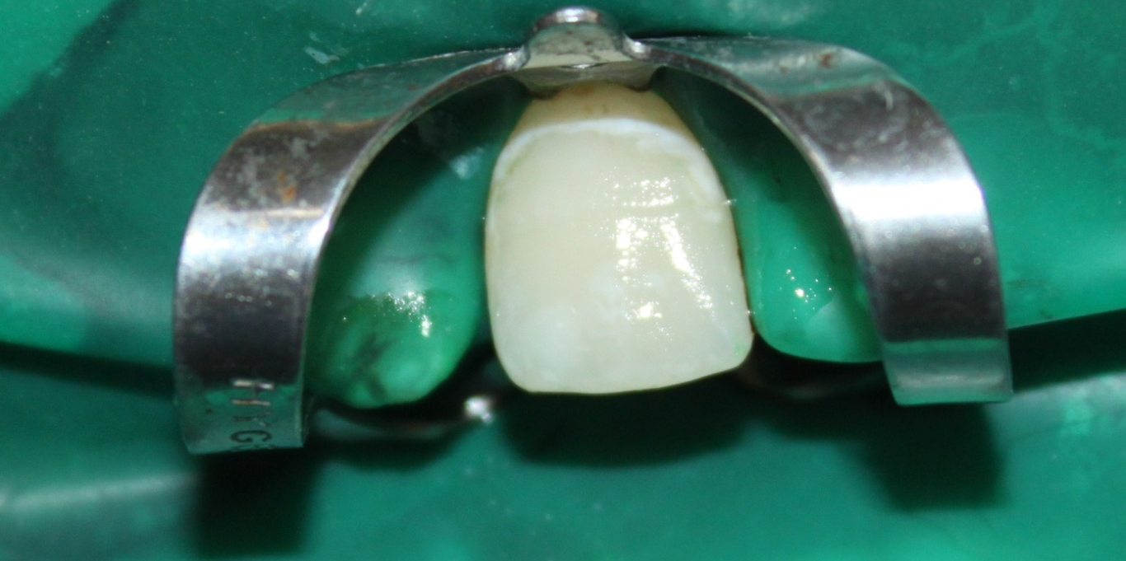
POST-TREATMENT

Slide 26
“Procedure”
Post treatment l*a*b values of tooth and white spot lesion were again recorded with software analysis of post treatment photograph.

Slide 27
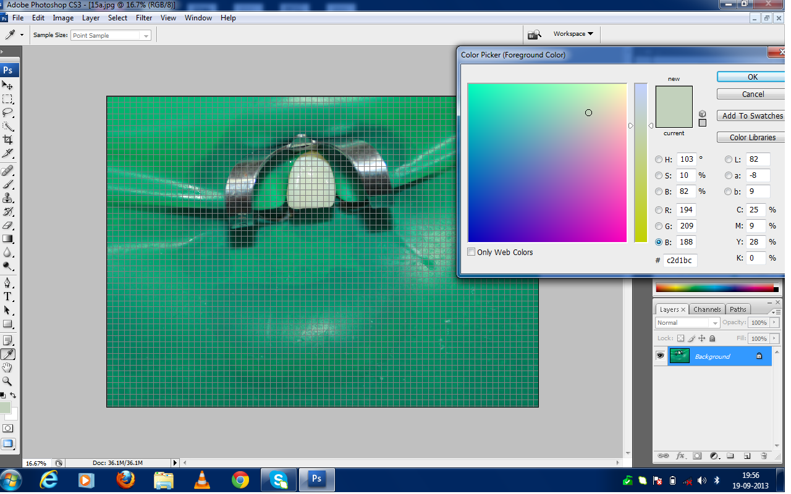

Slide 28

RESULTS

Slide 29
“Results”
Pre treatment and post treatment Color differences (delta E) of different samples were calculated using the following equation:
∆E = (∆l² + ∆a²+ ∆ b²) ½
l*-lightness /darkness
a*-red / green shade
b*-yellow or blue shade

Slide 30
“Results”
Students t test was performed to determine statistical significance (using p<.05) of color difference using delta E values of different samples.

Slide 31
“Results”
17 subjects (56.66%) had E >6 ,i.e. a very obvious change noticeable to human eye
11 subjects (36.66%) had E = 3.5-5 i.e. An obvious difference.
2 subjects(6.66%) had E= 2-3.5 i.e. medium difference
None of the patient had negative E value

Slide 32
Results
Overall color difference between sound enamel and white spot lesion decreased significantly after resin infiltration and showed significant post treatment results (p<.05) on color change of white spot lesion.

Slide 33
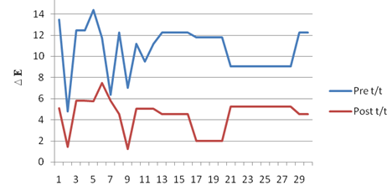
E VALUES OF L, A, B BEFORE AND AFTER TREATMENT
Notes:
This is the graph showing pretreatment and post treatment delta E values of 3o samples.and marked decrease in values of delta E was found in all samples after resin infiltration.

Slide 34
Patient satisfaction scale
7 point Likert scale was used to evaluate the patient satisfaction after resin infiltration with DMG-Icon.

Slide 35
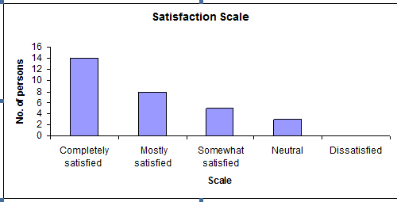
Graph showing patient satisfaction level of 30 samples according to 7-point Likert scale

Slide 36
Likert scale
14 samples (46.66%) found to be completely satisfied
8 samples (26.66%) found to be mostly satisfied
5 patients (16.66%) found to be somewhat satisfied
3 patients (10%) found to be neutral
None of the patients were unsatisfied

Slide 37

Discussion

Slide 38
Discussion
The present study evaluated the results from l*a*b values and ∆E unit of digital photographs using software analysis, which quantifies the discrepancy between the two colours

Slide 39
Discussion
In 30 subjects significant decrease in ∆E and L values with Increase in B value was found ,showing masking of white spot lesions of fluorosis towards normal tooth color.

Slide 40
Discussion
In contrast to remineralization using CPP–ACP, infiltrant resin can improve the colour, even in deeper lesions.
Resin infiltration is much less invasive than micro-abrasion or restoration.
An infiltrant resin shows very low viscosity, high surface tension, and low contact angle with the enamel. These properties are important for penetration of resin into the deeper layer of lesion.

Slide 41

Conclusions

Slide 42

Conclusion
The masking effect of resin infiltration was dramatic in some cases.
The long-term colour stability of this technique will be followed up through continuous clinical studies.

Slide 43




“Thank you for your Undivided Attention ”

