Slide 1



Differentiation between osteoblastic, osteolytic, mixed and healthy bone tissue in
CT images by texture analysis
Monika Béresova ^{1,4} , Andrés Larroza ², Estanislao Arana ³, Ervin Berényi ¹ , Lászlo
Balkay ⁴, Silvia Ruiz-Espana⁵, David Moratal ⁵
  ¹ Department of Medical Imaging, Radiology, University of Debrecen, Debrecen, Hungary
  ² Department of Medicine, Universitat de València, Valencia, Spain
  ³ Department of Radiology, Fundación Instituto Valenciano de Oncología, Valencia, Spain
  ⁴ Department of Medical Imaging, Medical Imaging Clinic Nuclear Medicine, University of Debrecen, Debrecen, Hungary
  ⁵ Center for Biomaterials and Tissue Engineering, Universitat Politècnica de València, Valencia, Spain
This work was partially supported by the „Richter Gedeon Talentum Alapítvány”!

Slide 2
INTRODUCTION I
OBJECTIVES
METHODS
RESULT
CONCLUSION
Texture analysis
Texture analysis refers to the characterization of regions in an image by their texture content.
The measurement of the texture parameters important in these cases:
quantitative description of texture
histological analysis
separation healthy tissue from pathological lesions
facilitate diagnosis
assessment of treatment planning
„greater heterogeneity = worse prognosis”
[Rodrigez M . 1998, 1999, Kim Y. 2013]
2/24

Slide 3
INTRODUCTION II
OBJECTIVES
METHODS
RESULT
CONCLUSION
Texture parameters are:
Global: - based on histogram analysis
(min, max, mean, SD, variance, skewness, kurtosis, SD/mean)
Local: - based on Co-occurrence matrix computing
(contrast, correlation, energy, homogeneity, entropy)
Regional: - intensity size-zone matrix
- voxel alignment matrix
Others: - convolution based area representation
(Gabor & Wavelet filters)
geometric features - box-count fractal dimension, surface area, volume, surface to volume ratio
3/24

Slide 4
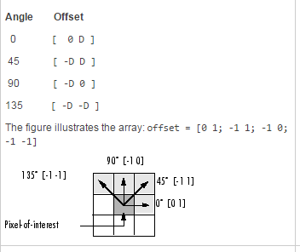
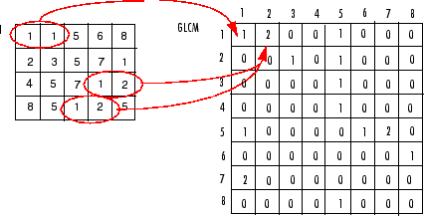
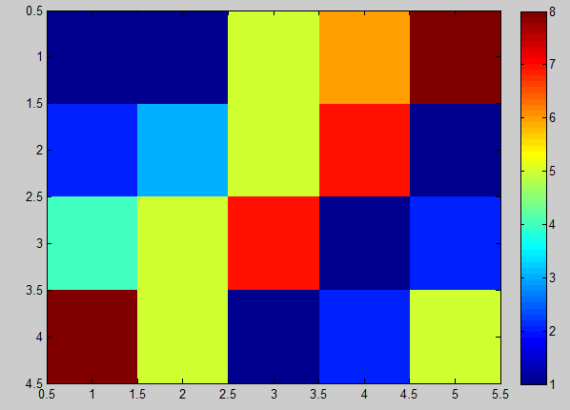
INTRODUCTION III
OBJECTIVES
METHODS
RESULT
CONCLUSION
How to compute gray-level co-occurrence matrix?
„grayscale” preselection – levels : 8, 16, 64,…
definition of pixelpairs:
  distance between the pixel of interest and its neighbour
  directions - for example: horizontal, vertical
  (in Matlab 4 directions 0°, 45°, 90°,135°)
4/24
Notes:
Siganl intensity
Original picures
To find
Once
Twice
and so on

Slide 5
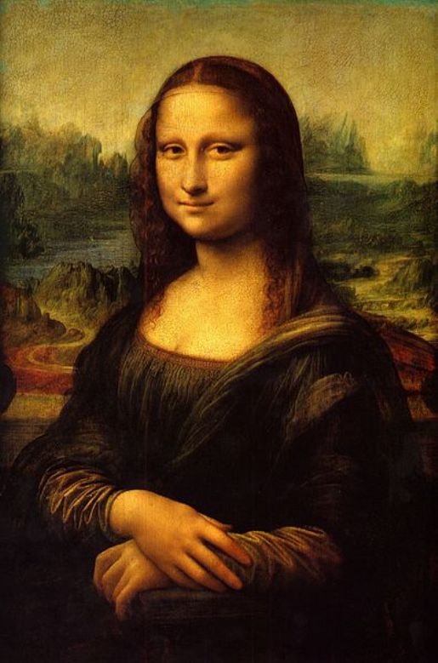
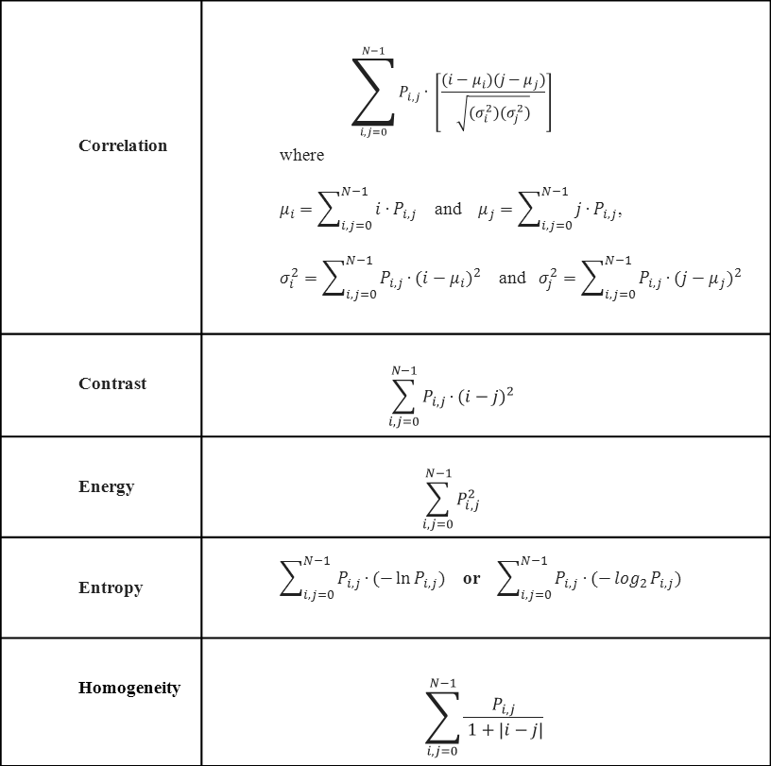


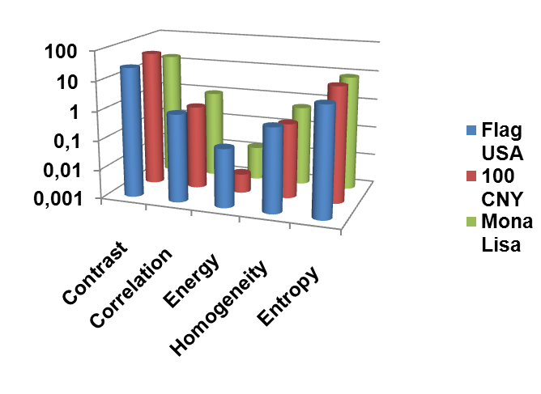
INTRODUCTION IV
OBJECTIVES
METHODS
RESULT
CONCLUSION
How the different heterogeneity parameters reflect the image texture in general?
5/24
Notes:
Siganl intensity
Original picures
To find
Once
Twice
and so on

Slide 6
INTRODUCTION
OBJECTIVES
METHODS
RESULT
CONCLUSION
The aim of this study was
to perform texture analysis of the bone metastasis
to find and describe the difference of heterogeneity parameters in
osteolytic
osteoblastic
mixed (osteolytic and osteoblastic)
and healthy bone lesions.
to analyse the volume dependence of each investigated texture parameter
6/24

Slide 7
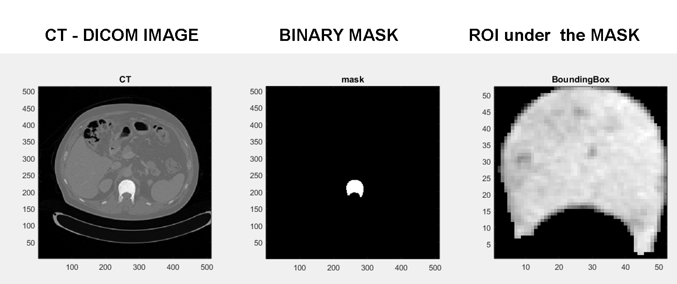
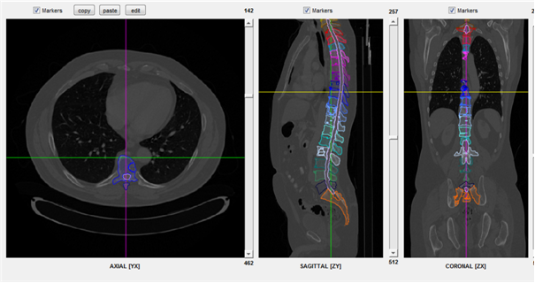
INTRODUCTION
OBJECTIVES
METHODS I
RESULT
CONCLUSION
In this study 5 patients with vertebral metastatic lesions were examined using CT images.
Pathological lesions were manually segmented and binary masks were created for them all in Matlab.
Binary masks: osteolitic, osteoblastic, mixed and healthy

Slide 8
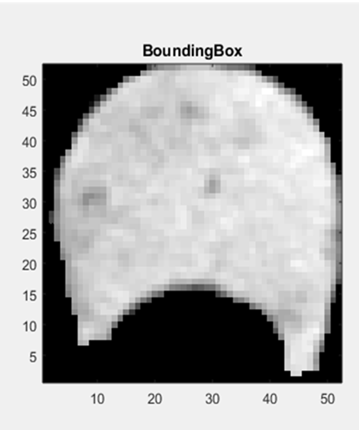
INTRODUCTION
OBJECTIVES
METHODS II
RESULT
ONCLUSION
CONCLUSION
Heterogeneity parameters :
histogram based features
(min, max, mean, SD, Variance, SD/mean)
2D
Co-occurrence matrix based features
Normalization to 64 gray levels (COM matrix size 64x64)
Matlab directions:
A = 0°
B = 45°
C = 90°
D = 135°
Contrast, Correlation, Energy, Homogeneity, Entropy
Final parameter is the average ( A, B, C, D)
8/24

Slide 9
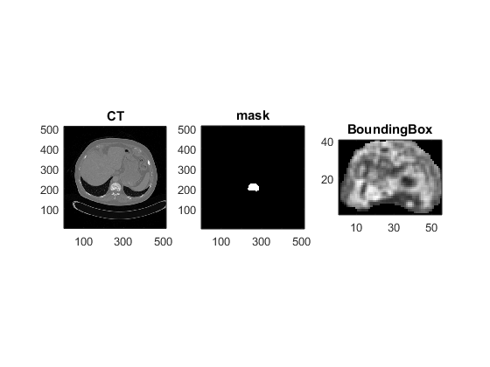
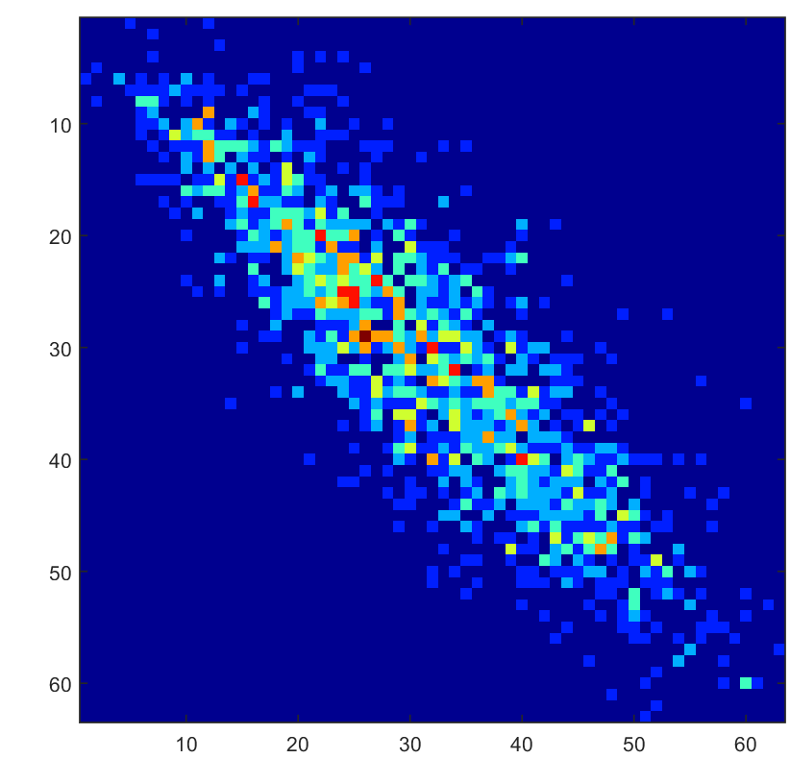
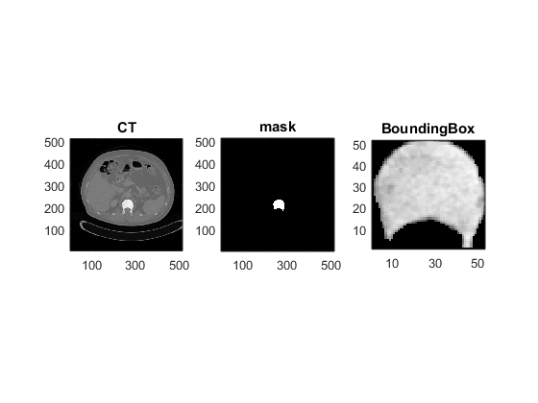
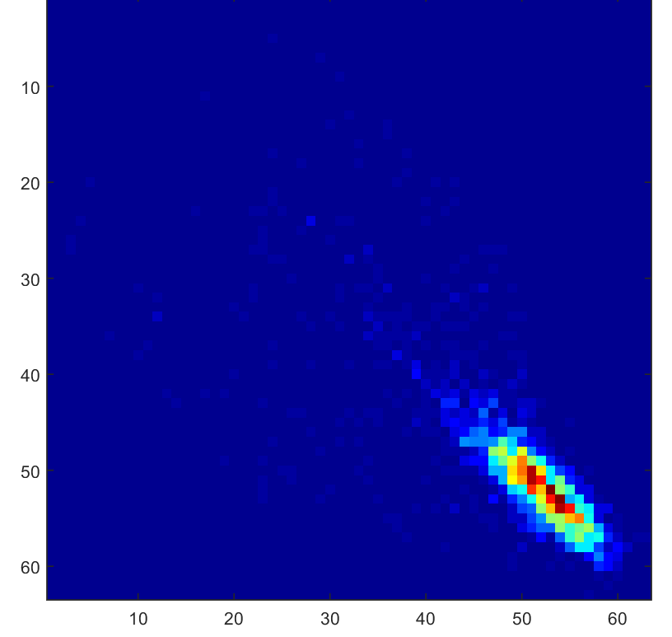
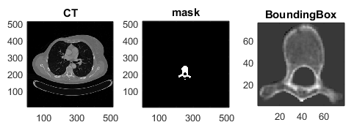
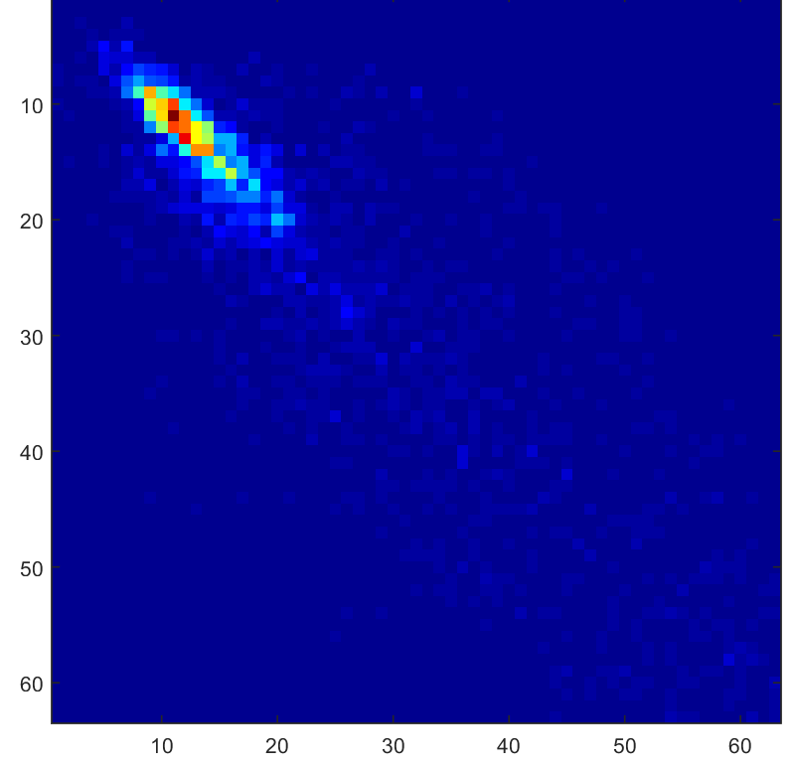
INTRODUCTION
OBJECTIVES
METHODS III
RESULT
CONCLUSION
CO-OCCURRENCE MATRIX
MIXED
MIXED
OSTEOBLASTIC
HEALTHY
9/24

Slide 10
INTRODUCTION
OBJECTIVES
METHODS IV
RESULT
CONCLUSION
Histogram (min, max, mean, SD, variance, SD/mean) and
co-occurrence matrix (contrast, correlation, energy, entropy,
homogeneity) features were extracted.
For statistical comparisons, the segmented lesions were split into four groups according to their sizes:
    (1) 0-0.25 cm ³
    (2) 0.25-0.5 cm³
    (3) 0.5-1 cm³
    (4) > 1 cm³
ROC analysis and Kolmogorov-Smirnov test were done and we used non-parametric Kruskal Wallis tests with Bonferroni correction to compare the different bone lesions.
10/24

Slide 11
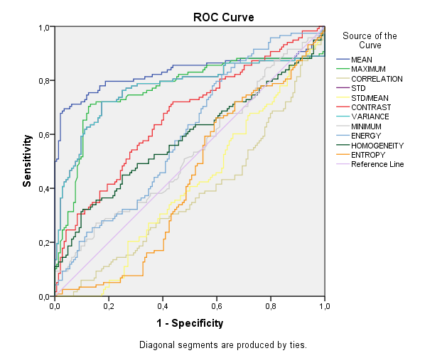
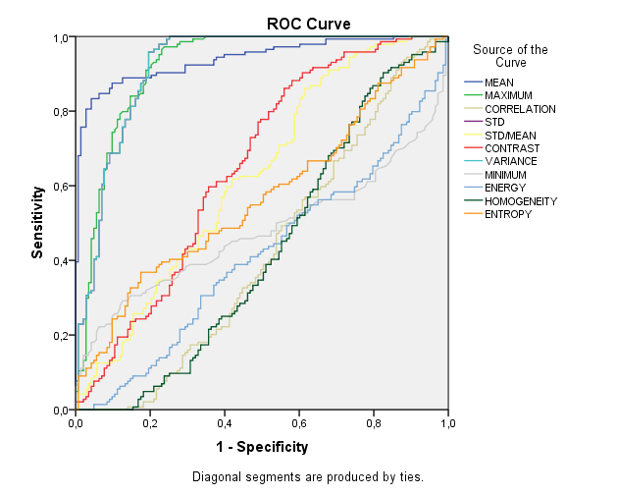
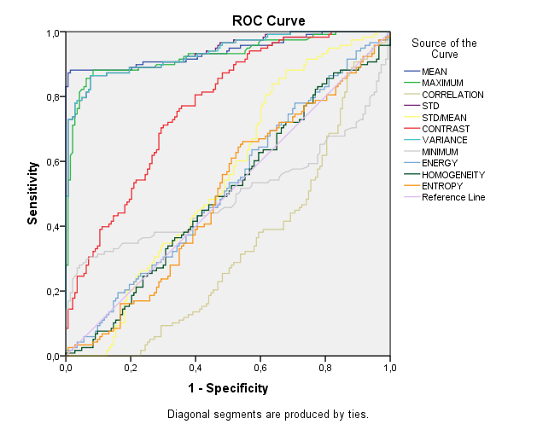
INTRODUCTION
OBJECTIVES
METHODS
RESULT I
CONCLUSION
A
B
A. Mixed vs. Osteoblastic
B. Mixed vs. Healthy
C. Healthy vs. Osteoblastic
Based on reliability and ROC analysis smallest ROIs (group 1.) were discarded, and osteolytic lesions were also excluded from this study, because their sizes fell into the 0-0.25cm³ range.
C
11/24

Slide 12
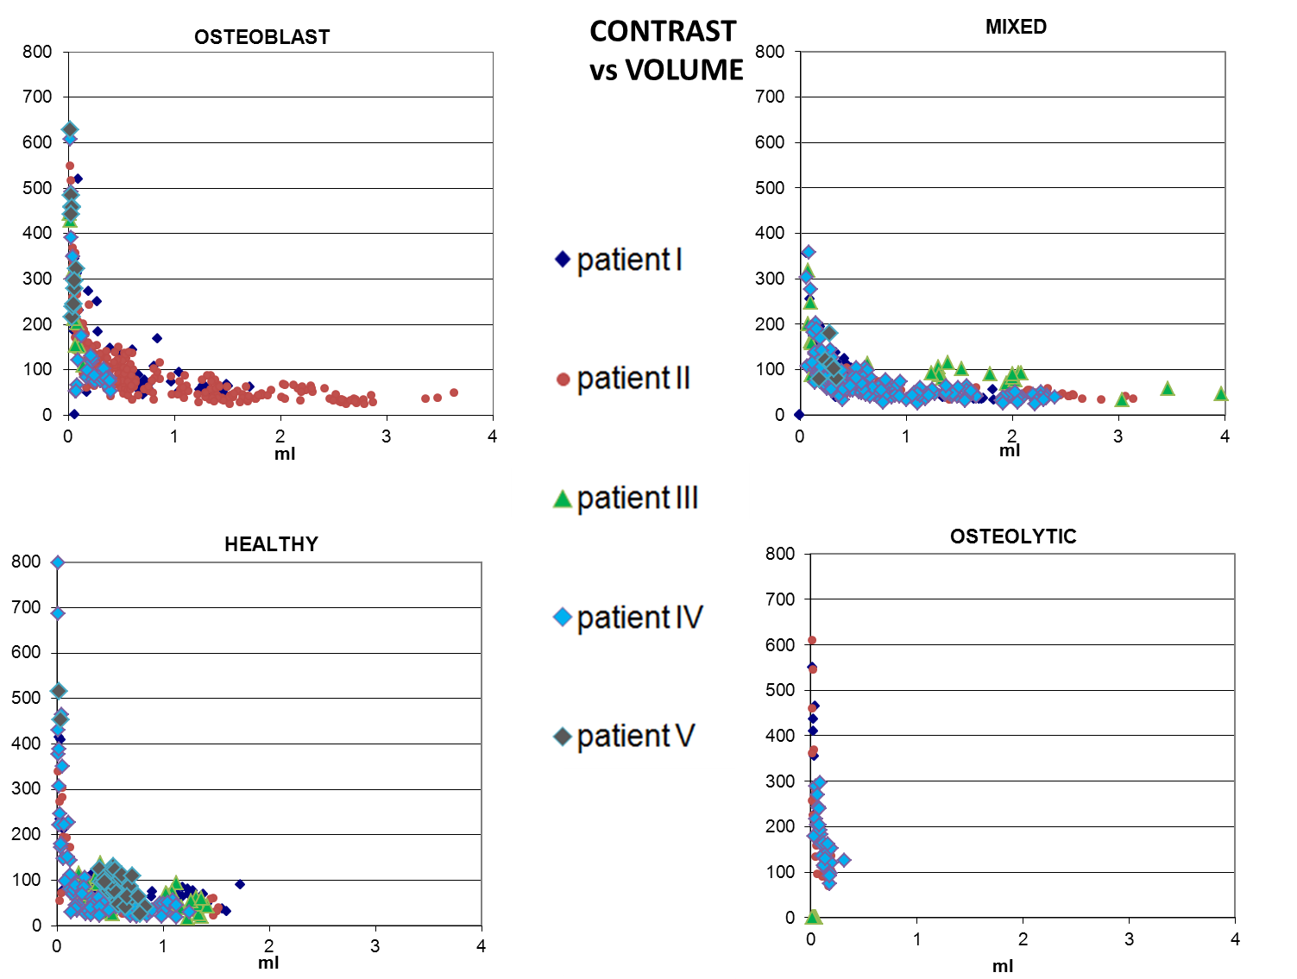

Slide 13
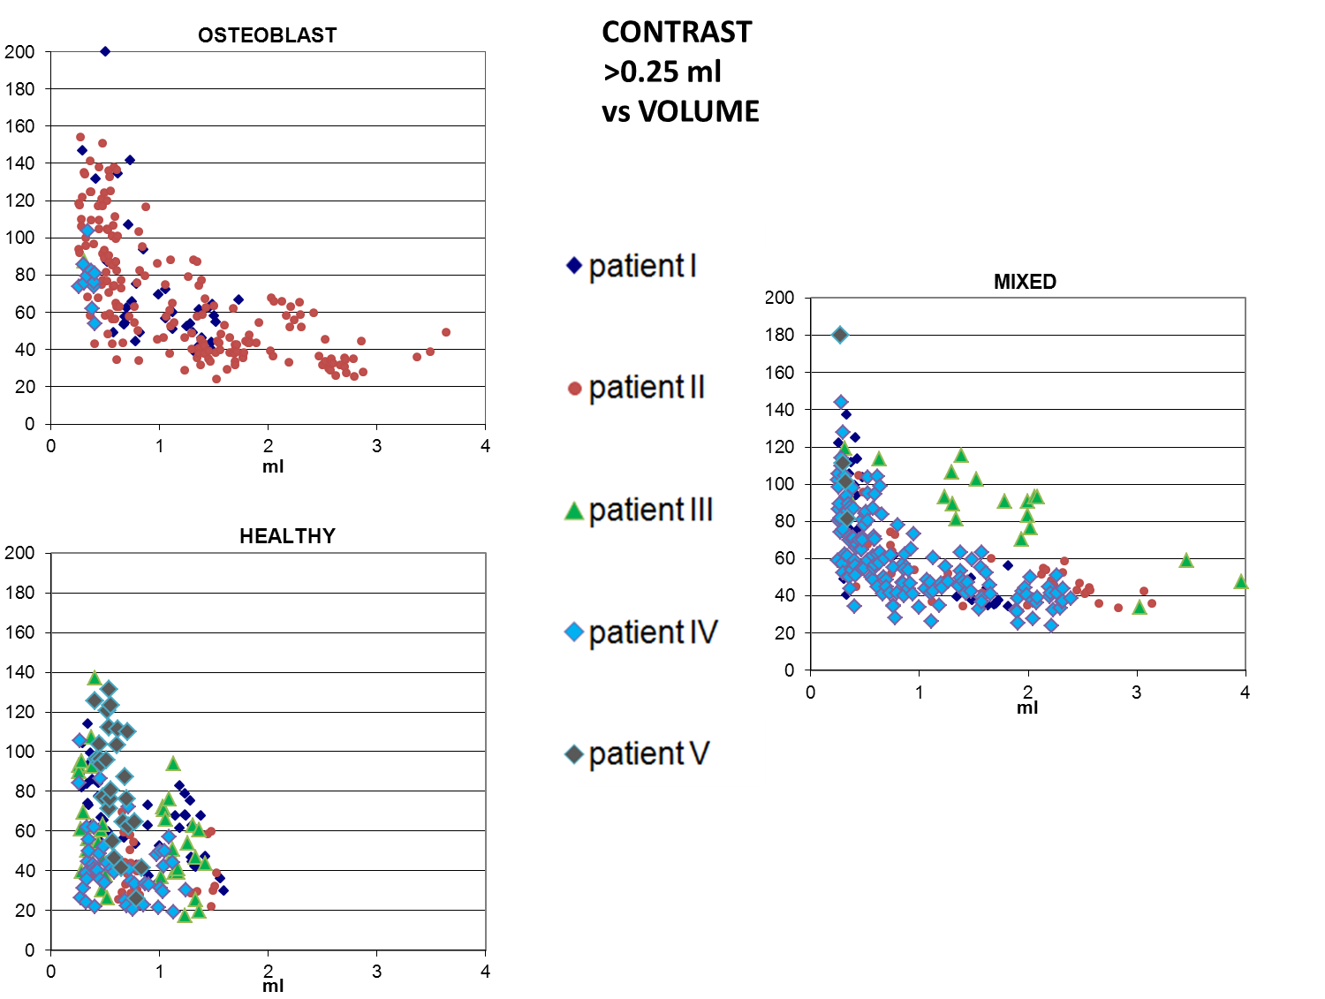

Slide 14
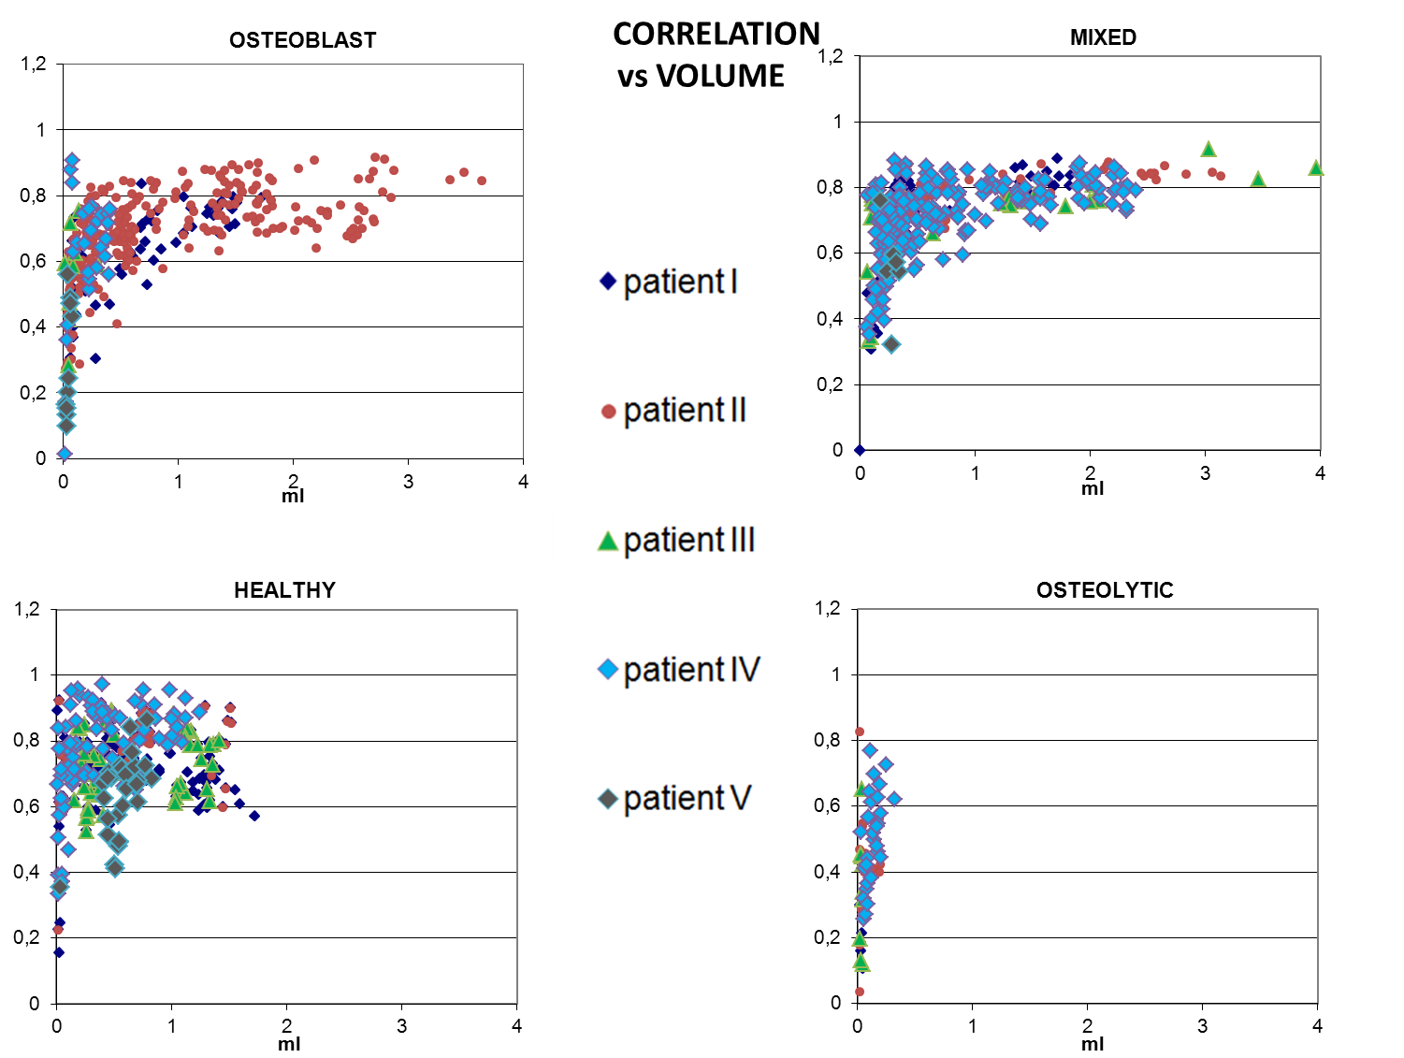

Slide 15
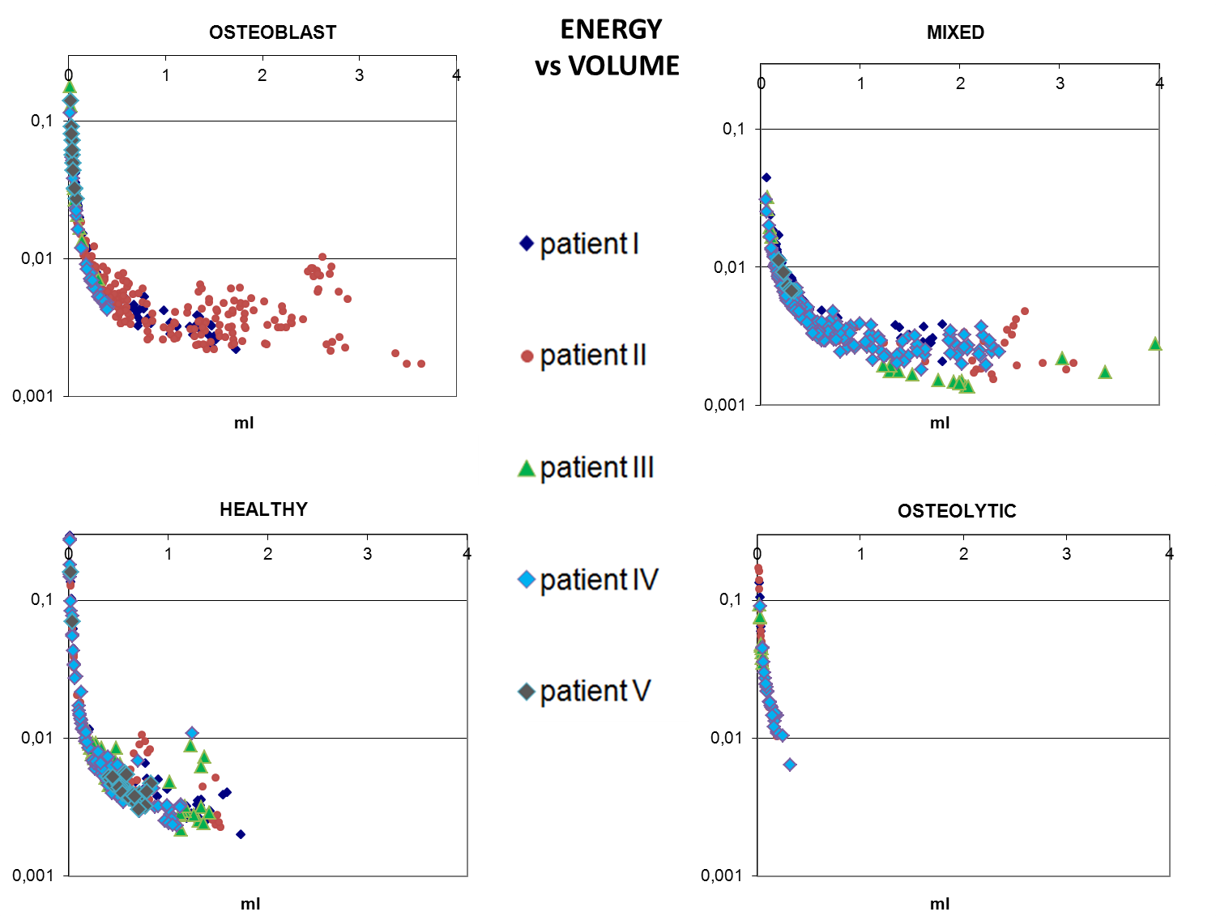

Slide 16
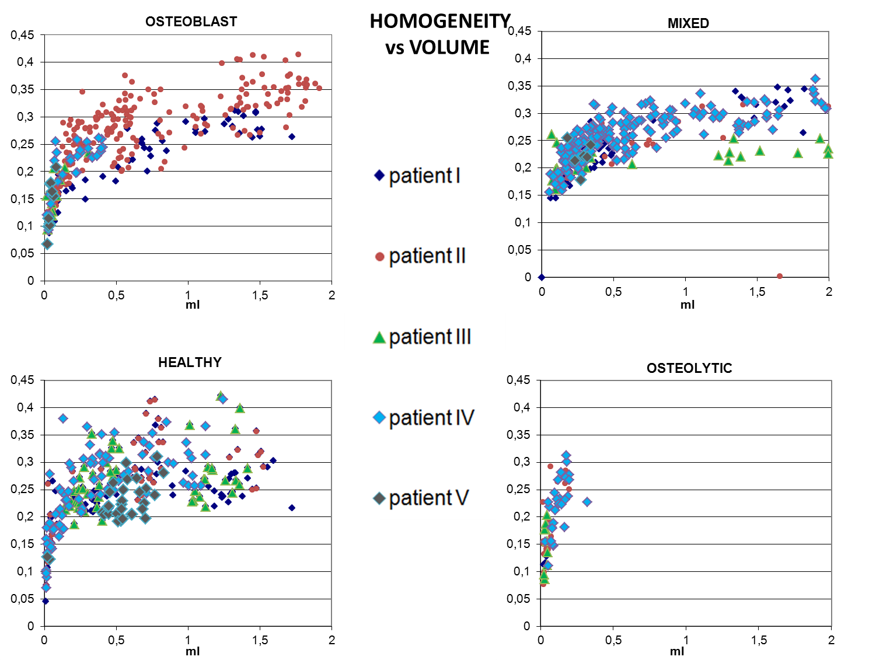

Slide 17
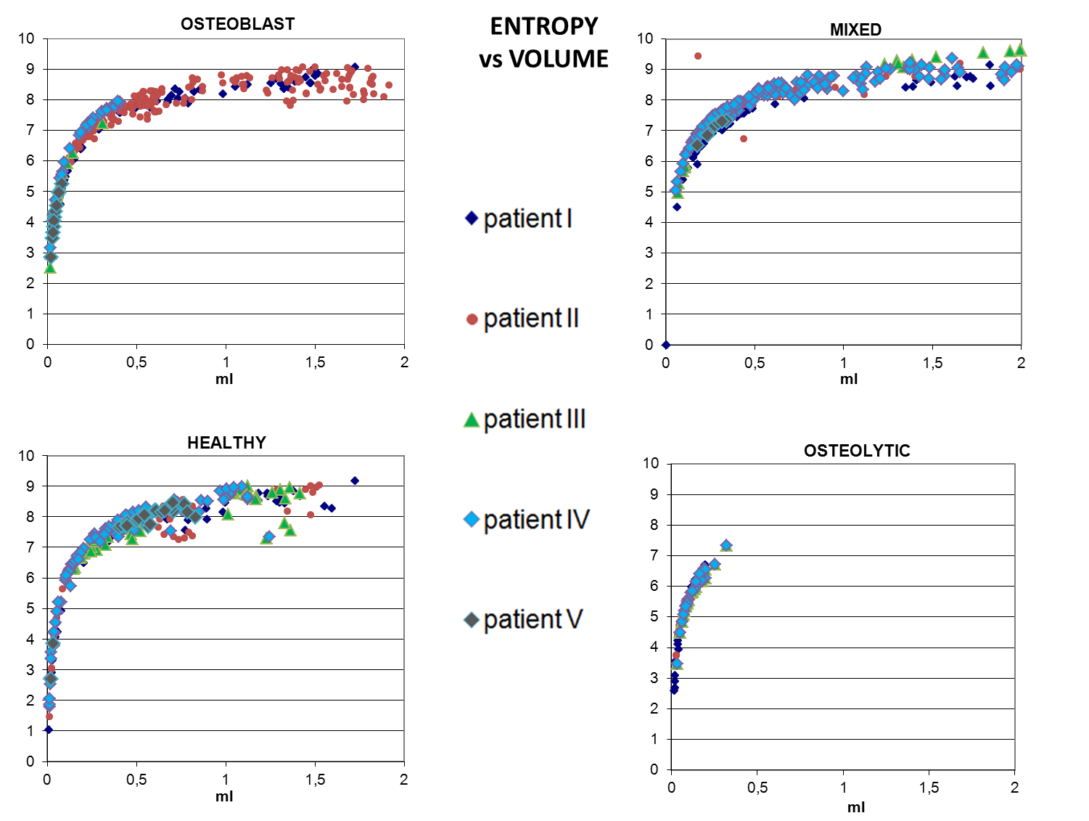

Slide 18
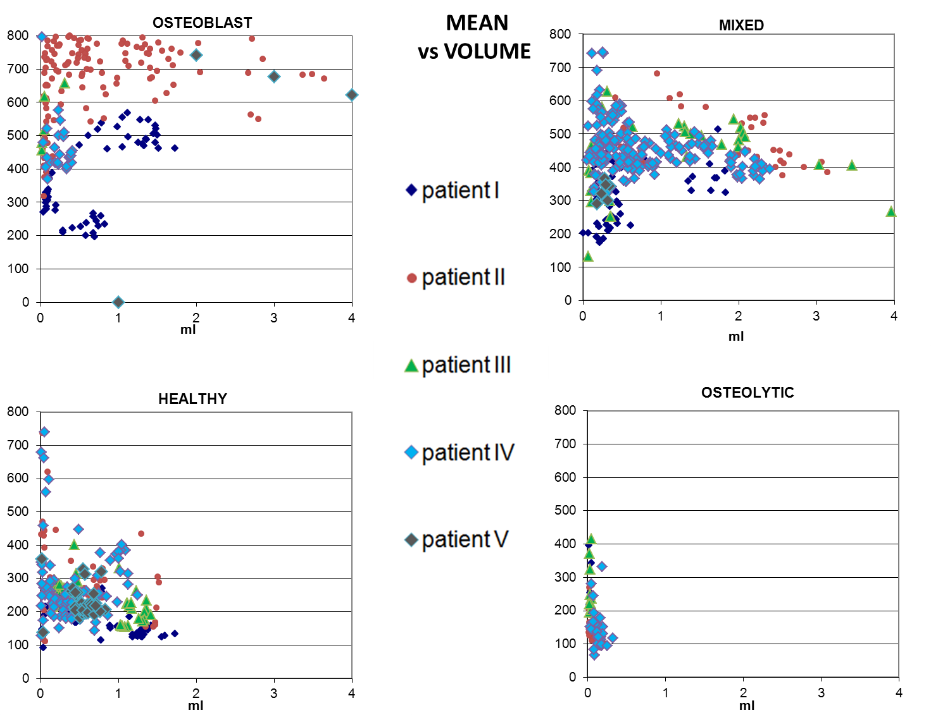

Slide 19
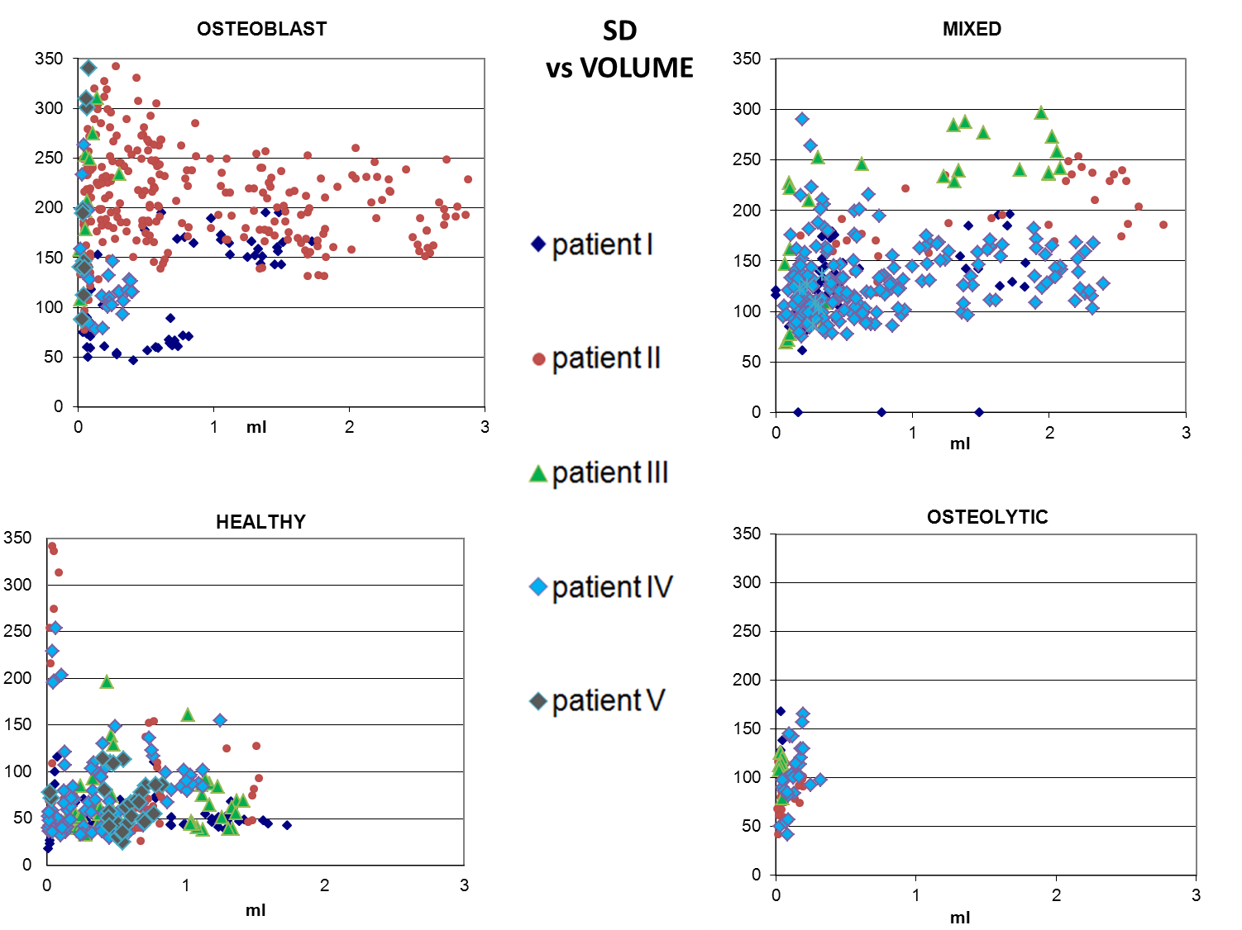

Slide 20
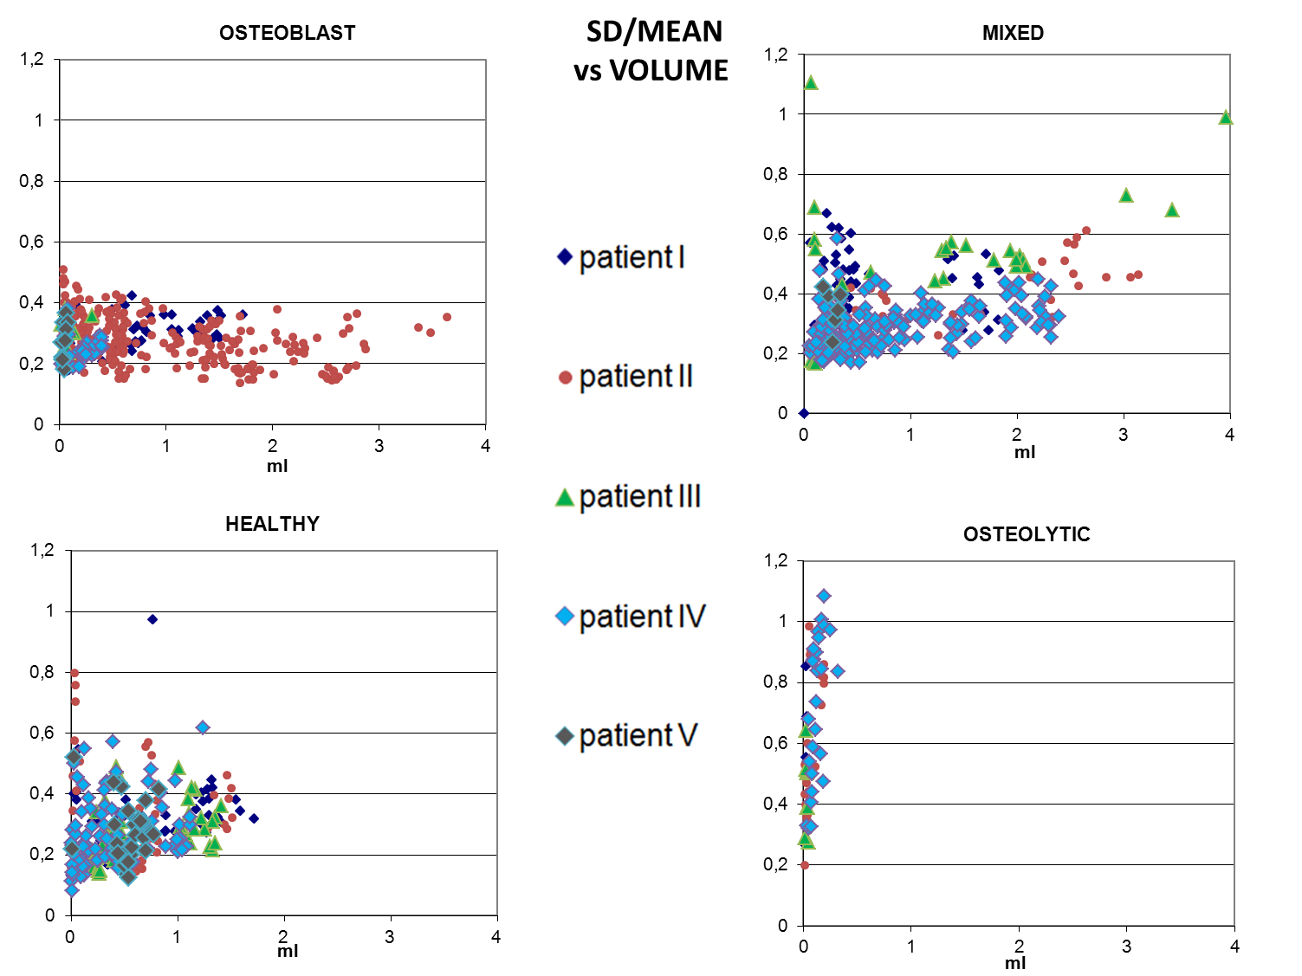

Slide 21
INTRODUCTION
OBJECTIVES
METHODS
RESULT II
CONCLUSION
Based on the Kruskal-Wallis test significant differences were found at ROI size larger then 0.25 cm³ between:
Mixed - Healthy lesions:
maximum, mean, SD, variance, SD/mean, contrast
Healthy - Osteoblastic lesions:
maximum, mean, SD, variance, contrast, correlation
Mixed - Osteoblastic lesions:
maximum, mean, SD, variance, contrast
20/24

Slide 22
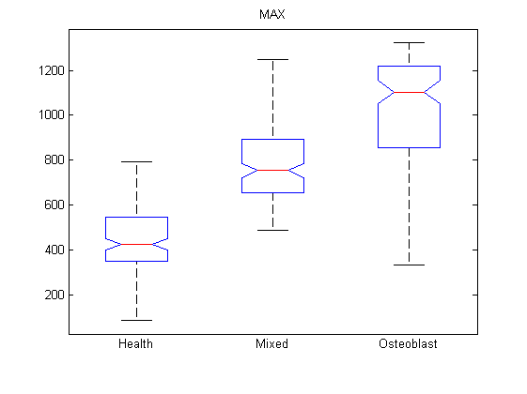
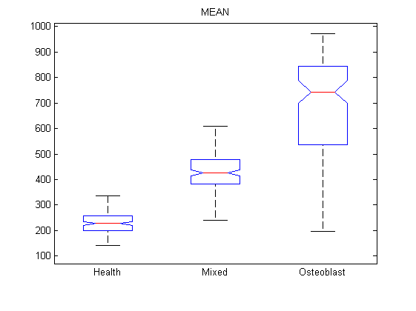
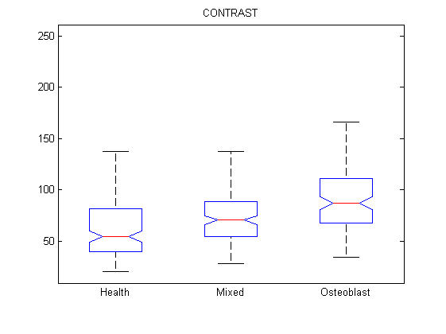
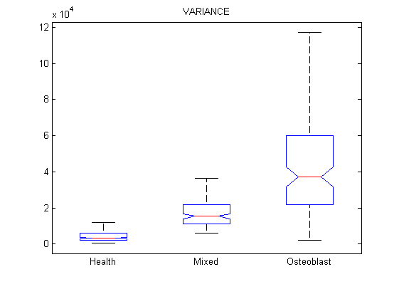
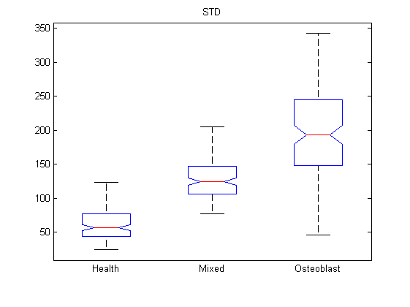
INTRODUCTION
OBJECTIVES
METHODS
RESULT III
CONCLUSION

Slide 23
INTRODUCTION
OBJECTIVES
METHODS
RESULT
CONCLUSION
In conclusion, we found several heterogeneity parameters showing differences between metastatic bone lesions.
Texture analysis was not reliable in small lesions (<0.25cm³), but we could differentiate the healthy, the mixed and the osteoblastic areas utilizing the following textural parameters: maximum, mean, SD, variance, contrast.
The heterogeneity parameters allowed us to describe the differences between pathological bone lesions.
Based on the volume dependence of the investigated textural parameters, the reliability of any texture indexes is affected by the spatial resolution of a given imaging modality.
23/24

Slide 24

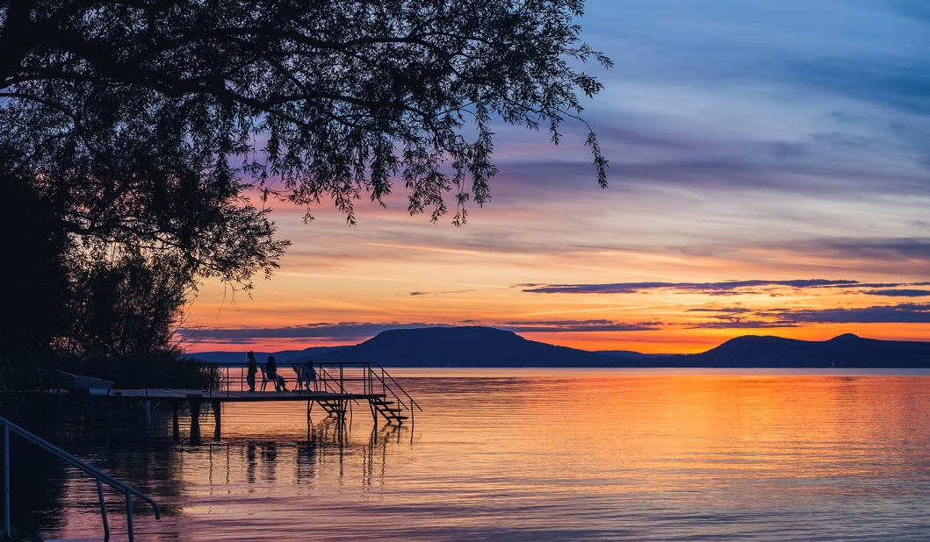
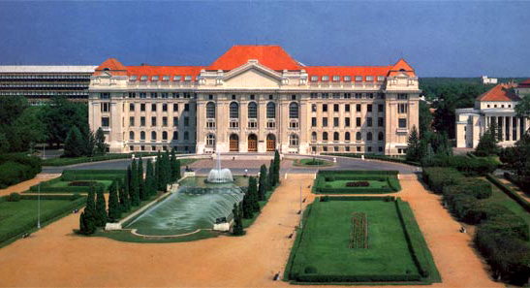
Budapest
Lake Balaton
University of Debrecen
THANK YOU FOR YOUR ATTENTION!

