Slide 1


Bioprocess Development
Upstream and Downstream
Technologies
Monica Chuong, PhD School of Pharmacy-Boston

Slide 2


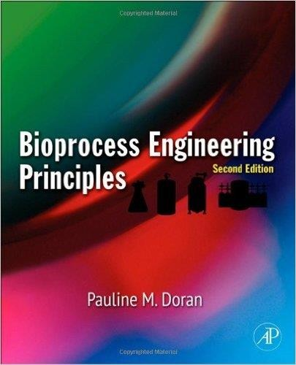
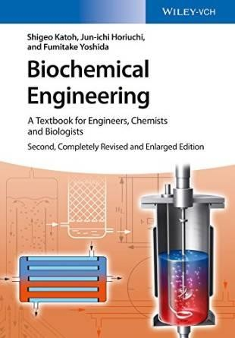
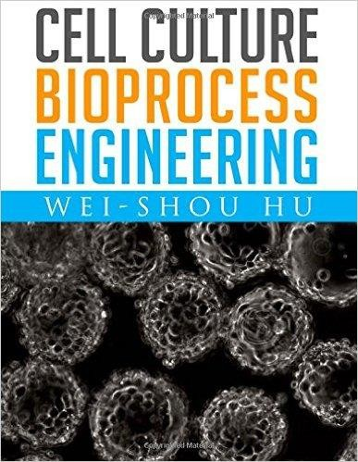
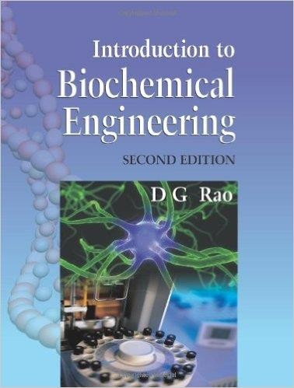
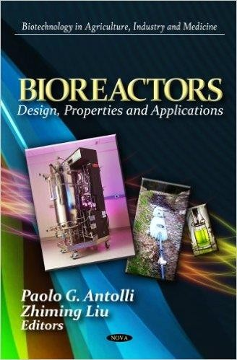

References

Slide 3
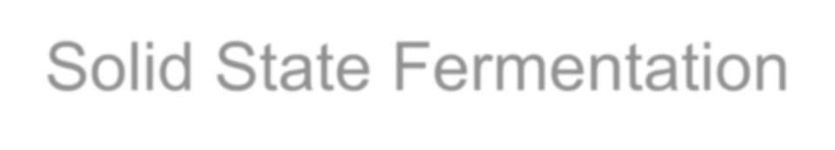

Solid State Fermentation
Microorganisms grow on a moistened solid
surface without free flowing water, but have
free access to air.
Low capital investment, water utilization, waste water, and energy requirement (no agitation)
No foam formation
Simple fermentation media
Less space
Less control techniques
Ease in controlling bacterial contamination
Ease in induction and suppression of spores
Low downstream processing

Slide 4
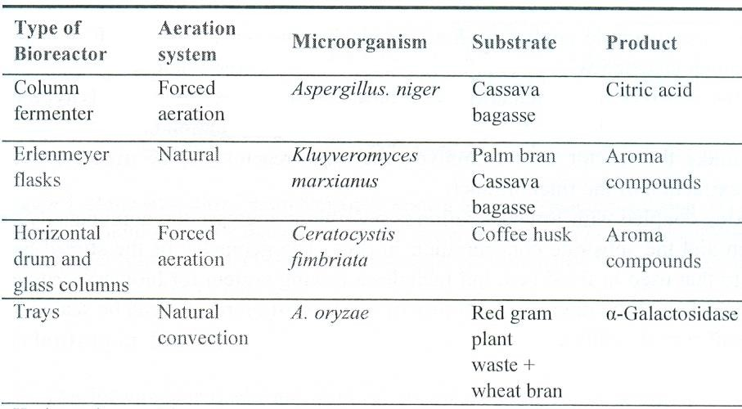

Slide 5
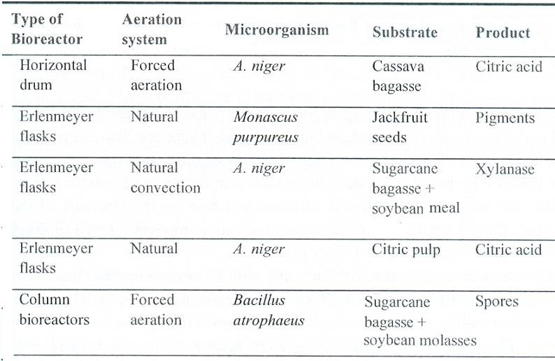

Slide 6
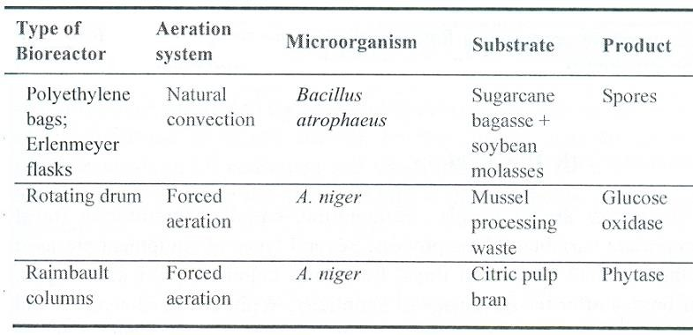

Slide 7

Submerged Fermentation
The microorganisms and the substrate are
present in the submerged state in the liquid medium.
Large solvent
The heat and mass transfer are more efficient
Amenable for modeling the process
Process scale-up is easy.
More popular

Slide 8
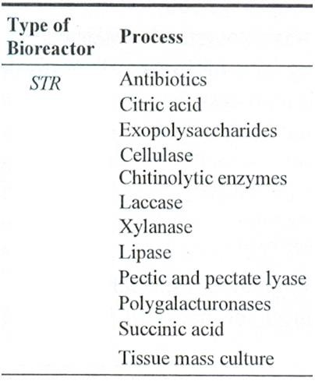
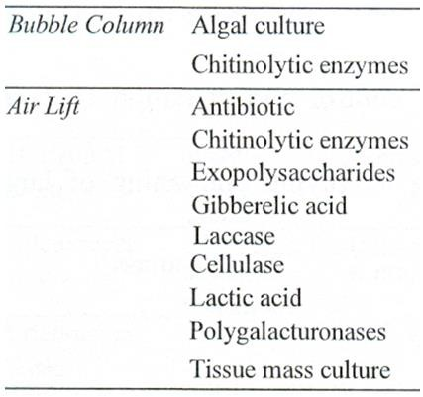

Slide 9
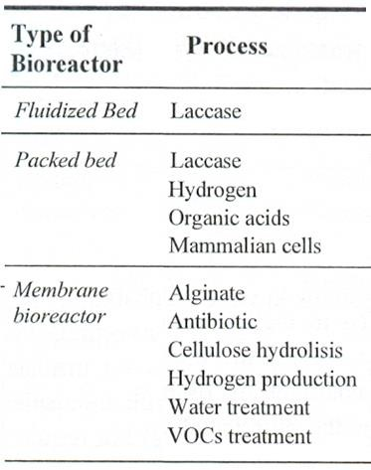

Slide 10
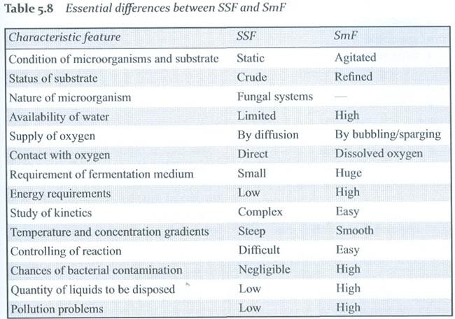

Slide 11
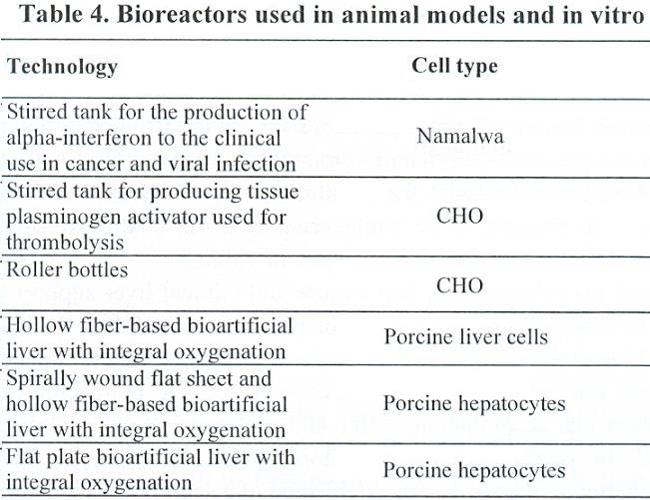

Slide 12
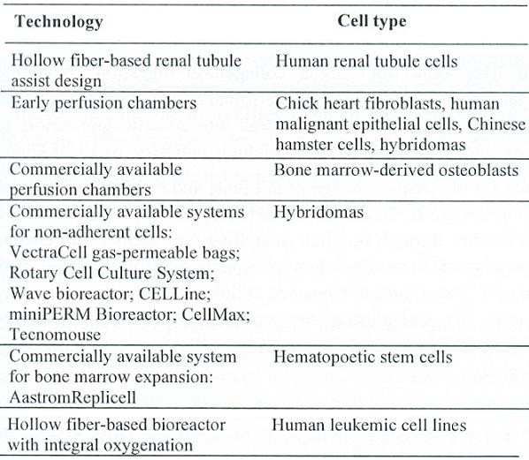

Slide 13
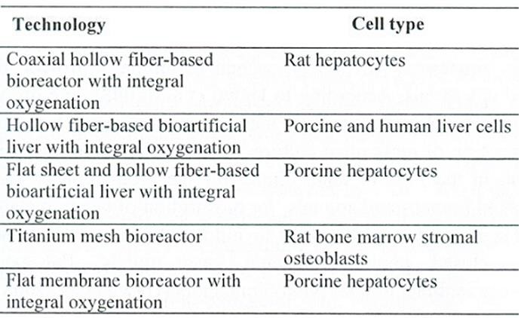

Slide 14
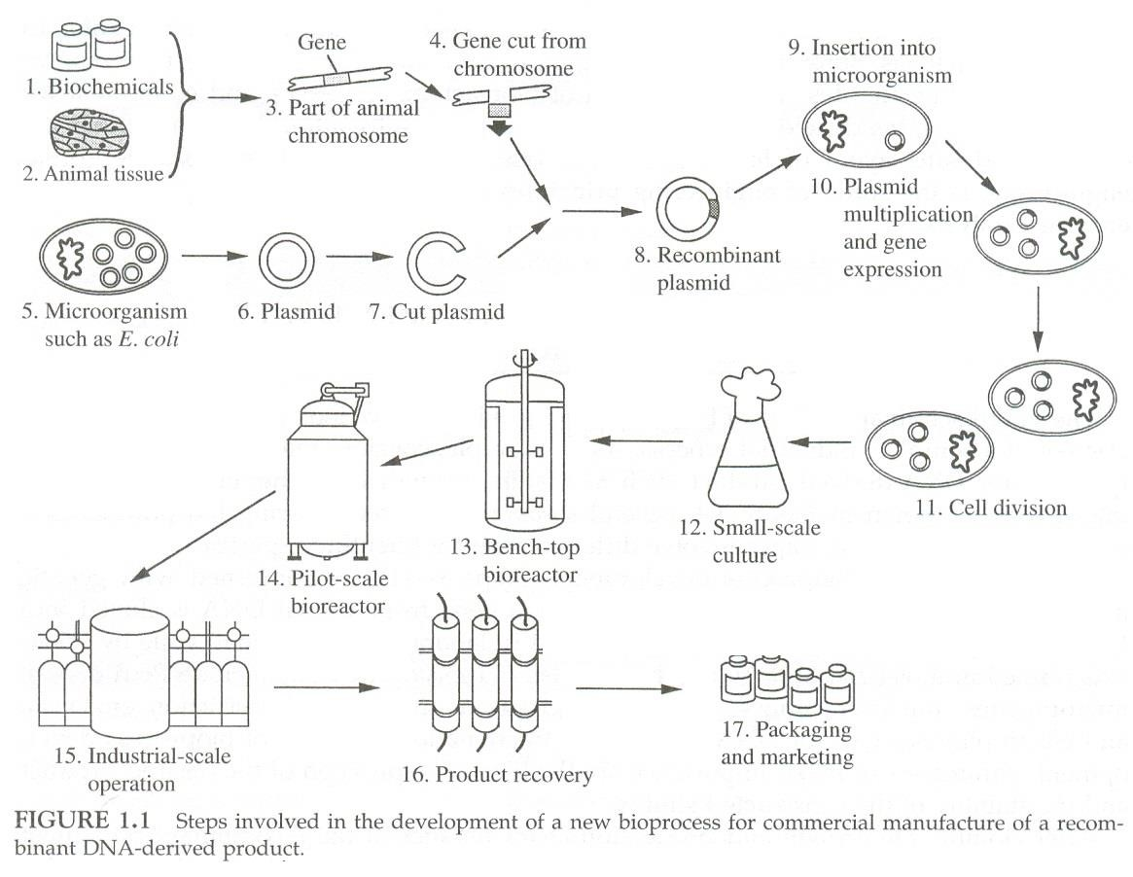

Slide 15
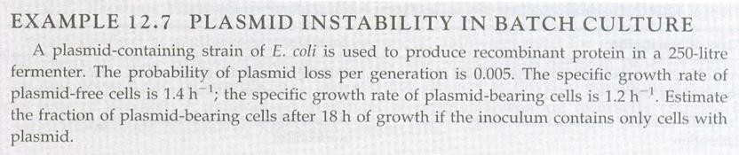
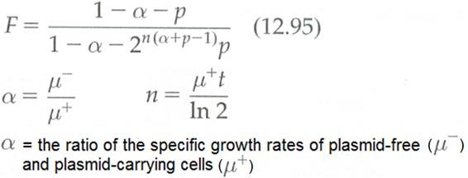

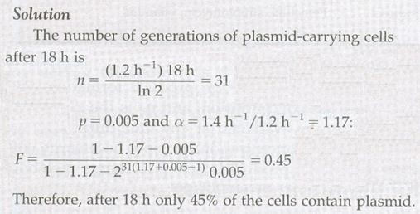

Slide 16
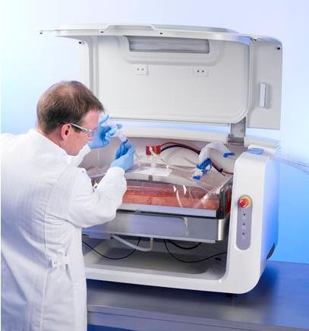
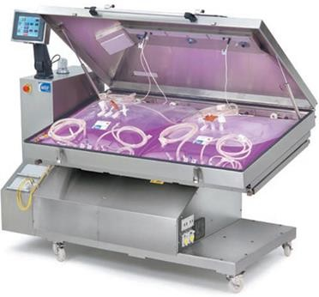
Pall’s XRS 20 Bioreactor is a bi-axial agitation bioreactor containing a pre-sterilized single-use biocontainer and a control tower.
http://vertassets.blob.core.windows.net/image/ cb1ce0d0/cb1ce0d0-5ccc-4096-8b57- 80ef507bc2e8/wavebioreactorimage.jpg

Slide 17



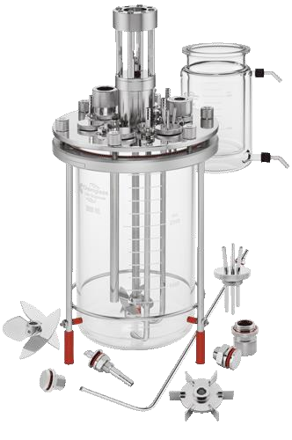
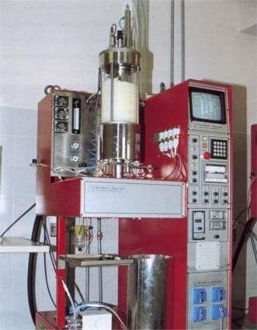
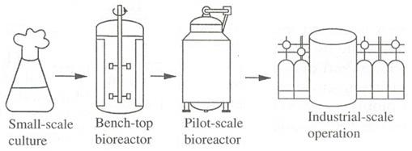
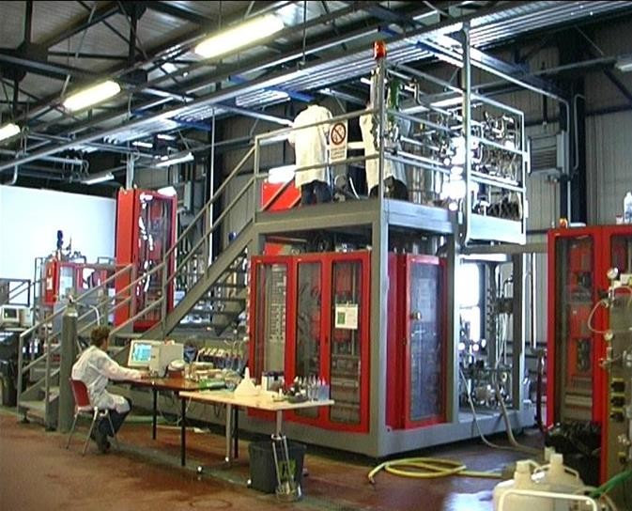
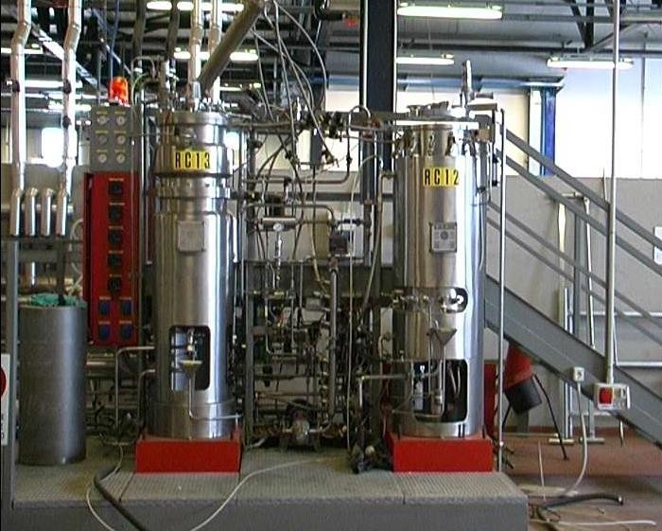
Stirred Bioreactors
15 L
150 L Bioreactor
1500 L Bioreactor
17
From CRAB Web Master

Slide 18
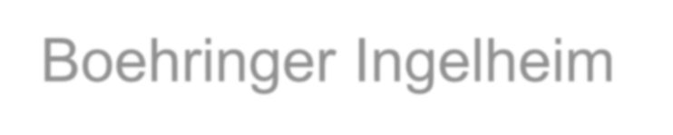


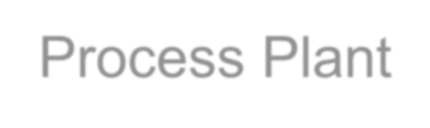
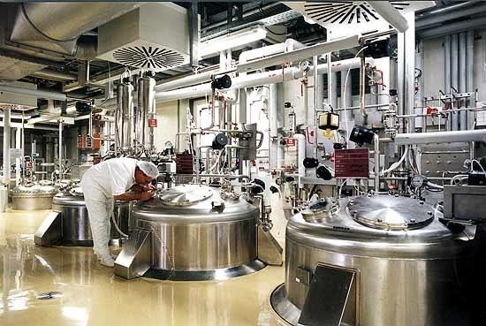
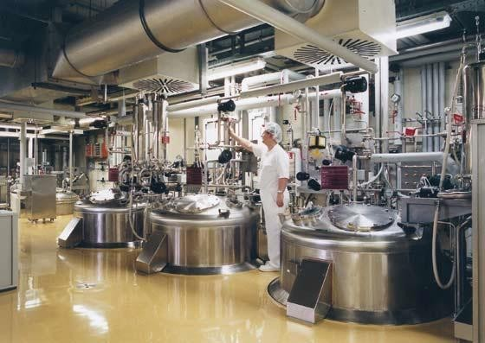
Boehringer Ingelheim Biotechnology Process Plant
http://www.pharmaceutical- technology.com/projects/biberach/images/bild_2.jpg

Slide 19

Stirred Tank Reactors
The least expensive shape is 1:1 ratio (liquid height to tank diameter)
Aeration (causing air to circulate through) allows longer contact times between the rising bubbles and liquid
Only 70-80% volume should be filled with liquid.
Foam breaker is preferred to be installed, because antifoam agents reduce the rate of oxygen transfer.

Slide 20
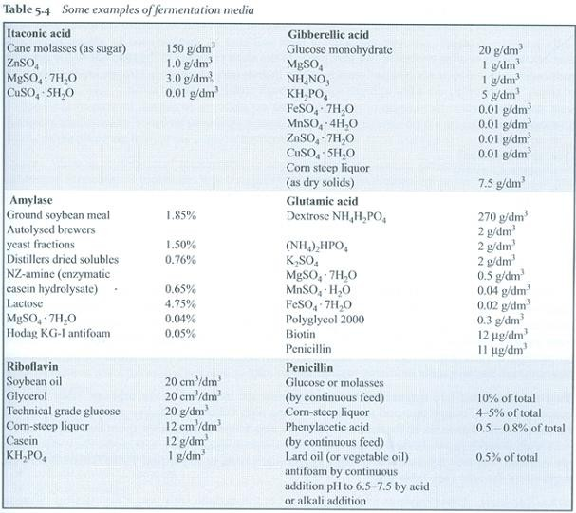

Slide 21
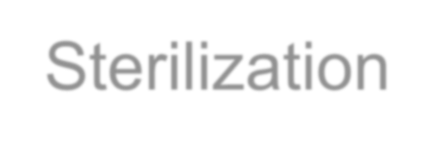
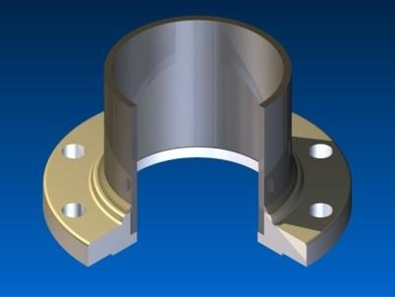
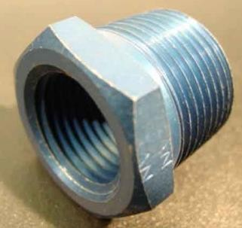
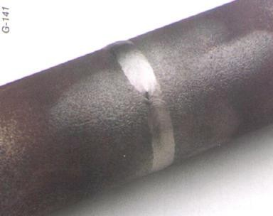
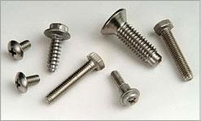
Sterilization
Sterilization of the fermenter and medium may be done separately or together.
The transport lines should be maintained aseptic.
Inside the fermenter should have minimum number of joints. The joints are made with welding and the joint points should be made as smooth as possible to avoid potential sources of contamination.
Threaded Joints
Flanged Joints
21

Slide 22
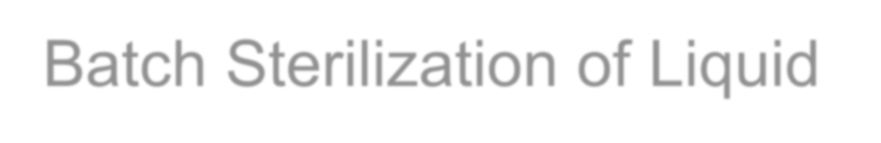

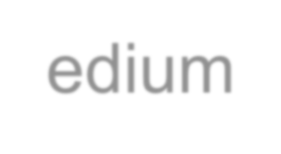
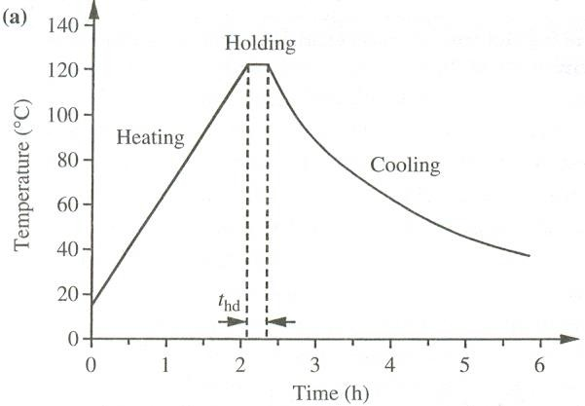
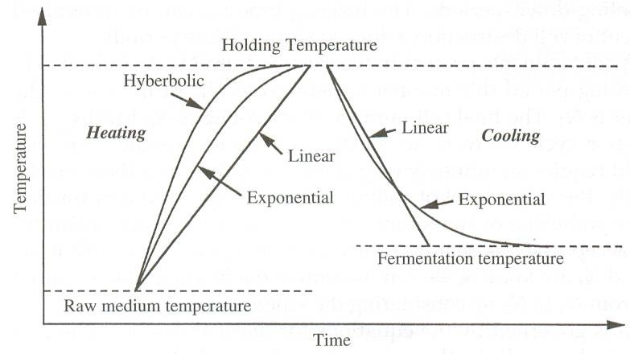
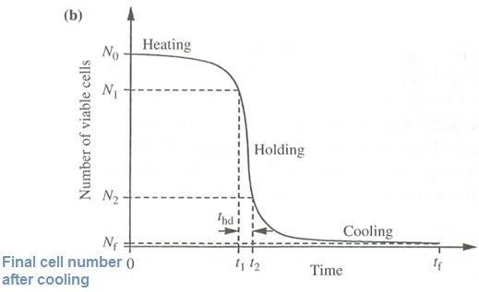
Batch Sterilization of Liquid Medium
(a) temperature time plot
(b) reduction in the viable
cell number with time

Slide 23
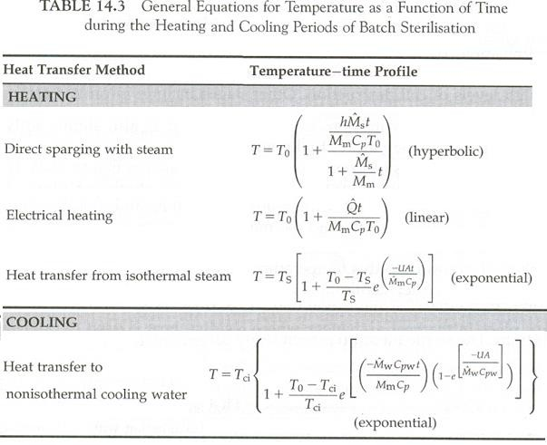

Slide 24
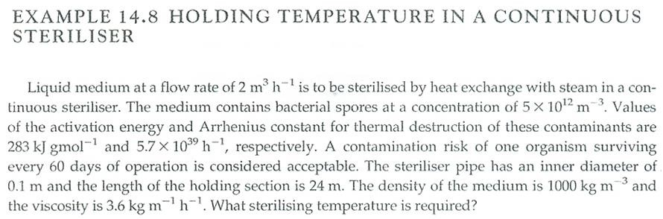

Slide 25
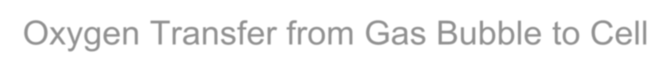
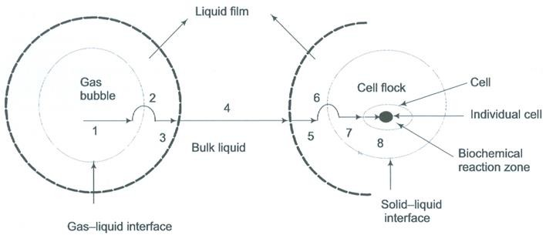
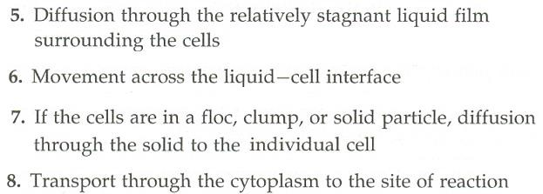
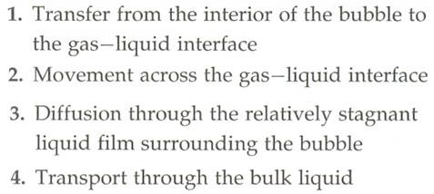
Oxygen Transfer from Gas Bubble to Cell

Slide 26

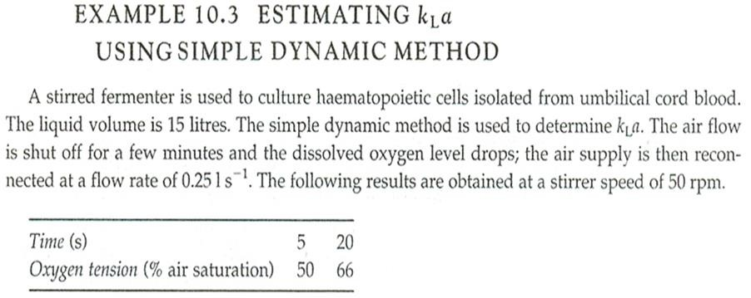
Mass transfer coefficient k_{L}a: characterize the oxygen transfer capability of fermenters (oxygen transfer coefficient) a = liquid gas interfacial area;
k_{L}= liquid phase mass transfer coefficient

Slide 27
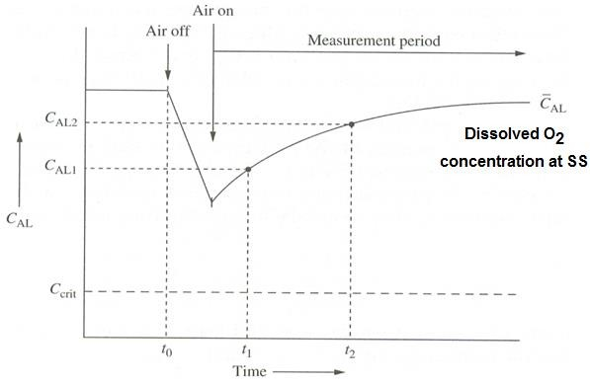

C_{AL}: oxygen dissolved in the fermentation broth.
C_{AL, 1} and C_{AL, 2}: two [O₂] measured during re-oxygenation at t₁ and t₂ (re-oxgenation is not steady state).

Slide 28



Stirred Patterns
Mixing and bubble dispersion are achieved by mechanical agitation.
Requires high input of energy
Baffles are used to reduce vortexing.
Radial-flow impeller
in a baffled tank
Axial-flow impeller
in a baffled tank

Slide 29





Impellers
Stirred Tank With Baffles

Slide 30




Sparger
Oxygen is measured in its dissolved form as dissolved oxygen (DO)

Slide 31



The capacity of the stirrer in handling gas
The amount of gas
introduced.

Slide 32
Impeller flooding: at high gassing rates or low stirrer speeds, liquid flow up the middle of the vessel.
Impeller loading: at higher stirrer speeds or lower gas flow rates, the impeller is loaded as gas is dispersed towards the vessel walls.
Complete gas dispersion.

Slide 33


Slide 34


Process Control

Slide 35




Scale-Ups vs. Scale-Down
Geometric similarity
Kinematic similarity
Dynamic similarity

Slide 36




Geometric
Similarity

Slide 37


Kinematic Similarity
Requires geometric similarity and characteristic velocities scale by the same ratio.
Dynamic Similarity
Requires both geometric and kinematic similarity and adds the characteristic forces scale by the same ratio.

Slide 38





Dynamic Similarity
Maintain the rate of turbulent energy dissipation (ε), or power intensity (power/volume, P/V) constant.

Slide 39




Bubble Column Bioreactors (BCRs)

Slide 40


Homogeneous vs. heterogeneous bubble columns
No mechanical
agitation.
Aeration and mixing are achieved by gas sparging.

Slide 41


Bubble Columns (Cont’d)
Gas-liquid mass transfer coefficients in reactors depend largely on
gas flow rate
bubble diameter
gas hold-up
Accurate estimation of the mass-transfer coefficient is difficult (exact bubble sizes and liquid circulation patterns are impossible to predict).

Slide 42


Air Lift Bioreactors (ARLs)

Slide 43




Airlift Reactors
http://www.babonline.org/bab/045/0001/bab0450001.htm
http://s9.postimg.org/ya85far7j/bab0450001f03.gif

Slide 44

Airlift Reactors
For plant and animal cell culture, because the shear levels are significantly lower than the stirred vessels.
The very high hydrostatic pressure at the bottom of these vessels considerably improves gas-liquid mass-transfer.

Slide 45


Airlift Reactors (Cont’d)
Gas hold-up and decreased fluid density
cause liquid in the riser to move upwards.
Gas disengages at the top of the vessel leaving heavier bubble-free liquid to recirculate through the downcomer.
Liquid circulates in airlift reactor as the result of the density different between riser and downcomer.

Slide 46


Because riser and downcomer are further
apart, gas disengagement is more effective.
The liquid densities differ in riser and downcomer are greater.
The circulation is faster and mixing is better.

Slide 47
Airlift Reactors
Large airlift reactors can have the
capacities of thousands of cubic meters.
The height of airlift reactors is about 10 times the diameter. For deep shaft systems the height-to-diameter ratio may be increased up to 100 (built underground).
The very high hydrostatic pressure at the bottom of these vessels considerably improves gas-liquid mass-transfer.

Slide 48


Glass Bead Reactor
For long term culture of attached dependent cell lines.

Slide 49



Microreactors
Parallel Flow
Cross Flow

Slide 50




Packed Bed Bioreactors (PBRs)

Slide 51




Packed-Bed Reactor with Medium
For perfusion culture of mammalian cells.
immobilized microorganism cells and
51

Slide 52


Fluidized Bed Reactors (FBRs)
52

Slide 53



Fluidized Bed Reactor
Fine inert carriers provide large surface area for adherence and growth of microorganism to adhere and grow.
The carriers are fluidized to enhance mass transfer and degradation rate of organic pollutants.
53

Slide 54
Four Modes of Operation
Batch reactor
Stirred semi-batch
Continuous stirred
(Above three: Completely stirred and uniform in composition)
Continuous plug flow reactors

Slide 55

Modes of Reactor Operations
Plug-flow: The long tube and lack of stirring device in the direction of flow.

Slide 56



Downstream Processing

Slide 57




Spray Dryer Lyophilizer
Nanofiltration (NF)
Reverse Osmosis (RO)
57

Slide 58


Supercritical Extraction Plant
Distillation Plant
Centrifugation Plant

Slide 59




Homogenization Unit
Freezer Rooms
Demineralized Water Plant
Steam Generation Plant

Slide 60



Chilled Water Plant
Warm Water Plant
Compressed Air Station

Slide 61



Effluent Treatments
Incineration

Slide 62





Trickling Filter (Packed Bed Bioreactors)

Slide 63
Biochemical oxygen demand (BOD)
The amount of
oxygen consumed breaking down the
by these organic
organisms in
materials in waste water.
Chemical oxygen demand (COD): The amount of oxygen required to chemically oxidize organic compounds in water.
However, COD is less specific, since it measures everything that can be chemically oxidized, rather than just levels of biologically active organic matter.
S⁻² + 2 O₂ → SO₄⁻² or 4Fe + 3O₂ → 2Fe₂O₃

Slide 64







Rotating Biological Contactors
www.edie.net/products
www.madep-sa.com/english/wwtp.html
info.industry.siemens.com
wpcontent.answers.com

Slide 65




Activated Sludge
Mechanism: Develop biological floc to reduces the organic content of the sewage.

Slide 66

Anaerobic Digesters
Acid fermenting bacteria degrade the waste to free volatile fatty acids, mainly acetic and propionic acid.
They are then converted to Methane and CO₂.
The gas product (biogas) is a useful by-product.

Slide 67




Landfilling
(Solid and Liquid Wastes)
Landfill gas (50-60% methane) can be collected for energy source.
www.eia.doe.gov/.../images/landfill.gif
techalive.mtu.edu/.../LandfillCrossSection.jpg⁶⁷

Slide 68


Bioprocess Economics

Slide 69



Bioprocess Economics (Cont’d)

Slide 70


Acknowledgements
Chemical Engineering, Civil and Environmental Engineering, University of Houston
Chemical Engineering, Oregon State University
School of Pharmacy, Massachusetts College of
Pharmacy and Health Sciences (MCPHS) University
Thank You! Questions?
monica.chuong@mcphs.edu
70

