Slide 1
Low Fat vs. Low Carbohydrate Diet Strategies for Weight Reduction
A Meta-Analysis
Prof. Mona Boaz, Department of Nutrition, School of Health Sciences, Ariel University; Epidemiology and Research Unit, E. Wolfson Medical Center

Slide 2
Globesity
Worldwide obesity has more than doubled since 1980
In 2014, 1.9 billion adults (39%) were overweight
More than 600 million adults (13%) were obese
  Together, 52% of adults on the planet are fatter than needed for optimal health
42 million children under the age of 5 were overweight or obese in 2013

Slide 3
The Problem is Expanding
Obesity prevalence is increasing in both developed and developing nations
Obesity may coexist with under-nutrition in developing countries
  Obesity prevalence rates often similar between urban developing countries and developed nations
Most of the world's population live in countries where overweight and obesity kill more people than underweight

Slide 4
Prevalence of overweight/obesity
(BMI≥25 kg/m²) by country, 2014, WHO
63%
68%

Slide 5


WHO’s Solution for Individuals
Limit energy intake from total fats and sugars
Increase consumption of fruit and vegetables, as well as legumes, whole grains and nuts
Engage in regular physical activity
  60 minutes a day for children
  150 minutes per week for adults

Slide 6
Not So Fast…..
Reducing total fat and sugar intake reduces total energy intake BUT
  Fat and sugar are generally more affordable than protein
  Overweight/obesity over-represented in lower income groups
No evidence that increased fruit and vegetable intake reduces body weight
  Often added without changing other dietary components
Physical activity without dietary alterations not associated with weight loss

Slide 7
Solutions?
Overweight and obesity rates increasing
Throughout the 20th and 21st centuries, various weight loss diet strategies have been developed
  Few are evidence based
  None are successful in the long term
Reflect fashion, business opportunities

Slide 8
Weight loss diet strategies over time
But do they work?

Slide 9

1930s-40s
When tempted…
Reach for a Lucky instead of a sweet
Smoke instead of eating = low calorie diet

Slide 10

1950s
Pray Your Weight Away
  Rev. Charlie W. Shedd, 1957
“More of Jesus, Less of Me”
  Jesus wants his followers to be slim
Prayer
Low carbohydrate, low fat, low calorie diet
Notes:
Strangely, prayer is paired with a low carbohydrate, low fat, low calorie diet, because Jesus wants you to eat this way.

Slide 11


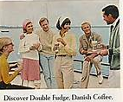
1960s
Meal replacement
  Sego, Metrecal
  Replace 1-2 meals/day with diet drink
Group support
  Weight Watchers
  Low carbohydrate, low calorie diet (originally)
Notes:
1-2 meals/day replaced by a “diet shake” of 200-250 kcal.
Group support “lifestyle” interventions – most famously Weight Watchers – founded. The original weight watchers diet was low carbohydrate and low calorie. It’s since evolved reflecting new knowledge and new marketing opportunities

Slide 12
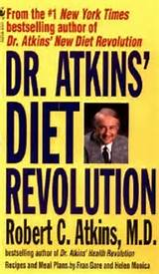


1970s
Dr. Atkins low (as in zero) carbohydrate diet
  Energy intake “automatically” reduced
Diet pills
  Over-the-counter (caffeine)
  Prescription (amphetamines)
  Criminal (cocaine, meth)
Nutrisystem
  All food provided plan
Notes:
Dr. Atkins original diet called for virtually 0 carbohydrates and then small amounts are added in as a desired weight is achieved. He stated that this would result in an “automatic” reduction of calorie intake, though no calorie prescription was made with this diet. Diet pills became popular, including over-the-counter varieties which mainly included caffeine or some other appetite suppressant. Also, amphetamines became popular, but required a prescription and later were known to be associated with many adverse events. Cocaine also became popular, though this was illegal and very expensive. Diet plans providing all meals ready made for the dieter like Nutrisystem emerged in this decade.

Slide 13



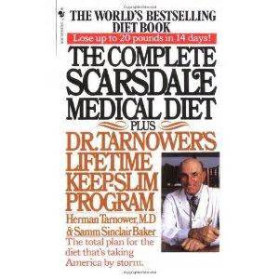
1980s
Diet soda
  Non-calorie, artificially sweetened soft drinks
Scarsdale Diet
  Very low calorie, low carbohydrate diet
The Rice Diet
  High carbohydrate, low calorie diet
Exercise
  Aerobic workout – in your own home!
Notes:
The 1980s were a time of excess. We see the marketing of diet soft drinks, which are touted as a way to lose weight – the dieter craving sweets consumes diet cola instead of sweets. As we know, the increase in overweight and obesity rates continued to rise despite diet soft drinks. The Scarsdale diet became a big hit. This very low calorie, low carbohydrate diet promised a weight loss of 9kg in two weeks. The problem was that the diet was so restrictive that nobody could continue it for very long. On the other extreme of macronutrient manipulations was the rice diet, which featured a very high carbohydrate, low calorie diet. This 800 kcal/day diet actually was originally developed in the 1940s but became famous in the 1980s with the publication of the Rice Diet Solution. The diet is rigid and criticized for providing inadequate dietary protein, calcium and vitamin D. The good news is its promise to rid you of 9 kg in a single week. The 1980s also saw a wave of popularity for aerobic exercise. This new craze, led by Jane Fonda and everybody else with a leotard and video camera, brought exercise into your very own living room with the advent of video players.

Slide 14
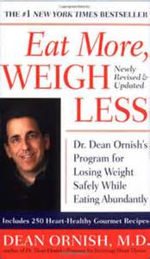




1990s
The return of Atkins
  Modifications: 20-120 g carbohydrate/day
Low fat, high carbohydrate diets
  Less than 15% fat
  70% carbohydrates
  Replacing fat with carbohydrates will reduce total energy intake
Notes:
In the 1990s, we were re-visited by Dr. Atkins, who modified his low carbohydrate diet to permit a more tolerable level of carbohydrates. A similarly modified version of the Atkins diet is the Zone. Of course, there were low fat, high carbohydrate diets. Dr. Dean Ornish, for example, popularized the very low fat diet (<15% fat), coupled with high carbohydrate intake (70%). Dr. Ornish reasoned that since carbohydrates have only 4 kcal/g, replacing fat (9 kcal/g) with carbohydrate would save 5 kcal/g per weight of food. His diet was made popular by Pres. Bill Clinton.

Slide 15

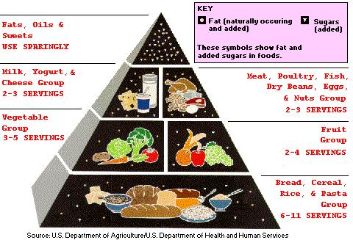
2000s
Institutionally endorsed low fat diets
  30% fat, 55% carbohydrate, 15% protein
  Reduce LDL, reduce cardiovascular risk
The South Beach Diet
  Low glycemic index carbohydrates, moderate fat and protein
Notes:
In the earliest years of the 21st century, we have the institutionally endorsed low fat diets: 30% fat, 55% carbohydrate, 15% protein, as approved by the ADA, AHA, NCEP, etc. These diets were (and still are) hailed as a way to reduce LDL and cardiovascular risk together with weight loss. At the same time, we have the popular South Beach Diet, which does not imbalance the food pyramid, but emphasized that carbohydrates consumed should be low glycemic index carbohydrates.

Slide 16
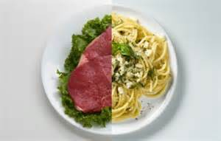
2010-Present
Feast/fast diets
Meal delivery systems*
Group support*
Meal replacement plans*
Macronutrient manipulation
Low fat (high carbohydrate) diets?
Low carbohydrate (high protein/fat) diets?
What is the evidence?!?
Notes:
Today, popular diets include feast/fast diets where the dieter adheres to a calorie restricted diet most of the week, but once or twice during the week consumes “free” foods. These diets vary in the number of days/meals at which the dieter goes “free.” Three diet types are considered evidence based for weight reduction: diets providing prepared meals, like Nutrasystem; diets providing group support and diet plans, like Weight Watchers; and diets providing eal replacement plans (like 310 Shakes, which, at 90 kcal, provides 15g protein and 5g fiber). Other diets popular today are based on macronutrient manipulation: low fat diets (which are generally high in carbohydrates); or low carbohydrate diets (which are generally high in protein and carbohydrates. But we need to evaluate the evidence for these types of diets!

Slide 17
Low Fat or Low Carbohydrate Diets for Weight Loss?
Meta-analysis
Notes:
To evaluate the evidence of an intervention, in this case low fat vs. low carbohydrate diets for weight loss, we want to look at well-designed, well-conducted randomized clinical trials, since clinical trials provide us with the best evidence of the efficacy of an intervention. More than that, we want to summarize many randomized clinical trials, using a method called, “meta-analysis”

Slide 18
Wait… Meta What?
A quantitative statistical method for integrating descriptive statistics from multiple primary research studies that test the same research question
Improves objectivity, power, generalizability, precision
Reduces bias
μ1-μ2
σ

Slide 19
Study methods
How you do it – How do you do it?
Notes:
So here is the meta-analysis of randomized clinical trials comparing low fat to low carbohydrate diets for weight reduction.

Slide 20
Objectives: Low Fat or Low Carbohydrate Diets for Weight Loss?
Primary objective
  Is there an advantage to macronutrient manipulation in weight loss diets?
Secondary objectives
  Is there an advantage to macronutrient manipulation on metabolic outcomes?
    Lipid profile, blood pressure, glucose?

Slide 21
Inclusion Criteria
Well designed randomized clinical trial in healthy adults
Minimum follow-up three months
Compare low carbohydrate to low fat diets
  Low fat: 30% or less of total kcal intake
  Low carbohydrate: 45% or less of total kcal intake
Primary endpoint: body weight
  Weight loss

Slide 22
The Search
Databases Searched
  PubMed, EMBASE, the Cochrane Collaboration Database of Systematic Reviews, Google Scholar
Search terms:
  Low carbohydrate diet; low fat diet; weight loss; randomized clinical trial; macronutrient composition and diet
Restriction/filter terms:
  Human subjects; adults; publication years 2010-present; English language

Slide 23
Data Extraction
Study data extracted using standardized data extraction form
  Anthropometric, biochemical, demographic data
  Dietary data
  Completion rates

Slide 24
Statistics
Effect size
  Standardized difference
  Between-group mean/pooled standard deviation of the means
Heterogeneity
  Q, I and Z statistics
Random effects model employed

Slide 25
Study results
Eureka

Slide 26
Study Selection
143 studies identified with search terms and restrictions, 135 after removing duplicates
80 exclusions for: not RCT; inappropriate population; inadequate follow-up duration
46 exclusions for: not parallel groups; not healthy adults; main endpoint not reported; endpoint inappropriate (i.e., weight loss maintenance)
55 full-text articles reviewed
9 trials included in meta-analysis

Slide 27
Total Participant Exposure
9 studies met inclusion criteria
56,624 person-weeks of follow-up
1161 included in analysis
Low carbohydrate exposure n=592
Low fat exposure n=569

Slide 28

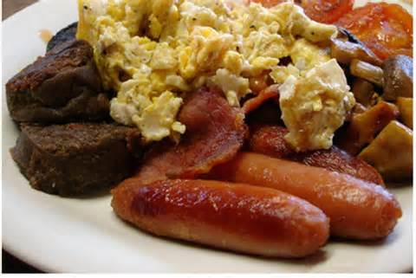
Mean Dietary Macronutrient Exposure
Low Fat Diet
  Fat: 27%
  Protein: 16%
  Carbohydrate: 57%
Low Carbohydrate Diet
  Fat: 36%
  Protein: 25%
  Carbohydrate: 39%

Slide 29
Follow-up Duration (weeks) | Enrolled | LCD Composition (F:P:C) | LFD Composition (F:P:C) | Study
52 | 79 | 30:30:40 | 20:20:60 | Llanos 2014
12 | 50 | 34:26:40 | 30:18:52 | Liu 2013
24 | 32 | 30:30:40 | 30:15:55 | Kitabachi 2013
104 | 307 | X:X:10 | 30:15:55 | Foster 2010
12 | 280 | 36:26:38 | 27:20:53 | de Luis 2013
52 | 148 | X:X:13 | 30:15:55 | Bazzano 2014
12 | 55 | 60:35:5 | 25:15:60 | Ruth 2013
52 | 88 | 20:35:45 | 20:17:63 | Dalle Grave 2013
24 | 122 | 40:18:42 | 30:18:52 | Juanola-Falgarona 2014
Food provided

Slide 30
Low carbohydrate diet | Low fat diet | Characteristic
47.2±11.3 | 42.5±4.1 | Age (years)
84.6 | 83.6 | Sex (% females)
94.4±17.6 | 93.3±16.1 | Weight (kg)
193.9±45.6 | 195.2±46.9 | Total cholesterol (mg/dl)
50.16±16.4 | 51.1±15.9 | HDL (mg/dl)
123.8±39.8 | 122.9±41.3 | LDL (mg/dl)
126.4±45.6 | 118.0±47.1 | TG (mg/dl)
99.0±19.6 | 98.8±21.3 | Glucose (mg/dl)
127.2±19.1 | 128.2±18.4 | Systolic blood pressure (mmHg)
80.5±13.9 | 80.6±12.0 | Diastolic blood pressure (mmHg)

Slide 31
Effect of dietary macronutrient composition on weight loss | % Completed | Study
No significant difference | 48 | Llanos 2014
No significant difference | 96 | Liu 2013
No significant difference but REE increased in LCD group | 75 | Kitabachi 2013
No significant difference | 62 | Foster 2010
No significant difference | 100 | de Luis 2013
Significantly greater weight loss in LCD group | 80 | Bazzano 2014
No significant difference | 60 | Ruth 2013
No significant difference | 78 | Grave 2013
Significantly greater weight loss in LCD group | 85 | Juanola-Falgarona 2014

Slide 32
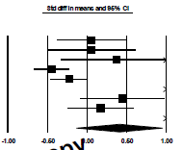
Macronutrient Composition and Weight Loss
0.422, 95% CI -0.13 to 0.98, p=0.14
-1.00
-0.50
0.00
0.50
1.00
Favors Low Fat Diet
Favors Low Carbohydrate Diet

Slide 33
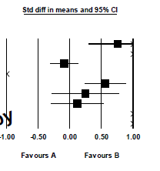
Macronutrient Composition and Serum Total Cholesterol
1.19, 95% CI -0.06 to 2.15, p=0.08
-1.00
Favors Low Fat Diet
Favors Low Carbohydrate Diet
Notes:
There is a marginally significant increase in total cholesterol, but the size of that increase is 3.17 mg/dl, which is clinically insignificant.

Slide 34
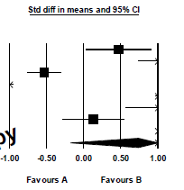
Macronutrient Composition and High Density Lipoprotein Cholesterol
0.73, 95% CI -0.18 to 1.65, p=0.11
-1.00
-0.50
0.0
0.50
1.00
Favors Low Fat Diet
Favors Low Carbohydrate Diet

Slide 35
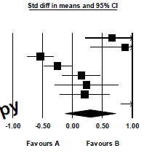
Macronutrient Composition and Low Density Lipoprotein Cholesterol
0.29, 95% CI -0.13 to 1.37, p=0.17
-1.00
Favors Low Fat Diet
Favors Low Carbohydrate Diet

Slide 36
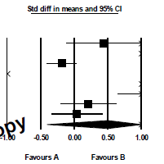
Macronutrient Composition and Triglycerides
0.49, 95% CI -0.41 to 1.40, p=0.28
-1.00
Favors Low Fat Diet
Favors Low Carbohydrate Diet

Slide 37
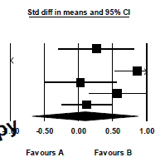
Macronutrient Composition and Glucose
0.09, 95% CI -0.68 to 0.87, p=0.81
-1.00
Favors Low Fat Diet
Favors Carbohydrate Fat Diet

Slide 38
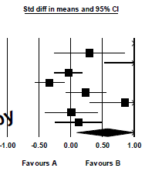
Macronutrient Composition and Systolic Blood Pressure
0.58, 95% CI -0.09 to 1.07, p=0.12
-1.00
Favors Low Fat Diet
Favors Low Carbohydrate Diet

Slide 39
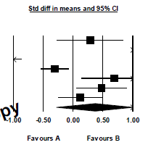
Macronutrient Composition and Diastolic Blood Pressure
0.37, 95% CI -0.28 to 1.02, p=0.27
-1.00
Favors Low Fat Diet
Favors Carbohydrate Fat Diet

Slide 40
Conclusion:
LFD and LCD diets produce similar weight reduction in healthy adult subjects followed for three months or longer
Dietary advice can be tailored to individual preferences
HOWEVER…….

Slide 41
Weight loss diets ultimately FAIL
Weight loss diets do not appear to be associated with long term maintenance of weight loss
Failure rate estimated to be 60-80%
  Failure=rebound weight gain to within 5% of baseline levels within five years
Notes:
Wing and Phelan. Am J Clin Nutr 2005; 82:222S-225S

Slide 42
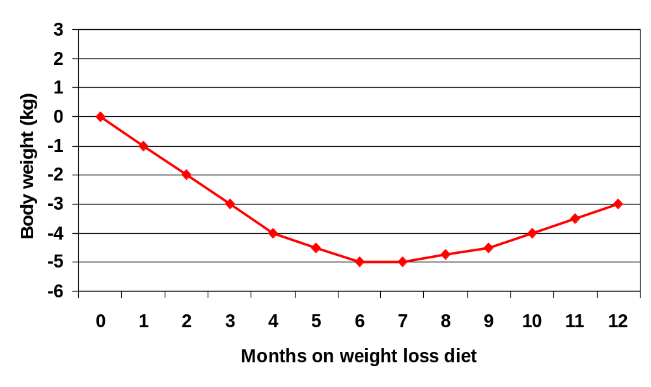
Weight loss over time
Decreased compliance
Metabolic adaptation to energy restriction

Slide 43
Thinking Outside the Box
Apply pressure!
  Food industry
    Healthier food formulations
    Price incentives for healthy food choices
  Workplaces, schools
    Availability of healthy food choices and regular physical activity practice in the workplace and at schools
  Local governments
    Parks, lighting, safety to encourage physical activity

Slide 44
Looking Outward and Onward
Overweight and obesity are largely preventable
Create anti-obesogenic environments
  Healthy foods and regular physical activity should be the easiest choice

