Slide 1
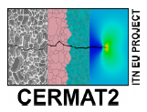

Boundary element analysis of a piezoelectric ceramic with an interfacial crack subjected to in-plane mechanical and electrical loading
Characterisation of pellets and beams from barium titanate perovskite granulates
M. Gromada
Institute of Power Engineering, Ceramic Department CEREL, Boguchwała, Poland
M. Biglar, F. Stachowicz, T. Trzepieciński
Rzeszow University of Technology, Rzeszów, Poland

Slide 2
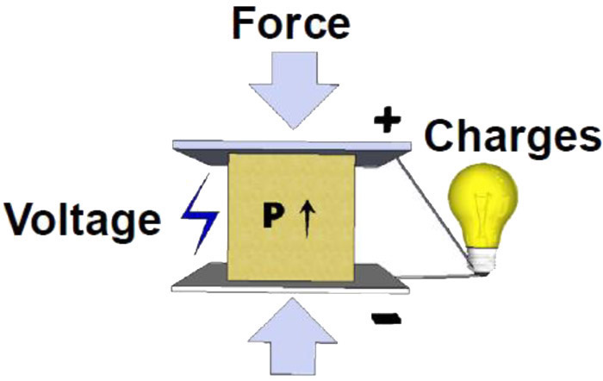
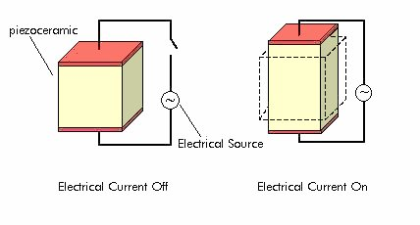
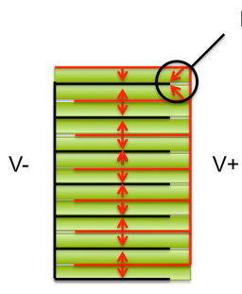

Motivation
Piezoelectric Materials

Slide 3
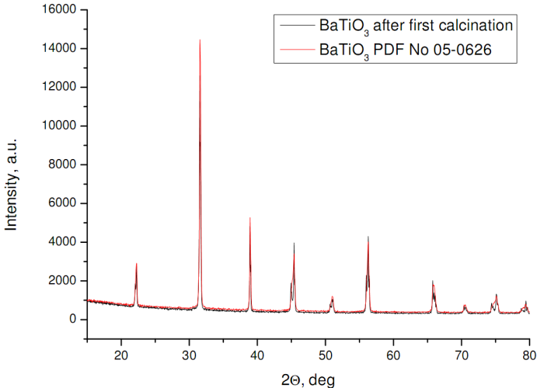
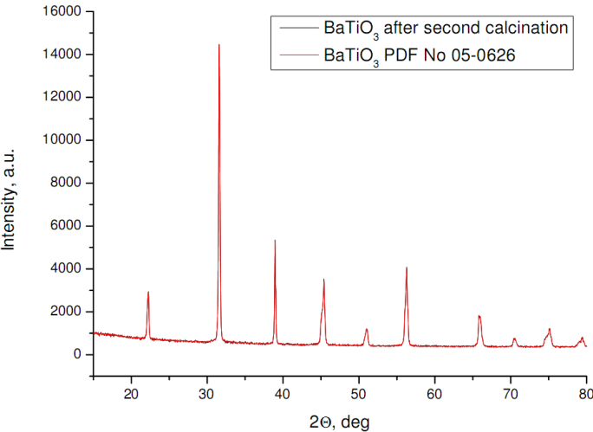
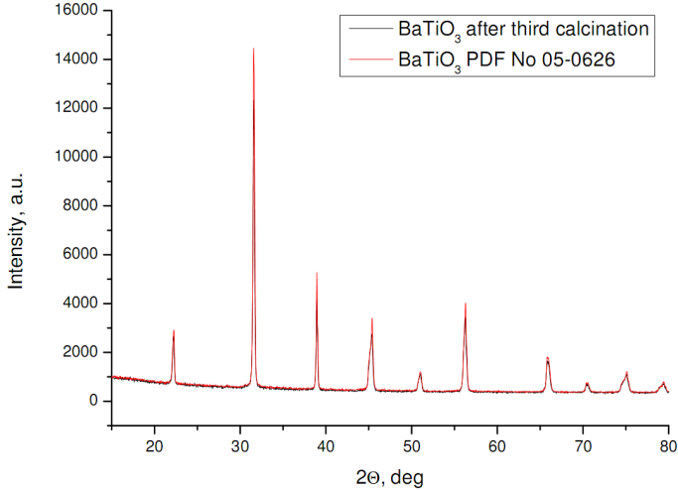
Synthesis of BaTiO₃ (BT) perovskite
XRD patterns of BaTiO₃ powder after first, second and third activation and calcination

Slide 4
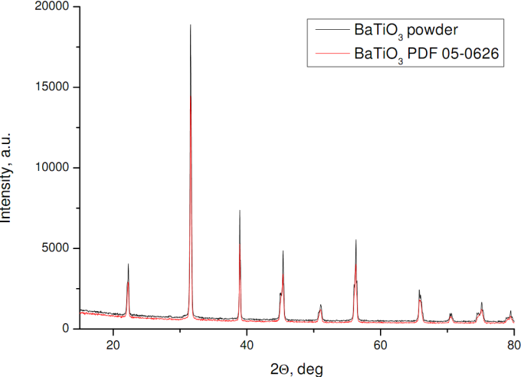
Synthesis of BaTiO₃ (BT) perovskite
XRD pattern of BaTiO₃ powder after second mechanical activation and calcination

Slide 5
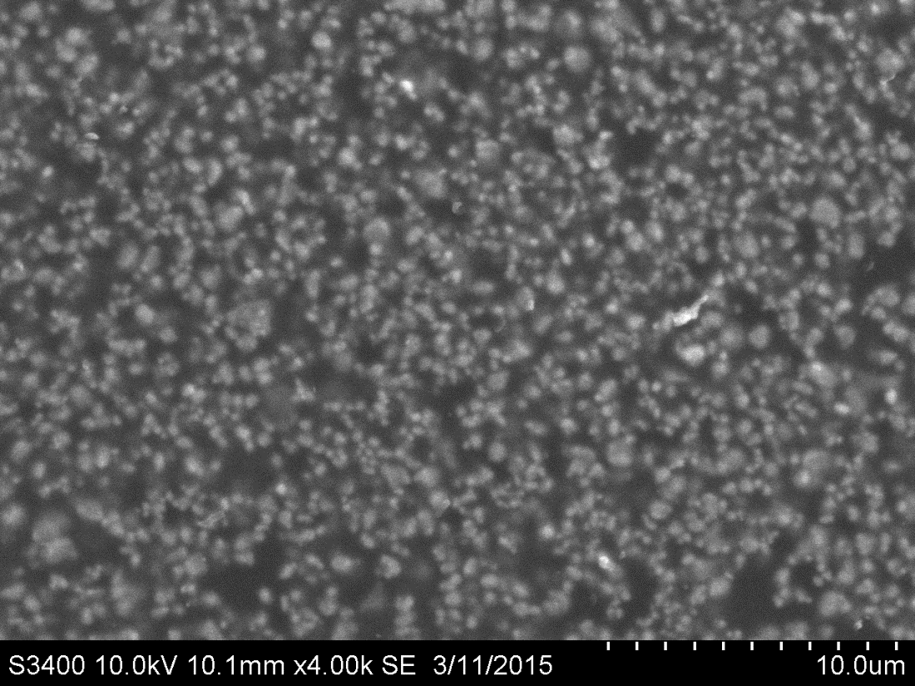
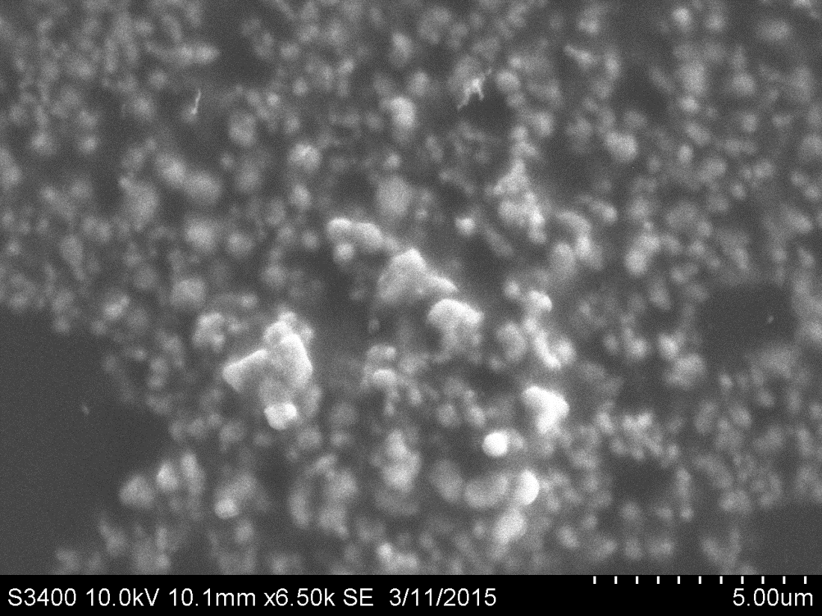
Synthesis of BaTiO₃ (BT) perovskite
SEM microstructure of BaTiO₃ powder in two different magnifications

Slide 6
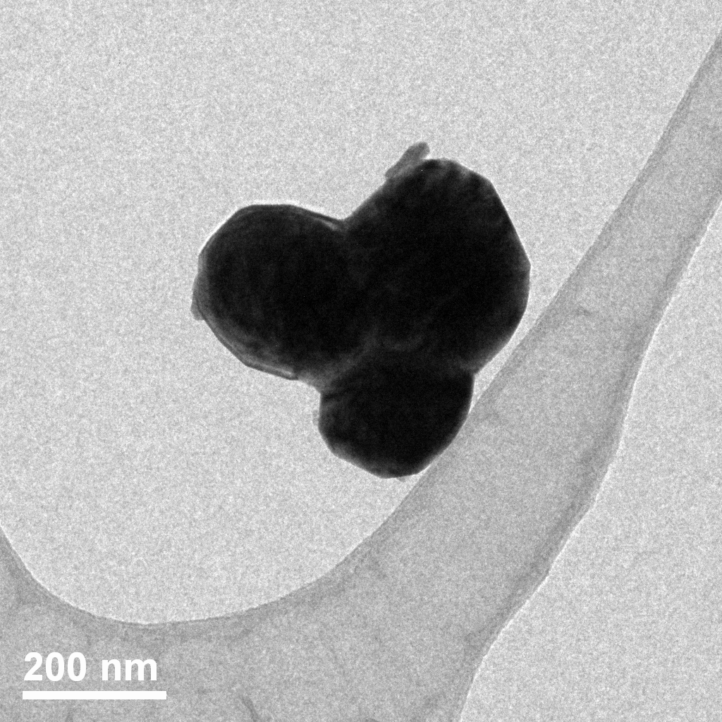
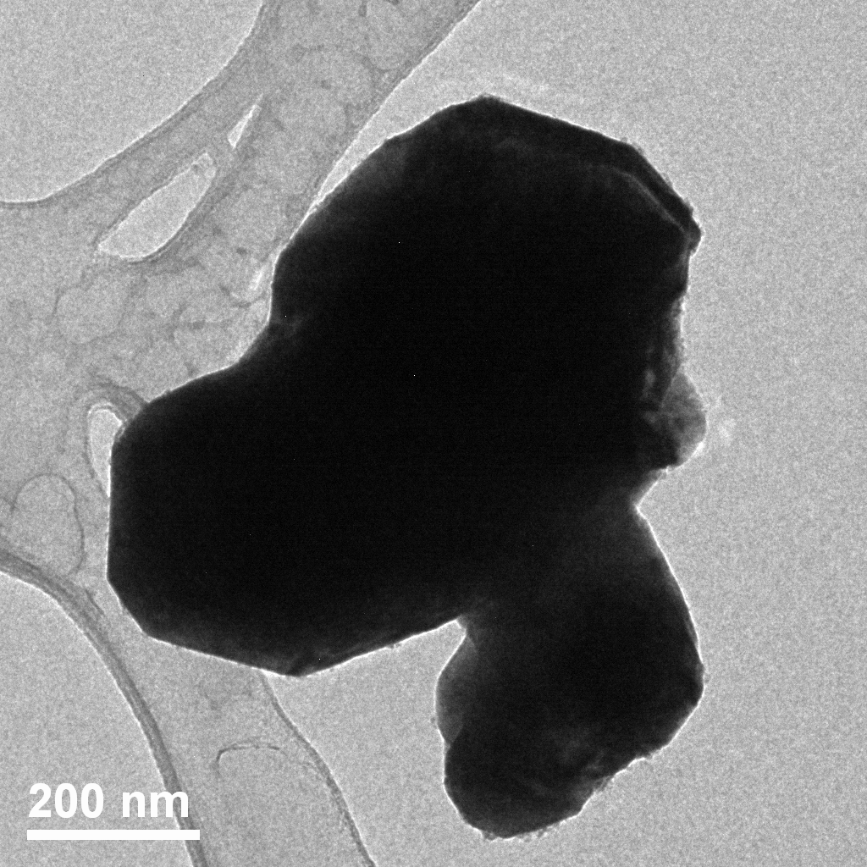
Synthesis of BaTiO₃ (BT) perovskite
TEM morphology of BaTiO₃ powder

Slide 7
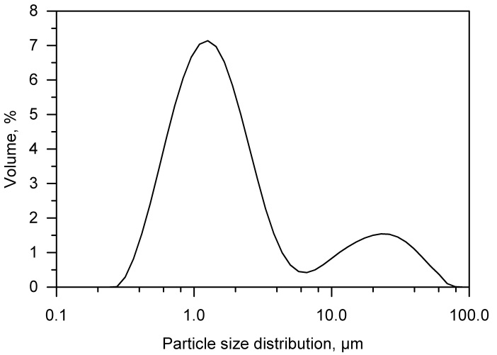
Synthesis of BaTiO₃ (BT) perovskite
The particle size distribution of BaTiO₃ powder

Slide 8
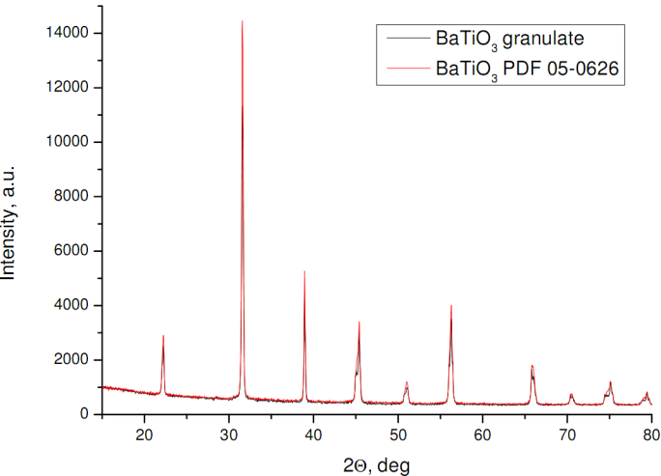
Fabrication of BaTiO₃ perovskite granulates
XRD pattern of BaTiO₃ granulate

Slide 9
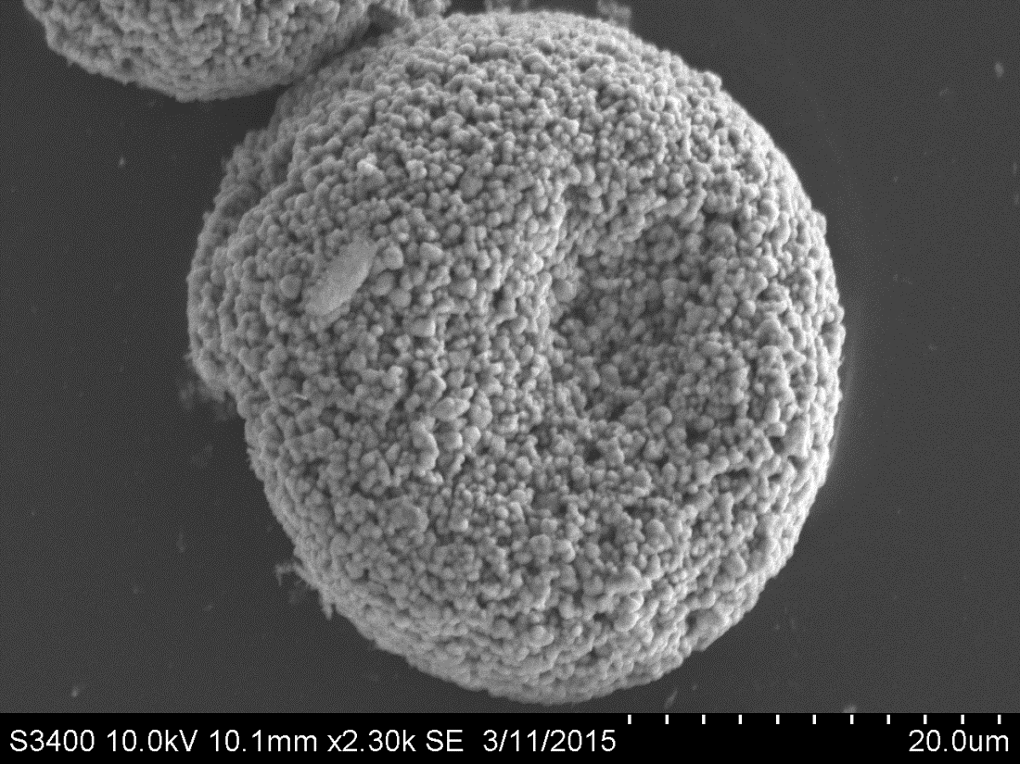
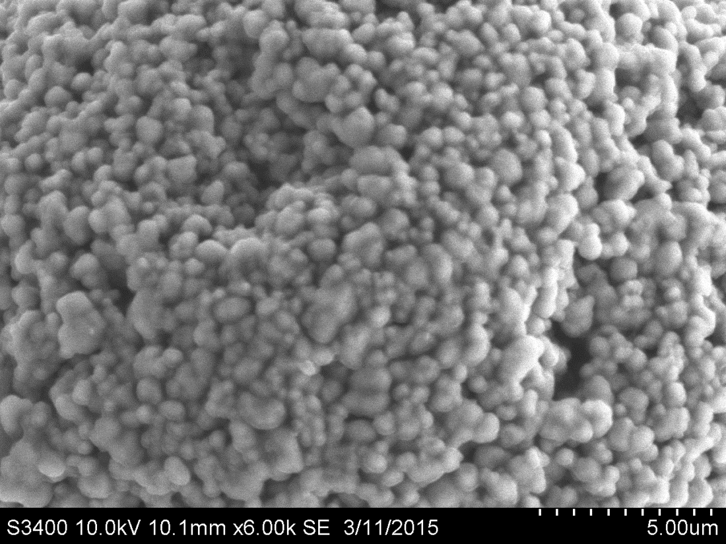
Fabrication of BaTiO₃ perovskite granulates
SEM microstructure of BaTiO₃ granulate in two different magnifications

Slide 10
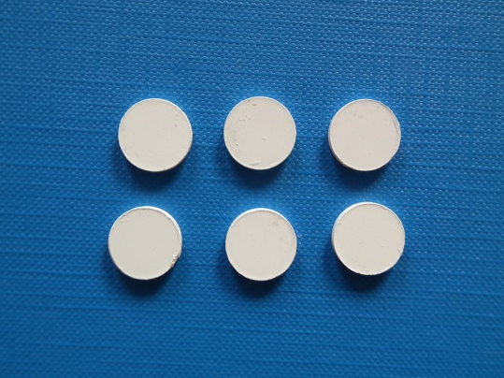
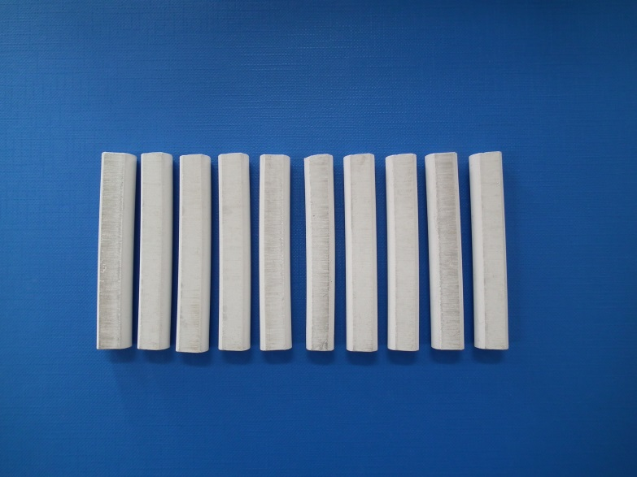
Preparation and characterisation of pellets
Photos of discs and beams after forming by isostatic pressing

Slide 11
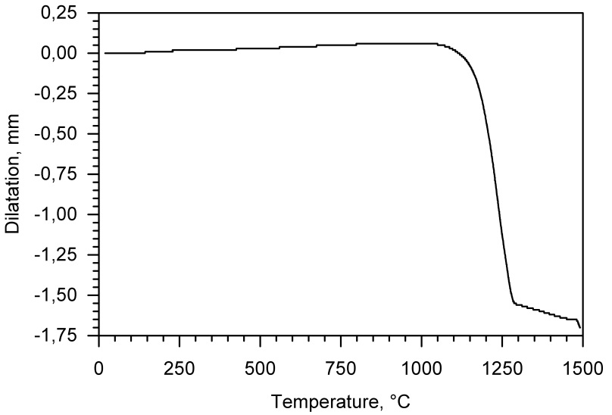
Preparation and characterisation of pellets
The dilatometric curve of beam before sintering

Slide 12
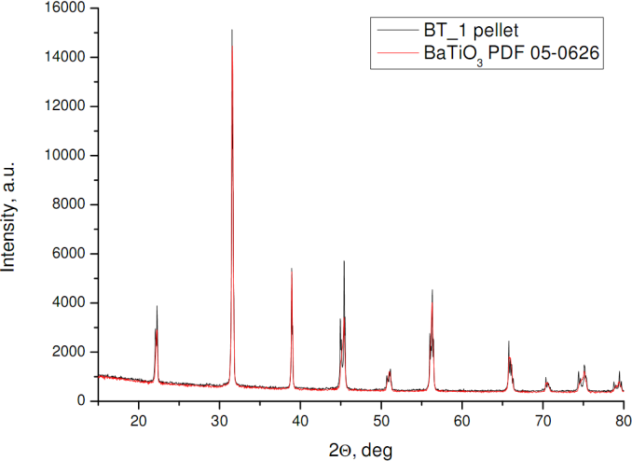
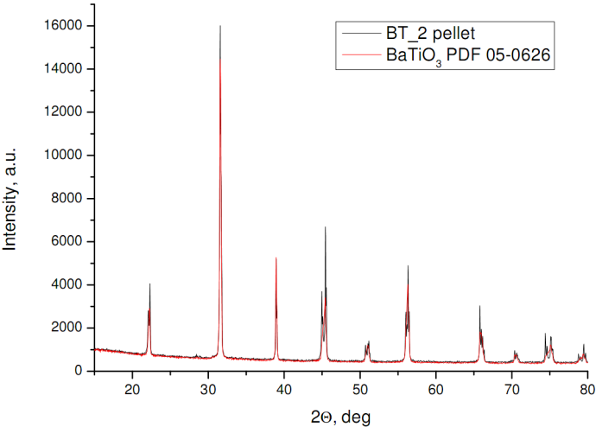
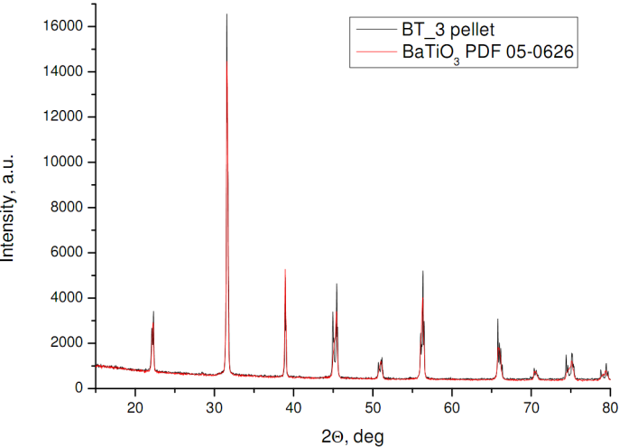
Preparation and characterisation of pellets
The apparent density, water absorbability and apparent porosity of sintered pellets
Material | The water absorbability, % | The apparent density, g/cm³ | The apparent porosity, % | The relative density, %
BT_0 | 0.03 | 5.84 | 0.19 | 97.01
BT_1 | 0.05 | 5.82 | 0.28 | 96.68
BT_2 | 0.06 | 5.83 | 0.37 | 96.84
BT_3 | 0.07 | 5.80 | 0.38 | 96.35
BT_4 | 0.09 | 5.87 | 0.50 | 97.51
XRD patterns of BaTiO₃ pellets sintered in three different maximal temperature

Slide 13
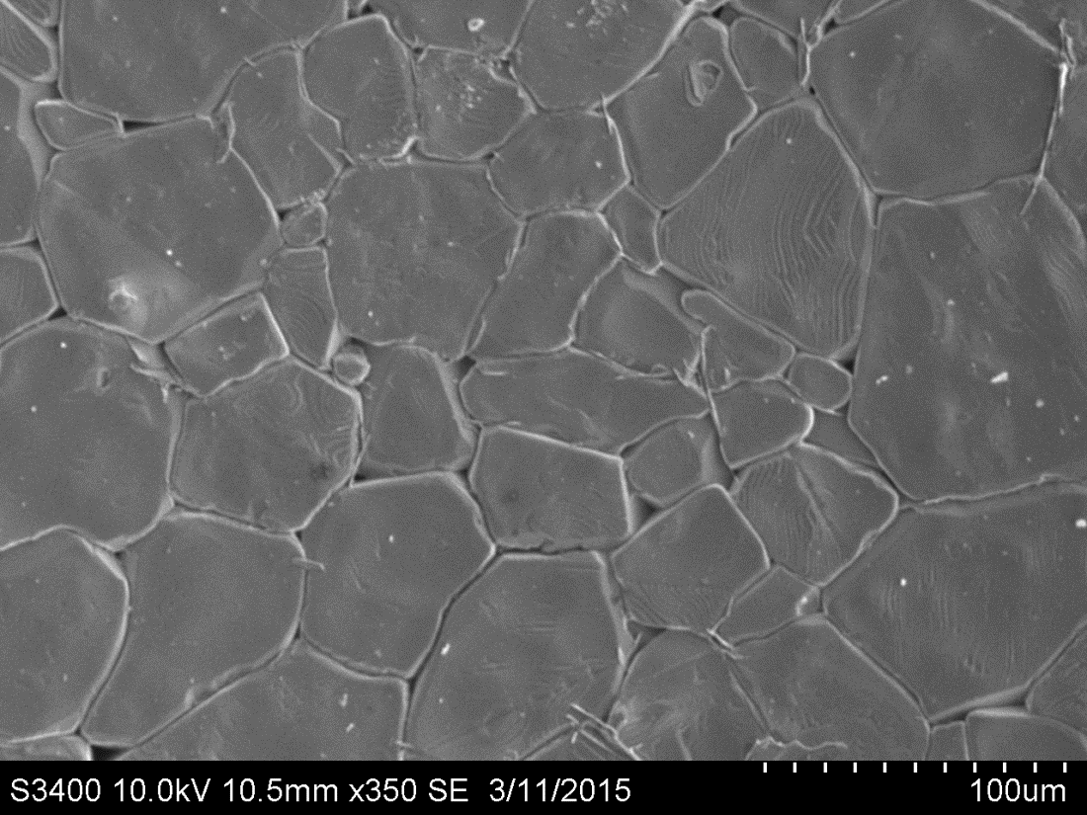
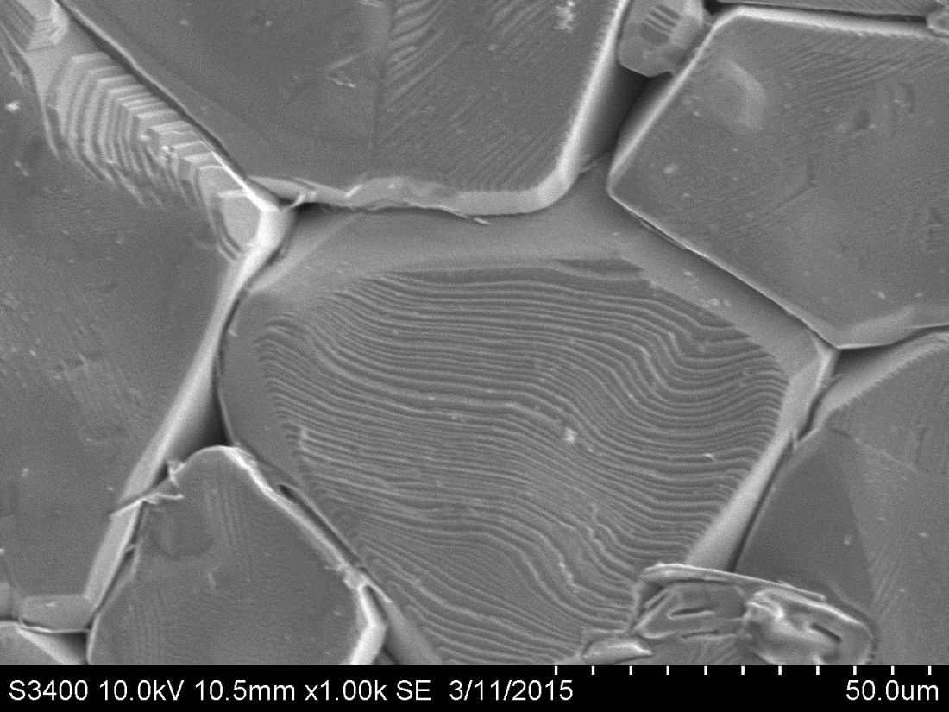
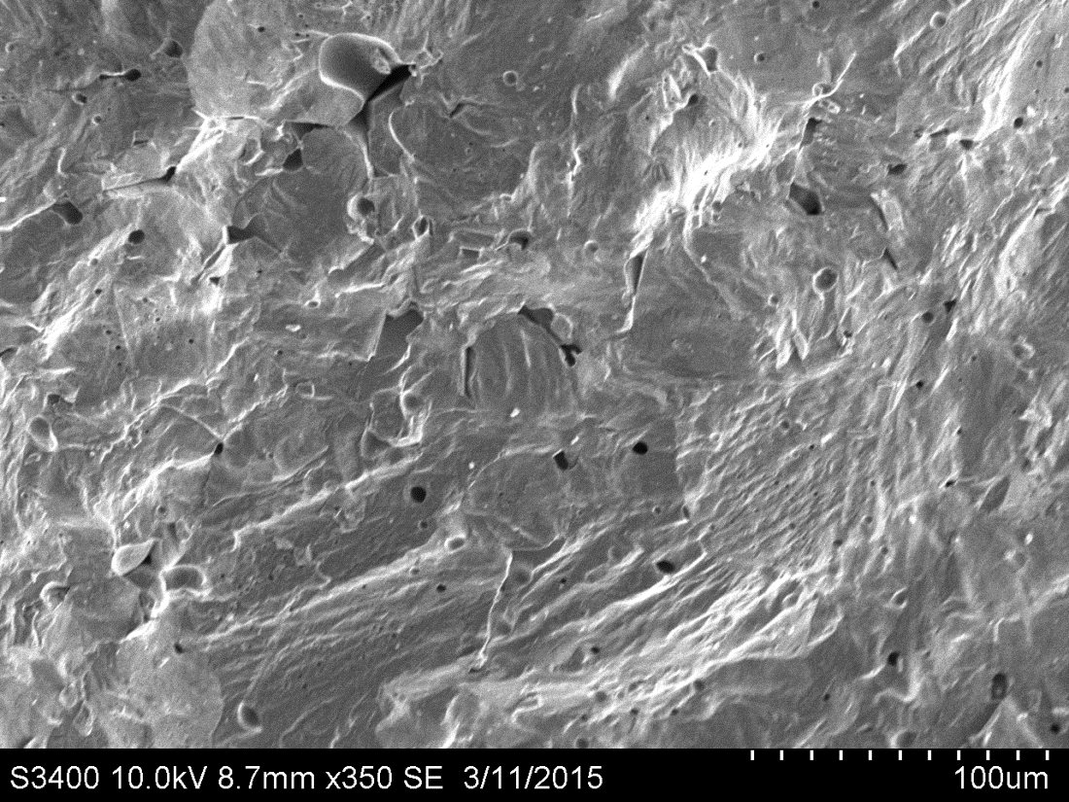
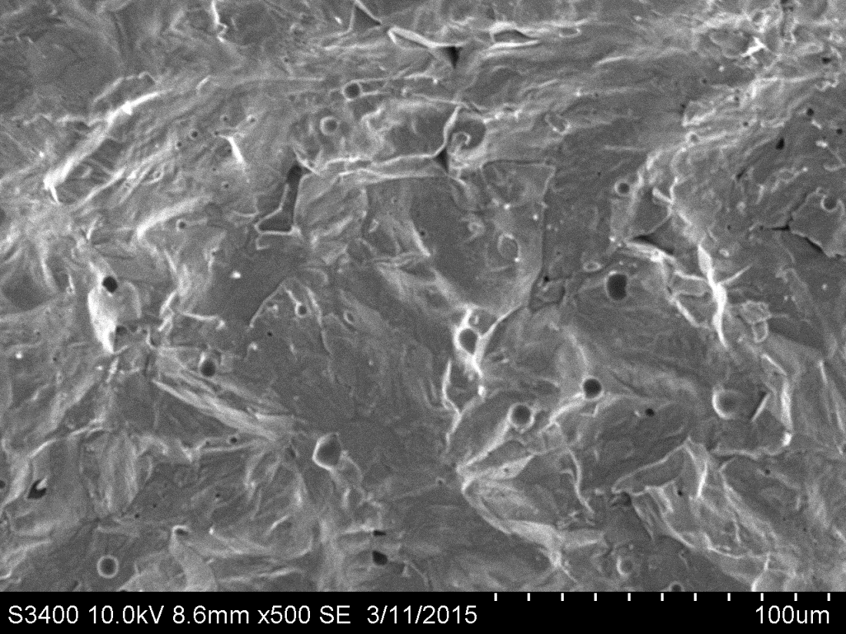
Preparation and characterisation of pellets
SEM microstructure of BT_1 pellet surface in two different magnifications
SEM microstructure of BT_1 pellet fracture surface

Slide 14
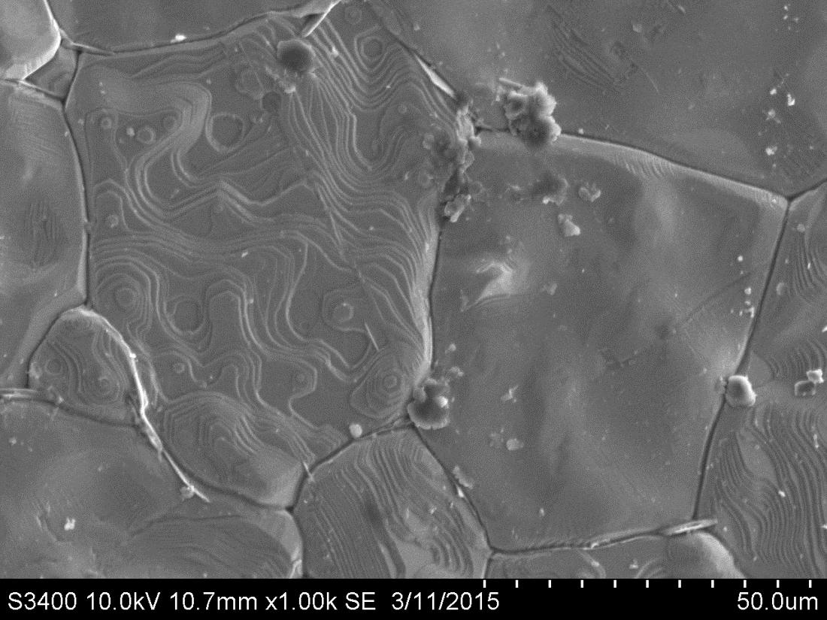
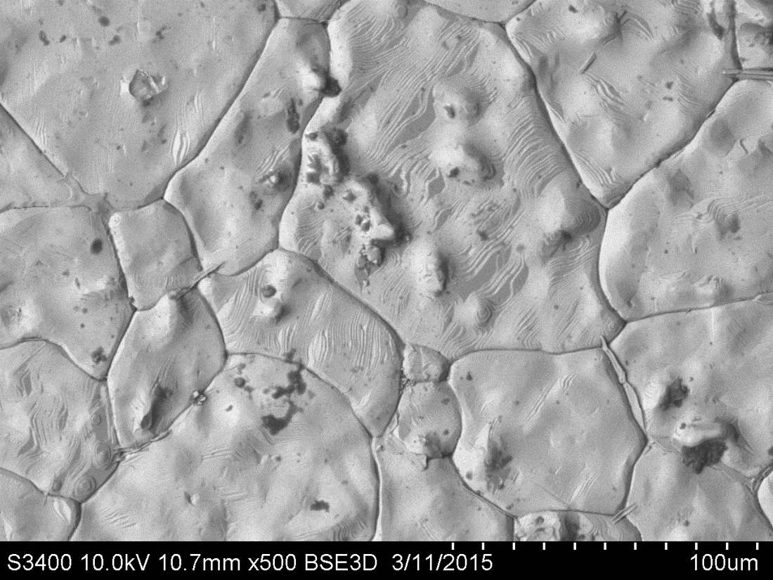
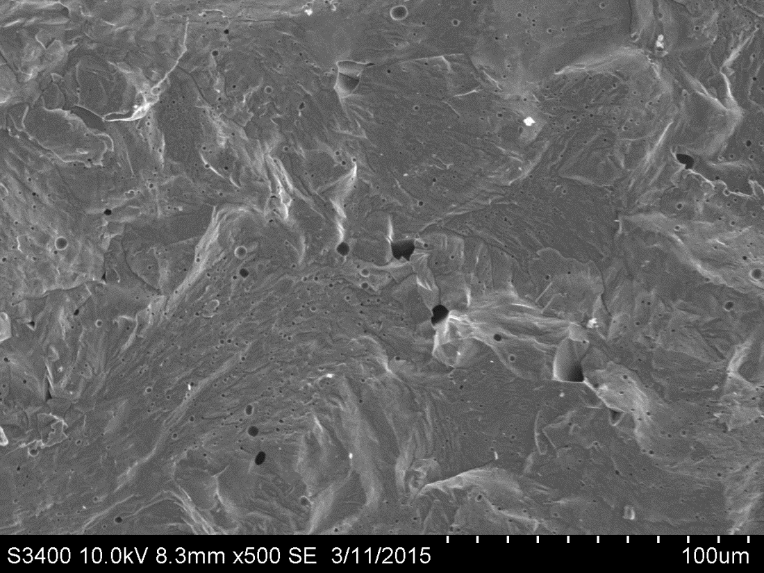
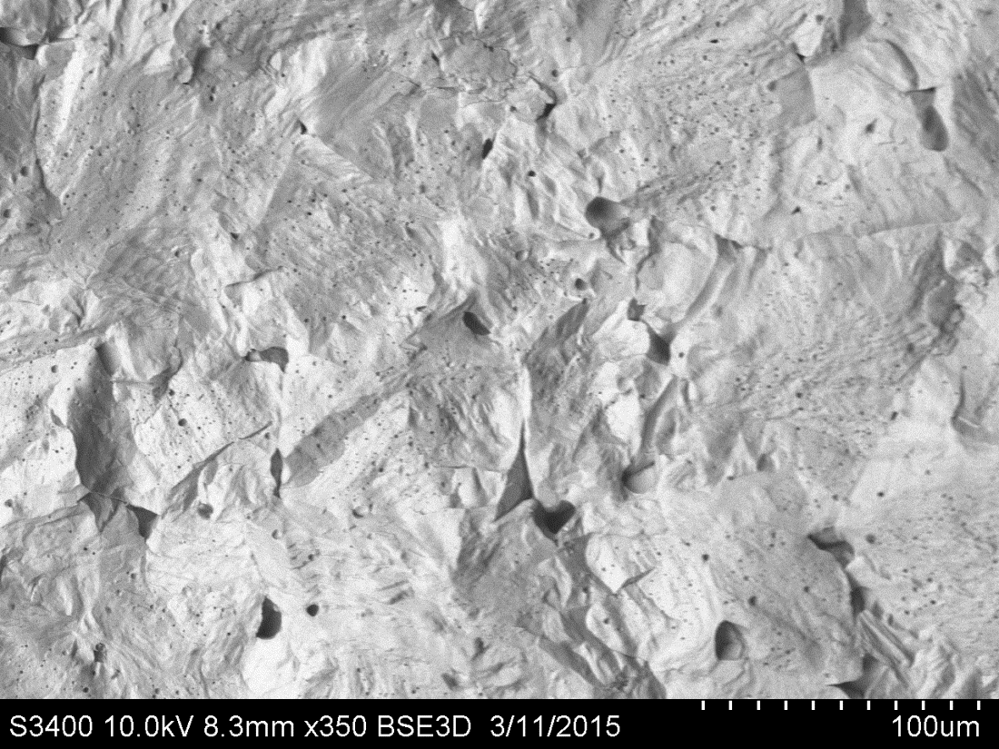
Preparation and characterisation of pellets
SEM microstructure (BSE and SE) of BT_2 pellet surface in two different magnifications
SEM microstructure (SE and BSE) of BT_2 pellet fracture surface

Slide 15
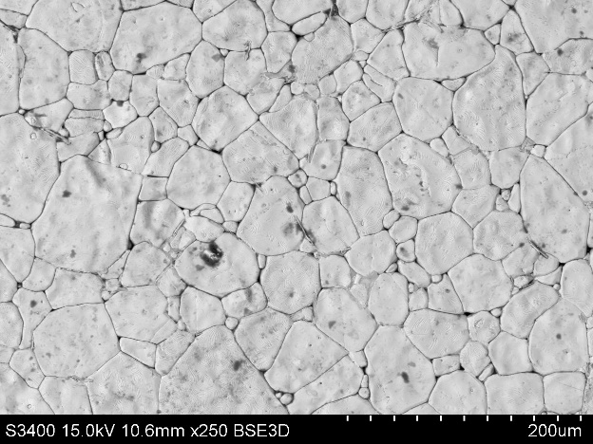
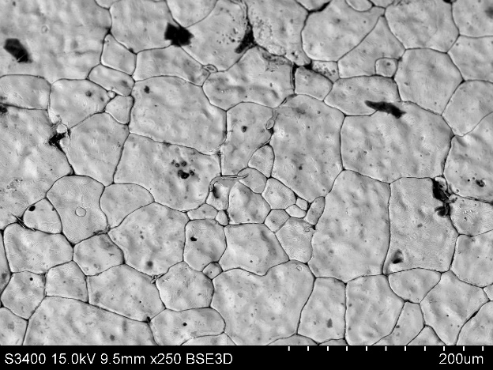
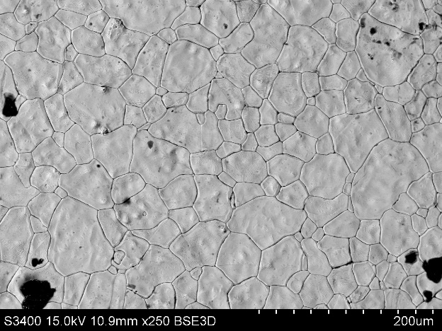
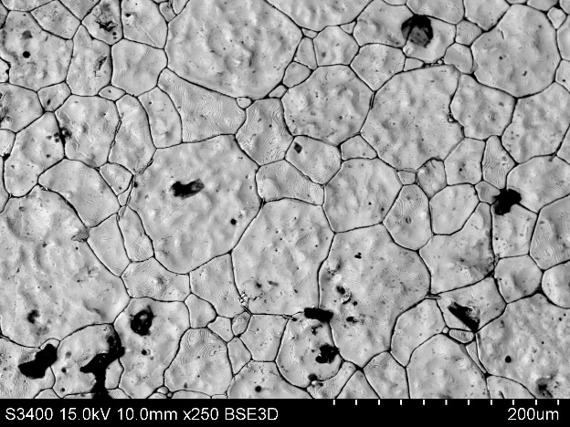
Preparation and characterisation of pellets
BT_0
BT_5
BT_6
BT_7
SEM microstructure of BT_0, BT_5, BT_6 and BT_7 pellets surface in the same magnification

Slide 16
Thank You For Your Attention

