Slide 1
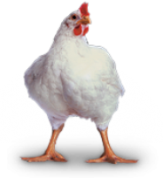
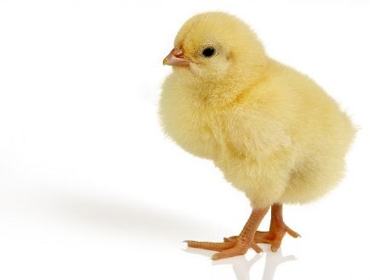
Reducing protein and energy rates in diet while maintaining broiler zootechnical performances: Case study of Nor-Spice AB® supplemented diet
Amine BENARBIA, DVM, PhD

Slide 2
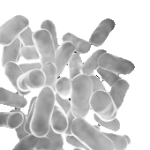
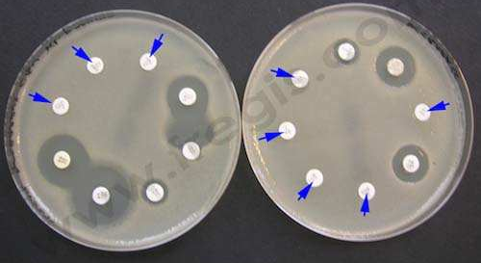

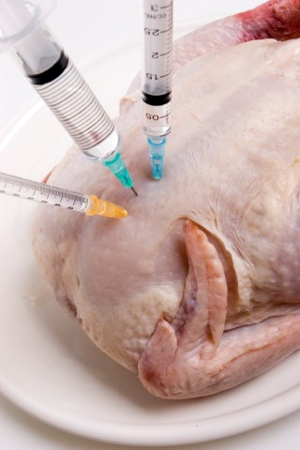
Introduction
Gut Health is important for the expression of the zootechnical performance of broilers.
The intestinal flora plays a key role in maintaining gut health.
(Chahine and Bahna, 2010)
The use of antibiotics as growth promoter have several sides effects:
Development of resistant strain of pathogenic bacteria
Beneficial bacteria
Pathogenic bacteria
Chemical residues in the food chain

Slide 3
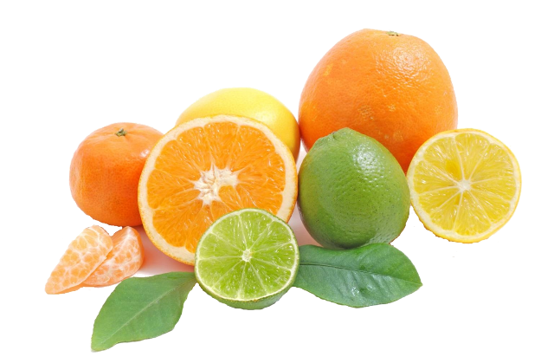
Nor-Spice AB® : a natural product
Control the development of pathogenic bacteria
Limonene
Citroflavonoïdes
POS
Poly-OligoSaccharides
essential oils of citrus
organic acids
Prebiotic effect
A complex composition for a complementary action.

Slide 4
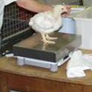

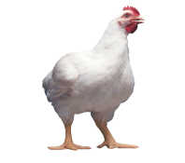
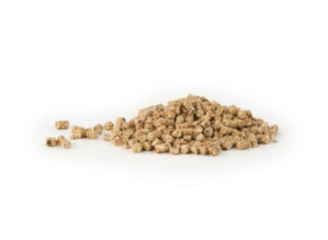
Experimental design
Group 1
Optimal feed
Feed intake
weight
Mortality
Group 2
Optimal feed
+ NSAB 250 ppm
D0
D18
D36
D42
Group 3
Low cost feed
Trials has been conducted in the BARC station.
Low cost feed : -7% energy, 5% Digestible AA
Group 4
Low cost feed
+NSAB 250 ppm

Slide 5
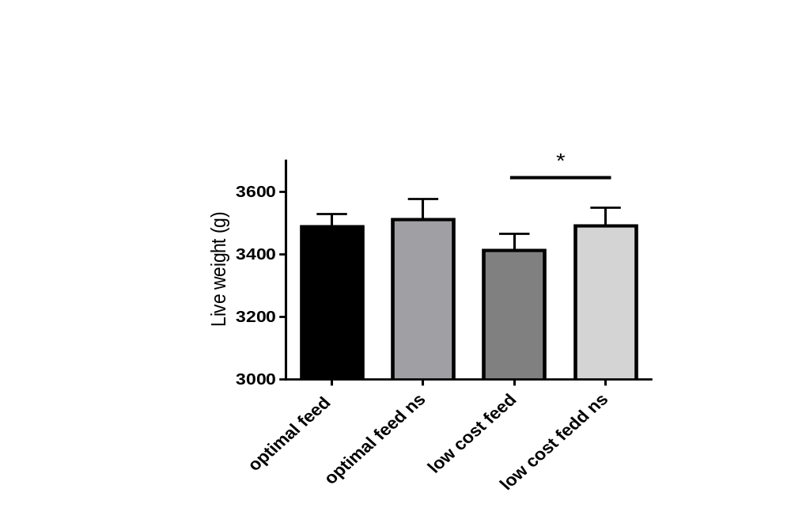
Results: Final live weight
Supplementation with the NOR-Spice AB® increases the final live weight.

Slide 6
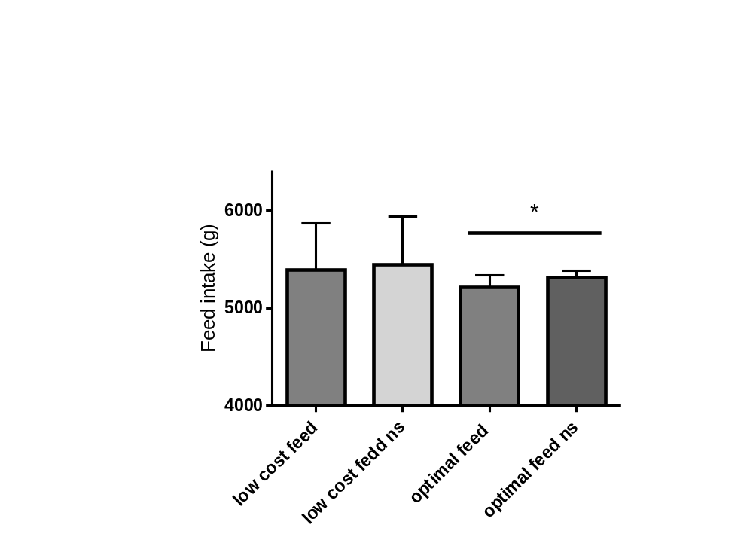
Results: feed intake
Feed supplementation with the NOR-Spice AB® tends to increase feed intake.

Slide 7
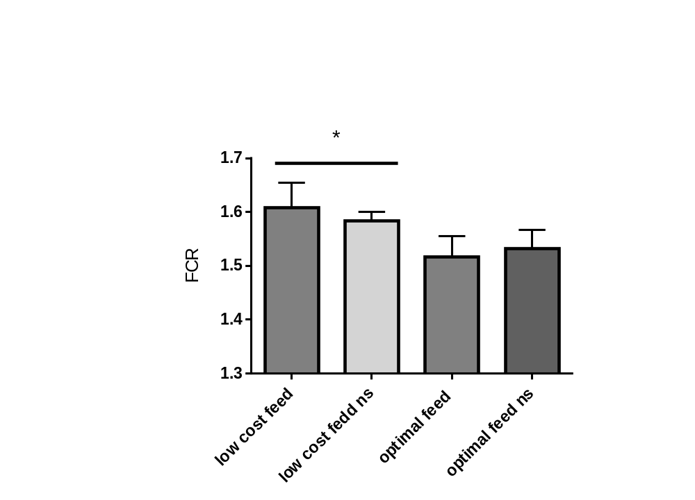
Results: Feed Conversion Rate (FCR)
Feed supplementation with NorSpice AB® improves the FCR.

Slide 8
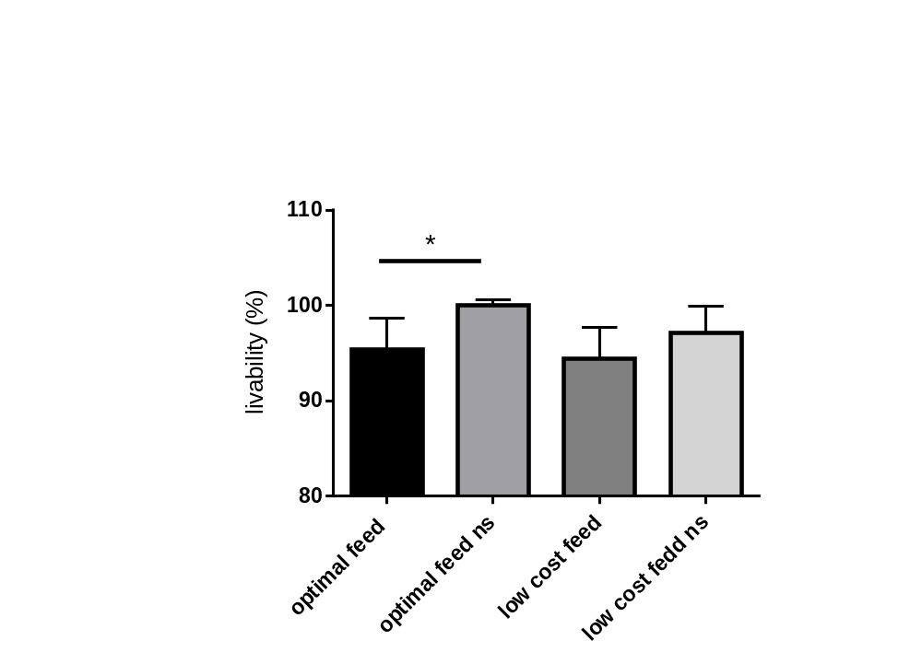
Results: livability
Feed supplementation with NorSpice AB® improve livability

Slide 9
Discussion
Increase in feed intake.
Increase in final body masse.
Improvement of feed conversion rate.
Decrease in mortality.
The effect of NSAB® Supplementation was more pronounce in case of use of economic feed.

Slide 10
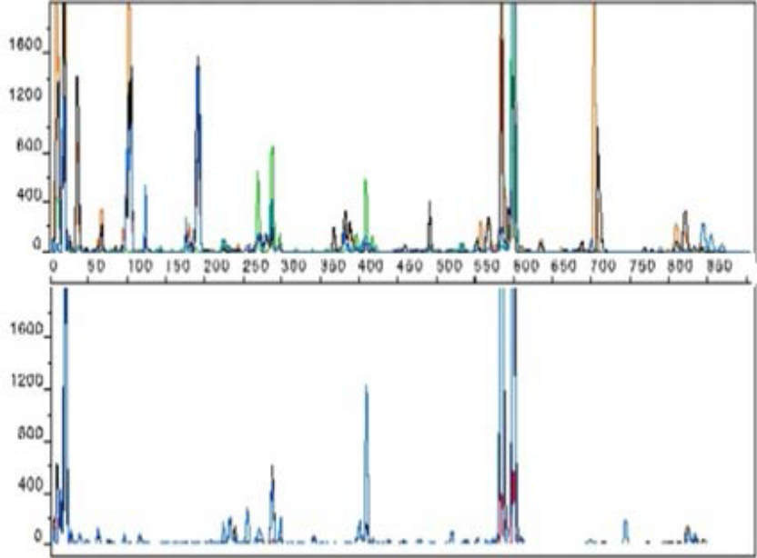
Discussion: Effects on intestinal microbiota
Ctrl
NSAB®
Pathogenic Flora
E. coli
Campylobacter
Brachyspira
Salmonella
Bacteroïde
Pasteurella
Prevotella
Beneficial lactic flora

Slide 11
Discussion: healthy gut= healthy bird= more efficient use of elements
NORSPICE AB®
Stabilization of the Microbiome=
Reduction of microbial toxins
Improving gut health
Increasing digestibility
Reduction of the inflammatory process
(Windisch et al., 2008; Perič et al., 2010; Steiner, 2006)
Mitsch et al., 2004; Kroismayr et al., 2008)
Steiner, 2006; Kroismayr et al., 2008
Helathy birds
More efficient

Slide 12
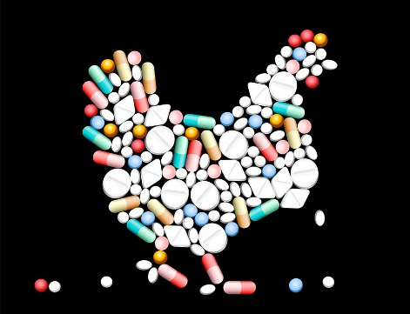

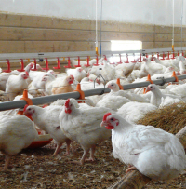
Advantages
An alternative for the use of AB as growth promotors.
Natural product:
  No withdrawal period.
  No residues.
Improve health and animal welfare=> Improve productivity.
Complex composition for a complementary action:
  No risk of developing resistant strains.

Slide 13
Summary
The action of supplementation of NSAB® was more marked in the case of a “low cost” diet.
Economic feed= charge less.
Equivalent performance with a 11.47% cheaper feed.
Efficient at low dose: 250 ppm (250 g/T feed).
ROI = 1:3 minimum

