Slide 1

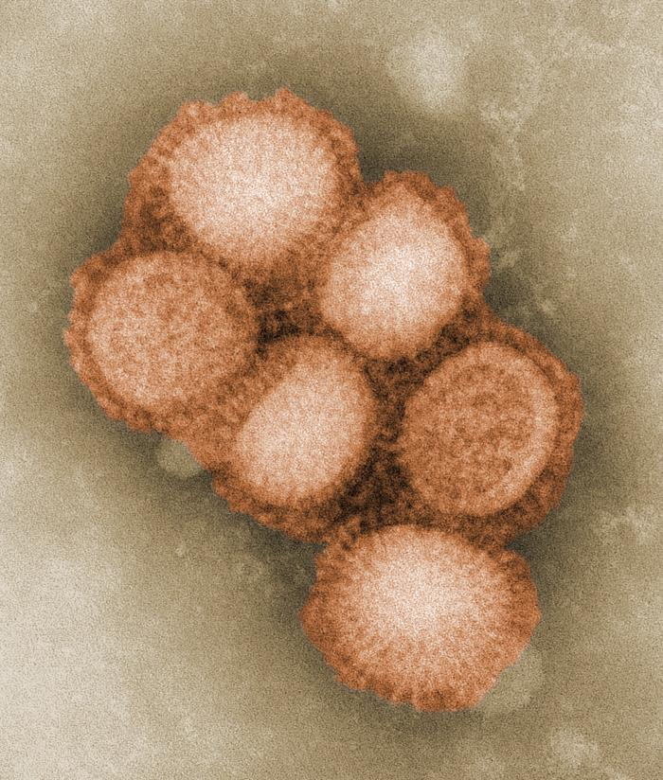
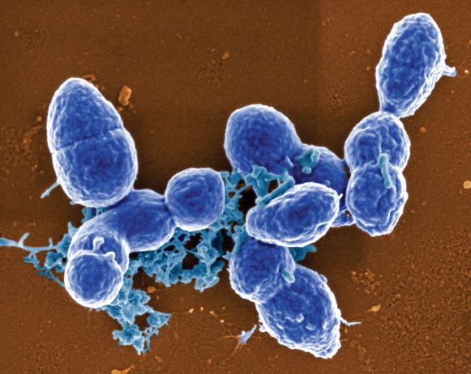

Gamma-ray inactivated vaccines:
Concepts and Applications
Dr Mohammed Alsharifi
Research Centre for Infectious Diseases
The University of Adelaide
Chief Scientific Officer
Gamma Vaccines Pty Ltd

Slide 2








Acknowledgments
The University of Adelaide
Prof James Paton
Prof Tim Hirst
Dr David Ogunniyi
Dr Austen Chen
Rachelle Babb
Shannon David
Josyane Lau
Jennifer Chan
Dr EnChi Wan
Formal group at JCSMR/ANU
Prof Arno Mullbacher
Dr Yoichi Furuya
Dr. Mario Lobigs
Dr Matthias Regner
Aulikki Koskinen
Victoria Smyth
Prof James Paton
Prof Arno Mullbacher
IMVS/ SA Pathology
Dr Tuckweng Kok
Dr Jim Manavis
Dr Peng Li
ANSTO
Dr Justin Davies
Dr Connie Banos
Rachelle Babb
Dr Yoichi Furuya
AAHL/ CSIRO
Dr Timothy R Bowden
Dr David B Boyle
Lee Trinidad
Prof Tim Hirst
Hanson Institute/ Adelaide
Dr John D. Hayball
Dr Kerrilyn R. Diener

Slide 3
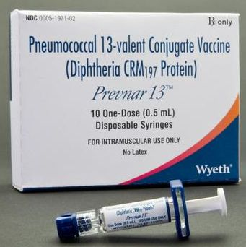
???
Gamma-ray inactivated universal flu vaccine

Slide 4
Outline:
Safety of gamma-irradiated products:
Sterilizing effects of gamma-irradiation
Gamma-irradiated influenza A virus vaccine (γ-FLU)
Gamma-irradiated Streptococcus pneumoniae vaccine (γ-PN)

Slide 5
Safety of gamma-irradiated products: gamma-irradiated food
Food irradiation has been examined thoroughly by the World Health Organization (WHO), the United Nations Food and Agriculture Organization (FAO), by the European Community Scientific Committee for Food, the United States Food and Drug Administration.
Used in more than 50 countries including Australia
Food Standards Australia New Zealand (FSANZ) approval of food irradiation:
  Irradiation of tropical fruits (breadfruit, carambola, custard apple, litchi, longan, mango, mangosteen, papaya and rambutan) (Application A443) (March 2003)
  Irradiation of persimmons (Application A1038) (August 2011)

Slide 6
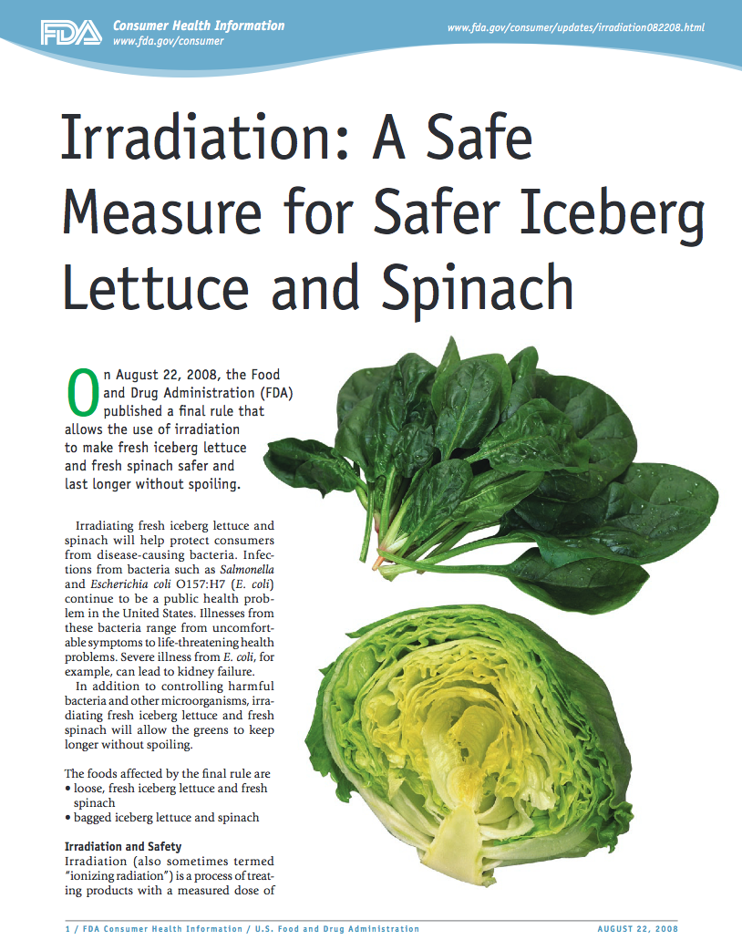
Safety of gamma-irradiated products: gamma-irradiated food
Irradiation of food:
Inactivates possible pathogens including bacteria and viruses
Sterilizes insect pests and stops the spread of foreign invasive species across national boundaries.
Gamma-irradiated products are safe and can be easily stored
How about clinically administered vaccines?

Slide 7
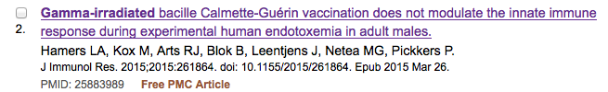
Safety of gamma-irradiated products: gamma-irradiated vaccines
Abstract
Bacille Calmette-Guérin (BCG) vaccine exerts nonspecific immunostimulatory effects and may therefore represent a novel therapeutic option to treat sepsis-induced immunoparalysis. We investigated whether BCG vaccination modulates the systemic innate immune response in humans in vivo during experimental endotoxemia. We used inactivated gamma-irradiated BCG vaccine because of the potential risk of disseminated disease with the live vaccine in immunoparalyzed patients. In a randomized double-blind placebo-controlled study, healthy male volunteers were vaccinated with gamma-irradiated BCG (n = 10) or placebo (n = 10) and received 1 ng/kg lipopolysaccharide (LPS) intravenously on day 5 after vaccination to assess the in vivo immune response. Peripheral blood mononuclear cells were stimulated with various related and unrelated pathogens 5, 8 to 10, and 25 to 35 days after vaccination to assess ex vivo immune responses. BCG vaccination resulted in a scar in 90% of vaccinated subjects. LPS administration elicited a profound systemic immune response, characterized by increased levels of pro- and anti-inflammatory cytokines, hemodynamic changes, and flu-like symptoms. However, BCG modulated neither this in vivo immune response, nor ex vivo leukocyte responses at any time point. In conclusion, gamma-irradiated BCG is unlikely to represent an effective treatment option to restore immunocompetence in patients with sepsis-induced immunoparalysis. This trial is registered with NCT02085590.
sepsis-induced immunoparalysis related clinical trials
gamma-irradiated BCG to stimulate the immune response
scar in 90% of vaccinated subjects at the site of injection
The vaccine did not modulate in vivo or ex vivo responses

Slide 8
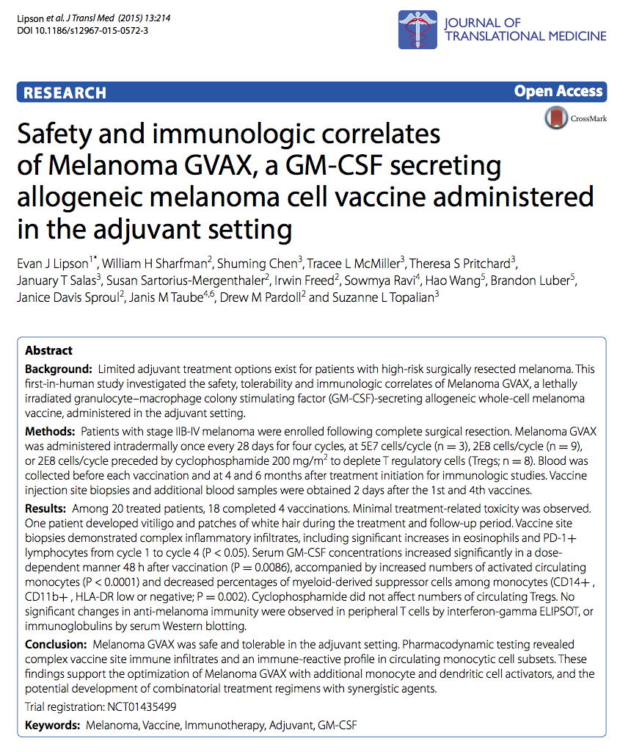
Safety of gamma-irradiated products: gamma-irradiated vaccines
Melanoma GVAX was administered intradermally once every 28 days for four cycles, at 5E7 cells/cycle (n=3), 2E8 cells/cycle (n=9)
Melanoma GVAX was safe and tolerable
J Transl Med. 2015 Jul 5;13:214. doi: 10.1186/s12967-015-0572-3.

Slide 9
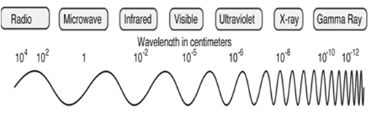
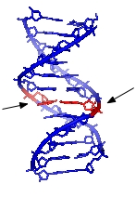
Sterilizing effect of gamma-irradiation
γ-rays are at the higher frequency end of the electromagnetic spectrum
  (Shortest wavelength and High energy)
γ-rays destroy the genetic material by creating nicks in the genomes (ssRNA, or dsRNA or dsDNA)
Two effects on materials:
DIRECT EFFECTS:
Direct interaction with nucleic acids (strand breakage)
INDIRECT EFFECTS
→ generation of short-lived free radicals
causes excess damage to structural components as well as nucleic acid
Irradiation conditions influence the indirect effect:
HIGH temperature → increases indirect effects
LOW temperature → reduces indirect effects and direct effects predominate (*PROTECTS PROTEINS)
Gamma-irradiations has been used to inactivate of highly infectious agents
i.e. Ebola and Lassa viruses

Slide 10
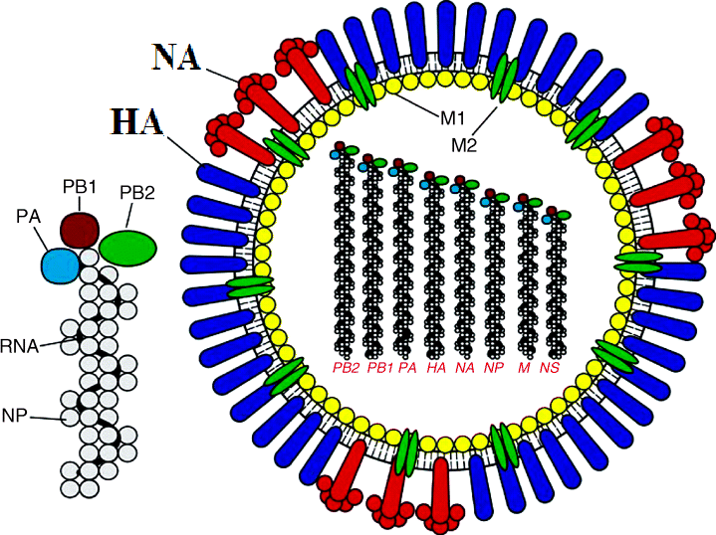
Gamma-irradiated influenza A virus vaccine (γ-FLU)
Structure of influenza A virus
Genome (ssRNA)
Linear, (-) ss RNA genome
8 segments (total size 13,600 nt)
Nucleocapsid
NP subunits wrap around genome
Associated with matrix protein
(to stabilize virus particles)
Enveloped by a lipid bilayer.
Major surface proteins are HA and NA
Enzymes
RNA dep RNA pol attached to each segment
PA, PB1, and PB2
Ambrose C.S., 2008. Influenza and other respiratory viruses. 2(6): 193-202
H1N1
http://www.cdc.gov/h1n1flu/images.htm

Slide 11
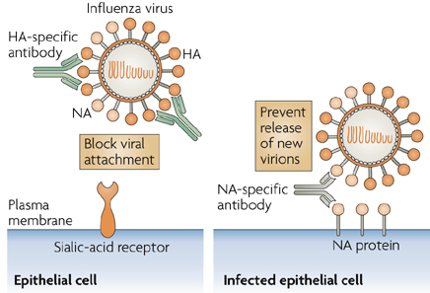
Adaptive Immune Response to Influenza Infection
Antibody-mediated immunity
Subbarao K, 2007. Nature rev Immunol. 7:267
Ab response is directed against surface proteins
Surface proteins are affected by antigenic shift and drift
Ab-mediated immunity is strain specific

Slide 12
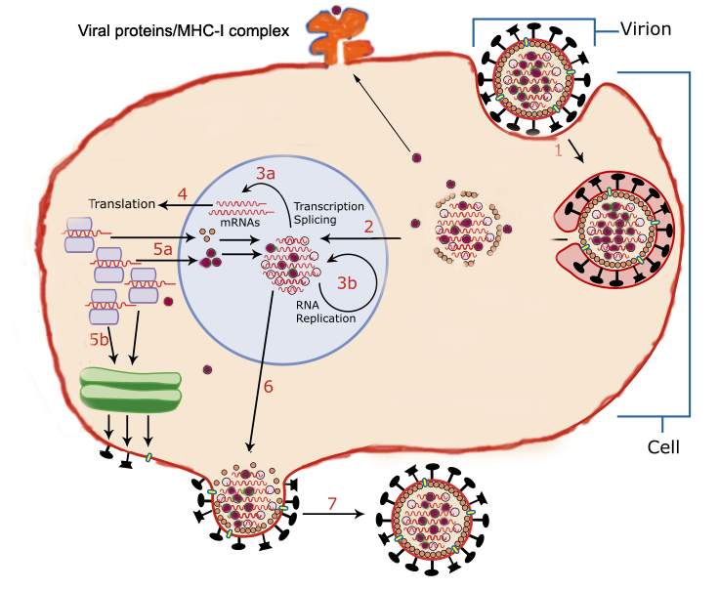
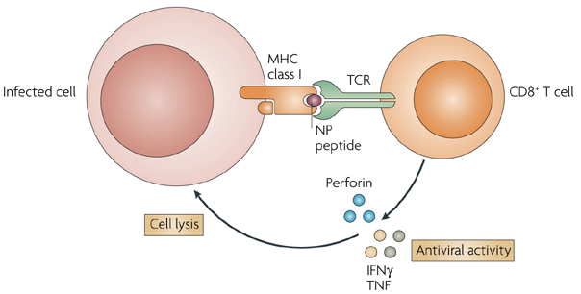
Adaptive Immune Response to Influenza Infection
Cell-mediated immunity
Antibody-mediated immunity
Subbarao K, 2007. Nature rev Immunol. 7:267
Subbarao K, 2007. Nature rev Immunol. 7:267
Ab response is directed against surface proteins
Surface proteins are affected by antigenic shift and drift
Ab-mediated immunity is strain specific
CD8+T cells recognize small peptides
Directed against internal viral proteins
CTL-mediated immunity is cross-reactive

Slide 13
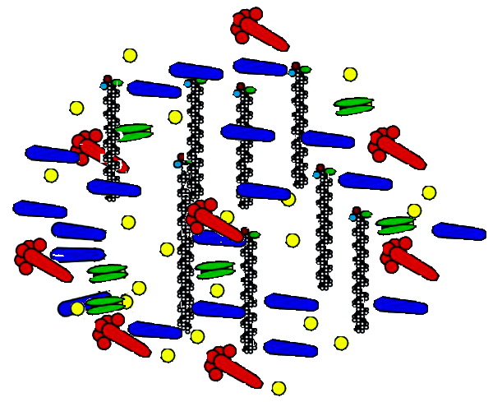
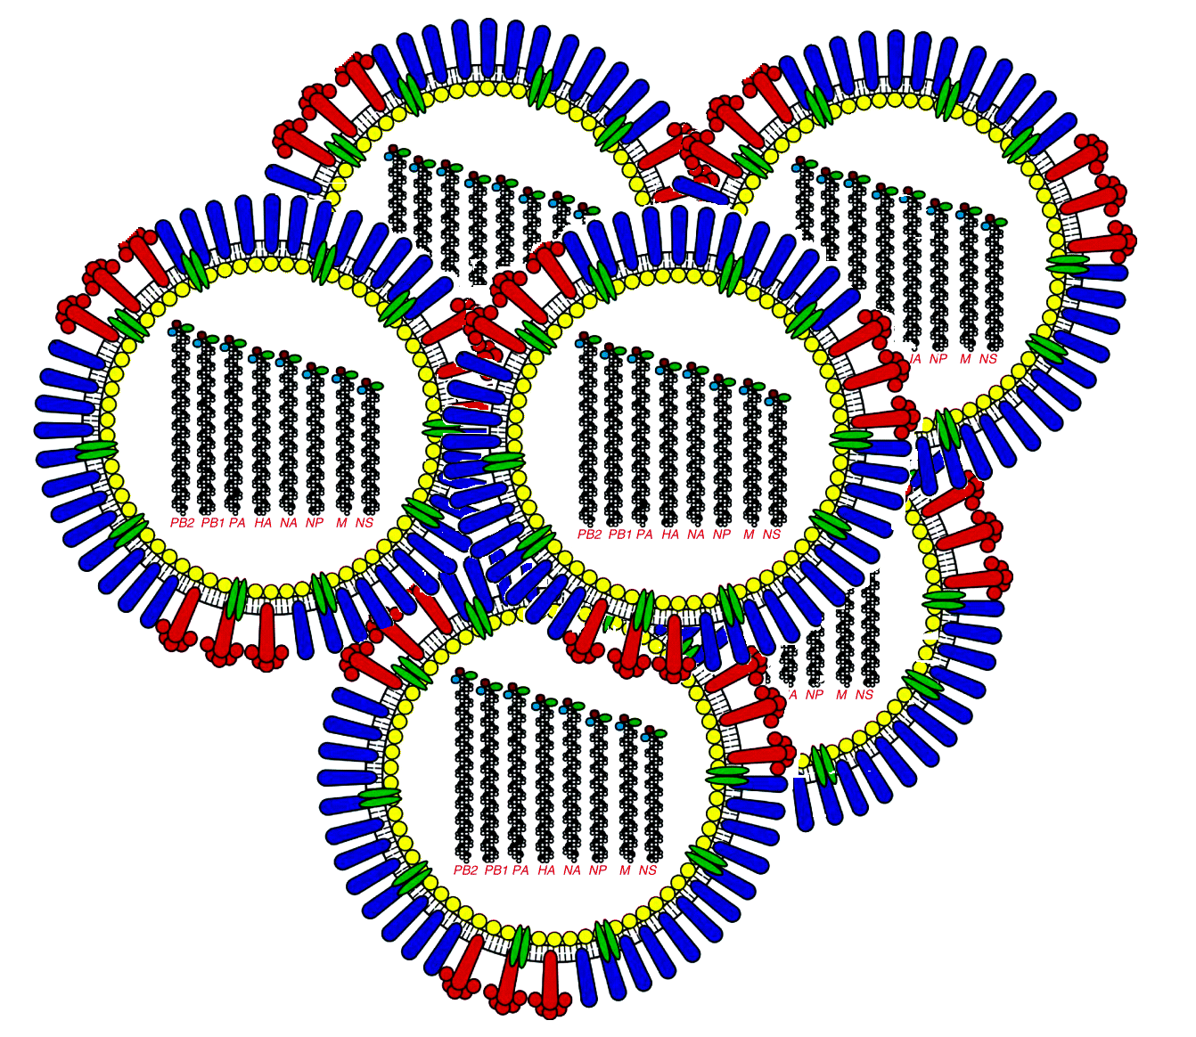

Current Inactivated Influenza Vaccines
Virus grown in eggs
2. Split virus vaccines
Disrupted with detergents.
fewer side effects
No CTL response
Induces antibody responses
(currently used in Australia)
Formalin inactivated
Disrupted with detergent
Whole virus vaccines
Inactivated using formalin
No CTL responses
Induces antibody responses
High side effects
Purification of surface proteins
3. Subunit virus vaccines
HA and NA antigens
Fewer side effects
No CTL response

Slide 14
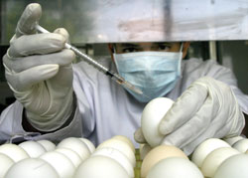
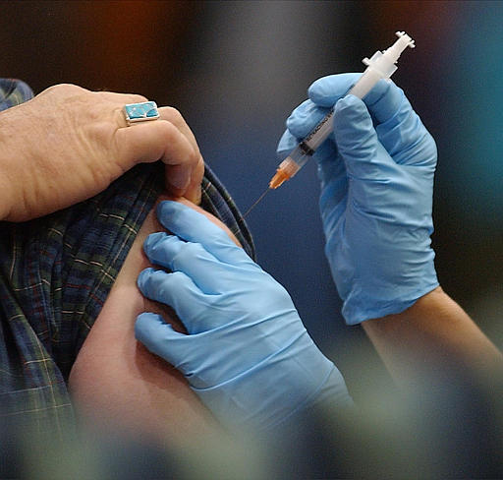
The composition of influenza A virus vaccines for use in Southern Hemisphere influenza seasons recommended by the WHO were:
2006 season
* an A/New Caledonia/20/99(H1N1)-like virus
* an A/California/7/2004(H3N2)-like virus
2007 season
* an A/New Caledonia/20/99(H1N1)-like virus
* an A/Wisconsin/67/2005(H3N2)-like virus
2008 season
* an A/Solomon Islands/3/2006 (H1N1)-like virus
* an A/Brisbane/10/2007 (H3N2)-like virus
2009 season
* an A/Brisbane/59/2007 (H1N1)-like virus
* an A/Brisbane/10/2007 (H3N2)-like virus
Pandemic H1N1 virus was not part of Flu vaccine composition for 2009 season
2010 season
an A/California/7/2009 (H1N1)-like virus
an A/Perth/16/2009 (H3N2)-like virus
Thus: we are playing a catch up game with influenza virus!
www.nature.com
www.jhsph.edu

Slide 15
Current Flu vaccines: strain specific vaccines
Either: Inactivated viruses inducing Antibody responses
Or: Live viruses inducing Antibody and T cell responses
What is the prospect of a universal flu vaccine?
limited
What is the alternative:
Cross-reactive CD8⁺T cell based vaccine
Gamma-irradiated influenza A virus vaccine

Slide 16
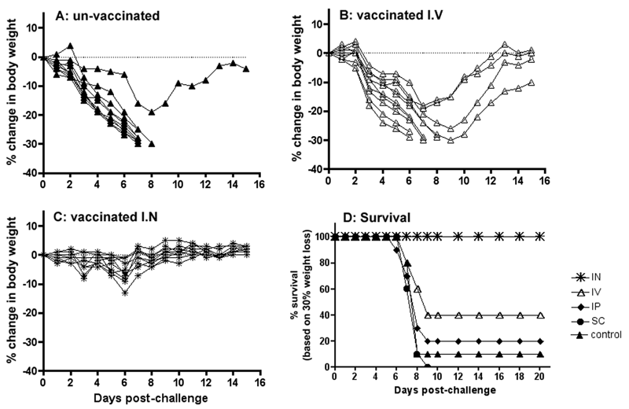
Gamma-irradiated influenza A virus vaccine (γ-FLU)
Virus is grown in 10 day embryonated eggs
The allantoic fluid is harvested and virus is concentrated using cRBCs
Concentrated stock exposed to gamma-irradiation on dry ice.
vaccination with γ-H3N2
Challenged with H1N1
Alsharifi M, et al. (2009) PLoS ONE 4(4): e5336. doi:10.1371/journal.pone.0005336

Slide 17
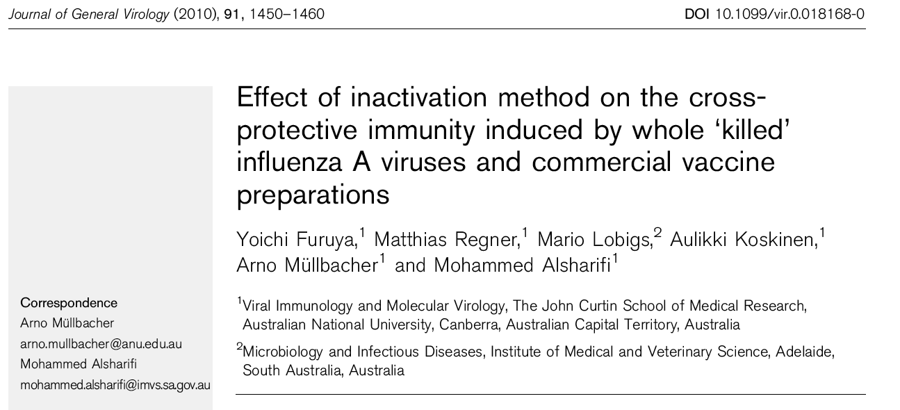
Homotypic challenge with H3N2 (A/PC)
I.N Vaccination Protection
Formalin-H3N2 NO
UV-H3N2 NO
γ-H3N2 Yes

Slide 18
Homotypic challenge with H3N2 (A/PC)
I.N Vaccination Protection
Formalin-H3N2 NO
UV-H3N2 NO
γ-H3N2 Yes
Heterosubtypic challenge with H1N1 (A/PR8)
I.N Vaccination Protection
Formalin-H3N2 NO
UV-H3N2 NO
γ-H3N2 Yes

Slide 19
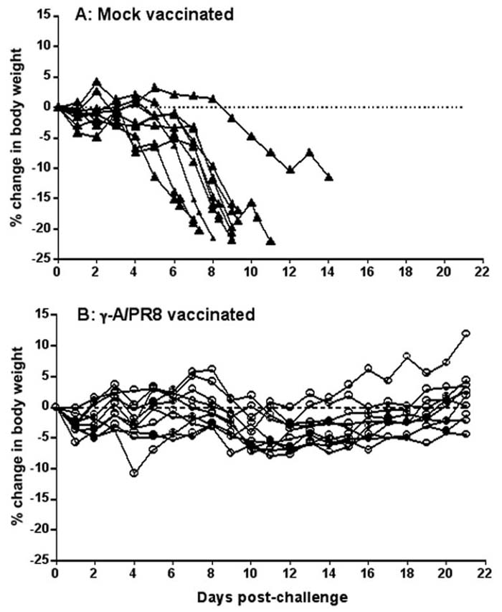
I.N vaccination with γ-H1N1 protects against avian H5N1
Group 1:
No vaccination
Challenged with H5N1
Group 2:
Vaccination with γ-H1N1
Challenged with H5N1
Alsharifi M, et al. (2009) PLoS ONE 4(4): e5336. doi:10.1371/journal.pone.0005336

Slide 20
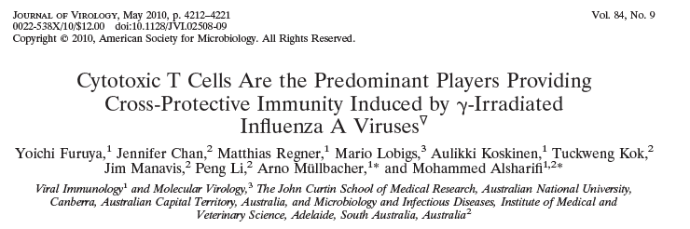

Slide 21
Vaccination with γ-H3N2
Challenged with H1N1
Early clearance of influenza virus from the lung of vaccinated animals

Slide 22
Adoptive transfer of T cells provided cross-protection

Slide 23
Early CTL responses in the lung of vaccinated animals

Slide 24
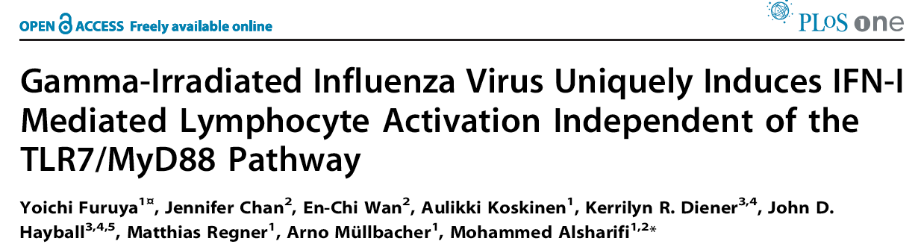
Furuya Y, et al. (2011). PLoS ONE 6(10): e25765
We illustrated the ability of γ-FLU to activate cytosolic receptors
We illustrated the The ability of g-FLU to sensitize target cells for lysis by Tc cells in a tap-dependent manner (Ag presentation via MHC-I)
RMA targets
RMA-S targets

Slide 25
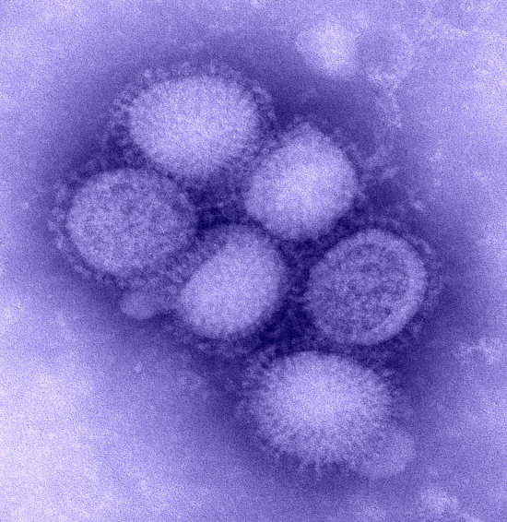
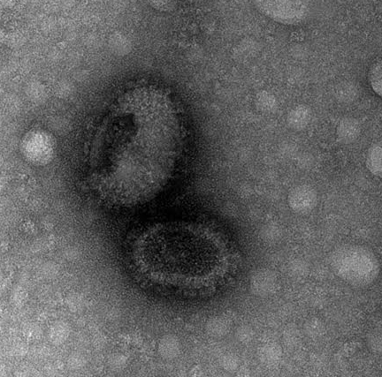
Transmission electron microscopy
Gamma-irradiated H1N1
A/California/07/2009 H1N1
Shannon David, PhD student

Slide 26
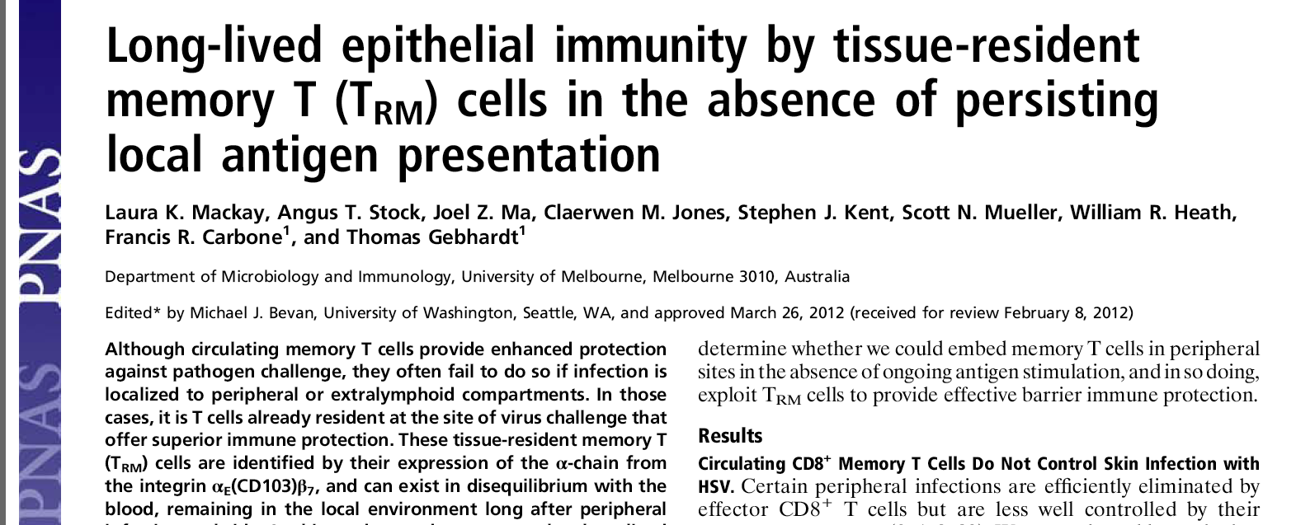
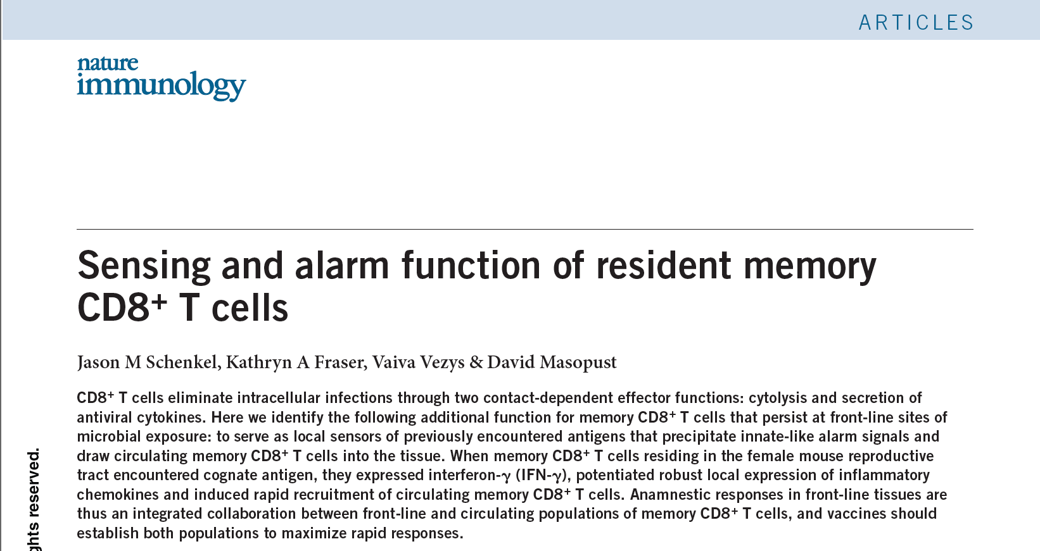
CD8⁺T cell responses: Tissue-resident memory T cells
Influenza A virus infection is expected to induce tissue-resident memory T cells

Slide 27
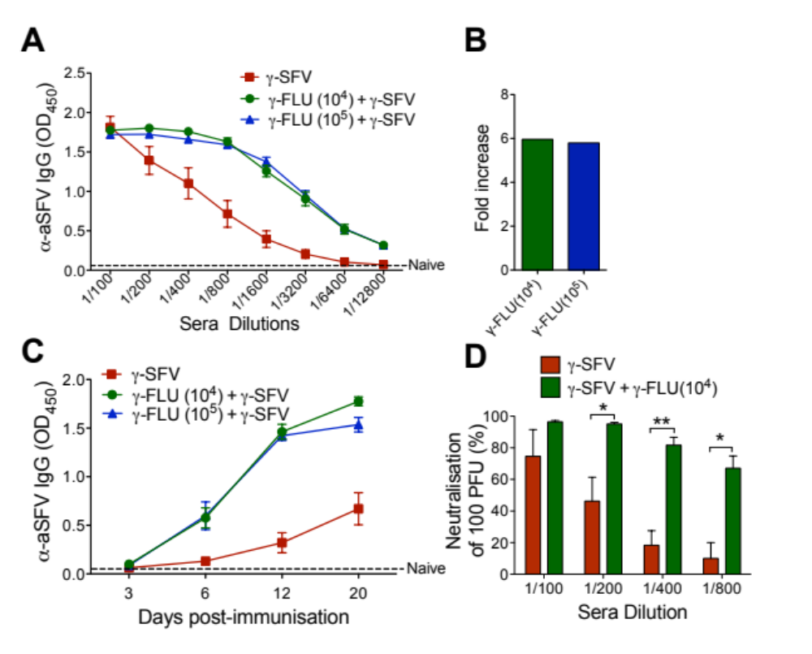
Adjuvant activity of γ-FLU
Co-administration of
γ-FLU and gamma irradiated semliki forest virus (γ-SFV)
enhanced protective SFV-specific antibody responses up to 6 fold
Heighted the kinetics of the SFV antibody response
Babb et al, Frontiers in Immunology, June 2014, 5:267
Is it possible to co-administer γ-FLU with other vaccines to increase immunogenicity??

Slide 28
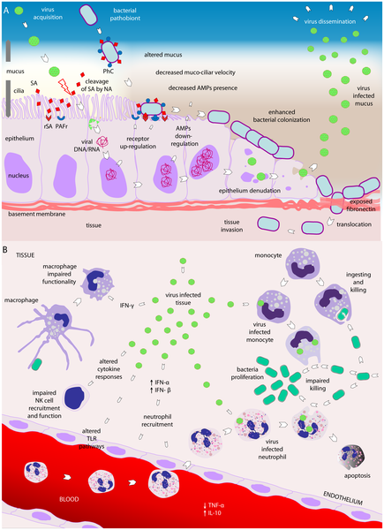

Viral–bacterial interactions
Compromised ciliary function
Upregulation of PAFr
Epithelial Destruction
PROMOTES COLONISATION
Decreased expression of MARCO receptor on macrophages
Inhibition of neutrophil function
Decreased chemoattractants
CXCL1 and CXCL2 (neutrophils)
CCL2 (macrophages)
IMPAIRED CLEARANCE OF BACTERIA
Bosch AATM, Biesbroek G, Trzcinski K, Sanders EAM, et al. (2013) Viral and Bacterial Interactions in the Upper Respiratory Tract. PLoS Pathog 9(1): e1003057. doi:10.1371/journal.ppat.1003057
http://www.plospathogens.org/article/info:doi/10.1371/journal.ppat.1003057

Slide 29
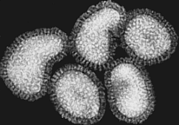
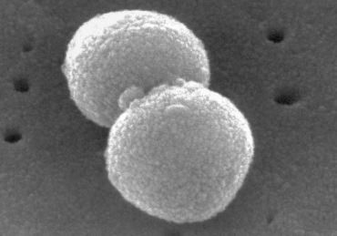
Secondary bacterial infections
Influenza
S. pneumoniae
Several bacteria implicated including S. pneumoniae, Haemophilus influenzae, Staphylococcus aureus
S. pneumoniae is the most common
Secondary bacterial pneumonia is responsible for excess mortality during influenza pandemics (**1918-19 pandemic)
Confirmed the presence of S. pneumoniae in tissue specimens and blood samples obtained from soldiers during the 1918 pandemic
→ more died from secondary bacterial infection as opposed to the primary viral infection

Slide 30
Streptococcus pneumoniae
Gram positive bacterium
TYPES: 93 serotypes (capsular polysaccharides)
TRANSMISSION: via aerosol droplets or direct contact with infectious secretions.
CAUSES: otitis media, pneumonia, bacteraemia and meningitis.
SYMPTOMS: fever, malaise, cough, shortness of breath, blood in sputum (pneumoniae).
Carried asymptomatically in 60 % of the the population, especially in children.
  1.2 million child deaths occur per year

Slide 31
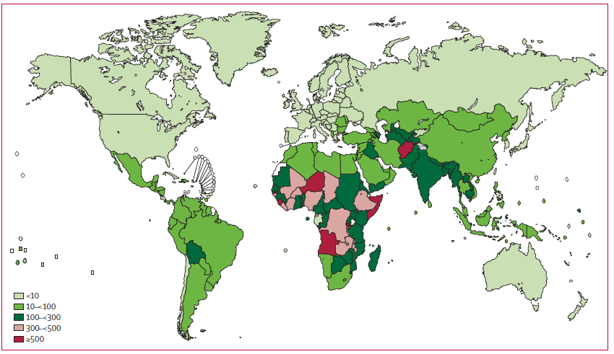
Epidemiology
Pneumococcal related deaths in children < 5 years old
- Pneumococcal mortality rate is highest in Africa and Asia

Slide 32
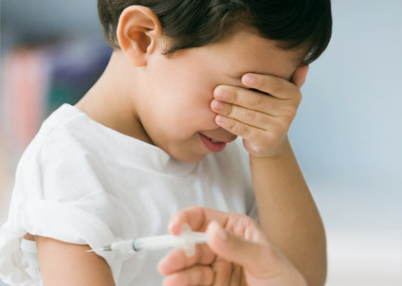
Pneumococcal Vaccines
PROBLEM?? 93 Serotypes based on capsular polysaccharides
Polyvalent polysaccharide vaccine
(23 common circulating serotypes)
Capsular polysaccharides (CPS)
Immunogenic in adults and children > 5 yrs
Ineffective in children < 5 years
2. Pneumococcal conjugate vaccines
Prevenar 13 (13 serotypes) since 2010.
CPS is conjugated to a protein carrier (diphtheria toxin cross-reactive material 197).
Immunogenic in infants and young children.

Slide 33
Problems with current vaccines
Serotype specificity → “serotype replacement”
High cost (purification of CPS)
Limited technology restricts number of serotypes included.
NEED A VACCINE WHICH:
- Induces effective immunity
Not restricted to age
Effective against all serotypes of S. pneumoniae (universal)

Slide 34
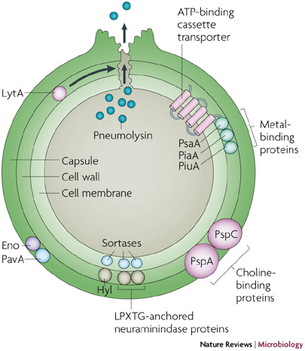
Gamma irradiated
Streptococcus Pneumoniae (γ-PN)
We desire 3 characteristics in our whole cell preparation:
1) Capsule deficient (serotype independent)
2) Pneumolysin mutant (toxoid)
3) Autolysin deficient (prevents cell lysis)

Slide 35
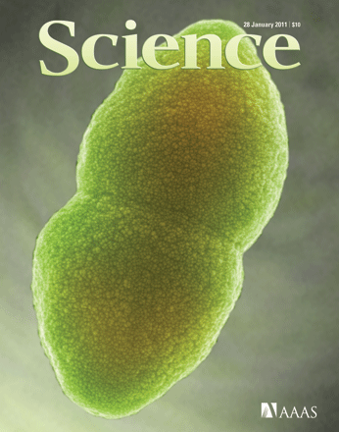
Gamma irradiated S.Pneumoniae
SCANNING ELECTRON MICROSCOPY
Irradiated with 24 KGy on Dry Ice
preserved structure of the gamma irradiation bacterium
Rachelle Babb, PhD student

Slide 36
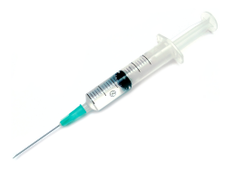
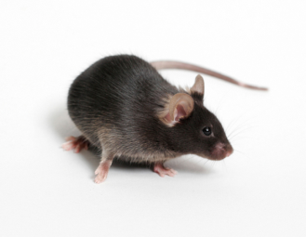
PROTECTION STUDIES
Intranasal vaccination **
I.N. vaccination
of γ-PN
(1x10⁸ CFU)
2nd dose
(1x10⁸ CFU)
Challenge
2 weeks later
2 weeks later
GROUPS:
PBS
γ-PN
Challenge:
D39 (Survival against encapsulated strain)
P9 (Serotype-independent protection)
Monitor for SURVIVAL
Rachelle Babb, PhD student

Slide 37
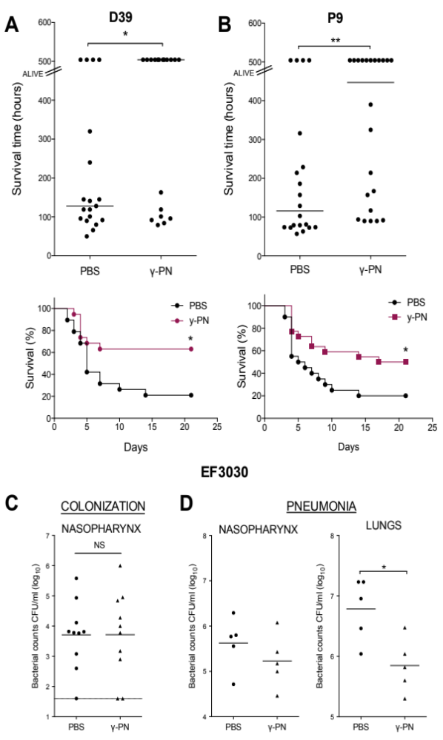
γ-PN provides serotype independent protection
Rachelle Babb, PhD student

Slide 38
PROTECTION STUDIES
Intranasal vaccination **
I.N. vaccination
of γ-PN
(1x10⁸ CFU)
2nd dose
(1x10⁸ CFU)
Challenge
2 weeks later
2 weeks later
GROUPS:
PBS
γ-PN
Challenge:
EF3030 Colonization model
EF3030 Pneumonia model
Harvest tissues and analyze bacterial counts
Rachelle Babb, PhD student

Slide 39
γ-PN does not protect against colonisation but still provides protection against pneumonia
Rachelle Babb, PhD student

Slide 40
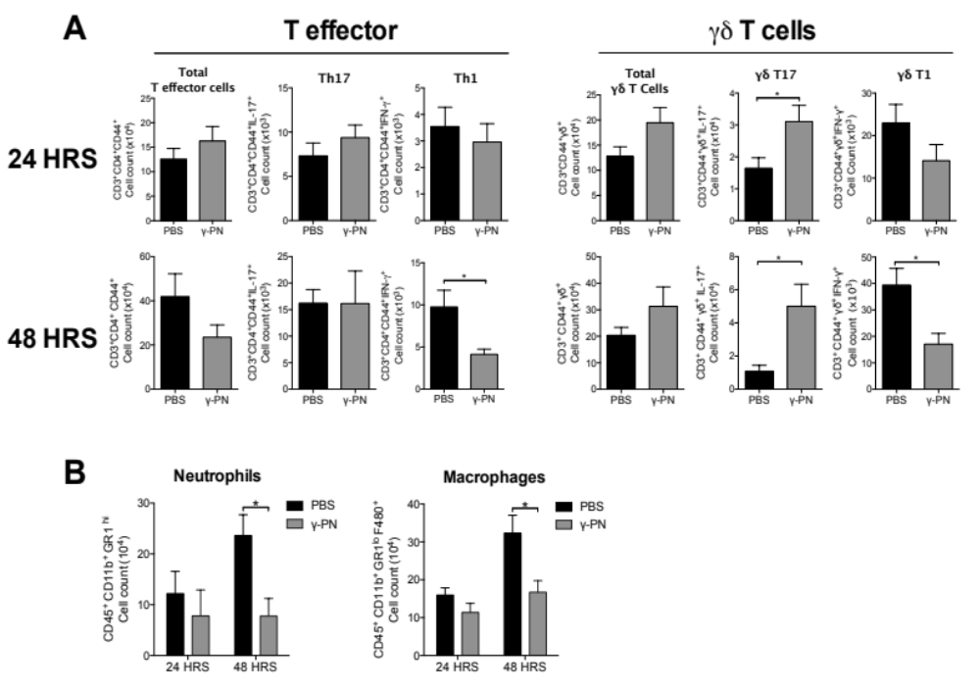
SOURCE OF IL-17
γ-PN induces innate IL-17 responses and accelerates innate effector cell response
Rachelle Babb, PhD student

Slide 41
SUMMARY- γ-PN
Vaccine provides serotype-independent protection without the use of an adjuvant
Protection is dependent on both IL-17 and B cell responses
The vaccine promotes innate IL-17 responses not Th17 responses

