Slide 1
Drug Delivery and Generic Medicine
The Challenge ahead; Choose where to play.
MENA as an Industry Model
Mohammad Refaat Khattab
Cairo University; Egypt
World Drug Delivery Summit
August 17-19, 2015 Houston, USA

Slide 2

Introduction
The generic industry has enjoyed a remarkable run over the past decade, with companied generating above average share holders return
The industry has along track record of strong, steady growth, often at double digit rates.
From 2009 to 2012, net revenue grew at an average of 8% per year – one and half time faster than the 54 % posted by small molecule originators

Slide 3
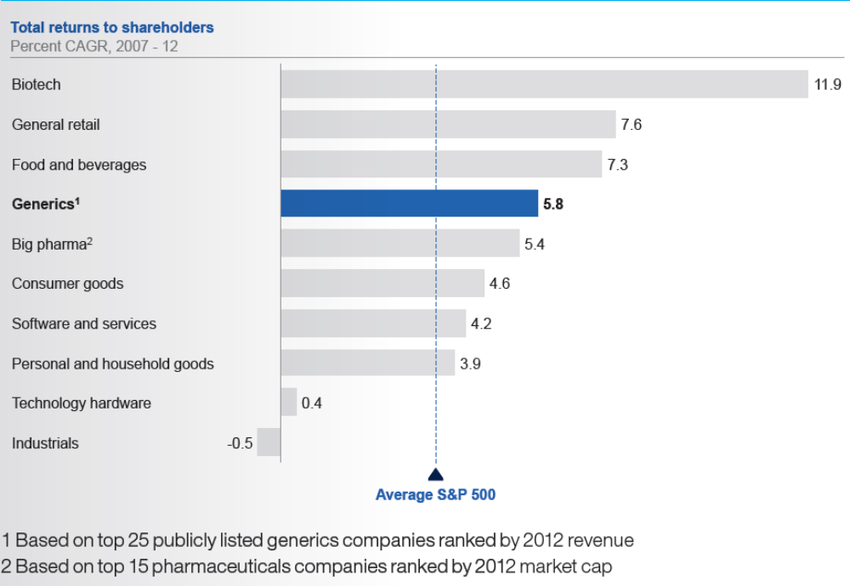
Generic Companies have generated above the – average return

Slide 4
The Challenges ahead
Although there is still room for growth in generics, delivering it has become more complex, given that penetration rate as high as 80% in USA and 70 % in central and eastern Europe, significant potential exists for volume penetration in many markets.
In addition between 20$ and 60$ billion of originators sales will continue to go off-patent each year
However generic companies face considerable challenges to their profitability and growth

Slide 5
The Challenges ahead
Commoditization, combined with extensive reforms in both regulated and unregulated markets is increasing pressure on prices
Although healthcare reforms have boosted sales of generics in recent years, many governorates are looking to reduce their generic drug expenses.
More and more countries have seen dramatic shift in their business model as payors become key stockholders through the implementation of tenders

Slide 6
The Challenges ahead
Products portfolio are becoming increasingly complex
The share of hard to make and specialized drug go off-patent- including drug/device combinations, sterile injectable, and biologics will increase by 2016.
8 of the top 10 pharmaceutical drugs will be biologics.

Slide 7
The Challenges ahead
Managing a business while maintaining a lean structure and striving for cost leadership has become more complex
The top two global players each have up to 1000 compounds on the market and even more products in pipeline covering oral solids, biosimilars, respiratory, sterile injectable and patches

Slide 8
The Challenges ahead
Quality control in manufacturing remains challenging
Comparing generic players with originators illustrates the scale of the problem
For example, 1.4 % of batches are rejected for generic companies as compared with 0.4 %for originators and there are 72 deviation per 1000 batches for generic players as compared with 53 deviations for originators

Slide 9
The Challenges ahead
New players are intensifying competition
New entrants in Generic market specially from originators such Abbott, Sanofi and GSK

Slide 10
The Challenges ahead
Conclusion
As a result of this challenges, financial markets are less optimistic than they were about the outlook of generics

Slide 11
Choosing where to play
Some might say that generics companies will find it increasingly difficult to launch new products now that originator products coming off-patent are becoming harder to develop, produce, and commercialize
Generic Companies have a wide range of opportunities to choose from
About $217 billion worth of originators products will lose their patent protection by 2018, and they span the full range from oral solids, Biologics, inhalers and sterile injectable to OTC medicine

Slide 12
Choosing where to play
The opportunities in these categories will varying in value and timing; for instance, biosimilar will be a large opportunity driven by the patent expiry of major products
While sterile injectable will be smaller opportunity by value; but with steady stream available each year
Each product opportunity will also vary in terms of its regulatory context, manufacturing requirements and commercialization challenges

Slide 13
Choosing where to play
Industry estimates suggest that generics are likely to have luxury of nearly $60 Billion in net growth in the next six years
Companies should make a careful assessment of where to invest before deciding on their development programs

Slide 14
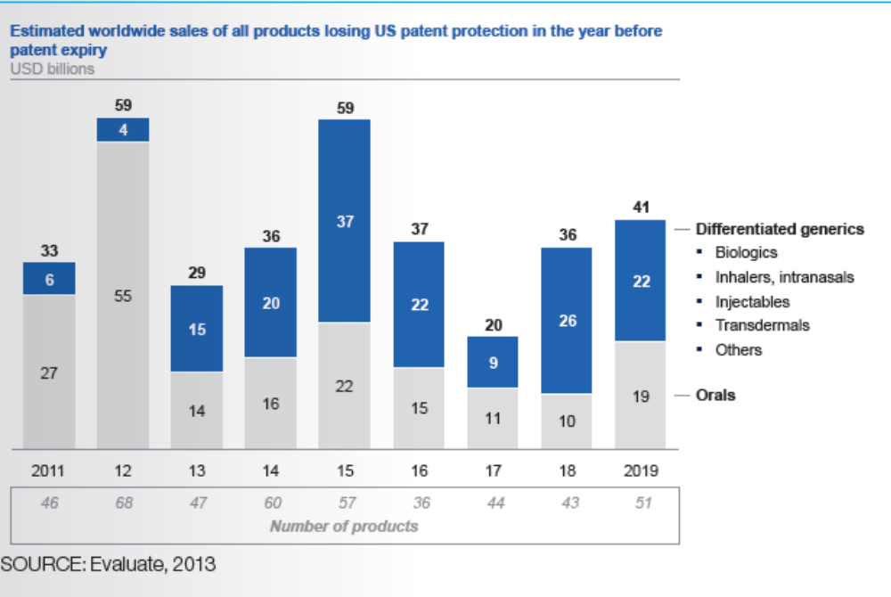
Choosing where to play

Slide 15
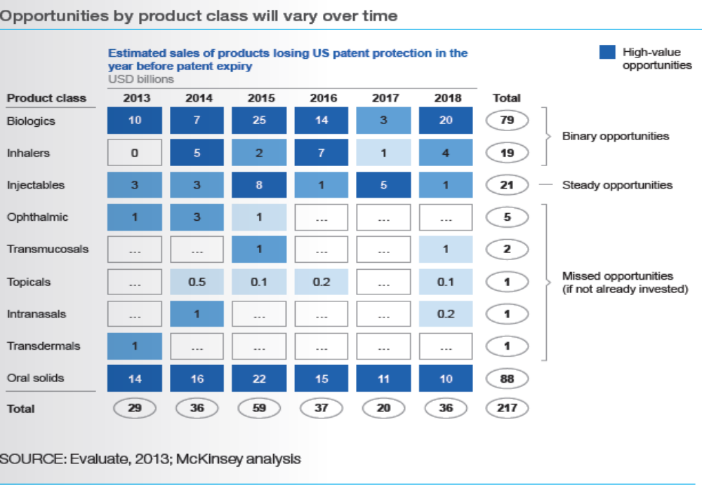
Choosing where to play

Slide 16
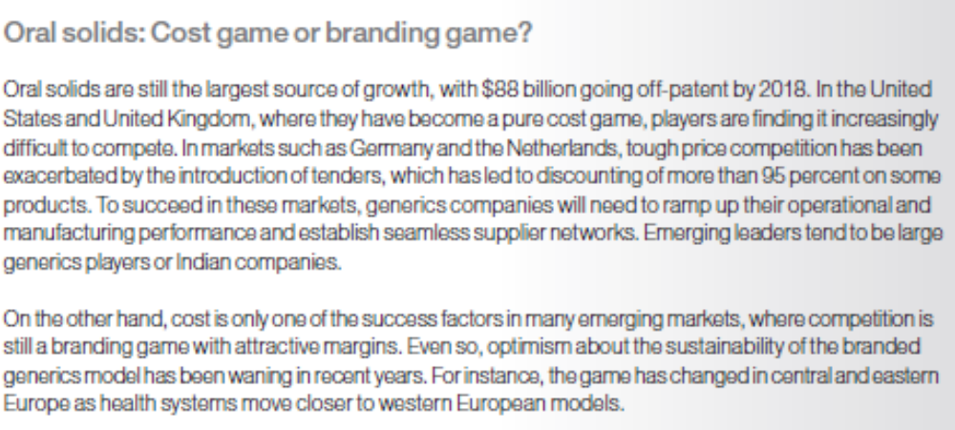
Choosing where to play

Slide 17
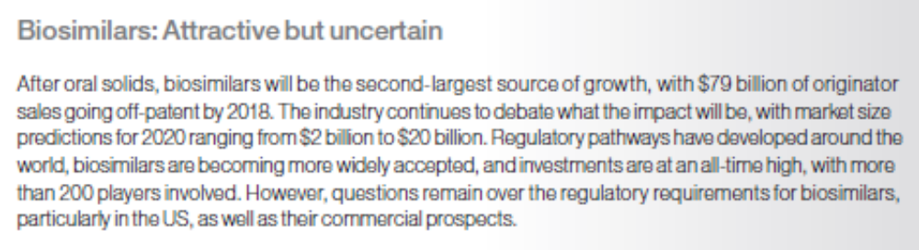
Choosing where to play

Slide 18
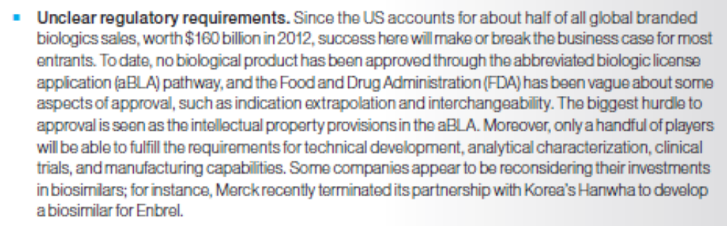
Choosing where to play

Slide 19
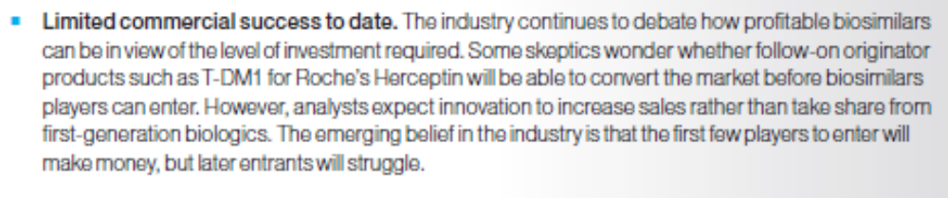
Choosing where to play

Slide 20
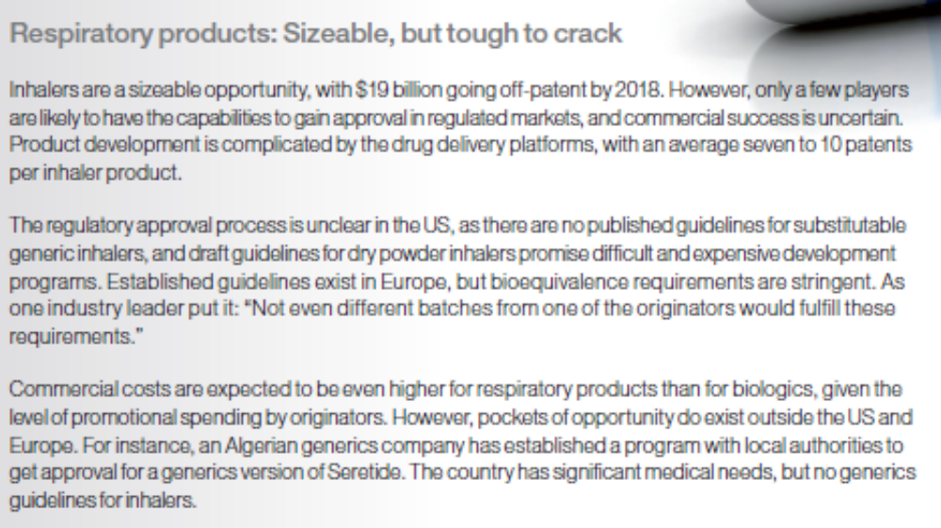
Choosing where to play

Slide 21
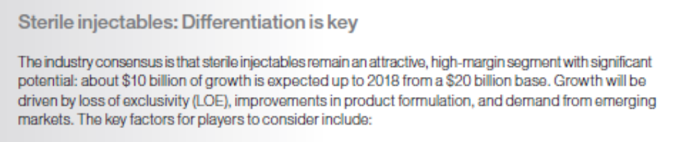
Choosing where to play

Slide 22
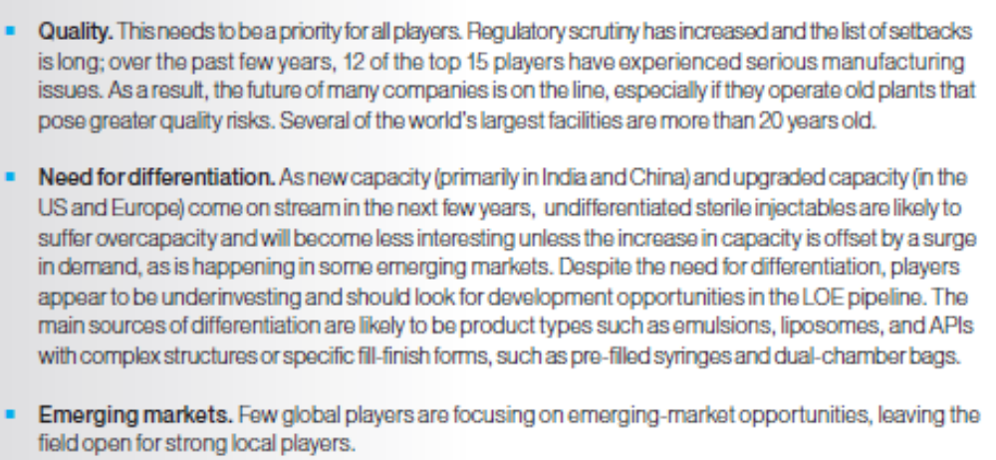
Choosing where to play

Slide 23
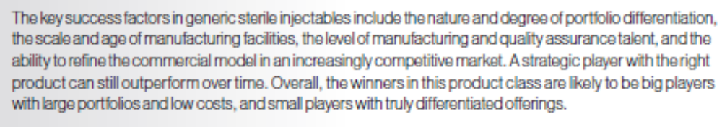
Choosing where to play

Slide 24
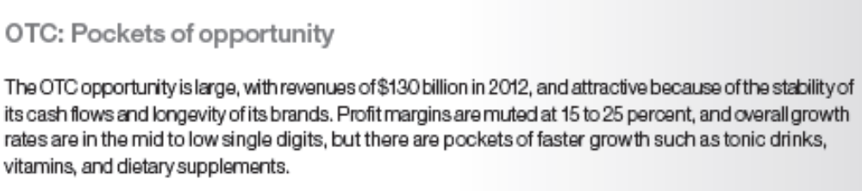
Choosing where to play

Slide 25
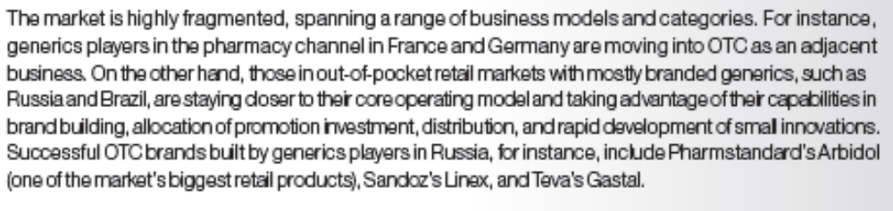
Choosing where to play

Slide 26
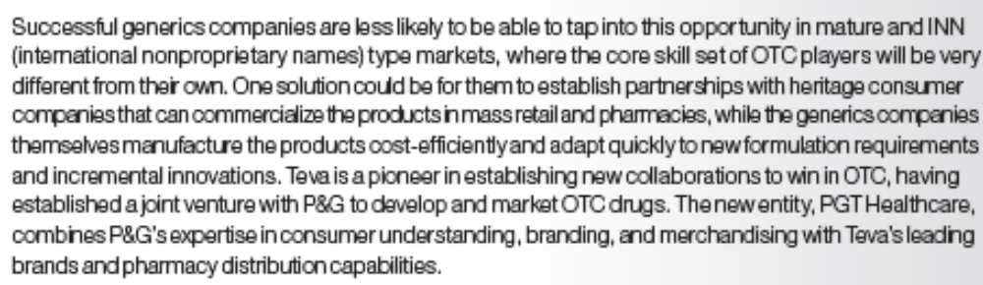
Choosing where to play

Slide 27
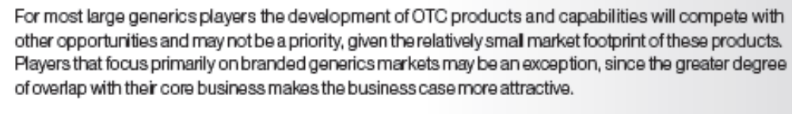
Choosing where to play

Slide 28

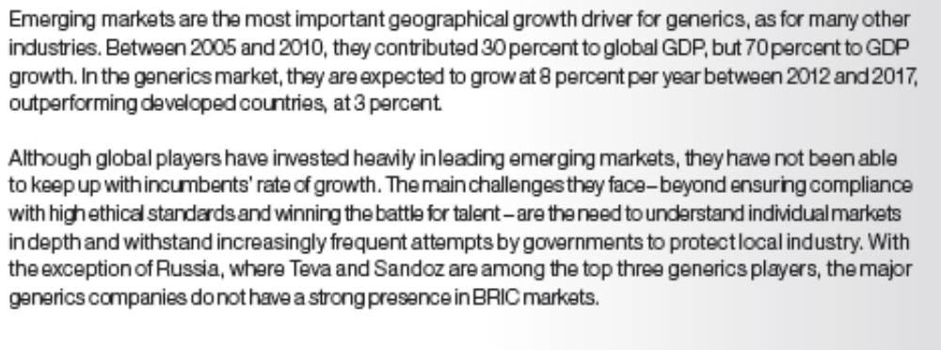

Slide 29
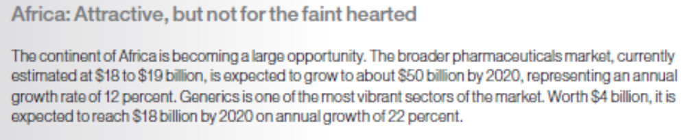

Slide 30
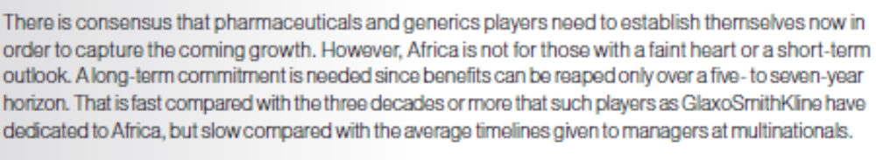

Slide 31
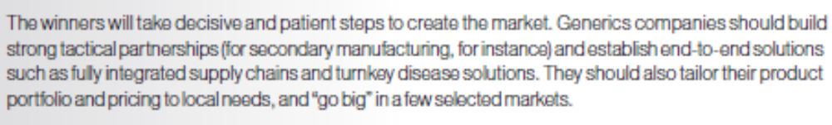

Slide 32

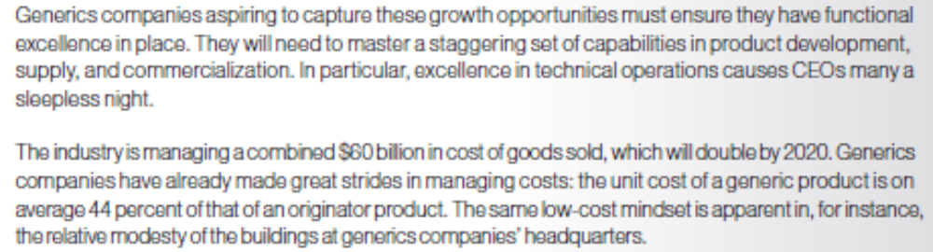

Slide 33
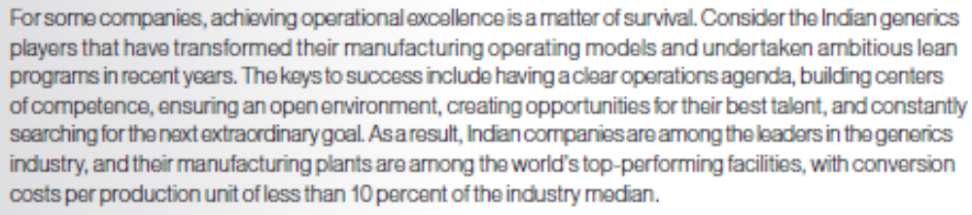

Slide 34
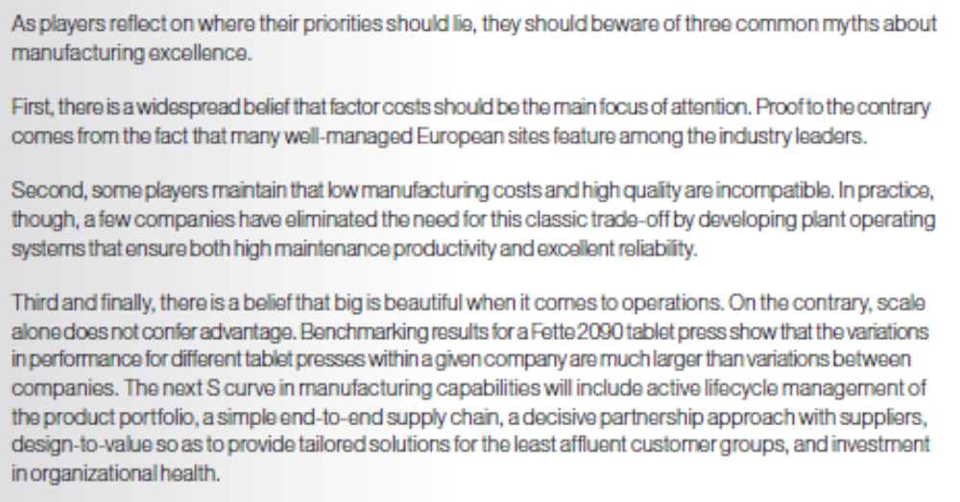

Slide 35
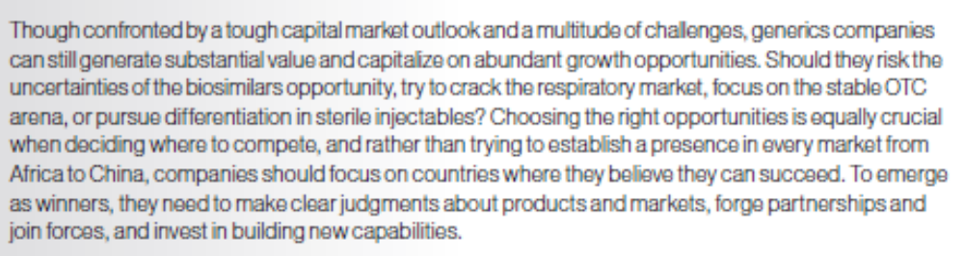

Conclusion

