Slide 1
Probiotics for the prevention of preterm labour
Dr Mohammad Othman
MB BS, PhD

Slide 2
Background
Preterm birth, defined as birth before 37 complete weeks of gestation.
Causes 60% to 80% of neonatal deaths.
Incidence 9-11%.
30-50% due to infection.

Slide 3
Evidence that infection causes preterm labour
Administration of microbial products to pregnant animals → preterm birth.
Systemic maternal infection → preterm labour.
Subclinical intrauterine infections → preterm birth.
Treatment of asymptomatic bacteriuria prevents preterm labour.
Clinical infection is increased in the infant and the mother after preterm birth.
10-15% of amniotic fluid cultures from preterm labour patients are positive for microorganisms.
(Romero 2004)

Slide 4
Antibiotics
The current recommendation is to screen and treat bacterial vaginosis and urinary tract infection in pregnancy.
Antibiotics are effective in killing pathogens as well as good bacteria (Lactobacillus species), and this increases risk of recurrent infections .
Urogenital pathogen drug resistance is on the increase.
Also, antibiotics can cause general adverse effects including palpitations, flushes, nausea, vomiting, diarrhoea, abdominal pain, rashes, headache and dizziness.

Slide 5
Probiotics
the good bacteria
Prebiotics
fiber food for the good
bacteria
Synbiotics
combined pro &pre

Slide 6
Probiotics
What are probiotics?
good bacteria (Lactobacilli)
Where are they found?
How they work?
-production of lactic acid, bacteriocin, and hydrogen peroxide
-blocking pathogen attachment to vaginal epithelium
-modulation of immunity
Are they used before?
Are they safe? WHO and FAO safe
What is the dose? 10⁹ to10¹¹ air-dried or freeze-dried bacteria

Slide 7
Cochrane Review
Othman M, Alfirevic Z, Neilson J. Probiotics for preventing preterm labour. Cochrane Database of Systematic Reviews. January 2007; Issue 1. Art. No.: CD005941. DOI: 10.1002/14651858.CD005941.pub2.
Othman M, Alfirevic Z, Neilson J. Probiotics for preventing preterm labour. Cochrane Database of Systematic Reviews. Update. August 2010; Issue 11. Art. No.: CD005941. DOI: 10.1002/14651858.CD005941.
Othman M, Alfirevic Z, Neilson J. Probiotics for preventing preterm labour. Cochrane Database of Systematic Reviews. Update. August 2012; Issue 2. Art. No.: CD005941. DOI:10.1002/14651858.CD005941.pub2.

Slide 8
Objective
To evaluate the efficacy and safety of probiotics when used to prevent preterm labor

Slide 9
Search strategy
The Cochrane Pregnancy and Childbirth Group’s Trials Register was searched.
Selection criteria
All randomised controlled trials assessing the prevention of preterm birth through the use of probiotics.
Data collection and analysis
Data was extracted using specially prepared form and analysed with the Review Manager software.

Slide 10
Outcomes
Primary
(1) Neonatal death or morbidity
(2) Preterm birth before 34 weeks
Secondary
(1) Preterm labour
(2) Preterm birth before 28, 32, and 37 weeks
(3) Preterm labour requiring hospital admission
(4) Genital infection
(5) Urinary tract infection
(6) Maternal side-effects
(7) Women's experiences and views

Slide 11
465Papers
From Cochrane
Search co-ordinator
7RCT’s
? Eligible
2 ongoing
Bocking 2005
Krauss-Silva 2006
2 excluded
Thiagarajan 1998
Shadid 2007
3 included
Nishijima 2005
Neri 1993
403 trials
Excluded
Probiotics not
In pregnancy
55 papers
Excluded
reviews
Luoto 2010

Slide 12
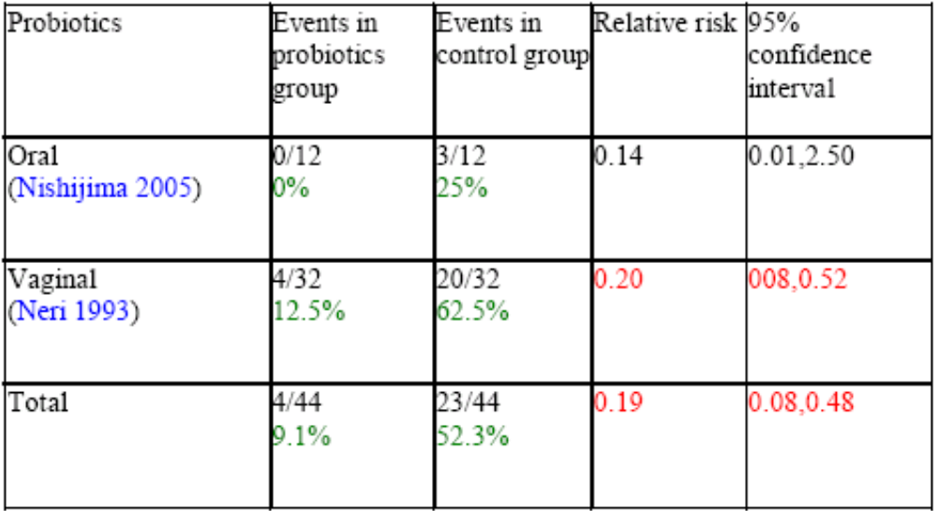
Genital infection outcome

Slide 13
Preterm birth before 34 weeks
Probiotics | Events in probiotics group | Events in Control group | Relative risk | 95% confidence interval
Oral (Luoto 2010) | 0/80 | 1/158 | 0.65 | 0.03, 15.88
Total | 0/80 | 1/158 | 0.65 | 0.03, 15.88

Slide 14
Conclusions
The use of probiotics appears to treat vaginal infections in pregnancy.
There are currently insufficient data from trials to assess impact on preterm birth and its complications.
More trials needed to address the probiotics and preterm labour issue.

Slide 15
The future
Probiotics for preventing preterm labour in high risk patients; randomised controlled clinical trial
Othman M. ProB Trial: Probiotics and the Prevention of Preterm Labour; A Randomised Controlled Trial Protocol. WebMed Central Obstetrics and Gynaecology 2012;3(6):WMC003535

Slide 16
Thank you

