Slide 1

Role of Vitamin D receptor (VDR) in HIV induced tubular injury
Mohammad Husain
Department of Biotechnology, Jamia Millia Islamia
New Delhi
07/10/2015

Slide 2
INTRODUCTION
  Vitamin D is technically not a Vitamin; rather, a prohormone produced photo chemically in the skin from 7- dehydrocholestrol.
  Expression and nuclear activation of Vitamin D Receptor (VDR) is necessary for the effects of VIT D.
  VDR tissue distribution and cellular localization has been reported in almost every organ.
  VDR regulates the expression of approximately >500 of the 20488 genes in human genome.

Slide 3
Biological actions of 1α 25 (OH)2 D3 through VDR
Functions as a pluripotent hormone in different arenas are:
  Adaptive Immune system
  Innate Immune system
  Insulin secretion by pancreatic beta cells
  Multifactorial heart functioning and Blood pressure regulation
  Reduction of Proteinuria
  Control of systemic Inflammation..

Slide 4
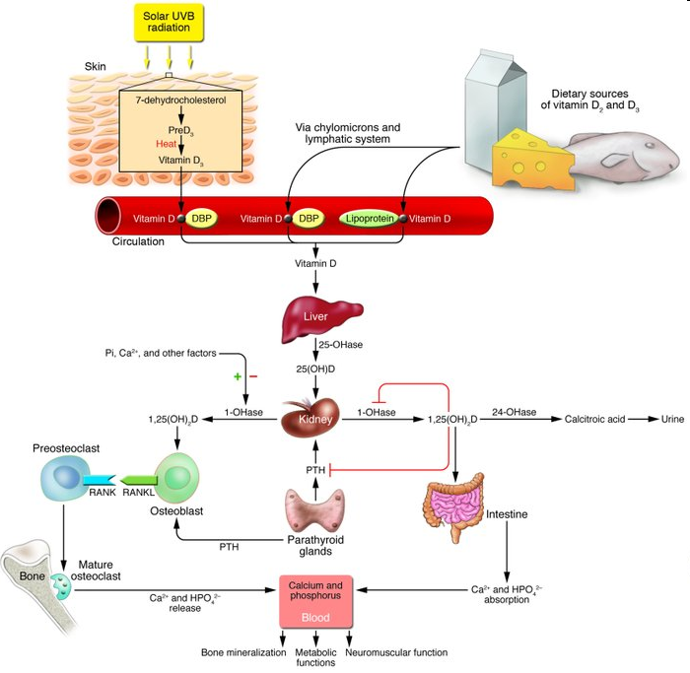
Vitamin D synthesis

Slide 5
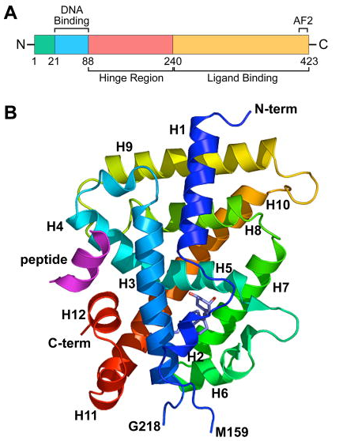
Vitamin D receptor (VDR)
A .Schematic of the VDR protein comprised of a DNA binding domain, a large ligand binding domain and a hinge region that links the two functional domain of the protein together. N, amino terminal end; C, carboxy terminal end; AF2, activation function 2. Amino acid numbers are shown.
B. Crystal structure of the VDR ligand binding domain comprised of 12 α-helices (H1–H12). The N-terminal and C-terminal portions of the molecule are shown.

Slide 6
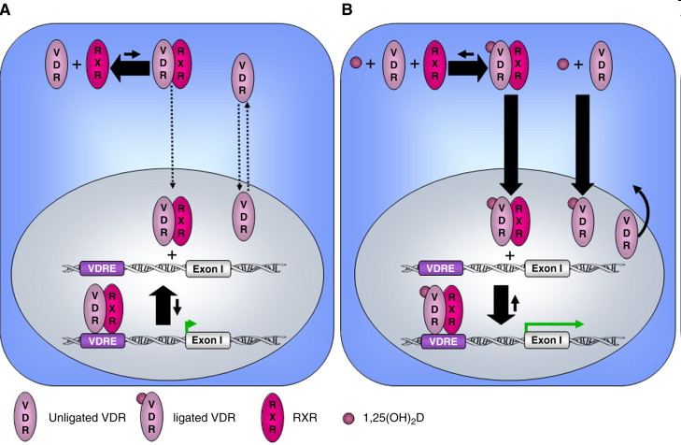
VDR - Member of a family of Nuclear steroid
hormone receptors
Intracellular organization of the VDR. In the absence of 1,25(OH)2D,
VDR shuttles between cytoplasm & nucleus.
The VDR can dimerize with RXR, but the formed heterodimer is not stable and has a low affinity for the VDRE.
This results in basal regulation of target gene transcription
Upon binding 1,25(OH)2D, VDR is activated and translocated to the nucleus
The VDR/RXR heterodimer is stabilized, giving it a high affinity for the VDRE, which results in an increased transactivation or transrepression of the genes

Slide 7
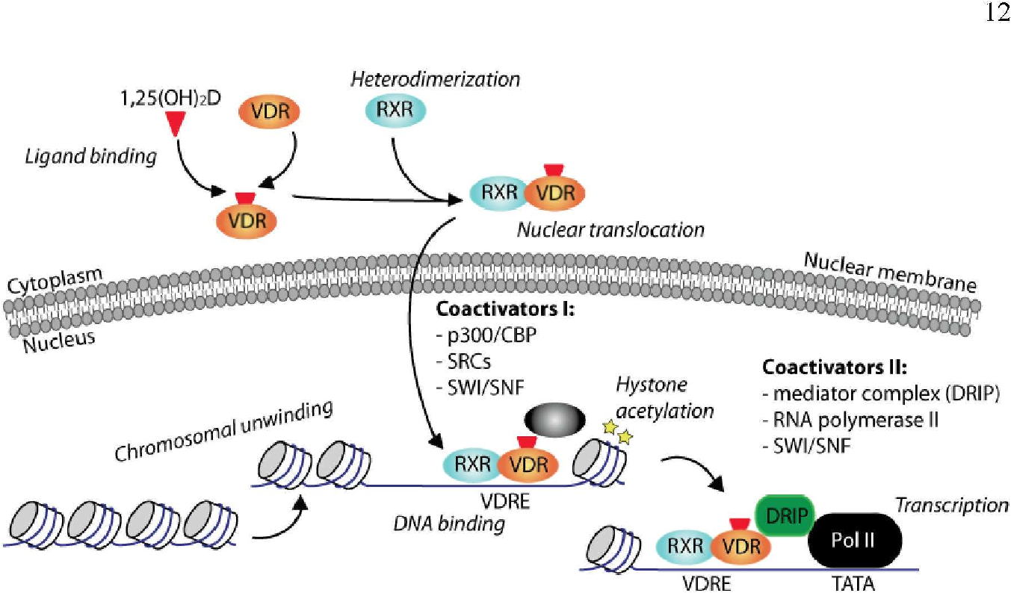

Slide 8
HIV infection and VITAMIN D deficiency
Observational studies have revealed very high low 25(OH)D levels in HIV-infected patients Could be due to :
  Traditional risk factors: Lack of UVB exposure, darker skin pigmentation.
  Antiretroviral therapy (ART)–As VIT D and PI( protease inhibitors) and NNRTI ( Non Nucleoside reverse transcriptase inhibitor) are metabolized by Cytochrome P 450 system.
The mechanism of HIV on VDR remains to be investigated?

Slide 9
VDR polymorphism and HIV infection susceptibility and progression
  The risk of HIV disease infection and progression has been examined in relation to the presence of a number of polymorphism in the VDR gene.
  The study by Nieto et al. and Barber et al. have examined the prevalence of mutations in a region of the VDR gene corresponding to Bsm I restriction enzyme and Fok I in relation to HIV status.
  The heterozygous genotype Bb and Ff was significantly associated to progression of AIDS and CD4 count drop to under 200/mm3

Slide 10
HIVAN
HIV-associated nephropathy (HIVAN) is a combined glomerular and tubular injury characterized by:
  Collapsing glomerulopathy (CG) with collapse of glomerular capillary structures and a striking hyperplasia of podocytes.
  Microcystic dilatation of renal tubules.
  Interstitial inflammation and fibrosis consequent to the glomerular and tubular injuries.

Slide 11
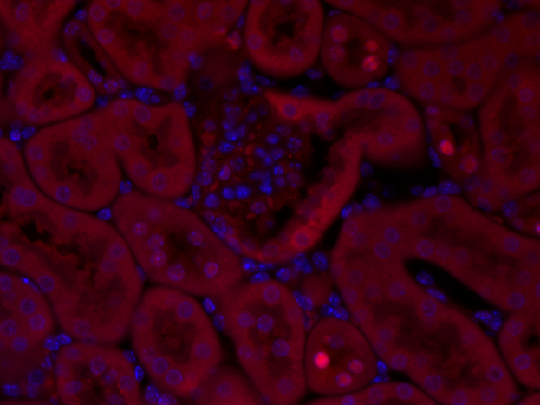
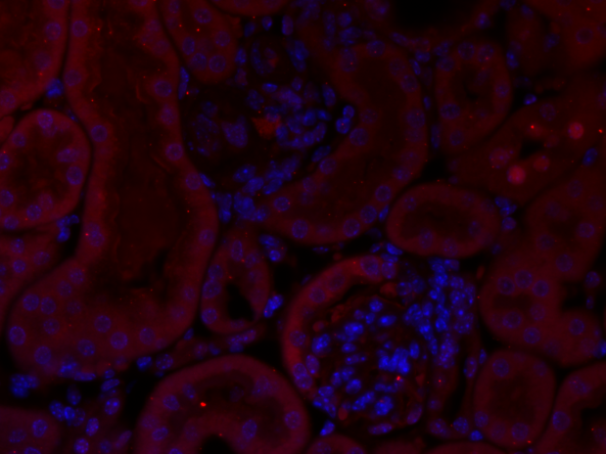
VDR expression in murine model of HIVAN(Tg26)
VDR/DAPI
Control
Tg26
  Tg26 mouse model was developed using gag/pol deleted clone of HIV-1
  to render the virus non-replicative

Slide 12
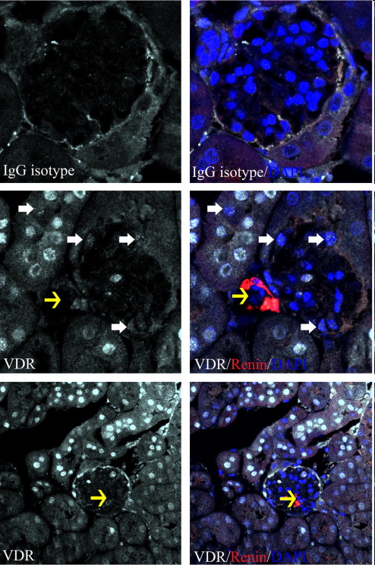
VDR localization in Kidney
VDR in mouse proximal renal Tubule, Distal tubule, Glomerulus.

Slide 13
HIV induces apoptosis
HIV has been reported to induce apoptotic phenotype in tubular cells.
Oxidative stress is involved in the induction of HIV-induced kidney cell apoptosis. It can contribute to HIV disease pathogenesis by
  Enhancing viral replication
  Increasing the inflammatory immune response
  Accelerating the loss of immune function .
HIV-1-induced overproduction of ROS, has been proposed to account for the activation of apoptosis in several cell types including tubular cells.
Role of VDR in HIV induced ROS generation in tubular cells?

Slide 14
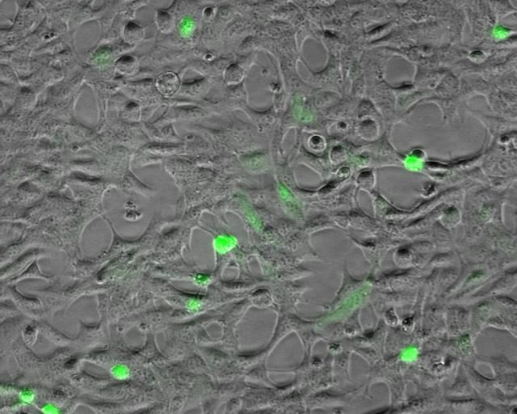
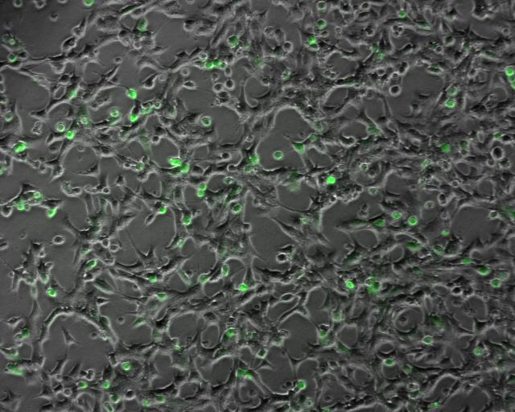
Morphological effect of HIV-1 expression on tubular cells
EV HIV

Slide 15
HIV down regulates VDR in tubular cells
VDR
Actin
C
EV
HIV
mRNA expression of VDR
VDR
Actin
0hr
4hr
6hr
12hr
18hr
24hr
TIME course of VDR down regulation with HIV
Protein expression

Slide 16
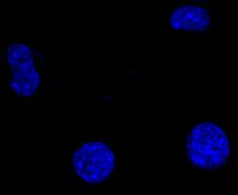
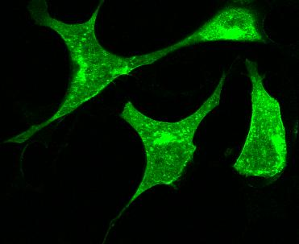
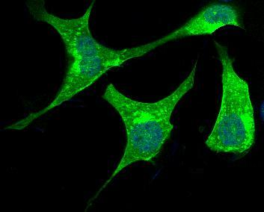
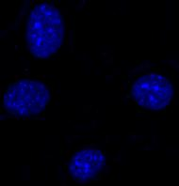
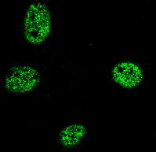
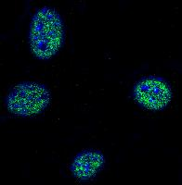
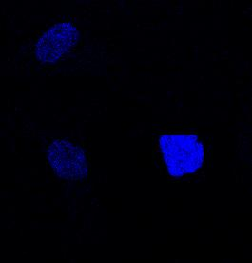
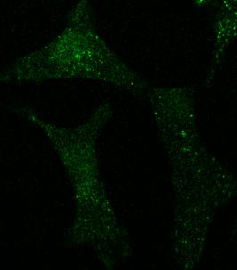
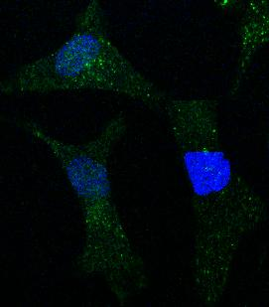
Immunofluoroscence study of VDR expression in tubular cells
DAPI
VDR
MERGED
Control
VD-A
HIV

Slide 17
Effect of VDA agonist (EB1089)
VDR
Actin
C EV HIV
C VDA
EV VDA
HIV VDA
50nm
100nm
50nm
100nm
50nm
100nm

Slide 18
HIV activates tubular cell Renin Angiotensin system
Renin
Actin
C
EV
HIV
p < 0.0131
p< 0.001

Slide 19
VDR as a negative regulator of RENIN
VDR
Renin
Actin
Cont
Cont
siRNA
VDR
siRNA
HIV
SiRNA- small interfering RNA
ANGIOTENSIN II ELISA

Slide 20
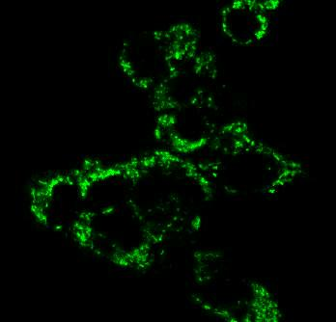
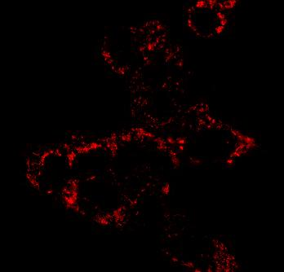
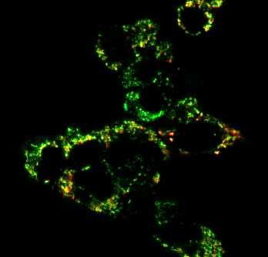
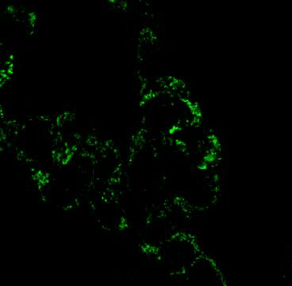
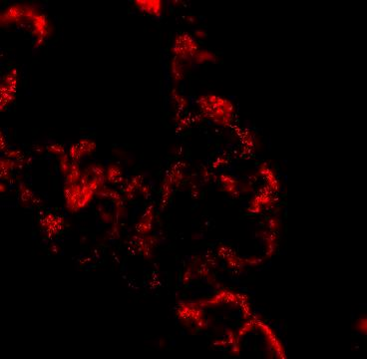
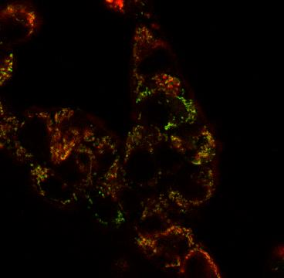
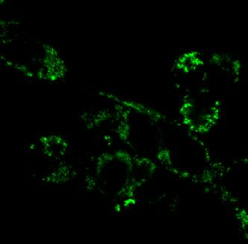
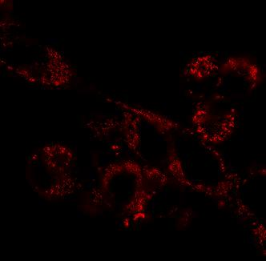
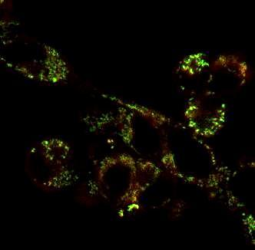
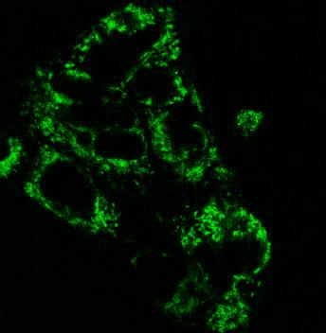
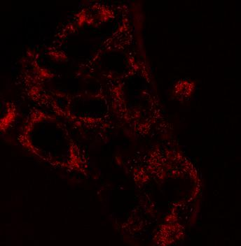
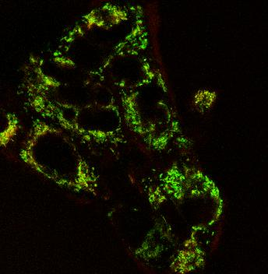
ROS generation in Mitochondria
Mitotracker green
RedCC1
Merge
EV
HIV
To determine the site of ROS in HIV milieu and its modulation by VDA and Ang II blockade, Both EV/MC and HIV/MC were treated with either buffer, VDA (50 nM), or losartan (10-7M) and then labeled with Red CC1 and MitoTracker green followed by fluorescence microscopy. HIV stimulated mitochondrial ROS generation; whereas, both VD and losartan partially inhibited HIV-induced ROS generation.
HIV+VDA
HIV+LOS

Slide 21

HOW HIV Down regulates VDR????

Slide 22
Oxidative stress / Reactive oxygen species
VDR
Actin
EV/HC HIV/HC HIV/HC + CAT
VDR
Actin
0 25 50 100 250 500
H2O2 (µM)

Slide 23
1. DNA Damage response
P-yH2ax
KU80
pyH2AX/Actin ratio
RAD51
C/HC EV/HC HIV/HC
ACTIN
C
EV
HIV
KU80/Actin ratio
KU80- Non homologous end joining protein
In G2 phase of cell cycle.
RAD51: Homologous recombination protein
In S phase of cell cycle
C/HC EV/HC HIV/HC

Slide 24
Cell Cycle arrest genes
phos-p53
p21
Phosp53/actin
Gadd45
Actin
p21/actin
C1 C2 EV1 EV2 H1 H2
p53-Tumour Suppressor gene
p21- Cyclin dependent kinase inhibitor -1
Gadd45- Growth arrest and DNA damage inducible 45 alpha
Gadd45/actin

Slide 25
2. Role of Inflammation
HIV infection induces high TNF-α state (Tumour necrosis factor)
TNF-α is associated with decreased 125(OH)2D3 levels.
(a)
TNF α
Actin
EV
HIV
(b)
VDR
Actin
C
EV
HIV
HIV
+Anti
TNFα
Ab
Anti
TNF α
Ab

Slide 26
3. EPIGENETIC Modifications
  Two changes are DNA methylation and Histone modification both of which serve to regulate gene expression without altering the underlying DNA sequence.
  DNA methylation in vertebrates typically occurs at CpG sites (cytosine-phosphate-guanine sites, that is, where a cytosine is directly followed by a guanine in the DNA sequence by DNA methyltransferase (DNMT) enzymes.

Slide 27
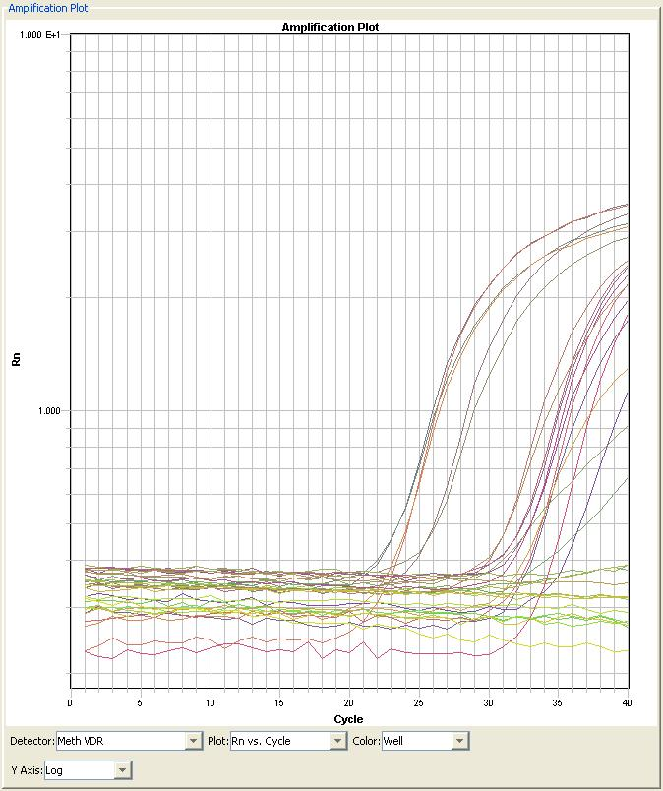
Methylation Studies
Dnmt3b
Actin
EV
HIV

Slide 28
Summary
HIV
?
AGT
TNFα
Epigenetic
modifications
Neg Regulator of transcription
VDR
Renin
ANGI
ROS Generation
ACE
ANGII
Endogenous DNA
Oxidative Damage
Double strand
DNA breaks
Apoptosis

Slide 29
THANK YOU!!

