Slide 1


Novel Method for Removal of Pb²⁺ from drinking water using Recombinant E. coli
5th World Convention on
Recycling and Waste Management
September 11-12, 2017 Singapore
Mohamed Shehata^{1, 2} and Ken-ichi Yamazaki¹
¹Laboratory of Environmental Molecular Biology, Faculty of Environmental Earth Science, Hokkaido University, Kita 10, Nishi 5, Kita-ku, Sapporo 060-0810, Japan.
²Zoology Department, Faculty of Science, Al-Azhar University, Cairo, Egypt.

Slide 2


Introduction
The recycling of drinking water is one of the crucial issues for developed and non developing countries. 663 millions of people are living without access to safe water.
WHO, 2015
Introduction Methodology Results conclusion

Slide 3
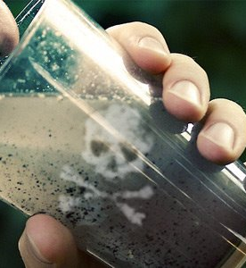
Low-quality drinking water has been cited as an important factor for many chronic and acute diseases, which affect the health and economic situation in these countries.
Hanaa et. al., ICEHM2000
Introduction Methodology Results conclusion

Slide 4
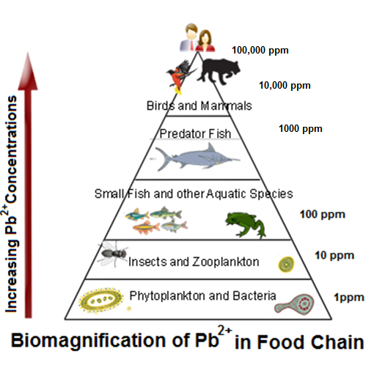
Heavy-metal pollution
Environmental pollution by metals with a high relative atomic mass, such as lead and mercury. These metals derive from a number of sources, including lead in petrol, industrial effluents, and leaching of metal ions from the soil into lakes and rivers by acid rain. They are easily incorporated into biological molecules and exert their toxic effects by displacing essential metals of a lower binding power in biologically active molecules or by acting as noncompetitive inhibitors of enzyme.
Introduction Methodology Results conclusion

Slide 5
Current methods for heavy metals removal
Physical methods
Sedimentation
Chemical methods
Chemical precipitation
Biological methods
Aerobic
Anaerobic
Screening
Filtration
Membrane separation
Coagulation
Ion exchange
Adsorption
Neutralization
Solvent extraction
Introduction Methodology Results conclusion

Slide 6
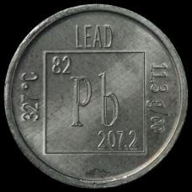
Lead (Pb) is found naturally in the environment, usually in coal and ore with other metals such as zinc, silver and copper (WHO, 2001). It is estimated that three hundred million tons of lead have been released into the environment through mining and ore processing over the last five centuries (Tong et al., 2000; Hernberg, 2000).
Lead is used in a hundreds of products, including protective equipment, petrol, paint, cabling, hair dye, computer and electrical equipment, wheel balancing weights and fishing sinkers and so on. (Gillis et. al., 2012).
The extensive use of lead has resulted in widespread human exposure to this toxic metal. There are no natural mechanisms for the breakdown of lead, and once released into the environment it persists for very long periods (WHO, 2010).
Introduction Methodology Results conclusion

Slide 7



USA Today reports they have, “Identified almost 2,000 additional water systems spanning all 50 states where testing has shown excessive levels of lead contamination over the past four years. The water systems, which reported lead levels exceeding Environmental Protection Agency standards, collectively supply water to 6 million people.”
A recent study in Ontario (Canada) found that the average concentration of lead in water actually consumed over a 1-week sampling period was in the range 1.1–30.7 µg/l, with a median level of 4.8 µg/l.
In the United Kingdom in 1975– 1976, there was virtually no lead in the drinking-water in two thirds of households, but levels were above 50 µg/l in 10% of homes in England and 33% in Scotland. In Glasgow (Scotland), where the water was known to be plumbosolvent, the lead concentration in about 40% of the samples exceeded 100 µg/l.
Introduction Methodology Results conclusion

Slide 8
Why is Lead Dangerous?
Impact of lead exposure in humans has been known to cause wide variety of health problems such as
• Various forms of blood disorders and Anemia
• Rapid deterioration of brain and the nervous system
• Reduced fertility both in men and women
• Failure of the kidney
• Alzheimer disease
In 2000, the allowable level of lead in drinking water was reduced from 0.6 ppm to 0.05 ppm. However, no level of lead is considered to be actually safe today.
Brooks et al., 2010
Introduction Methodology Results conclusion
Notes:
High concentrations of lead in the body can cause
death or permanent damage to the central nervous system, the brain, and kidneys (Jennings,
et. al., 1996). This damage commonly results in behavior and learning problems (such as
hyperactivity), memory and concentration problems, high blood pressure, hearing problems,
headaches, slowed growth, reproductive problems in men and women, digestive problems,
muscle and joint pain. Studies on lead are numerous because of its hazardous effects. Lead is
H. M. Salem et al. / ICEHM2000, Cairo University, Egypt, September, 2000, page 542- 556
552
considered the number one health threat to children, and the effects of lead poisoning can last
a lifetime. Not only does lead poisoning stunt a child’s growth, damage the nervous system,
and cause learning disabilities, but also it is now linked to crime and anti-social behavior in
children (US.G.A.O, General Accounting Office report, 2000).

Slide 9
Aim of our work
In this study, a novel method was introduced to remove Pb²⁺ from drinking water with 100% efficiency by using genetically modified bacteria.
We inserted heavy metals binding polypeptides between the signal polypeptide and β domain of Ag43 gene and transformed into DH5α E. coli cells, the new recombinant E. coli cells showed an ability to adsorb even low concentrations of Pb²⁺ from drinking water.
Introduction Methodology Results conclusion

Slide 10
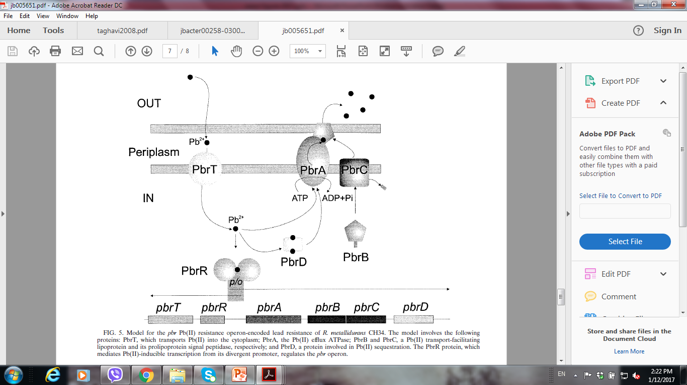
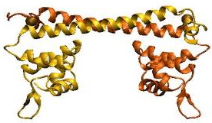
Lead Binding Protein (PbrR)
Model for the pbr Pb(II) resistance operon-encoded lead resistance of R. metallidurans CH34. BORREMANS et. al; 2001. JOURNAL OF BACTERIOLOGY, DOI: 10.1128/JB.183.19.5651–5658.2001
Introduction Methodology Results conclusion
Notes:
The model involves the following proteins: PbrT, which transports Pb(II) into the cytoplasm; PbrA, the Pb(II) efflux ATPase; PbrB and PbrC, a Pb(II) transport-facilitating lipoprotein and its prolipoprotein signal peptidase, respectively; and PbrD, a protein involved in Pb(II) sequestration. The PbrR protein, which mediates Pb(II)-inducible transcription from its divergent promoter, regulates the pbr operon.

Slide 11
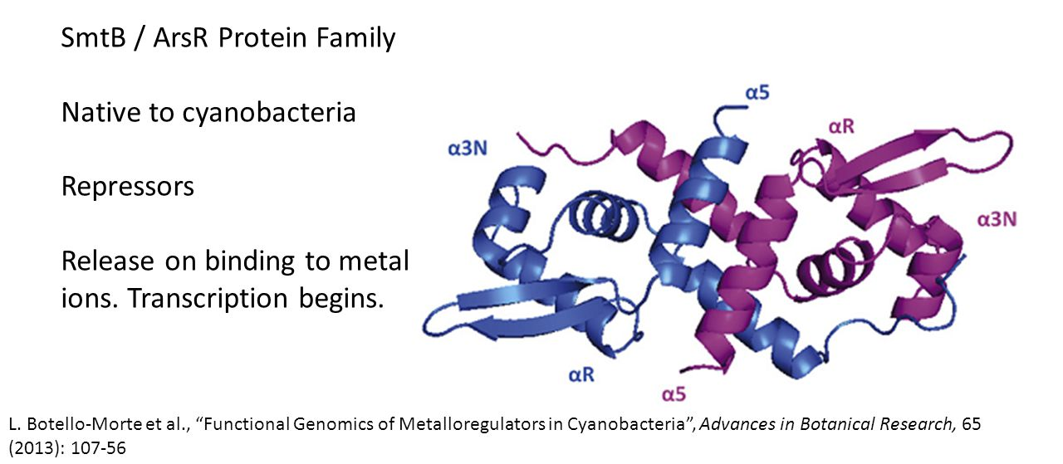
Introduction Methodology Results conclusion

Slide 12
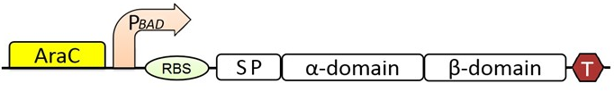
Materials and Methods
E. Coli expressing wild type Ag43
Introduction Methodology Results conclusion

Slide 13
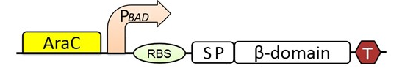
Materials and Methods
E. Coli expressing Autotransporter (AT)
Introduction Methodology Results conclusion

Slide 14
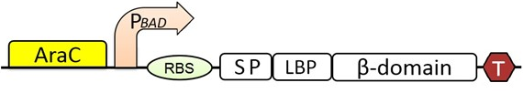
Materials and Methods
E. Coli expressing PbrR (LBP-AT)
Introduction Methodology Results conclusion

Slide 15

Materials and Methods
E. Coli expressing SmtB (MT-AT)
Introduction Methodology Results conclusion

Slide 16
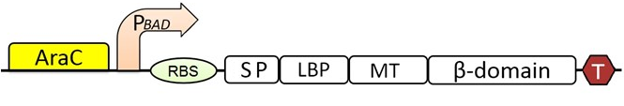
Materials and Methods
E. Coli expressing SmtB & PbrR (LBP/MT-AT)
Introduction Methodology Results conclusion

Slide 17
Possible applications
Incubation with shaking
Introduction Methodology Results conclusion

Slide 18
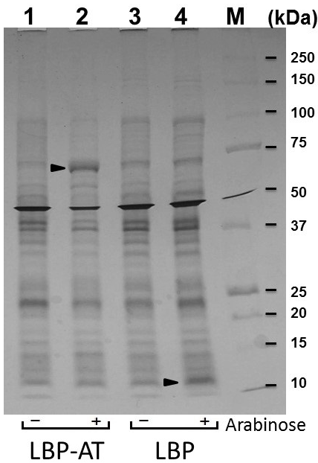
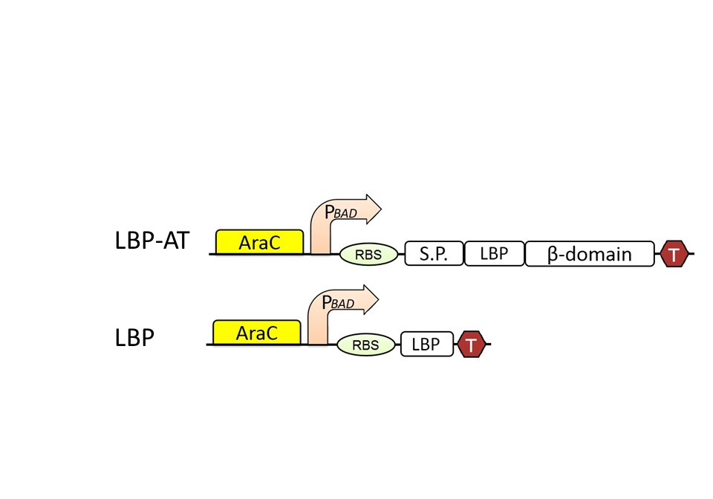
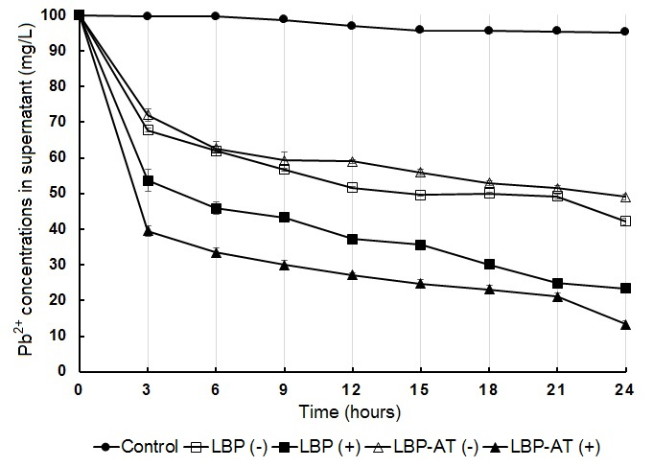
Constructs and expression of genes encoding recombinant lead binding proteins.
Introduction Methodology Results conclusion

Slide 19
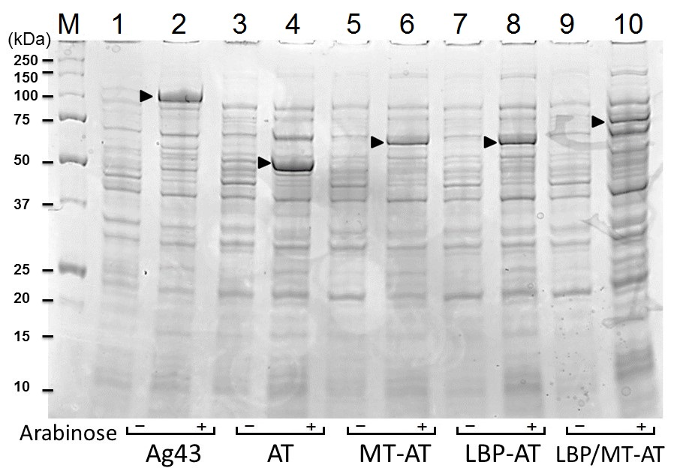
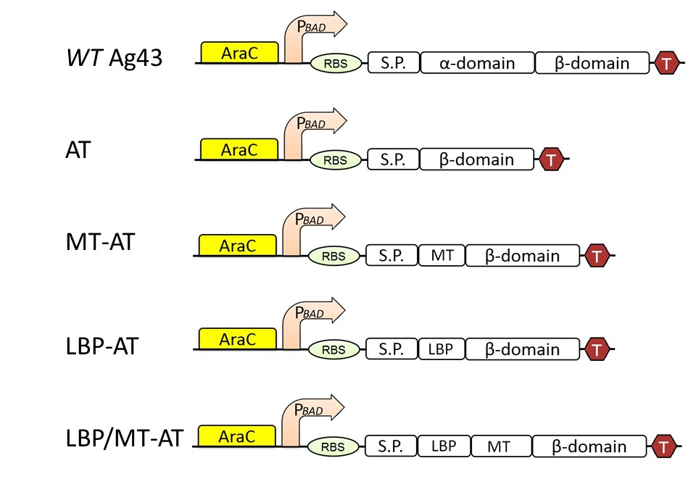
Constructs and expression of genes encoding Lead Binding protein and Metallothionein.
Introduction Methodology Results conclusion

Slide 20
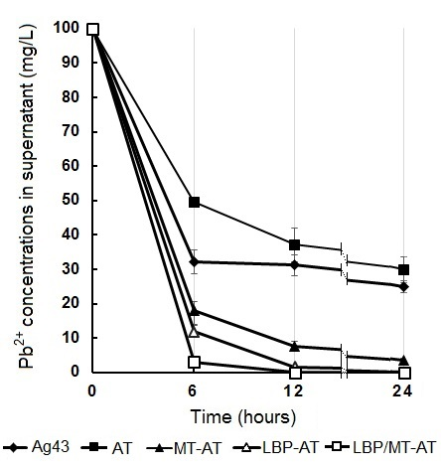
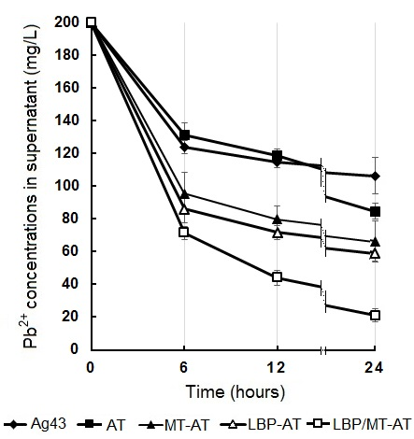
Results of reduction of Pb2+ concentrations in supernatant of Pb2+ contaminated water
Introduction Methodology Results conclusion

Slide 21
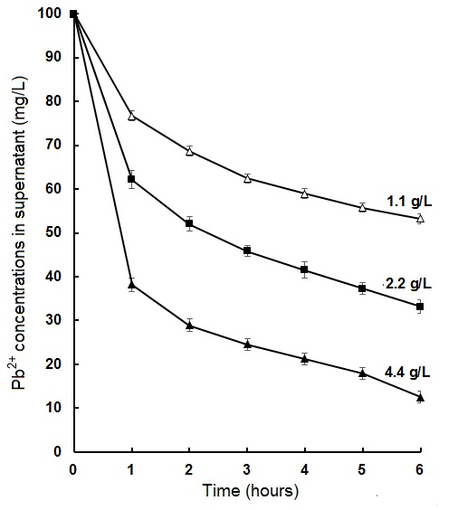
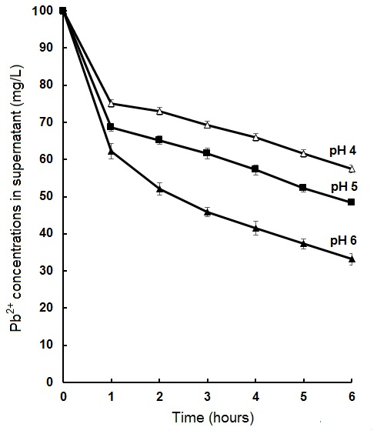
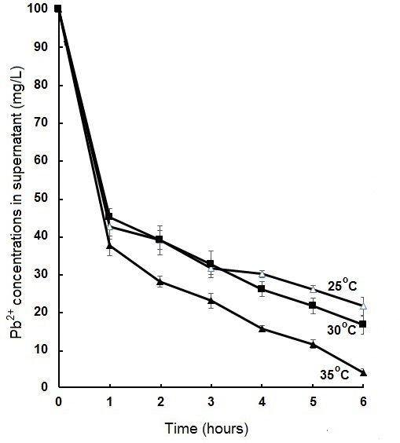
Effect of
Studding the optimum conditions for increasing the efficiency of adsorption
1- Temperature
2- pH
3- Amount of adsorbent
Introduction Methodology Results conclusion
Notes:
variables are proportional

Slide 22
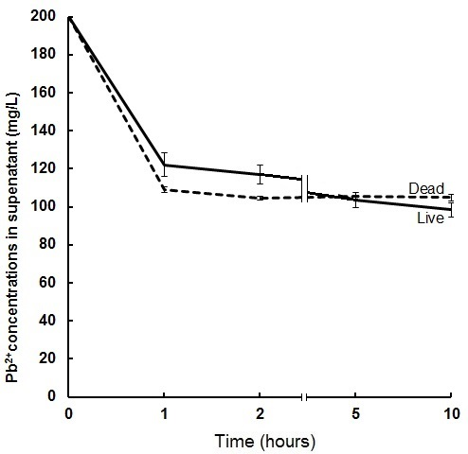
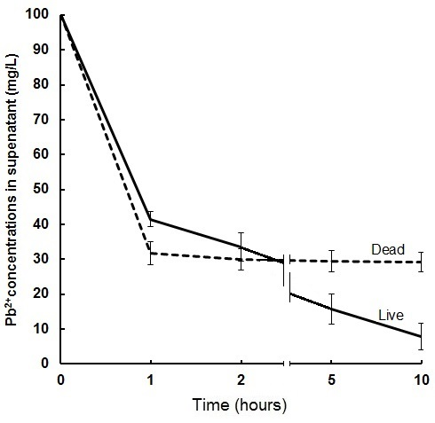


Effect of heat treatment of E.coli Cells
Introduction Methodology Results conclusion

Slide 23
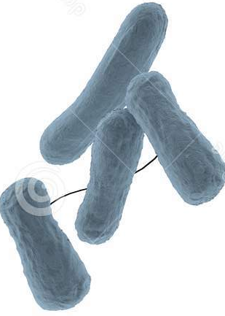

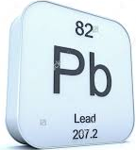
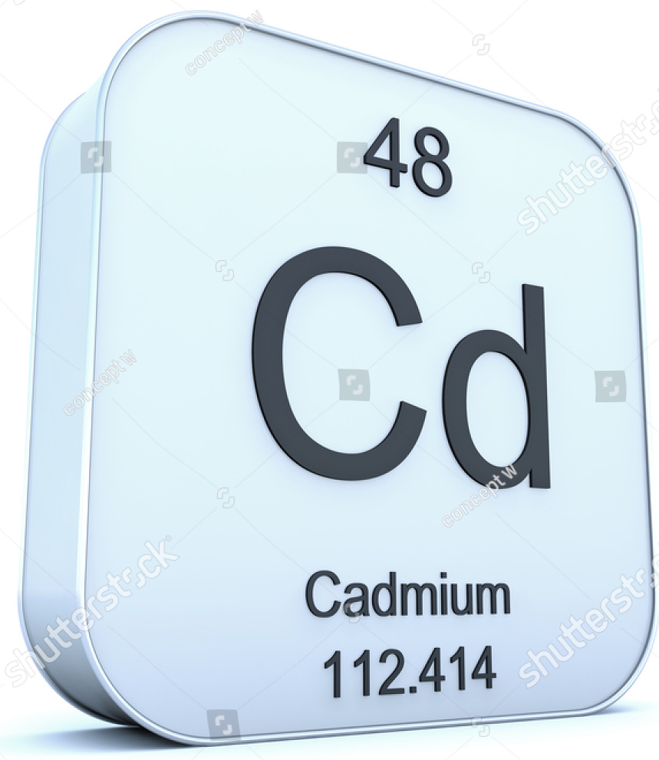
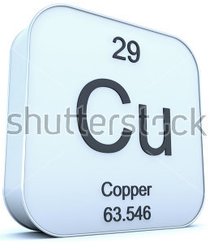
Selective adsorption of heavy metal ions (Pb2+, Cd2+ and Cu2+)
Introduction Methodology Results conclusion

Slide 24
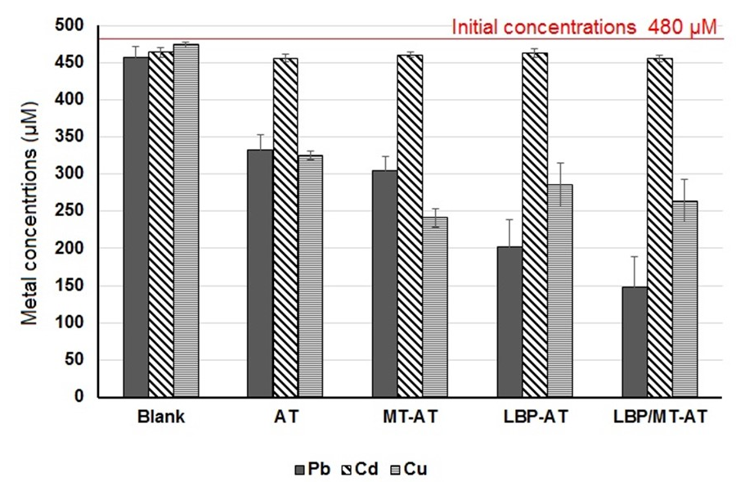
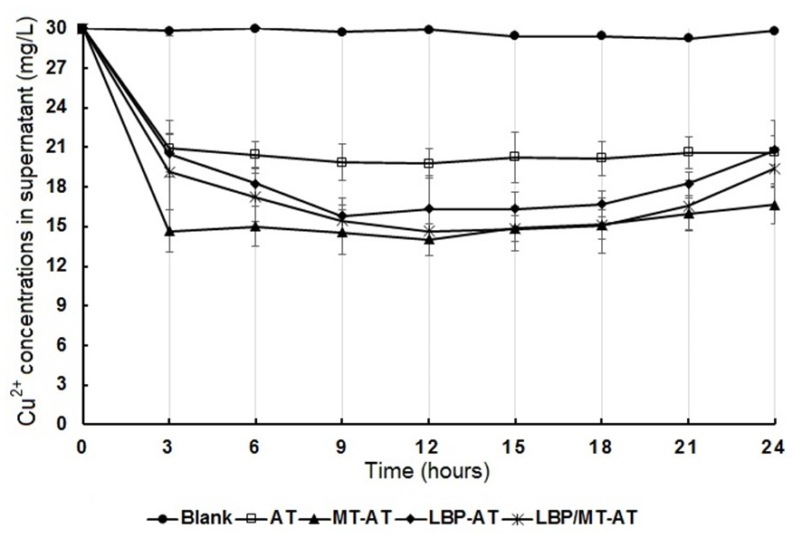
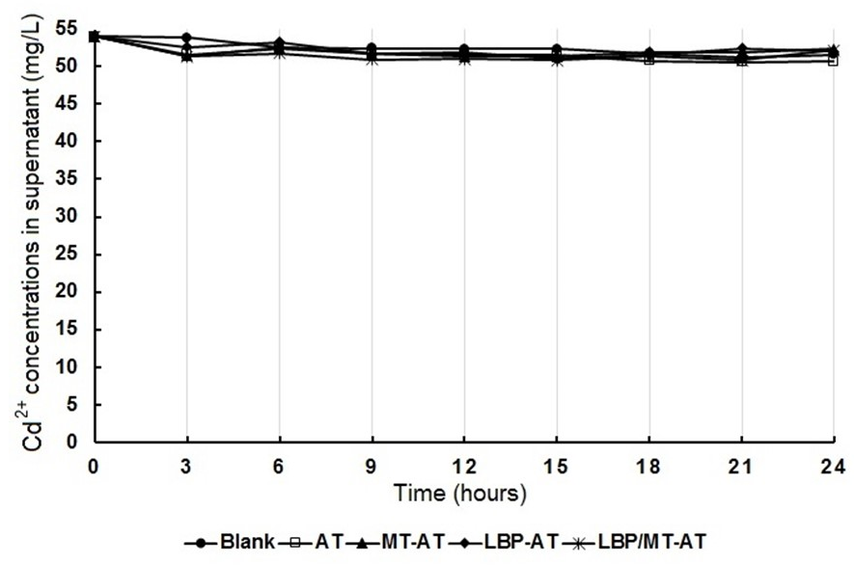
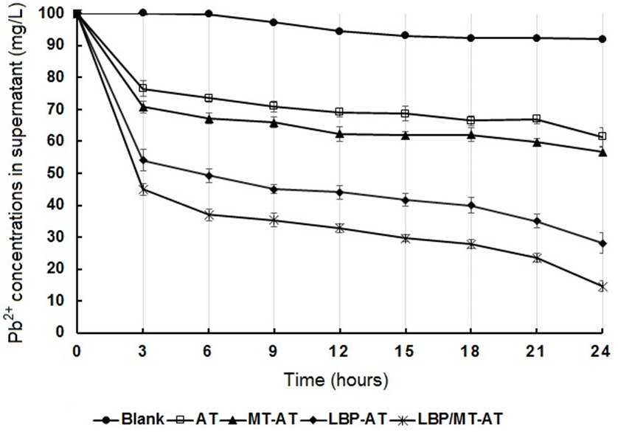
Selective adsorption of heavy metal ions (Pb2+, Cd2+ and Cu2+)
Introduction Methodology Results conclusion

Slide 25
Conclusion
The insertions of MT and LBP into autotransporter system of Ag43 increase the ability of E. coli to accumulate Pb²⁺ from circumstance.
The results of removal efficiency of MT and LBP indicate that, the ability of LBP to adsorb Pb²⁺ is higher than ability of MT.
The combination of both domains (MT and LBP) into AT system, showed higher Pb²⁺ removal efficiency than existence of MT or LBP alone.
4.4 g/L of E. coli cells encode LBP/MT-AT protein adsorbed all metals with 100% efficiency after 5 hours when the initial concentrations of Pb²⁺ were 100 mg/l, that’s considered as a promising method for removing Pb²⁺ from contaminated water.
Introduction Methodology Results conclusion

Slide 26


