Slide 1


Novel Method for Removal of Pb²⁺ from drinking water using Recombinant E. coli
5th World Convention on
Recycling and Waste Management
September 11-12, 2017 Singapore
Mohamed Shehata^{1, 2} and Ken-ichi Yamazaki¹
¹Laboratory of Environmental Molecular Biology, Faculty of Environmental Earth Science, Hokkaido University, Kita 10, Nishi 5, Kita-ku, Sapporo 060-0810, Japan.
²Zoology Department, Faculty of Science, Al-Azhar University, Cairo, Egypt.

Slide 2


Introduction
The recycling of drinking water is one of the crucial issues for developed and non developing countries. 663 millions of people are living without access to safe water.

Slide 3
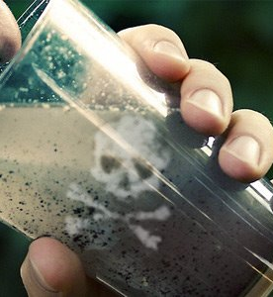
Low-quality drinking water has been cited as an important factor for many chronic and acute diseases, which affect the health and economic situation in these countries.

Slide 4
Current methods for heavy metals removal
Physical methods
Sedimentation
Chemical methods
Chemical precipitation
Biological methods
Aerobic
Anaerobic
Screening
Filtration
Membrane separation
Coagulation
Ion exchange
Adsorption
Neutralization
Solvent extraction

Slide 5
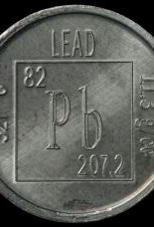
Lead (Pb) is found naturally in the environment, usually in coal and ore with other metals such as zinc, silver and copper (WHO, 2001). It is estimated that three hundred million tons of lead have been released into the environment through mining and ore processing over the last five centuries (Tong et al., 2000; Hernberg, 2000).
Lead has a very versatile substance, and it is used in literally hundreds of products, including protective equipment (for example x-ray shields and fire protection gear), petrol (as an anti-knocking agent - though this use is close to being phased out globally), paint (to increase durability of the pigment and speed up drying), cabling, ammunition, jewellery, hair dye, computer and electrical equipment, wheel balancing weights and fishing sinkers.
The extensive use of lead has resulted in widespread human exposure to this toxic
metal. There are no natural mechanisms for the breakdown of lead, and once
released into the environment it persists for very long periods (WHO, 2010).

Slide 6



USA Today reports they have, “Identified almost 2,000 additional water systems spanning all 50 states where testing has shown excessive levels of lead contamination over the past four years. The water systems, which reported lead levels exceeding Environmental Protection Agency standards, collectively supply water to 6 million people.”
A recent study in Ontario (Canada) found that the average concentration of lead in water actually consumed over a 1-week sampling period was in the range 1.1–30.7 µg/l, with a median level of 4.8 µg/l.
In the United Kingdom in 1975– 1976, there was virtually no lead in the drinking-water in two thirds of households, but levels were above 50 µg/l in 10% of homes in England and 33% in Scotland. In Glasgow (Scotland), where the water was known to be plumbosolvent, the lead concentration in about 40% of the samples exceeded 100 µg/l.

Slide 7
Why is Lead Dangerous?
Impact of lead exposure in humans has been known to cause wide variety of health problems such as
• Various forms of blood disorders and Anemia
• Rapid deterioration of brain and the nervous system
• Reduced fertility both in men and women
• Failure of the kidney
• Alzheimer disease
In 2000, the allowable level of lead in drinking water was reduced from 0.6 ppm to 0.05 ppm. However, no level of lead is considered to be actually safe today.
Brooks et al., 2010

Slide 8
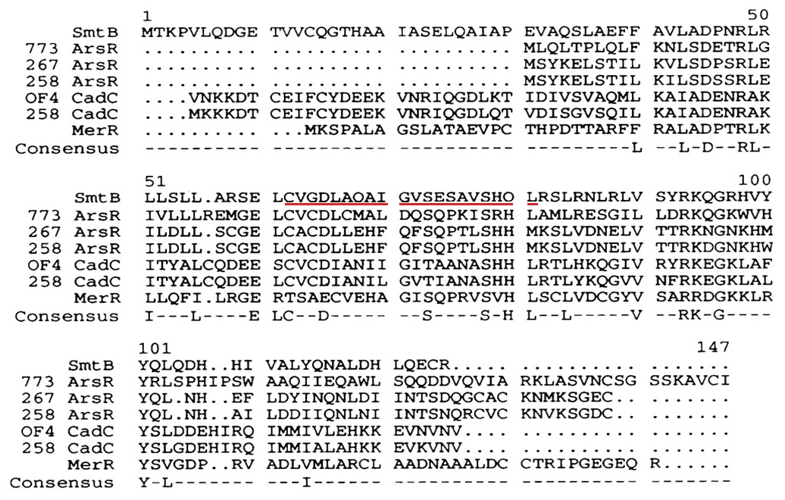
Multiple sequence alignment of SmtB from Synechococcus PCC 7942, ArsR from E. coli (plasmid R773), ArsR from Staphylococcus xylosus (plasmid pSX267), ArsR from Staphylococcus aureus (plasmid p1258), CadC from Bacillus firmus OF4, CadC from Staphylococcus aureus (plasmid pl258) and MerR from Streptomyces lividans.
A consensus sequence is shown with a plurality of 6. The putative DNA-binding region of SmtB is underlined. Anderw et. al; 1993 Nucleic Acids Research, 1993, Vol. 21, No. 4 921-925

Slide 9
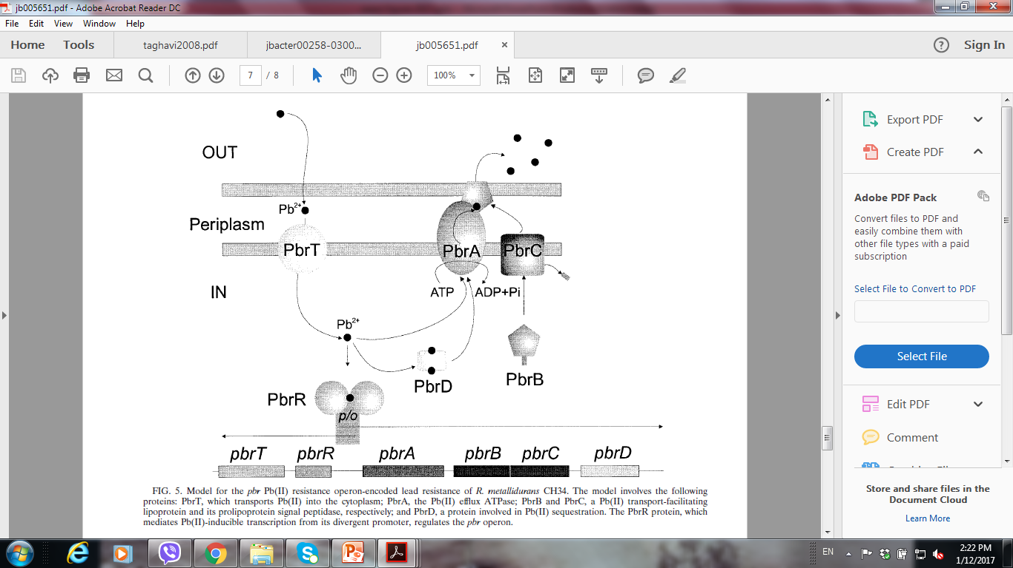
Model for the pbr Pb(II) resistance operon-encoded lead resistance of R. metallidurans CH34. The model involves the following proteins: PbrT, which transports Pb(II) into the cytoplasm; PbrA, the Pb(II) efflux ATPase; PbrB and PbrC, a Pb(II) transport-facilitating lipoprotein and its prolipoprotein signal peptidase, respectively; and PbrD, a protein involved in Pb(II) sequestration. The PbrR protein, which mediates Pb(II)-inducible transcription from its divergent promoter, regulates the pbr operon.
BORREMANS et. al; 2001. JOURNAL OF BACTERIOLOGY, DOI: 10.1128/JB.183.19.5651–5658.2001

Slide 10

Materials and Methods
E. Coli expressing wild type Ag43

Slide 11

Materials and Methods
E. Coli expressing Autotransporter (AT)

Slide 12

Materials and Methods
E. Coli expressing Metallothionein (Mt)

Slide 13

Materials and Methods
E. Coli expressing Lead Binding Protein (LBP)

Slide 14

Materials and Methods
E. Coli expressing Metallothionein (Mt) and
Lead Binding Protein (LBP)

Slide 15
Incubation with shaking

Slide 16
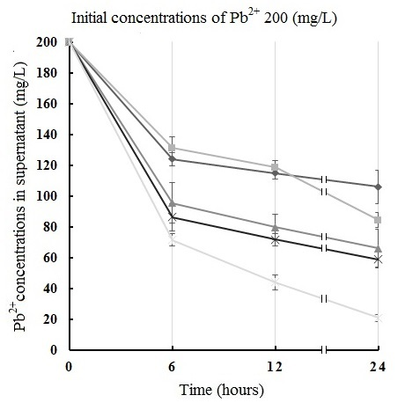
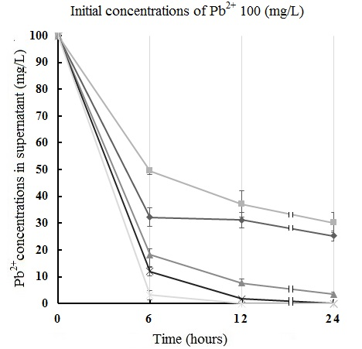
Results and Discussion

Slide 17
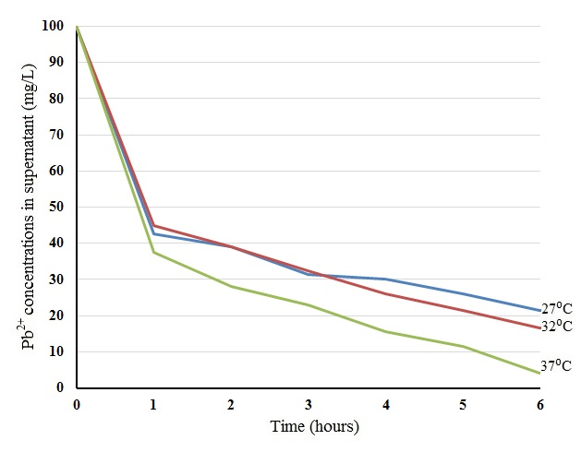
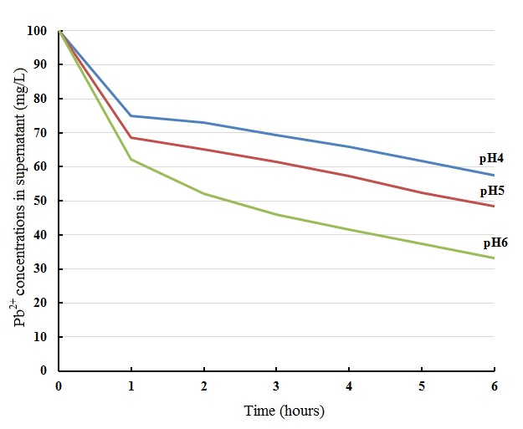
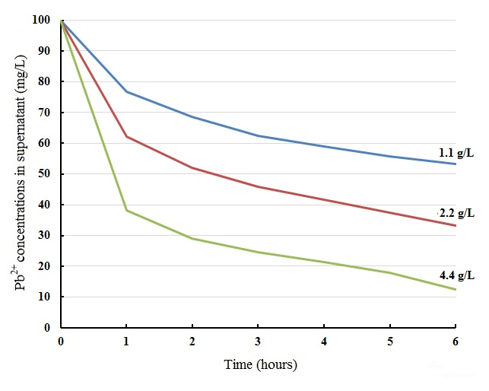
Studying the effect of
1- Temperature
2- pH
3- Amount of adsorbent

Slide 18
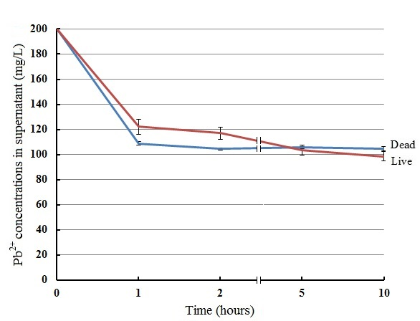
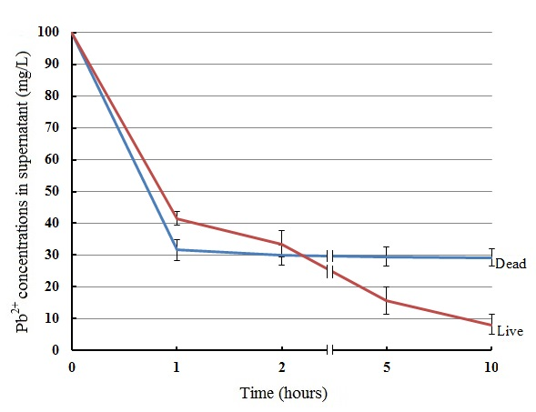
Viability of E.coli Cells

Slide 19
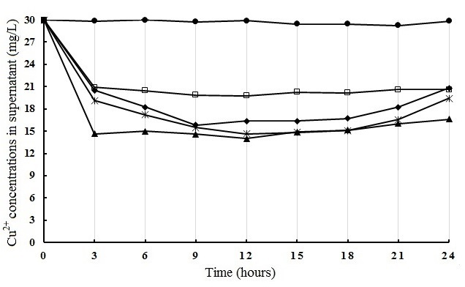
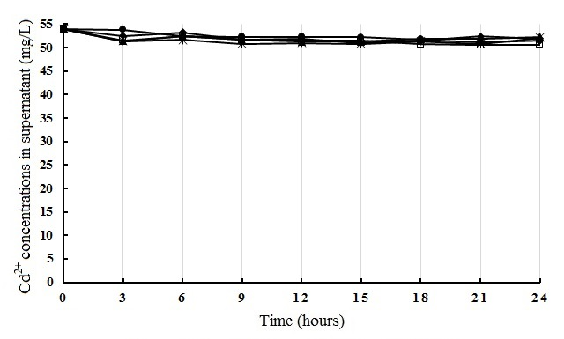
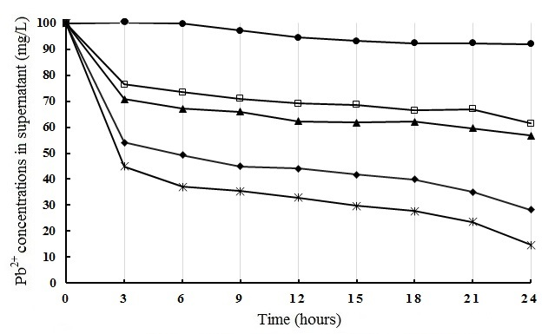
Metals Selectivity

Slide 20
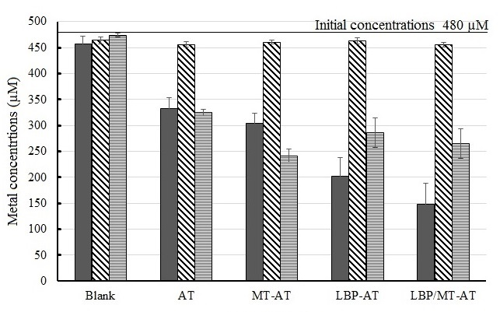
Metals Selectivity

Slide 21
Conclusion
The insertions of MT and LBP into autotransporter system of Ag43 increase the ability of E. coli to accumulate Pb²⁺ from circumstance.
The results of removal efficiency of MT and LBP indicate that, the ability of LBP to adsorb Pb²⁺ is higher than ability of MT.
The combination of both domains (MT and LBP) into AT system, showed higher Pb²⁺ removal efficiency than existence of MT or LBP alone.
4.4 g/L of E. coli cells encode LBP/MT-AT protein adsorbed all metals with 100% efficiency after 5 hours when the initial concentrations of Pb²⁺ were 100 mg/l, that’s considered as a promising method for removing Pb²⁺ from contaminated water.

Slide 22
Thank you for your attention

