Slide 1


Fibrinogen-Based Drug Delivery as a Novel Therapeutic Approach for Leukemia and Rheumatoid Arthritis
Mohamed Salah Omar
Division of Biochemistry, Department of Pharmacology,
College of Clinical Pharmacy, Taif University, Saudi Arabia
2015

Slide 2
Introduction
Methotrexate (MTX) is one of the oldest and most widely utilized chemotherapy drug.
Oncology
Hematology
Autoimmune diseases

Slide 3
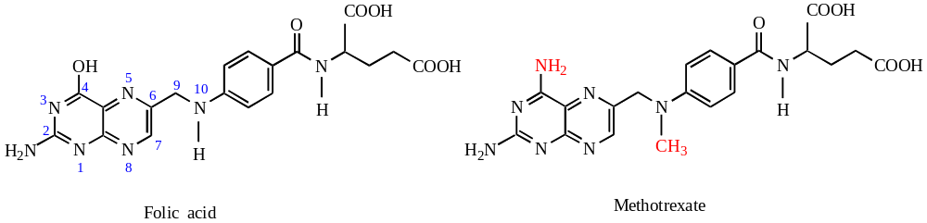
Introduction
The action of MTX relies on the fact that it is a structural analogue of folic acid.
MTX works by inhibiting enzymes used in purine and pyrimidine synthesis such as dihydrofolate reductase and thymidylate synthase.
Notes:
MTX differs from folic acid only in that a OH group in position 4 of the pteridine portion of the molecule is substituted by an NH₂ and a CH₃ group is added in position 10 of the p-amino-benzoic acid structure.
The pteridine ring in MTX serves as the active site for the molecule.

Slide 4
Introduction
The use of MTX had a limited success due to lack of potency and insufficient selectivity for tumor versus normal tissue.
The use of MTX-carrier conjugates is a frequent strategy was applied to solve this problem by altering the pharmacokinetic behavior by:
- increasing its plasma half-life
- passive targeting of MTX-carrier conjugates

Slide 5
Introduction
Coupling of MTX with various macromolecules has been extensively investigated:
fibrinogen (Goszczyński T. et al. Biochim Biophys Acta. 2013; Kanska et al. 2005; Boratynski J., et al. Cancer Letters, 2000),
albumin (Taheri A. et al. Int J Pharm. 2012),
antibodies (Majumdar S. et al. J Pharm Sci. 2012),
branched polypeptide (Koczan et al. 2002),
dextrans (Nevozhay D. et al. Anticancer Res. 2006),
gelatin (Pica K. et al., J Pharm Sci. 2006) and/or
polyethylene glycol (Riebeseel et al., 2002).

Slide 6
Aim of the study
Developing a new method of MTX conjugation to macromolecules.
Characterization and evaluation of the anti-leukemic and anti-arthritic activities of the prepared conjugates.

Slide 7
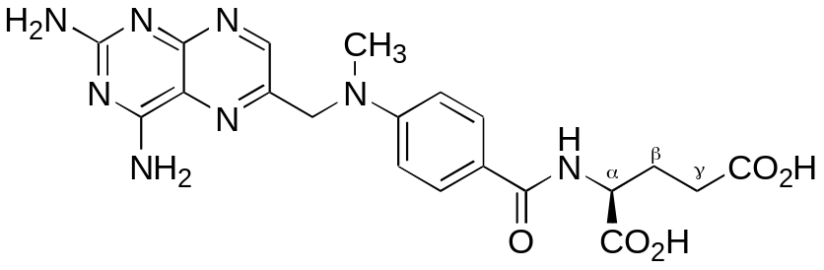
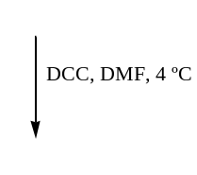


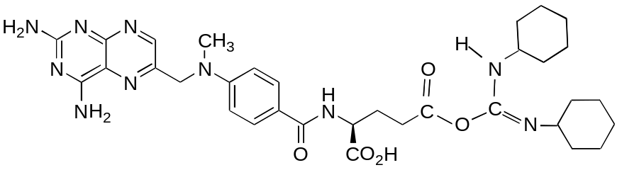
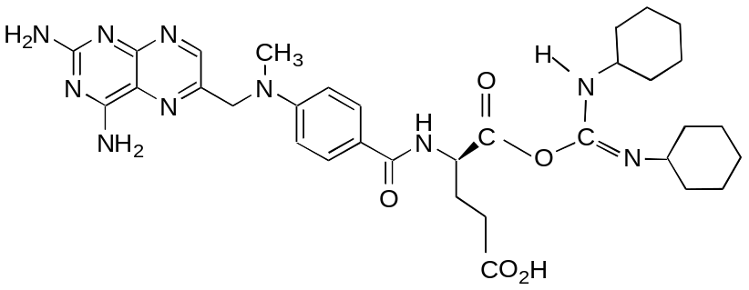


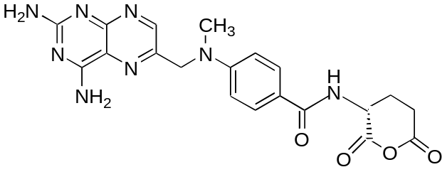
Synthesis of MTX-Protein conjugates
i) Activation of MTX.

Slide 8
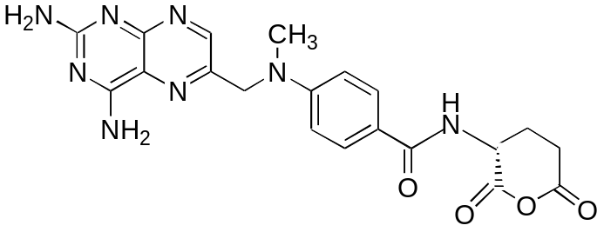
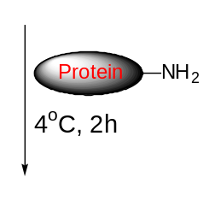
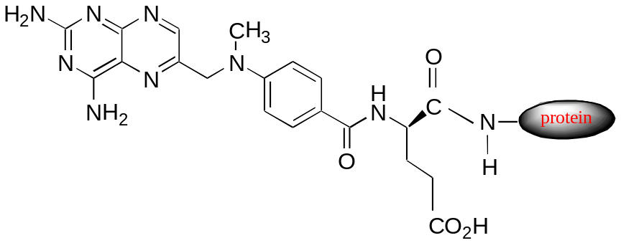
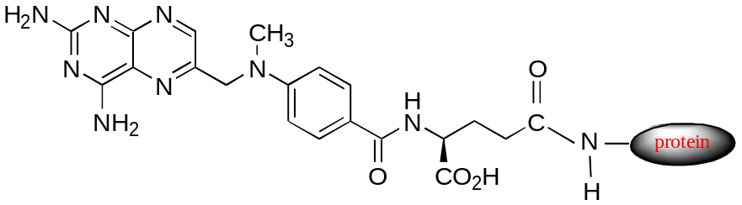

Synthesis of MTX-Protein conjugates
i) MTX anhydride method.

Slide 9
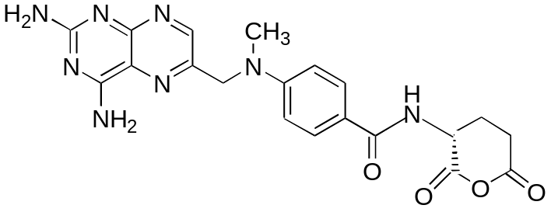
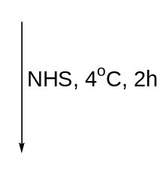
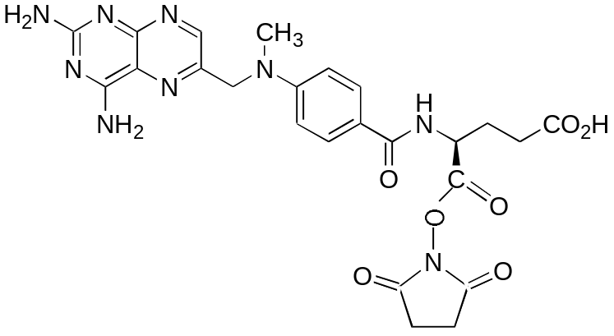
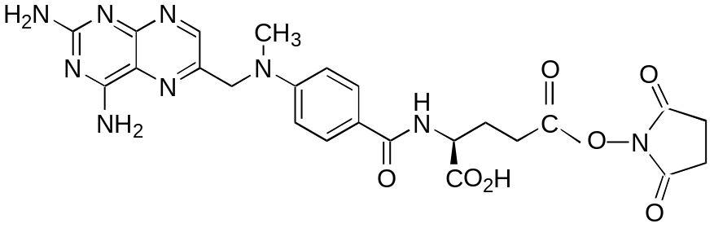
Synthesis of MTX-Protein conjugates
ii) Activation of MTX anhydride.

Slide 10
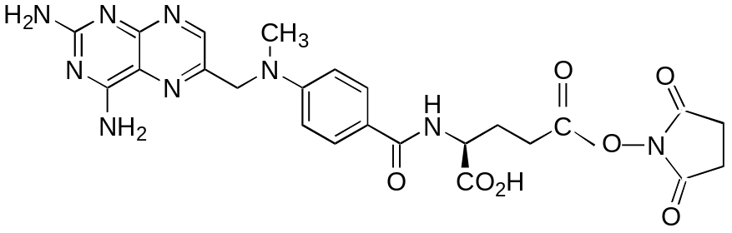
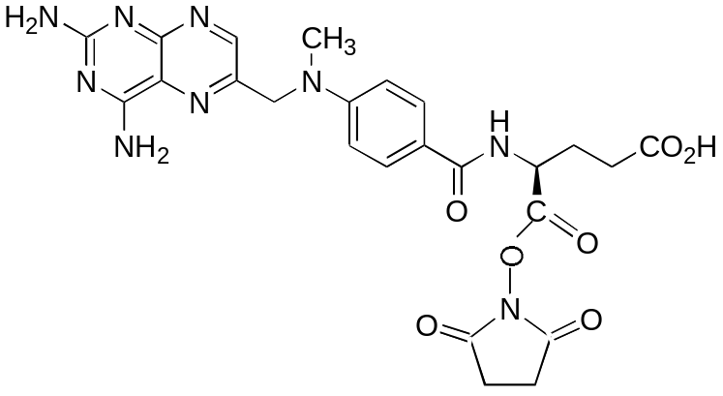

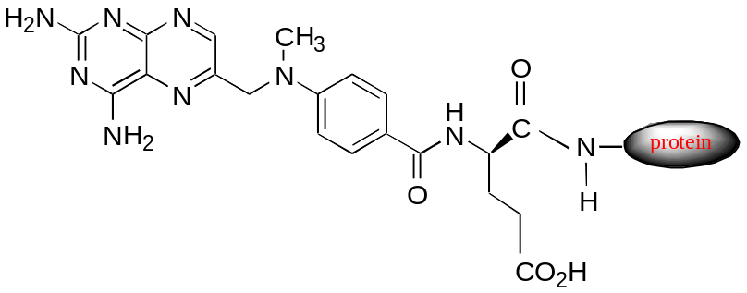

Synthesis of MTX-Protein conjugates
ii) MTX active monoester method.

Slide 11
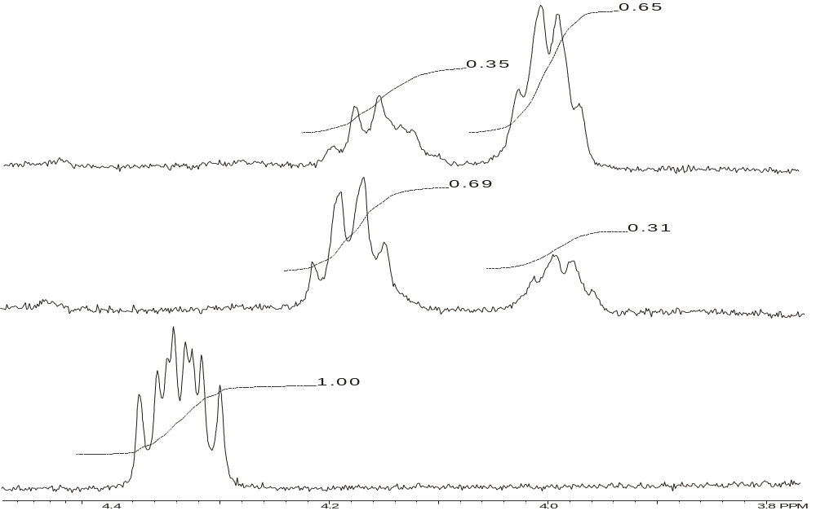
¹H NMR spectra of MTX-methylamides
α -amide isomer
γ -amide isomer
b)
b) MTX active monoester
a)
a) MTX anhydride
MTX
A mixture of 70 : 30 % α and γ- amide isomers.
30 : 70% α : γ ratios were observed for the amide isomers.
Notes:
Comparison of ¹H NMR spectra of the reaction products obtained from the reaction of MTX anhydride with methylamine (a), and its active monoesters (b) compared to MTX.

Slide 12
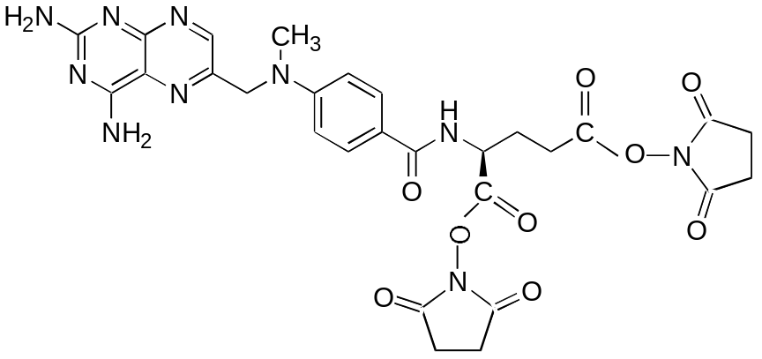
Synthesis of MTX-Protein conjugates
Old method of MTX activation Kulkarni et al. (1981).
Both MTX and NHS were incubated together, followed by the addition of DCC.
Notes:
The activated bis-derivative of MTX is unfavorable because it can lead to cross-linking of proteins in the subsequent conjugation reaction.

Slide 13
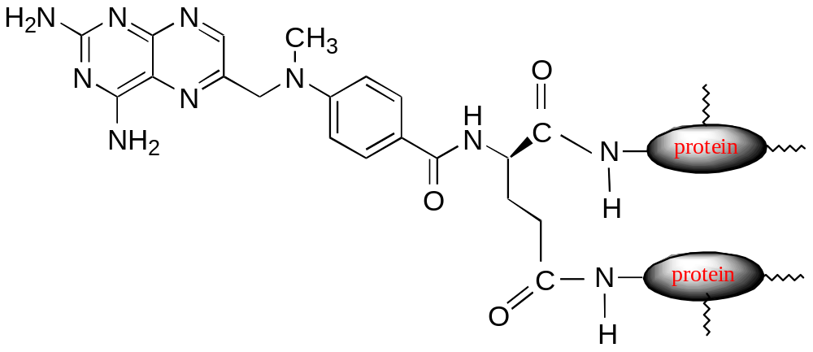
Synthesis of MTX-Protein conjugates
iii) by the use of MTX-NHS active esters.
Cross-linked protein-MTX conjugate (Boratynski J, et al.Cancer Letters, 2000)

Slide 14
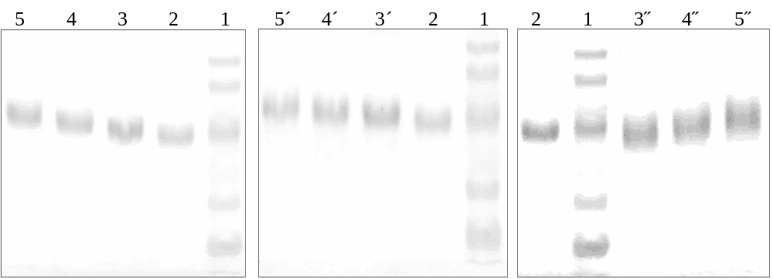
Characterization of BSA-MTX conjugates
i) SDS polyacrylamide gel electrophoresis.
b) MTX active
monoester
c) MTX active esters
a) MTX anhydride
Lane 1: standard of molecular weights (116, 97.4, 66, 45, 29 kDa); lane 2: native BSA; lanes 3, 4, 5: BSA-MTX conjugates prepared by using 0.5, 1.0, 2.5 µmoles of MTX active form with 0.0724 µmole of BSA.
Notes:
The obtained conjugates by means of a) MTX anhydride, and b) MTX active monoesters; were characterized by:
reasonable uniformity,
high purity,
lower hydrophobicity, and
the lack of cross-linking.

Slide 15
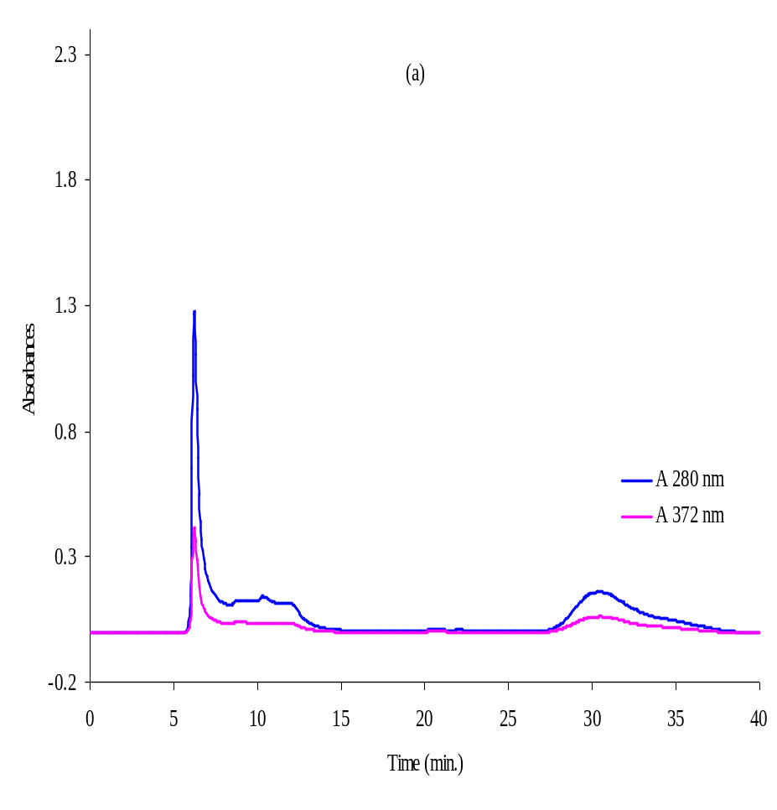
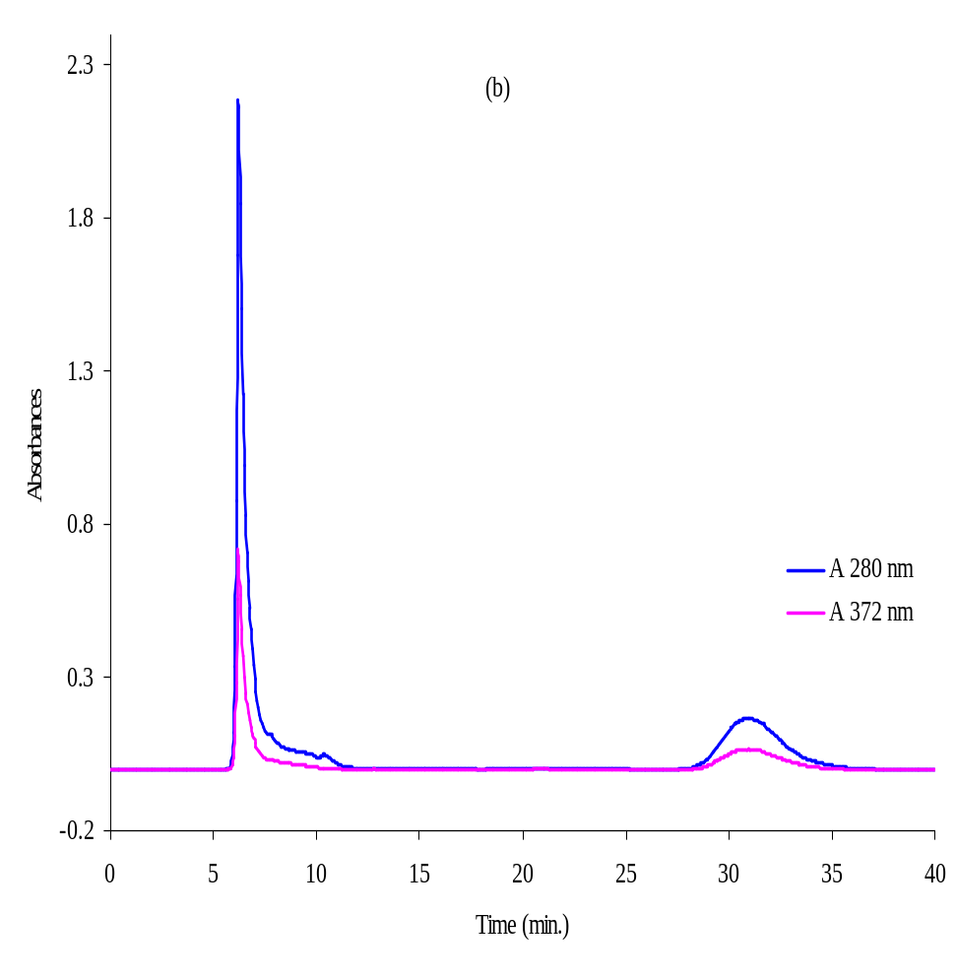
Characterization of BSA-MTX conjugates
ii) HPLC analysis of BSA-MTX conjugates prepared by MTX anhydride.
a) Low substituted
b) High substituted
Notes:
Conjugates of a certain substitution level could be prepared depending on the ratio of the carrier to MTX anhydride in the reaction mixture.

Slide 16
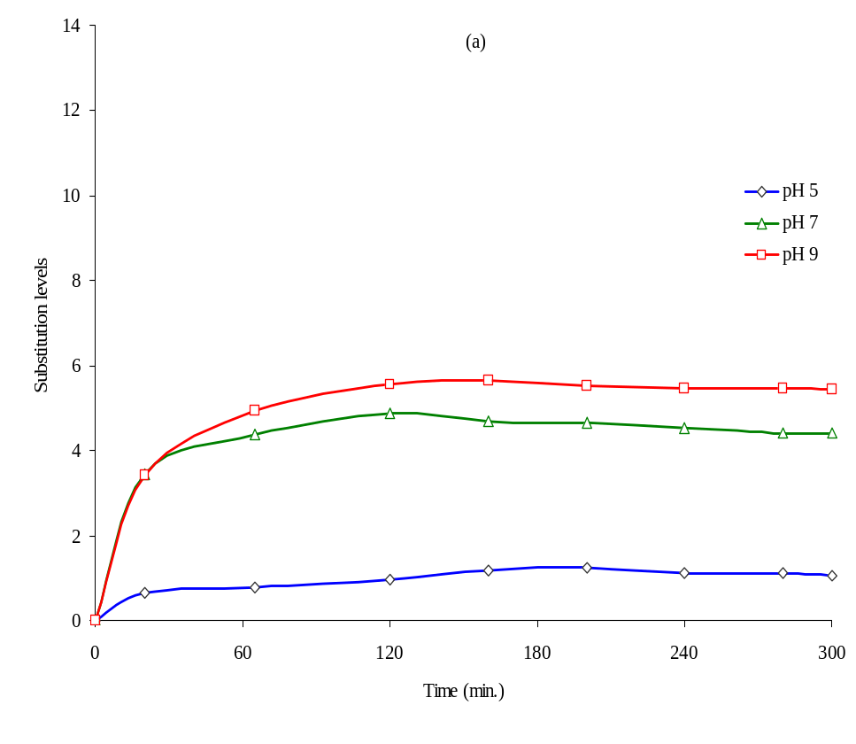
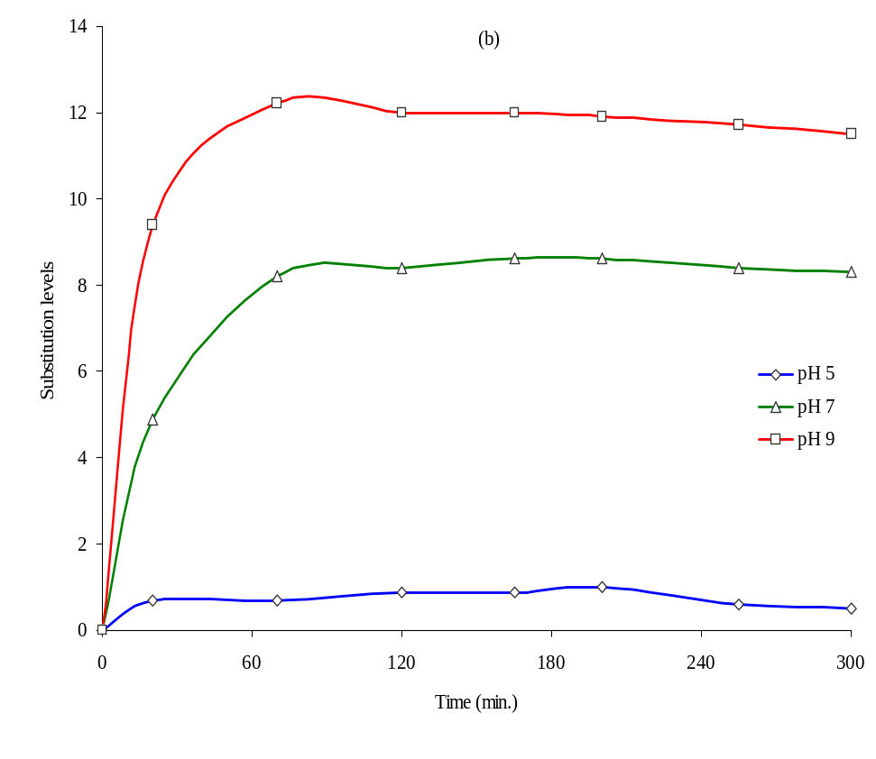
Characterization of BSA-MTX conjugates
iii) Kinetics of BSA-MTX conjugation reaction using:
a) MTX anhydride
b) MTX active monoester.
Notes:
The use of MTX active monoesters method was more effective than MTX anhydride.

Slide 17
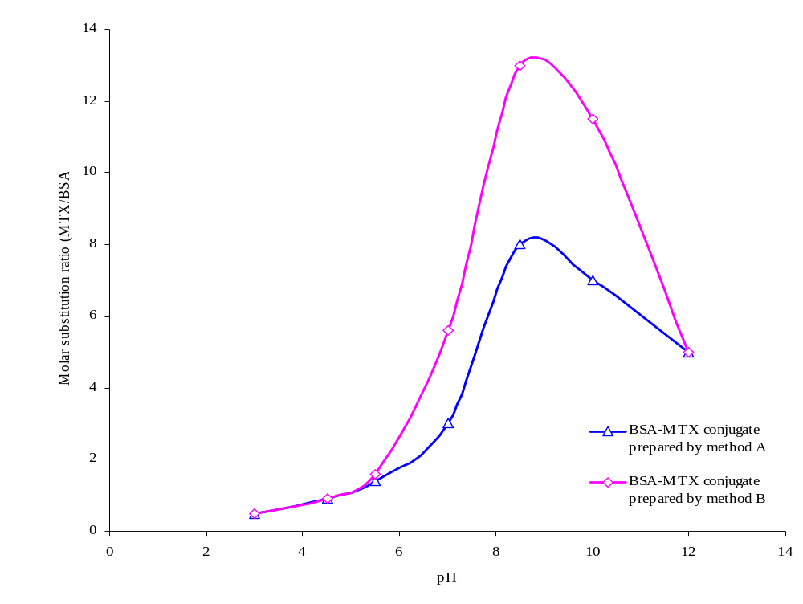
Characterization of BSA-MTX conjugates
vi) Effect of pH on the coupling reaction of BSA with:
MTX anhydride
MTX active monoester
Notes:
The highest value of substitution level was obtained at a pH=8–9.

Slide 18
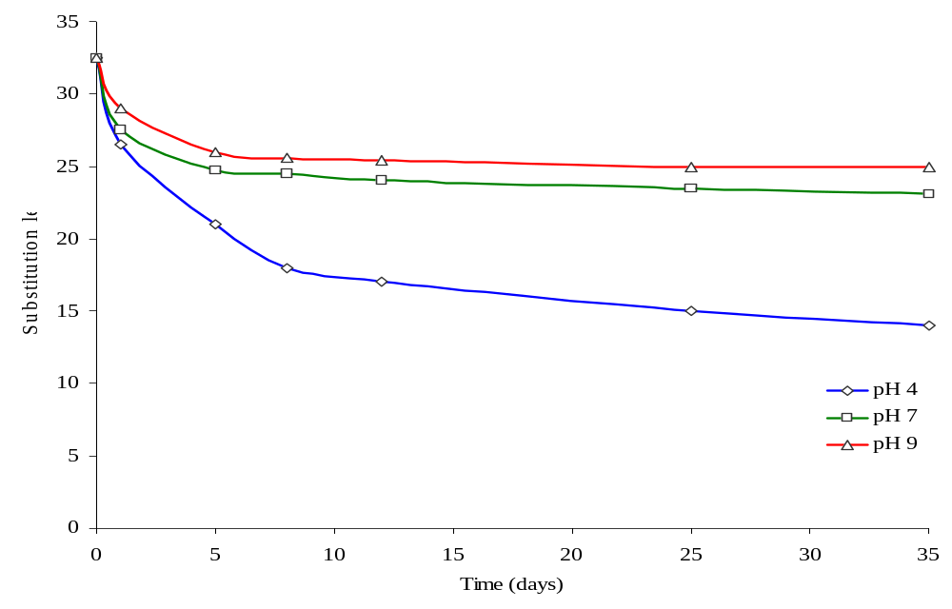
Characterization of BSA-MTX conjugates
v) Stability of BSA-MTX conjugate at 37ºC.
Notes:
After one day of storage; the maximum release of MTX bound to BSA was 20%, 24%, and 35.4% pH of 4.0, 7.0, and 9.0, respectively.
The stability of BSA-MTX conjugates depended on the type of linkage created during the conjugation reaction.

Slide 19
Biological activity of MTX conjugates
1) Anti-leukemic activity.
Animals were divided into groups.
Mice were inoculated with leukemia cells.
24 hrs. later (day 0) treatment was started.
Tumor weight and survival data were collected daily.
Antitumor effect was evaluated using:
a) Increase in life span (ILS %).
ILS % = (AST_{T}/AST_{C}) x 100 – 100%
b) Long-term survivors (LTS) – expressed as percentage of mice which survived tumor-free for at least 60 days.
Notes:
Antitumor effect was evaluated using:
a) Increase in life span of treated mice over the control (ILS %).
ILS % = (AST_{T}/AST_{C}) x 100 – 100%
Where:
AST_{T} is the average survival time of treated animals,
AST_{C} is the average survival time of untreated control.
b) Long-term survivors (LTS) – expressed as the number and/or percentage of mice which survived tumor-free for at least 60 days.

Slide 20
Anti-leukemic activity
i) Survival of leukemia-bearing mice treated with free MTX or one of its conjugates with native and glycated fibrinogen.
Notes:
All conjugates revealed higher antitumor activity in vivo.
One out of 6 mice, in the group treated with FG65-MTX conjugate, survived more than 2 months after tumor cells inoculation.

Slide 21
Results and discussions
Notes:
All conjugates have generally higher antitumor activity in vivo.
The animal group treated with FG-MTX_{L} conjugate had the highest number of long-term survivors.
The animal group treated with FF-MTX_{H} conjugate, there were no mice died before control group, and still one long-term survivors.

Slide 22
Anti-arthritic activity
i) Preparation of antigen and immunization of animals
Collagen type II solution & Complete Freund Adjuvant (CFA) were prepared.
Collagen solution was emulsified in the CFA.
Collagen-induced arthritis (CIA) was provoked in mice, the mice were immunized by an intra-dermal injection.
ii) Treatment protocol
DBA/1LacJ mice were distributed randomly in groups.
Two weeks after the immunization treatment was started.
The animals received 5 injections i.p. at days 14, 21, 28, 35 and 42 from the immunization.

Slide 23
Anti-arthritic activity
iii) Assessment of arthritis
The mice have been inspected for arthritis twice weekly since day 14 to 63 from the immunization.
Arthritis severity was evaluated using four-degree score (Rosloniec et al., 1996).
According to the detailed description in Table 1, points were admitted for redness or edema of joints and their sum for each paw was calculated.
Then, points was converted into a degree of CIA according to scale shown in Table 2.
CIA activity (arthritis score, AS) for single animal was expressed as a summation of degrees of points of four paws.
Notes:
Rosloniec E.F., Cremer M., Kang A., and Myers L.K. (1996): Collagen-induced arthritis. In: Coligan J.E., Kruisbeek A.M., Margulies D.H., Shevach E.M., Strober W., editor. Current Protocols in Immunology.; Vol. 3. New York: Wiley.; 15.5.1-15.5.19.

Slide 24
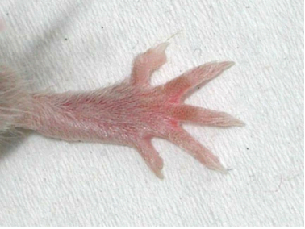
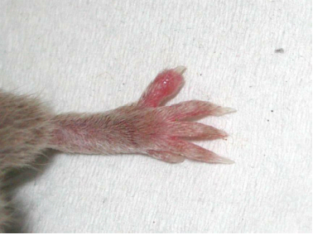
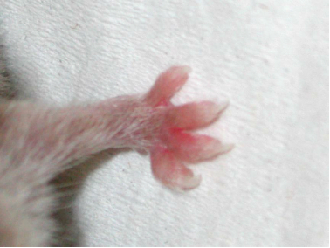
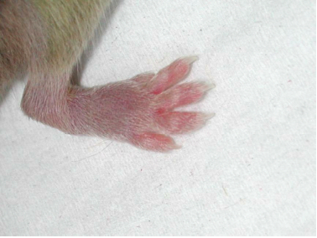
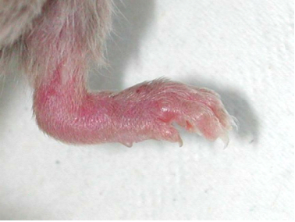
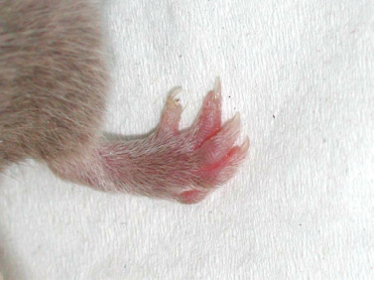
Anti-arthritic activity
normal rear paw | rear paw – edema of one finger | front paw – edema of four finger
mild edema of the ankle, all fingers are inflammed | intensive edema of the ankle, all fingers are inflammed | rear paw – edema and deformation of all fingers
Examples of varying degrees of inflammation in murine DBA/1LacJ CIA model.

Slide 25
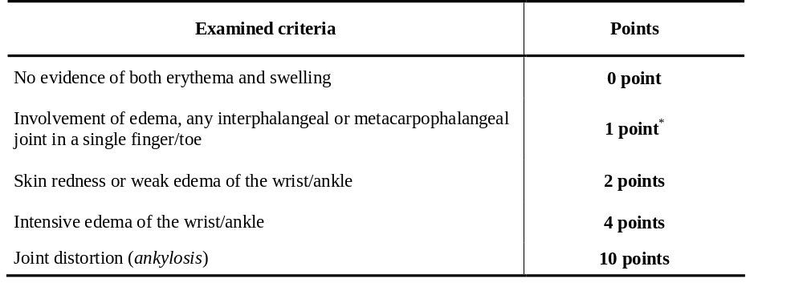
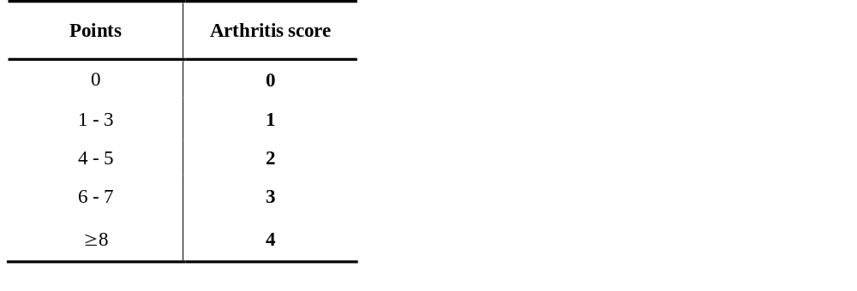
Anti-arthritic activity
Table 1. Visual criteria for evaluation of arthritis severity in CIA.
*for each involved finger.
Table 2. Conversion of points to arthritis score.

Slide 26
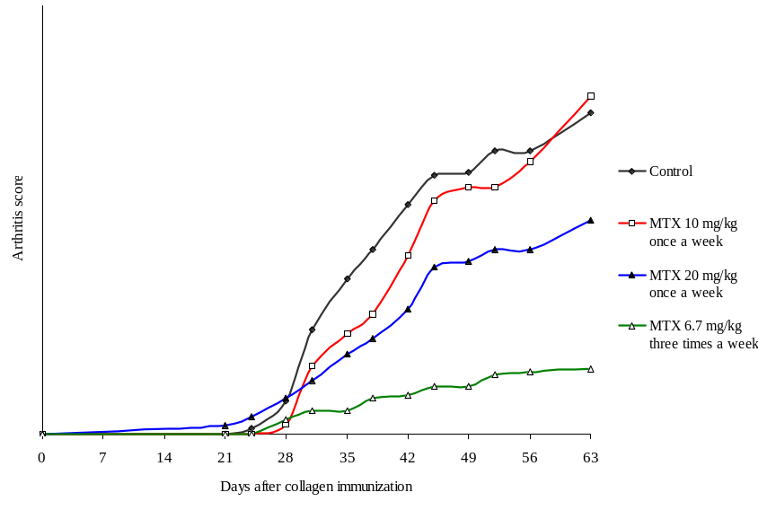
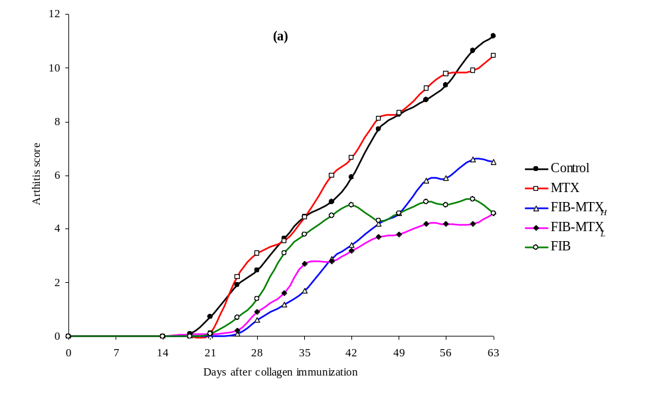
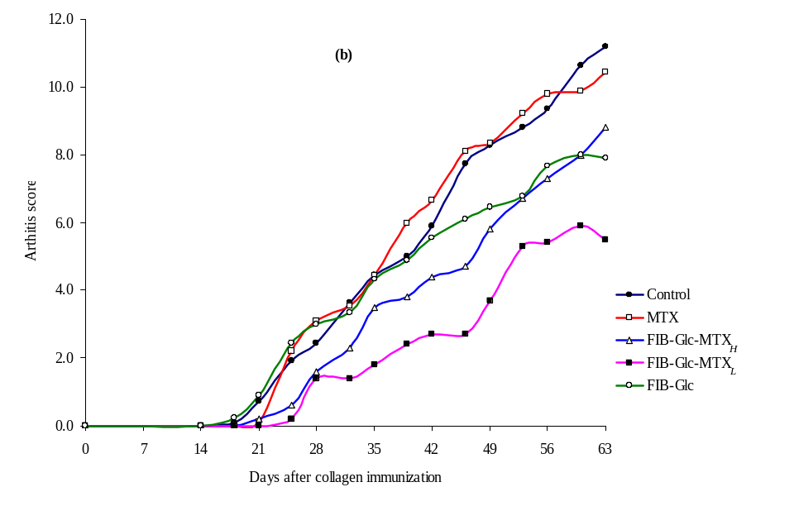
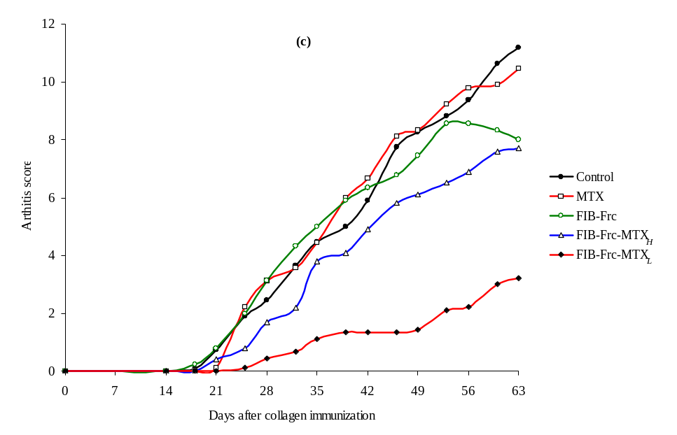
Anti-arthritic activity
a)
b)
c)
d)
Notes:
The relationship between MTX dose and the frequency of its administration upon the development of CIA.
FIB based-MTX conjugates in a dose of 10 mg of MTX/kg of the body weight.
FIB-Glc based-MTX conjugates in a dose of 10 mg of MTX /kg of the body weight.
FIB-Frc based-MTX conjugates in a dose of 10 mg of MTX /kg of the body weight.

Slide 27
Conclusions
The activation of MTX with DCC produces an active intramolecular anhydride.
MTX anhydride reacts with nucleophiles to form stable MTX α- and γ-MTX mono-derivatives.
MTX conjugates prepared by the use of its anhydride were characterized by reasonable uniformity and purity, lower hydrophobicity and the lack of cross-linking.
Native and glycated fibrinogens-MTX conjugates revealed higher antitumor activity in vivo than free MTX.
Native fibrinogen and glycated fibrinogens-MTX conjugates significantly reduced the development of collagen-induced arthritis.

Slide 28


Acknowledgments
Janusz Boratynsk, and Ryszard Międzybrodzki
Institute of Immunology and Experimental Therapy, PAS, Wroclaw, Poland
Chemistry Department, Faculty of Science, Benha University, Benha, Egypt

Slide 29


The End

Slide 31
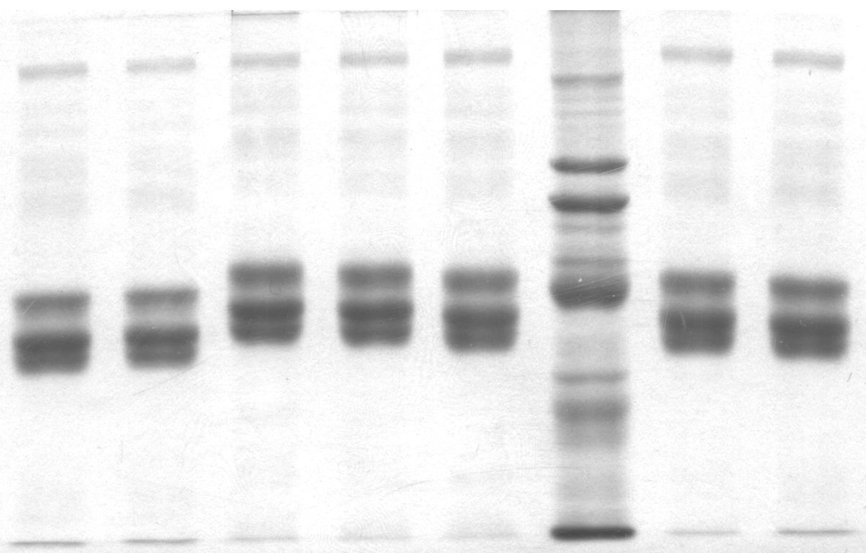
Results and discussions
7) Effect of glycation temperature on Fibrinogen substitution with D-glucose.
Lane 1: native bovine fibrinogen; lane 2: fibrinogen co-lyophilized with D-glucose, not heated; lane 3: fibrinogen-D-glucose conjugate, reaction at 85ºC; lane 4: fibrinogen-D-glucose conjugate, reaction at 80ºC; lane 5: fibrinogen-D-glucose conjugate, reaction at 75ºC; lane 6: standard of molecular weights
1 2 3 4 5 6 7 8

Slide 32
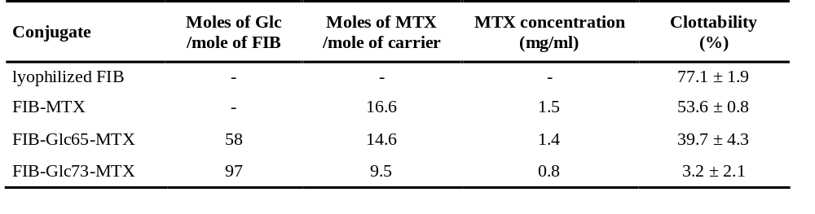
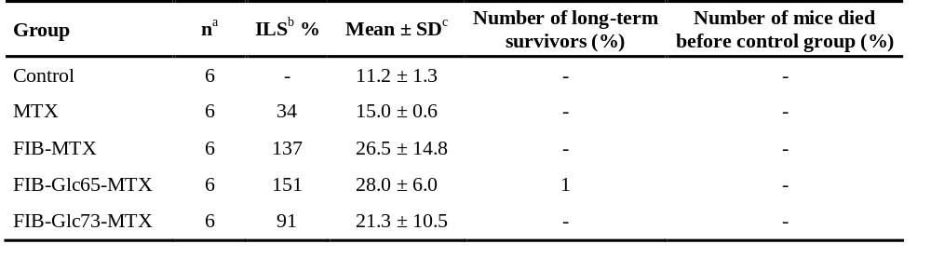
Biological activity
iv-a) In vivo cytotoxicity of native and glycated FIB -MTX conjugates.
Three different MTX conjugates were examined: FIB-MTX, FIB-Glc65-MTX and FIB-Glc73-MTX.
Survival of P388 leukemia-bearing mice treated with free MTX or one of FIB-MTX, FIB-Glc65-MTX and FIB-Glc73-MTX conjugates in a dose of 40 mg of MTX /kg of the body weight.
ª n: number of mice in the group, ^{b} ILS: increase in life-span, and ^{c} Mean ± SD: Mean survival time (days) ± standard deviation.

Slide 33
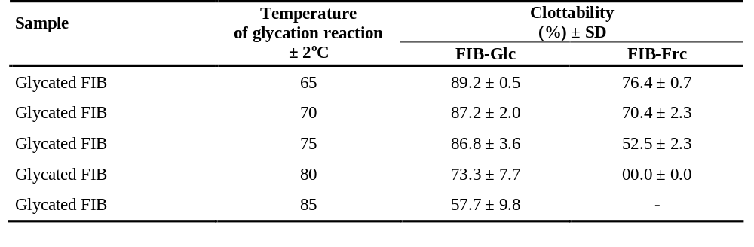
Results and discussions
8) Clottability of native and glycated fibrinogens
The clottability of the lyophilized FIB was 77.1 ± 1.9
The clottability of FIB lyophilized with sugar not heated was 81.0 ± 2.1
The clottability of FIB heated at 85°C was 75.7 ± 0.2
The clottability of glycated FIB gradually decreased with increasing glycation temperature.
Native FIB and its conjugates did not resist degradation by plasmin compared to their analogues without plasmin.

Slide 34
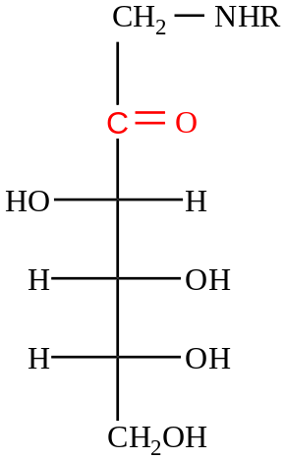



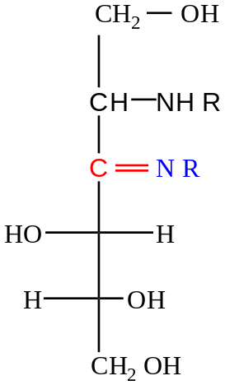
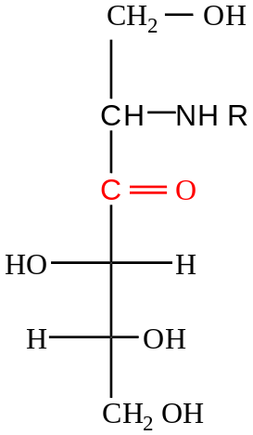
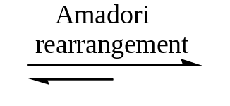
Glycation of fibrinogen
No reaction
etc

Slide 35
Anti-arthritic activity
i) Preparation of antigen and immunization of animals
collagen type II solution was prepared in acetic acid at least 24 hours prior to use, keeping the solution overnight at 4°C.
Complete Freund Adjuvant (CFA) was prepared by mixing of heat-inactivated Mycobacterium tuberculosis with incomplete Freund’s adjuvant.
collagen solution was emulsified in the CFA using two connected syringes at 4°C.
collagen-induced arthritis (CIA) was provoked in mice, the mice were immunized by one intradermal injection of 0.1 ml of the emulsion, approximately 1-2 cm from the base of the tail.
ii) Treatment protocol
DBA/1LacJ mice were distributed randomly among groups.
two weeks after the immunization with collagen, treatment was started.
the animals received 5 injections i.p. at days 14, 21, 28, 35 and 42 from the immunization.

Slide 36
Anti-arthritic activity
iii) Assessment of arthritis
The mice have been inspected for arthritis twice weekly since day 14 to 63 from the immunization.
Arthritis severity was evaluated using four-degree score (Rosloniec et al., 1996).
The method of the assessment of arthritis degree was modified to consider the different combinations of inflammed groups of joints and to reduce the influence of the subjectivity on the investigator’s evaluation.
According to the detailed description in Table 1, points were admitted for redness or edema of joints and their sum for each paw was calculated.
Then, it was converted into a degree of collagen-induced arthritis (CIA) according to scale shown in Table 2.
The CIA activity (arthritis score, AS) for single animal was expressed as a summation of degrees of points of four paws.
Rosloniec E.F., Cremer M., Kang A., and Myers L.K. (1996): Collagen-induced arthritis. In: Coligan J.E., Kruisbeek A.M., Margulies D.H., Shevach E.M., Strober W., editor. Current Protocols in Immunology.; Vol. 3. New York: Wiley.; 15.5.1-15.5.19.

Slide 37
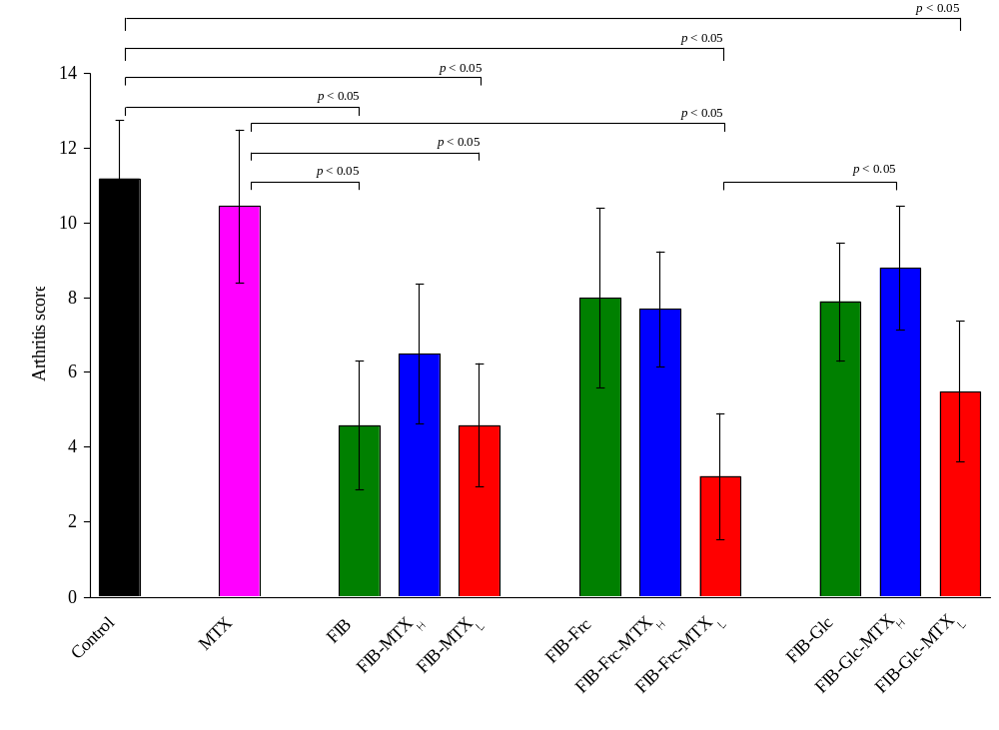
Anti-arthritic activity
Mean arthritis score (± SE) of mice with CIA at day 63 after arthritis induction. Statistically significant differences (p < 0.05) were shown (analysis was done with Fisher LSD test); (a) animal groups treated with either MTX alone; FIB-MTX_{L}; FIB-MTX_{H}; FIB-Glc-MTX_{L}; FIB-Glc-MTX_{H}; FIB-Frc-MTX_{L}; or FIB-Frc-MTX_{H} in a dose of 10 mg of MTX /kg of the body weight.

Slide 38
Quantitation of MTX bound to proteins
Quantitation of MTX bound to proteins
- The average amount of MTX bound to the carrier macromolecule (substitution level, SL) was calculated using equation (3.1) described bellow.
The results were expressed as mg MTX coupled with 1 mg carrier or as the mean amount of MTX moles bound to one mole of the carrier macromolecule.
SL = C_{MTX}/C*_{P}
C_{MTX} = PA_{372,MTX}/ε_{MTX}
C*_{P} = [PA₂₈₀ – (PA₃₇₂ x F)]/ε_{P}
F = A_{280,MTX}/A_{372,MTX}
SL: substitution level.
C_{MTX}: molar concentration of MTX.
C*_{P}: molar concentration of protein after correction.
F: coefficient correcting molar concentration of protein respecting absorbance of MTX at 280 nm.
ε: molar absorbance coefficient.
PA: peak area.

Slide 39
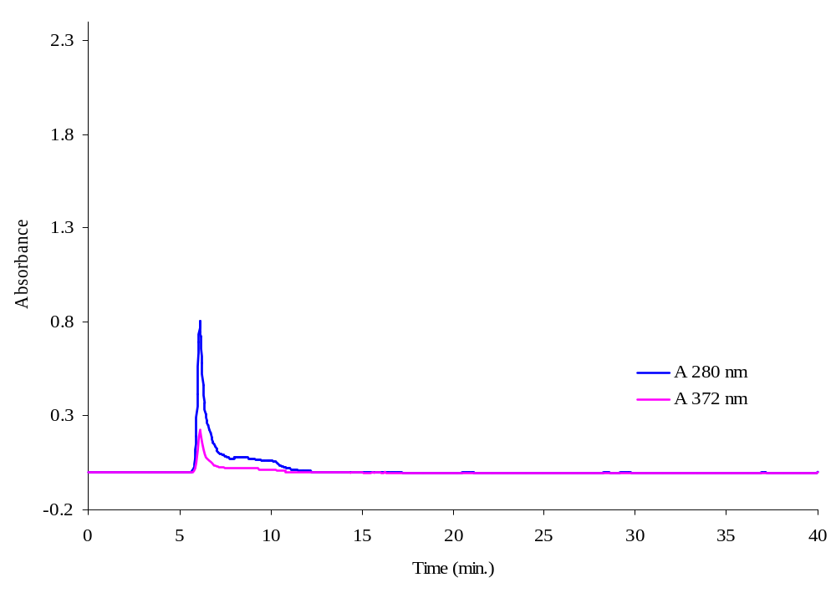
Characterization of BSA-MTX conjugates
HPLC analysis of BSA-MTX conjugates prepared by the use of MTX anhydride and dialyzed against NaHCO₃ buffer (0.1M, pH 8.3, containing 0.03% NaN₃) for 48 h.
Dialysis of the conjugation reaction mixture against NaHCO₃ buffer for 48 h removed unconjugated and weakly bound drug molecules, so that subsequent gel filtration showed no MTX in the position of the low-molecular-weight peak as detected by the absorbance at 372 nm.

Slide 40
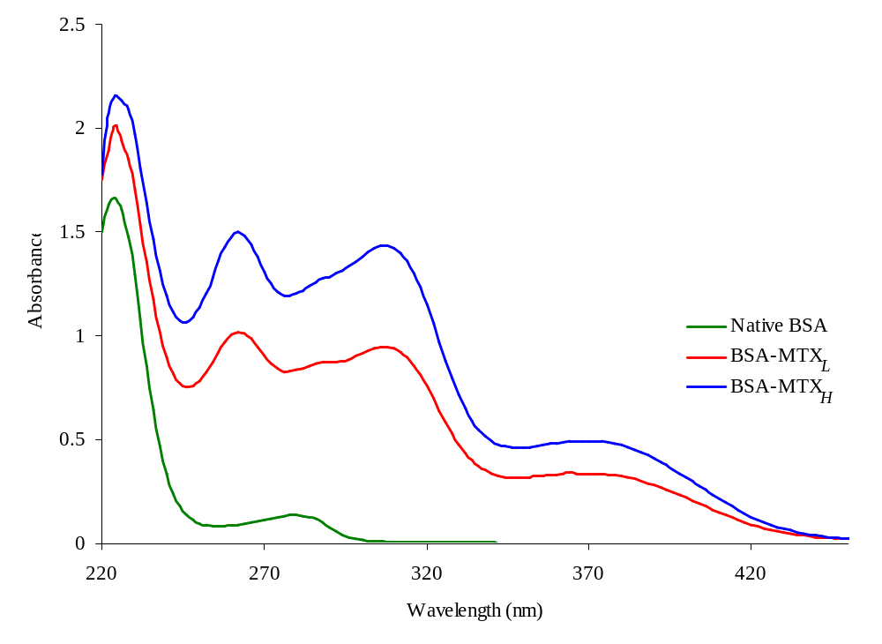
Characterization of BSA-MTX conjugates
UV-VIS spectra of BSA-MTX conjugates prepared by the use of MTX anhydride; low and highly substituted conjugates; 20 and 38 moles of MTX /mole BSA, respectively.
under specific conditions the average amount of MTX bound to the carrier molecule could be controlled.
conjugates of certain substitution level could be prepared depending on the ratio of the carrier to MTX anhydride in the reaction mixture.

Slide 41
Results

