Slide 1

Monitor and study horizontal and verticals changes at land surface using remote sensing and GIS technology: case of study Wenchuan area
By
MOHAMED MHMOD
(Syria)
Postdoctor, CHINA –Jilin university
Notes:
Aim: The aim of this thesis is to studyNeotectonic and movement of plate in Wenchuan
area by processing, to analysis and interpretation of aerial photographs images and
satelliteimages,toidentificationofrangeoffaultsandthedirectionofplatemovementin
study area, to monitor changes on surface by follow phenomena in same area during
periodsoftime.Andtoshowtheeffectofplatemovementofriverview.

Slide 2
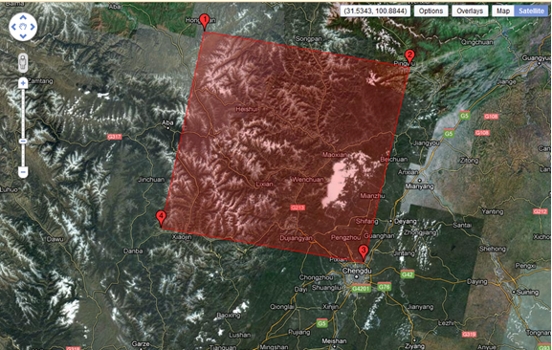
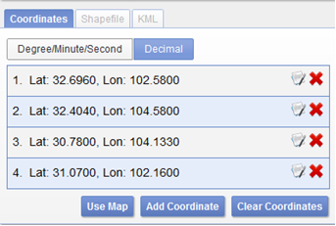
General information about study area
Wenchuan (汶川) is located in the northwest edge of Sichuan Basin, at Aba Tibetan & Qiang Autonomous Prefecture
.
Notes:
On May 12, 2008, earthquake struck Wenchuan 7.9 MW eastern edge of the Tibetan plateau, destroyed cities along the northwest margin of the Sichuan Basin, caused more than 80,000 dead and 380,000 wounded

Slide 3
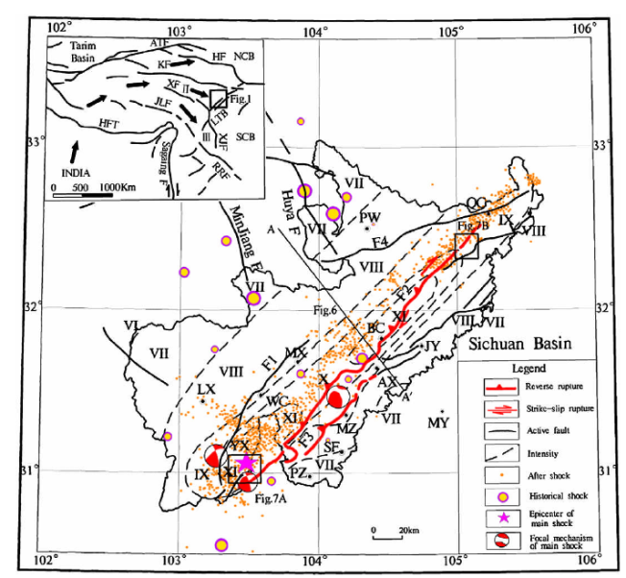
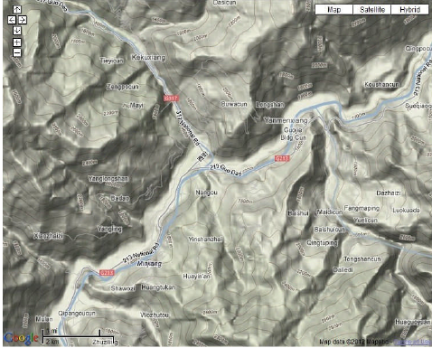
Tectonic and geology setting of Wenchuan:
Shows contour lines in Wenchuan
active tectonic map of the study area and the surface rupture zones induced by the earthquake
Notes:
The active tectonic map of the study area and around it, shows the different kind of the
fault,wheretherearereveres,strike-slipruptures(Figure3-2).
Sequence was imbricate and emplaced eastward over the lower structural sequence in
Late Triassic to Middle Jurassic time. Transitional units between the two structural
sequences are generally not found. Thrust sheets override the older fore deep deposits,
and thrust contacts are sealed in places by Middle Jurassic strata, constrainingthe end of
thrusting to the pre–Middle Jurassic. The fore deep deposits continue into the Late
Cretaceous, but large post–Middle Jurassic, pre-Oligocene structures have not been
identified.TheMesozoicthrustcomplexanditsunderlyingautochthonwererefoldedand
thrust eastward in Cenozoic time. Cenozoic folding of the Precambrian basement is well
expressed in the Baoshan and Pengguan massifs (Figs.3-3 and3-4). Along the
southwestern margin of the Sichuan Basin, Eocene and probable Oligocene red beds are
deformed by northeast-trending folds and thrust faults that merge northward into the
LongmenShan.TheserocksconstraintheCenozoicdeformationinthisareatohavebeen
initiatedinthelateorpost-Oligocene.

Slide 4
Brief about work methods
COLLECTING DATA
GOOGLE EARTH
SRTM IMAGES
LAND SAT 2, 4,7IMAGES
Combination, & CUT IMAGES
GEOMETRIC CORRECTION
Landmarks POINT
EXTRACT IMAGES
ENHANCEMENT
USE LAND MARKS AS GPS
USE ARCGIS
USE ARCGIS
Combination, & CUT IMAGES
USE ARCGIS
ANALYSIS AND INTERPRETATION STAGE
Notes:
Determine the study area with four coordinates and the use of satellite images Land sat 2, 4 and 7 in order to monitoring horizontal changes and plate movements. Digital elevations images (DEM) used to monitor vertical change as well as understanding the mechanism of horizontal movements in the selected area. Due to the lack of data for the same satellite during a period of 40 years .has been study- specific years that necessary data are available and make comparisons between them.
as well as the benefit from the program Google Earth free as the software provided with aerial photographs and satellite images with geographical coordinates of and the advantage in the use of landmarks apparent on all pictures between the year 2005-2010 as points of GPS.
Study materials& DATA METHODOLOGY and results
Remote sensing is used as a tool to extract information about the land surface structure,
composition or subsurface, but is often combined with other data sources providing
complementary measurements. Multispectral data can provide information on lithology or rock composition based on spectral reflectance. Radar provides an expression of surface topography and roughness, and thus is extremely valuable, especially when integrated with another data source to provide detailed relief.
Remote sensing is not limited to direct geology applications - it is also used to support logistics, such as route planning for access into a mining area, reclamation monitoring, and generating base maps upon which geological data can be referenced or superimposed
Geological applications of remote sensing include the following: surficial deposit / bedrock mapping - lithological mapping, structural mapping - sand and gravel (aggregate) exploration/ exploitation, mineral exploration - hydrocarbon exploration, environmental geology – geobotany,baseline infrastructure - sedimentation mapping and monitoring
Event mapping and monitoring - geo-hazard mapping - planetary mapping
Geological application of remote sensing includes the following:
Materials:
Satellite images and set programs (ENVI 4.6.1, global mapper13, ArcGIS, Google earth, Photo shop.
Data methodology and results
.1 Processing stage::-geometric correction: Geometric correction: conversion of data to ground coordinates by removal of distortions from sensor geometry ,enable mapping relative to data layers enable and comparison .The used images (land sat 2,4,7) were provide with coordinated of four corner of the images which used for geometric correction.
2-special processing
image transformation, Image filtering, Final processing:
To access images cover the study area .there was cutting from some images which was bigger than study are or combining some images to cover study area
Image enhancement: in order to aid visual interpretation, visual appearance of the objects in the image can be improved by image enhancement techniques such as grey level stretching to improve the contrast and spatial filtering for enhancing the edges

Slide 5
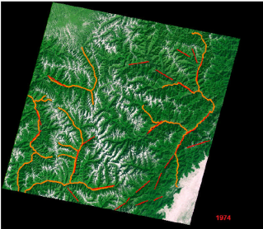
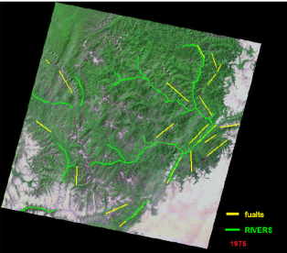
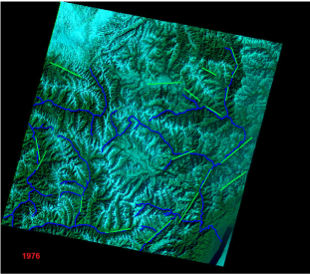
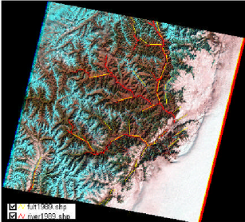
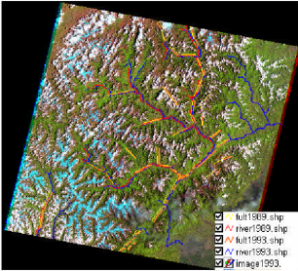
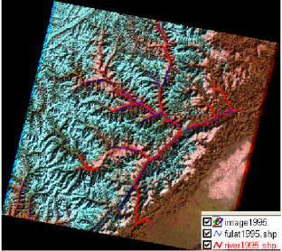
Horizontal changes
LANDSAT-1 1974-1976 images:UsingWDWorldGeodeticSystem1972(WGS72)
Image from landsat1974
Image from landsat1975
Image from landsat1976
Imagesl4-5TM1989-1996
1989
1993
1996

Slide 6
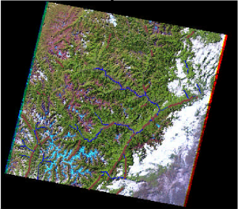
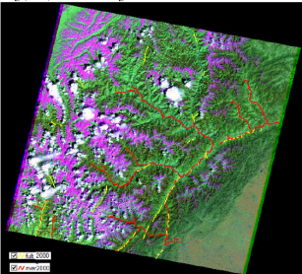
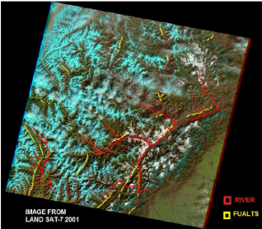
LANDSAT-7 images from 1999 to2005
1999
2000
2001
L7 2003-2005:

Slide 7
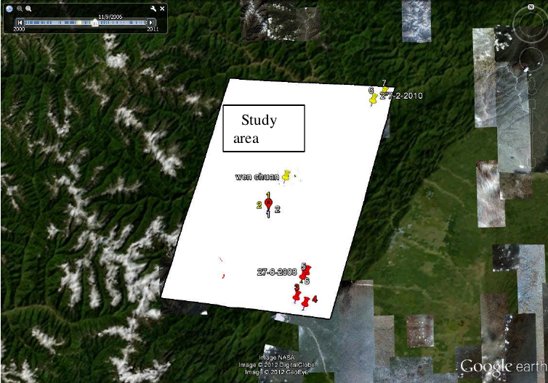
Monitor horizontal movements Using Google earth and land GPS
(2005-2008)(Before and after Wenchuan earthquake:
shows the distribution of some parameters taken as points of GPS the study area.
Notes:
GoogleearthitssoftwareprovidefreesatelliteandArialimages.
Herewewilltakeagroupofparameters (house,school,etc....) andclear thatappearon
allimagesasapointofGPSandthatofothersispossiblethattherewillbeachangeinits
positionduetohumanactivity.
For example: Select one corner of a school, write its coordinates, then select the same
corner on another photo during a different time period and determine the coordinates.
After that convert geographic coordinates (photos in Google has been taken with
geographic coordinates) to the coordinates (X., Y) then compared between new
coordinatestheoldcoordinates.
Choose some clear points (these points cover most of the study area) before and after
earth quake in Wenchuan (12may2008) then compare between the coordinated of same
pointbeforeandafterearthquack(ontowdifferentimagesforsamepoint’s

Slide 8
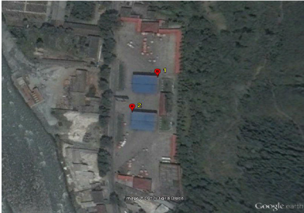
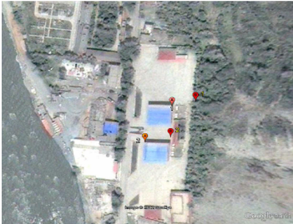
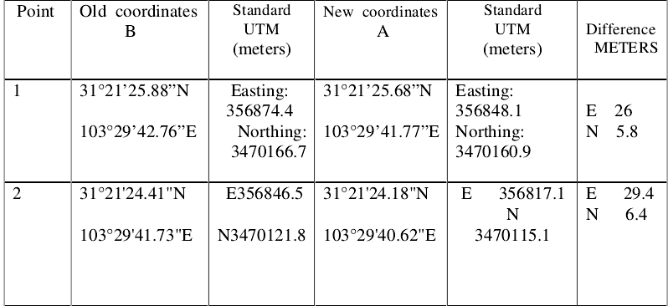
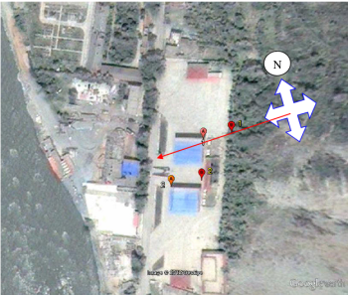
Point(1): before and after earthquake 5/12/2008
Shows tow points(B1,B2)taken in8/9/2005
shows(A1,A2) they are the same points(B1,B2 8/9/2005)but on image taken 5/22/2008.
Coordinates:
Shows the direction
Of movement
in points(B,A)

Slide 9
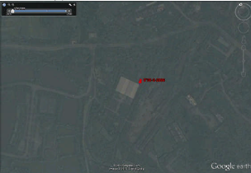
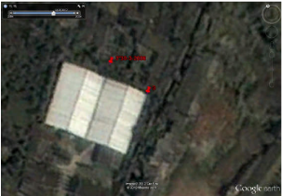
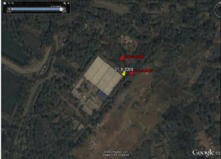
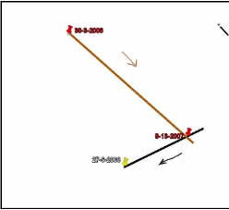
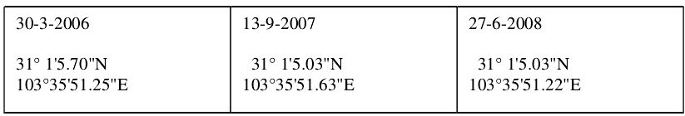
POINT(3)
30-3-2006
13-9-2007
27-6-2008
Coordinates:

Slide 10
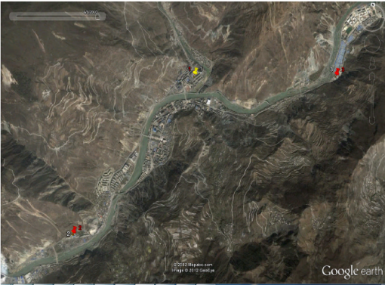
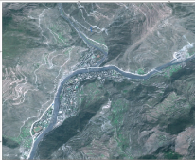
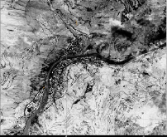
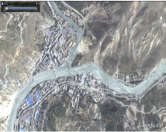
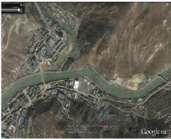
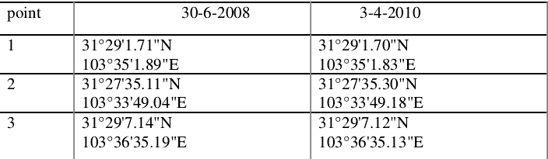
20-3-2007 14-5-2008
Images of Wenchuan from different years before and after earthquake12 may 2008
30-6-2008
3-4-2010
Coordinates:

Slide 11
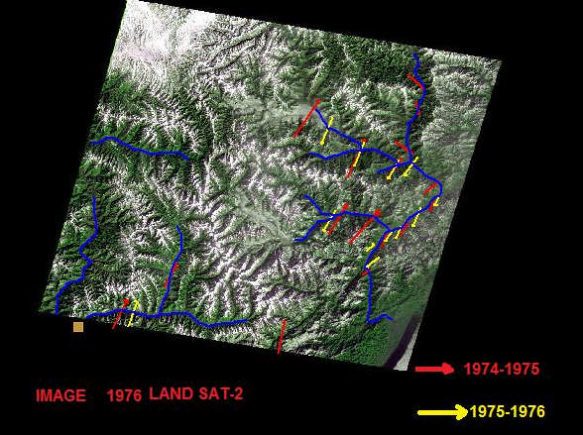
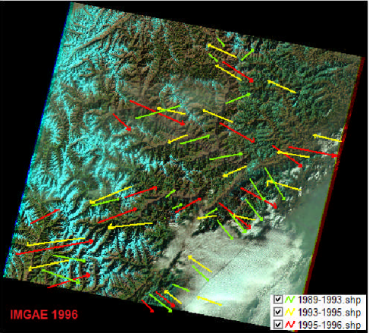
Horizontal changes
Show direction of plate movements
1989-1996
Shows direction of movements
1974-1976

Slide 12
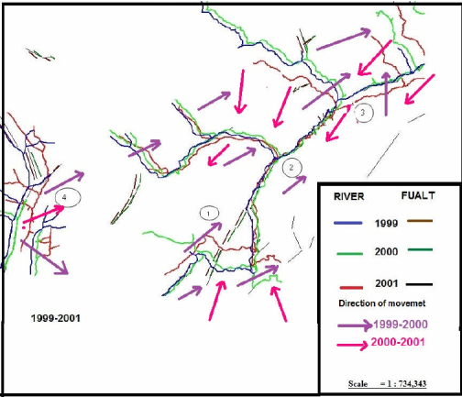
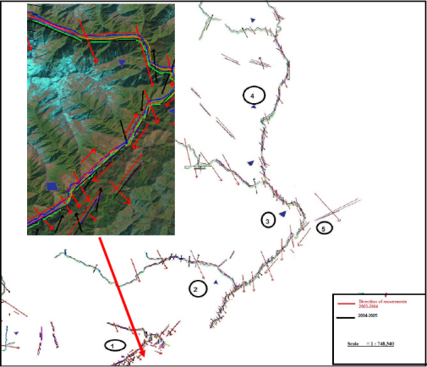
Shows the rivers,faults,directions of movements from1999-2001
Shows directions movements2004-2005

Slide 13
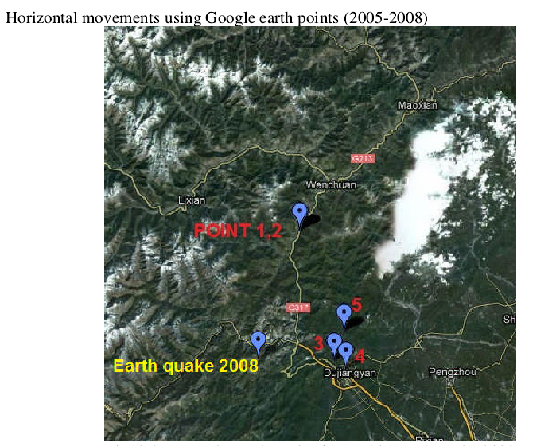
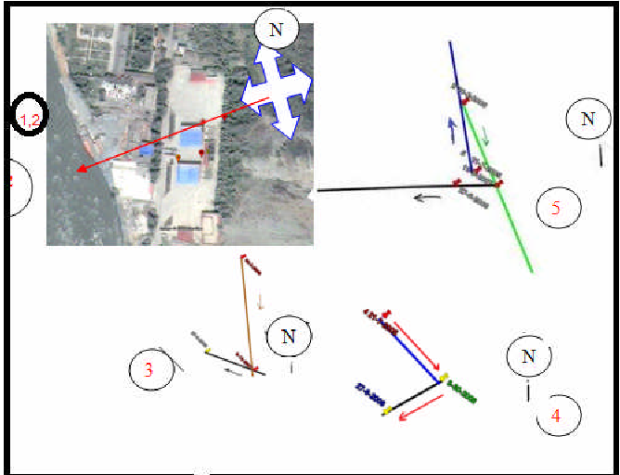
Direction of movements from2005-jun2008

Slide 14
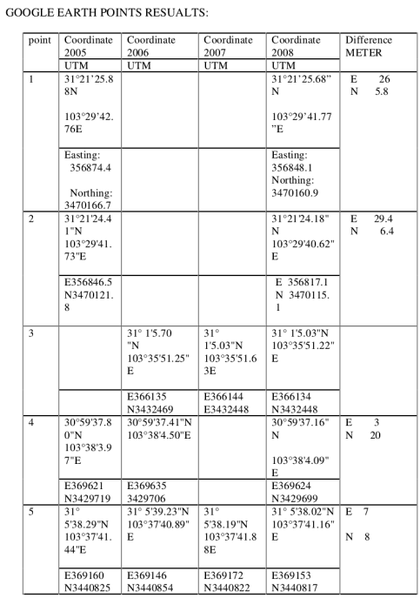
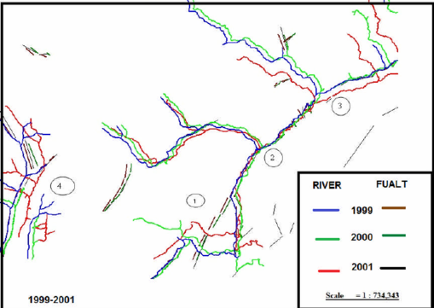
Shows fault and rivers network from1999-2001
CONVERT FORM WGS-84 TO UTM ZONE48

Slide 15
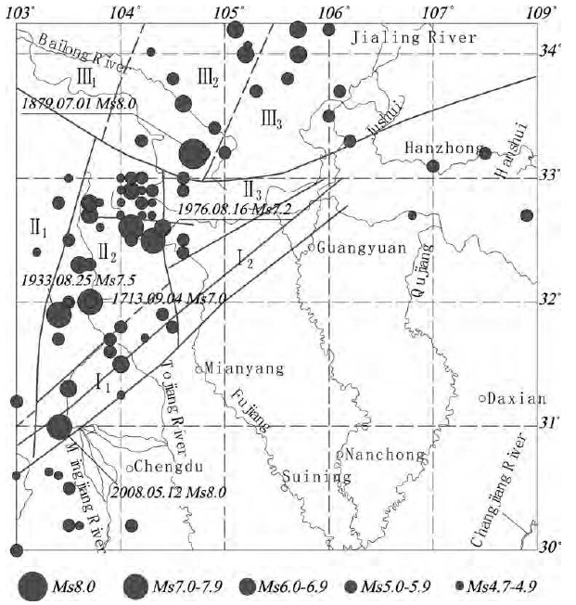
Historical earthquakes in northwestern Sichuan(fromHuXingpingetal2008 Modified)

Slide 16
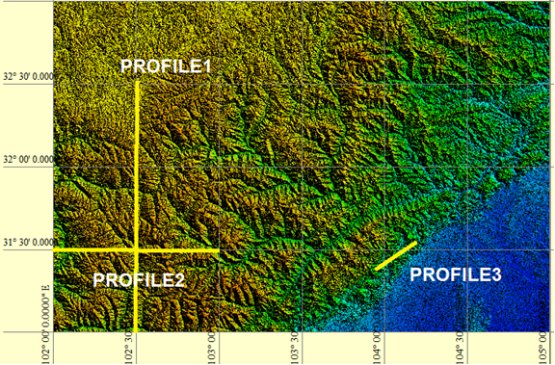
Vertical changes:
shows the profile took for comparing (Arrow refer to begging -end of the profile)

Slide 17
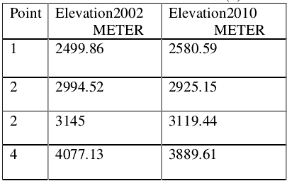
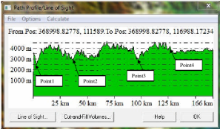
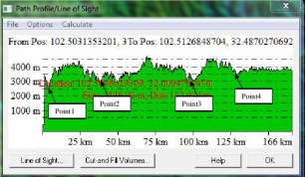
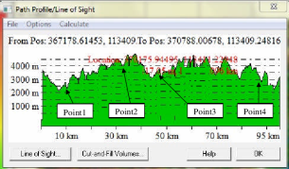
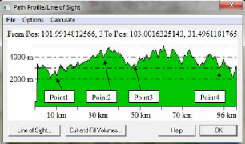
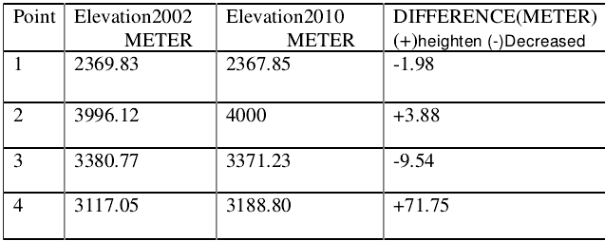
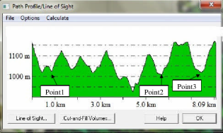
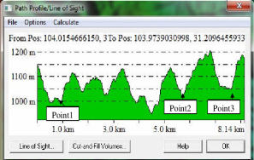
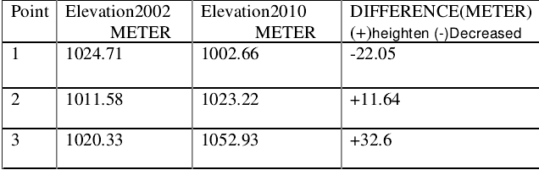
Some points took for comparing.
Profile(1)2002
Profile(1)2010
PROFILE(2)2002
PROFILE(2)2010
Profile(3)2002
Profile(3)2010

Slide 18
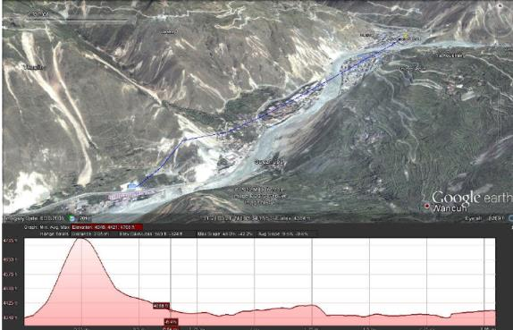
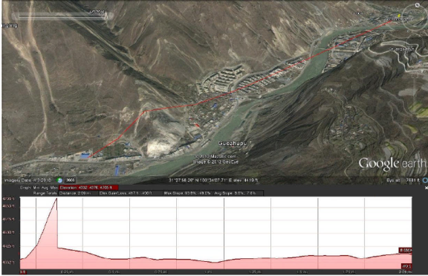
Image from Google earth,blueline”30-6-2008
Wenchuan (after)
Image from Google earth redline“3-4-2010
Wenchuan(before)

Slide 19


Application
Image from Google earth2005 before earthquake
Image from Google earth 5/22/2008 after earthquake

Slide 20
Future work projects
Micro seismic project “use for exploration in space “
Monitor and study the changes of land surface “moon”

Slide 21
Thank you

