Slide 1


Modeling Life Cycle Sustainability in Buildings using System Thinking
Environmental Health & Safety
October 24-25, 2016 Valencia, Spain
Mohamed Marzouk and Mostafa El-Hawary
Structural Engineering Department, Faculty of Engineering, Cairo University, Egypt

Slide 2
Agenda
Problem Statement
System Dynamics Modeling
Modeling Facility Management
Decision Making Tool
Conclusions

Slide 3
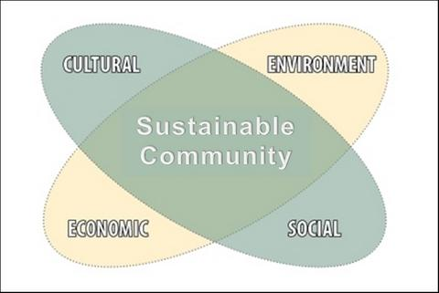
  Problem Statement
Community’s social and cultural practices impact its surroundings, environment, and people
Sustainability concepts improves Social, Economic, Cultural and Environmental conditions for present and future generations, and enhances quality of life to allow people to live in a healthy environment

Slide 4
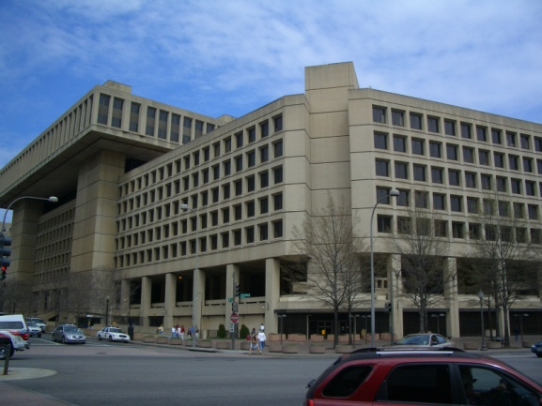
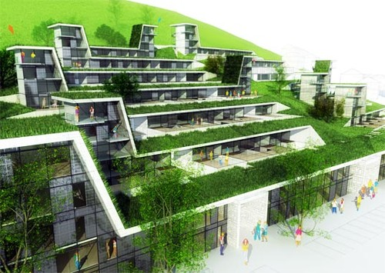
  Problem Statement
The practice of creating structures and using processes that are environmentally responsible and resource-efficient throughout a building's life-cycle from sitting to design, construction, operation, maintenance, renovation and deconstruction*
* Definition by : US- Environmental Protection Agency

Slide 5
  Problem Statement
Environmental damage and consumption of non-renewable resources
The construction sector has a huge impact on the environment
waste production,
high energy consumption, external and internal pollution, CO2 emissions,

Slide 6




  Problem Statement
Rating Systems
There are more than 600 rating systems worldwide for evaluating sustainability in the construction industry
Holistic, Static, and Single Analysis method
Factors Interaction
over length of Time
(whole Building Lifecycle)

Slide 7
Agenda
Problem Statement
System Dynamics Modeling
Modeling Facility Management
Decision Making Tool
Conclusions

Slide 8
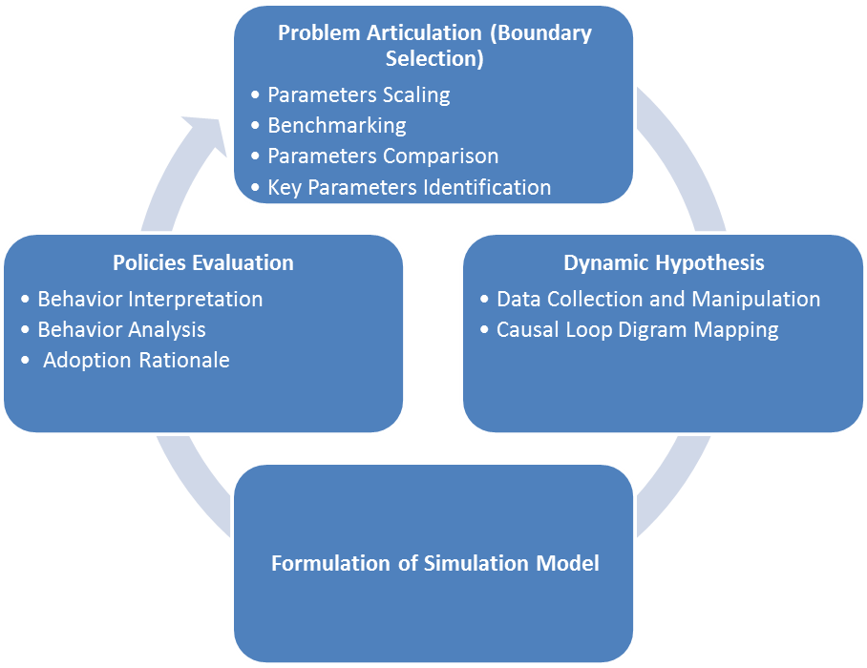
  System Dynamics Modeling

Slide 9
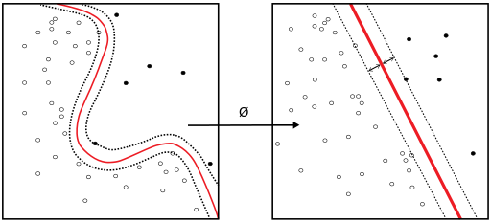
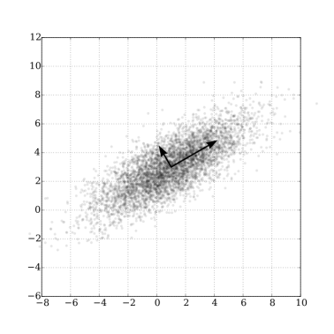
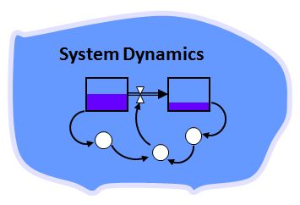
  Implementation Techniques
Factor Analysis
A statistical method used to describe variability among observed, correlated variables
Principal component analysis (PCA)
is a technique to emphasize variation and bring out strong patterns in a dataset.
System dynamics
An approach to understand the nonlinear behavior of complex systems over time

Slide 10
  Results
Group | Code | Criteria |  | Group | Code | Criteria
Sustainable Sites (SS) | SS-1 | Site Selection |  | Material Selection and Recycle (continue) | MS-11 | Building Product Optimization
 | SS-2 | Construction Activity Pollution Prevention |  |  | MS-12 | Use of higher durability materials
 | SS-3 | Reuse of Land |  |  | MS-13 | Use of prefabricated elements
 | SS-4 | Remediation of Contaminated Land |  |  | MS-14 | Design for Disassembly
 | SS-5 | Provision of Public Transport |  |  | MS-15 | Modular Flooring Systems
 | SS-6 | Bicycle Facilities |  |  | MS-16 | Organic Waste Management
 | SS-7 | Low-Emitting Vehicles |  |  | MS-17 | Operational Waste Management
 | SS-8 | Parking Capacity |  |  | MS-18 | Construction Waste Management
 | SS-9 | Protection of habitat |  |  | MS-19 | Recycled Aggregates
 | SS-10 | Enhancing Site Ecology |  |  | MS-20 | Recyclable Waste Storage
 | SS-11 | Maximize Open Space |  |  | MS-21 | Floor Finishes
 | SS-12 | Light Pollution Reduction |  |  | MS-22 | Life Cycle Cost
 | SS-13 | Reduce Heat Island Effect |  |  | MS-23 | High thermal mass material
 | SS-14 | Site assessment
 | SS-15 | Proximity to amenities |  | Indoor Environmental Quality (IE) | IE-1 | Low-Emitting Materials
 | SS-16 | Travel Plan |  |  | IE-2 | Smoking Control
 | SS-17 | Respect for sites of historic or cultural interest |  |  | IE-3 | Acoustic Performance
 | SS-18 | Development Density and Community Connectivity |  |  | IE-4 | Ventilation System
 | SS-19 | Private Outdoor Space |  |  | IE-5 | Thermal Comfort
 |  |  |  |  | IE-6 | Interior Lighting
Water Efficiency and Conservation (WE) | WE-1 | Indoor water consumption |  |  | IE-7 | Thermal Zoning
 | WE-2 | Outdoor water consumption |  |  | IE-8 | Daylight
 | WE-3 | Water consumption monitoring |  |  | IE-9 | Quality views
 | WE-4 | Water leakage detection |  |  | IE-10 | Minimum Indoor Air Quality Performance
 | WE-5 | Efficient water use during construction |  |  | IE-11 | Outdoor Air Delivery Monitoring
 | WE-6 | Sanitary pipe used |  |  | IE-12 | Construction Indoor Air Quality Management Plan
 | WE-7 | Storm water Management |  |  | IE-13 | Legionella Prevention
 | WE-8 | Waste water management |  |  | IE-14 | Control of Indoor Pollutants
 | WE-9 | Innovative wastewater technologies |  |  | IE-15 | Car Park Air Quality Management
 | WE-10 | Harvesting of rain water |  |  | IE-16 | internal landscape
 | WE-11 | Conservation strategy
 | WE-12 | Quality of drinking water |  | Innovation and Regional Priority (IR) | IR-1 | Innovation
 | WE-13 | Cooling Tower Water Use |  |  | IR-2 | Regional Priority
 |  |  |  |  | IR-3 | Exceeding Benchmarks
Energy Efficiency and Conservation (EE) | EE-1 | Minimum energy performance |  |  | IR-4 | Gendered spaces
 | EE-2 | Measurement and verification |  |  | IR-5 | Effects of customs on the built environment
 | EE-3 | Ozone Impacts |  |  | IR-6 | Islamic design requirements
 | EE-4 | Improved Energy Performance |  |  | IR-7 | Documentation in Arabic Language
 | EE-5 | Vertical Transportation
 | EE-6 | Green and Renewable Energy |  | Design and Management (DM) | DM-1 | Commissioning
 | EE-7 | Energy Efficient Appliances |  |  | DM-2 | Considerate Constructors
 | EE-8 | Cool Building Strategies |  |  | DM-3 | Construction Environmental Management
 | EE-9 | Peak Load Reduction |  |  | DM-4 | Building User Guide
 | EE-10 | Environmental Impact |  |  | DM-5 | Security
 | EE-11 | External Lighting |  |  | DM-6 | Integrated Development Strategy
 | EE-12 | Energy and Carbon Inventories |  |  | DM-7 | Environmental Purchasing
 | EE-13 | HVAC system |  |  | DM-8 | Emergency Response Plan
 | EE-14 | Demand Response |  |  | DM-9 | Guest Worker Accommodation
 |  |  |  |  | DM-10 | Building Envelope Verification
Material Selection and Recycle (MS) | MS-1 | Regional Materials |  |  | DM-11 | Sustainability Communication
112 Parameter Selected and Surveyed – Industry Engagement

Slide 11
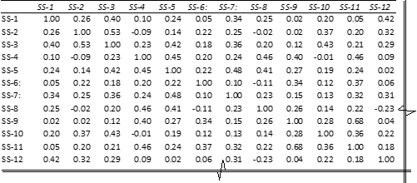
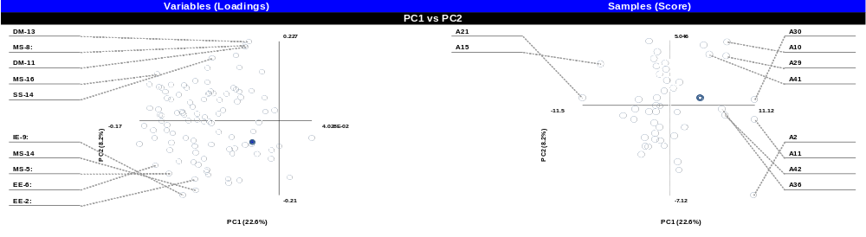
  Results
Factor Analysis / Principal Components Analysis
Component | Contribution (%) | Contribution Accumulation (%) | Eign value
1 | 23 | 23 | 23.03
2 | 8 | 31 | 8.32
3 | 7 | 38 | 7.08
4 | 5 | 43 | 5.46
5 | 5 | 48 | 4.63
6 | 4 | 52 | 4.07
7 | 3 | 55 | 3.55
8 | 3 | 58 | 3.20
9 | 3 | 61 | 3.12
10 | 3 | 64 | 2.74

Slide 12
  Results
Principal Components Analysis
Code | Criteria | LEED | BREEAM | GPRS | Pearl | Sum
IE-8 | Water consumption monitoring | 0 | 1 | 1 | 1 | 3
IE-9 | Vertical Transportation | 0 | 1 | 1 | 1 | 3
SS-12 | Minimum energy performance | 1 | 0 | 1 | 1 | 3
IR-2 | Control of Indoor Pollutants | 1 | 1 | 1 | 0 | 3
IE-10 | Acoustic Comfort | 0 | 1 | 1 | 1 | 3
SS-13 | Improved Energy Performance | 1 | 0 | 1 | 1 | 3
SS-17 | Materials Reuse | 1 | 1 | 0 | 1 | 3
SS-18 | Daylight | 1 | 1 | 0 | 1 | 3
IR-3 | Measurement and verification | 1 | 1 | 1 | 1 | 4
IR-4 | Views | 1 | 1 | 1 | 1 | 4
IR-5 | Remediation of Contaminated Land | 1 | 1 | 1 | 1 | 4
IR-6 | Provision of Public Transport | 1 | 1 | 1 | 1 | 4
IR-1 | Innovation | 1 | 1 | 1 | 1 | 4
DM-1 | Indoor water consumption | 1 | 1 | 1 | 1 | 4
DM-2 | Ozone Impacts | 1 | 1 | 1 | 1 | 4
DM-3 | Green and Renewable Energy | 1 | 1 | 1 | 1 | 4
DM-4 | Construction Waste Management | 1 | 1 | 1 | 1 | 4
DM-5 | Ventilation System | 1 | 1 | 1 | 1 | 4
DM-6 | Thermal Comfort—design, verification, and system controllability | 1 | 1 | 1 | 1 | 4
19 Parameter identified as most influencing
Scoring 3-4 and possess major part in PCA-1

Slide 13
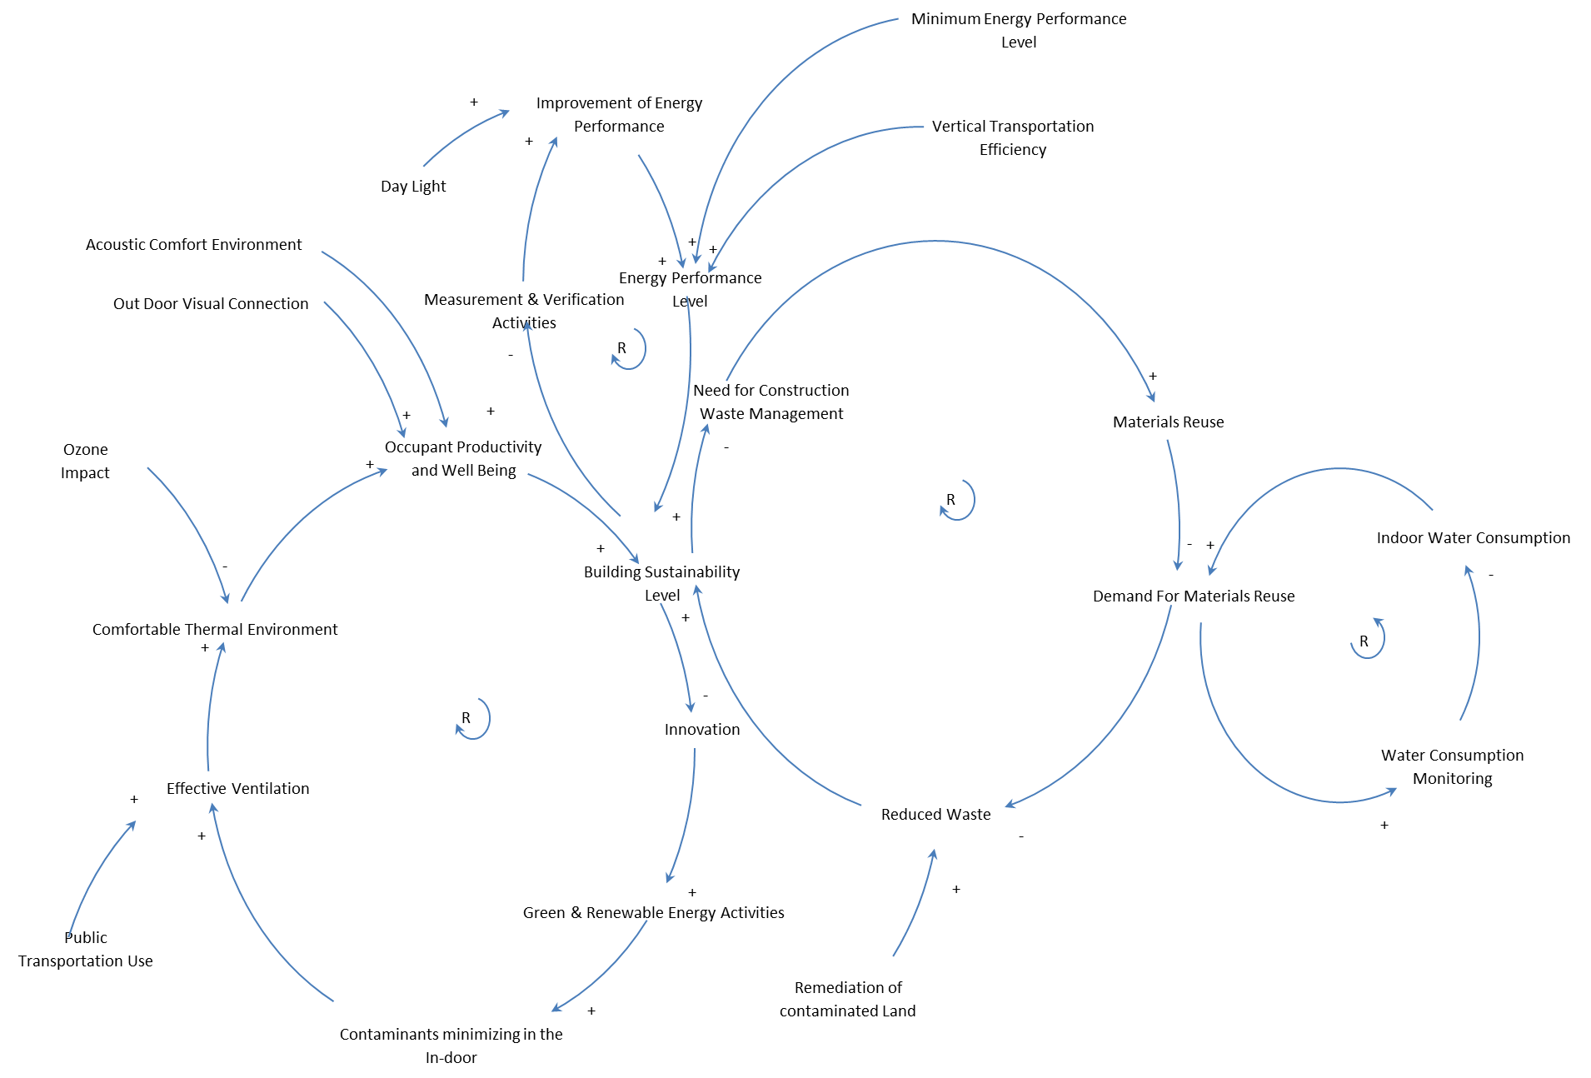
Causal Loop Diagram

Slide 14
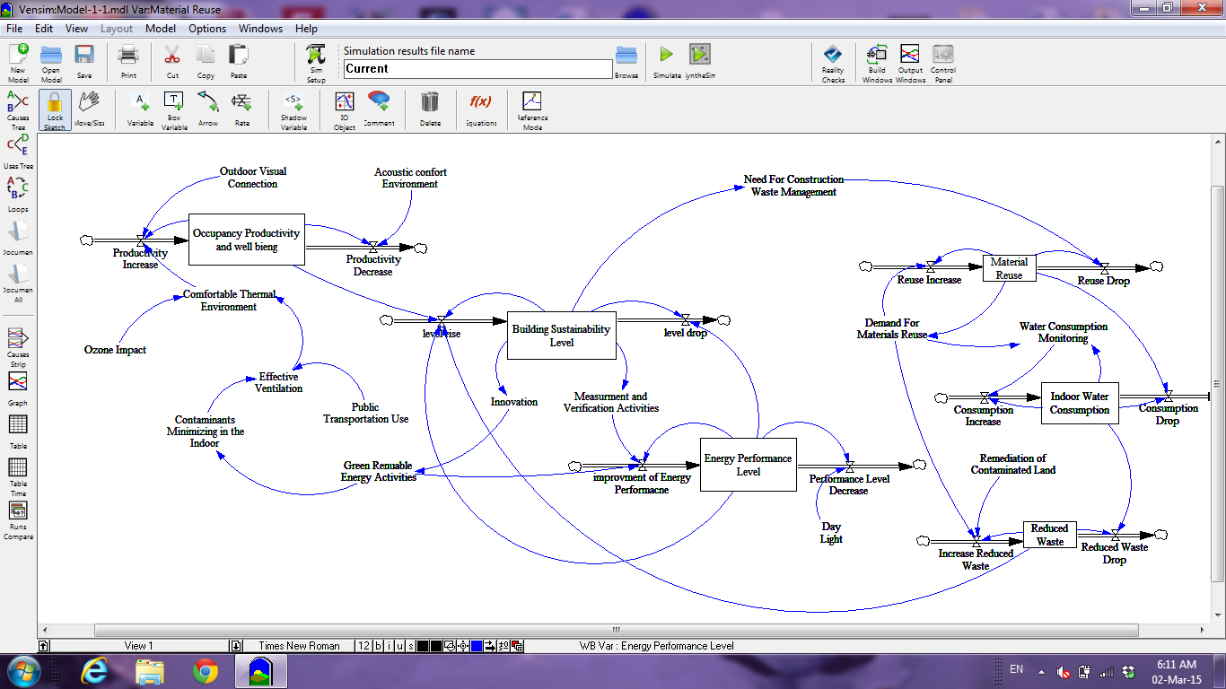
System Dynamics Model

Slide 15
  Results
Results
Occupancy Productivity and Well Being Behavior
Building Sustainability Level Behavior
Indoor Water Consumption Behavior

Slide 16
  Results
Energy Performance Level Behavior
Results
Materials Reuse
Reduced Waste

Slide 17
Agenda
Problem Statement
System Dynamics Modeling
Modeling Facility Management
Decision Making Tool
Conclusions

Slide 18
COBIE
COBIE (Construction Operation Building Information Exchange)
The COBIE spreadsheet supports the exchange of building, system and product information through the life of the project

Slide 19
COBIE Divisions
The spreadsheet is organized by project phase, each phase in an individual worksheet
The project phases:
  Early Design
  Detailed Design
  Construction
  Operation and Maintenance

Slide 20
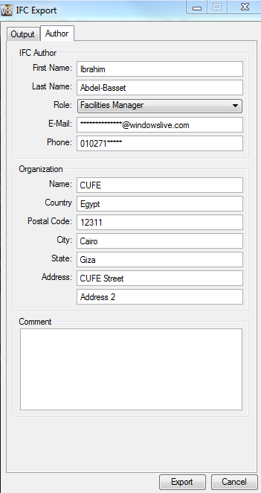
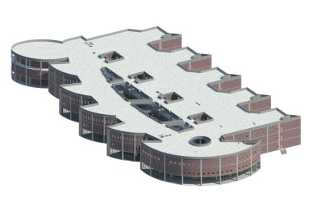
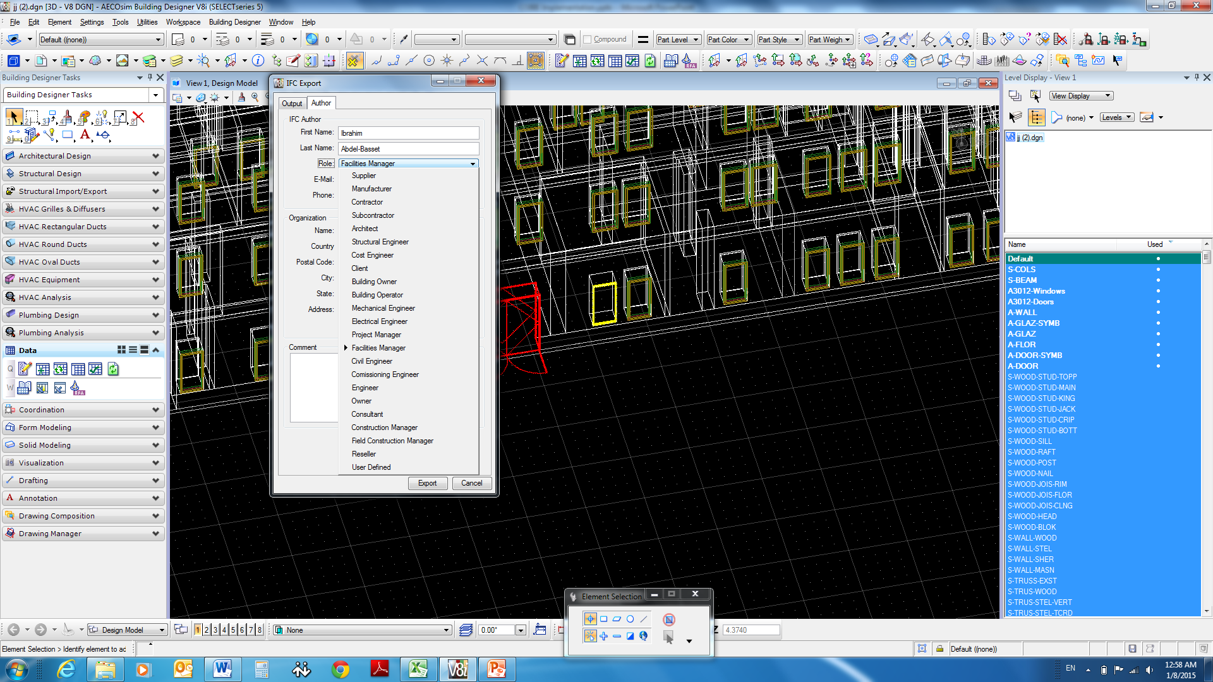
Author exporting COBIE
Exporting author information to Spreadsheet and as a consequence the COBIE -as an IFC- producer will be known in the spreadsheet contact workbook

Slide 21
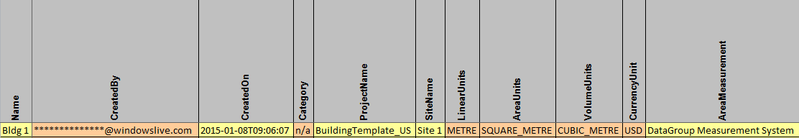
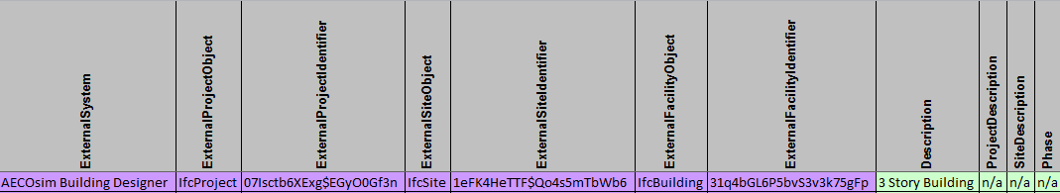
Early Design issues
COBIE Template
General Information about the project and the current project phase (Construction, Operation& Maintenance, .. ) and some information about Area, Responsible persons

Slide 22
Modeling Facility Management
In modeling Facility Management, COBIE is used to:
  Full monitoring on building objects
  Facilitate maintenance and operations
  Link model objects and improve IAQ
    New tab for new measurements linked to the model objects and spaces through the Unique element identifier

Slide 23
Agenda
Problem Statement
System Dynamics Modeling
Modeling Facility Management
Decision Making Tool
Conclusions

Slide 24
Decision Making
Objectives were defined and ranked using AHP
A questionnaire -that reflects experts opinions- was conducted to perform AHP process
Objective | Weight
Operating Cost Savings (Electricity & Fuel) | 0.31
Energy Consumption | 0.26
Lifecycle Cost Savings (With initial costs) (20 years) | 0.23
Carbon Emissions | 0.21

Slide 25
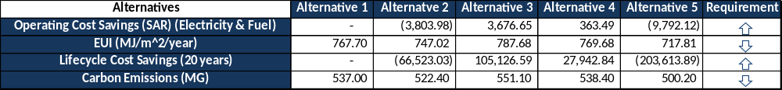
Decision Making
Then Alternatives were ranked using SIR (Superiority and Inferiority Ranking)
    Different Scenarios were tested to study the alternatives behavior and perform a sensitivity analysis
    SAW and TOPSIS (ƛ = 1,2,10) trials were applied
Base Run (Building Default)

Slide 26
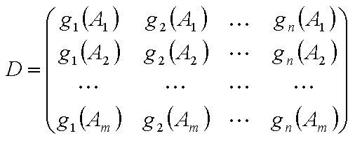
Superiority and Inferiority
Proposed by Xu (2001)
Decision Matrix
Measured criteria (g₁, g₂,... , g_{n}) and alternatives (A₁, A₂,..., A_{m}) form a decision matrix that is called D:

Slide 27
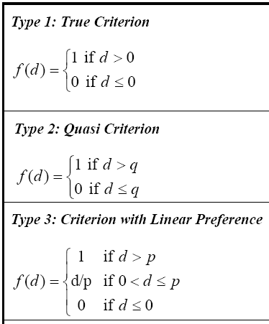
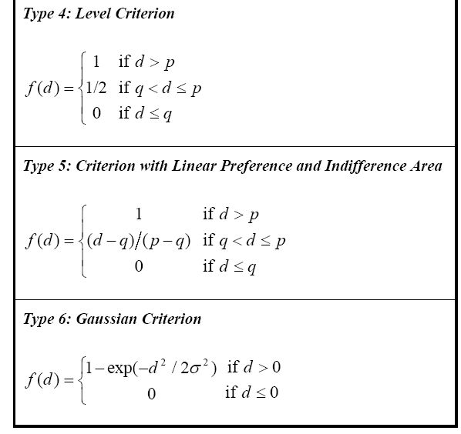
Superiority and Inferiority
Generalized Criterion Types
Six Types

Slide 28

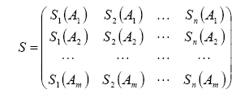
Superiority and Inferiority
Superiority index
S-Matrix

Slide 29

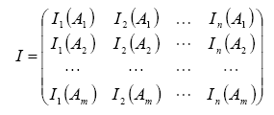
Superiority and Inferiority
Inferiority index
I-Matrix

Slide 30





Superiority and Inferiority
Estimation of Flows
S-Flow
I-Flow
n-Flow
r-Flow

Slide 31




Superiority and Inferiority
Complete Ranking
S-ranking
I-ranking

Slide 32

Superiority and Inferiority
Partial Ranking:
is obtained by combining S-ranking and I-ranking.
Preference relation (P)
Indifference relation (I)
Incomparability relation (R)

Slide 33
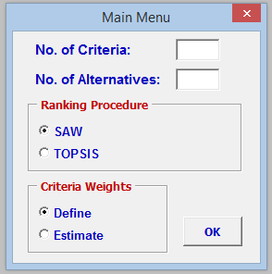
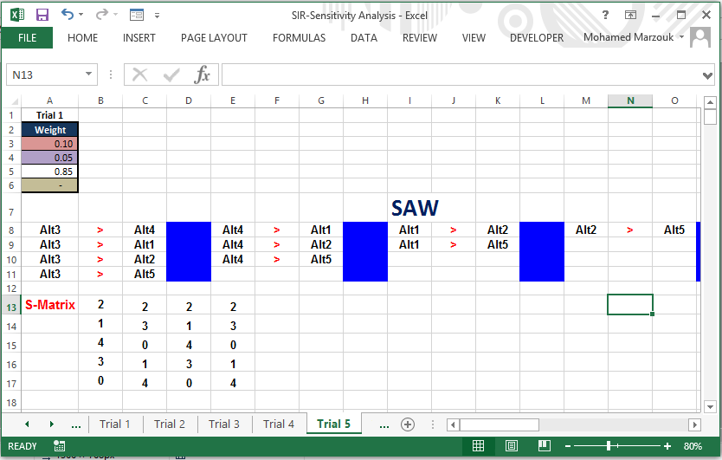
Decision Making
Alt 3
Alt 4
Alt 1
Alt 2
Alt 5

Slide 34
Decision Making
Sensitivity Analysis Applied on objectives’ weights to determine their criticality and effectiveness. It enables:
  Identifying critical parameters, testing robustness and overall riskiness of decision
  Increasing confidence, credibility and explicitly showing critical assumptions
  Increased understanding for relationships between input/output variables
  Identifying needs for more accurate measurements

Slide 35
Agenda
Problem Statement
System Dynamics Modeling
Modeling Facility Management
Decision Making Tool
Conclusions

Slide 36
Conclusions
Developed framework is considered the cornerstone for future work to properly describe, analyze and enhance building life sustainability behaviour.
Building life sustainability behaviour may provide a well-ground for debit of using activities interaction outcome rather than individual cost influence accompanied in defining, evaluating, and planning for sustainability investments.
Also, the developed tool is considered an early successful endeavour for developing wealthier and reliable yet simple method for measuring building performance

Slide 37
Thank You

