Slide 1
Lateral Humeral Condyle Fractures in Children: The Potential Role of Initial Assessment in Decision-Making
Prof. Mohamed M. Zamzam, MD
Professor and Consultant Orthopaedic Surgeon
College of Medicine, King Saud University
Riyadh, Saudi Arabia

Slide 2
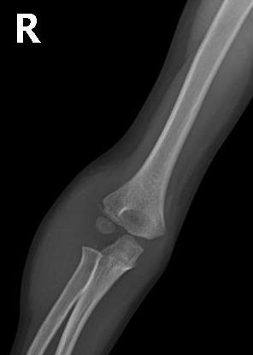
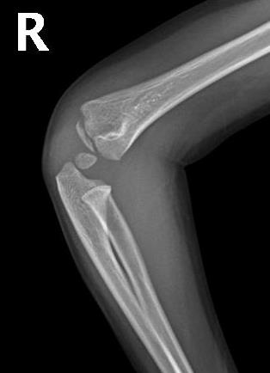
Accounts for 10-20% of all childhood elbow fractures
The diagnosis and treatment remain challenging

Slide 3
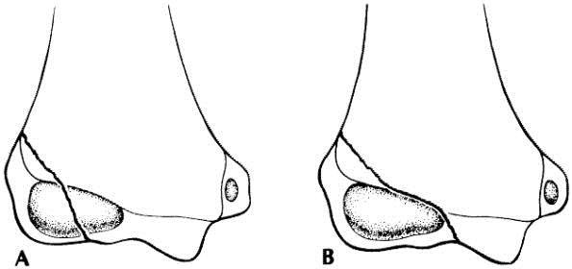
Fracture Classification
Milch classification (1964)
  Based on fracture location through the epiphysis
  The most commonly cited classification system,
  Not predictive of outcome or suggestive for the treatment

Slide 4
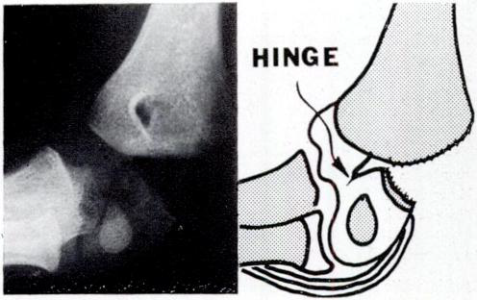
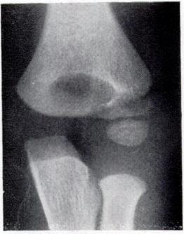
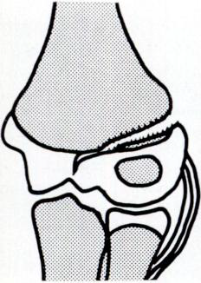
Fracture Classification
Jacob et al (1975) described two types of nondisplaced fractures
  An incomplete fracture with a cartilaginous bridge that prevents subsequent displacement

Slide 5
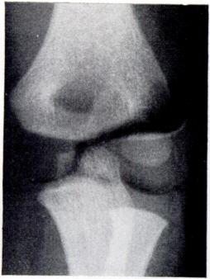
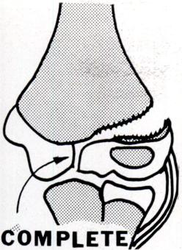
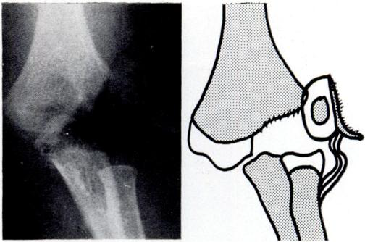
Fracture Classification
  A complete fracture with risk for further displacement

Slide 6
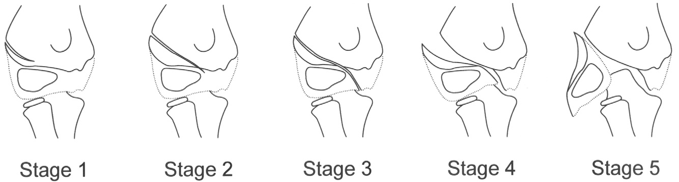
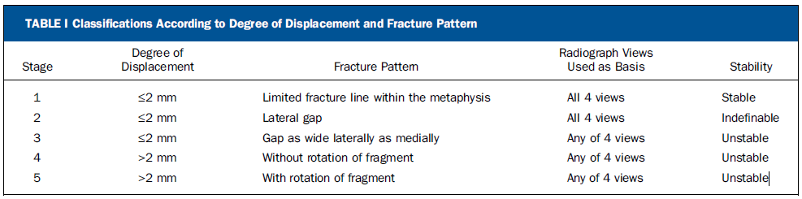
Fracture Classification
Song et al (2008)designed a comprehensive classification system that is linked to a treatment algorithm

Slide 7
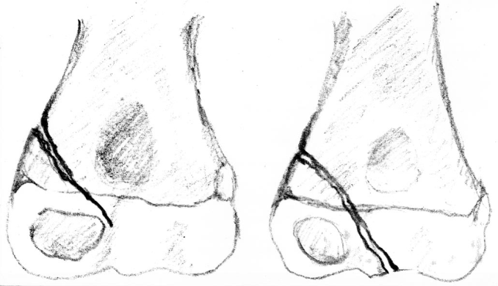
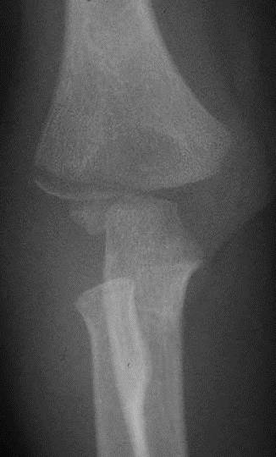
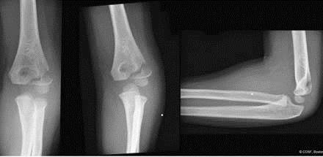
Fracture Classification
  Degree of Displacement
  Nondisplaced
  Minimally displaced
  Displaced

Slide 8
Imaging
  All attempts for the differentiation are either invasive or expensive
  Arthrography
  MRI
  Ultrasonography
  are frequently used

Slide 9
Treatment
There is consensus that the treatment of displaced fractures is closed or open reduction and internal fixation
The treatment of nondisplaced or minimally displaced fractures remains controversial

Slide 10
Treatment
The risk for subsequent displacement of these fractures has been reported as 11-42%
Delayed surgery with attempts to mobilize the fragment by stripping soft tissues have often led to avascular necrosis
Some investigators have recommended closed reduction with percutaneous pinning for minimally displaced fractures

Slide 11
Purpose of the Study
Our aim was
To recognize the impact of further displacement of nondisplaced and minimally displaced fractures on the outcome
To define the fracture displacement that necessitates primary surgical intervention
To ascertain which fractures need early follow up to avoid delayed surgery.

Slide 12
Patients
Inclusion Criteria
From 2004 to 2010
Complete information
Full radiographic examination
Follow up of at least four years

Slide 13
Patients
Exclusion Criteria
Associated injury of the same limb
Neuromuscular disorders

Slide 14
Methodology
The collected Data Include
Initial assessments
Treatment method
Operative data
Cast immobilization
Follow up
Complications
Healing

Slide 15
Methodology
The authors reviewed blindly all initial radiographs
Clinical practice pathway for paediatric lateral humeral condyle fracture
  Hairline fracture is considered nondisplaced
  A fracture gap ≤ 2 mm is minimally displaced
  A fracture gap ˃ 2 mm is a displaced fracture

Slide 16
Methodology
The outcome for each patient was graded according to the Cardona et al (4) modification of the Hardacre functional rating system
 | Clinical and Radiological Assessment
Excellent | No loss of motion, normal carrying angle, the patient is asymptomatic, and radiographs revealed a healed fracture
Good | An extension loss of no more than 15°, mild alteration of the carrying angle, and radiographs revealed a healed fracture
Poor | Significant and disabling loss of motion, a conspicuous alteration of the carrying angle, ulnar neuritis, or radiographic findings of non-union or avascular necrosis.

Slide 17
Results
98 children
67 boys (68.4%) and 31 girls
Age range 3-10 years (average, 5.7)
Right elbow in 38 patients (38.8%) and left in 60

Slide 18
Results
The initial assessment
  7 nondisplaced fractures (7.1%)
  29 minimally displaced fractures (29.6%)
  62 displaced fractures (63.3%)
63 were treated by surgical fixation within 24 hours
8 Redisplacement treated by delayed surgery
52 patients had internal oblique radiographic view
  49 displaced fracture
  3 minimally displaced

Slide 19
Results
The authors' assessments were compared with the initial assessments
Initial Assessment |  | Authors’ Assessment
 |  | Nondisplaced |  | Minimally displaced | Displaced
 | Nondisplaced (7) |  | 5 | 2 | 0
 | Minimally displaced (29) |  | 1 | 21 | 7
 | Displaced (62) |  | 0 | 0 | 62
 | Total (98) |  | 6 (6.1%) | 23 (23.5%) | 69 (70.4%)

Slide 20
Results
Significant association of open reduction with both minimally displaced and displaced fractures
Initial Diagnosis |  | Surgical Procedure and Method of Fixation |  |  |  | Total
 |  | Closed reduction 2 K-wires |  | Open reduction 2 K-wires | Open reduction 3 K-wires
 | Minimally displaced |  | 1 | 6 | 2 | 9
 | Displaced |  | 10 | 41 | 11 | 62
 | Total |  | 11 | 47 | 13 | 71

Slide 21
Results
The mean cast time was 5.1 weeks (range, 4-6)
The average follow-up was 50.2 months (range, 48-61)
5 superficial infection at the site of wire entry
21 children underwent a rehabilitation program
5 required an extended period of intensive PT

Slide 22
Results
4 poor results (minimally displaced fractures)
3 were proven to be displaced fractures
Three variables, specifically the initial assessment, the time from injury to surgery, and the casting period were significantly associated with the final outcome by crude analysis

Slide 23
Results
Significant association of poor results with open reduction
Treatment Method |  | Final Results |  |  |  | Total
 |  | Excellent |  | Good | Poor
 | Closed Reduction |  | 8 | 3 | 0 | 11
 | Open Reduction |  | 46 | 10 | 4 | 60
 | Non-operative |  | 27 | 0 | 0 | 27
 | Total |  | 81 (82.7%) | 13 (13.3%) | 4 (4.1%) | 98

Slide 24
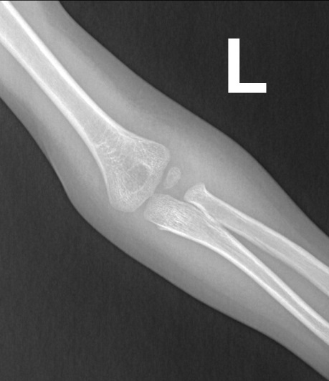
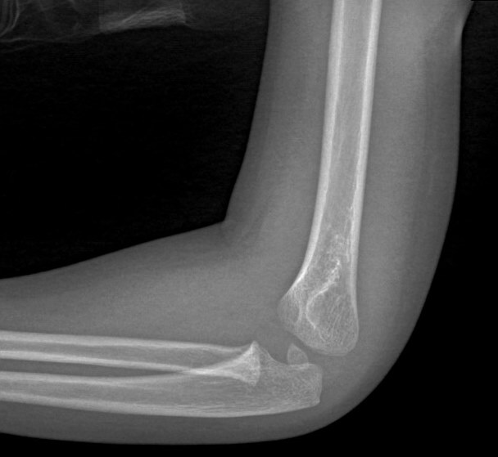
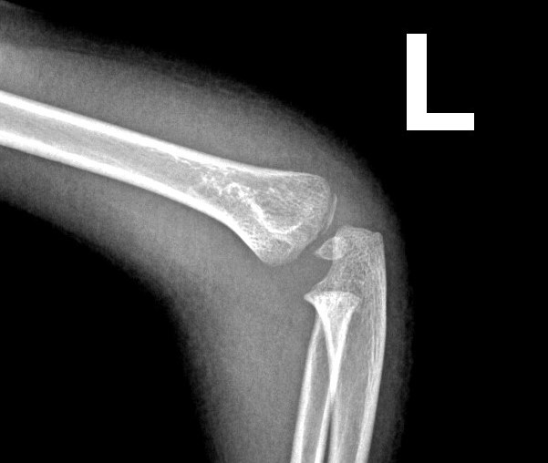
Lateral Humeral Condyle Fractures in Children
The results highlighted the significance of the initial assessment in decision-making
Most poor results were due to inaccurate initial evaluation and thus inadequate management

Slide 25
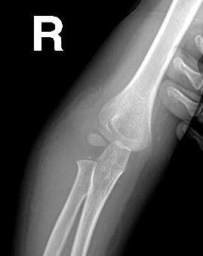
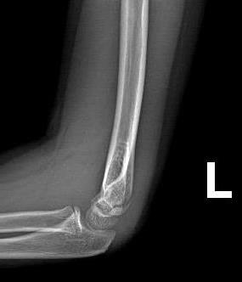
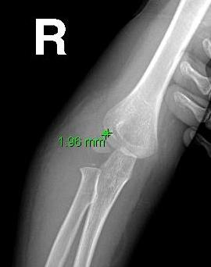
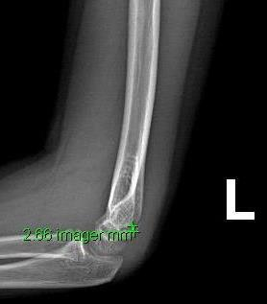
Lateral Humeral Condyle Fractures in Children
Standard classification system
Standardization of displacement definitions improved the initial assessment by 75%
Fracture with displacement ≥ 2 mm is considered displaced

Slide 26
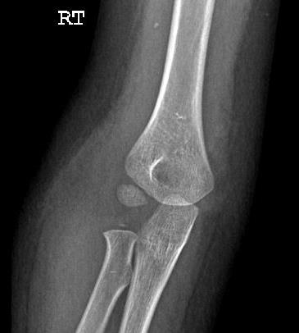
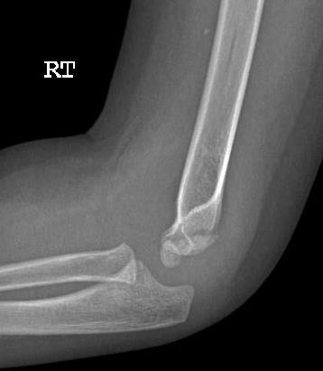
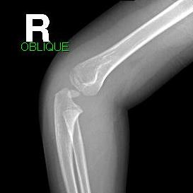
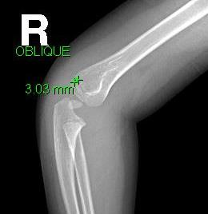
Lateral Humeral Condyle Fractures in Children
AP and Lat. views
Internal oblique view
Stress radiography, MRI, arthrography, and US are additional tools
Inherent drawbacks
Certain situations

Slide 27
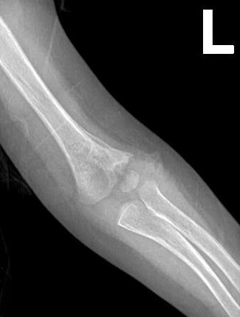
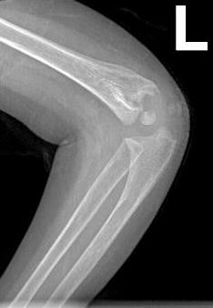
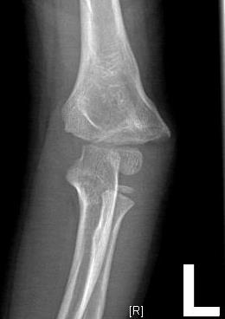
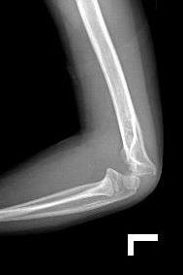
Lateral Humeral Condyle Fractures in Children
Most complications were associated with operative treatment
Minor
Major that led to substantial functional loss
Delayed surgery and complications

Slide 28
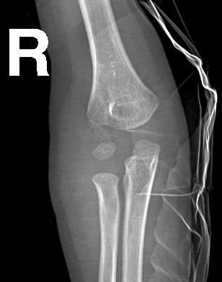
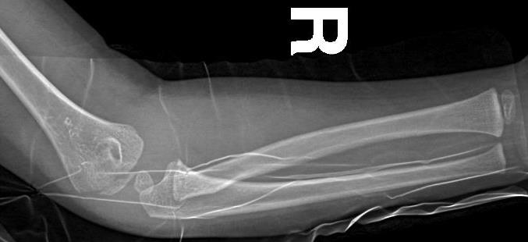
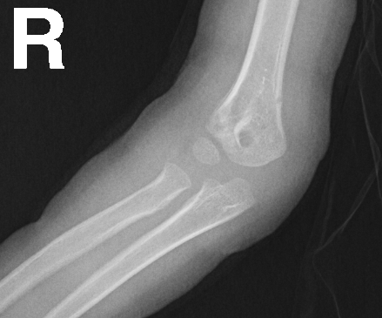
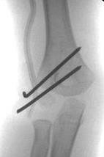
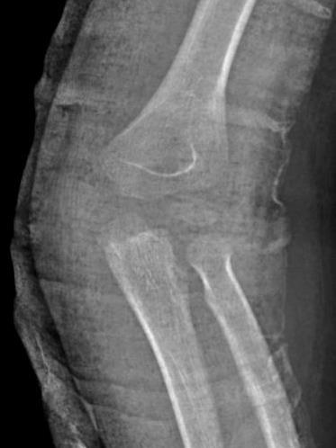
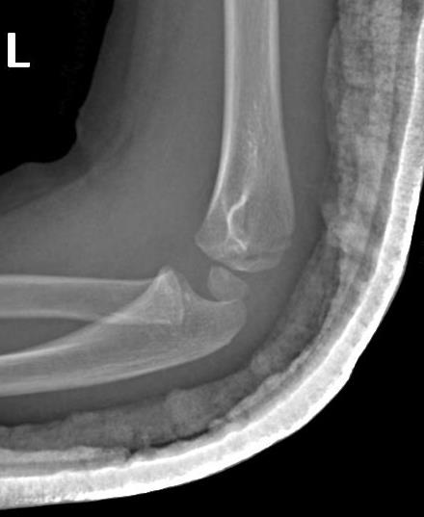
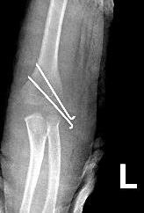
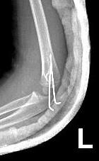
Lateral Humeral Condyle Fractures in Children
Key to obtaining a satisfactory outcome
Avoid delayed surgical intervention.
Determine the proper time for the first follow-up radiograph
No need to remove the cast to improve the x-ray quality

Slide 29
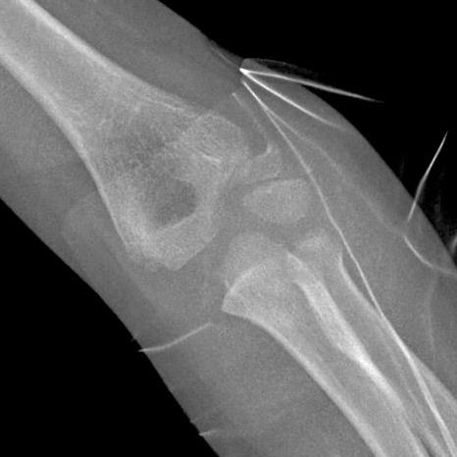
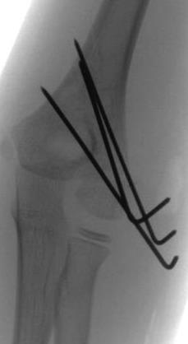
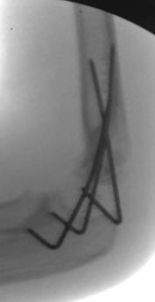
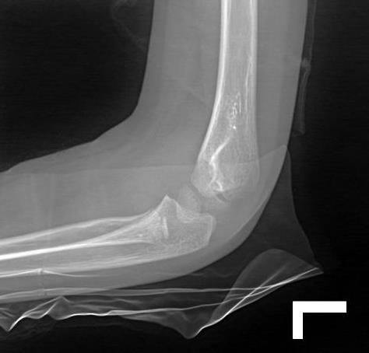
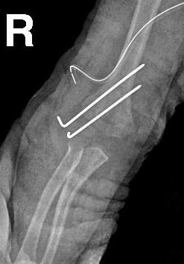
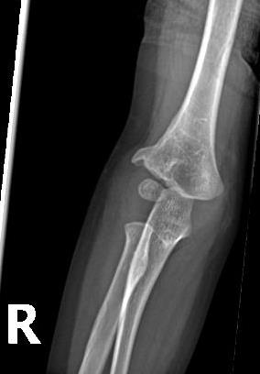
Lateral Humeral Condyle Fractures in Children
Closed or open reduction
Anatomic reduction
Tow or three K-wires

Slide 30
Conclusion
Careful initial assessment using the IO view in addition to standard x-ray views is crucial for adequate treatment
Fractures with ≥ 2 mm displacement should be primarily treated by surgical fixation
Fractures with < 2 mm displacement must be reviewed 4-6 days after cast application
If the patient's compliance with early follow up is not guaranteed and the fracture is not hairline, then primary closed reduction and percutaneous fixation is indicated.

