Slide 1


Slide 2
Use of Nanotechnology in Remediation of Heavy Metals Polluted Soils
by
Dr. Mohamed . I. D. Helal
Prof. Soil Sci. Dept., Fac. of Agric.,
Cairo University

Slide 3
Contents
Scientific Definitions
Properties of Nano Materials
General Methods for Preparation of Nano Materials
Introduction
Remediation of Heavy Metals Polluted Soils
- Remediation Techniques:
- Methods of production of nano particles
- Characteristics of the prepared nano particles
- Immobilization of Cd and Pb in polluted soils
- Distribution of Cd and Pb among soil fractions
- Conclusion

Slide 4
INTRODUCTION

Slide 5
Nano-science :
is an emerging science which comprises the world of atoms, molecules, macromolecules, quantum dots, and macromolecular assemblies.

Slide 6
Nano-technology
Nanotechnology is the technology for design, fabrication and manipulation of nanometre scale systems, in the scale of 1-100 nm.
Is any technology which exploits phenomena and structures that can only occur at nanometer scale.

Slide 7
What is Nanotechnology?
Nanotechnology deals with the creation of USEFUL materials, devices and systems using the particles of nanometer length scale and exploitation of NOVEL properties (physical, chemical, biological) at that length scale

Slide 8
Nanomaterials
NMs are materials have at least one dimension of size ~ 70nm (1-100 nm).

Slide 9

Classification of Nanomaterials
1- Nanomaterials are categorized according to their Dimensions.
Example | Nanomaterial dimension
Nano films, layers and coatings | One dimension < 100 nm
Nanowires, Nanotubes, fibres | Two dimensions < 100 nm
Nanoparticles, quantum dots, nanoshells , nanorings , microcapsules | Three dimensions < 100 nm

Slide 10
Properties of Nano materials

Slide 11
Properties of Nano materials
Familiar materials can have completely different properties at nanoscale.
The familiar classical physics guideposts of magnetism and electricity are no longer dominant.
The applicable laws of physics shift as Newtonian mechanics give way to quantum mechanics.

Slide 12
Properties of Nano materials
- Nanoscale sizes can lead to different physical and chemical properties:
  Melting point
  Boiling point
  Band gap
  Optical properties
  Electrical properties
  Magnetic properties
For example, metals with a so-called grain size of around 10 nanometers are as much as seven times harder and tougher than their ordinary counterparts with grain sizes in the micro meter range.

Slide 13
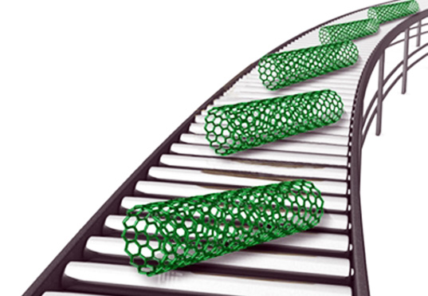
The vastly increased ratio of surface area to volume opens new possibilities in surface-based science, such as catalysis.
Interactions of individual atoms and molecules take place
Surface effects such as
Van der Waals force attraction,
hydrogen bonding,
electric charge,
ionic bonding,
covalent bonding,
hydrophobicity,
hydrophilicity and quantum mechanical tunneling.

Slide 14
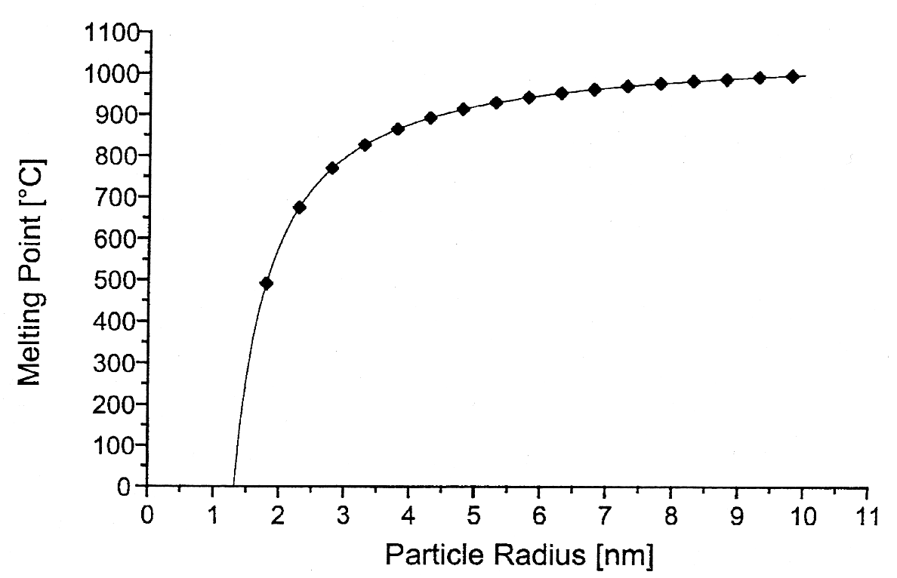
Properties of Nano materials
The melting point of gold particles decreases dramatically as the particle size gets below 5 nm
Melting Point
Source: Nanoscale Materials in Chemistry, Wiley, 2001

Slide 15
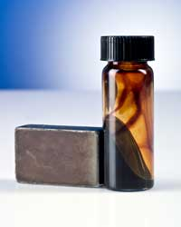
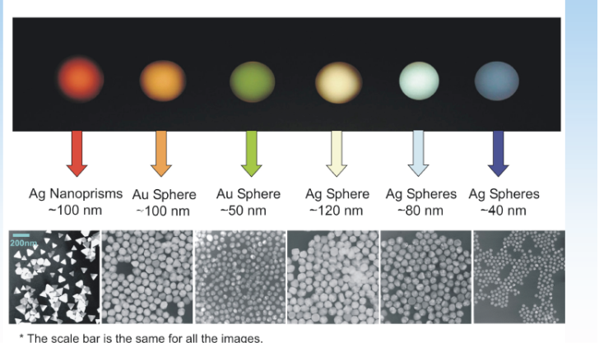
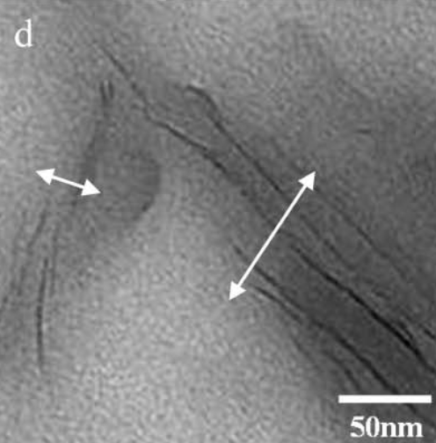
Properties of Nano materials
  Optical properties – color changes with size

Slide 16
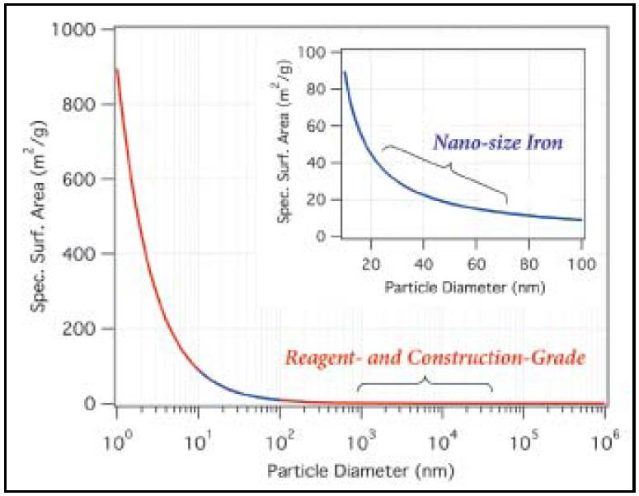
Properties of Nano materials Surface area dependence on particle size

Slide 17
Importance of Nano Materials
- Nano particles are of interest because of the new properties (such as chemical reactivity and optical behavior) that they exhibit compared with larger particles of the same materials.

Slide 18

Methods of Production
of Nanoparticles

Slide 19
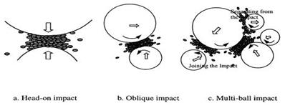
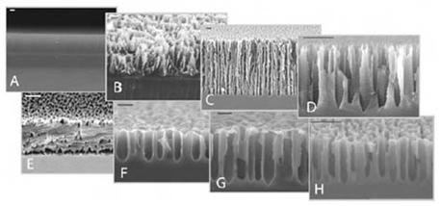
General Methods:
First : (top-down) method
Start from bulk until you reach the nano-cutting through the following:
1 – Milling method
2 - Scratching or etching method :
This method is used to produce particles of silicon nano particles

Slide 20
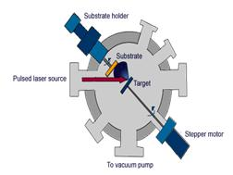
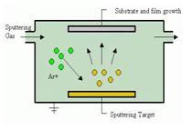
3- Laser ablation method : use of a laser pulse with a high-energy focused on the goal of the heart
4- (Sputtering) method :
Used to make thin film

Slide 21
Second : (Bottom-up) method
This method starts from the bottom of any of the atoms begin to separate them and then aggregated up to the level of nano scale methods used :
1 - (sol-gel) method
2- Aerosol method
3- Chemical vapor deposition method ( CVD )

Slide 22
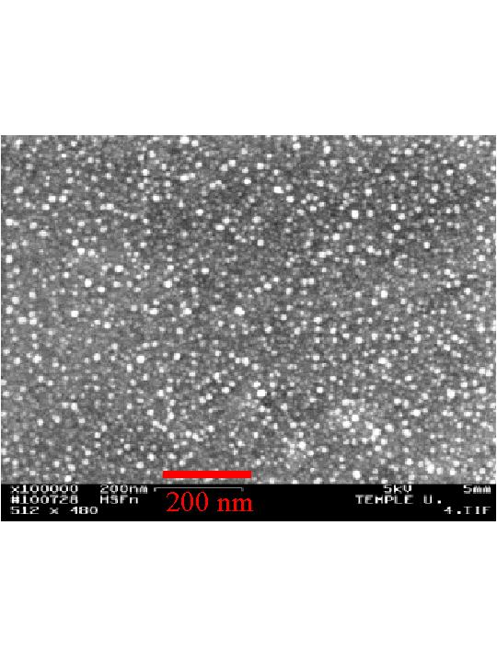
Iron Nano Particle

Slide 23
Remediation of Heavy Metals Polluted Soil

Slide 24
Remediation of Heavy Metals Polluted Soil
Definition:
Heavy metals are widely defined as metallic elements
that have a specific gravity of 5.0 g/cm³ or more.
Heavy metals are the most toxic inorganic pollutants
exist in soils.
They can be of natural or anthropogenic origin
(Bradl, 2004 and Sedgwick, 2005).
- There are about 50 elements can be classified as heavy metals, but only 17 are considered to be very toxic, e.g., Hg,, Pb, Cd, Ni and Cr.

Slide 25
Remediation of Heavy Metals Polluted Soil
Remediation technologies are scientific techniques used to remove pollutants and/or rehabilitate polluted natural materials.

Slide 26
Remediation techniques
Removing of pollutants
Stabilization/ immobilization
Soil leaching
Phytoremediation
Chemi- Remediation
Chemical Reactions, Absorption, Ion exchange, Precipitation.
Ex situ
Or
In situ
Hyper accumulators
Environmental safe
Conventional
Reagents (cement, phosphate, rock,…..)
Water or suitable solution
Need long time
cause pollution of the ground water (in situ
Extremly
Expensive
Nano materials

Slide 27
EXPERIMENTAL
&
RESULTS

Slide 28
Nano Immobilizing Materials
- Several nano particles are prepared and used for immobilization of Cd and Pb in polluted soils;
1- nZVI
2 - Bentonite supported nZVI (Bent-nZVI),
3 - Nano carbon
4 - Nano alginit

Slide 29
Methods of production of Nano Particles

Slide 30
Methods of production of Nano Particles
Nano particles used in our research are prepared using either:
1 - Chemical Methods
(nZVI and bent-nZVI)
II - Physical Methods
(nano alginit)

Slide 31
Methods of production of Nano Particles
I - Chemical Methods:
A - Nano-scale Zero Valent Iron (nZVI):
Synthesis of nZVI is based on reduction of Fe (II) using borohydride (Wang and Zhang, 1997 and Wang et al., 2006).
FeCl₂. 4H₂O and NaBH₄ are used. The proposed reaction is:
Fe⁺² + 2BH⁻ + 6H₂O → Fe⁰ + 2B(OH)₃ + 4H₂ ↑
- Sample of the product was inspected using TEM, and the particle size ranged from 13- 103 nm.

Slide 32
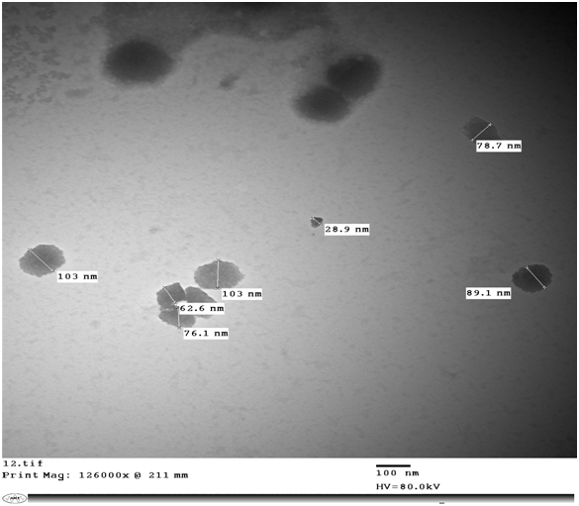
Figure1.Transmission Electron Microscopy “TEM” images of nZVI.
a

Slide 33
B - Bentonite Supported nZVI (bent-nZVI):
- 5.34 g FeCl₂.4H₂O was dissolved in a 4:1 (v/v) ethanol/water mixture (24 ml ethanol + 6 ml deion. H2O), then 1.5 g bentonite was added.
-The mixture was held on a magnetic stirrer to be mixed.
- Solid particles were washed three times with 25 ml portions of absolute ethanol to remove all water.
- Drying the synthesized nanoparticles overnight at 45 C°.
- TEM showed that particle size ranged from 28-110 nm

Slide 34
Methods of production of Nano Particles
II- Physical methods:
Nano alginite:
Alginite is a naturally occurring rock. It is greyish-green, it has high specific surface area, high number of functional groups and high CEC.
Nano alginit was prepared in lab by ball-milling (Photon company, Egypt). Portions of alginit were placed in a stainless steel canister with metal balls of different three sizes, and stirred for 27 hours at speed of 1000 rpm.
A sample of milled alginite was inspected using TEM, and the size of the alginite particle ranged from 13 – 23nm.

Slide 35
Nano Carbon : Thermal Preparation
- Nano carbon was collected from ovens of bread in
Iraq.
- TEM showed that particle size ranged from
12.9-23.9 nm

Slide 36
Table 1. Important characteristics of nanoparticles
Reagents | Particle Size Range (nm) | Surface area (m²/g) | CEC (Cmol_{(c)}/kg)
Nanoalginite | 53.5 – 63.1 | 194.2 | 47.7
nZVI | 12.7 – 103 | 235.7 | 42.5
Bent-nZVI | 27.8 – 110 | 225.4 | 47.7
nano carbon | 12.9 – 23.9 | 259.7 | -

Slide 37
Reaction Mechanisms of Nanoscale Zero Valent Iron (nZVI)

Slide 38
Reduction Power of nZVI
nZVI has been used extensively to reduce (dehalogenate) chlorinated solvents and sequester metals.
The small particle size and high surface area make iron nano particles highly reactive and extremely versatile.
Nano-particles can remediate more material at a higher rate and with a lower generation of hazardous byproducts (Zhang, 2003).

Slide 39
Oxidation of Organic Contaminants using Nanoparticles Zero Valent Iron (ZVI)
In an experiment with the pesticide molinate and ZVI, no change was observed in the concentrations of either one when bubbling nitrogen gas through the solution.
Air showed a marked reduction in molinate.

Slide 40
Oxidative Power of nZVI
Oxygen reacts with ZVI in two fashions.
In the useful pathway : Fe0 reacts with O2 to form Fe+2 and O2-2. The O2-2 reacts with hydrogen to form hydrogen peroxide which reacts with Fe+2 to form Fe+3 and hydroxyl radicals (Fenton's reaction) that are highly reactive oxidants.
The usefulness of the reaction depends on the efficiency of the branching process to favor hydroxyl radical formation.

Slide 41
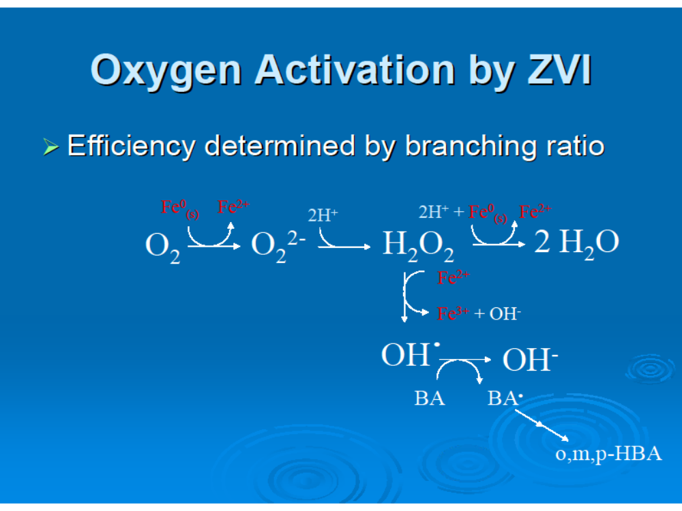

Slide 42
IMMOBILIZATION OF
Cd and Pb
IN
POLLUTED SOIL

Slide 43
Remediation of Heavy Metals Polluted Soil
The concept of immobilization technique based on:
The soluble/mobile form of an element in soil is considered to be a better indicator of the risk associated with heavy metals (e.g. leaching, bio-uptake) than the total metal concentration.
- Heavy metals are immobilized in soil through different processes, e.g., specific adsorption, cation-exchange and precipitation (carbonates, phosphates, sulfides, ….).

Slide 44
Immobilization of Cd and Pb in polluted soil
Heavy metals polluted soils are treated with nano materials at different ratios, 0, 0.1, 0.5 and 1%, and incubated for one month. During this period the samples were submitted to four cycling of wetting and drying.
The samples were extracted using DTPA before and after treating with nano materials.
DTPA solution consists of 0.005 M DTPA “Diethylene-triamine-penta acetic acid”, 0.01 M CaCl₂ and 0.1 M TEA “Tri ethanolamine” at pH 7.3.
DTPA solution is recommended to extract amount of metal represent the so called “ plant available Cd and Pb” in polluted soil

Slide 45
Table 2 : Initial contents of plant available (DTPA), and total Cd and Pb (mg/kg), and their ratios in polluted soils
Soil | DTPA-Cd | Total - Cd | Ratio (DTPA/ Total)% | DTPA-Pb | Total - Pb | Ratio (DTPA/ Total)%
1 | 3.2 | 8.9 | 36.6 | 52.7 | 180.0 | 29.3
2 | 19.9 | 47.5 | 42.0 | 47.3 | 275.0 | 17.2
3 | 3.7 | 8.7 | 43.0 | 41.5 | 150.0 | 27.7
4 | 7.6 | 21.0 | 36.3 | 33.6 | 135.0 | 24.9

Slide 46
Table 3 : Plant available Cd (mg/kg) in polluted soils before and after treating with Nano particles
DTPA- extractable Cd (mg/kg )
Treatment | Rate of addition % | Soil 1 | Soil 2 | Soil 3 | Soil 4
nZVI | 0.0 | 3.24 | 19.9 | 3.74 | 7.61
 | 0.1 | 1.71 | 9.36 | 1.66 | 3.21
 | 0.5 | 0.91 | 4.73 | 1.04 | 2.65
 | 1.0 | 0.23 | 2.01 | 0.11 | 2.17
Level of non polluted soil (Aboulroos et al,1988) |  | 0.06 | 0.06 | 0.06 | 0.06

Slide 47
Table 4 : Plant available Cd (mg/kg) in polluted soils before and after treating with Nano particles
DTPA- extractable Cd (mg/kg )
Treatment | Rate of addition % | Soil 1 | Soil 2 | Soil 3 | Soil 4
Bent-nZVI | 0.0 | 3.24 | 19.9 | 3.74 | 7.61
 | 0.1 | 1.56 | 10.05 | 1.48 | 3.14
 | 0.5 | 0.78 | 5.83 | 0.62 | 2.39
 | 1.0 | 0.15 | 3.79 | 0.15 | 1.51
Level of non polluted soil (Aboulroos et al,1988) |  | 0.06 | 0.06 | 0.06 | 0.06

Slide 48
Table 5: Plant available Pb (mg/kg) of polluted soils before and after treating with nano particles
DTPA- extractable Pb (mg/kg )
Treatment | Rate of addition % | Soil 1 | Soil 2 | Soil 3 | Soil 4
nZVI | 0.0 | 52.7 | 47.3 | 41.5 | 33.6
 | 0.1 | 24.6 | 25.1 | 21.5 | 11.5
 | 0.5 | 8.7 | 9.8 | 8.44 | 3.4
 | 1.0 | 3.2 | 3.5 | 2.9 | 1.62
Level of non polluted soil (Aboulroos et al, 1988) |  | 2.2 | 2.2 | 2.2 | 2.2

Slide 49
Table 6: Plant available Pb (mg/kg) of polluted soils before and after treating with nano particles
DTPA- extractable Pb (mg/kg )
Treatment | Rate of addition % | Soil 1 | Soil 2 | Soil 3 | Soil 4
Bent-nZVI | 0.0 | 52.7 | 47.3 | 41.5 | 33.6
 | 0.1 | 21.8 | 22.2 | 21.5 | 11.6
 | 0.5 | 7.3 | 8.2 | 8.4 | 2.9
 | 1.0 | 3.2 | 3.5 | 2.9 | 0.9
Level of non polluted soil (Aboulroos et al, 1988) |  | 2.2 | 2.2 | 2.2 | 2.2

Slide 50
Fig. 2. DTPA extractable-Cd expressed as percentages of the initial values of the studied samples after treating with three rates of nano immobilizing materials.

Slide 51
Fig. 3. DTPA extractable-Pb expressed as percentages of the initial values of the studied samples after treating with three rates of nano immobilizing materials.

Slide 52
PARTIONING
OF
Cd AND Pb
AMONG
DIFFERENT
SOIL FRACTIONS

Slide 53
Partitioning of Cd and Pb among different soil fractions:
A sequential extraction procedure was employed to study the effect of nano immobilizing materials on the distribution of Cd and Pb among various soil chemical forms;
1- exchangeable (EXCH),
2- bound with carbonate (CARB),
3- organic matter (OM),
4- oxides (OX) and
5- residual (RES).

Slide 54
Table 7 : Sum of all all fractions of Cd and Pb, total contents (mg/kg), and their ratios in soils
Soil | Cd |  |  | Pb
 | Sum of fractions | Total | Ratio (SUM/Total)% | Sum of fractions | Total | Ratio (SUM/Total)%
1 | 8.2 | 8.9 | 93.0 | 179.2 | 180.0 | 99.6
2 | 44.7 | 47.5 | 94.1 | 267 | 275.0 | 97.1
3 | 8.4 | 8.7 | 96.6 | 149.7 | 150.0 | 99.8
4 | 19.6 | 21.0 | 93.3 | 132 | 135.0 | 97.8

Slide 55
Table 8. Different fractions of Cd sequentially extracted from soil (1) before and after treating with nano particles
Treatment |  | Cd fractions (mg/kg)
 |  | EXCH | CARB | OX | OM | RES | SUM
 | Initial | 2.8 | 0.8 | 1.3 | 0.6 | 2.7 | 8.2
 | nZVI | 0.4 | 1.9 | 2.5 | 0.6 | 3.0 | 8.4
 | Bent-nZVI | 0.6 | 2.7 | 1.4 | 0.7 | 3.2 | 8.6

Slide 56
Table 9. Different fractions of Cd sequentially extracted from soil (2) before and after treating with nano particles
Treatment |  | Cd fractions (mg/kg)
 |  | EXCH | CARB | OX | OM | RES | SUM
 | Initial | 23.3 | 5.2 | 7.3 | 2.4 | 6.5 | 44.7
 | nZVI | 3.2 | 11.9 | 8.6 | 4.0 | 15.1 | 42.7
 | Bent-nZVI | 3.1 | 10.3 | 8.1 | 3.8 | 22.2 | 47.5

Slide 57
Table 10: Different fractions of Pb sequentially extracted from soil (1) before and after treating with nano particles
Treatment |  | Pb fractions (mg/kg)
 |  | EXCH | CARB | OX | OM | RES | SUM
 | Initial | 22.3 | 29.6 | 36.0 | 17.5 | 73.8 | 179.2
 | nZVI | 9.8 | 22.4 | 70.5 | 20.3 | 54.6 | 177.6
 | Bent-nZVI | 9.1 | 36.2 | 67.5 | 20.3 | 47.7 | 180.8

Slide 58
Table 11: Different fractions of Pb sequentially extracted from soil (2) before and after treating with nano particles
Treatment |  | Pb fractions (mg/kg)
 |  | EXCH | CARB | OX | OM | RES | SUM
 | Initial | 20.3 | 26.7 | 44.9 | 103.6 | 71.6 | 267.0
 | nZVI | 10.1 | 66.4 | 82.1 | 60.3 | 55.8 | 274.7
 | Bent-Nzvi | 10.1 | 68.4 | 78.3 | 65.8 | 51.2 | 27.0

Slide 59
Conclusion
All immobilizing nano materials efficiently reduced the contents of plant available Cd and Pb in polluted soils as extracted in DTPA solution.
The magnitude of the reduction of plant available Cd and Pb varied as the immobilizing nano materials and its rate of application varied.
Increasing application rate of immobilizing nano materials significantly decreased DTPA extractable-Pb of all tested soils.
The immobilizing nano materials could be arranged in descending order according to their efficiency in immobilizing Cd and Pb as follows:
bent-nZVI > dendrimers > nZVI > nano alginite > nano carbon.

Slide 60
Conclusion
Regarding partitioning of soil-Cd and -Pb among different factions;
the exchangeable Cd was the dominant one in all soils, followed by carbonate one, which indicates the high mobility of soil Cd.
Whereas a great potion of soil Pb exists in immobile fractions, e.g., residual and oxide ones.
All immobilizing nano materials significantly reduced the contents of exchangeable Cd and Pb in polluted soils, whereas those of other fractions; carbonate, oxide, organic and residual; significantly increased, indicating high efficiency of nano immobilizing materials to alter Cd and Pb form mobile to immobile fraction.
All immobilizing nano materials, particularly nZVI and bent-nZVI, are recommended to be used for remediation of Cd and Pb polluted soils due to their high efficiency, low cost, and safety to environment and human hygiene.

Slide 61

THANK YOU

Slide 62
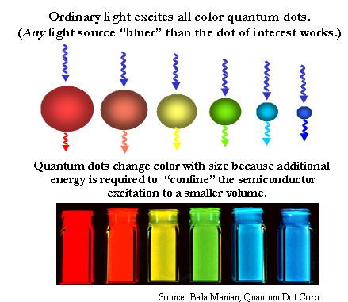
Optical Properties

