Slide 1


Predictors of response to methotrexate in juvenile idiopathic arthritis
Albarouni, Mohammed 1, Becker, Ingrid 2, Horneff, Gerd 1
1 Asklepios Klinik Sankt Augustin, Sankt Augustin
2 Institute of Medical Statistics, Informatics and Epidemiology, University of Cologne, cologne

Slide 2
Abstract
Objectives. To determine predictors for response to treatment with methotrexate in juvenile idiopathic arthritis patients (JIA).
Methods. Demographic, clinical, articular and laboratory variables of JIA patients newly treated with methotrexate were analysed by bivariate and logistic regression analysis to identify predictors of response to methotrexate. Minimal response was defined by the American College of Rheumatology pediatric (PedACR) 30 and strong response by the PedACR 70 criteria.
Results. The patient population consisted of 731 patients. At month 3, 77.4% and at month 12 83.1% of patients were responders according to the PedACR 30 criteria, while 43.1% and 65.9% of patients had a PedACR 70 response. Thus minimal response was frequently already reached at month 3 while strong response to MTX treatment took usually longer to achieve.

Slide 3
In multivariate analysis the number of tender joints (p=0.002), active joints (p<0.001), concomitant use of NSAID (p=0.027) and the parents evaluation of overall well-being (p<0.001) were significant baseline parameters predicting minimal response at month 3, while at month 12 the determinants for reaching PedACR 70 were a disease duration < 1 year (p=0.001), a lower number of tender (p <0.001) but a higher number of active joints (p<0.001), a higher score of the parent’s evaluation of child’s pain (p=0.029), and the presence of morning stiffness (p =0.014).
Conclusion. Baseline parameters for minimal response after 3 months of treatment and strong response after 12 months of treatment could be identified. Beside parameters defining activity and severity of disease, the disease duration and the concomitant use of NSAID were influencing factors. Overall the model of prediction could support physicians in making treatment decisions.

Slide 4
Background and Objectives
Juvenile idiopathic arthritis (JIA) is the most common chronic rheumatic illness in children and it is responsible for short and long-term disability.
Methotrexate (MTX) is the most common second line therapeutic agent used in treatment of JIA.
However, there is variation in the clinical response to MTX among the patients.
Identification of predictors of response might also be helpful to develop recommendations for MTX use.
The aim of this study is to determine baseline predictors for MTX response in patients with JIA.
Singh JA, Furst DE, Bharat A, et al. 2012 update of the 2008 American College of Rheumatology recommendations for the use of disease-modifying antirheumatic drugs and biologic agents in the treatment of rheumatoid arthritis. Arthritis Care Res (Hoboken). 2012;64(5):625-39.
Ravelli A, Martini A. MTX in juvenile idiopathic arthritis: answers and questions. J Rheumatol. 2000:27:1830-3
Gutierrez-Suarez R, Burgos-Vargas R. The use of methotrexate in children with rheumatic disease. Clin Exp Rheumatol. 2010sep-oct;28:122-7

Slide 5
Although serious toxicity in patients using MTX is uncommon, a prevalence of adverse effects as high as 42 % has been reported [12]. The main goal of JIA treatment is the achievement of wellbeing with minimal risk of side effects. Prediction of response can prevent further exposing patients to side effects of MTX and also saving the time by progressing to the treatment with an alternative therapy (e.g. biological drugs) as soon as possible to prevent irreversible complications.

Slide 6
Patients and Methods
Patient selection
Patient's data were taken from the German BIKER Registry founded in 2001.
The registry is a non-interventional long term study and has been approved by the ethics committee of the Aerztekammer Nordrhein, Duesseldorf, Germany.
Since 2005 patients, after formal approval of MTX for treatment of JIA, patients newly starting treatment with MTX were recruited.
Patients’ characteritics
915 patients were screened
731 (79.9%) patients were treated for at least 3 months and had a full data set
707 could be identified for month 12 analyses.
Females 68.7%
Persistent oligoarthritis is the most common JIA category with 201 patients (28.3%) followed by RF negative polyarthritis with 200 patients (27.3%). 18 patients (2.5%) had unclassified arthritis.

Slide 7
Inclusion and Exclusion Criteria
Inclusion Criteria
Admittance to the registry until December 31, 2010
Diagnosis of JIA according to the International League of Association for Rheumatology (ILAR) criteria
Treatment with MTX just started
Duration of MTX treatment of at least 3 months
Complete pretreatment data set available
Exclusion Criteria
Patients who had ever received biologics
Petty RE, et al. International League of Associations for Rheumatology, classification of juvenile idiopathic arthritis: second revision, Edmonton, 2001. J Rheumatol 2004;31:390-392

Slide 8
Evaluation of response to treatment
In this study early response to treatment was analysed at months 3 and additionally at 12 months.
Patients were divided into responders and non-responders according to the American College of Rheumatology Paediatric (PedACR) 30 or 70 improvement criteria.
Giannini EH, Ruberto R, Ravelli A, and paediatric Rheumatology International Trials Organization (PRINTO). Preliminary definition of improvement in juvenile arthritis. Arthritis Rheum. 1997;4:1202-9

Slide 9
Statistics
Descriptive Statistics:
  medians, first and third quartiles
  mean ± standard deviation (SD)
Pearson or Spearman correlation coefficients were calculated to detect relations between PedACR response and the potentially influencing parameters
Multivariate logistic regression analyses were performed to evaluate the role of all factors that were significantly correlated with the response parameters

Slide 10
Results
Month 3 Month 12
PedACR30 77.4% 83.1%
PedACR 70 43.1% 65.9%
The majority of JIA patients of all JIA categories reached a minimal response according to the PedACR30 criteria already after 3 months of treatment.
The number of patients reaching a PedACR 70 at month 3 was markedly lower but dramatically increased after 12 months of treatment with MTX in all JIA categories,
A 12 month duration of treatment was necessary to judge about a strong response.

Slide 11

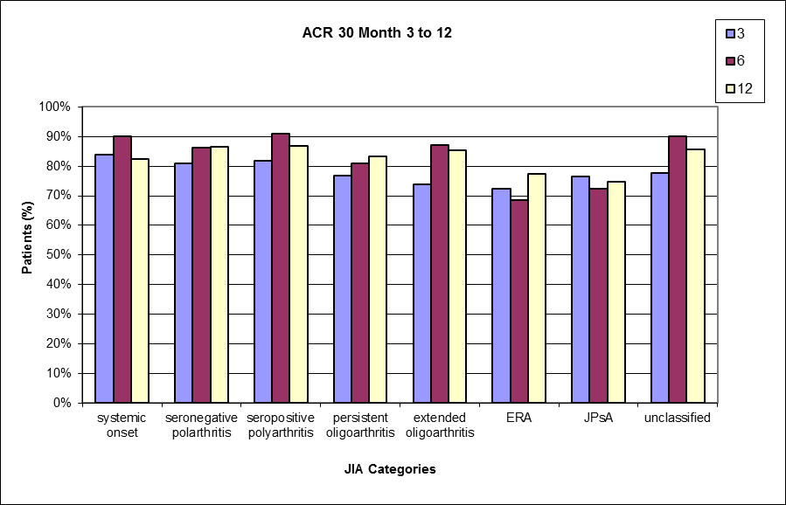
PedACR30 and JIA categories

Slide 12
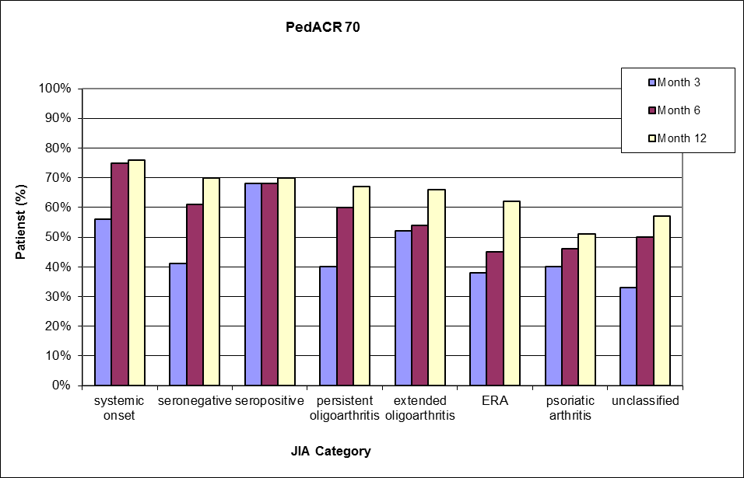
PedACR70 and JIA

Slide 13
PedACR30 response at month 3 predicts PedACR70 response at month 12 (Odd’s ratio 4.03 [95% CI 2.64-6.14]; p<0.001, χ2-test).
PedACR30 Month 3 PedACR70 Month 12
Yes n=567 (77.4%) Yes n= 320 (56.4%)
No n= 123 (21.7%)
no data* n= 124 (21.9%)
No n= 165 (22.6%) Yes n= 47 (28.5%)
No n= 73 (44.2%)
no data* n= 45 (27.3%)
* had not jet reached month 12

Slide 14
Patients’ characteristics: JIA Categories
Parameter | PedACR 30 at 3 months (n= 731) |  | PedACR 70 at 12 months (n= 707)
 | Responder 566 (77.4%) | Non responder 165 (22.6%) | Responder 466 (65.9%) | Non responder 241 (34.1%)
Systemic onset JIA | 21 (84%) | 4 (16%) | 13 (76.5%) | 4 (23.5%)
RF-negative Polyarthritis | 162 (81%) | 38 (19%) | 135 (70.3%) | 57 (29.7%)
RF-positive Polyarthritis | 18 (81.8%) | 4 (18.2%) | 16 (69.6%) | 7 (30.4%)
Persistent Oligoarthritis | 159 (76.8%) | 48 (23.2%) | 145 (67.4%) | 70 (32.6%)
Extended Oligoarthritis | 71 (73.9%) | 25 (26.1%) | 63 (66.3%) | 32 (33.7%)
Enthesitis related arthritis | 66 (72.5%) | 25 (27.5%) | 52 (61.9%) | 32 (38.1%)
Psoriatic Arthritis | 55 (76.4%) | 17 (23.6%) | 34 (50.7%) | 33 (49.3%)
unclassified JIA | 14 (77.8%) | 4 (22.2%) | 8 (57.1%) | 6 (42.9%)

Slide 15
Patients’ characteristics:
Parameter | PedACR 30 at 3 months (n= 731) |  | PedACR 70 at 12 months (n= 707)
 | Responder 566 (77.4%) | Non responder 165 (22.6%) | Responder 466 (65.9%) | Non responder 241 (34.1%)
Gender, female | 386 (68.2%) | 116 (70.3%) | 318 (68.2%) | 172 (71.4%)
Age at onset of disease (years) | 6.8 (3.3-11) | 6.4 (3.8-10.5) | 6.1 (2.9-10.4)** | 8.6 (3.9-12.1)
Age at MTX start (years) | 9.7 (5.3-13.5) | 9.5 (6-13.3) | 8.5 (4.8-13)*** | 11.4 (6.8-14.5)
Disease duration before MTX start (years) | 0.9 (0.3-2.9) | 1.1 (0.4-3.2) | 0.6 (0.3-2.3)*** | 1.3 (0.5-3.4)
Physician’s global assessment of disease activity | 40 (25-65)*** | 29 (19-51.7) | 45 (26-67)*** | 30 (20-55)
Parents evaluation of overall wellbeing | 44 (19-61)*** | 27 (8-46) | 42 (20-59)** | 31.5 (10-57)
Parents evaluation of Child’s pain | 40 (15-60.2)** | 26.5 (4.2-53) | 40 (17.2-58.7)** | 29.5 (5-56.25)
CHAQ-DI | 0.5 (0.12-0.87)*** | 0.25 (0-0.6) | 0.5 (0.12-0.9)*** | 0.25 (0-0.75)

Slide 16
Patients’ characteristics: Disease Activity parameters
Parameter | PedACR 30 at 3 months (n= 731) |  | PedACR 70 at 12 months (n= 707)
 | Responder 566 (77.4%) | Non responder 165 (22.6%) | Responder 466 (65.9%) | Non responder 241 (34.1%)
HLA B27 positive | 94 (19.2%) | 35 (22.9%) | 77 (19.4%) | 42 (18.8%)
ANA positive | 271 (49.2%) | 76 (48.4%) | 240 (53.7%) | 117 (48.9%)
ESR (mm/h) | 18 (10.0-31)*** | 12 (6.0-23.5) | 19.5 (10-36)*** | 12 (6.5-24)
CRP (mg/dl) | 4.2 (1.1-12) | 3 (1-7) | 5 (2-15.35)*** | 3 (1-7)
No. of active joints | 4 (2-8)*** | 2 (1-3) | 4 (2-8)*** | 2 (1-5)
No. of tender joints | 3 (2-7)*** | 2 (1-4 ) | 3 (2-7)** | 2 (1-6)
No. of swollen joints | 4 (2-8)*** | 2 (1-4) | 3 (2-7)*** | 2 (0-5)
No. of joints with LOM | 4 (2-8)*** | 2 (1-4) | 4 (2-8)*** | 2 (1-5)
Presence of morning stiffness | 360 (63.6%)*** | 71 (43%) | 300 (64.4%)*** | 120 (49.8%)

Slide 17
Bivariate analysis
Minimal response (PedACR 30): Significant associations
Month 3 Month 12
Concomitant use of NSAID + +
Presence of morning stiffness + +
Higher numbers of active joints + +
Higher numbers of tender joints + +
Higher numbers of swollen joints + +
Higher numbers of joints with LOM + +
Higher disability score in the CHAQ, + +
Higher parent’s evaluation of overall wellbeing, + +
Physician’s global assessment of disease activity + +
ESR + +
Higher parent’s evaluation of child’s pain +
Shorter disease duration before MTX +
Lower age at onset of disease +
Lower age at MTX start +

Slide 18
Bivariate analysis
Strong response (PedACR 70) ): Significant associations
Month 3 Month 12
Shorter disease duration + +
Higher numbers of active joints + +
Higher numbers of swollen joints + +
Higher numbers of tender joints + +
Higher numbers of LOM-joints + +
Higher CHAQ disability score + +
Higher Parent’s eval. overall wellbeing + +
Higher physician’s global + +
Higher ESR + +
Lower age at onset of disease +
Lower age at MTX start +
Higher pain score +
Higher CRP value +

Slide 19
Multivariate Analysis
Multivariate logistic regression analysis of baseline parameters was performed with all variables that did significantly correlate with PedACR 30 at month 3 and PedACR 70 response at month 12.
The predictor’s accuracy was evaluated by ROC (receiver operating characteristic) curve analysis. The results for PedACR 30 at month 3 yielded an AUC of 0.736 with a specificity of 12.4% and a sensitivity of 98.7%.
For the PedACR 70, we found a reasonable regression model at month 12 (AUC = 0.672, specificity =27.0% and sensitivity=90.7%). The model at month 3 showed accuracy ≤60%, which is barely above chance, and therefore not useful as prediction model.

Slide 20
Multivariate Analysis
Final logistic regression models for PedACR response
Determinants of response | OR (95% CI) | p-value
PedACR 30 at month 3
No. of tender joints | 0.92 (0.88-0.97) | 0.002
No. of active joints | 1.26 (1.16-1.36) | <0.001
Parents evaluation of overall wellbeing [VAS 0-100mm] | 1.02 (1.01-1.03) | <0.001
Concomitant use of NSAIDs | 1.89 (1.08-3.34) | 0.027
Model performance: AUC Sensitivity Specificity | 73.6% 98.7% 12.4%

Slide 21
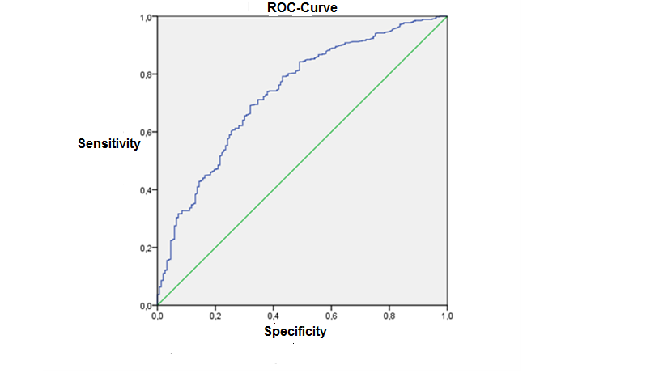
Figure 3. ROC-Curve for PedACR 30 at month 3 (AUC=0,736, specificity=12.4%, sensitivity= 98.7%)

Slide 22
Multivariate Analysis
Determinants of response | OR (95% CI) | p-value
Ped ACR70 at month 12
Disease duration >1 year | 0.54 (0.39-0.77) | 0.001
No. of tender joints | 0.92 (0.88-0.97) | <0.001
No. of active joints | 1.10 (1.05-1.16) | <0.001
Parent’s evaluation of child’s pain [VAS 0-100mm] | 1.01 (1.00-1.01) | 0.029
Presence of morning stiffness | 1.58 (1.10-2.28) | 0.014
Model performance: AUC Sensitivity Specificity | 67.2% 90.7% 27.0%

Slide 23
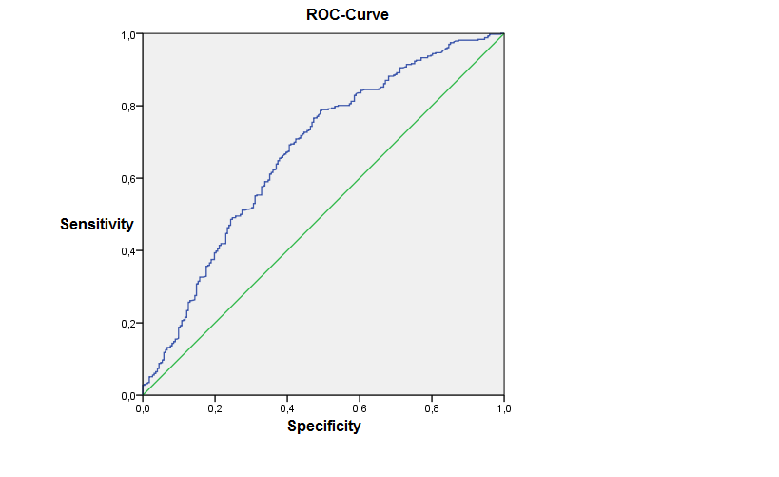
Figure 4. ROC-Curve for PedACR 70 at month 12 (AUC=0,672, specificity=27%, sensitivity=90.7%)

Slide 24
Discussion
Predictors for response/non-response to treatment with MTX were identified.
These findings can be considered for recommendations for the use of MTX in patients with JIA.
Non-Response (failure to achieve ACR70) is linked to a longer disease duration, a lower number of active joints, a higher number of tender joints, a lower score of parent’s evaluation of child’s pain at baseline.
Early PedACR 30 responders (Month 3) were 4 fold more likely to reach a strong response later on. Thus non-response at month 3 should prompt to a treatment escalation as recommended in the ACR recommendations.

Slide 25
Discussion
The recent concept of JIA treatment suggests that the early aggressive intervention may buy long term disease suppression [17, 31].
Previous studies have shown conflicting results regarding predictors of response to MTX. In three previous studies, the results indicate a different effect of MTX according to the type of JIA. Halle and Prieur found that the systemic form seemed less responsive than ANA positive form with polyarticular course [22], while Woo et al found that MTX is an effective treatment for both extended oligoarthritis and systemic JIA [21], Ravelli et al concluded that the extended oligoarticular category is the best predictor of MTX efficacy [19]. However the analysis of the PRINTO MTX trial showed that the frequency of JIA categories was comparable between responders and non-responders [17].

Slide 26
Discussion
The present study confirms the observations of the PRINTO study regarding JIA categories. In the multivariate analyses JIA categories did not significantly predict the response to MTX according to PedACR 70 criteria.
The PedACR 70-response rate in our study increased markedly from month 3 to month 12. The increasing number of responders in the course of treatment suggests that the low success at three months may be affected by the delay of clinical response achieved by MTX treatment. These findings are in line with common view that the maximum therapeutic effect usually becomes apparent 4 to 6 months after the beginning of treatment [5].
In this study the achievement of PedACR 30 at month 3 was a highly significant positive predictor for reaching PedACR 70 at month 12 with an odd’s ratio of 4.03 [95% CI 2.64-6.14].

Slide 27
After 12 months from the beginning of therapy with MTX, the strong response according to PedACR 70 was associated with disease duration less than 1 year, higher numbers of active joints, lower numbers of tender joints, higher scores for parent’s evaluation of pain and the presence of morning stiffness.
The presence of the number of active joints as a part of the PedACR score of improvement could hardly explain the relationship, which most likely is due to anti-inflammatory mechanism of action of MTX.
This may explain the relationship between reaching of strong response and the number of active joints as well as other activity parameters such as morning stiffness and pain, which in the present study was assessed by patient or parents global assessment of pain.

Slide 28
The significant relationship between the number of tender joints and reaching a PedACR 70 response can be explained by the indirect effect of presence of tenderness or pain on the components of PedACR criteria, not only on physician’s global assessment score and parent’s evaluation of overall well-being, but also on CHAQ-DI, which comprises two indices, the first is the disability index, and the other is discomfort index which is determined by the presence of pain measured by a 100 mm analogue scale [30].
Disease duration before MTX start as a variable was not significant in multivariate analysis, while the categorized disease duration (less or more than 1 year) had a significant effect on reaching PedACR 30 and 70. We found that a shorter disease duration (< 1 year) was significantly associated with reaching a strong response (PedACR 70) at month 12, while higher disease duration (> 1 year) was predicted a poor response. This finding supports the results of the PRINTO study and the previous clinical experience which suggests that the early treatment is more effective [17, 26, 31].

Slide 29
In contrast to the PRINTO study of predictors of response to MTX, in our study the presence of ANA as well as CHAQ score were no significant predictors for a strong response (PedACR 70) [17].
These variations may be due to many differences between the present study and the PRINTO study, although the general designs were similar. Bivariate and logistic regression analysis was used to identify baseline predictors of poor response. Also the improvement was assessed according to the American College of Rheumatology criteria for pediatrics, by using PedACR 30 for minimal improvement analysis and PedACR 70 for strong improvement analysis.
In the PRINTO study, the patients with seropositive polyarthritis, psoriatic arthritis and enthesitis related arthritis categories were excluded from the study sample, while in the present study all JIA categories were included.
An important difference between the two studies is the time of evaluation of improvement, while in the PRINTO study the evaluation of improvement was done at month 6 only, in our study the evaluation was done at month 3 and 12.

Slide 30
This gives advantages to the present study and allows for better assessment of early response as well as the response after long duration of treatment and determination which variables could predict the response at these times. Another advantage of the present study is the larger study. Our sample included 731 patients, while in the PRINTO study the sample was restricted to 563 patients.
In conclusion, we have found that a longer disease duration, a lower number of active joints, a higher number of tender joints, a lower score of parent’s evaluation of child’s pain at baseline were significantly at risk not to achieve a PedACR 70 response, while the presence of morning stiffness was a positive predictor to reach PedACR 70. Interstingly, early PedACR 30 responders were much more likely to reach a strong response later on. These findings can be considered as recommendations for the use of MTX in patients with JIA, since the presence of these baseline determinants predict a response to MTX, even after prolongation of exposure for up to 12 months, thereby may prompt the physicians to start an alternative drug therapy earlier.

Slide 31
References
1. Petty RE, et al. International League of Associations for Rheumatology, classification of juvenile idiopathic
arthritis: second revision, Edmonton, 2001. J Rheumatol 2004;31:390-392
2. Weis JE, Ilowite NT. Juvenile idiopathic arthritis. Rheum Dis Clin N Am 2007;33:441-470
3. Singh JA, Furst DE, Bharat A, et al. 2012 update of the 2008 American College of Rheumatology
recommendations for the use of disease-modifying antirheumatic drugs and biologic agents in the treatment of
rheumatoid arthritis. Arthritis Care Res (Hoboken). 2012;64(5):625-39.
4. Holzinger D, Frosch M, Föll D. Methotrexate in the therapy of juvenile idiopathic arthritis. Z Rheumatol
2010;69:496-504
5. Ravelli A, Martini A. MTX in juvenile idiopathic arthritis: answers and questions. J Rheumatol. 2000:27:1830-3
6. Ruberto N, Murray KJ, Gerloni V, et al. Arandomized trial of parentral methotrexate comparing an intermediate
dose with higher dose in children with juvenile idiopathic arthritis who failed to respond to standard doses of
methotrexate. Arthritis Rheum 2004;50:2191-201
7. Gutierrez-Suarez R, Burgos-Vargas R. The use of methotrexate in children with rheumatic disease. Clin Exp
Rheumatol. 2010sep-oct;28:122-7
8. Horneff G, De Bock F, et al.; German and Austrian Paediatric Rheumatology Collaborative Study Group. Safety
and efficacy of combination of etanercept and methotrexate compared to treatment with etanercept only in patients with juvenile idiopathic arthritis (JIA): preliminary data from the German JIA registry. Ann Rheum Dis.
2009;68:519-25
9. Foeldvari I and Horneff G: Methotrexate is protective against the new onset of uveitis under etanercept treatment: data from the German etanercept Registry. Ann.Rheum. Dis. 2010;69(suppl.3)

Slide 32
10. Horneff G. Update on biologicals for treatment of juvenile idiopathic arthritis. Expert Opin Biol Ther.
2013;13(3):361-76.
11. Klein A, Horneff G, et al. Efficacy and safety of oral and parenteral methotrexate therapy in children with juvenile idiopathic arthritis: An observational study with patients from the German Methotrexate Registry. Arthritis Care and Research. 2012 Sep;64(9):1349-1356
12. Raveli A, Gerloni V, Corona F, et al .Oral versus intramuscular methotrexate in juvenile chronic arthritis. Clin Exp Rheumatol. 1998;16:181-3
13. Horneff G, Schmeling H, et al. The German etanercept registry for treatment of juvenile idiopathic arthritis (JIA). Ann Rheum. Dis. 2004;63:1638-1644
14. Lovell DJ, Giannini EH, Reiff A, et al . Etanercept in children with polyarticular juvenile rheumatoid arthritis. N Engl J Med 2000;342:763-9
15. Ruberto N, Lovel DJ, et al. Arandomized, placebo controlled trial of infliximab plus methotrexate for the treatment of polyarticular course juvenile rheumatoid arthritis. Arhritis Rheuma 2007;56(9):3096-106
16. Lovell DJ, Ruperto N, et al. Adalimumab with or without methotrexate in juvenile rheumatoid arthritis. N Engl J Med 2008;359:810-20
17. Vilca I, Munitis PG, et al. Predictors of poor response to methotrexate in polyarticular-course juvenile
idiopathic arthritis: analysis of the PRINTO methotrexate trial. Ann Rheum Disease 2010;69:1479-1483
18. Giannini EH, Ruberto R, Ravelli A, and paediatric Rheumatology International Trials Organization (PRINTO). Preliminary definition of improvement in juvenile arthritis. Arthritis Rheum. 1997;4:1202-9
19. Ravelli A, Viola S, et al. The oligoarticular subtype is the best predictor of methotrexate efficacy in juvenile idiopathic arthritis. J Pediater 1999;135:316-20

Slide 33
21. Woo P, Southwood TR, et al. Randomized, placebo-controlled , crossover trial of low-dose oral methotrexate
in children with extended oligoarticular or systemic arthritis. Arthritis Rheum 2000; 43:1849-57
22. Halle F, Prieur AM. Evaluation of methotrexate in the treatment of juvenile chronic arthritis according to the
subtype. Clin Exp Rheumatol 1991;9:297-302
23. Felici E, Novarini C, et al. Course of joint disease in patients with antinuclear antibody-positive juvenile
idiopathic arthritis. J Rheumatol 2005;32:1805-10
24. Oen K. Long-term outcomes and predictors of outcomes for patients with juvenile idiopathic arthritis. Best
Pract Res Clin Rheumatol 2002;16:347-60
25. Ravelli A, Martini A. Juvenile idiopathic arthritis. Lancet 2007;369:767-78
26. Anderson JJ, Wells G, et al. factors predicting response to treatment in rheumatoid arthritis. The importance
of disease duration. Arthritis Rheum 2000;43:22-9
27. Ringold S, Wallace CA. Measuring Clinical Response and Remission in Juvenile Idiopathic Arthritis: Measures
of Disease Activity. Curr opin Rheumatol CME. 2007;19(5):471-476
28. Pincus T, Sokka T, Kavanaugh A. Relative versus absolute goals of therapies for RA: ACR 20 or ACR 50 responses versus target values for “near remission” of DAS or single measures. Clin Exp Rheumatol
2004;22(5Suppl 35): S50-6.
29. Silverman E, Spigel L, Hawkins D, et al. Long term open label preliminary study of the safety and efficacy of
leflunomide in patients with polyarticular course juvenile rheumatoid arthritis. Arthritis Rheum 2005;52:554
30. Duffy CM. Measurement of Health status, Functional status and Quality of Life in children with Juvenile Idiopathic Arthritis : clinical science for the paediatrician. Rheum Dis Clin N Am 2007;33:389-402
31. Albers HM, et al. Time to treatment as an important factor for the response to methotrexate in juvenile
idiopathic arthritis. Arthritis Rheum. 2009 Jan 15;61(1):46-51

