Slide 1

Potential for biocontrol of food-borne pathogens with Bacteriovorax sp. and implications for food safety
Modesto Olanya and Gary Richards
USDA Agricultural Research Service, Eastern Regional Research Center, Wyndmoor, PA and USDA-ARS, Dover, DE

Slide 2
Comparison of predatory prokaryotes
Parameters | Bdellovibrio / Bacteriovorax | Vampiricoccus | Daptobacter
Occurrence | Seawater, soil, water | Fresh water | Fresh water
Size & morphology | 0.35 x 1.2 µm, curved rods | 0.6 µm, ovoid | 0.5 x 1,5 µm Straight rods
Motility | Single polar sheath flagellum | Non-motile | Single polar, un-sheathed flagellum
Site in prey | Periplasmic space | Epibiotic – attached to cell wall | Endobiotic / cytoplasm
Reproduction Prey hosts | Bdelloplasts, segmentation Gram negative bacteria | Binary fission Chromatium sp., phototrophs | Binary fission Chromatiaceae, phototrophs
Host specificity | Obligate / host independent forms | Obligate | Obligate
Adapted: from | Guerreo et al. 1986
Notes:
58% yield increase from PP to SI under rainfed mgmt.

Slide 3
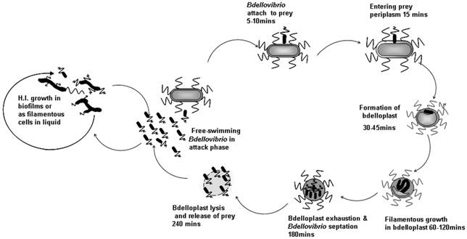
Source: Sockett et al. 2004. PLoSONE

Slide 5
Biocontrol of plant pathogens with predatory bacteria
Plant pathogens | Host | Disease | Reference
Pseudomonas glycinea | Soybean | Bacterial blight | Scherff, 1972
Burkholderia glumae | Rice | Grain rot | Song 2004
Xanthomonas oryzae | Rice | Sheath blight | Uematsu, 1980
Erwinia carotovora | Potato slices | Soft rot | Epton et al. 1990

Slide 6
Biocontrol of foodborne pathogens with predatory bacteria
Predator | Pathogen | Host / Media | Reference
Bdellovibrio bacteriovorus | Pseudomonas tolaasii | Mushroom (pilei brown spot) | Saxon et al. 2014
Bacteriovorax sp. | Vibrio vulnificus / V. parahaemolyticus | Oysters / seawater | Richards et al. 2012
B. bacteriovorus | E. coli O157:H7 | In vitro assay | Sockett 2009
B. bacteriovorus | Staphylococcus aureus | Human epithelial cells | Monappa et al. 2014
B. bacteriovorus B. bacteriovorus | Drug-resistant Gram negative bacteria P. aeruginosa and S. aureus | In vitro assay In vitro assay | Kadouri et al. 2013 Valerio et al. 2014

Slide 7
Objectives
To optimize the plaque assay and assess the
predation of E. coli O157:H7 and other foodborne
pathogens by Bacteriovorax sp. (Predatory bacteria).
To evaluate the effect of temperatures on the
predation of E. coli O157:H7 and other foodborne
pathogens by Bacteriovorax sp. and subsequently
their potential as biocontrol agents.

Slide 8
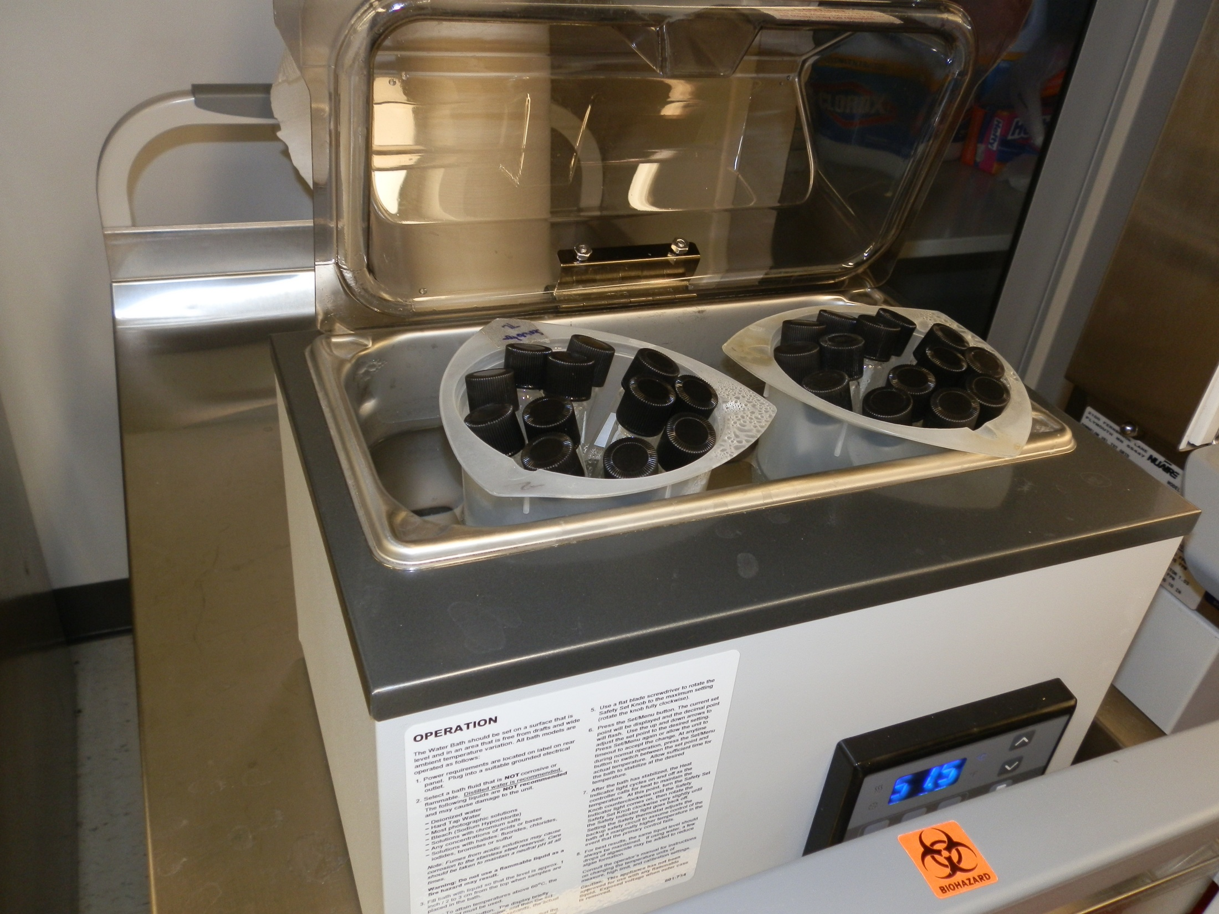

Slide 9
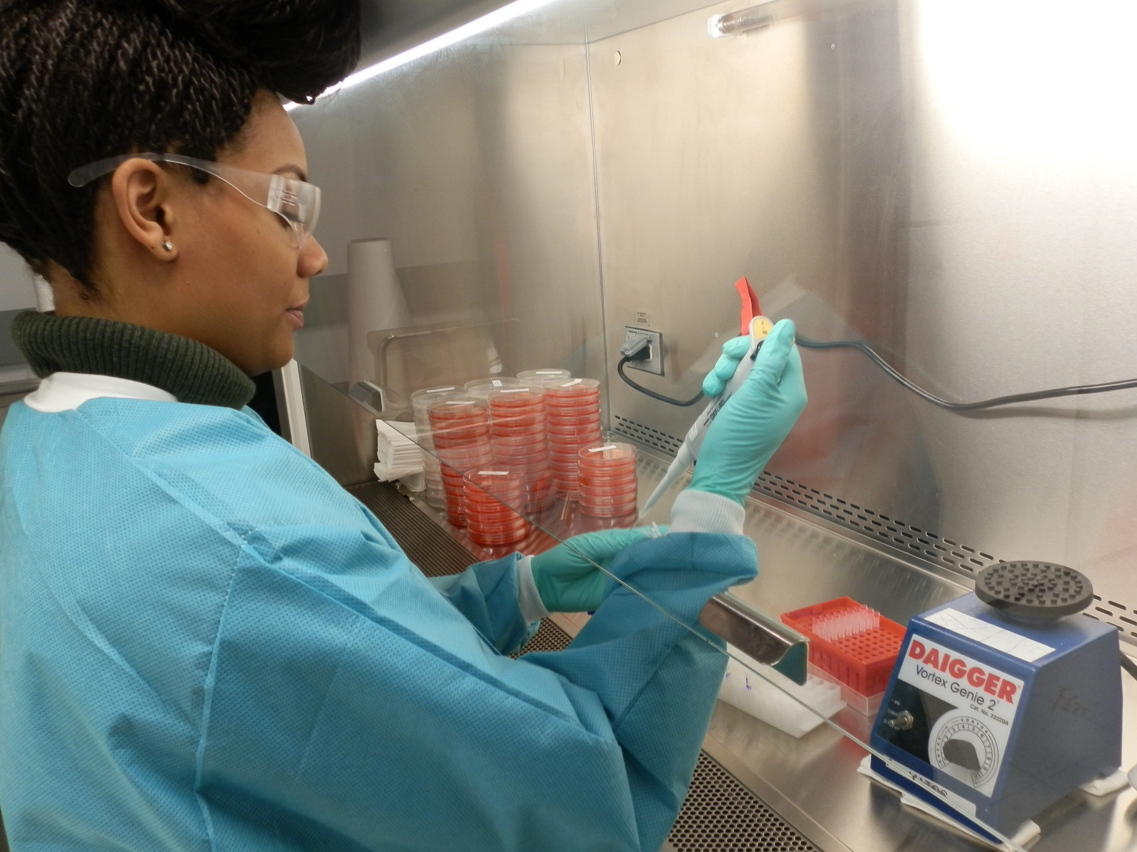

Slide 10
RESULTS
Optimization of Plaque assay
Temperature effects on plaque formation and predation of bacteria host cells

Slide 11
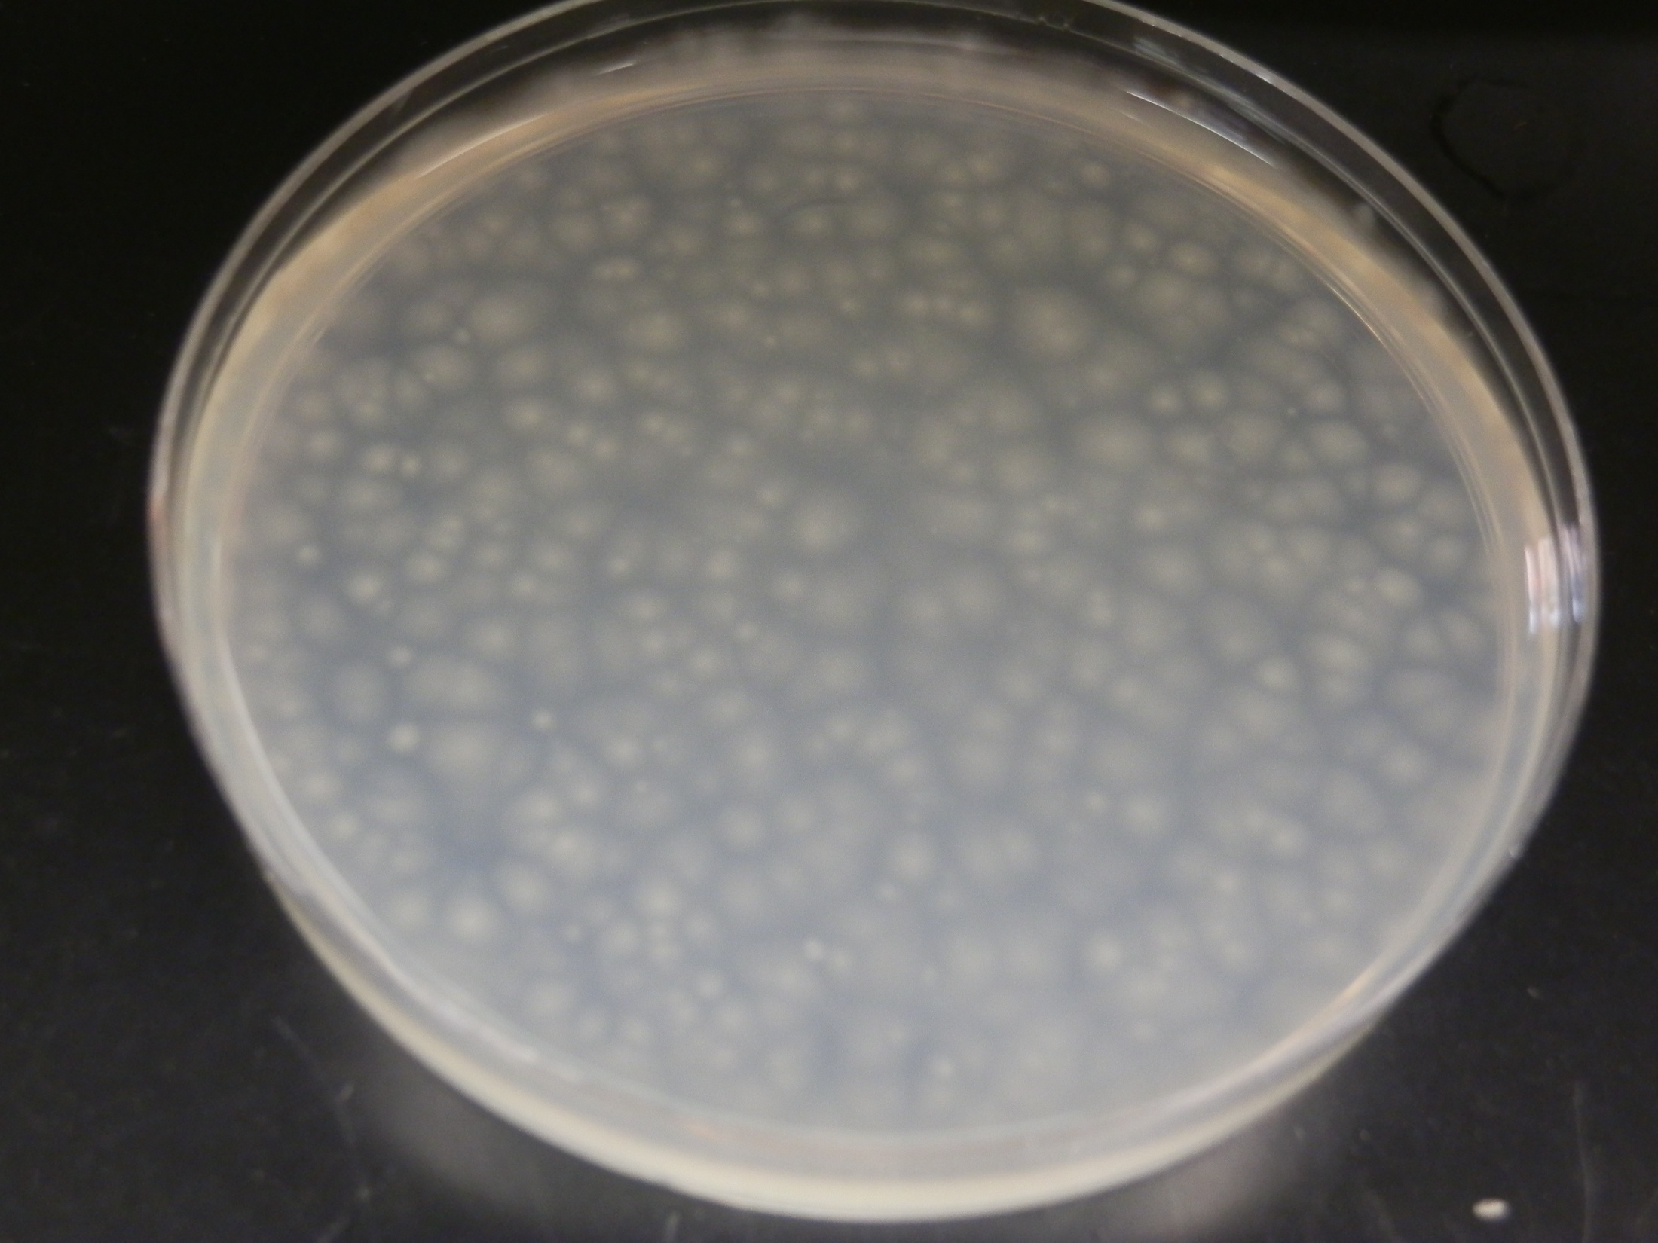

Slide 12
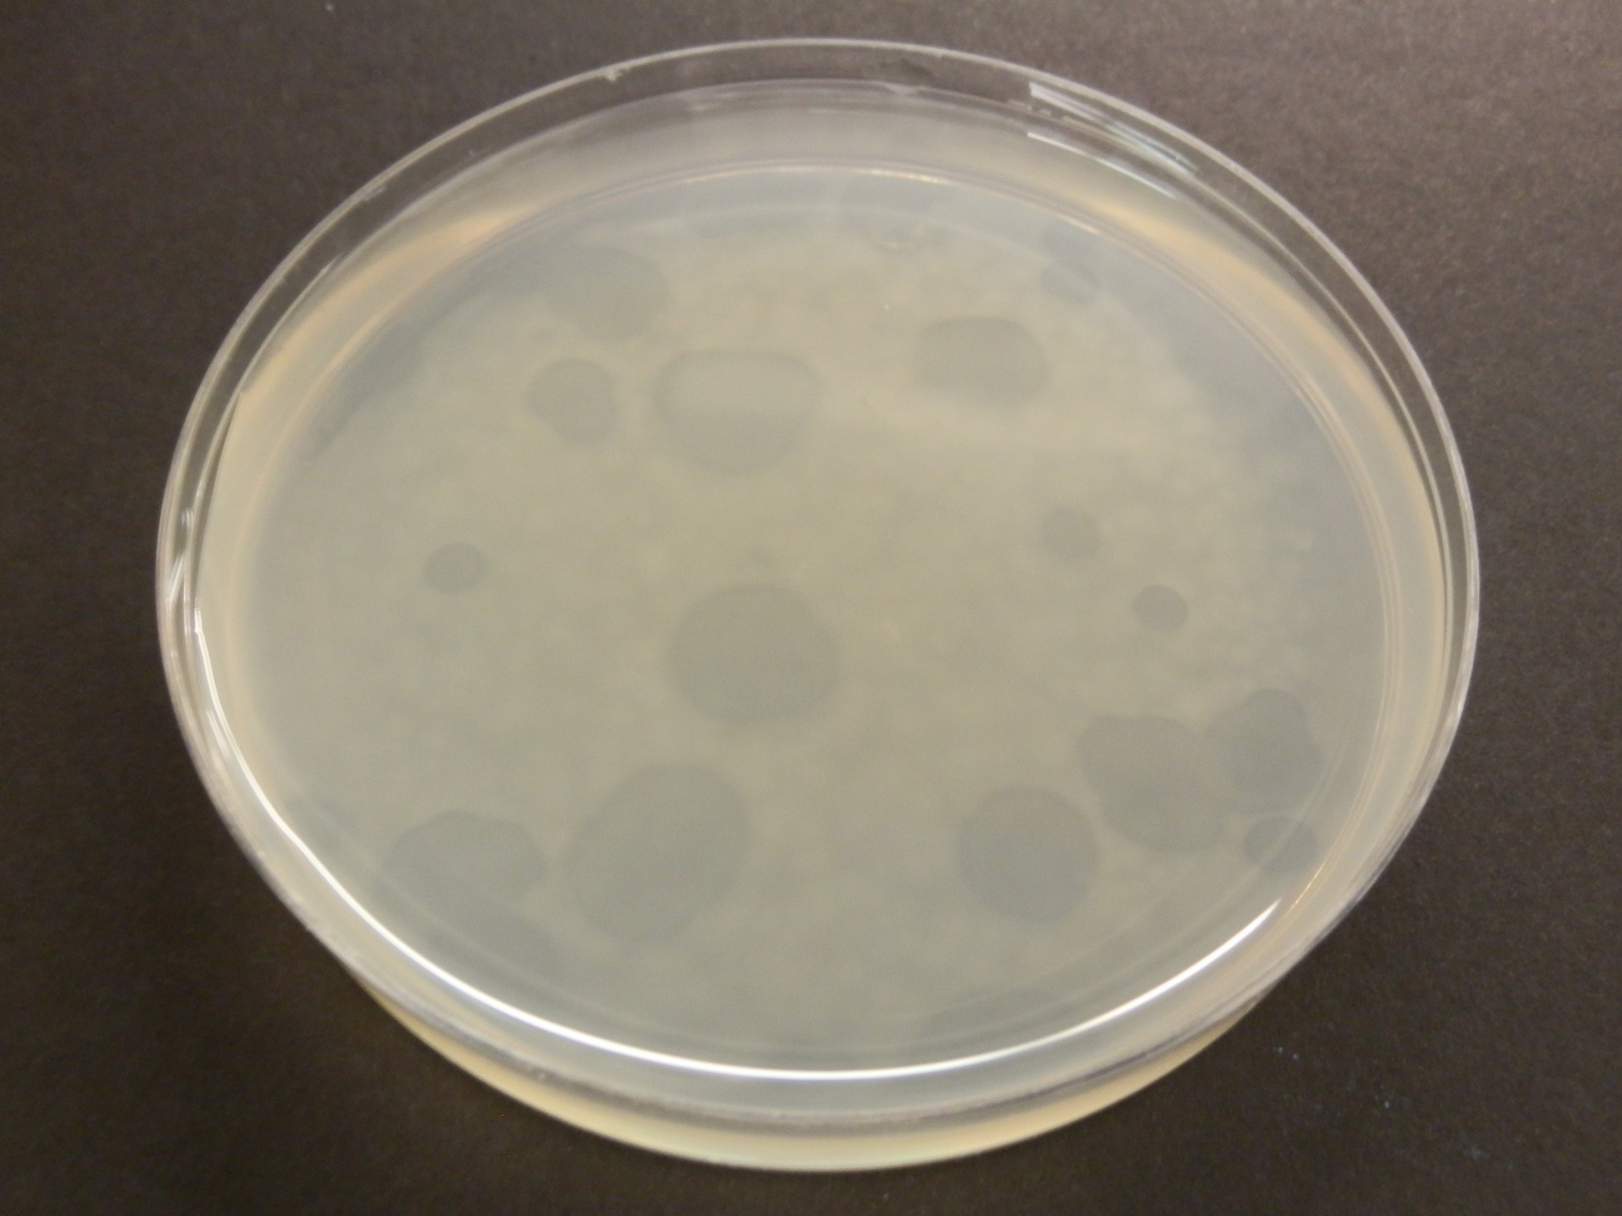

Slide 13
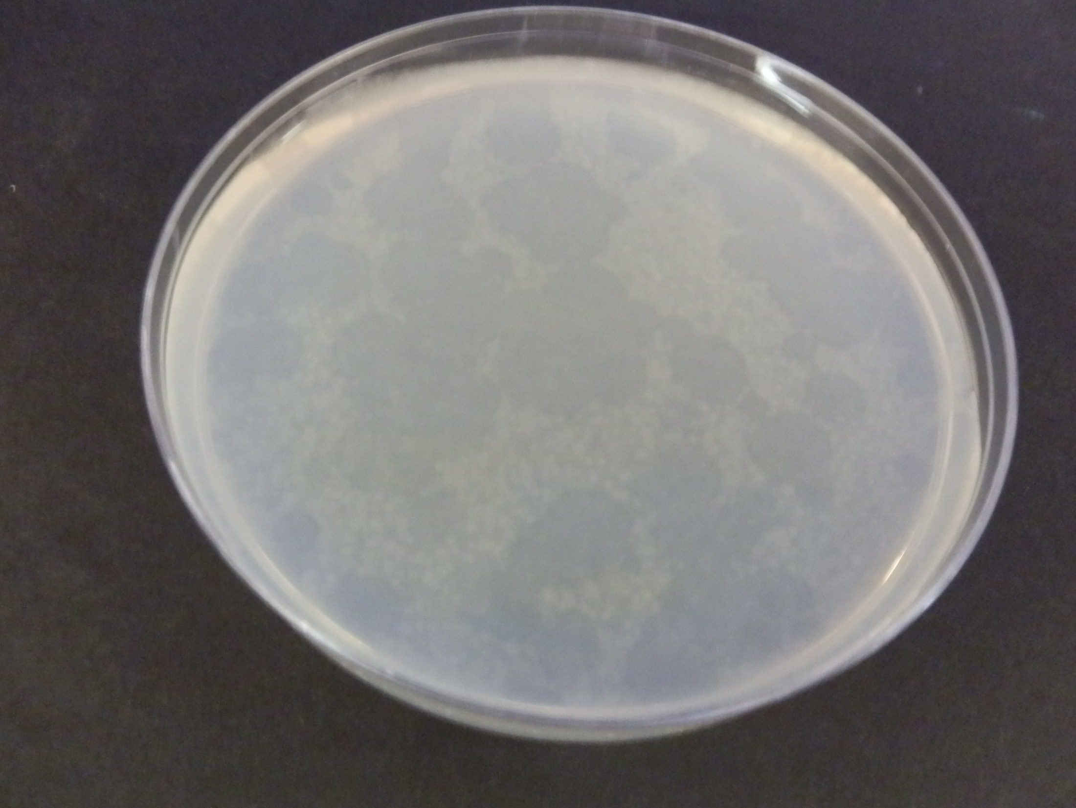

Slide 14
Table 1. Amendment of polypeptone peptone medium with seawater, NaCl, and salts of divalent cations on plaques by Bacteriovorax strains on E. coli O157:H7
Treatments | G3 (PFU/ml) | S11 (PFU/ml)
NaCl (BL)+SW (TL) | 1.13x 10⁶ +0.11x10⁶ | 0.44x 10⁶ +0.10x10⁶
SW (BL)+NaCl (TL) SW (BL)+ SW (TL) NaCl-MgCl₂-CaCl₂ (BL) + NaCl (TL) | 1.50x 10⁶ +0.17x10⁶ 1.22x 10⁶ +0.26x10⁶ 1.22x 10⁶ +0.26x10⁶ | 0.25x 10^⁶ +0.06x10⁶ 0.09x 10⁶ +0.02x10⁶ 1.22x 10⁶ +0.26x10⁶
LSD _{(0.05)} BL=bottom layer, | 1.47x10⁶ TL=top layer of PP20 | 0.15x10⁶ 1 µL of Bvx & 1 ml of Ec

Slide 15
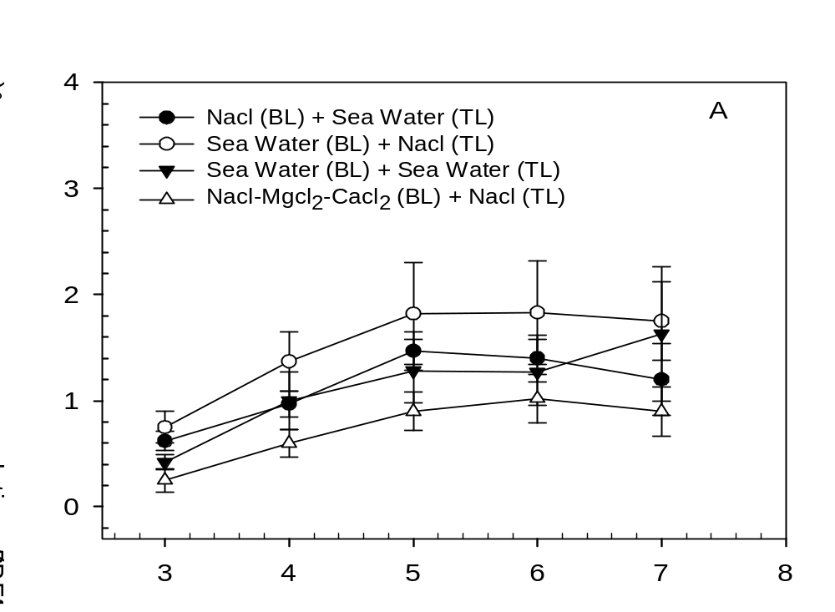
Days after incubation

Slide 16
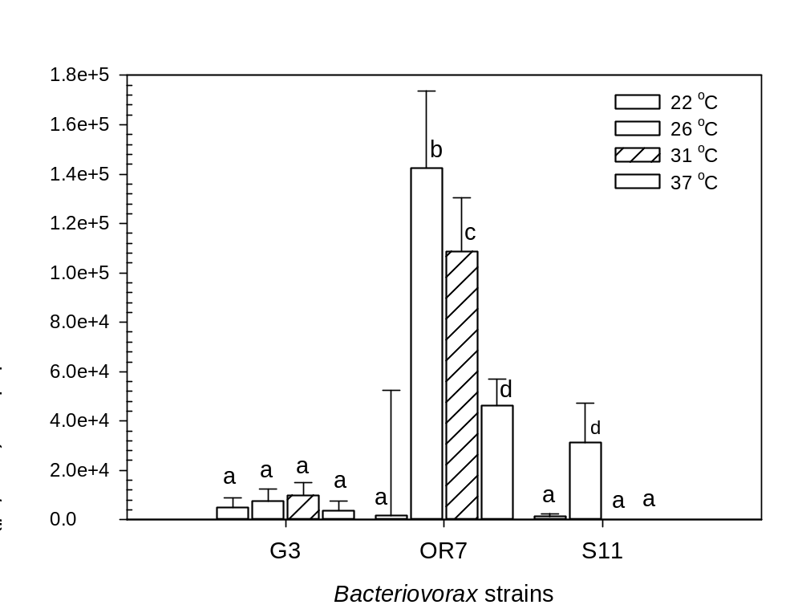

Slide 17
Summary
The plaque assay was optimized for quantifying Bacteriovorax sp. on lawns of E. coli O157:H7 host cells.
The predation of E. coli O157:H7 host cells by Bacteriovorax (Bvx) sp. was documented, indicating their biocontrol potential.
Plaque forming units (PFU/ml) on PP20 amended with Seawater ranged from 0.56x10⁶ (OR7) to 2.07x10⁶ (S11).
Plaque numbers on Polypeptone peptone (PP20) medium amended with NaCl and divalent salts (Ca²⁺ and Mg²⁺) varied.

Slide 18
Summary
Growth of pathogens and Bvx on PP20 devoid of seawater suggest that modified assay may be suitable in assessing efficacy of Bacteriovorax in biocontrol studies.
Storage temperature effects on plaque development varied with Bacteriovorax spp. (Bvx) as the optimum temperature for OR7 and S11 was 26 ºC.
Biocontrol recorded at various temperatures imply that reductions of foodborne pathogens may be possible under diverse conditions (on produce & food contact surfaces).

Slide 19
Acknowledgements
Janysha Taylor for technical support
USDA-ARS collaborators

