Slide 1
About OMICS Group
OMICS Group International is an amalgamation of Open Access publications and worldwide international science conferences and events. Established in the year 2007 with the sole aim of making the information on Sciences and technology ‘Open Access’, OMICS Group publishes 400 online open access scholarly journals in all aspects of Science, Engineering, Management and Technology journals. OMICS Group has been instrumental in taking the knowledge on Science & technology to the doorsteps of ordinary men and women. Research Scholars, Students, Libraries, Educational Institutions, Research centers and the industry are main stakeholders that benefitted greatly from this knowledge dissemination. OMICS Group also organizes 300 International conferences annually across the globe, where knowledge transfer takes place through debates, round table discussions, poster presentations, workshops, symposia and exhibitions.

Slide 2
About OMICS Group Conferences
OMICS Group International is a pioneer and leading science event organizer, which publishes around 400 open access journals and conducts over 300 Medical, Clinical, Engineering, Life Sciences, Phrama scientific conferences all over the globe annually with the support of more than 1000 scientific associations and 30,000 editorial board members and 3.5 million followers to its credit.
OMICS Group has organized 500 conferences, workshops and national symposiums across the major cities including San Francisco, Las Vegas, San Antonio, Omaha, Orlando, Raleigh, Santa Clara, Chicago, Philadelphia, Baltimore, United Kingdom, Valencia, Dubai, Beijing, Hyderabad, Bengaluru and Mumbai.

Slide 3
Scalable Production of Highly Sensitive Nanosensors Based on Graphene Functionalized with a Designed G Protein-Coupled Receptor
Dr. Mitchell Lerner
SPAWAR Systems Center Pacific – US Navy
Materials Science 2014
San Antonio, TX
Email: mitchell.lerner@navy.mil

Slide 4
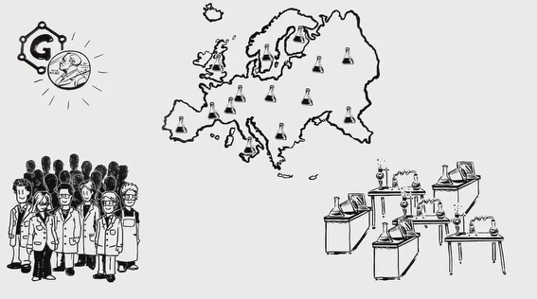
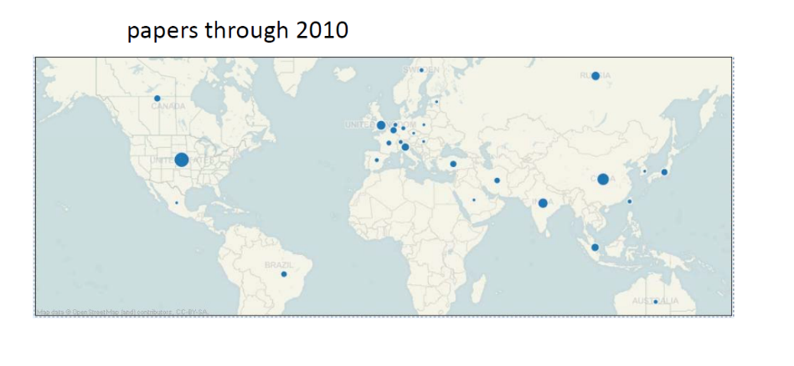
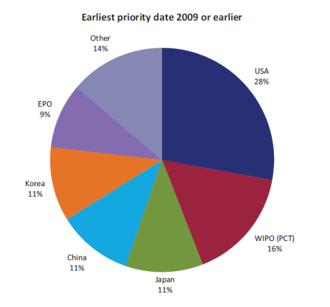

Motivation
Nanomaterials research is attracting international attention:
US DoD
Europe – Graphene Flagship
Totals $15M/year, graphene research is near 1% of DoD annual basic research budget
  DARPA CERA Program, $30M
  2 Air Force MURIs, $15M
  3 Navy MURIs, $22M
  Army MURI, $8M
US holds 40% of graphene-related patents, trailing Asia (45%)
Patent landscape is rapidly
shifting towards Asia
Initiating biggest research initiative ever to increase graphene IP stake (12%)
→ €1B ($1.38B) over 10 years
Graphene publications in 2010
Asia
China and Korea are rapidly becoming the pacesetters in
terms of graphene manufacturing, packaging and integration.
Earliest priority filing date 2009 or earlier
Earliest priority filing date 2010 or later
EPO
Japan
Other
Other
EPO
USA
USA
Korea
Korea
China
Basic research publications by China outnumber US 3:2
China
WIPO
WIPO
Japan

Slide 5
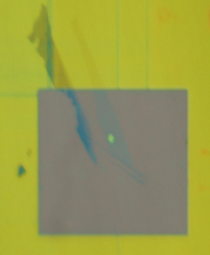
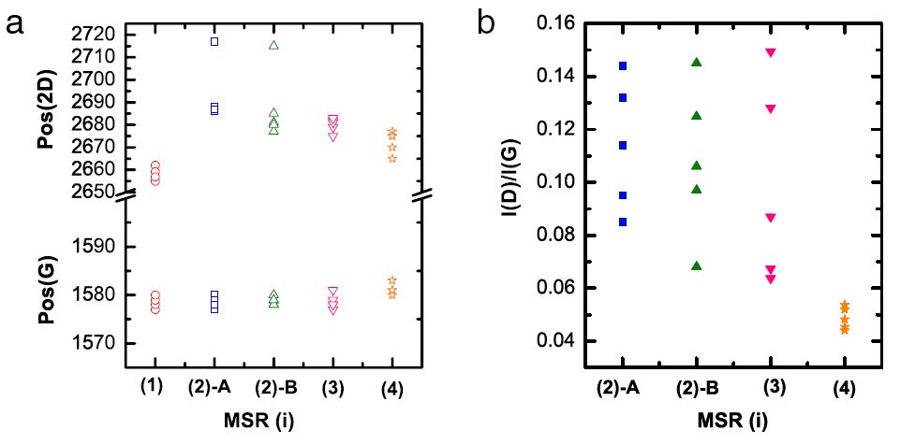
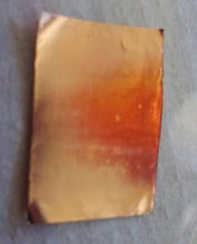
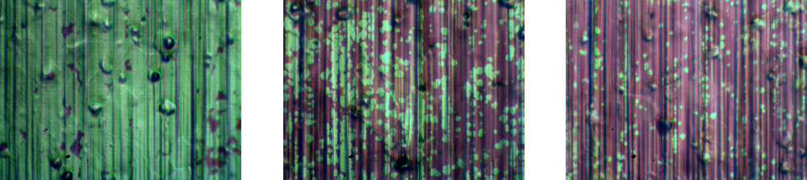
Motivation
Are we maximizing our return on investment?
Devices fall short of theoretical performance limits because of contamination issues
There exists variation across a single sample and batch to batch variation
Reproducibility and reliability are necessary for viable manufacturing process
Fan et al., Solid State Communications (2011)

Slide 6
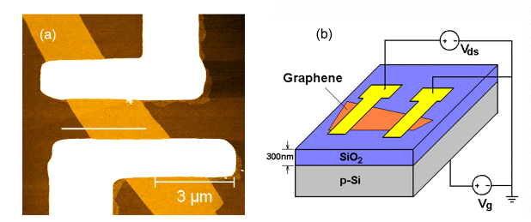
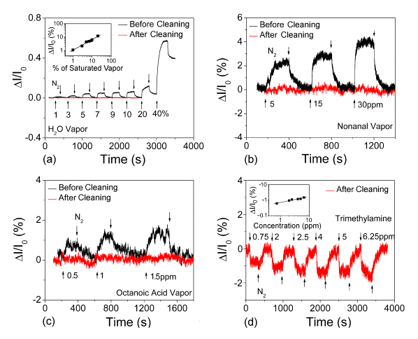
Motivation
Variability can have a dramatic impact on device properties
As an example, graphene devices used in chemical sensing applications demonstrate a false response from resist residue
Clean devices do not sense well, and intentionally functionalized devices function more reliably
Dan et al., Nano Letters (2009)

Slide 7
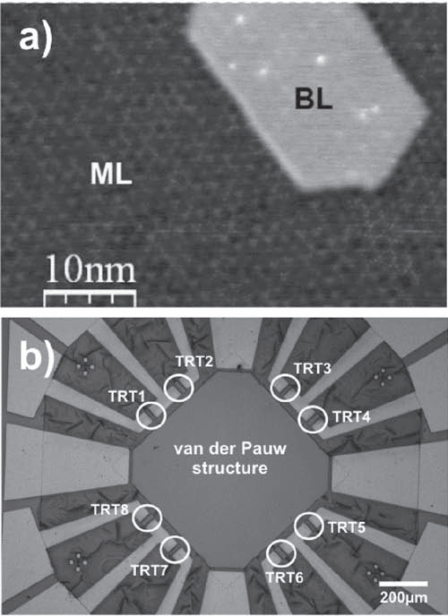
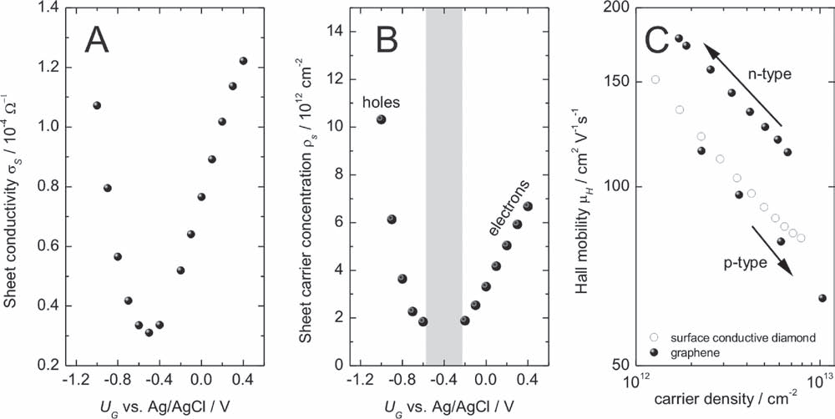
Towards Large Scale Device Manufacturing
Dankerl et al., Advanced Functional Materials (2010)
Epitaxial graphene, solution gated, mobility ~ 100-200 cm² V⁻¹ s⁻¹
Only a handful of examples exist in the literature reporting large scale (hundreds or greater) arrays of graphene electronic devices.
Success in maintaining the native graphene quality is limited.

Slide 8
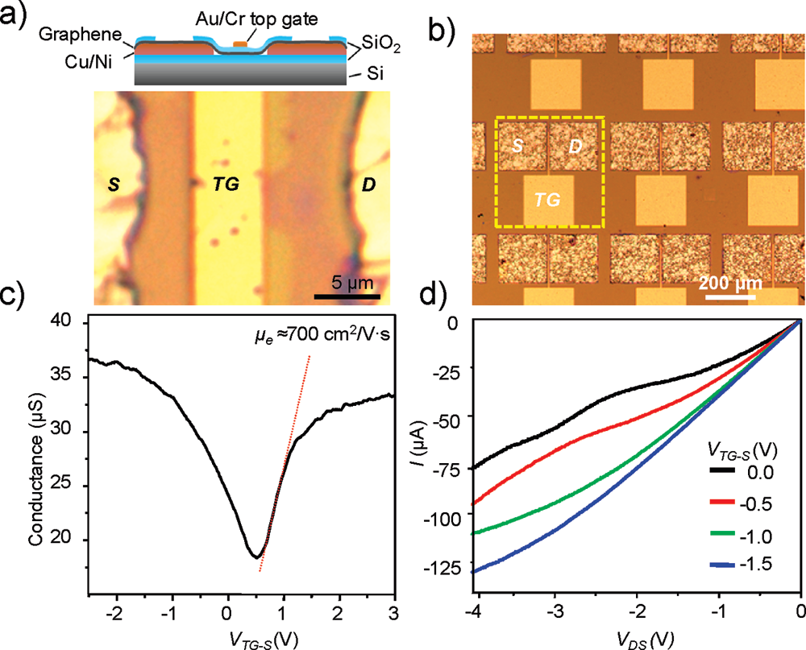
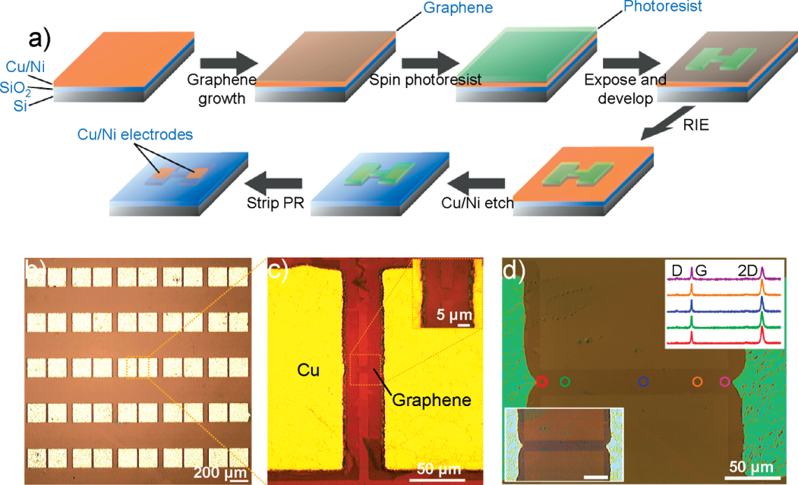
Towards Large Scale Device Manufacturing
Levendorf et al., Nano Letters (2009)
CVD graphene, back gated, mobility ~ 700 cm² V⁻¹ s⁻¹
Only a handful of examples exist in the literature reporting large scale (hundreds or greater) arrays of graphene electronic devices.
Success in maintaining the native graphene quality is limited.

Slide 9
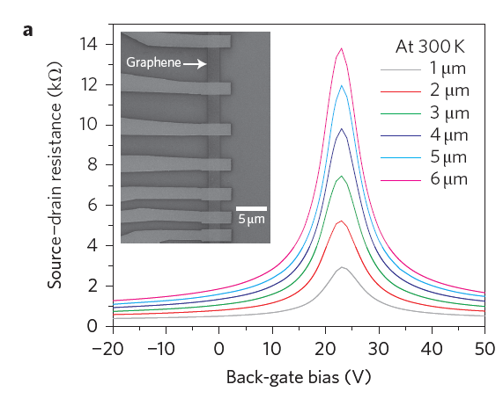
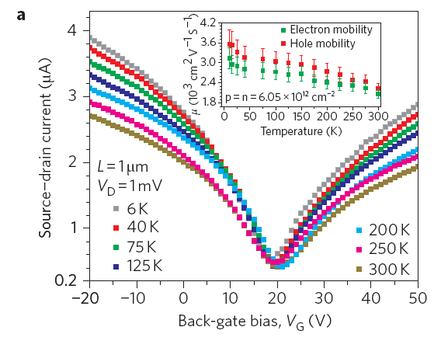
Towards Large Scale Device Manufacturing
Xia et al., Nature Nanotechnology (2011)
Exfoliated graphene, back gated, mobility ~ 2000 cm² V⁻¹ s⁻¹
Only a handful of examples exist in the literature reporting large scale (hundreds or greater) arrays of graphene electronic devices.
Success in maintaining the native graphene quality is limited.

Slide 10

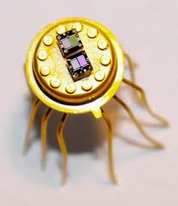
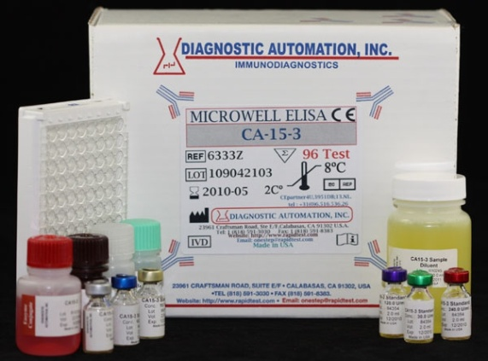
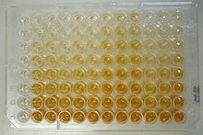
Motivation: Better Diagnostics
Clinical immunoassays have limitations:
  Costly
  Significant processing time
  Specific for a particular analyte
Environmental Monitoring sensors are inflexible
  One sensor, one analyte
Best sensor available is not technologically matched
PSA ELISA kit

Slide 11
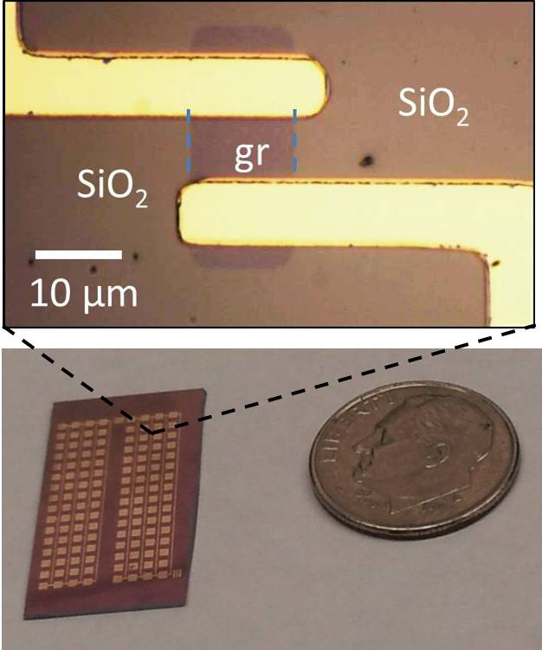
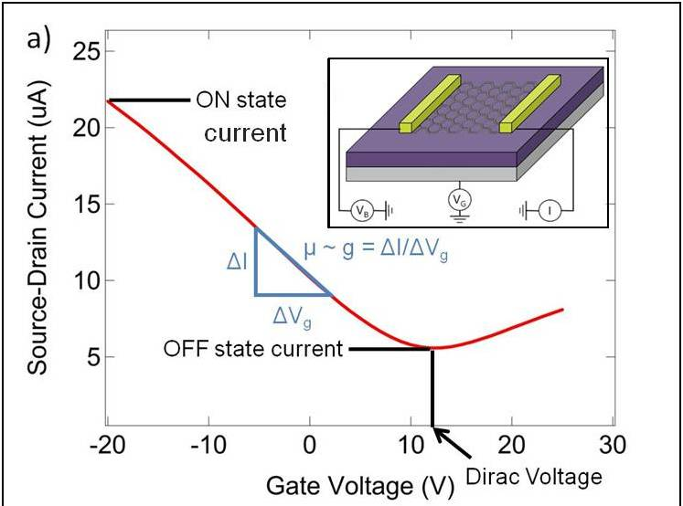
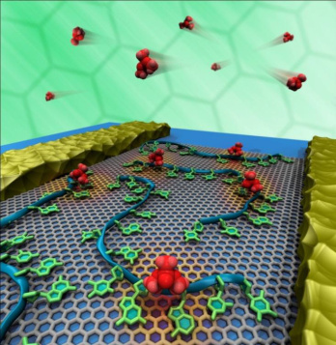
Chemical Detection Platform: NanoCarbon Transistors
Goal: Develop a modular chemical detection platform adaptable to any vapor or liquid target with high sensitivity and selectivity
NanoCarbon Platform:
  Transistor devices based on carbon nanotubes and graphene can be fabricated into large arrays and then functionalized with biochemical agents for tailored detection of molecules of interest.
    Scalable: 100 sensors on a dime
    Modular: Generic chemistry can be easily modified to detect any molecule
    Low cost: Materials cost <$0.10 per sensor
    Rapid detection: Minutes
    Robust to possible interfering compounds
Sensor Fabrication:
High yield process (>98%) for making large arrays of transistors at a small size scale [1]
Sensor Operation:
Electrical characterization of the devices produces several parameters for chemical detection, hence a multidimensional feature vector [2]
Sensor Functionalization:
Transistors are chemically modified to detect molecules of interest [3]
[1] Kybert, Lerner, et al. ACS Nano (2013) [2] Lerner et al. AIP Advances (2011) [3] Lu, Lerner et al. Applied Physics Letters (2011)

Slide 12
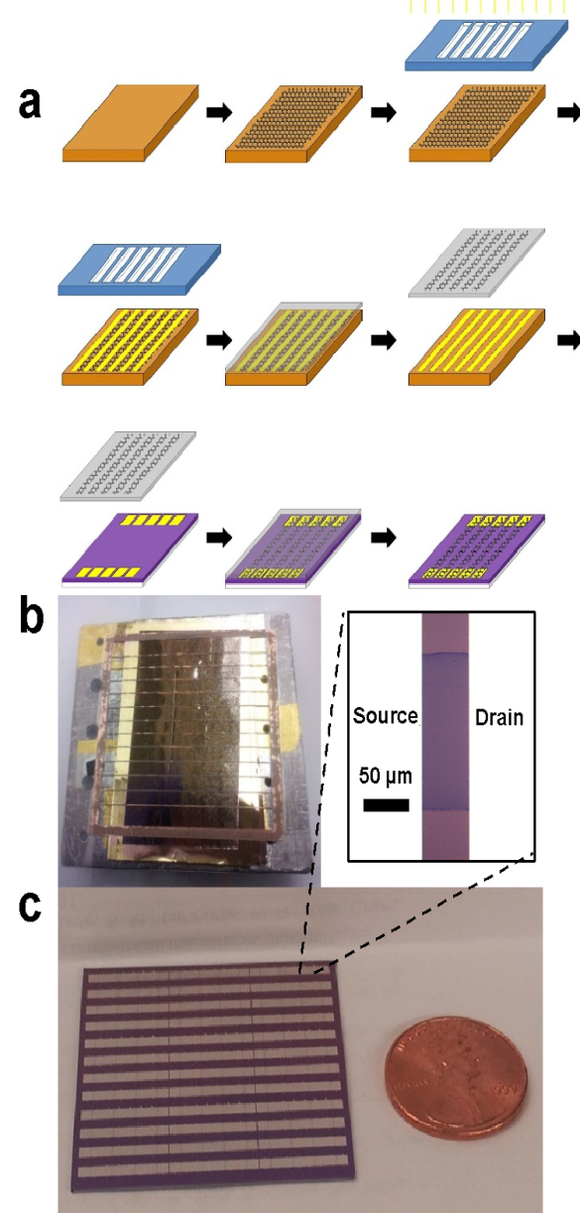
Device Fabrication
Graphene field effect transistor (GFET) fabrication process:
Graphene patterned by conventional lithography is contaminated by resist residue
Need a method to pattern graphene during transfer
Gold is evaporated onto the graphene using a shadow mask
Gold/Cu foil covered in PMMA
PMMA removed by bubble transfer technique
→ Uncovered graphene is removed
preferentially
Graphene strips are transferred to Pd electrodes
Yield is >99%
[1]Lerner et al., Nano Letters (2014)

Slide 13
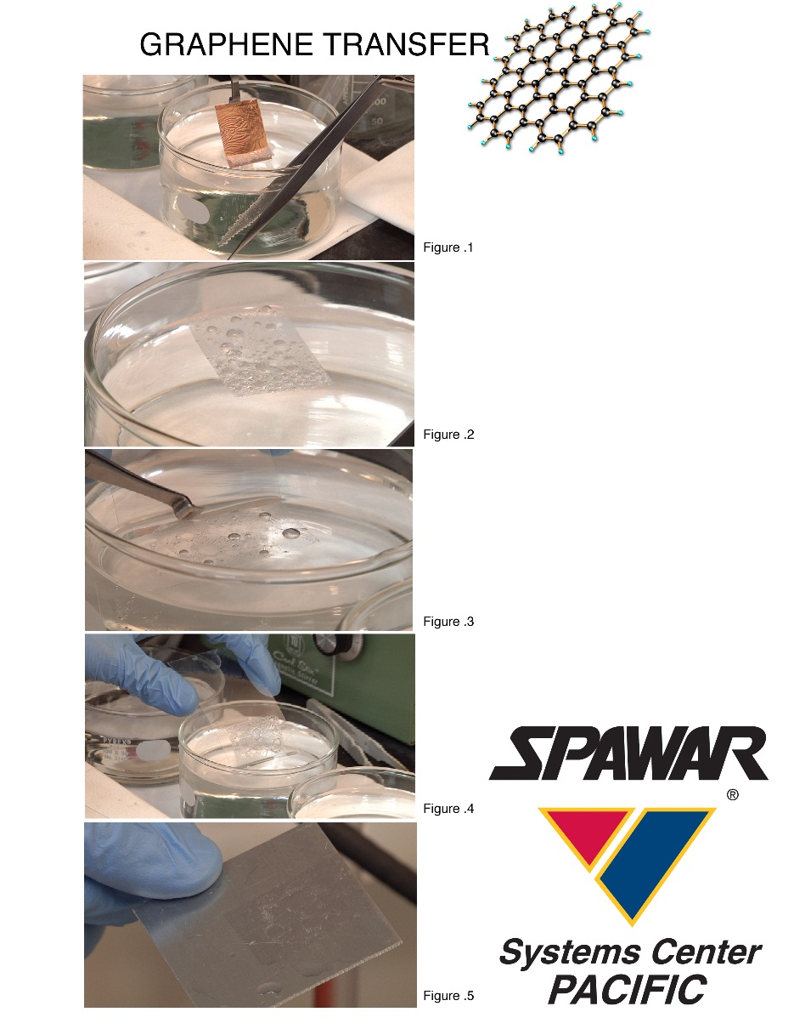
Device Fabrication
Bubble transfer:
Cu/Graphene/PMMA stack is lowered into a solution of NaOH
There is a potential difference maintained between the copper foil and the solution
Electrochemically drives the formation of hydrogen and oxygen bubbles at the electrodes
Bubbles gently lift graphene/PMMA from the copper
Gao et al., Nature Communications (2012)

Slide 14
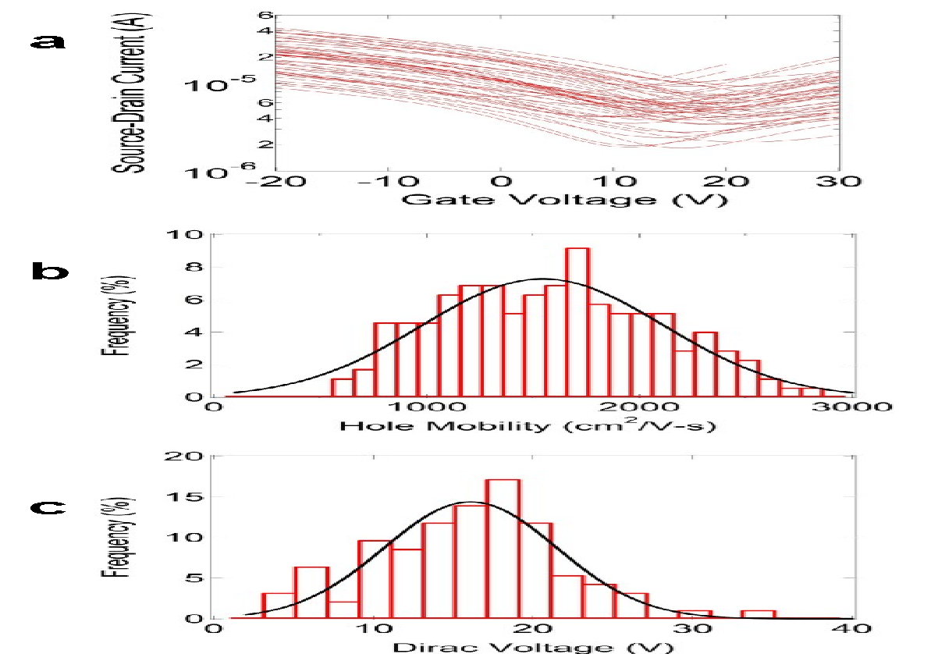
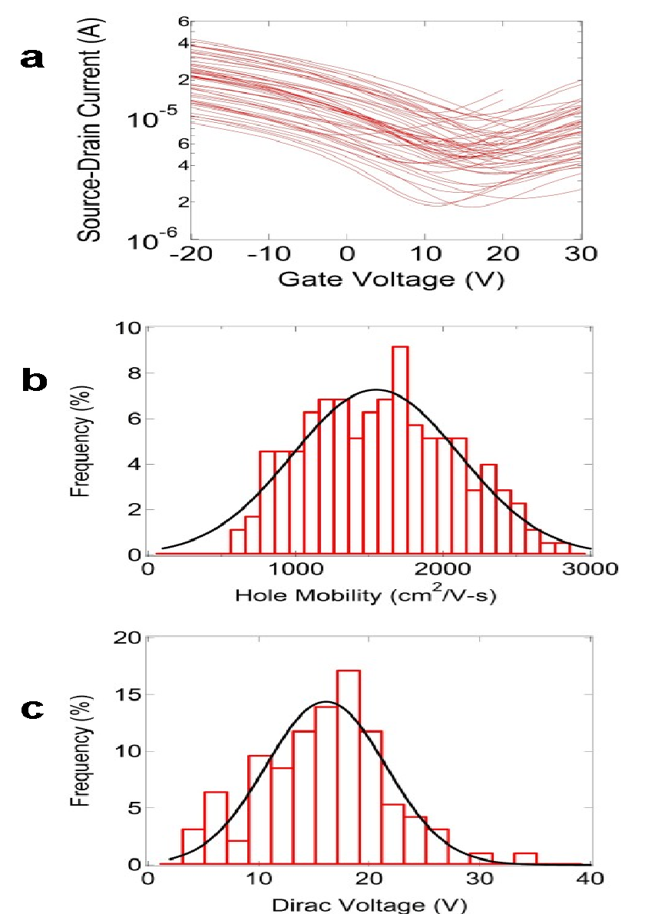
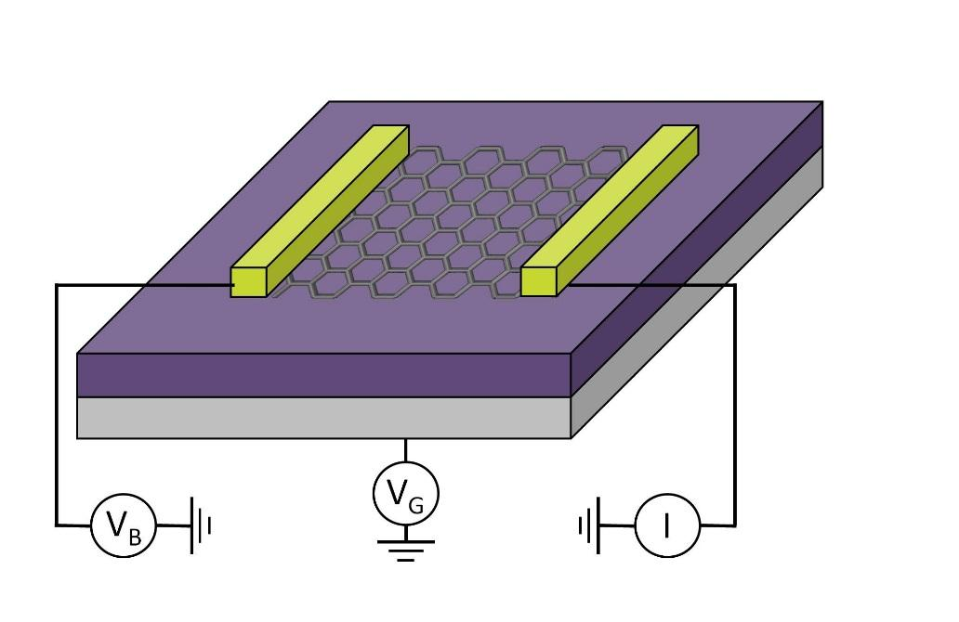
Electrical Characterization of Transistor Array
Performance characteristics of GFETs:
Representative set of 50 highly uniform I-V_{g} curves along with graphene FET schematic
Histogram of GFET mobility
  Average at 1500 cm² V⁻¹ s⁻¹
Histogram of GFET Dirac Voltage
  Average at 15 V
[1]Lerner et al., Nano Letters (2014)

Slide 15
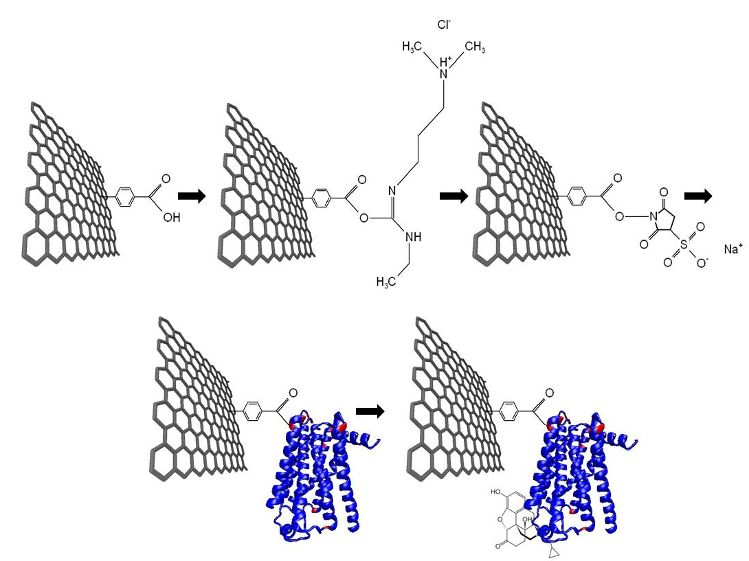
Chemical Detection Platform: Opioid Functionalization
Tailored chemical detection of opioids:
Diazonium-based approach to chemical functionalization
Activation and stabilization with EDC/sNHS
Mu opioid receptor (GPCR) displaces sNHS at lysine residues
Mu receptor binds target naltrexone
[1]Lerner et al., Nano Letters (2014)

Slide 16
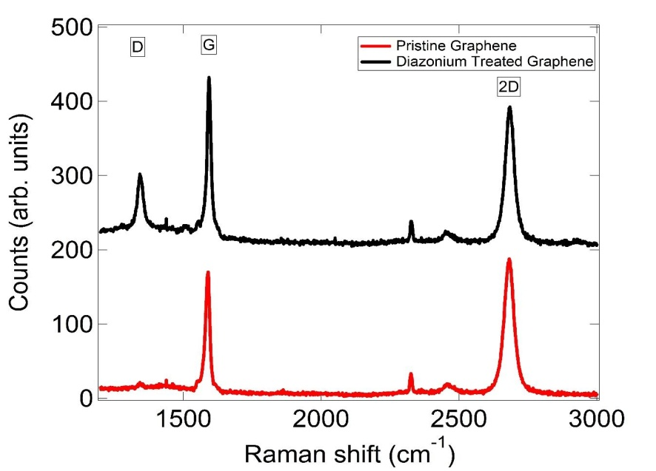
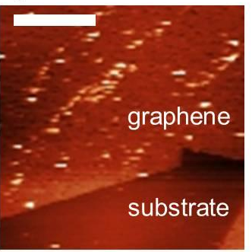
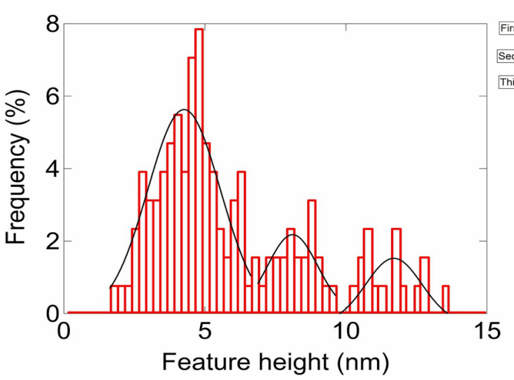
Chemical Detection Platform: Opioid Functionalization
Characterization by Raman spectroscopy and Atomic Force Microscopy:
Raman spectra show strongly enhanced D-band (near 1360 cm⁻¹) after diazonium treatment
Indicates the formation of sp³ hybridized carbon-carbon bonds on the graphene surface.
AFM image of mu receptors decorating the graphene surface
Histogram of the heights of proteins indicates that the 46 kDa mu receptor monomer is ~4 nm tall on the surface, with dimers and trimers of 8 nm and 12 nm respectively.
[1]Lerner et al., Nano Letters (2014)

Slide 17
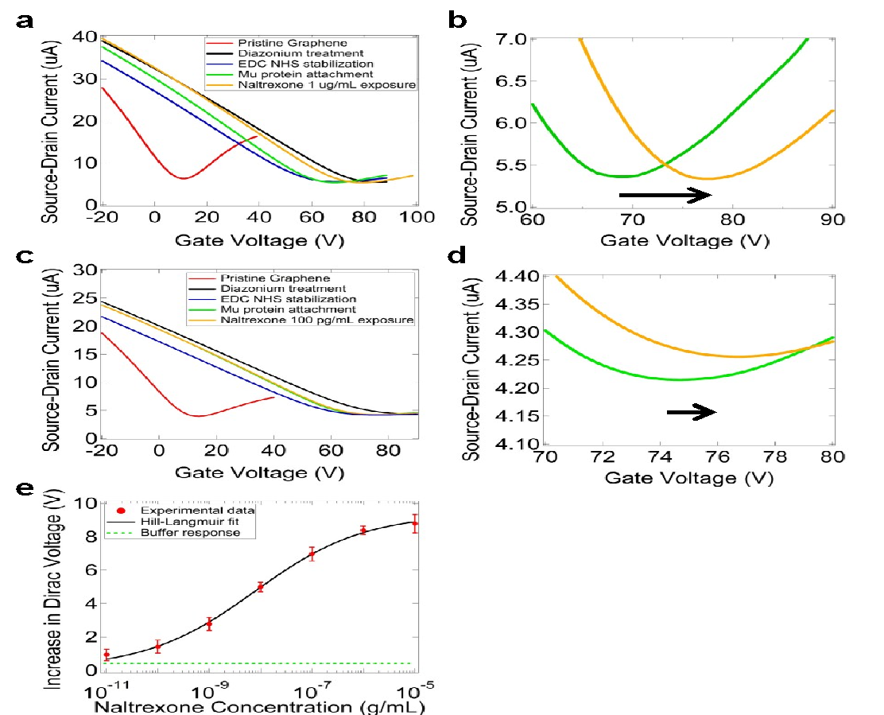
Chemical Detection Platform: Opioid Functionalization
Current-gate voltage (I-V_{G}) characteristic measurements:
I-V_{G} plots after successive functionalization steps at 1µg/mL naltrexone
Naltrexone in buffer leads to an increase in the Dirac voltage of 8.5 V (green curve to orange curve).
I-V_{G} plots after successive functionalization steps at 100 pg/mL naltrexone
Naltrexone in buffer leads to an increase in the Dirac voltage of 1.8 V (green curve to orange curve).
[1]Lerner et al., Nano Letters (2014)

Slide 18
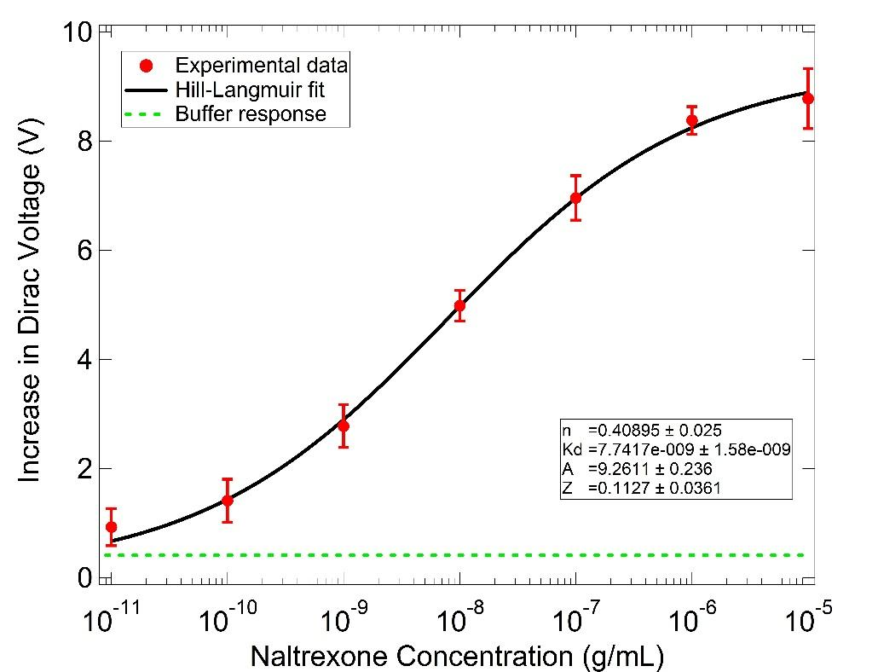
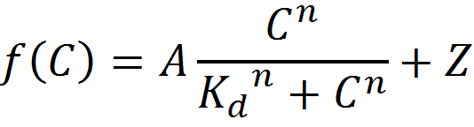
Chemical Detection Platform: Opioid Functionalization
Sensor response (increase in Dirac voltage) shows discernable signal from the bare buffer response at 10 pg/mL naltrexone.
The data are well explained by a modified Hill-Langmuir equation (black curve).
[1]Lerner et al., Nano Letters (2014)

Slide 19
Chemical Detection Platform: Opioid Functionalization
Sample | Analyte | Average Dirac Voltage Shift (V)
MUR-GFET | Buffer with no Naltrexone | 0.04 ± 0.38
MUR-GFET | Flumazenil at 10 µg/mL | -0.23 ± 0.43
MUR omitted | Naltrexone at 10 µg/mL | -0.25 ± 0.35
anti-HER2 scfv-GFET | Naltrexone at 10 µg/mL | -0.31 ± 0.48
MUR-GFET | Naltrexone at 10 µg/mL | 8.78 ± 0.55
[1]Lerner et al., Nano Letters (2014)

Slide 20
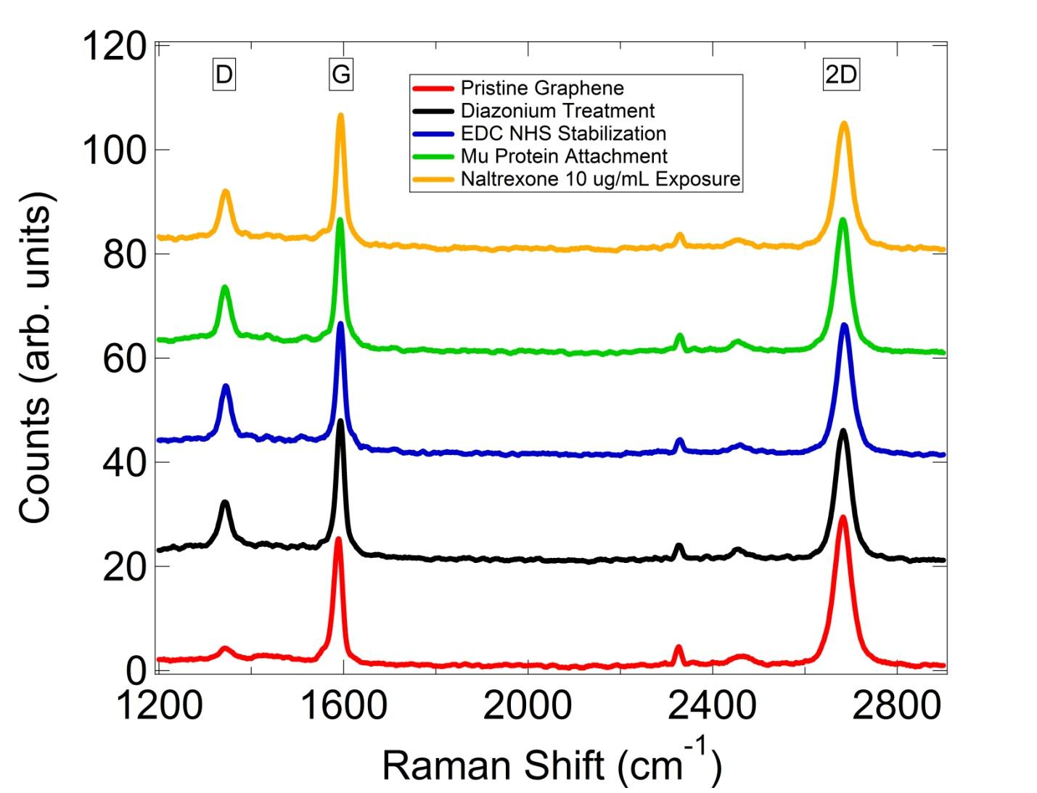
Chemical Detection Platform: Raman Readout
Raman spectra during functionalization steps:
D/G ratio increased after diazonium treatment and 2D/G ratio decreased from 1.5 to 0.95
Little change between diazonium treatment and mu protein attachment
Upon exposure to Naltrexone, there were significant shifts in the G-peak and 2D peak positions which were concentration dependent
[1]Lerner et al., Nano Letters (2014)

Slide 21
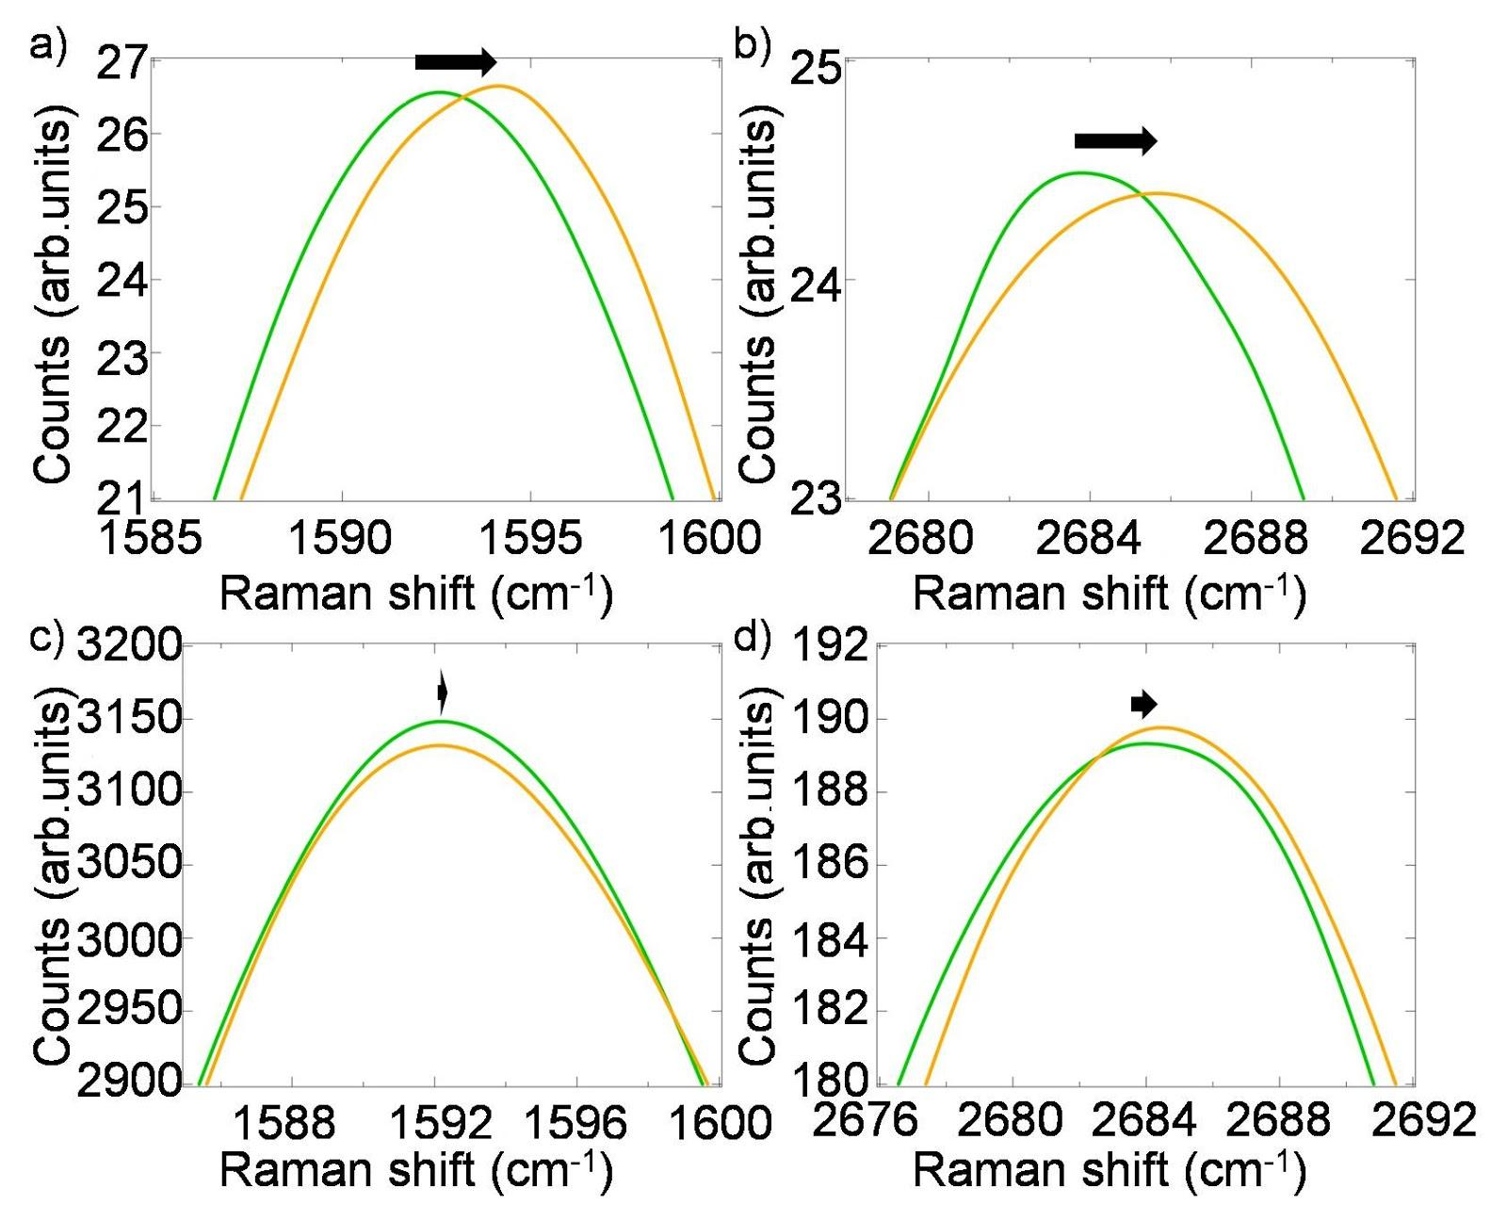
Chemical Detection Platform: Raman Readout
Mu-functionalized device showing Raman G peak shift of ~1.5 cm⁻¹ before (green) and after (orange) Naltrexone exposure at 10 µg/mL.
2D peak position shift of ~2 cm⁻¹ for same device
For device exposed to pure buffer, G peak does not appreciably shift
2D peak position is only slightly affected by buffer exposure, shifting only 0.5 cm⁻¹ for this device.
[1]Lerner et al., Nano Letters (2014)

Slide 22
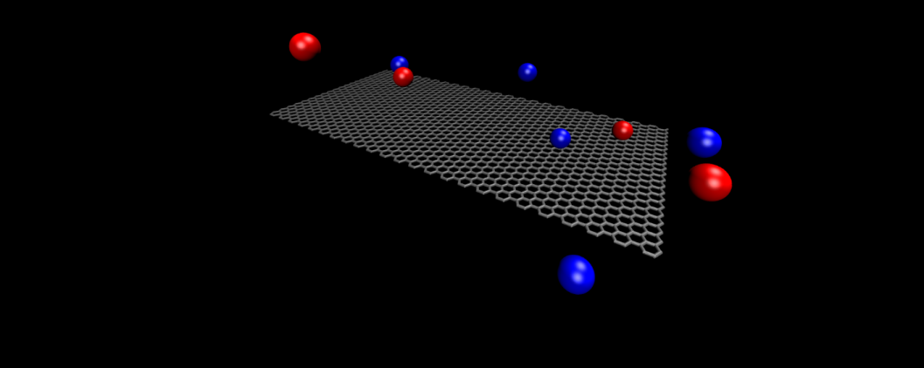
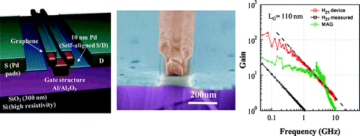
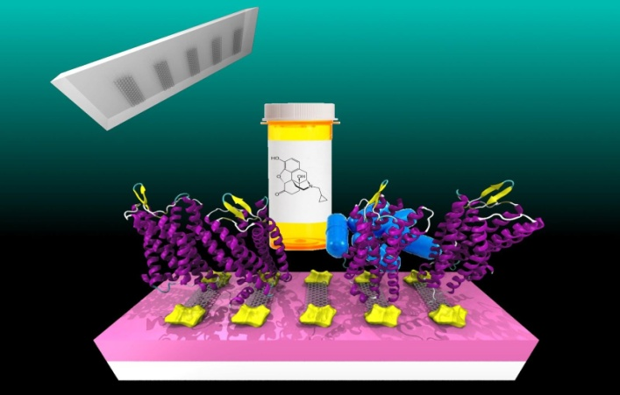
Conclusions
Many publications cite contamination as an issue in production of lithographically defined graphene devices
Performance of complex device architectures suffer
Better understanding of the contamination mechanism and alternative fabrication procedures are needed to have graphene devices realize their ultimate potential.
Badmaev et al., ACS Nano (2012)

Slide 23





Acknowledgements
Prof. Charlie Johnson
Prof. Renyu Liu
Prof. Jeff Saven
Dr. Gang Hee Han
Dr. Brett Goldsmith
Dr. John Rockway
Dr. Israel Perez
Materials Science 2014 Organizing Committee
Thank you for your attention!

Slide 24
Let Us Meet Again
We welcome you all to our future conferences of OMICS Group International
Please Visit:
http://materialsscience.conferenceseries.com/
Contact us at
materialsscience.conference@omicsgroup.us
materialsscience@omicsgroup.com

