Slide 1


Cosmetic Products Regulations in Saudi Arabia
Mishal A. Al Tamimi
Cosmetic Products Notification Manager, SFDA

Slide 2
Contents
About SFDA
SFDA and Cosmetics
New Directive
Notification
Statistics
Guidelines
Contents

Slide 3
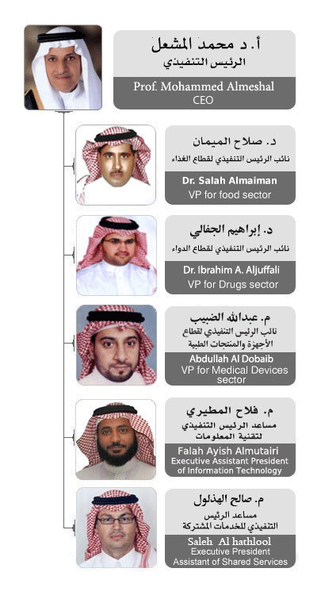
Saudi Food & Drug Authority (SFDA)
Established on 10th March 2003.
Objective is to ensure the safety of
food and drugs and the safety of biological and chemical substances, as well as electronic products.
Including whether they are imported or locally manufactured.

Slide 4
Vision and Mission
Vision:
To be the leading regional regulatory authority for food, drugs and medical devices with professional and excellent services that contributes to the protection and advancement of the health in Saudi Arabia.

Slide 5
Vision and Mission
Mission:
To ensure the safety of food; the safety, quality and efficacy of drugs; and the safety and effectiveness of medical devices, by developing and enforcing an appropriate regulatory system.

Slide 6
SFDA Main Objectives
Observe the safety, security and effectiveness of food and drugs for humans and animals.
Observe the safety of complementary biological and chemical substances, cosmetics and pesticides.
Observe the safety of medical devices and their impact on public health.
Ensure accuracy and safety of medical and diagnostic devices.

Slide 7
SFDA Main Objectives (cont.)
Launch clear policies and procedures for food, drugs, cosmetics and plan to implement and enforce these policies.
Conduct relevant research and studies.
Control and supervise license procedures for food, drugs, cosmetics and medical devices.
Disseminate and exchange information with local and international scientific and legal agencies.

Slide 8
Product
Cosmetics
Herbal
Drug
Food
Health Product
Medical Device

Slide 9
SFDA Objectives regarding Cosmetic Products
To ensure the safety of cosmetics with the absence of any hazardous substances; this goal is achievable by:
  Establishing an electronic system (eCosma) to notify all imported and locally manufactured cosmetics.
  Issuing clearance approvals to customs.

Slide 10
SFDA Objectives regarding Cosmetic Products (cont.)
  Creating safety guidelines for the prohibited substances that may be used in cosmetics as well as restricted substances, colours and preservatives.
  A periodical plan for Post Market Surveillance (PMS).
  Educating consumers and stakeholders.

Slide 11
SFDA Tools in Cosmetic Products Regulation
Regulations
eCosma
Law

Slide 12
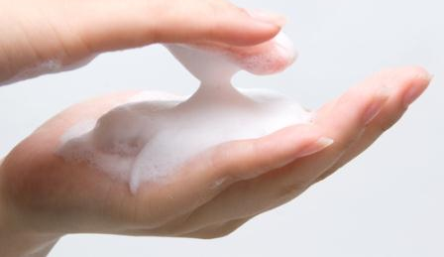


How SFDA defines Cosmetic Products ?

Slide 13
Cosmetic product is…
Any substance or preparation intended to be placed in contact with the various external parts of human body (epidermis, hair system, nails, lips, and external genital organs) or with the teeth and the mucous membranes of the oral cavity with a view exclusively or mainly to cleaning them, perfuming them, changing their appearance and/or correcting body odours and/or protecting them or keeping them in good condition.

Slide 14
This definition includes the following products:
– Creams, emulsions, lotions, gels and oils for the skin (hands, face, feet, etc.).
– Face masks (with the exception of peeling products).
– Tinted bases (liquids, pastes, powders).
– Make-up powders, after-bath powders, hygienic powders, etc.
– Toilet soaps, deodorant soaps, etc.
– Perfumes, toilet waters and eau de cologne.

Slide 15
– Bath and shower preparations (salts, foams, oils, gels, etc.).
– Depilatories.
– Deodorants and antiperspirant.
– Hair care products.
– Shaving products (creams, foams, lotions, etc.).
– Products for making up and removing make-up from the face and eyes.
– Products intended for application to lips.
– Products for care of teeth and the mouth.

Slide 16
– Products for nail care and make-up.
– Products for external intimate hygiene.
– Sunbathing products.
– Products for tanning without sun.
– Skin-whitening products.
– Anti-wrinkle products.
– Eye decorative cosmetic products (Eye shadow, Mascara, brows, lids, pencil, lashes, cream and Athmad (Al-kohol).

Slide 17
Cosmetic Products Directive (Law)
Starting from 2016, the new cosmetic products directive will be in full effect. This new directive covers the following aspects:
Definitions
Ingredients regulations
Importation and Clearance
Cosmetic products notification (eCosma).
Notifying person (responsible person)
Cosmetic product label
Licensing (domestic manufactures and warehouse)
Advertisements
Withdraws and recalls
Post market surveillance
Penalties and Punishments

Slide 18

Cosmetic Products Notification

Slide 19


Cosmetic Products Notification Concept

Slide 20
Cosmetic Products Notification
Product Notification
A process which ends by listing the product in the cosmetic products database.
Notifying Person
The responsible person under whom the cosmetic product is listed.

Slide 21

Who must submit a notification request?

Slide 22
Cosmetic Products Notification
Manufacturer or owner of the company (for the locally manufactured products) or importer (for all imported products), or any person they authorise.

Slide 23

Time needed for SFDA to review a request

Slide 24

From submitting a complete request

Slide 25
Notifying Person Responsibilities

Slide 26
Cosmetic Products Notification
Product safety
Notify SFDA if any adverse effect or recall happened in any country
Keep PIF
Notify SFDA if any amendment or update regarding the product
Keep sales records
Notify SFDA if any misuse of the product happened

Slide 27
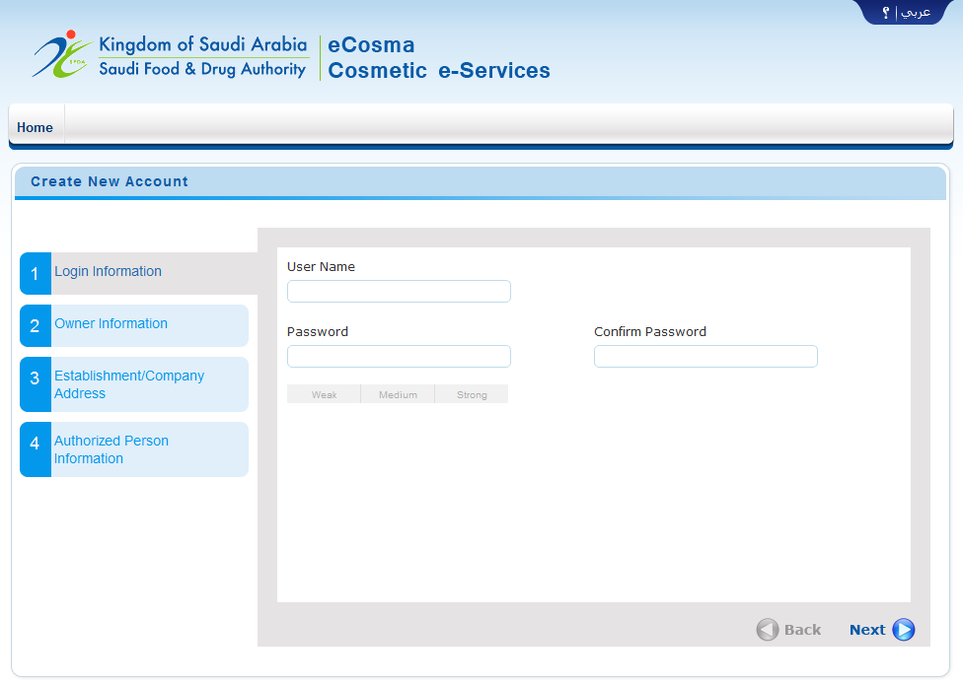

Slide 28

Safety Guidelines

Slide 29
SFDA has approved a number of guidelines to ensure cosmetic products safety.
Safety guidelines describe the mandatory criteria for:
  Labeling
  Storage
  Packaging
  Ingredients

Slide 30
Safety guidelines include number of lists such as:
  Prohibited ingredients
  Restricted ingredients
  Colour additives
  UV filters
  Preservatives

Slide 31

Cosmetic Products Market Statistics in Saudi Arabia

Slide 32
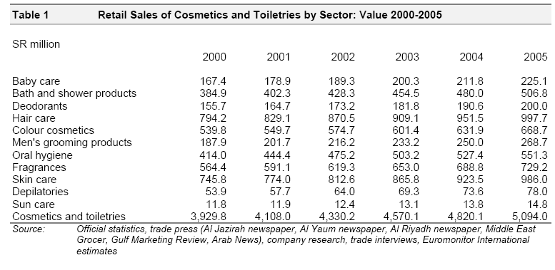
In 2006, cosmetics sales totalled $1.5 billion*
*2005 Euro monitor

Slide 33
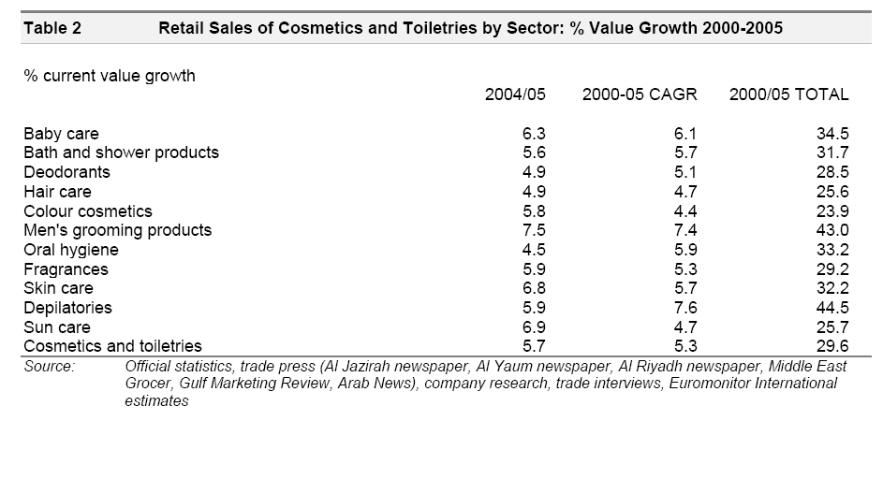
From 2000 to 2005, the growth value of cosmetics sales was approximately 5% per annum

Slide 34
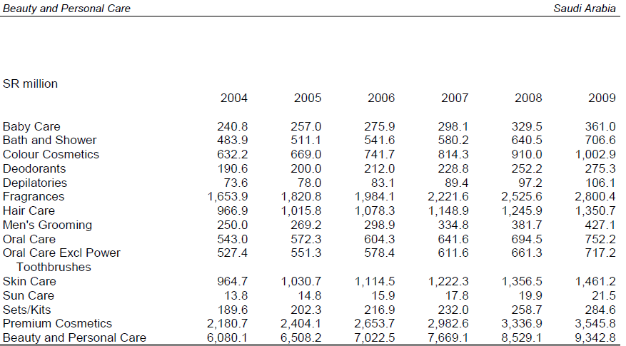
From 2004 to 2009, cosmetics sales increased from $6 billion to $9.3 billion

Slide 35
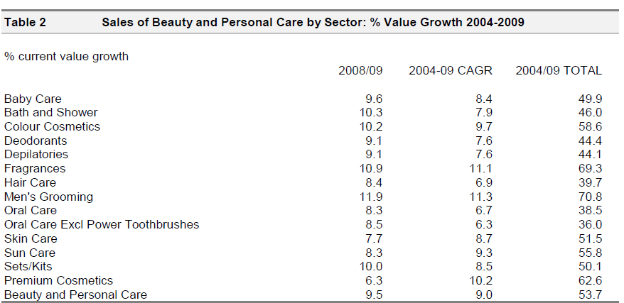
The growth value of cosmetics sales increased from 5% in 2005 to 9.5% in 2009

Slide 36


Executive Directorate of
The Safety of Cosmetic Products, SFDA

Slide 37

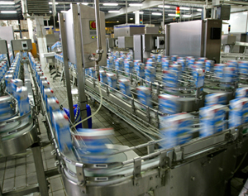
Aim..
To act as regulatory body for imported and locally manufactured cosmetic products.

Slide 38
Departments
Standards Setting
PMS
Notification
Safety Guidelines
Good Manufacturing Practices
Control claims
Manage databases
Approvals
Post Market Surveillance
Safety

Slide 39
Tasks and Responsibilities
1. Establishment of database to notify all locally produced and imported cosmetic products, where manufacturers and importers can provide all the necessary information about their cosmetic products before they are permitted marketing authorisation.
2. Clearance authorisation of the imported cosmetic products and to enforce that the importers withdraw any dangerous or unsafe products from the market.

Slide 40
The Directorate’s Tasks
3. Development of standard specifications for prohibited substances that may be used in cosmetics as well as restricted substances, colours and preservatives.
4. PMS for the cosmetic product to ensure the safety of these products before they used by the consumers.

Slide 41
The Directorate’s Tasks (cont.)
5. The Vigilance & Crisis Management department is responsible for monitoring and following-up with any reports on side-effects related to cosmetics.
6. Coordination with the compliance and enforcement department to withdraw any dangerous or unsafe cosmetic products.

Slide 42
The Directorate’s Tasks (cont.)
7. Coordination with the Communication and Awareness department to promote awareness to the consumers regarding the safe use of cosmetics products.
8. Control of the advertisement of cosmetics products and to prevent any non-proven medical claim for those products.
9. Establish and update the standards that regulate examination and analysis of raw material and final product.

Slide 43
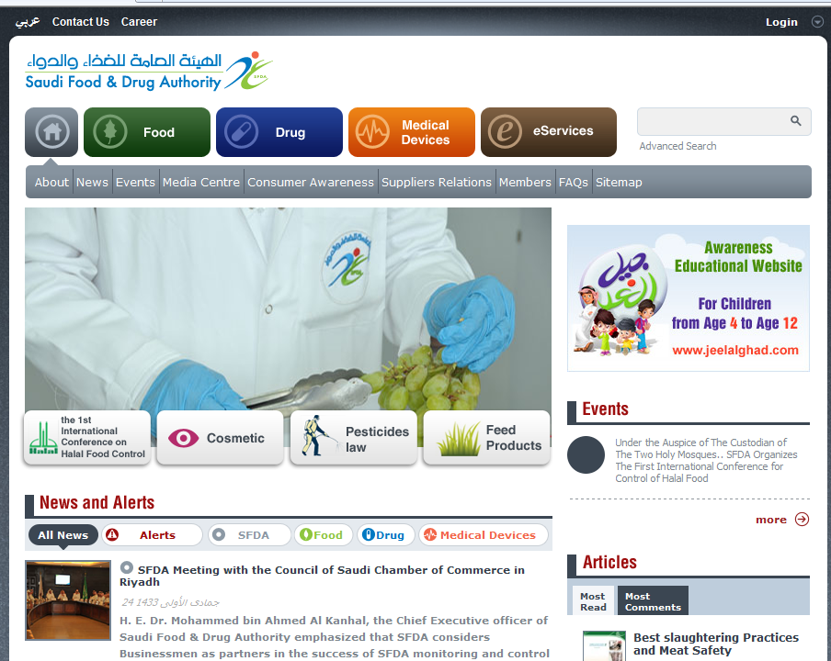
Thank you
Please visit us at… www.sfda.gov.sa

