Slide 1
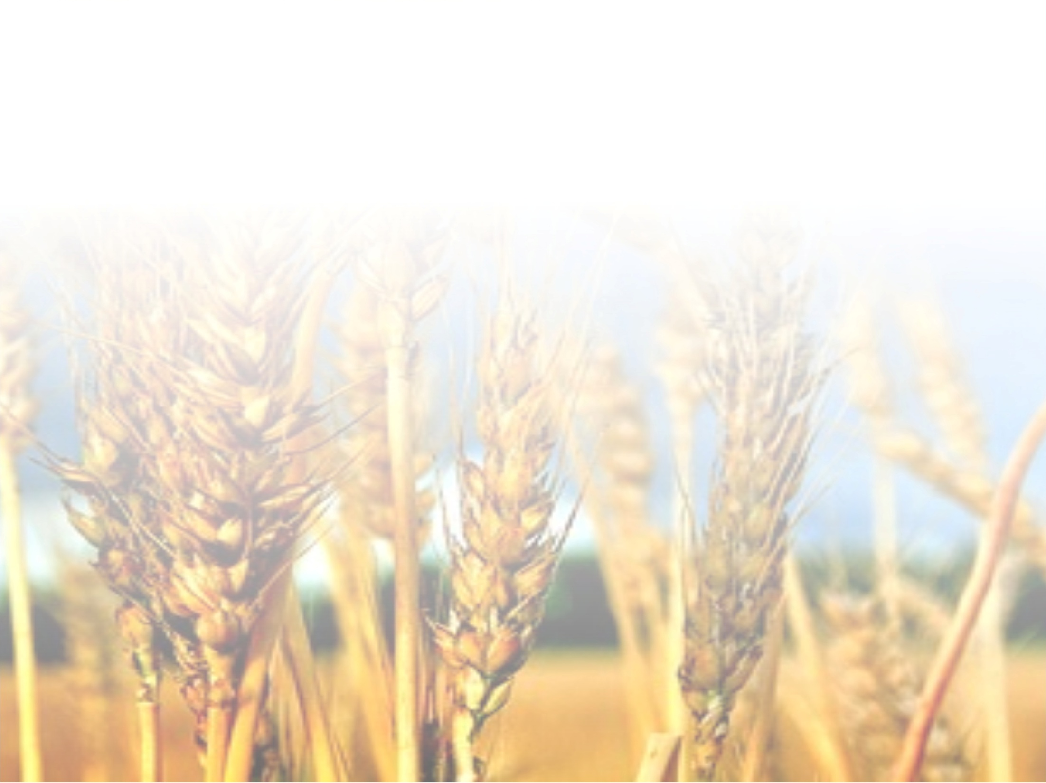



Food Technology-2015 conference, August 10-12, London, UK
COMPARATIVE INVESTIGATIONS ON NUTRITIONAL COMPOSITIONS OF ORGANICALY AND CONVENTIONALY
GROWN CEREALS AND THEIR RELATIONSHIPS
Dr. Mirjana Menkovska, Ss.Cyril and Methodius University, Skopje, Macedonia

Slide 2
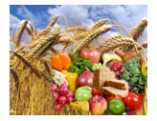
Food is esential to life

Slide 3
Food systems
Conventional
Economies of scale
Production model Maximizing efficiency
Alternative
Local food systems
Economies of scale
Organic
food
systems
efficiency
Food systems are either conventional or alternative according to their model of food lifespan from origin to plate.^{[1]}
^{[1][}Discovering the Food System - A Primer on Community Food Systems: Linking Food, Nutrition and Agriculture http://foodsys.cce.cornell.edu/primer.html

Slide 4
Organic food systems
Are characterized by a reduced dependence on chemical inputs and an increased concern for transparency and information.
Organic produce is grown without the chemical pesticides and fertilizers of industrial food systems, and livestock is reared without the use of antibiotics or growth hormones.
The reduced inputs of organic agriculture can also lead to a greater reliance on local knowledge, creating a stronger knowledge community amongst farmers.^{[16][17]}
The Alternative Farming Systems Information Center. “Organic Food
Production.” National Agricultural Library, USDA 2003.
.^{[16][} Morgan, K and J. Murdoch (2000) “Organic vs. conventional agriculture: knowledge, power and innovation in the food chain” Geoforum 31(2): 159-173
^{[17]}Renkin, A.M., K. Lyons and R.C.N. Laurence (2002) in Proceedings from the 14th IFOAM Organic World Congress, Victoria, BC, August 2002

Slide 5
Principles of organic food production
  Biodiversity
  Ecological balance
  Sustainability
  Natural plant fertilization
  Natural pest management,and
  Soil integrity

Slide 6
Regulation
In 1992 the European Community developed organic standards and a certification scheme (8 ).
The International Federation of Organic Agriculture Movements (IFOAM) (9 ) also has a set of organic principles which were the basis of the guidelines for organically produced foods of the internationally recognized
Codex Alimentarius (10) of the World Health Organization and Food and Agriculture Organization of the United Nations (WHO/FAO food standards). Codex Alimentarius is the internationally accepted food safety standard for all food products traded worldwide. There is a set of standards within the Codex Alimentarius that covers organic food.
8. "Fact Pages: Organic Farming." European Commission Directorate General for Agriculture and Rural Development. (Europa Website). 2007.
10. "Guidelines for the Production, Processing, Marketing and Labelling of Organically
Produced Foods." The Codex Alimentarius Commission and the FAO/WHO Food Standards
Programme. 1999.

Slide 7
In October 2002, the production and marketing of organic food came under regulation by the US Department of Agriculture’s (USDA) National Organic Program. The National Organic Standards Board, a federal advisory panel to the USDA for developing organic legislation.
The low for organic agricultural production, food products and food in Republic of Macedonia was introduced in 2009, and the changes and supplements in 2011*
* Macedonian low of agricultural production, food products and food, Official paper 146/2009, with changes and supplements of 14.4.2011.

Slide 8
The average Western diet with high intakes of meat, fat and sugar is a risk for individual health, social systems and the environmental life support systems.
Wide-spread diet-related diseases:
  obesity,
  type 2 diabetes,
  hypertension,
  osteoarthritis, and
  cancer
The promotion of a healthy diet also reduces the environmental footprint of food consumption in Europe and globally.
( SCAR Report p. 132)
Changes in diet: Recent decades have seen a trend towards less sustainable and less healthy diets, with European citizens consuming "..too much energy, too many calories, too much fat and sugar, and salt".
EU platform for action on diet, physical activity and health

Slide 9
A high dietary fiber (DF) intake is generally recommended by most diabetes and nutritional associations. Its nutritional benefits relate to its resistence to digestion.
Dietary fiber quantitation in foods has been of significant interest in the nutrition analytical community for over 50 years.

Slide 10
Dietary Fiber-Definition
Dietary fiber consists of carbohydrate polymers with ten or more monomeric units, which are not hydrolyzed by the endogenous enzymes in the small intestine of humans and belong to the following categories:
edible carbohydrate polymers naturally occurring in the food as consumed;
carbohydrate polymers which have been obtained from food raw material by physical, enzymatic or chemical means and which have been shown to have a physiological effect of benefit to health*, and;
synthetic carbohydrate polymers which have been shown to have a physiological effect of benefit to health*
*as demonstrated by generally accepted scientific evidence to competent authorities.

Slide 11
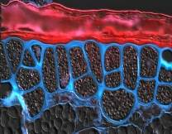
a. When derived from a plant origin, dietary fiber may include fractions of lignin and/or other compounds when associated with polysaccharides in the plant cell walls and if these compounds are quantified by the AOAC gravimetric analytical method for dietary fiber analysis: fractions of lignin and the other compounds (proteic fractions, phenolic compounds, waxes, saponins, phytates, cutin, phytosterols, etc.) intimately “associated” with plant polysaccharides in the AOAC 991.43 method.
b. Decision on whether to include carbohydrates of 3 to 9 monomeric units should be left up to national authorities.
Codex Alimentarius (2010)

Slide 12
Other classification of DF
DIETARY FIBRE
SOLUBLE DF (SDF)
INSOLUBLE DF (IDF)
According to FAO recommendation
DIETARY FIBRE
Non-Fementable
Fementable

Slide 13
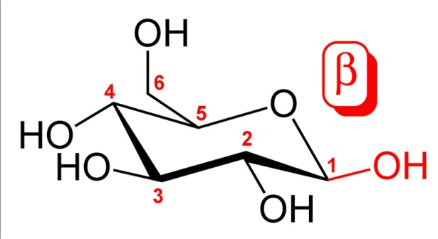
The soluble dietary compound (1-3) (1-4)- β-D-glucan is an important DF components which has health claim related to cereal- derived beta-glucan. It may significantly reduce the risk of deseases and strengthen the immune system.
The β(1,3)D-glucans extracted from grains tend to be both soluble and insoluble.
By definition, β-glucans are chains of D-glucose polysaccharides, linked by
beta-type glycosidic bonds.

Slide 14
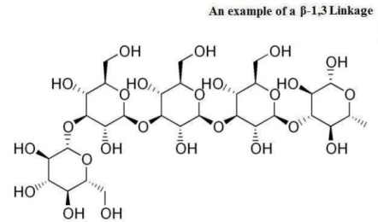
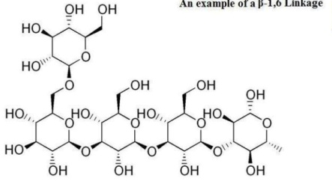
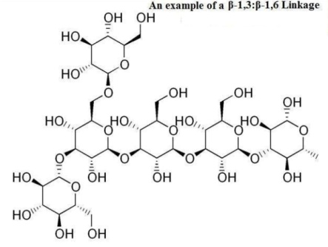
Examples of various β-glucan glycosidic linkages
β(1,3) linkage
β(1,6) linkage
These six-sided D-glucose rings can be connected to one another, on a variety of positions on the D-glucose ring structure. Some β-glucan compounds are continual repeats of D-glucose attached at a specific position.
β(1,3) (1,6) linkage

Slide 15
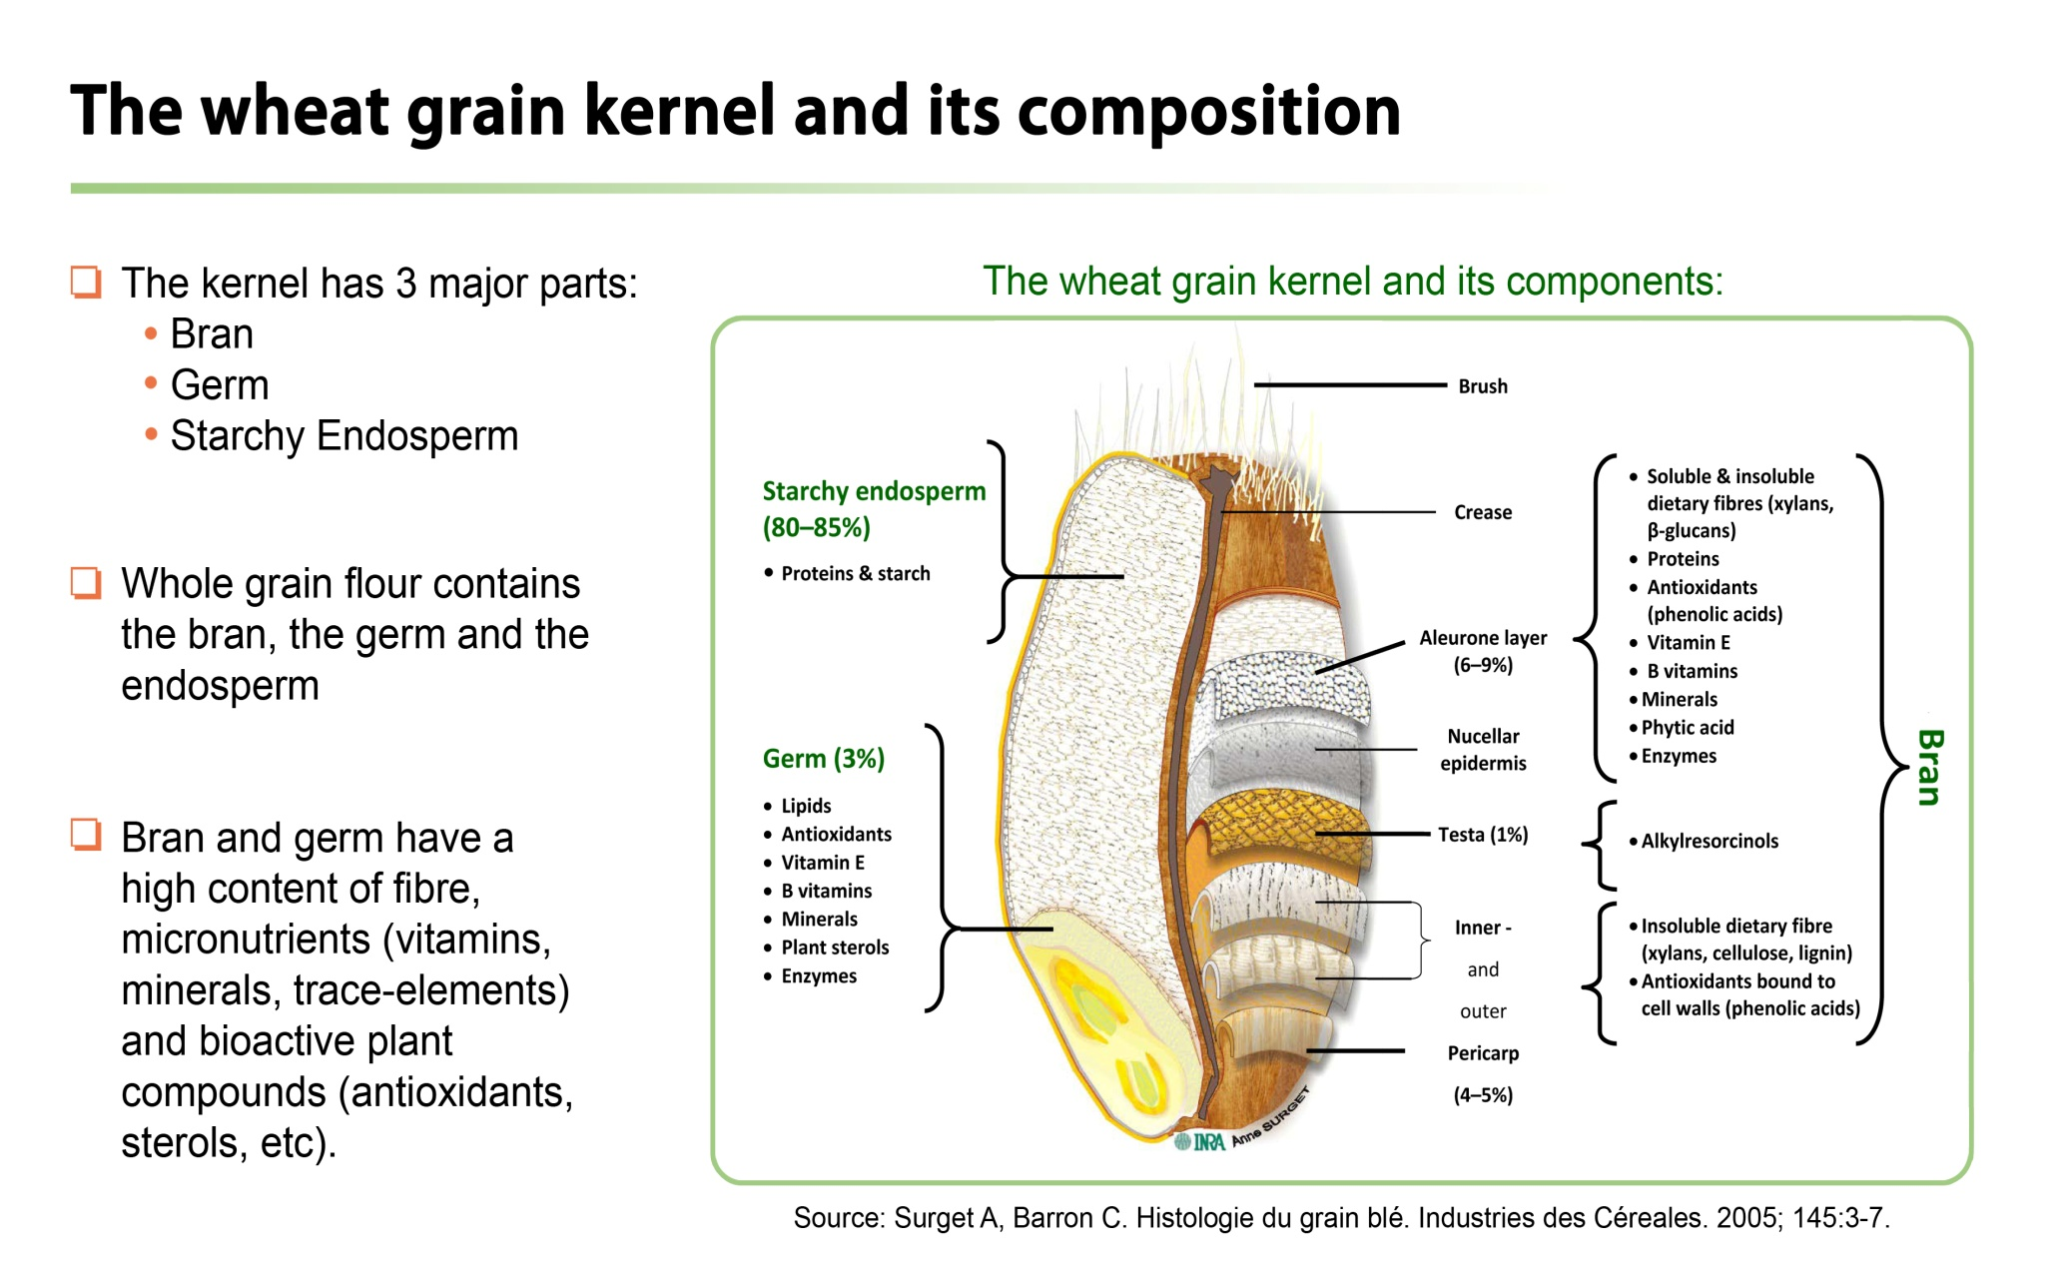
Source of dietary fibre
Cereal grains are naturally rich in dietary fibre (DF), and provide in many countries the most abundant source of DF in the diet.
Source: Health grain, http://wwwhealthgrain.org/regulatory_issues

Slide 16
Measurement of DF
The procedure for the determination of total dietary fibre is based on the methods of Lee et al.(1), and Prosky et al (2,3) (AOAC 991.43, AOAC 985.29, AACC 32-07.01 and AACC 32-05.01).
Standardized enzymatic-gravimetric method-the Megazyme Total Dietary Fiber Kit was used in the analyses of TDF, SF and ISF of cereal samples.
(1) Lee et al., J.Assoc.Off.Anal.Chem., 75:395-416 (1992),
(2) Prosky et al., J.Assoc.Off.Anal.Chem., 71:1017-1023 (1988).
(3) Prosky et al., J.Assoc.Off.Anal.Chem., 75:360-367 (1992).

Slide 17
Dietary fibre health claims
The health benefits of DF have been well established for over 30 years.
Initially, observational studies showed associations between high fibre diets and reduction in diseases like heart disease, canser, diabetes,as well as gastro intestinal effects.
Due to this, interest in fibre grew and science started to look closer at the bioactive compounds also found in some high fibre food sources, like cereal brans, and grapeskins, etc.
Lately specific attention is given to the role of fibre on appetite control, improving insulin sensitivity and biomarkers of inflammation.
There is an evidence that the soluble dietary compound (1-3) (1-4)- β-D-glucan has health claim related to cereal- derived beta-glucan may significantly reduce the risk of deseases and strengthen the immune system.
Additionally, beta-glucan is said to increase the body's defense against the harmful effects of stress.

Slide 18
EU authorised Health Claims on Cereal Fibre and Cholesterol levels
Material | Health claim | Conditions of use | EFSA opinion reference
β-glucans (Bg) | Maintenance of normal cholesterol levels (Article 13.1 claim) | Daily intake of 3 g required Food with ≥ 1 g of Bg per quantified portion. | 2009;7(9):1254, 2011;9(6):2207
Oat β-glucan | Oat (respectively barley) beta-glucan has been shown to lower/reduce blood cholesterol. High cholesterol is a risk factor in the development of coronary heart disease Article 14.(1)(a) claim (disease reduction claim) | Daily intake of 3 g required Foods which provide at least 1g of oat (respectively barley) per portion | Q-2008-681
Barley β-glucan |  |  | Q-2011-00798 and Q-2011-00799
Source: Health grain, http://wwwhealthgrain.org/regulatory_issues

Slide 19
EU authorised Health Claims on Cereal Fibre and reduced glucose rise after a meal
Material | Health claim | Conditions of use | EFSA Opinion Reference
Arabinoxylan produced from wheat endosperm | Reduction of blood glucose rise after a meal | Daily intake ≥ 8g AX rich fibre | 2011;9(6):2205
β-glucans from oats and barley |  | Intake ≥ 4g / 30g digestible carbs | 2011;9(6):2207
Resistant starch (RS) |  | RS Content ≥ 14% of total starch | 2011;9(4):2024
Source: Health grain, http://wwwhealthgrain.org/regulatory_issues

Slide 20
AIM OF INVESTIGATION
To determine:
● The values of Total Dietary Fiber and of its components-Soluble dietary fibre, Insoluble dietary fibre, and ᵦ-beta-glucans in different cereal samples,
● Their nutritional composition,
● The influence of the cereal kind, growing location and farming method on their values and their relations and
● The possible associations between particular nutritive components in cereal samples.

Slide 21
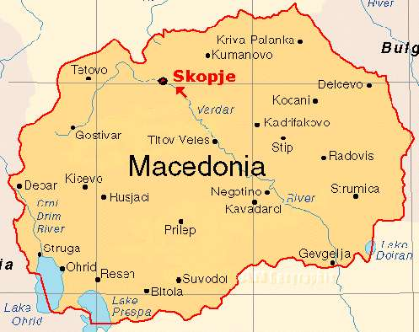
MATERIALS
27 cereal samples of wheat, barley, rye, oat and millet
They were collected in 2013 from three locations in Macedonia: Veles, Stip-Ovce Pole, and Negotino
Production: by organic and conventional farming, and some in conversion production

Slide 22
METHODS OF ANALYSIS
The content of nutritive components in cereals-moisture, ash, protein and fat was analysed by standard AOAC method of analysis.
Standardized enzymatic-gravimetric method -the Megazyme Total Dietary Fiber Kit was used in the analyses of TDF, SF and ISF of cereal samples.
A mixed-linkage β-glucan assay kit (Megazyme Ireland) was used for determination in the analysis of β-glucan value, based on the method published by McCleary and Codd 1991*.
The method has been accepted by the AOAC (Method 995.16), AACC (Method 32-23.01) and ICC Standard Method(No.166).
The results have been shown as a mean values ± standatrd deviation, and were calculated on dry weight basis.
*McCleary B.V., Codd R., 1991. Journal of Food Science and Agriculture, 55, p.303-312.

Slide 23
In order to find out the existance of associations between average value of cereal nutrients/components and farming type, cereal kind-farming method by chemical-technological trait biplot analysis was done within R 2.9.0 program environment (R Development Core Team, 2010).
A phenotype by trait biplot can help understand the associations among breeding objectives and identify traits that are positively or negatively correlated, traits that are redundantly measured, and traits that can be used in indirect selection for another trait (Lee et al. 2003, Yan and Tinker, 2006).
It also helps to visualize the trait profiles of phenotypes (Yan and Kang 2003), what is of particular importance for selection programs, agronomic practice and food processing industry.

Slide 24
Analytical cheme for Total Dietary Fibre (TDF),
Soluble (SDF) and Insoluble Dietary Fibre (IDF) determination
1 g sample in duplicate
Protease
α-amylase
1 g sample in duplicate
α-amylase
Protease
Amyloglucosidase
α
Amyloglucosidase
2 residues
Protein
Total Dietary Fibre
Ash
Residue
Few steps
Protein
IDF
Ash
Residue
Protein
SDF
Ash

Slide 25
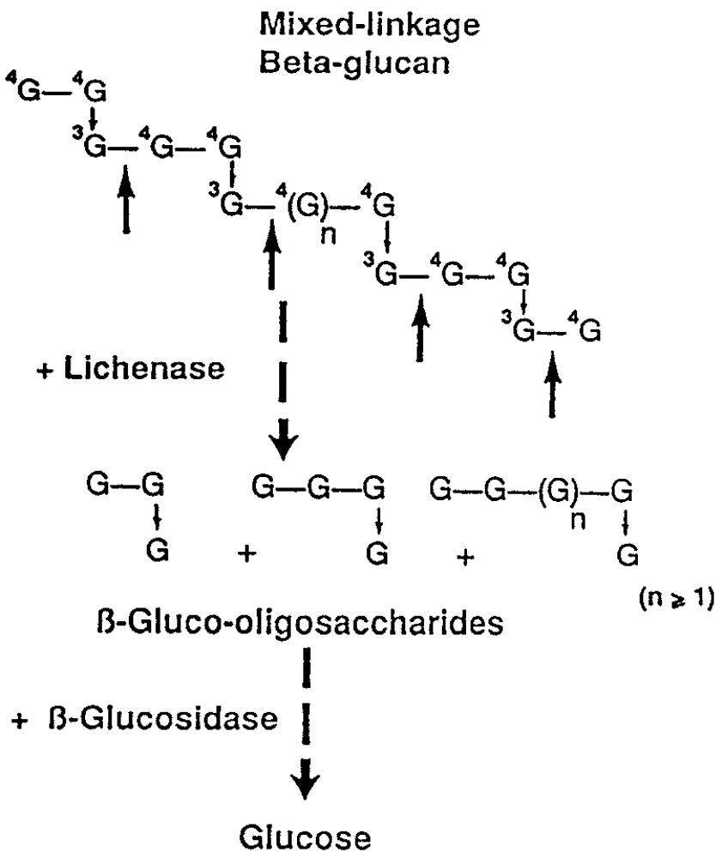
(Method for determination of β-glucan content-to be continued)
● samples were suspended and hydrated in sodium phosphate buffer pH 6.5
● hydrolysis with purified lichenase enzyme and filtered
● hydrolysis with β-glucosidase
● glucose product was assayed using a glucose/peroxidase reagent
● β-glucan was measured in two parallel assay of each sample
● the results have been shown as a mean values ± standatrd deviatio
● β-glucan content value was calculated on dry weight basis.

Slide 26
DETERMINATION OF CEREAL NUTRIENTS

Slide 27
Ash
Wheat
Barley
Oat
Rye
Millet
Figure 1. Content of ash in cereal ssamples cultivated conventionally and organically

Slide 28
Protein
Fig.2. Content of protein in cereal samples cultivated conventionally
and organically

Slide 29

Fat
Wheat
Barley
Oat
Rye
Millet
Fig.3. Content of protein in cereal samples cultivated conventionally
and organically

Slide 30
Dry matter
Fig.4. Content of gry matter in cereal samples cultivated conventionally
and organically

Slide 31
The obtained results from the investigation have shown:
There was a significant increase in the content of ash, dry matter, protein and fat in organic produced cereals in comparisson with those which were produced either by conventional or in conversion method,
  the increase of ash content was 15% with wheat, 7% with barley, and 71% with millet,
  the increase of protein content was 37% with oat and 3% with rye, and the decrease of 15% with barley,
  the increase of crude fat content was 15% with wheat, 3% with oat, 29% with rye and 7% with millet,
Barley grown by either conventional or in conversion farming method proved to have the highest content of dry matter.
Oat obtained from organic farming method exhibited the highest fat, protein and ash content.

Slide 32
DETERMINATION OF BETA –GLUCAN CONTENT

Slide 33
Figure 5. Content of beta-glucan in wheat cultivated conventionally and organically

Slide 34
Figure 6. Content of brta-glucanin wheat cultivated conventionally and organically

Slide 35
Figure 7. Content of brta-glucan in oat cultivated conventionally and organically

Slide 36
Figure 8. Content of brta-glucan in rye cultivated conventionally and organically

Slide 37
Comparing the results obtained for β-D-glucan values in organic and conventional cereals, it was noticed:
slight increase in organic wheat (9.84%), and
slight decrease in oat (2.91%), and
small decrease in rye (18.06%).
There was no change in the content of β-D-glucan value for barley which was grown either by organic or conventional farming.

Slide 38
Persentage of increasing/decreasing of beta –glucan value in relation to farming type
Cereal | Relation | Beta-Glucan (g/100 g)
Wheat | Organic/Conventional | +9.84%
Barley | Organic/Conventional | -2.91%
Barley | Organic/In conversion | -7.73%
Barley | In conversion/Conventional | +4.97%
Oat | Organic/Conventional | -9.36%
 | Organic/Conventional | -18.06%

Slide 39
Associations between average value of nutrients and cereal farming type
Fig. 9.
Cereal kind-farming method by chemical-technological trait biplot
(drymatter, protein, ash, fat, moisture, TDF, SDF, ISF) .
O- organic farming method,
C-conventional farming method,
IC-in conversion farming method

Slide 40
Cereal kind-farming method by chemical-technological trait biplot explained high proportion of G + GE variance of 76.64% and revealed existance of positive associations between:
average dry matter content and average beta-glucan content and barley produced from the in conversion farming method and also little weaker for barley produced with the conventional farming method.
average fat content, average protein content and average ash content and oat produced with the organic farming method and also little weaker for oat produced with the conventional farming method;
average moisture content and wheat and rye conventionally farmed.

Slide 41
Cereal kind-farming method by chemical-technological trait biplot (Figure 1) revealed existance of negative associations between:
average dry matter content and average beta-glucan content and wheat and rye conventionally farmed;
average fat content and wheat and rye organically farmed and to lesser extent for wheat and rye obtained from conventional farming method;
average protein content and average ash content and wheat and rye produced with the conventional farming method;
average moisture content and barley produced with the in conversion farming method and little weaker for barley obtained from conventional farming method.

Slide 42
DETERMINATION OF TDF, SDF AND IDF CONTENT

Slide 43
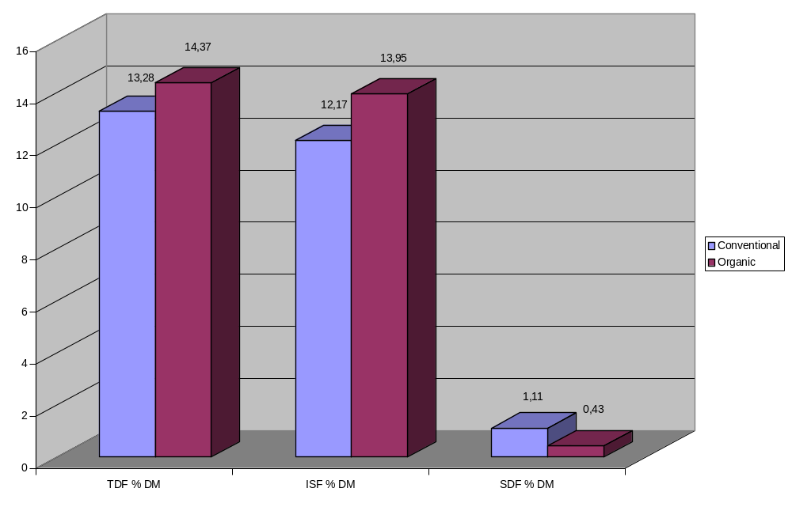
Figure 10. Content of TDF, ISF and SDF in wheat cultivated conventionally and organically

Slide 44
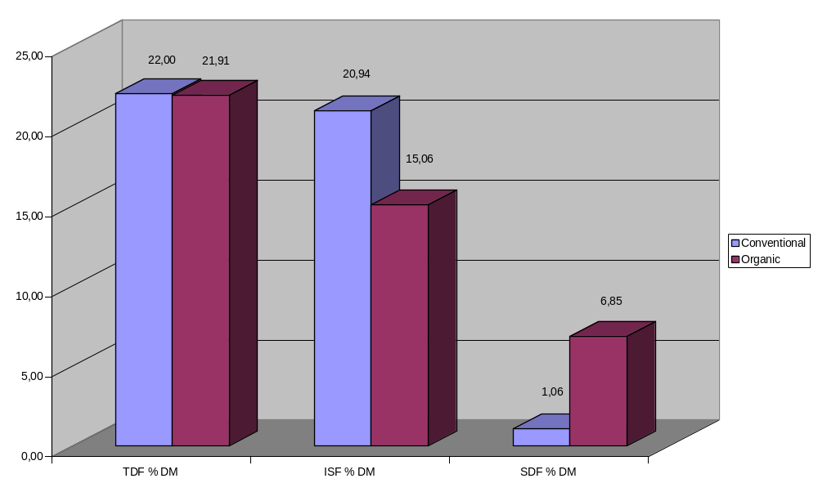
Figure 11. Content of TDF, ISF and SDF in barley cultivated conventionally and organically

Slide 45
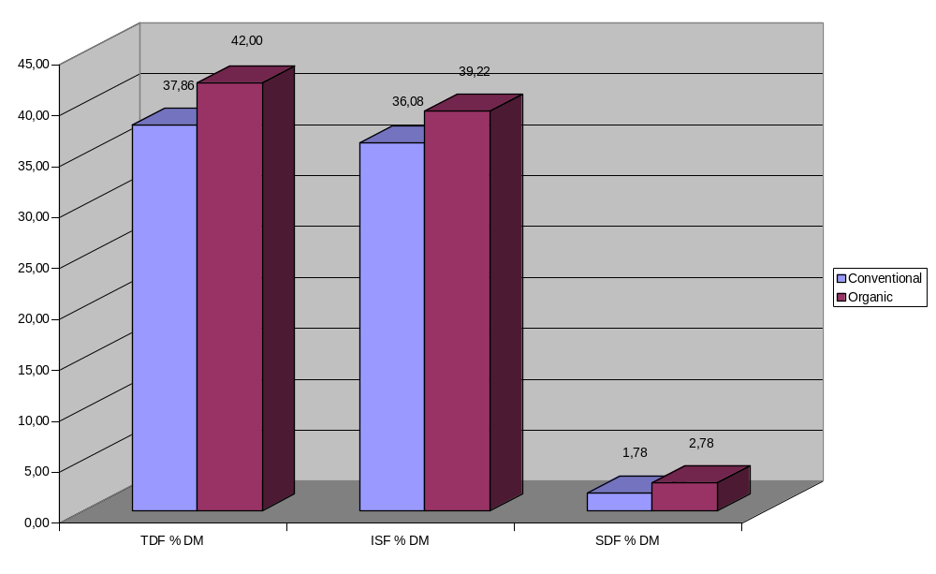
Figure 12. Content of TDF, ISF and SDF in oat cultivated conventionally and organically

Slide 46
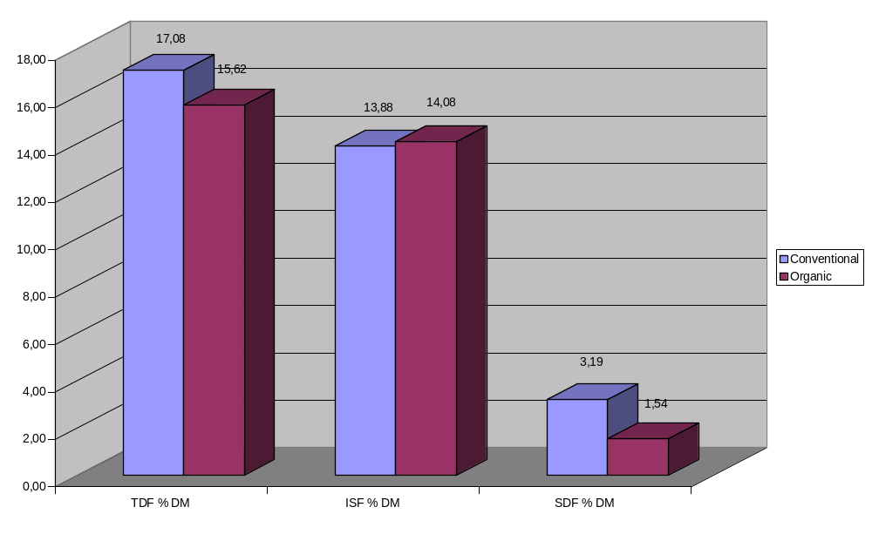
Figure 13. Content of TDF, ISF and SDF in rye cultivated conventionally and organically

Slide 47
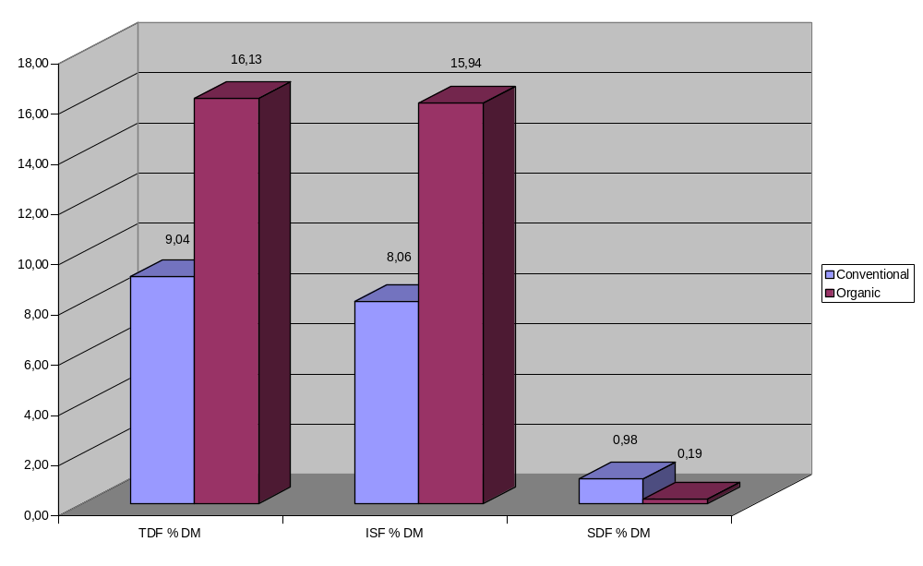
Figure 14. Content of TDF, ISF and SDF in millet cultivated conventionally and organically

Slide 48
Among the all investigated cereals which were grown by the both organic and conventional farming, including also those grown by in conversion farming method was noticed:
Organically grown oat has shown maximal average values (%,db) of TDF (42.0±1.39), and of ISF (39.22±0.58).
The maximal average value (%,db) of SF (6.85±3.85) has shown organically grown barley.
With conventionally grown wheat was observed minimal average value of TDF (%,db) of 13.28±0.72, while the minimal average values (%,db) of ISF (8.06±8.13) and of SF (0.43±0.39) were observed with conventionally grown millet.

Slide 49
Persentage of increasing/decreasing of TDF value and of its fractions in relation to farming type
Cereal | Relation | TDF % DM | ISF % DM | SDF % DM
Wheat | Organic/Conventional | +7.59 % | +12.75% | -61.26%
Barley | Organic/Conventional | -0.41% | -28.08% | +84.52%
 | Organic/In conversion | +4.20% | -2.90% | +20%
 | In conversion/ Conventional | -4.59% | -25.93% | +80.66%
Oat | Organic/Conventional | +9.86% | +8.01% | +35.97%
Rye | Organic/Conventional | -8.55% | +1.42% | -51.72%
Millet | Organic/Conventional | +43.96% | +49.43% | -80.61%

Slide 50
Associations between average value of nutrients and cereal farming type
Fig.15.
Cereal kind-farming method by chemical-technological trait biplot
(drymatter, protein, ash, fat, moisture, TDF, SDF, ISF) .
O-organic farming method,
C-conventional farming method,
IC-in conversion farming method

Slide 51
Cereal kind-farming method by chemical technological trait biplot explained high proportion of G + GE variance of 69.45% and revealed existance of positive associations between:
● average protein content, average TDF content and average ISF content and oat produced with the organic farming;
● average fat content and oat produced with the conventional farming method;
● average SDF content and barley obtained from in conversion farming method and to lesser extent from barley produced by the organic farming method;
● average dry matter content and barley produced from in conversion farming method;
● average moisture content and average ash content and millet produced by conventional farming method.

Slide 52
Cereal kind-farming method by chemical technological trait biplot revealed existance of negative associations between:
● average dry matter content and millet conventionally farmed;
● average fat content, average protein content, average TDF content and average ISF content and rye organically farmed;
● average SDF content and millet produced by the organic farming method;
● average moisture content and average ash content and barley obtained by in conversion farming method.

Slide 53
C O N C L U S I O N S
Based on the cereal kind-farming method by chemical-technological trait biplot the possibilities are derived that could be used for agronomic practice, breeding and food processing industry at improving the important properties- dry matter, protein, fat, ash, moisture, beta glucan,
as well as TDF, SDF and ISF in cereal crops.
As contents of protein, dry matter, beta glucan, fat and ash were positively associated the same-directional breeding for these traits would be possible, while due to negative association with moisture the co-breeding for moisture content in the same direction would not be possible.
Barley grown by either conventional or in conversion farming method proved to have the highest content of dry matter and beta-glucan content when compared to other cereals investigated, whereas oat obtained from organic farming method exhibited the highest fat, protein and ash content.
Organic farming method proved to be effective for oat for all examined chemical–technological traits except moisture and for barley for dry matter, beta-glucan, ash and protein contents.

Slide 54
As content of protein, dry matter, fat, TDF and ISF were positively associated the same-directional breeding for these traits would be possible, while due to negative association with moisture the co-breeding for moisture content in the same direction would not be possible.
Average ash content and average moisture content were positively associated leading for the possibility of the same-directional breeding for these traits.
As content of protein, dry matter, TDF and SDF were positively associated the same-directional breeding for these traits would be possible, while due to negative association with average moisture content and average ash content the co-breeding for moisture content and ash content in the same direction would not be possible.
Barley grown by either organic or in conversion farming method proved to have the highest content of dry matter and SDF content of other cereals investigated, whereas oat obtained from organic farming method exhibited the highest protein, TDF and ISF content.
Organic farming method proved to be effective for oat for all examined chemical–technological traits except moisture and ash.

Slide 55
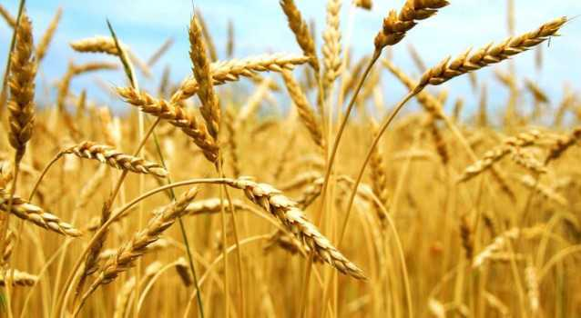
THANK YOU FOR YOUR ATENTION

