Slide 1
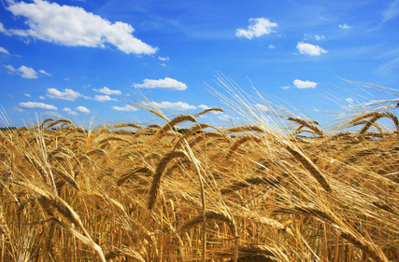



MMM
Food Technology-2015 conference, August 10-12, London, UK
CEREAL DIETARY FIBRE PERSPECTIVES ON SUSTAINABLE FOOD AND NUTRITION
Prof. Mirjana Menkovska, Ss.Cyril and Methodius University, Skopje, Macedonia

Slide 2
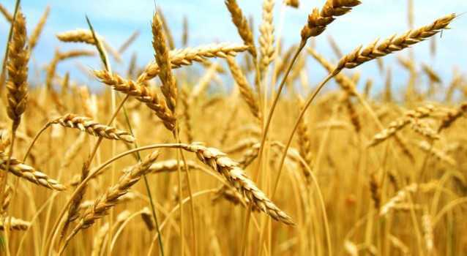
Life
Cultural identity
Food
Health
Economy

Slide 3
A food system includes all processes and infrastructure involved in feeding a population: growing, harvesting, processing, packaging, transporting, marketing, consumption, and disposal of food and food-related items.
Food systems
Food
Nutrition
Health
Community economic
development
Agriculture
A food system operates within and is influenced bysocial, political, economic and environmental contexts.
It also requires human resources that provide labor, research and education

Slide 4
Food systems
Conventional
Economies of scale
Production model Maximizing eefficiencyfficiency
Alternative
Local food systems
Organic
food
systems
Economies of scale

Slide 5
A food system includes all processes and infrastructure involved in feeding a population: growing, harvesting, processing, packaging, transporting, marketing, consumption, and disposal of food and food-related items.
A food system operates within and is influenced by social, political, economic and environmental contexts.
It also requires human resources that provide labor, research and education
Food systems

Slide 6
Food systems are either conventional or alternative according to their model of food lifespan from origin to plate.^{[1]}
Conventional food systems
Operate on the economies of scale.
Are geared towards a production model that requires maximizing efficiency in order to lower consumer costs and increase overall production,
They utilize economic models such as vertical intergration, economic specialization, and global trade.
The term “conventional” when describing food systems is large part due to comparisons made to it by proponents of other food systems, collectively known as alternative food systems.
^{[1][}Discovering the Food System - A Primer on Community Food Systems: Linking Food, Nutrition and Agriculture

Slide 7
1. Local food systems
Are networks of food production and consumption that aim to be geographically and economically accessible and direct.
They contrast to industrial food systems by operating with reduced food transportation and more direct marketing , leading to fewer people between the farmer and the consumer
Alternative food systems
Are those that fall outside the scope of conventional agriculture

Slide 8
2. Organic food systems
Are characterized by a reduced dependence on chemical inputs and an increased concern for transparency and information.
Organic produce is grown without the chemical pesticides and fertilizers of industrial food systems, and livestock is reared without the use of antibiotics or growth hormones.
The reduced inputs of organic agriculture can also lead to a greater reliance on local knowledge, creating a stronger knowledge community amongst farmers.^{[16][17]}
The Alternative Farming Systems Information Center. “Organic Food Production.” National Agricultural Library, USDA 2003.
.^{[16][} Morgan, K and J. Murdoch (2000) “Organic vs. conventional agriculture: knowledge, power and innovation in the food chain” Geoforum 31(2): 159-173
^{[17]}Renkin, A.M., K. Lyons and R.C.N. Laurence (2002) in Proceedings from the 14th IFOAM Organic World Congress, Victoria, BC, August 2002

Slide 9
Principles of organic food production
Biodiversity,
ecological balance,
sustainability,
natural plant fertilization,
natural pest management, and
soil integrity.

Slide 10
Organic food products
Are grown or raised by a producer who uses practices in balance with the natural environment, using methods and materials that minimize negative impact on the environment. The organic farmer is committed to replicating the ecology of the natural environment by maintaining biodiversity and fostering healthy soil and growing conditions.
Are produced on land that has been free of known and perceived toxic and persistent chemical pesticides and fertilizers for at least three years prior to certification, and synthetic fertilizers and pesticides are not used in production.

Slide 11
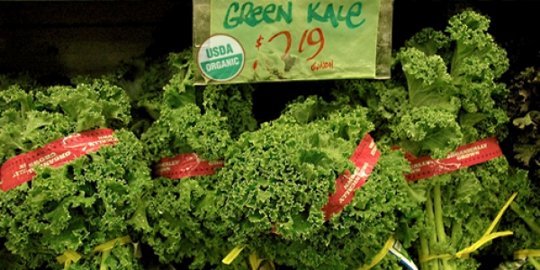
Are planted on a rotating basis within the farm system. Crops are rotated from field to field, rather than growing the same crop in the same place year after year. Cover crops such as clover are planted to add nutrients to the soil and prevent weeds.
Organic meat, poultry and egg products come from farms that use organic feed, do not administer added hormones to promote growth or any antibiotics and they allow animals the space and freedom to behave naturally.
Organic kale being sold at Berkeley Bowl (CA)

Slide 12
Regulation
In 1992 the European Community developed organic standards and a certification scheme (8) .
The International Federation of Organic Agriculture Movements (IFOAM) (9) also has a set of organic principles which were the basis of the guidelines for organically produced foods of the internationally recognized.
Codex Alimentarius (10) of the World Health Organization and Food and Agriculture Organization of the United Nations (WHO/FAO food standards). Codex Alimentarius is the internationally accepted food safety standard for all food products traded worldwide. There is a set of standards within the Codex Alimentarius that covers organic food.
8. "Fact Pages: Organic Farming." European Commission Directorate General for Agriculture and Rural Development. (Europa Website). 2007.
10. "Guidelines for the Production, Processing, Marketing and Labelling of Organically Produced Foods." The Codex Alimentarius Commission and the FAO/WHO Food Standards Programme. 1999.

Slide 13
In October 2002, the production and marketing of organic food came under regulation by the US Department of Agriculture’s (USDA) National Organic Program. The National Organic Standards Board, a federal advisory panel to the USDA for developing organic legislation.
The low for organic agricultural production, food products and food in Republic of Macedonia was introduced in 2009, and the changes and supplements in 2011*
* Macedonian low of agricultural production, food products and food, Official paper 146/2009, with changes and supplements of 14.4.2011.

Slide 14
Specifically, the regulations:
Prohibit most synthetic (and petroleum derived) pesticides and fertilizers (for a list see the National List of Allowed and Prohibited Substances)
Prohibit all antibiotics, genetic engineering, irradiation4 and sewage sludge. Require all organically produced animals have 100% organic feed (which does not contain any animal byproducts or growth hormones)
Require all organically produced animals to have access to the outdoors.5
Require that processed products labeled organic contain at least 95% organic ingredients.6
4. "Fact Sheet: National Organic Production and Handling Standards." USDA Agricultural
Marketing Service. Accessed online April 2008.
5. National Sustainable Agriculture Information Service. "Organic Livestock Workbook.
"National Agricultural Library, USDA. 2007.
6. "Fact Sheet: Organic Labeling and Marketing Information". USDA Agricultural Marketing
Service. Accessed online April 2008.

Slide 15
Changes in diet: Recent decades have seen a trend towards less sustainable and less healthy diets, with European citizens consuming "..too much energy, too many calories, too much fat and sugar, and salt".
EU platform for action on diet, physical activity and health
Wide-spread diet-related diseases:
The promotion of a healthy diet also reduces the environmental footprint of food consumption in Europe and globally.
(SCAR Report p. 132)
obesity,
type 2 diabetes,
hypertension,
osteoarthritis, and
cancer

Slide 16
DIETARY FIBRE
A high dietary fiber (DF) intake is generally recommended by most diabetes and nutritional associations. Its nutrition benefits relate to its resistence to digestion.
Dietary fiber quantitation in foods has been of significant interest in the nutrition analytical community for over 50 years.
A number of AOAC Official Methods of Analysis have been adopted for the analysis of dietary fibre and some of its fractions and components.

Slide 17
Dietary Fiber-Definition
Dietary fiber consists of carbohydrate polymers with ten or more monomeric units, which are not hydrolyzed by the endogenous enzymes in the small intestine of humans and belong to the following categories:
edible carbohydrate polymers naturally occurring in the food as consumed;
carbohydrate polymers which have been obtained from food raw material by physical, enzymatic or chemical means and which have been shown to have a physiological effect of benefit to health*, and
synthetic carbohydrate polymers which have been shown to have a physiological effect of benefit to health*
*as demonstrated by generally accepted scientific evidence to competent authorities.

Slide 18
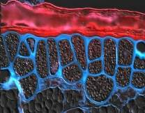
When derived from a plant origin, dietary fiber may include fractions of lignin and/or other compounds when associated with polysaccharides in the plant cell walls and if these compound s are quantified by the AOAC gravimetric analytical method for dietary fiber analysis:
fractions of lignin and the other compounds (proteicfractions, phenoliccompounds, waxes, saponins, phytates, cutin, phytosterols, etc.) intimately “associated” with plant polysaccharides in the AOAC 991.43 method.
a.
b. Decision on whether to include carbohydrates of 3 to 9 monomeric units should be left up to national authorities.
Codex Alimentarius (2010)

Slide 19
Other classification of DF
DIETARY FIBRE
(DF)
According to FAO recommendation
SOLUBLE
DIETARY FIBRE
(SDF)
INSOLUBLE
DIETARY FIBRE
(IDF)
Fementable
DIETARY FIBRE
Non-Fementable

Slide 20
Measurement of DF
Serious research on dietary fiber in the 1950’s resulted in a definition by Trowel et al in 1976 (1).
AOAC International validated Official Methods (2) 985.29, 991.42, 992.16, 993.19, 993.21, and 994.13 to match that definition beginning in 1980.
Scientific advances in the subsequent two decades resulted in the conclusion that additional components such as resistant starch and non-digestible oligosaccharides are validly included in the Trowel et al definition on a physiological bases, therefore

Slide 21
AOAC Official Methods 992.28, 995.16, 997.08, 999.03, 2000.11, 2001.02, 2001.03, and 2002.02 for these components have been validated.
The CODEX Committee on Nutrition and Foods for Special Dietary Uses (CCNFSDU) recently has produced a clarifying definition of Dietary Fiber (see ALINORM 09/32/26) that reflects the scientific findings of the past 5 plus decades in a single, concise definition.
AOAC International scientists are validating an all inclusive method commensurate with this definition.

Slide 22
AOAC International has been a leader in proving Official Methods of Analysis consistent with the state of dietary fiber science.
Over the past two decades, the most widely used methods for the measurement of dietry fibre have been AOAC Methods 985.29 and 991.43.
However, these methods do not measure resistent oligosaccharides and generally underestimate resistat starch.

Slide 23
To address this limitation, a method (1) that is based on AOAC Method 991.43 (total dietary fibre) and AOAC Method 2001.03 (non-digestible) oligosaccharides), has been developed and is currently the subject of an inerlaboratory evaluation under the auspices of AOAC International.
This procedure involves the incubation of sample with pancreatic alpha-amylase plus amyloglucosidase under conditions similar to those used in the measurement of resistant starch.

Slide 24
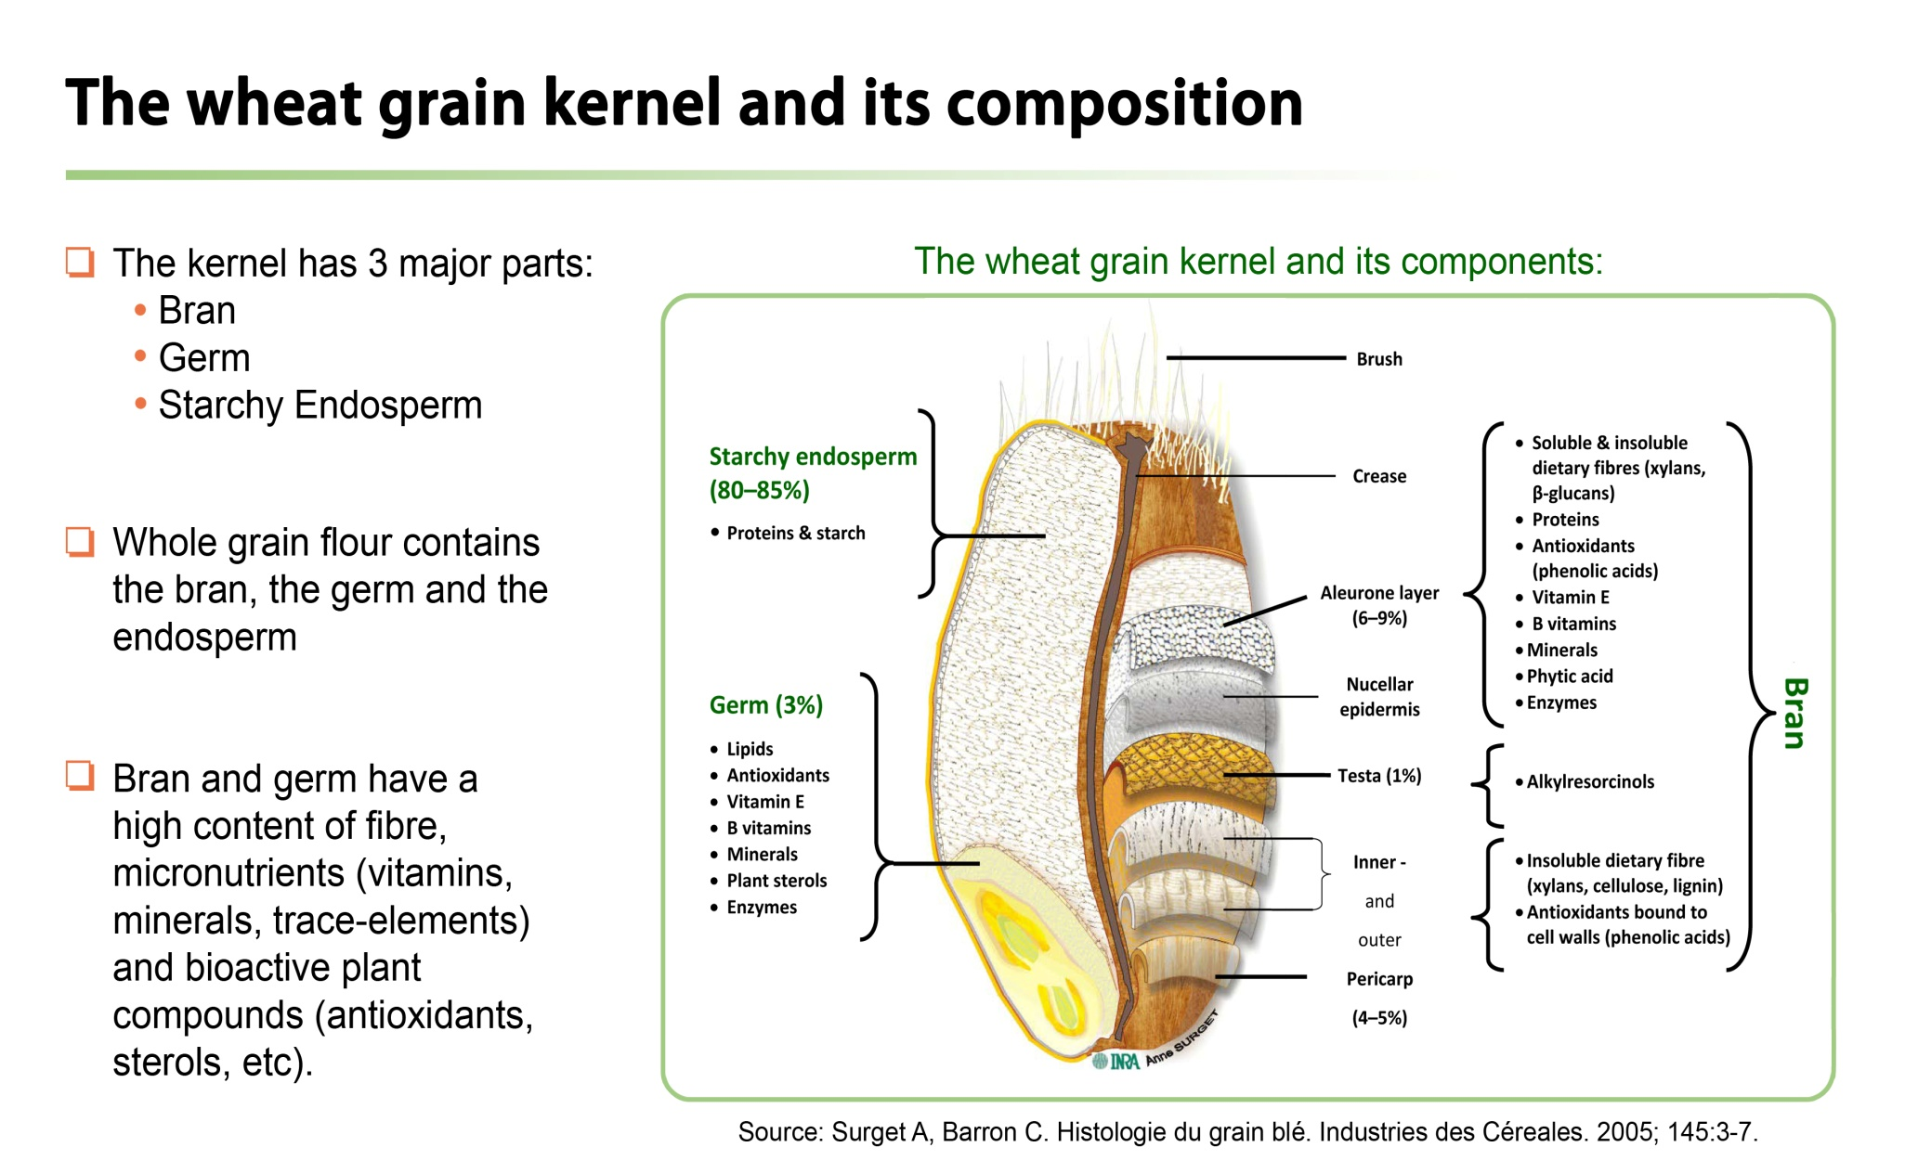
Source of dietary fibre
Cereal grains are naturally rich in dietary fibre (DF), and provide in many countries the most abundant source of DF in the diet.
Source: Health grain, http://wwwhealthgrain.org/regulatory_issues

Slide 25
Dietary fibre health claims
The health benefits of DF have been well established for over 30 years.
Initially, observational studies showed associations between high fibre diets and reduction in diseases like heart disease, canser, diabetes,as well as gastro intestinal effects.
Due to this, interest in fibre grew and science started to look closer at the bioactive compounds also found in some high fibre food sources, like cereal brans, and grapeskins, etc.
Lately specific attention is given to the role of fibre on appetite control, improving insulin sensitivity and biomarkers of inflammation.

Slide 26
Healthy lifestyle
Cereal fibre
weight
Manage-ment
Choles-terol
Reduction
Glycaemic
Control
Bowel
Function
Gut brain/liver axis and immunostimulation
Obesity
Cardiovascular
diseases
Diabetes
Cancers
Appetite control
Biomarkers of inflammation
Insulin sensitivity
Life expectancy
Source: Health grain, http://wwwhealthgrain.org/regulatory_issues

Slide 27
The European Agency for Food Safety (EFSA) has approved health claims associated with diets containing dietary fiber intakes greater than 25 g per day, resulting in a reduced risk of coronary heart disease and type 2 diabetes and improved management of body weight.
Specifically for oat and barley β-glucans, in the case of daily intake of 3 g, there is approved claim for reducing blood cholesterol levels applicable for foods that provide at least 1 g beta-glucan per serving.

Slide 28
Nutrition claims for fibre (including cereal fibre):
EU and other regulations:
Nutritional statements on products in Europe are regulated in
SOURCE OF FIBRE: Foods with at least 3g fibre/ 100g or
1,5 g /100 kcal
HIGH FIBRE Foods with at least 6g fibre/ 100g or
3 g /100 kcal
INCREASED FIBRE: Foods being at least a source of fibre and with at least 30% more fibre than a similar product
REGULATION (EC) No 1924/2006
on nutrition and health claims made on foods-Annex 1
CODEX recommendations for Source of and High list as additional option 10 % and 20% of daily reference value per serving.
Source: Health grain, http://wwwhealthgrain.org/regulatory_issues

Slide 29
EU authorized Health Claims on Cereal Fibre-Laxation
Material | Health claim | Conditions of use | EFSA opinion reference
Rye fibre | Normal bowel function | Foods should be high in that fibre (i.e. fibre ≥ 6g/ 100g product) and daily intake ≥ 10g is required | 2011;9(6):2258
Barley grain fibre | Increase in faecal bulk |  | 2011;9(6):2249
Oat grain fibre | Increase in faecal bulk |  | 2011;9(6):2249
Wheat bran fibre | Increase in faecal bulk
 |  |  | 2010;8(10):1817
Wheat bran fibre | Accelerated intestinal transit | Foods should be high in that fibre and daily intake ≥ 10g is required | 2010;8(10):1817
Source: Health grain, http://wwwhealthgrain.org/regulatory_issues

Slide 30
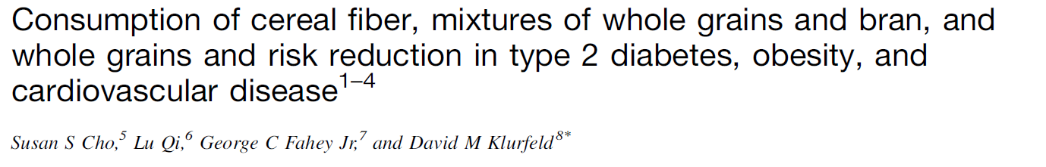
Scientific Statements of Cereal Fibre and Disease
American Society for Nutrition
American Society for nutrition
Evidence level: A (strong evidence)- D (inadequate evidence)
 | T2D | Obesity | CVD | Hypertension
Cereal Fibre | B | B/C | B | D
Mixtures of whole grains and bran | B | B/C | B | D
Whole grains | C | C/D | C | D
        The ASN position: Consumption of foods rich in cereal fibre or mixtures of whole grains and bran is modestly associated with a reduced risk of obesity (B/C), T2D (B), and CVD (B).
        Statement based on current available literature from 1965-2010.
        No long-term RCTs (>1y) using cereal fibre was available for disease endpoint.
Cho et al. Am J Clin Nutr (2103)
Source: Health grain, http://wwwhealthgrain.org/regulatory_issues

Slide 31
Recommended dietary fibre consumption across the world
 | Intake/ day | Remarks
EFSA (2010) | 25 g | 25 g is adequate for normal laxation in adults. Diets rich in fibre containing foods at DF intakes ≥ 25g are associated with additional health benefits
WHO (2003) | ≥ 25g | Total dietary fibre from whole grain cereals, fruit and vegetables
Germany, Aus- tria, Switzer-land (D-A-CH,2008) | ≥ 30g | At least 30 grams of dietary fibre daily, especially from whole-grain products
Netherlands (GR, 2001, 2006) | 30-40g | 30-40 g dietary fibre via products not enriched with isolated and purified dietary fibre
Nordic Countries (NNR 2012) | 25-35g
USA (IoM, 2005) | 25-38g | Total fibre from whole grain cereals, fruit and vegetables for women and men, respectively
USA (USDA, 2010) |  | Consuming enough whole grains helps meet nutrient needs. Choosing whole grains that are higher in dietary fibre has additional health benefits
UK (DoH, 1991) | 18 g (NSP) | 18 g non-starch polysaccharides Cho et al. Am J Clin Nutr (2103 Van Der Kamp and Lupton 2013
Source: Health grain, http://wwwhealthgrain.org/regulatory_issues

Slide 32
AIM OF INVESTIGATION
To determine:
● the Soluble, Insoluble, and Total Dietary Fiber values in cereal samples, as well as
● their nutritional composition, and
● to find out the influence of the cereal kind, growing location and farming method on their values and their relations.

Slide 33
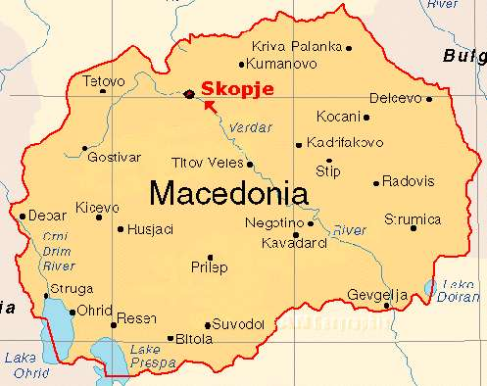
MATERIALS
27 cereal samples of wheat, barley, rye, oat and millet
They were collected in 2013 from three locations in Macedonia: Veles, Stip-Ovce Pole, and Negotino
Production: by organic and conventional, and some in conversion production

Slide 34
METHODS OF ANALYSIS
The procedure for the determination of total dietary fibre is based on the methods of Lee et al.(1), and Prosky et al (2,3) (AOAC 991.43, AOAC 985.29, AACC 32-07.01 and AACC 32-05.01).
Standardized enzymatic-gravimetric method-the Megazyme Total Dietary Fiber Kit was used in the analyses of TDF, SF and ISF of cereal samples.
In order to find out the existance of associations between average value of cereal nutrients/components and farming type, cereal kind-farming method by chemical-technological trait biplot analysis was done within R 2.9.0 program environment (R Development Core Team, 2010).
(1) Lee et al., J.Assoc.Off.Anal.Chem., 75:395-416 (1992),
(2) Prosky et al., J.Assoc.Off.Anal.Chem., 71:1017-1023 (1988).
(3) Prosky et al., J.Assoc.Off.Anal.Chem., 75:360-367 (1992).

Slide 35
Genotype by trait biplot represents typical multivariate analysis of standardized matrix of genotype × trait, whereas when treating each genotype-environment combination as a phenotype, a genotype-environment-trait three-way becomes a phenotype by trait table (Yan and inker, 2006).
A phenotype by trait biplot can help understand the associations among breeding objectives and identify traits that are positively or negatively correlated, traits that are redundantly measured, and traits that can be used in indirect selection for another trait (Lee et al. 2003, Yan and Tinker, 2006).
It also helps to visualize the trait profiles of phenotypes (Yan and Kang 2003), what is of particular importance for selection programs, agronomic practice and food processing industry.

Slide 36
Analytical cheme for soluble and insoluble dietary fibre determination
The principle of the method:
1 g dried cereal sample (duplicate) is subjected to sequential enzymatic digestion by heat-stable α-amylase, protease and amyloglucosidase
1 g sample in duplicate
MES-TRIS buffer, PH 8.2 at 24 °C
α-amylase
Water bath
protease
Water bath
washing
amyloglucosidase
Filtrate+water washing
}
Weigh solution
95%EtOH
residue
precipate
filtrate
protein
ash
IDF
protein
ash
SDF

Slide 37
Analytical cheme for total dietary fibre determination
1 g sample in duplicate
MES-TRIS buffer, PH 8.2 at 24 °C
α-amylase
protease
amyloglucosidase
2 residues
protein
ash
Total Dietary Fibre (TDF)

Slide 38
RESULTS
DETERMINATION OF TDF, SDF AND IDF VALUE

Slide 39
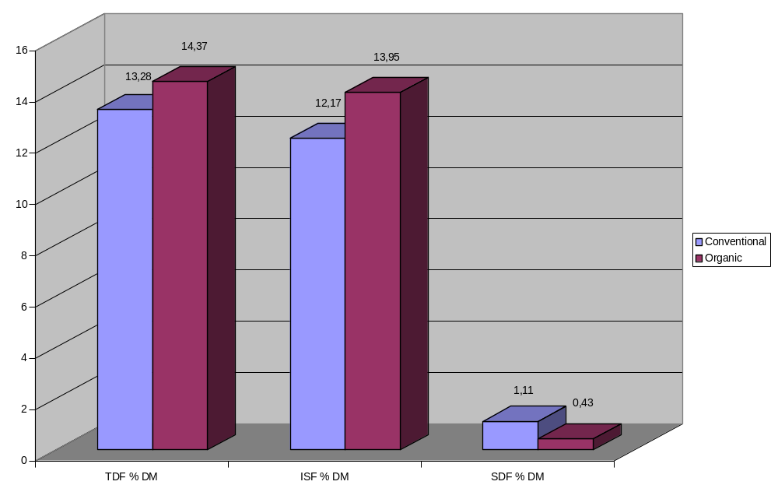
Figure 1. Content of TDF, ISF and SDF in wheat cultivated conventional and organic

Slide 40
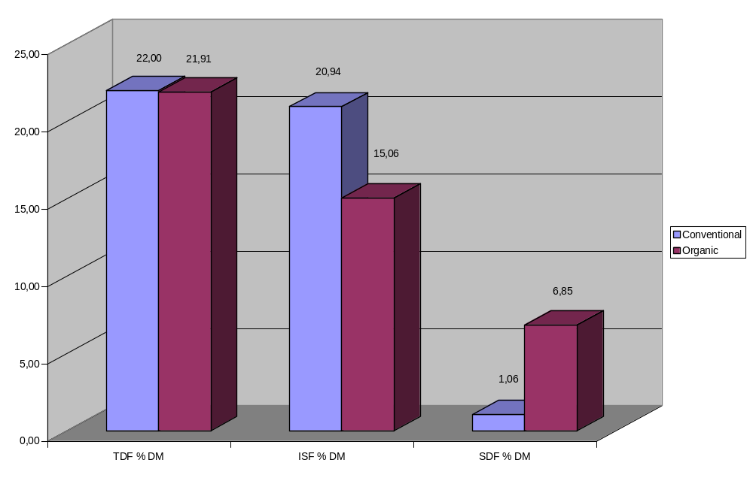
Figure 2. Content of TDF, ISF and SDF in barley cultivated conventional and organic

Slide 41
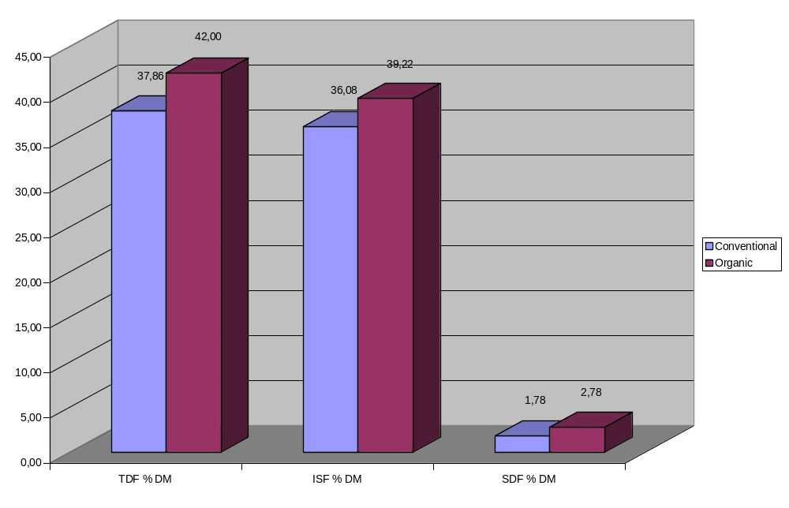
Figure 3. Content of TDF, ISF and SDF in oat cultivated conventional and organic

Slide 42
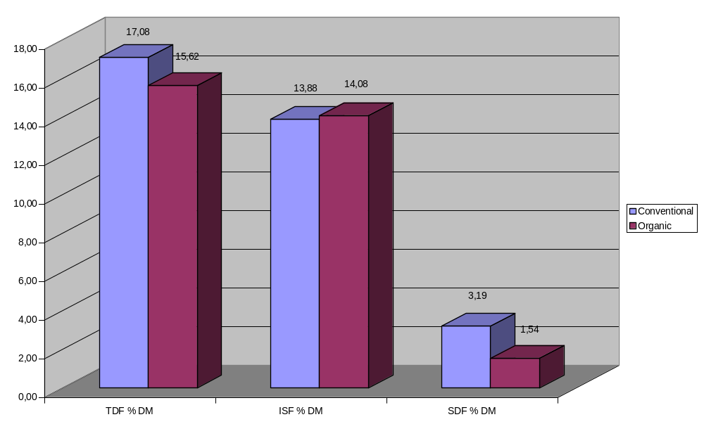
Figure 4. Content of TDF, ISF and SDF in rye cultivated conventional and organic

Slide 43
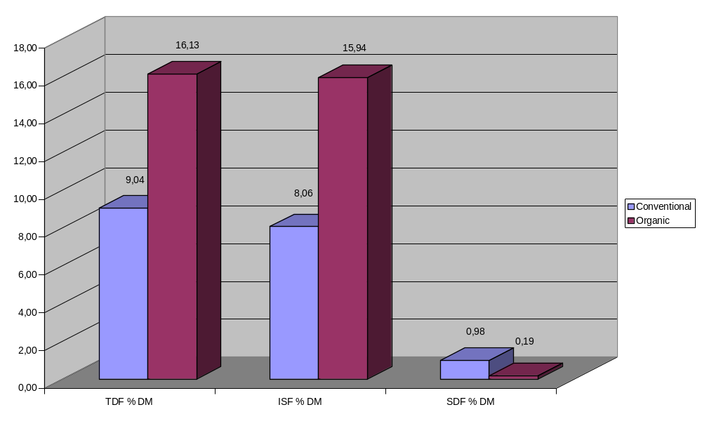
Figure 5. Content of TDF, ISF and SDF in millet cultivated conventional and organic

Slide 44
Among the all investigated cereals which were grown by the both organic and conventional farming, including also those grown by in conversion farming method was noticed:
Organically grown oat has shown maximal average values (%,db) of TDF (42.0±1.39), and of ISF (39.22±0.58).
The maximal average value (%,db) of SF (6.85±3.85) has shown organically grown barley.
With conventionally grown wheat was observed minimal average value of TDF (%,db) of 13.28±0.72, while the minimal average values (%,db) of ISF (8.06±8.13) and of SF (0.98±0.39) were observed with conventionally grown millet.

Slide 45
Persentage of increasing/decreasing of TDF value and of its fractions in relation to farming type
Cereal | Relation | TDF % DM | ISF % DM | SDF % DM
Wheat | Organic/Conventional | +7.59 % | +12.75% | -61.26%
Barley | Organic/Conventional | -0.41% | -28.08% | +84.52%
 | Organic/In conversion | +4.20% | -2.90% | +20%
 | In conversion/ Conventional | -4.59% | -25.93% | +80.66%
Oat | Organic/Conventional | +9.86% | +8.01% | +35.97%
Rye | Organic/Conventional | -8.55% | +1.42% | -51.72%
Millet | Organic/Conventional | +43.96% | +49.43% | -80.61%

Slide 46
Associations between average value of nutrients and cereal farming type
Figure 6.
Cereal kind-farming method by chemical-technological trait biplot (dry matter, protein, ash, fat, moisture, TDF, SDF, ISF) .
O-organic farming method,
C-conventional farming method,
IC-in conversion farming method

Slide 47
Cereal kind-farming method by chemical technological trait biplot explained high proportion of G + GE variance of 69.45% and revealed existance of positive associations between:
● average protein content, average TDF content and average ISF content and oat produced with the organic farming;
● average fat content and oat produced with the conventional farming method;
● average SDF content and barley obtained from in conversion farming method and to lesser extent from barley produced by the organic farming method;
● average dry matter content and barley produced from in conversion farming method;
● average moisture content and average ash content and millet produced by conventional farming method.

Slide 48
Cereal kind-farming method by chemical-technological trait biplot revealed existance of negative associations between:
● average dry matter content and millet conventionally farmed;
● average fat content, average protein content, average TDF content and average ISF content and rye organically farmed;
● average SDF content and millet produced by the organic farming method;
● average moisture content and average ash content and barley obtained by in conversion farming method.

Slide 49
C O N C L U S I O N S
In regard to TDF, ISF and SF, besides the cereal kind, the farming type has also influence on their values.
Compairing the organic farming with conventional one, the organically cereals, primarily oat and barley, have a good perspective in cereal processing and technology, food market and nutrition, satisfying the consumer demands and nutritional recommendations towards better health.
Organic farming method proved to be effective for oat for all examined chemical–technological traits.

Slide 50
Based on the cereal kind-farming method by chemical-technological trait biplot the possibilities are derived that could be used for agronomic practice, breeding and food processing industry at improving the important nutritive properties-protein, dry matter, fat, ash, moisture, TDF, SDF and ISF in cereal crops.
As content of protein, dry matter, fat, TDF and ISF were positively associated the same-directional breeding for these traits would be possible, while due to negative association with moisture the co-breeding for moisture content in the same direction would not be possible.
Average ash content and average moisture content were positively associated leading for the possibility of the same-directional breeding for these traits.

Slide 51
As content of protein, dry matter, TDF and SDF were positively associated the same-directional breeding for these traits would be possible, while due to negative association with average moisture content and average ash content the co-breeding for moisture content and ash content in the same direction would not be possible.
Barley grown by either organic or in conversion farming method proved to have the highest content of dry matter and SDF content of other cereals investigated, whereas oat obtained from organic farming method exhibited the highest protein, TDF and ISF content.
Organic farming method proved to be effective for oat for all examined chemical–technological traits except moisture and ash.

Slide 52
THANK YOU FOR YOUR ATENTION

