Slide 1

Correlation between Binaural Perception
and Brainstem Lesions
Miriam Furst
School of Electrical Engineering Tel Aviv University

Slide 2
This talk is based on the published chapter :
“Hearing Disorders in Multiple “clerosis”
In the book:
“The Human Auditory “ystem: Fundamental
Organization and Clinical Disorders”
Edited by Celesia G.G. and Hickok G.
As part of the series:
“Handbook of Clinical Neurology”
Volume 129 (2015)

Slide 3
Talk Outline
Binaural Perception in Healthy People
Binaural Perception in Subjects with brainstem
lesions due to either MS or CVA
Detecting Lesions in the Brainstem Auditory
Pathway
Correlation between the site of the lesions and
binaural abilities

Slide 4

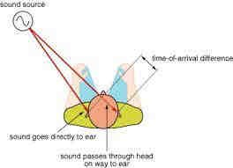

Sound Localization and Lateralization
Lateralization
Localization

Slide 5
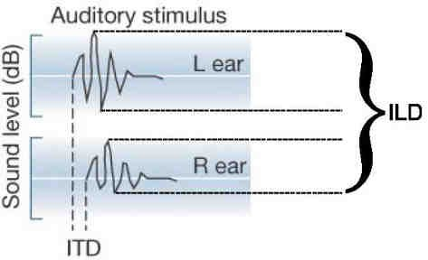
Binaural Cues For
Localization and Lateralization
Interaural Time Delay (ITD)
Interaural Level Difference (ILD)

Slide 6

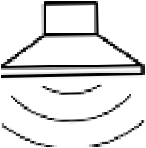

Sound Lateralization with Clicks
The perceived location is by the ITD
Right
t
Left
t

Slide 7

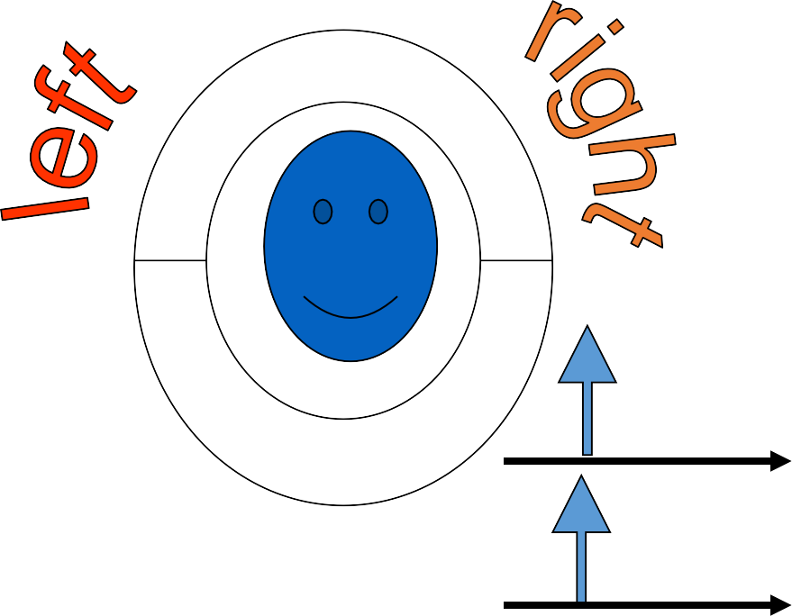
LATERALIZATION EXPERIMENT
Perception
Stimulus
R
ILD
5
L
4
6
3
7
2
1
8
9
R
ITD
L
R
ITD=ILD=0
L

Slide 8
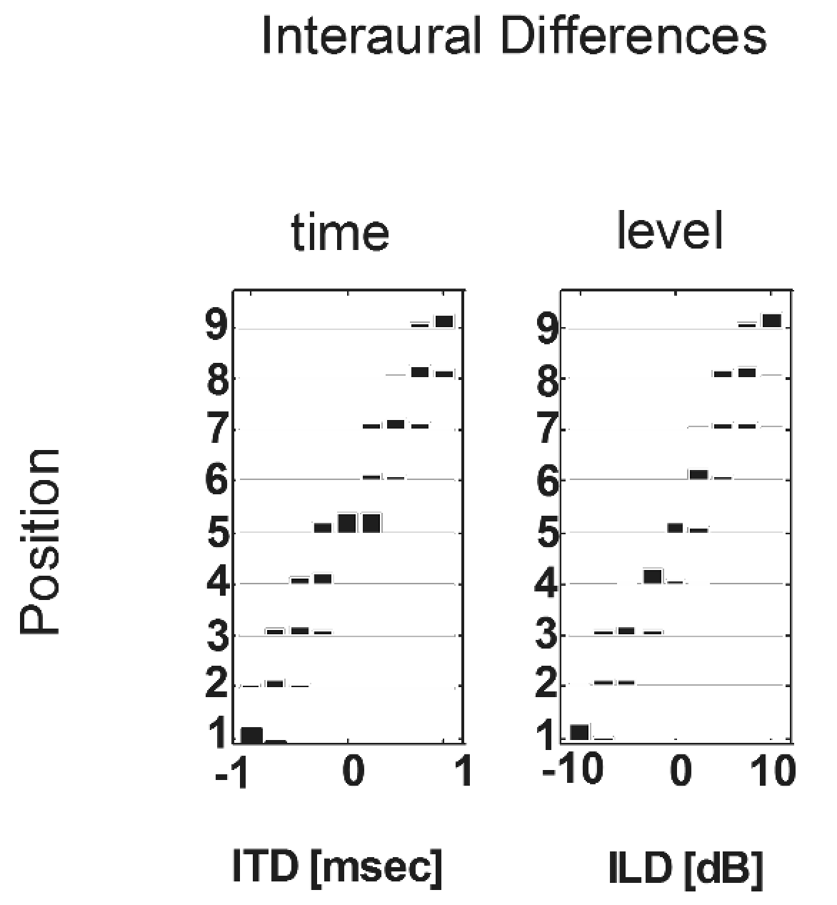
Normal Performance
Histograms =
number of times a subject reported perceiving a position when ITD or ILD presented

Slide 9
Abnormal Performance
Center-Oriented
Side --Oriented
9
8
7
6
9
8
7
6
5
9
8
7
6
5
4
3
2
9
8
7
6
5
4
3
2
position
position
5
4
3
2
1
4
3
2
1
1
1
- 1 0
1
- 1 0
0
1 0
- 1 0
1
- 1 0 0
ILD(dB)
1 0
ITD(msec)
ILD(dB)
ITD(msec)

Slide 10
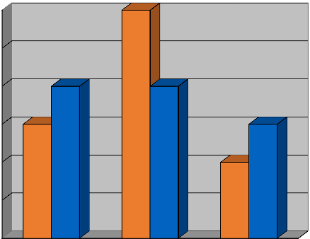
Patients’ Performance
66
55
44
CVA MS
33
CVA
MS
22
11
00
NNoorrmmaall
CCeenntteerr
SSiiddee

Slide 11
Is Abnormal Performance
Correlates
to an Existing Lesion in the
Auditory Pathway?

Slide 12
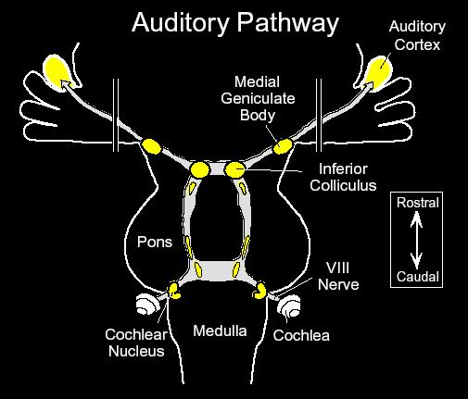
Schematic Representation of the
Brainstem Auditory Pathway

Slide 13
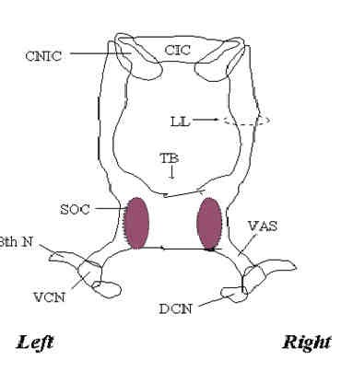
Human Brainstem Auditory Pathway Atlas

Slide 14
The MRI Protocol
Contiguous 5mm sections were obtained using T2 spin- echo sequences from three orthogonal planes of the brainstem :
axial:
brainstem
coronal: ventricle
sagittal :
perpendicular to the long axis of the
parallel to the plane of the floor of the fourth
perpendicular to the plane of the floor of the
fourth ventricle and in the plane of the long axis of the brainstem.

Slide 15
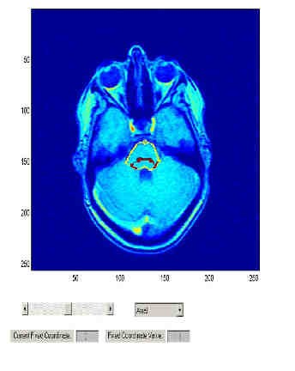
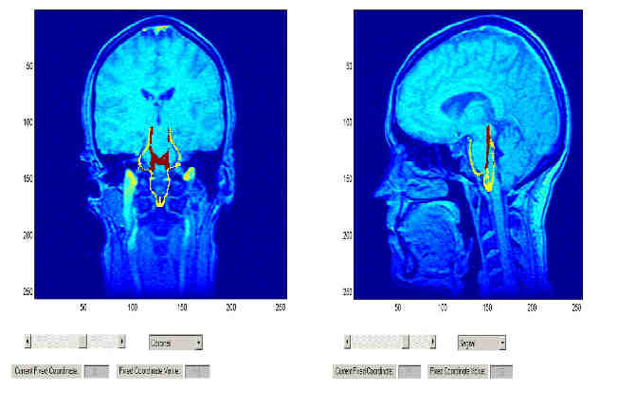
Superimposing the Human
Auditory Pathway on MRI Scans

Slide 16
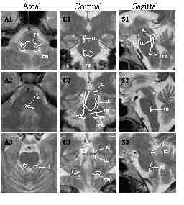
Overlap of Auditory Pathway on MRI Scans

Slide 17
Lesion is defined as
overlapping the auditory pathway
if and only if
it overlaps the auditory pathway in at least 2 orthogonal planes.

Slide 18
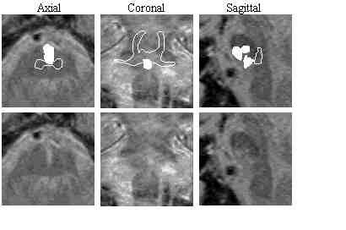
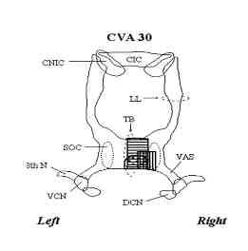
Lesion Detection Example

Slide 19
Results
➢All the Patients that performed abnormally in the lateralization experiment had lesions that overlapped the brainstem auditory pathway
➢All the Patients that performed normally in the lateralization experiment did not have lesions that overlapped the brainstem auditory pathway

Slide 20
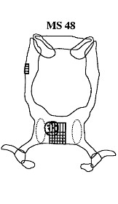
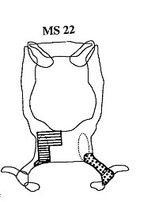
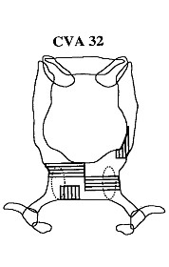
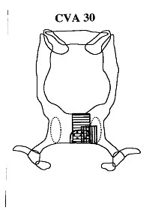
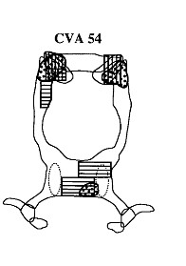
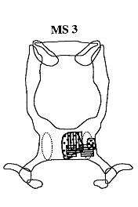
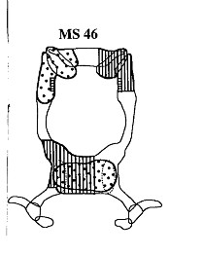
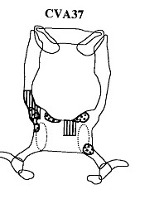
Samples of
Center-Oriented Lateralization

Slide 21
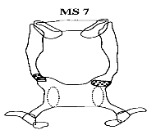
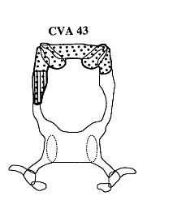
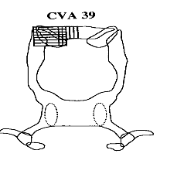
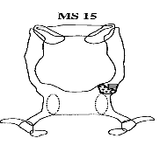
Samples of
Side-Oriented Lateralization

Slide 22
Correlation between MRI and Lateralization
MRI LATERALIZATION | NO LESIONS | TB LESIONS | TB&LL LESIONS | LL LESIONS
NORMAL PERFORMANCE | 30%
CENTER- ORIENTED |  | 25% | 20%
SIDE-ORIENTED |  |  |  | 25%

Slide 23
Experimental Summary and Conclusions
Two types of abnormal lateralization performance were found : center-oriented and side-oriented.
Both types of abnormalities were found in patients with either MS or Stroke
Center-oriented lateralization is correlated with TB/SOC lesions
Side-oriented lateralization is correlated with LL/IC lesions

Slide 24

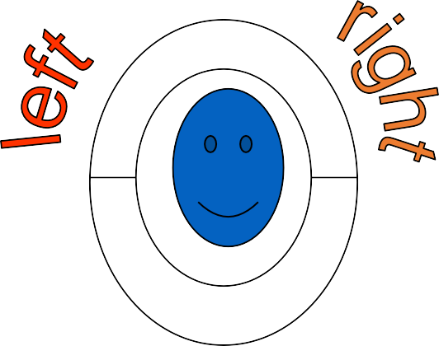
Our Suggestion:
Use the Lateralization Experiment to detect lesions in the brainstem auditory pathway
5
4 6
3 7
2
1
8
9

Slide 25


Acknowledgments
Thanks to all the colleagues and students who took part in the project:
Robert A. Levine
Amos D. Korczyn
Barbara C. Fullerton
Rina Tadmor
Hillel Pratt
Vered Aharonson
Roy Tenny
The study was supported by BSF Grant 89-00447 and ISF 563/12

