Slide 1

Nephroprotective efficacy of Apocynin against hyperoxaluria induced nephrolithiasis in male wistar rats
Minu Sharma¹, Tanzeer Kaur ², SK Singla *
^{1,*} Department of Biochemistry, Panjab University, Chandigarh
²Department of Biophysics, Panjab University, Chandigarh

Slide 2
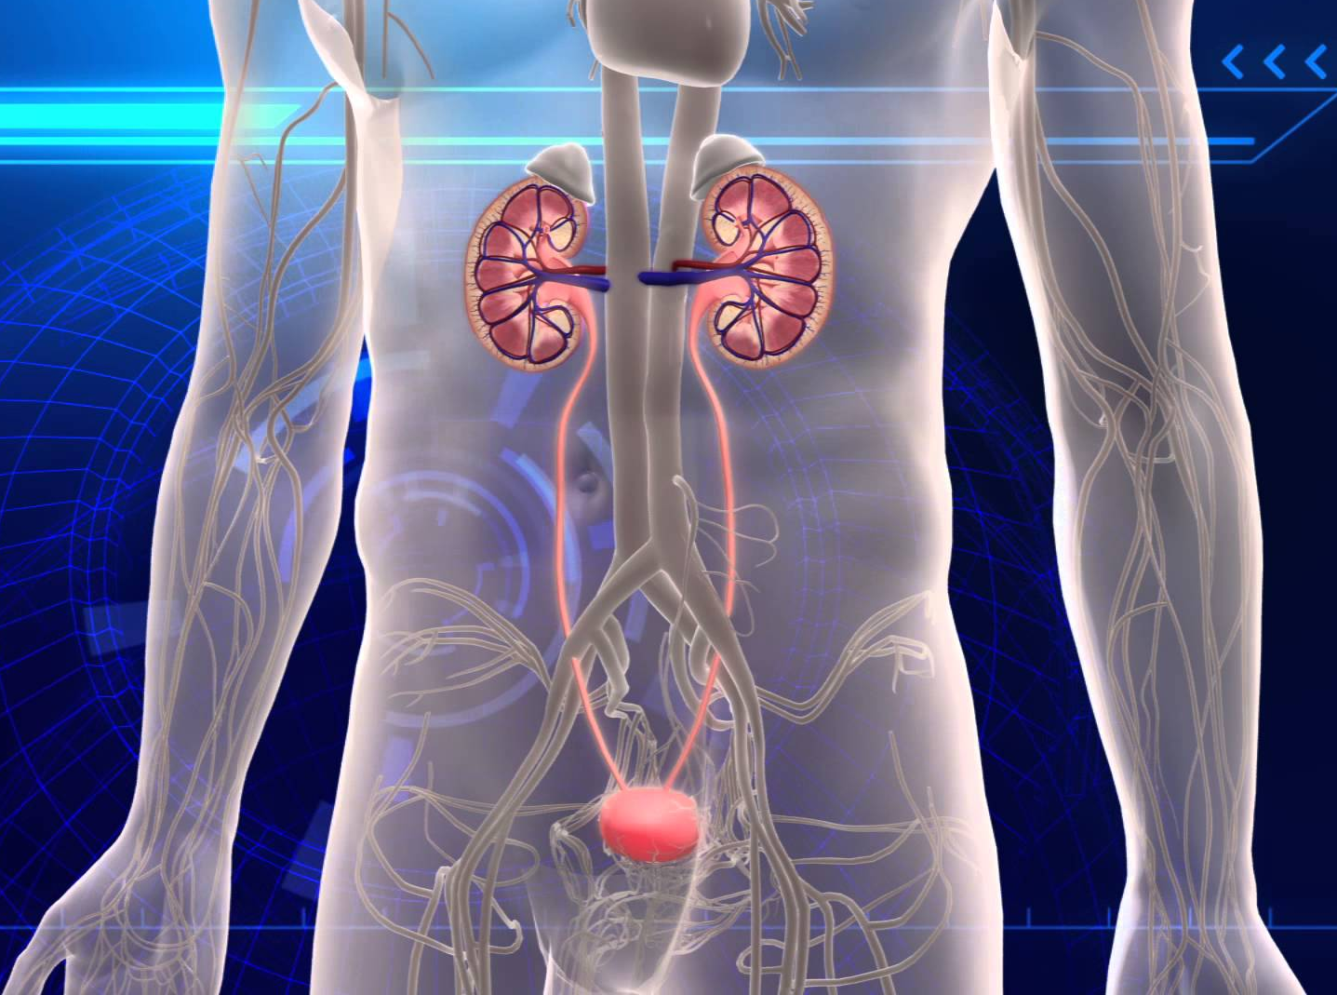
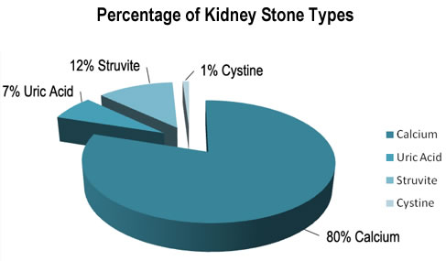
Background
Nephrolithiasis, refers to the condition of having stones (calculi) in the kidney or collecting system
Hyperoxaluria
Urinary oxalate excretion greater than 40mg/day
Stone

Slide 3
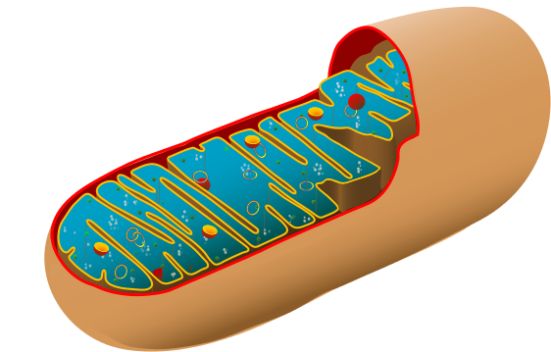
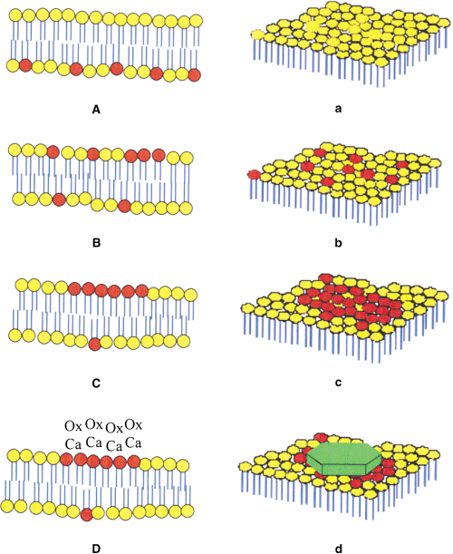
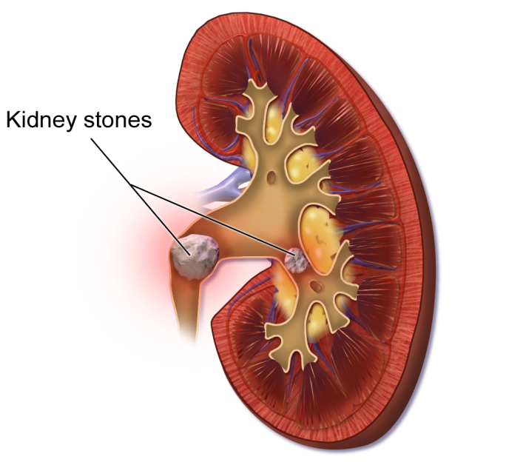
Hyperoxaluria
Angiotensin II
ROS
O₂
O2^{.-}
gp 91
phox
Mitochondrion
P22
phox
Rac
GTP
Cytochrome c
Rac
GDP
P47 phox
P67 phox
Apoptosis
P40 phox
P
P
P
NADPH
NADP+
Activated
Resting
Renal injury
NADPH Oxidase (NOX)

Slide 4
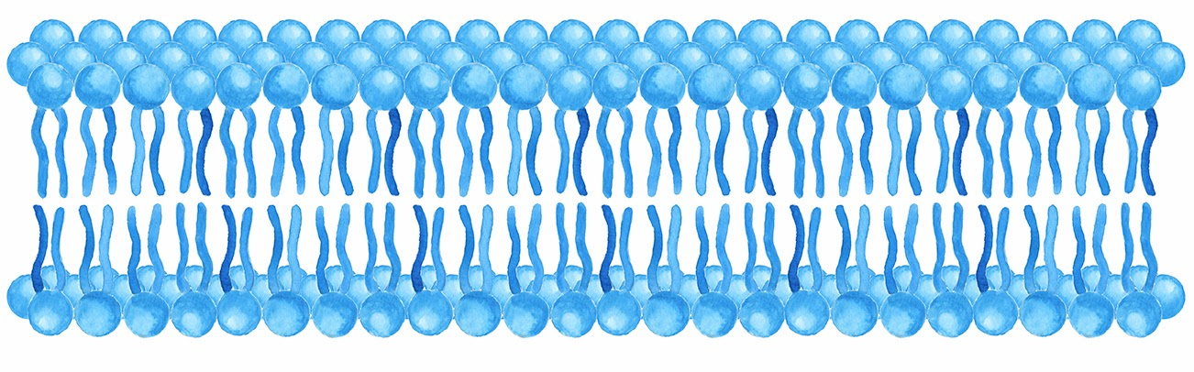
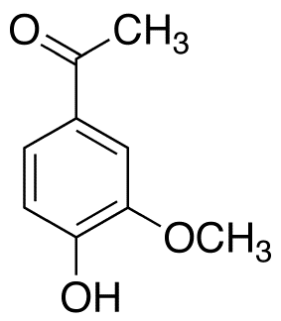
gp 91
phox
P22
phox
Apocynin
Rac
GDP
P47 phox
P40 phox
P67 phox

Slide 5
Aim
To study the effect of Apocynin , a NADPH oxidase inhibitor, against hyperoxaluria induced nephrolithiasis in male wistar rats.
Objectives
Mitochondrial dysfunction
NADPH oxidase activity
Histopathological studies
Serum and urinary biochemistry
Apocynin

Slide 6
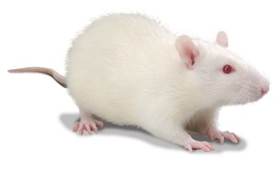
Group Design
  Normal saline intraperitoneal
  0.4 % Ethylene glycol (EG) + 1% Ammonium chloride in drinking water for 9 days
Control
EG
  200 mg/kg/day Apocynin, intraperitoneal, for 9 days
  0.4% EG + 1% Ammonium chloride in drinking water and
  200 mg/kg/day Apocynin, intraperitoneal, for 9 days
APO
EG +APO

Slide 7
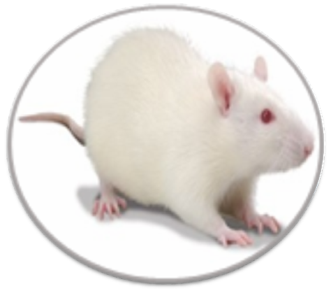
Serum & Urinary analysis
OXALATE : Method by Hodgkinson and Williams, 1972.
LACTATE DEHYDROGENASE estimation kit (DGKC method ).
CREATININE estimation kit (Jaffe’s method).
UREA estimation kit (GLDH - UREASE method).
CREATININE CLEARANCE : Method by Bijarnia et al.,2008.
Urinary crystal study
Urine was examined by light microscopy to analyze crystalluria.
`
Oxidative damage
LIPID PEROXIDATION (Buege and Aust, 1978)
ROS (Wang and Joseph, 1999)
Oxidative damage:
LIPID PEROXIDATION method by Buege and Aust, 1978.
Antioxidants level:
SUPEROXIDE DISMUTASE method by Kono, 1978.
CATALASE method by Luck, 1971.
GLUTATHIONE method by Zahler and Cleland, 1968.
NADPH Oxidase assay
The NADPH oxidase activity was evaluated by NADPH-dependent superoxide production examined using
SOD-inhibitable cytochrome c reduction method as suggested by Li et al., 2002.
NADPH Oxidase analysis
MTT assay (Liu et al .,1997)
Mitochondria
analysis
Antioxidants level
SUPEROXIDE DISMUTASE (Kono, 1978)
GLUTATHIONE (Zahler and Cleland, 1968)
Histopathological studies
The kidneys were removed and its transverse sections were fixed in 10% buffered formalin solution (pH 7) and finally stained with Delafield’s Hemotoxylin and Eosin staining (H & E staining) , viewed under polarized light using Leica DM3000 light microscope.
Electron transport chain
COMPLEX I (King & Howard,1967)
COMPLEX II (King et al., 1976)
COMPLEX IV (Sottocasa et al. ,1967)
Kidney tissue
analysis

Slide 8
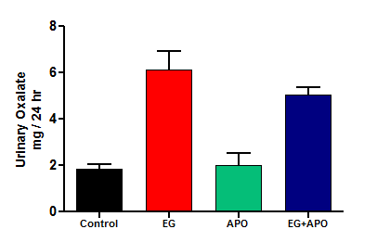
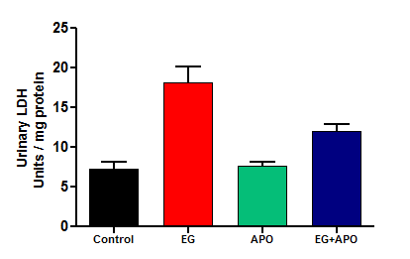
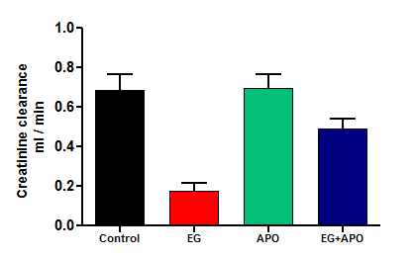
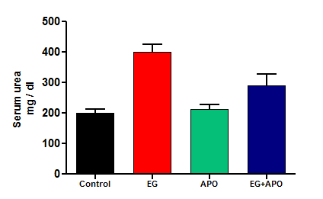
Results & Discussion
Urine & Serum biochemistry
α
α
β
β
β
α
β
α
Values are expressed as mean± SD: n=6. α Significantly different from control group (p<0.05); β Significantly different from EG group (p< 0.05)

Slide 9
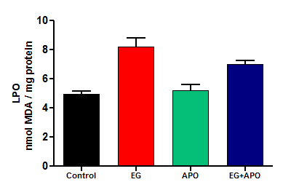
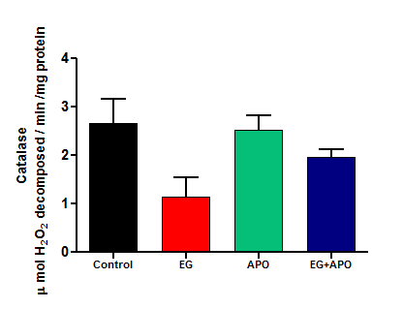
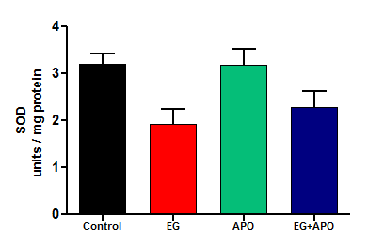
Oxidant / Antioxidant status of renal tissue
α
β
β
α
β
α
Values are expressed as mean± SD: n=6. α Significantly different from control group (p<0.05); β Significantly different from EG group (p< 0.05)

Slide 10
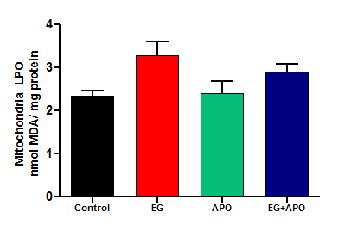
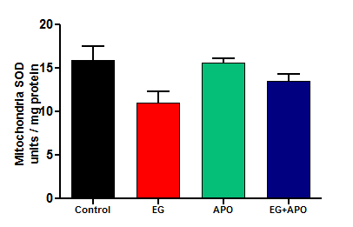
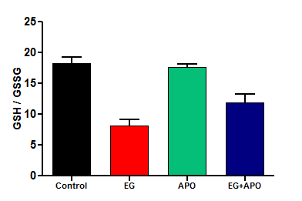
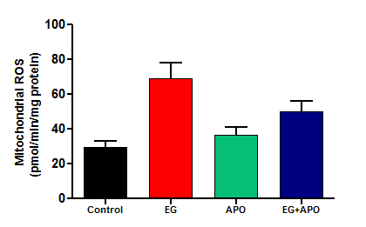
Mitochondrial Oxidant / Antioxidant status
α
β
β
α
α
β
β
α
Values are expressed as mean± SD: n=6. α Significantly different from control group (p<0.05); β Significantly different from EG group (p< 0.05)

Slide 11
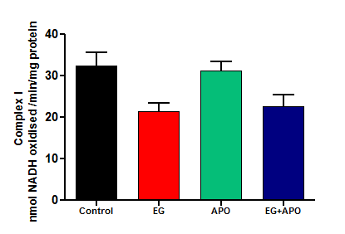
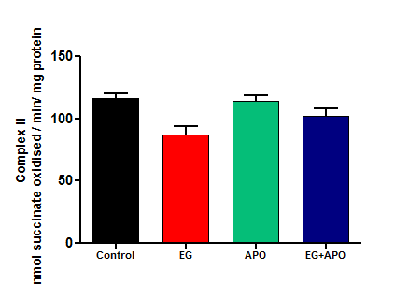
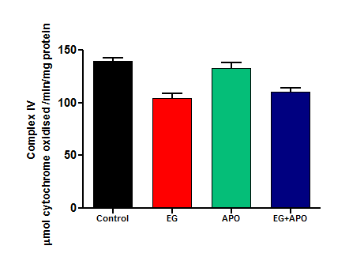
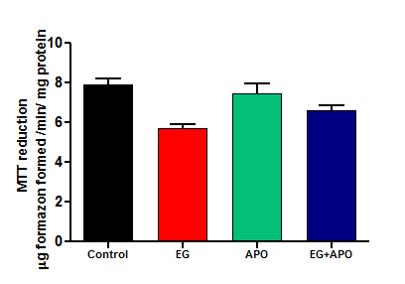
Mitochondrial ETC Complexes and MTT Assay
β
β
α
α
α
β
β
α
Values are expressed as mean± SD: n=6. α Significantly different from control group (p<0.05); β Significantly different from EG group (p< 0.05)

Slide 12
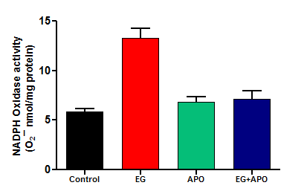
NADPH Oxidase Assay
α
β
Values are expressed as mean± SD: n=6. α Significantly different from control group (p<0.05); β Significantly different from EG group (p< 0.05)

Slide 13
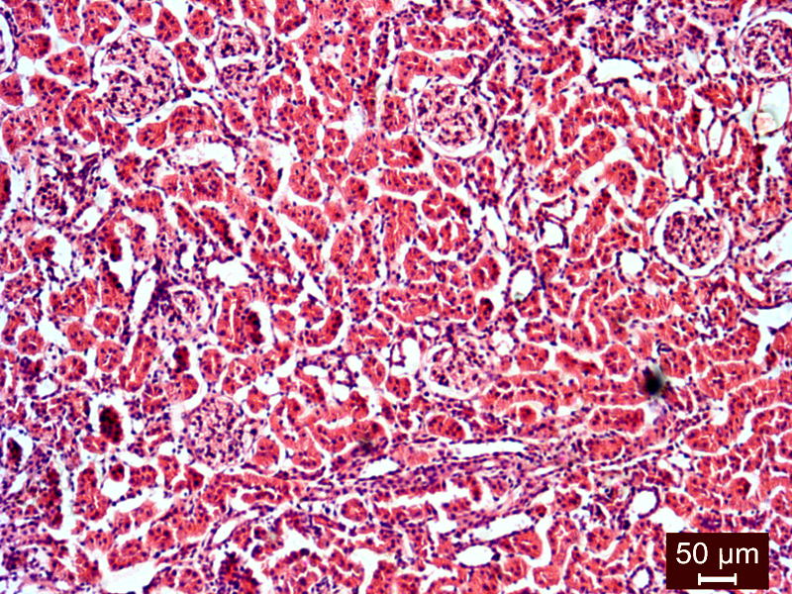
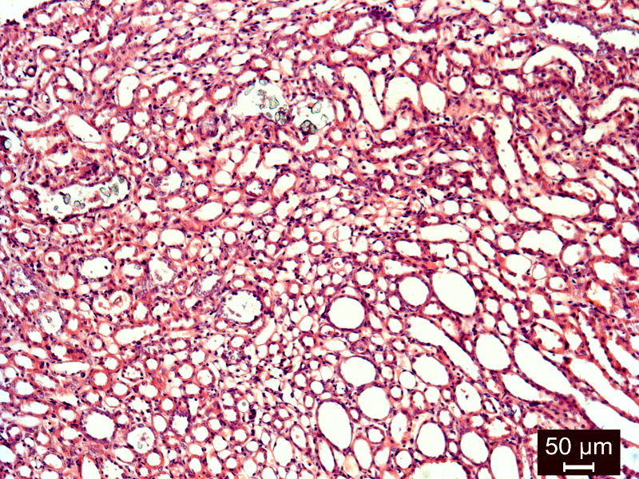
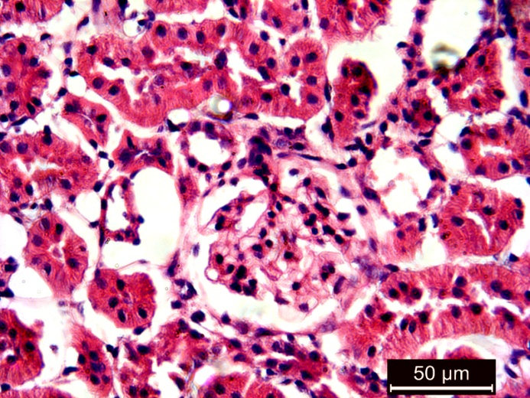
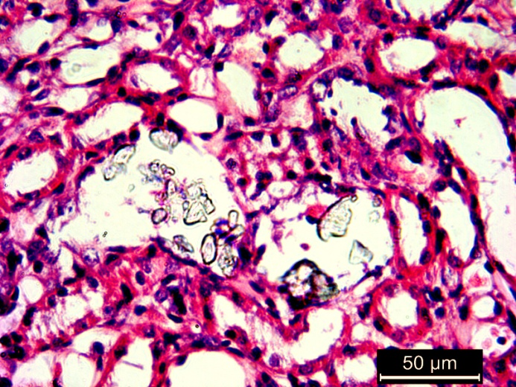
Renal tissue Histology
A
B
Fig.1 Control
Fig.2 EG
Fig1 &2: (H&E stain) Histopathological examination of kidney slides of Control and EG groups seen under a microscope (Leica DME) at 100 X & 400 X. A showing crystal deposits & B showing dilated tubules.

Slide 14
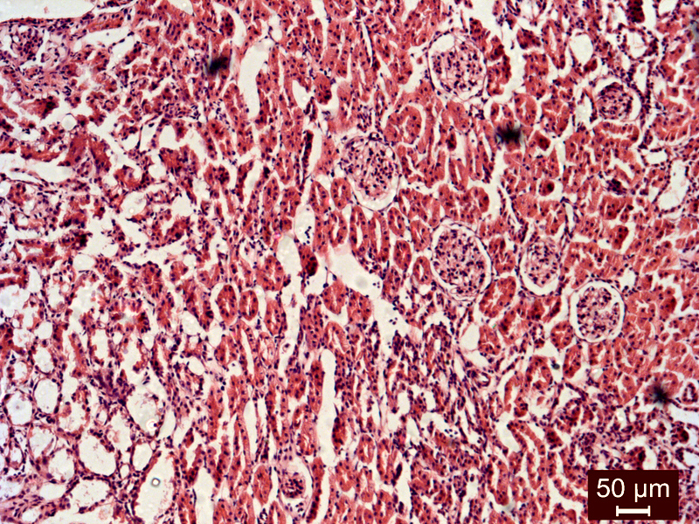
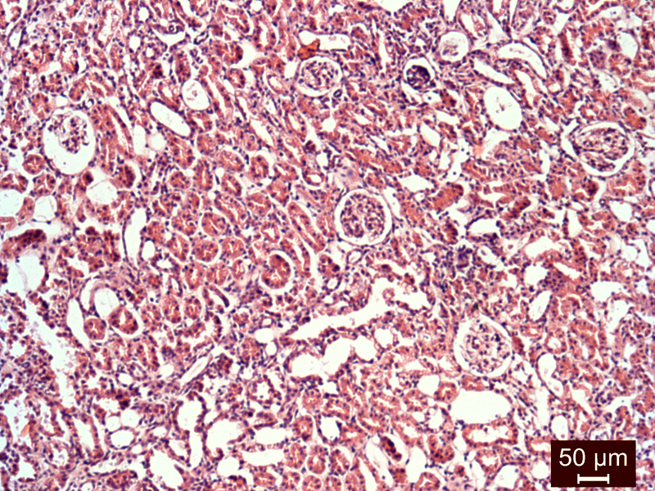
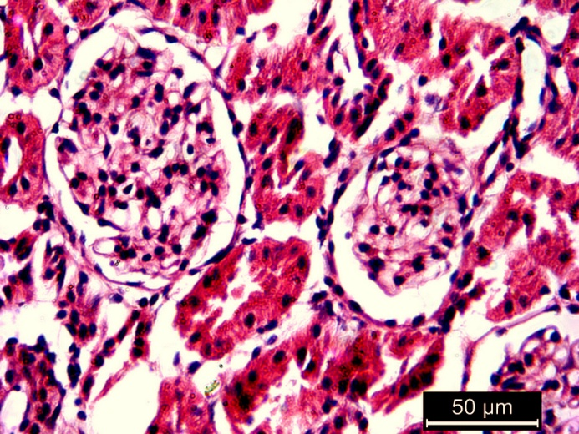
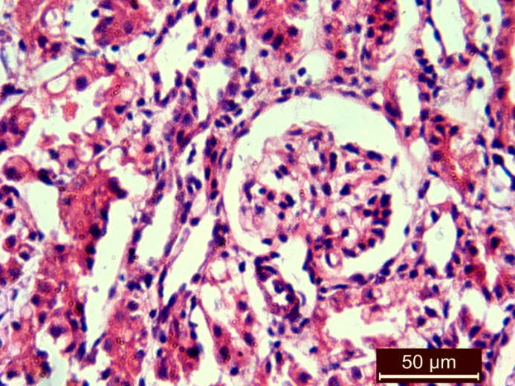
Fig.3 APO
Fig.4 EG+APO
Fig 3 & 4: (H&E stain) Histopathological examination of kidney slides of APO group and EG + APO group seen under a microscope (Leica DME) at 100 X & 400 X.

Slide 15
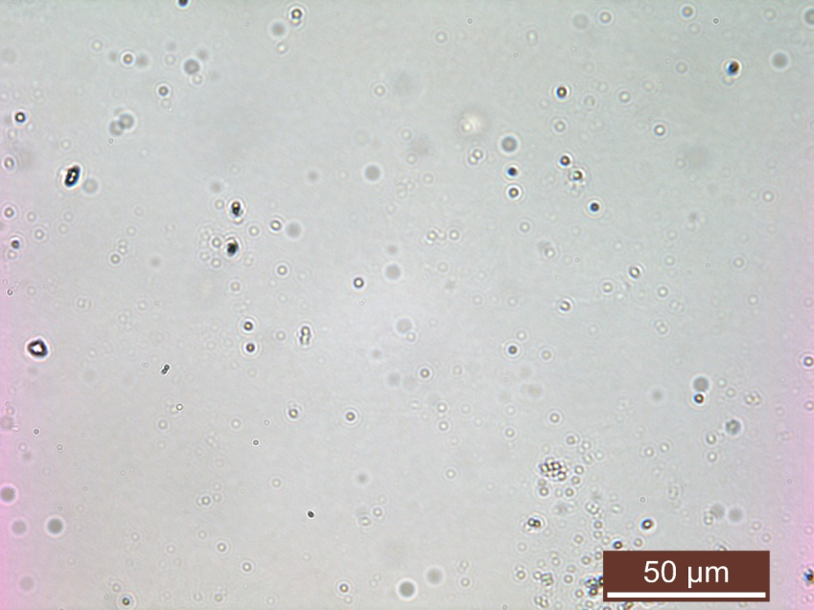
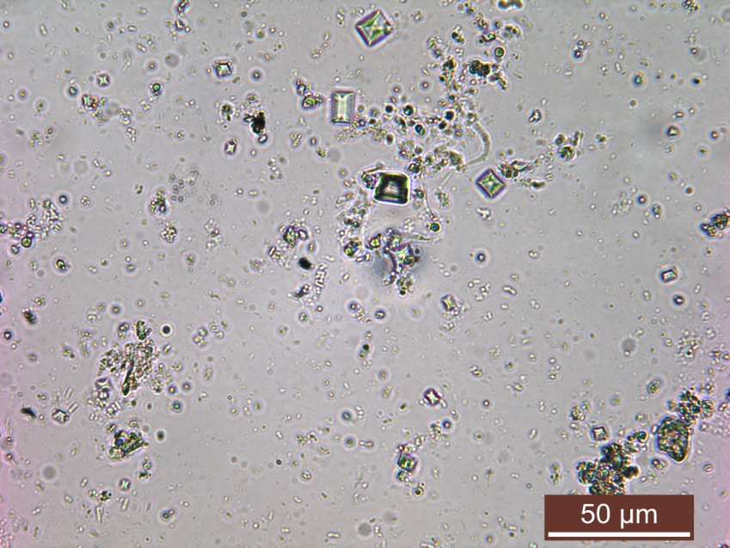
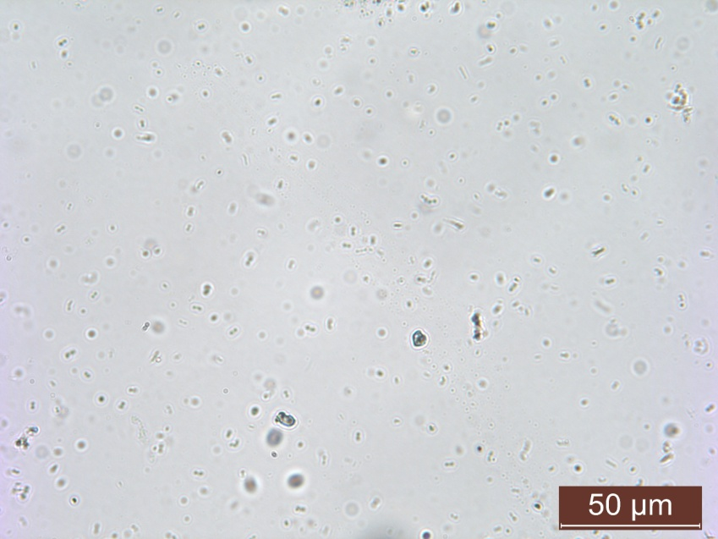
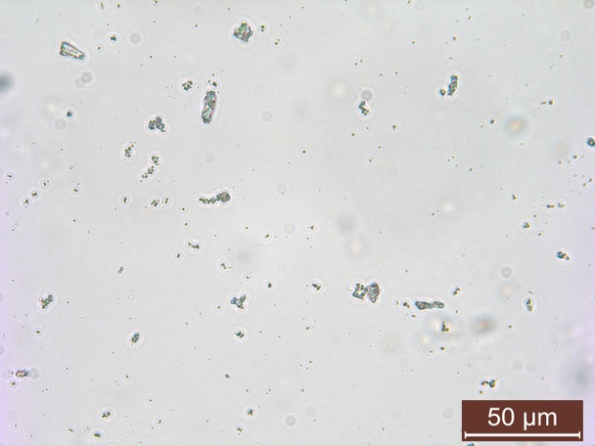
Urinary crystals
Control
EG
COD
A
B
APO
EG + APO
C
D
Fig 5. Crystalluria depicted by polarization micrographs of urine sample from Control (A), EG (B), APO (C), EG+APO (D). Original magnification 100 X. Arrows indicate Bipyramidal calcium oxalate dihydrate (COD) crystals.

Slide 16
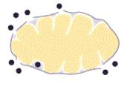
As NADPH Oxidase inhibitor which can be engaged in the management of nephrolithiasis and other renal disorders wherein NADPH Oxidase functions are perturbed
Apocynin
Renal cell
ROS
O2
Mitochondrion
damage
Renal injury
Kidney stones
O2^{.-}
NADPH Oxidase
Hyperoxaluria

Slide 17
Acknowledgment
The financial assistance provided by the University Grants Commission, New Delhi is gratefully acknowledged .

Slide 18
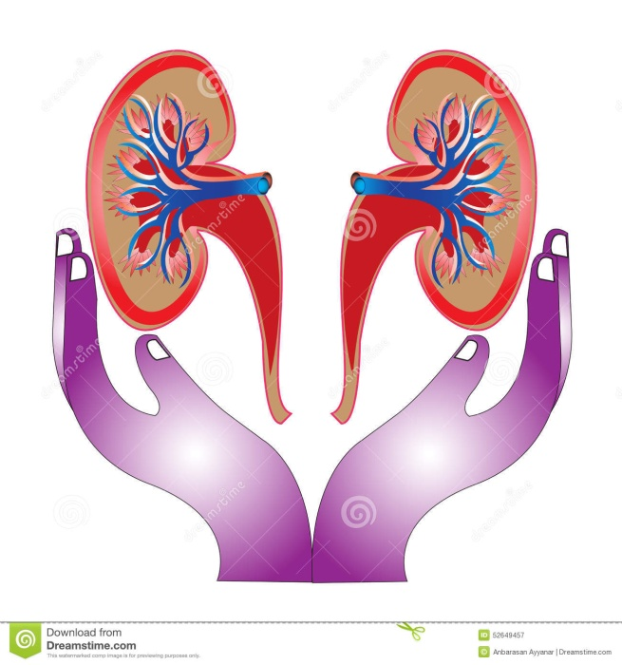
Thank You ..

