Slide 1

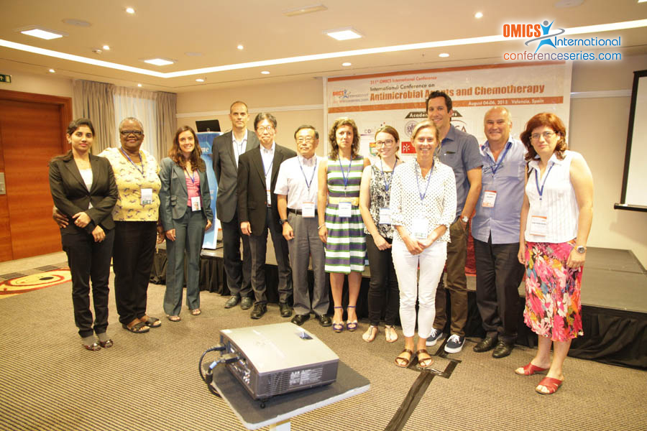
Chemotherapy-2015
Valencia, Spain
August 04- 06, 2015
Minoru Yoshida

Slide 2


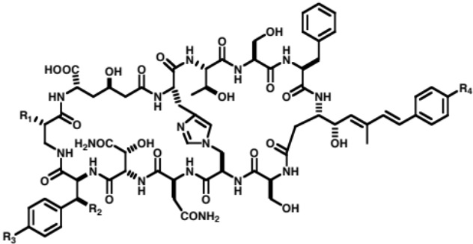
O
H
O
O
O
N
O
N
H
O
H
O
N
HN
H
N
O
S
N
O
S
H
NH
HN
O
O
O
N
O
O
N
H
O
Trichostatin A (TSA)
JBC 1990
Trapoxin B (TPX)
JBC 1993
PNAS 2001
FK228 (romidepsin)
ECR 1998
Cancer Res 2002
HDAC
O
O
O
O
O
O
O
O
O
N
H
O
O
H
H
O
O
O
H
Leptomycin B (LMB)
JBC 1994
Cell 1997
Spliceostatin A
Nat Chem Biol 2007
Theonellamide
Nat Chem Biol, 2010
CRM1/exportin 1
Spliceosome
3β-hydroxysterol

Slide 3

Physical interaction
Chemical
Gene
Protein
Phenotype
Chemical
Genetic interaction
Gene
Protein
Phenotype

Slide 4
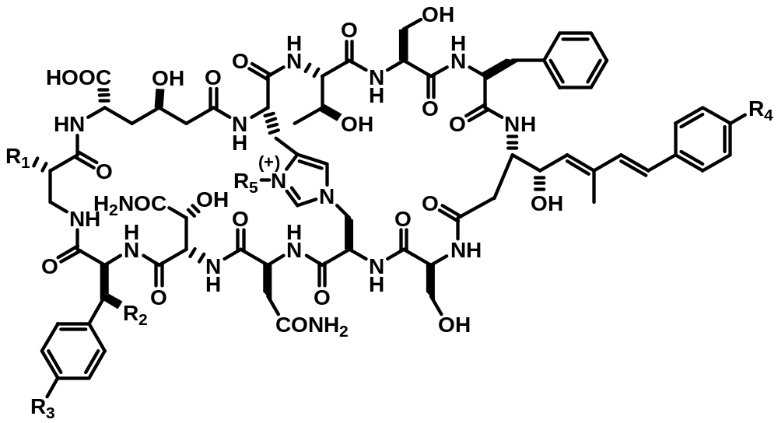
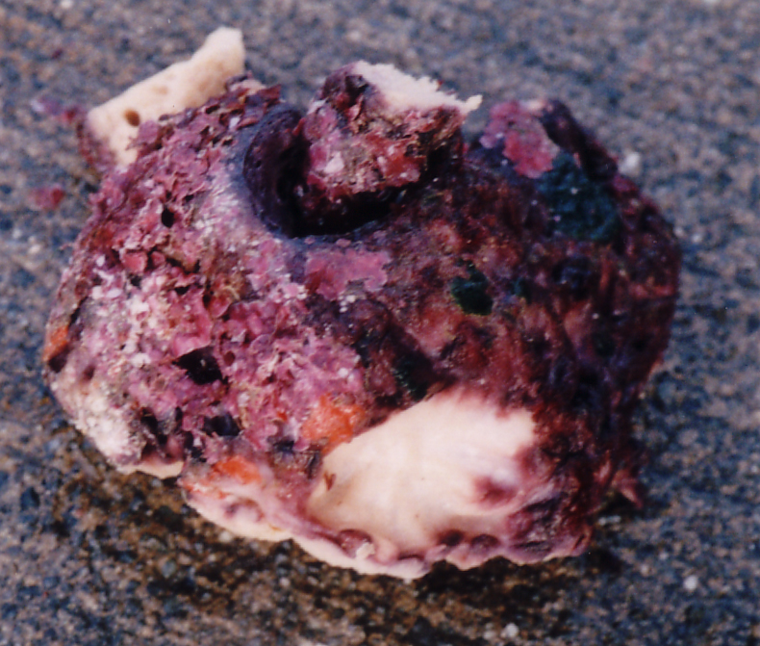
Structure and activity of theonellamides, marine antifungals
Theonella swinhoei
MIC (μg/ml)
 | R₁ | R₂ | R₃ | R₄ | R₅
TNM-A: | OH | Me | Br | H | β-D-Gal
TNM-B: | OH | Me | Br | Br | H
TNM-C: | H | H | H | Br | H
TNM-D: | H | H | Br | Br | β-D-Ara
TNM-E: | H | H | Br | Br | β-D-Gal
TNM-F: | H | H | Br | Br | H
TNM-A
Miconazole
A. fumigatas
3.13
1.56
C. albicans
6.25
3.13
C. neoformans
3.13
0.20
S. pombe
0.50
0.25
Isolation: Matsunaga, S., et al. (1989) J. Am. Chem. Soc. 111, 2582-2588.
Matsunaga, S. & Fusetani, N. (1995) J. Org. Chem. 60, 1177-1181.

Slide 5
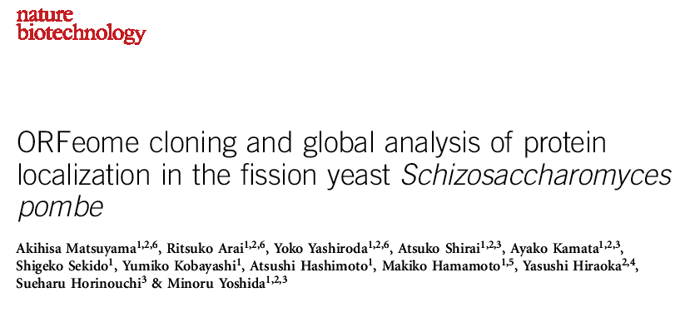
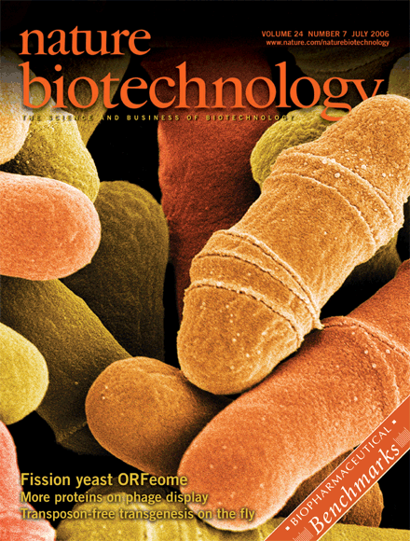
ORFeome and localizome data are
available at
http://www.riken.jp/SPD/index.html
ORF clones are available from
RIKEN BioResource Center
http://www.brc.riken.jp/lab/dna/en/yoshidayeast_en.html
Colored scanning electron micrograph (SEM) of dividing Schizosaccharomyces pombe cells. Matsuyama et al. have cloned and partially characterized all protein-encoding open reading frames (the ORFeome) of fission yeast (p 841). Credit: Steve Gschmeissner/Science Photo Library.

Slide 6
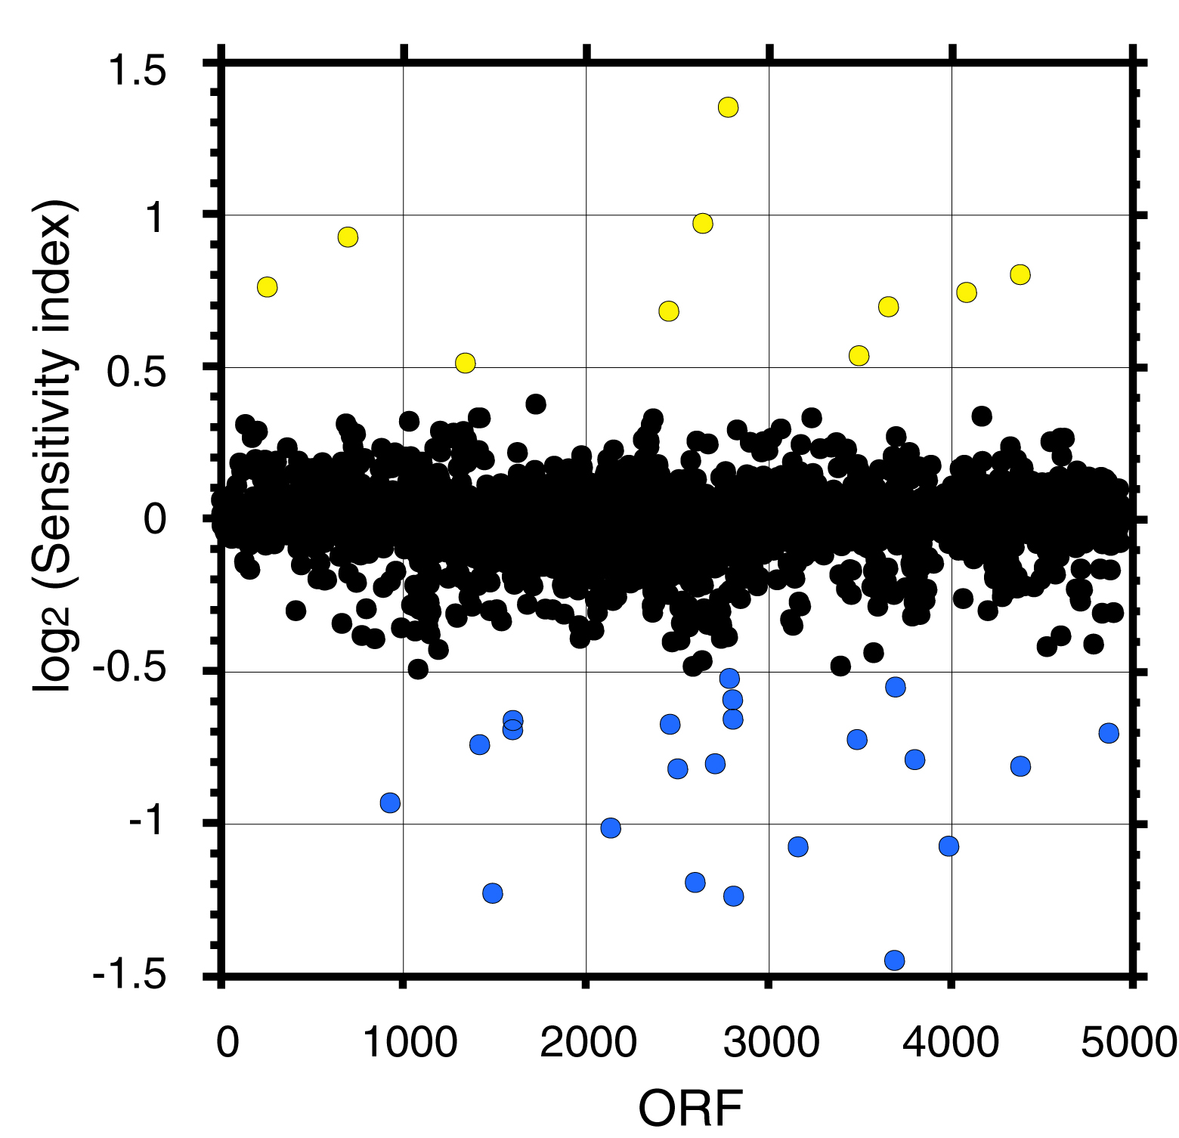
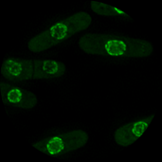
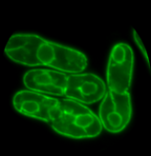
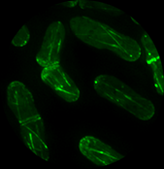
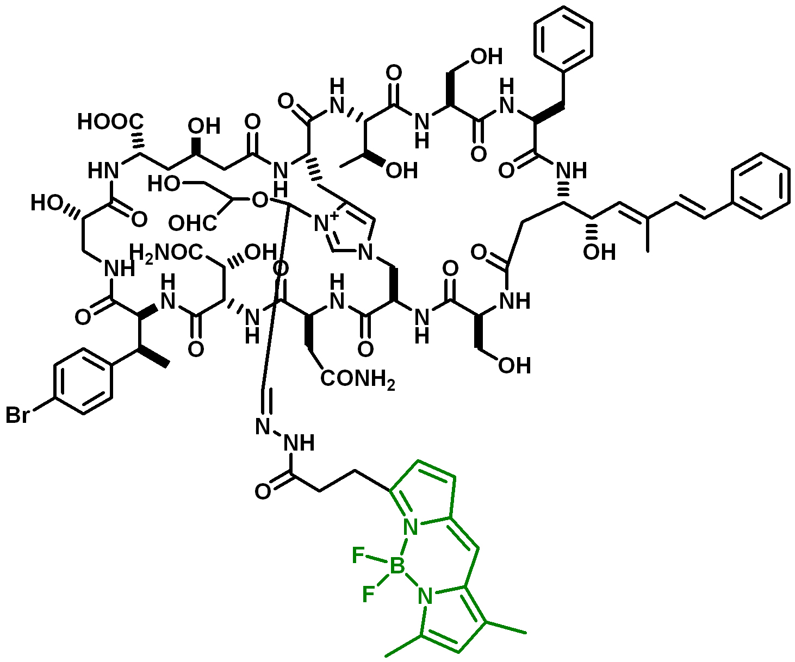
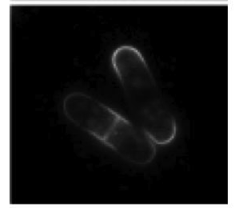
Strategy for target identification of theonellamide F
The fission yeast expression library
FLAG₂
His₆
Pnmt1
ORF
leu1⁺
TADH
YFP
His₆
His₆
ORF
Chr. I
cen1
ORF
FLAG₂
Chr. II
leu1 locus
FLAG₂
Chr. III
cen3
Resistant
Global analysis of localization（Localizome）
Sensitive
TNM-BODIPY-FL

Slide 7
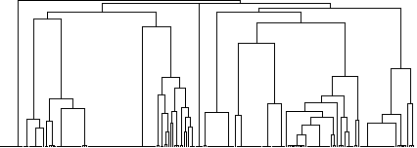
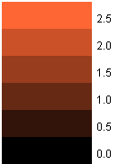
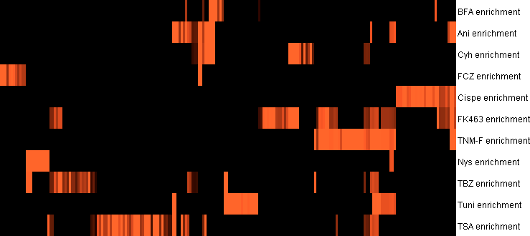
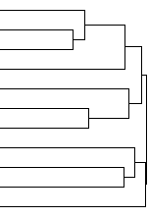
2D-clustering analysis of GO terms of hit genes
BFA
Anisomycin
Cycloheximide
FCZ
Cispentacin
FK463
TNM-F
Nystatin
TBZ
Tunicamycin
TSA
FK463: an inhibitor of 1,3-β-glucan synthase
212 GO categories x 11 compounds
Log₂ of fold enrichment with p < 0.02, otherwise 0
Pearson correlation (centered), average linkage

Slide 8
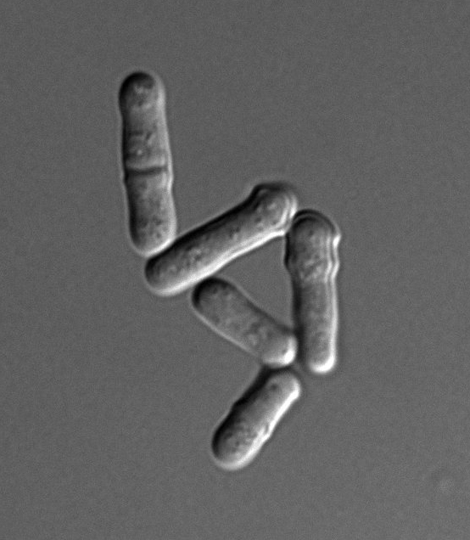
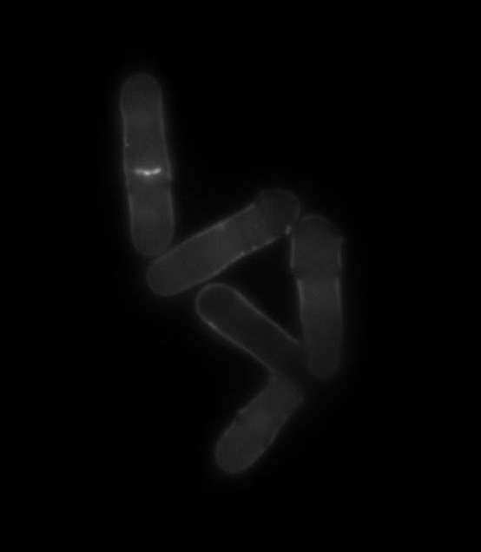
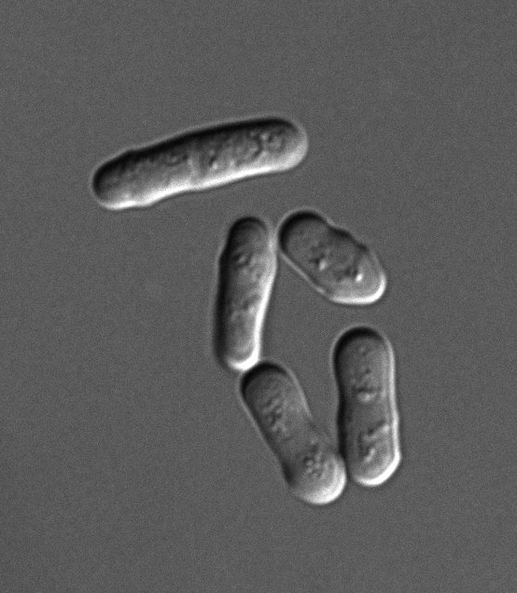
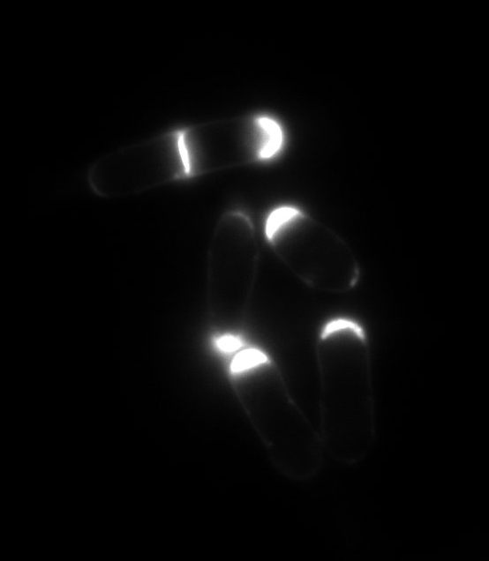
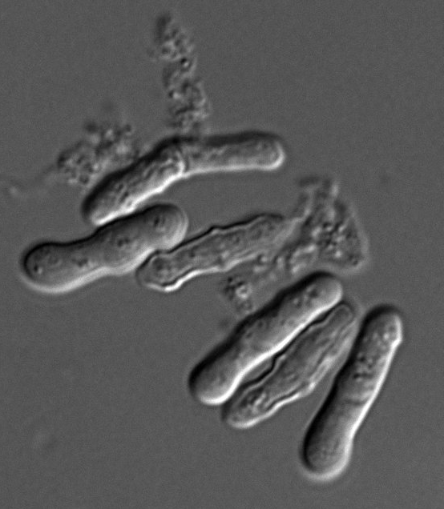
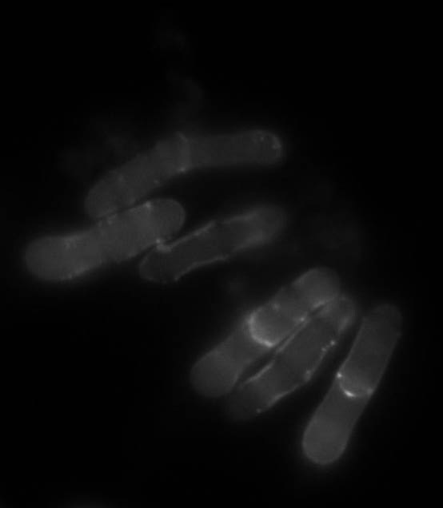
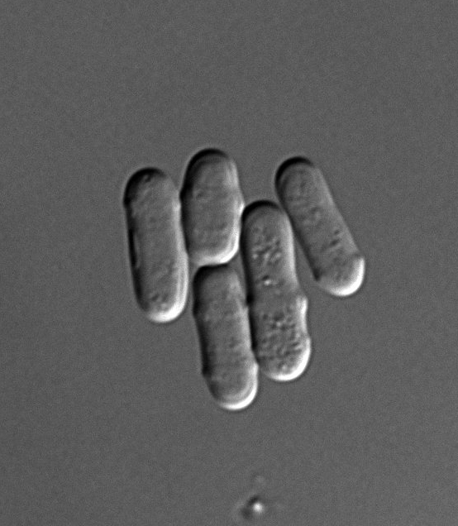
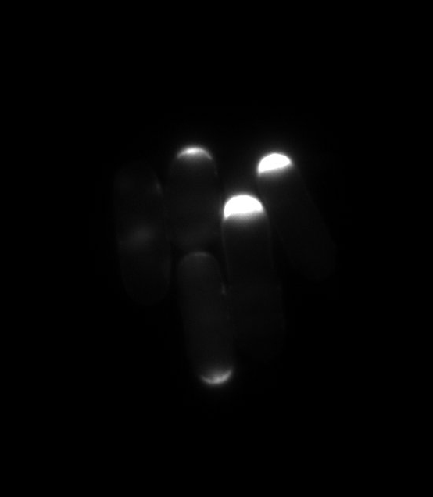
Theonellamide F counteracts FK463 (Micafungin)
DMSO
TNM-F (5 μg/ml)
DMSO
FK463
(20 μg/ml)
10 μm
(In YE + 1.2 M sorbitol)

Slide 9
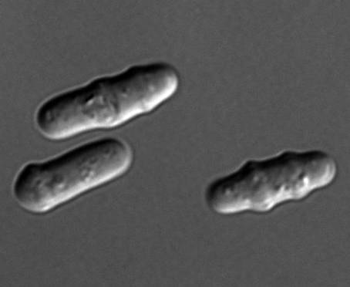
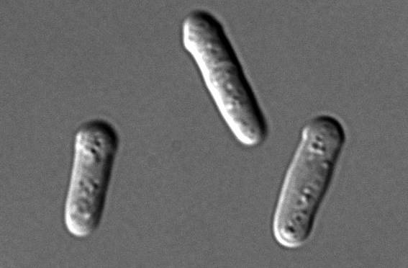
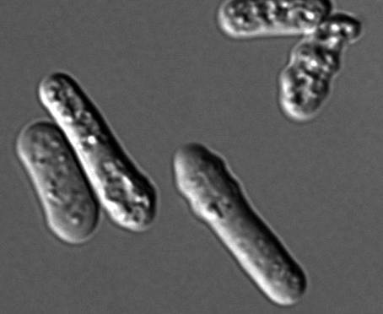
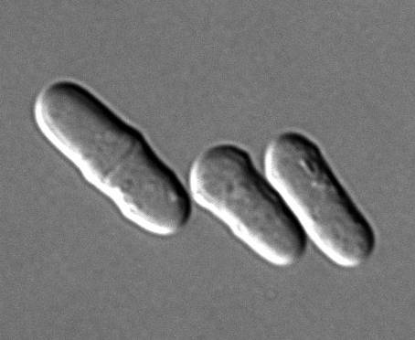
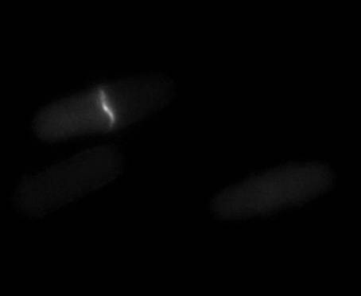
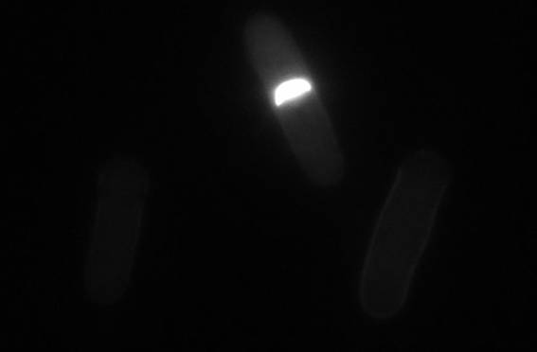
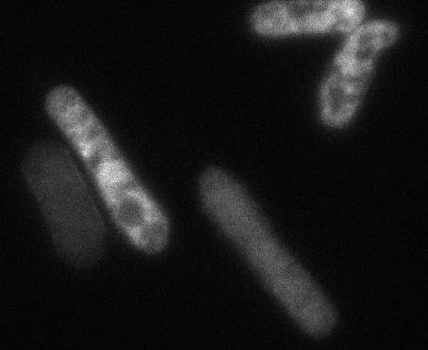
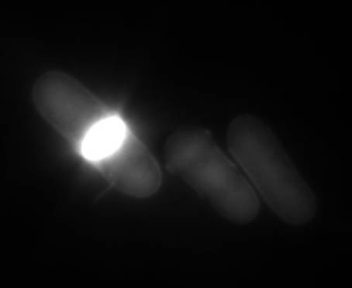
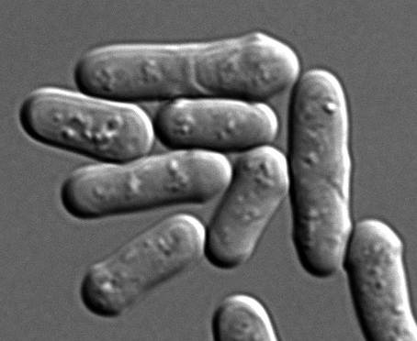
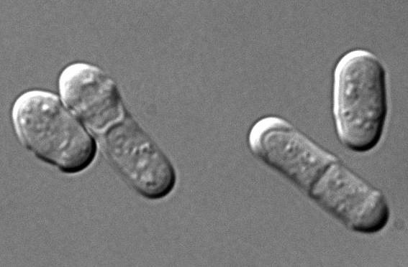
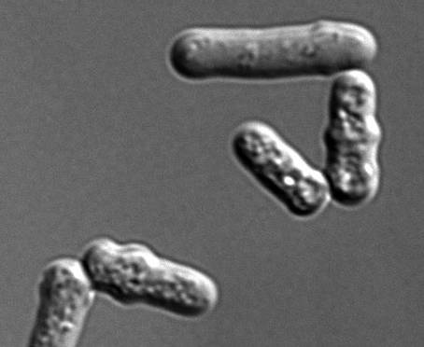
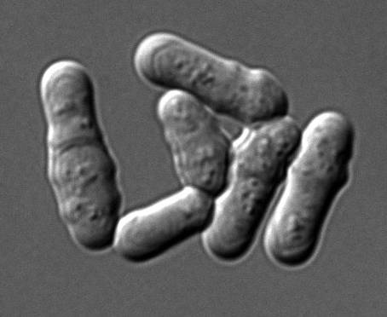
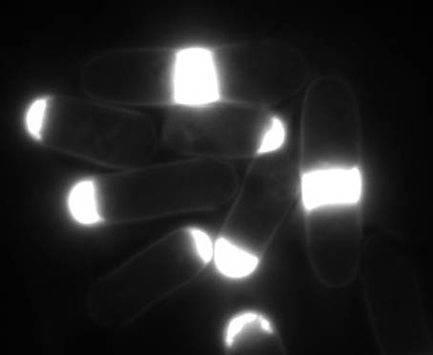
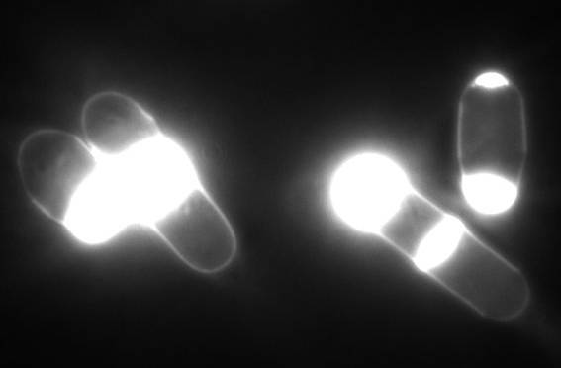
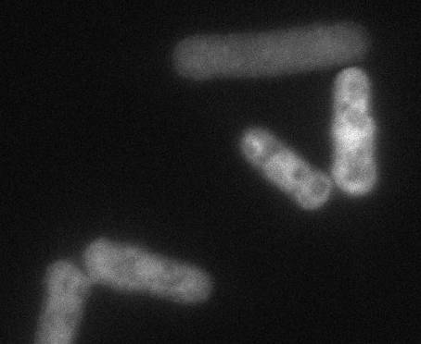
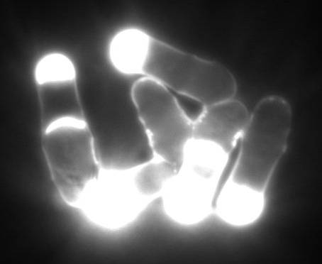
TNM-induced cell wall synthesis is mediated by Rho1
control
Rho1^{WT}
Rho1^{T20N}
Rho1^{Q64L}
DMSO
TNM-F
10 μm

Slide 10
A screen for the target protein using localizome
Localizome
(Catalogue of protein localization)
Fluorescent compound
Subcellular localization
of the target
Target candidates

Slide 11
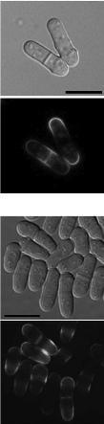
Subcellular localization of theonellamide target
TNM-BF
TNM-BODIPY-FL
Pma1-YFP

Slide 12
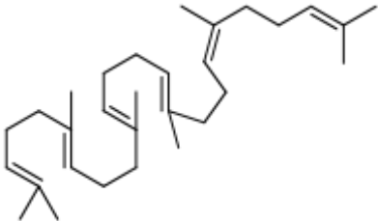
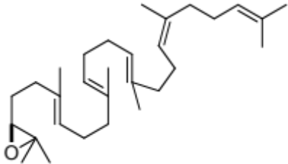
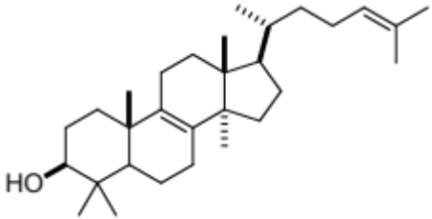
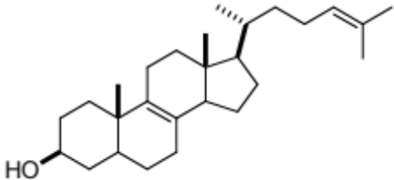
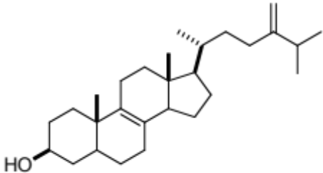
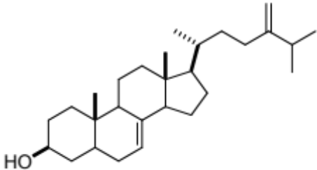
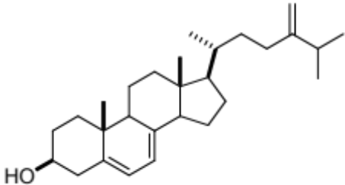
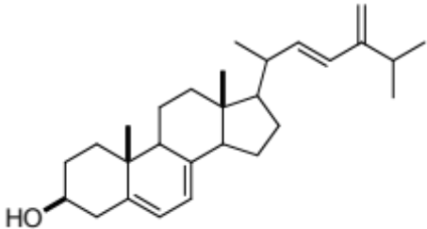
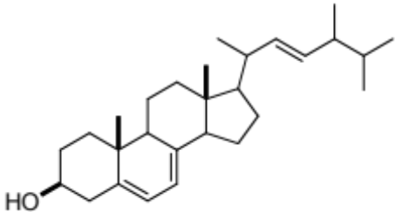
Ergosterol biosynthesis
squalene
Squalene-2,3-epoxide
lanosterol
Erg6
Erg2
Erg31, Erg32
zymosterol
fecosterol
episterol
Erg5
Sts1/Erg4
5,7,24(28)-ergostatrienol
5,7,22,24(28)-ergostatetraenol
ergosterol

Slide 13

Theonellamide recognizes ergosterol & cholesterol
: BODIPY-FL
: TNM-BODIPY-FL
Blocking reagent: 1% skim milk.

Slide 14



3β-hydroxyl group: structural feature required for TNM binding

Slide 15

























Co-localization with filipin, a probe for sterols
Filipin III
TNM-BF
DIC
Filipin
TNM-B
TNM-BODIPY-FL (1.3 μM, 30 min) & filipin (5 μg/ml)
5 μm

Slide 16


Theonellamide as a novel class of sterol-binding molecules
Theonellamide F
FK463
Amphotericin B
β-1,3-glucan
細胞壁
GS
Rho1
細胞膜
Vacuole fusion
: ergosterol
: upstream regulator of GS machinery
Nishimura et al. Nature Chem. Biol., 2010
: ions, etc.

Slide 17








Theonellamides induce membrane phase separation
TNM-AMCA
EGFP-Lysenin
relative fluorescence unit
0
10
20
30
40
50
60
rhodamine-DOPE
merge
cholesterol (%)
0 min
20 min
control
phase separation (%)
TNM-A
control
TNM-A
Arita et al. Chem. Biol., 2015

Slide 18



10 um
Liposome
Cell membrane
Cell morphology
w/o
Theonellamides
theonellamide
cell membrane
Lo
Ld
phase separation
order perturbation
contraction
dysregulation of cytoskeleton
w/
cytoskeleton
energy-dependent cell contraction
Arita et al. Chem. Biol., 2015

Slide 19
Meet the eminent gathering once again at
Chemotherapy-2016
Dallas, USA
June 06-07, 2016
Chemotherapy-2016
Website: chemotherapy.conferenceseries.com

