Slide 1
Generation of mAbs to FMDV/A and application in a cELISA for the detection of FMDV/A antibodies
Dr. M. Yang
National Center for Foreign Animal diseases
/Canadian Food Inspection Agency

Slide 2
Introduction
Foot-and-mouth disease (FMD) remains one of the world’s
most widespread epizootic and highly contagious disease.
FMD can cause major economic losses even in previously
FMD free countries.
Over 100 countries around world are not considered FMD free
by the OIE. FMD is endemic in many areas of Asia, Africa,
and South America
FMDV is recognized as 7 serotypes: O, A, C, Asia 1, SAT 1, SAT 2
and SAT 3. O and A are the most wide spread.
FMD is caused by a single-stranded RNA virus belonging
to the family Picornaviridae.

Slide 3
FMD is difficult to control and eradicate
because of
1. rapid virus replication
2. high mutation rate
3. high levels of viral excretion
4. small doses required for infection
5. multiple forms of transmission (contact, aerosols)
6. wide geographical distribution
7. broad host range (cattle, buffaloes, pigs, sheep, goats, and ~ 70 wildlife species)
8. ability to establish carrier status (not in pigs)
9. antigenic diversity leading to poor cross immunity among serotypes
10. relatively short duration of immunity
(Longjam et al., 2011; Maree et al, 2011)

Slide 4
FMDV antibody detection
FMDV specific antibody identification is very useful for:
(1) as an indicator of FMDV infection
(2) the screening of animals for the presence of antibodies before inter‑territorial movement,
(3) testing vaccine potency and monitoring the effectiveness of vaccinations
(4) for epidemiological studies of disease in animal populations
(Have and Jensen, 1983)

Slide 5
Virus neutralization test
VNT is routinely used to detect FMDV antibodies
1. VNT is costly and labour intensive
2. The procedure requires live virus, limiting the test to BL3
3. VNT requires 2-3 days to obtain results.
ELISAs are sensitive, specific, rapid (hours), easy to perform and scale up. cELISA is suitable for the detection of antibodies from different species.

Slide 6
Objectives
To generate and characterize FMDV/A specific mAb
2. To develop a cELISA for serological detection of
FMDV‑A antibodies
3. To validate the cELISA
Advantages using mAbs
low cross-reactivity; easy in standardization;
and less batch to batch variations

Slide 7
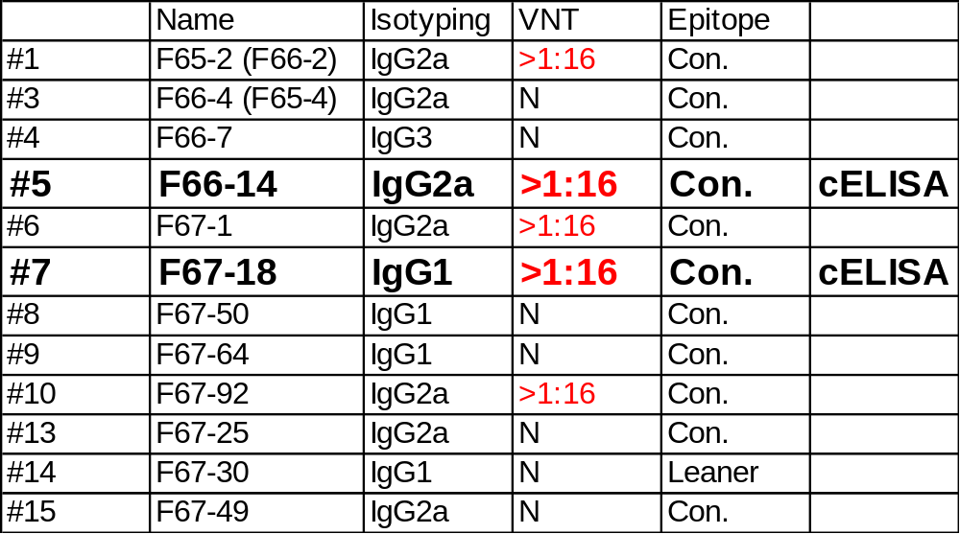
Characterization of the mAbs against FMDV serotype A

Slide 8
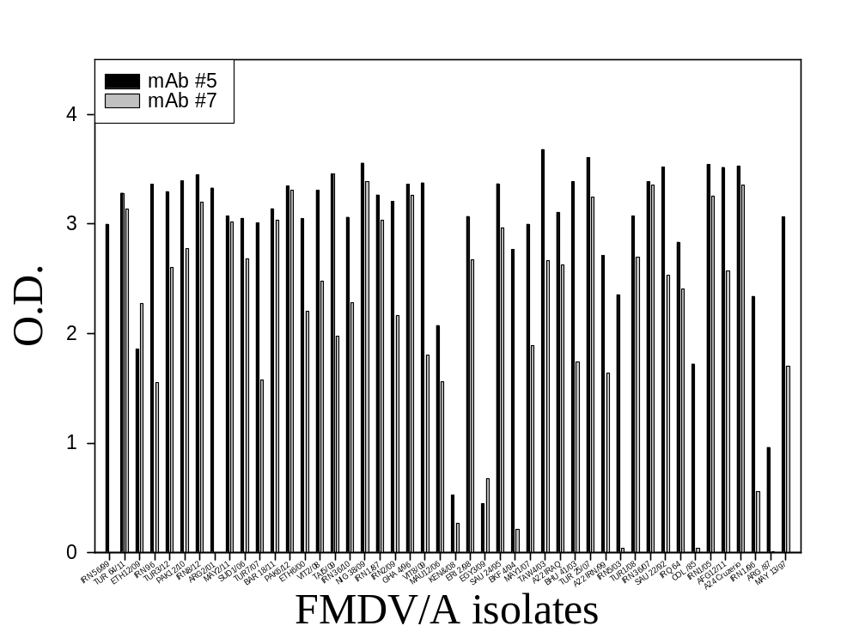
Reactivity of mAbs against FMDV/A 46 isolates in DAS ELISA

Slide 9
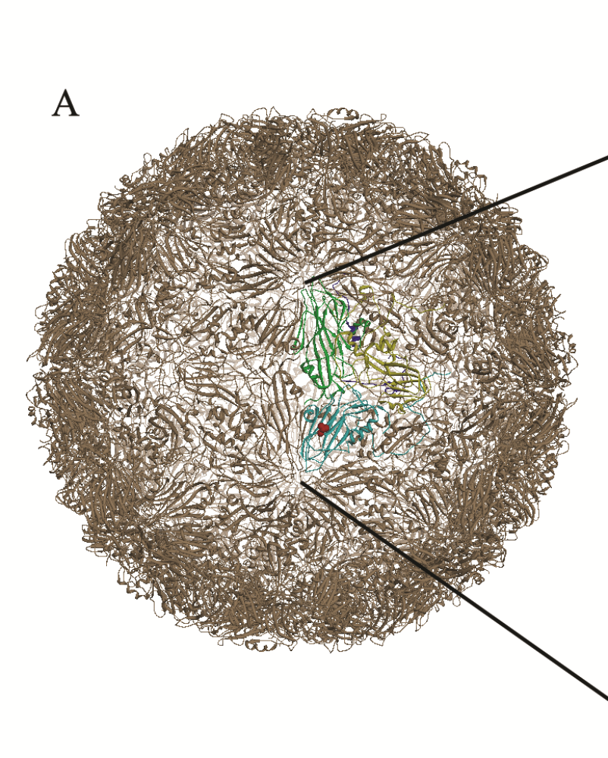
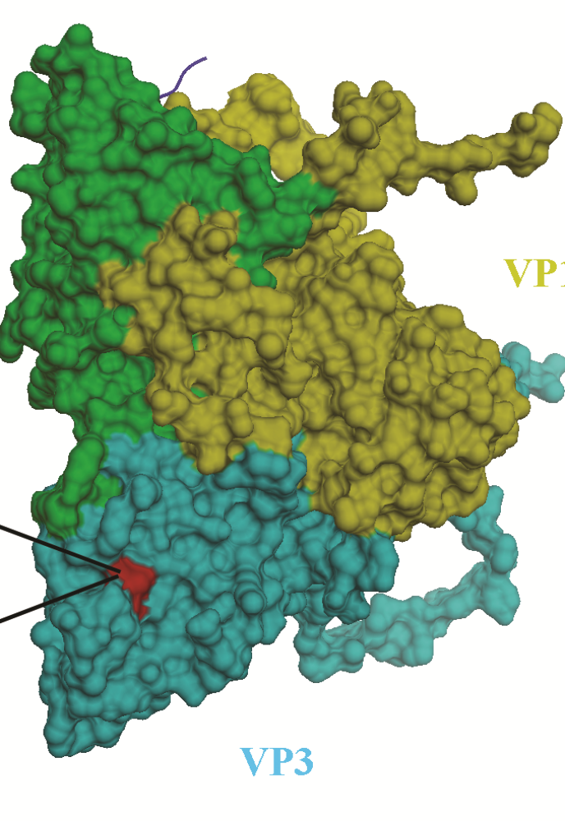
3D structure of FMDV
VP2
1
In mature virus particle, 60 copies of the four structural proteins VP1-4 associate to form a capsid which surrounds and protects the genome.

Slide 10
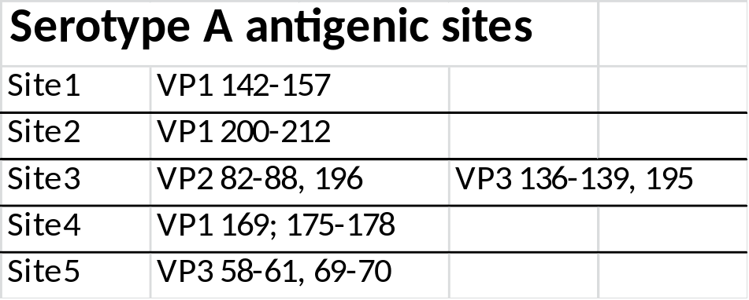
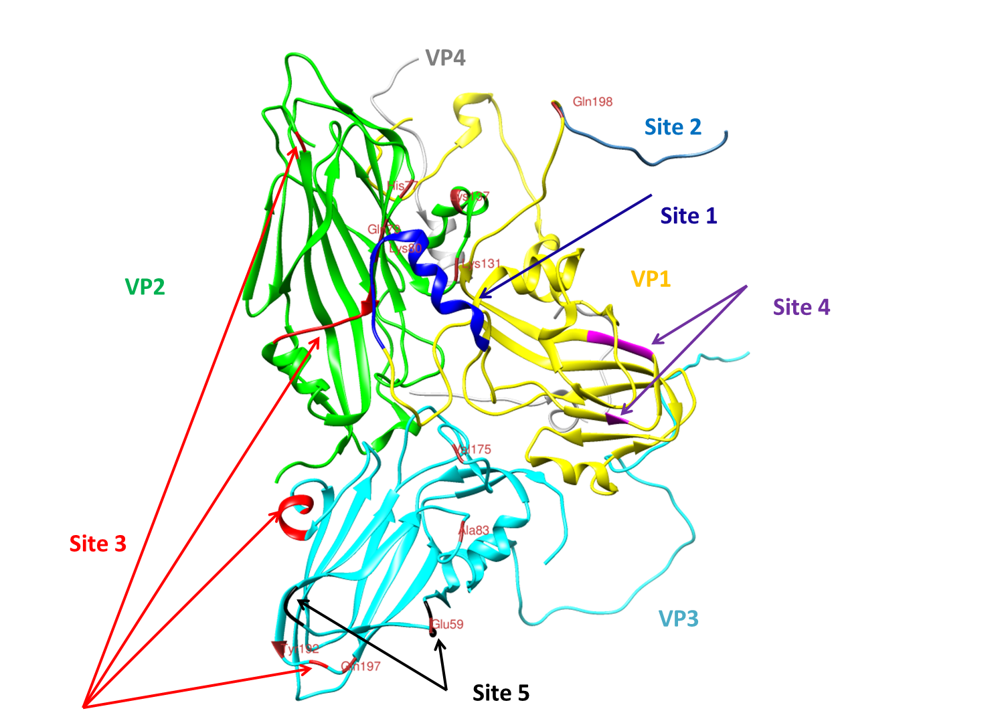
Localization of FMDV/A antigenic sites in capsid protein
Maree et al, 2011

Slide 11
mAb resistant mutant selection
for conformation epitope identification
1.FMDV/A22 Iraq and purified mAbs were incubate for 30 min at 37ºC.
2. The virus/mAb mixture and controls were inoculated onto MVPK cells.
3. The flasks were incubated until 100% CPE observed and culture supernatants were collected. 1-3 steps were repeated 6 times.
4. The mutants were purified by plaque purification.
5. The selected mutants were sequenced. Pairwise Sequence Alignment is used to identify mutation regions.

Slide 12
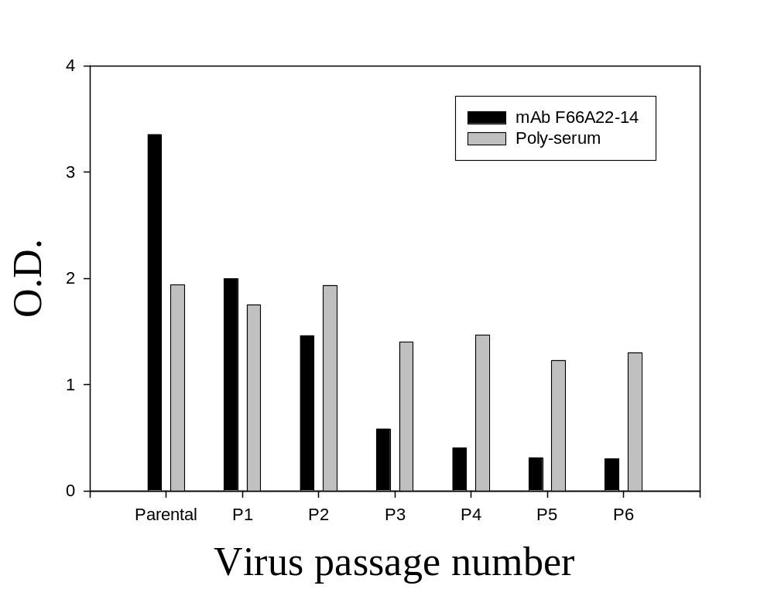
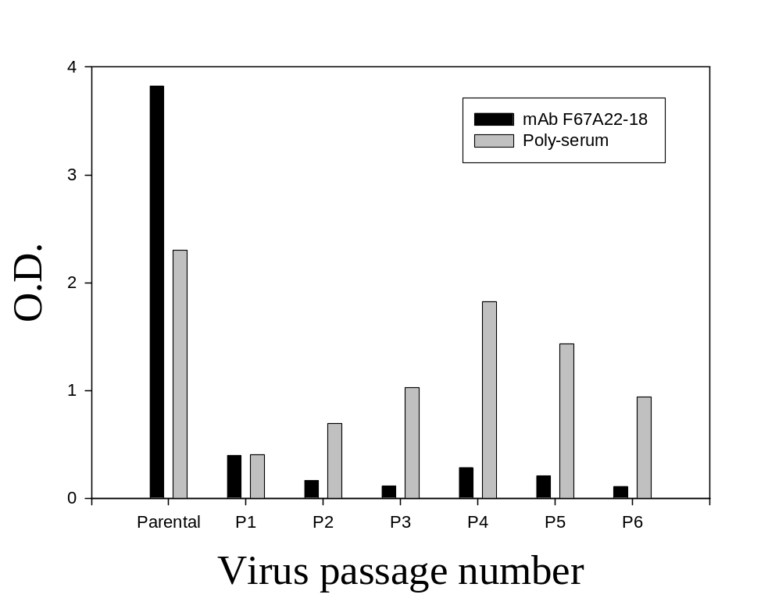
ELISA results after mutant selection
mAb #5
mAb #7

Slide 13
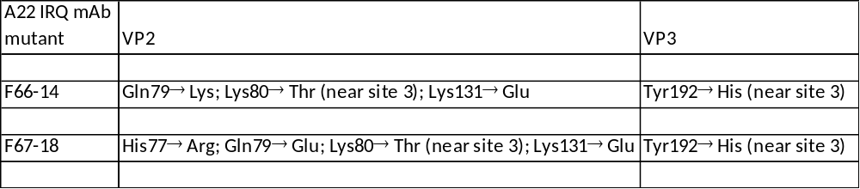

Identification of neutralization sites of the two mAbs in capsid protein

Slide 14
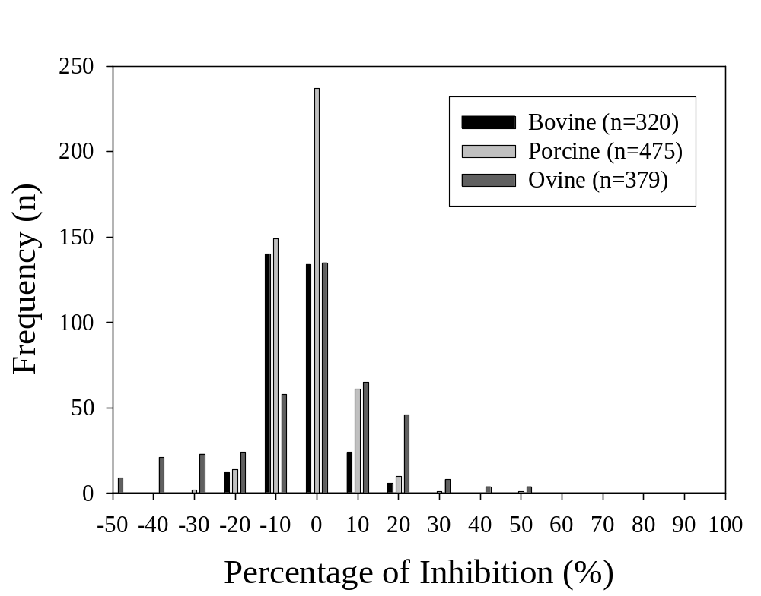
Frequency distribution of the negative sera in A/cELISA
The frequencies of the PI generated from these sera were normal distributed
Calculated diagnostic specificity is 99.7%

Slide 15
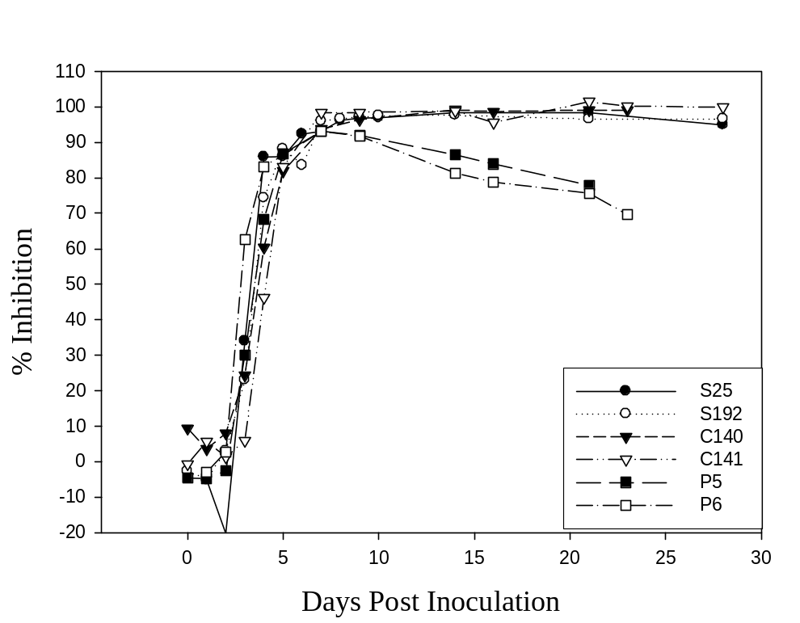
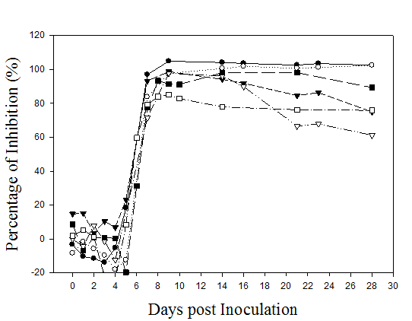
Detection of FMDV antibodies in animals inoculated with FMDV/A24
A/cELISA
3B cELISA
3B cELISA is used for surveillance to monitor FMDV circulation (Chen et al., 2011)
0% positive at 5 dpi
83% seroconversion at 7 dpi
100% seroconversion at 5 dpi

Slide 16
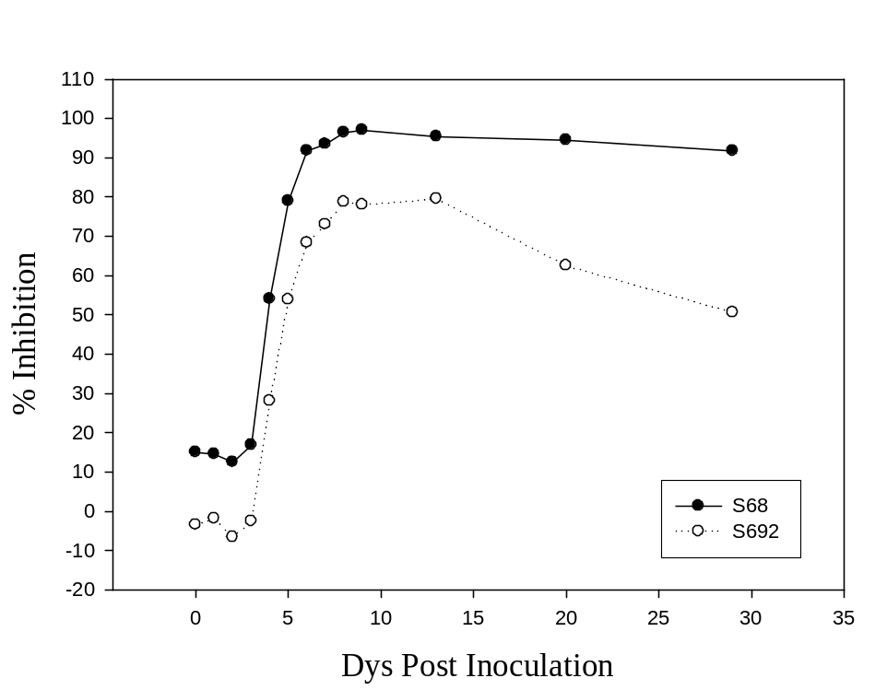
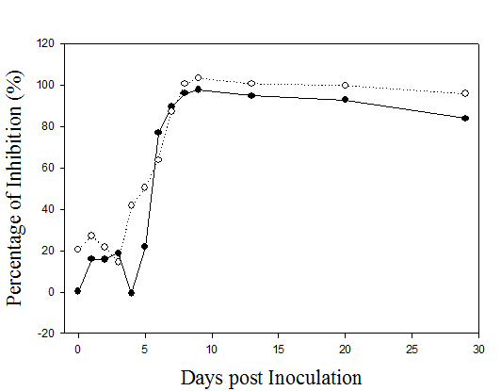
Detection of FMDV antibodies in animals inoculated with FMDV/A22 Iraq
A/cELISA
3B cELISA
Both were seropositive at 5 dpi
Both were positive at 6 dpi

Slide 17
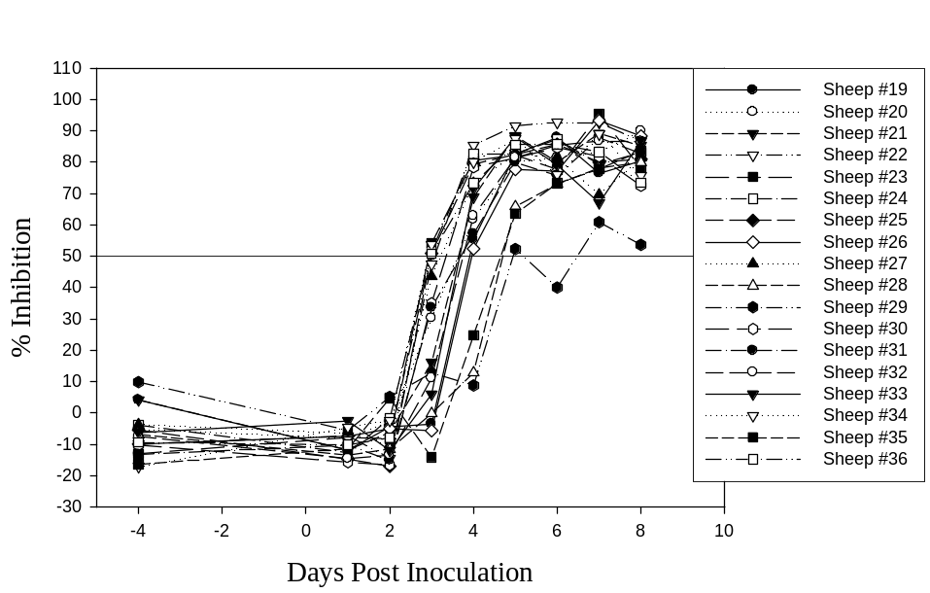
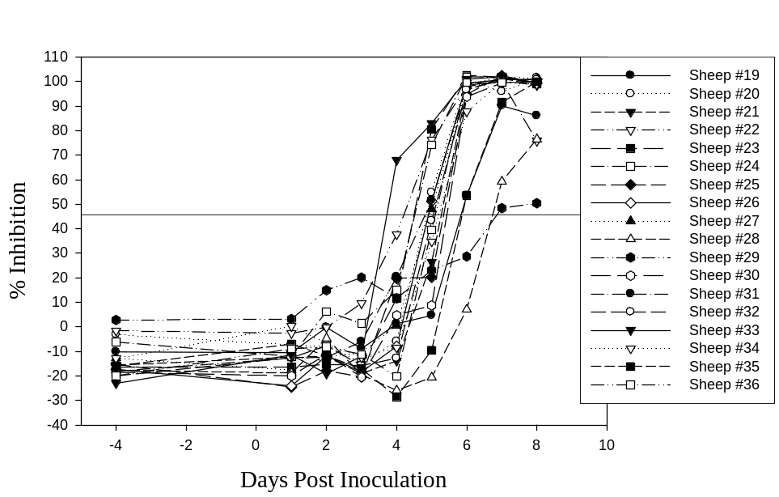
Detection of FMDV antibodies in sheep inoculated with FMDV/A Vietnam/13
#19-28 coronary band inoculated and #29-36 contact infected by Jacquelyn Horsington
A/cELISA
3B cELISA
100% seroconversion at 7 dpc
VNT 100% at 9 dpc
38.9% seroconversion at 7dpc
100% at 10 dpc

Slide 18
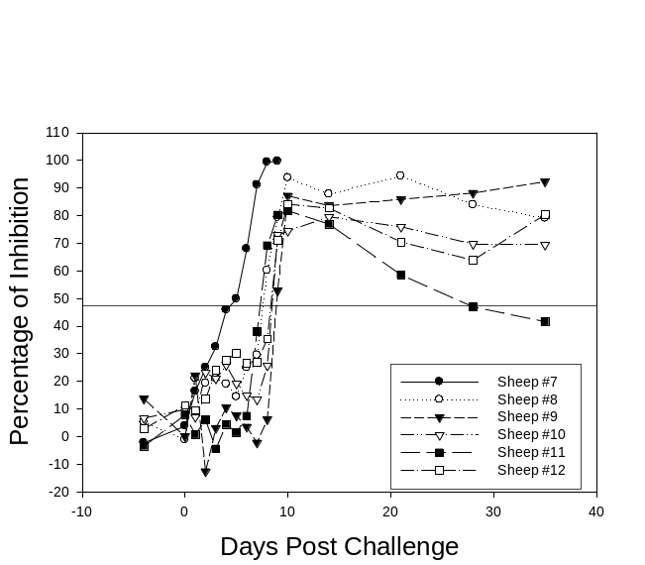
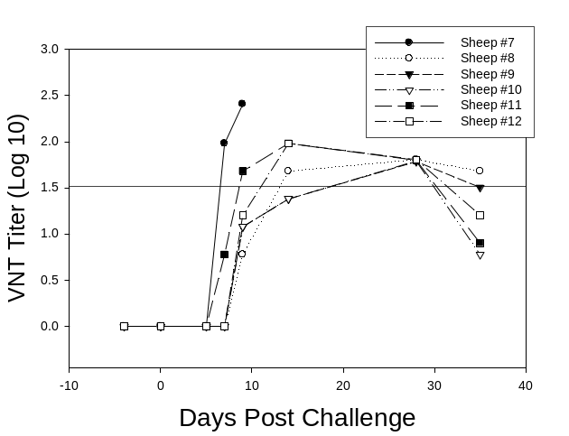
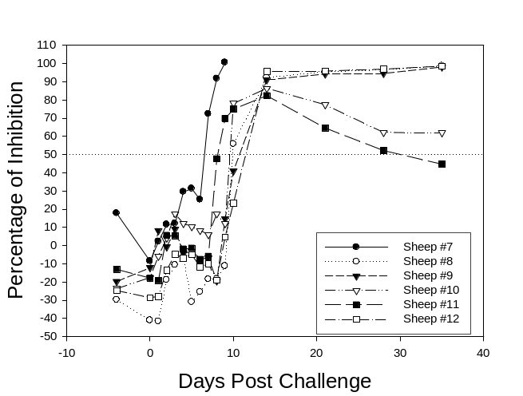
Detection of FMDV antibodies in vaccinated and challenged-sheep
A/cELISA
VNT
3B cELISA
Sheep were vaccinated with A22 Iraq and challenged with A Vietnam/13 after 4 days vaccination
Seroconversion
A/cELISA VNT 3B cELISA
8 dpc 50% 17% 17%
9dpc 100% 33% 33%

Slide 19
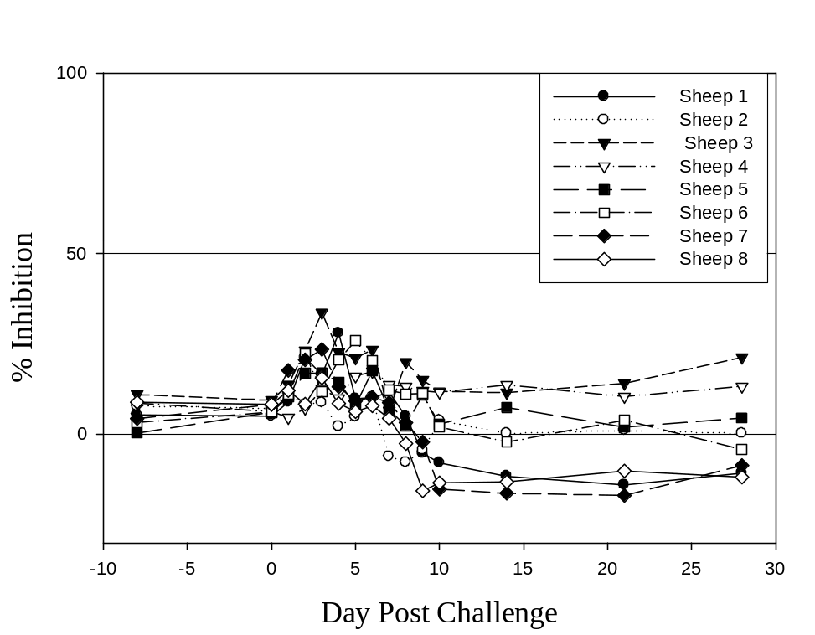
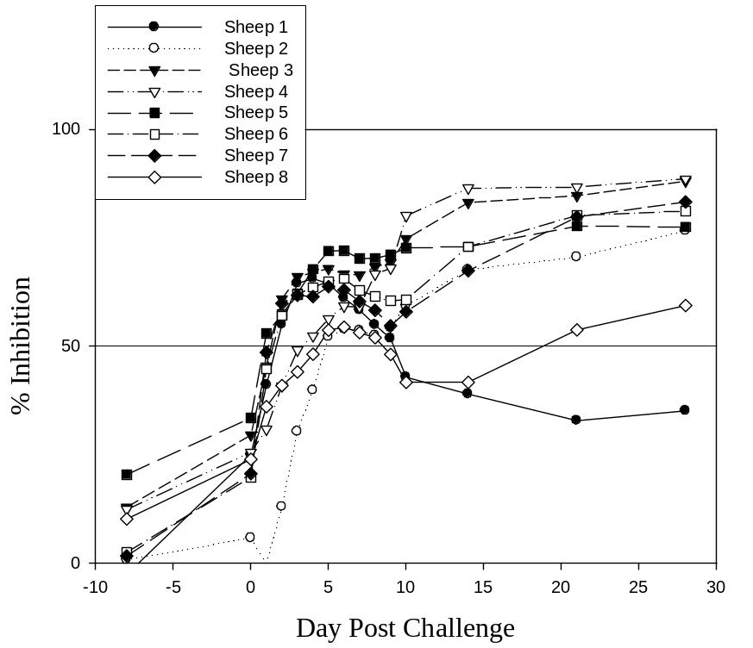
A/cELISA specificity using sera from sheep vaccinated with O1 Manisa and challenged with O/SKR/10
O/cELISA
A/cELISA
(Jacquelyn Horsington et al., 2014)

Slide 20
Summary
1. A panel of FMDV/A specific mAbs were generated. The binding epitopes of the two mAb used in this A/cELISA were well characterized.
2. One of the mAbs’ binding sites is conserved among all the tested isolates of FMDV/A.
3. The FMD A/cELISA that was developed using two mAbs and BEI inactivated FMDV/A antigen.
4. The A/cELISA exhibited comparable performance to the VNT and 3B cELISA, but more sensitive than the VNT and 3B cELISA
5. The cELISA is a simple and rapid test for the detection of FMDV/A-specific Abs.

Slide 21
Acknowledgements
NCFAD/CFIA
Hilary Bittner, Wanhong Xu, Melissa Goolia, Haben Gabir, Kate Hola, Tim Salo,
Dr. Charles Nfon
Animal care staffs
Australian Animal Health Laboratory
Dr. Jacquelyn Horsington

