Slide 1

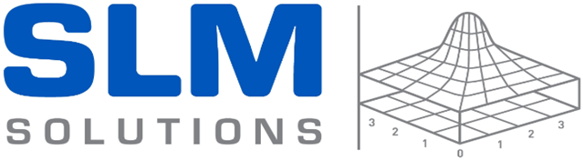
Consistency of 3D Printing Spodumene Articles
Ming Xuan Gan, S. Techanithisawat, and Chee How Wong
Presenter: Ming Xuan Gan
Singapore Centre for 3D Printing, Nanyang Technological University.
SLM Solutions Singapore Pte Ltd, Singapore.
26th June 2017

Slide 2
Outline
Introduction
  Additive manufacturing (AM)
  Selective laser melting (SLM)
SLM of spodumene
  Multilayer printing
  Properties characterisation
Summary

Slide 3
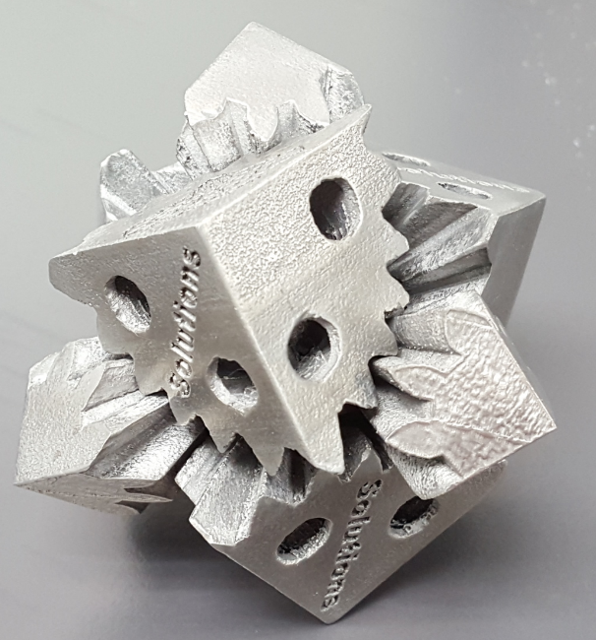
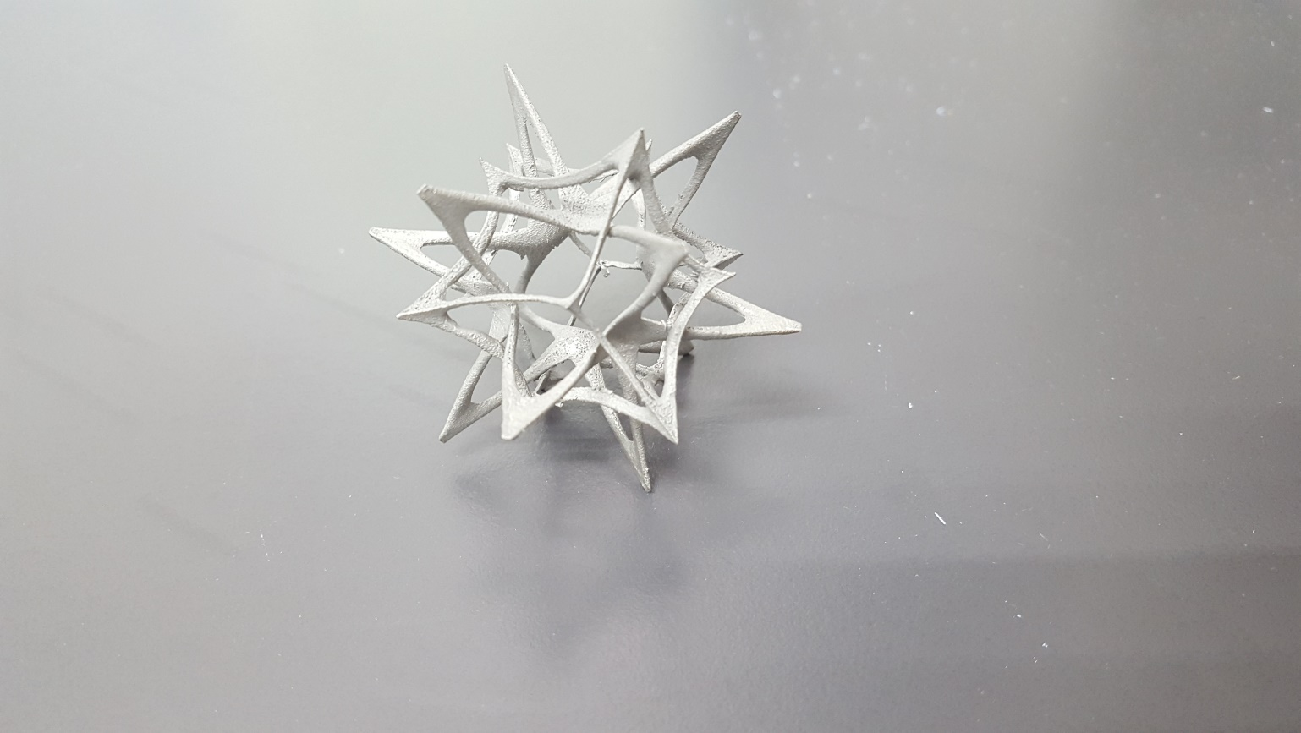
Introduction
Additive Manufacturing (AM)
  3D printing
  Layer by layer process
  Fabrication of complex geometries
Additive manufacturing
Material format | Powder | Solid | Liquid
Material types | Metal/Polymer | Metal/Polymer | Polymer
Joining means | Laser or Electron beam/Binder jetting | Laser/Heating coil | UV* source, material jetting
Joining methodology | Melting or sintering/Solidifying | Melting/Fusing | Photo-curing
Chua, C.K., Leong, K.F., 3D PRINTING AND ADDITIVE MANUFACTURING: Principles and Applications (with Companion Media Pack) of Rapid Prototyping, World Scientific Publishing Co Inc2014.

Slide 4
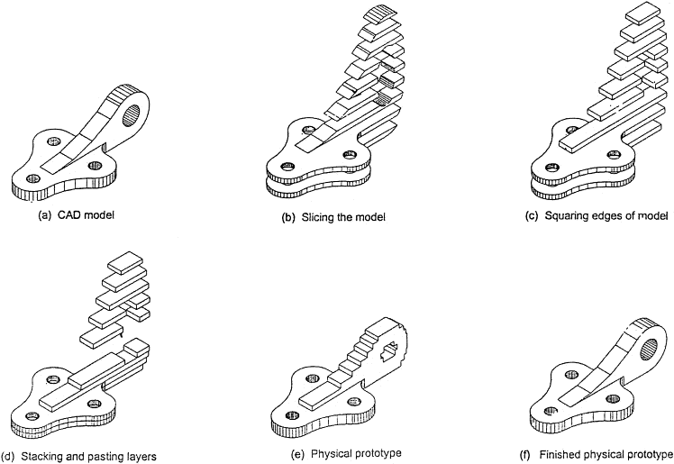
How does it work?

Slide 5
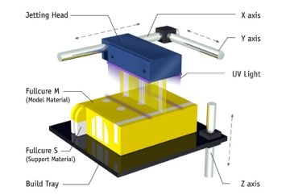
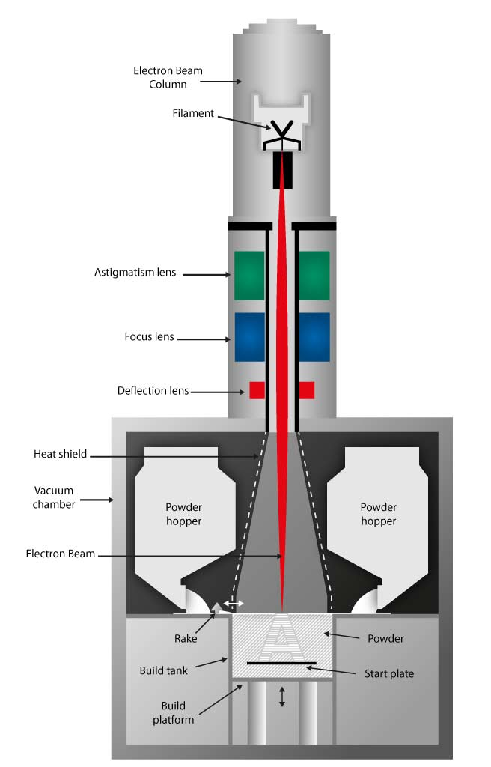
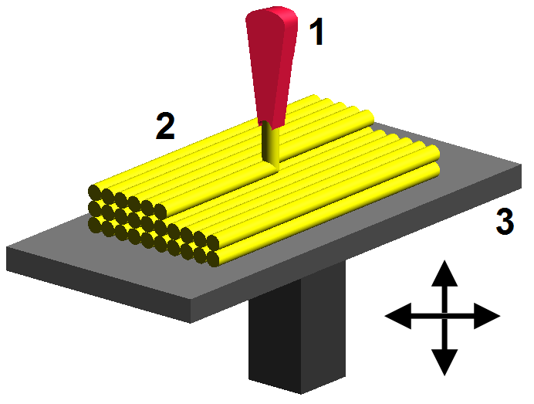
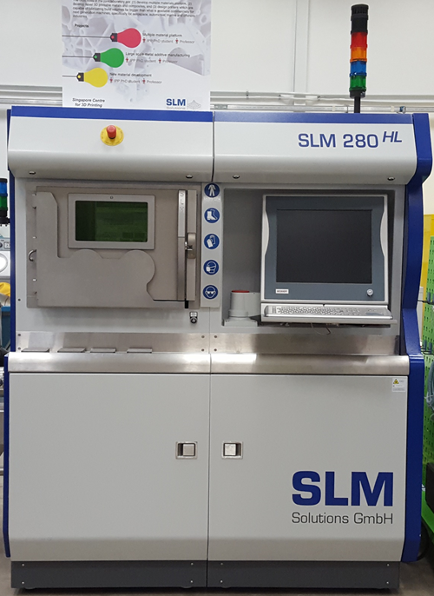
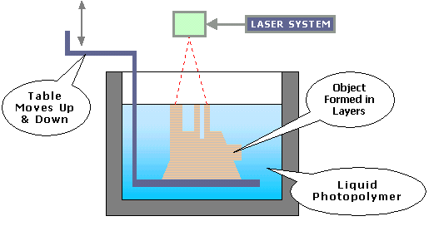
Typical AM methods
Polymers
Metals

Slide 6
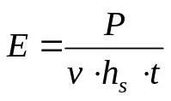
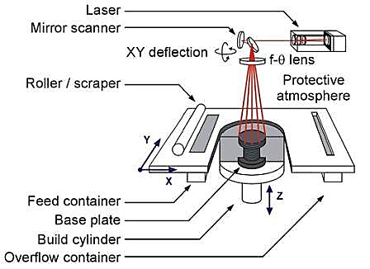

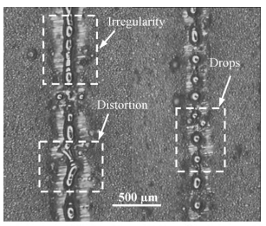
Selective Laser Melting
Energy density of laser beam:
Material’s optical properties:
Limited to metals
Kruth, J.-P., et al., Binding mechanisms in selective laser sintering and selective laser melting. Rapid prototyping journal, 2005. 11(1): p. 26-36.
Yadroitsev, I., et al., Single track formation in selective laser melting of metal powders. Journal of Materials Processing Technology, 2010. 210(12): p. 1624-1631.

Slide 7
Literature
Laser additive manufacturing of ceramics
Table 1: Summary of indirect selective laser sintering of ceramics.
Material | Binders | Relative green density (%) | Relative sintered density (%) | References
Alumina | Polyamide | – | 92 | 4
Alumina | Polypropylene | 83 | 88 | 5
Alumina | Semi-crystalline PVA | 57 | 98 | 6
Yttrium stabilized tetragonal zirconia | Polypropylene | – | 85 | 6
Silicon carbide | Polymethylsilsesquioxan | 60 | 50 | 7
Table 2: Summary of direct ceramic stereolithography.
Material | Relative sintered density (%) | Flexural strength (MPa) | References
Alumina | 90.5 | – | 8
Alumina | 98.0 | 476 | 9
Zirconia-stabilised alumina | – | 175 | 10
Glass-infiltrated Alumina | – | 415 | 11
Silicon carbide | 73.0 | 128 | 12

Slide 8
Literature
Table 3: Selective laser melting of ceramics.
Material |  | Flexural strength (MPa) | Micro-hardness (HV₅₀₀) | References
Al₂O₃-ZrO₂ |  | 538.1 | – | 13
Al₂O₃-ZrO₂ |  | > 500 | – | 14
Yttria-stabilised ZrO₂ |  | – | 1209 ± 262 | 15
[4] Deckers, J., et al., Isostatic pressing assisted indirect selective laser sintering of alumina components. Rapid Prototyping Journal, 2012. 18(5): p. 409-419.
[5] Shahzad, K., et al., Additive manufacturing of alumina parts by indirect selective laser sintering and post processing. Journal of Materials Processing Technology, 2013. 213(9): p. 1484-1494.
[6] Tang, H.-H., M.-L. Chiu, and H.-C. Yen, Slurry-based selective laser sintering of polymer-coated ceramic powders to fabricate high strength alumina parts. Journal of the European Ceramic Society, 2011. 31(8): p. 1383-1388.
[7] Friedel, T., et al., Fabrication of polymer derived ceramic parts by selective laser curing. Journal of the European Ceramic Society, 2005. 25(2): p. 193-197.
[8] Hinczewski, C., S. Corbel, and T. Chartier, Ceramic suspensions suitable for stereolithography. Journal of the European Ceramic Society, 1998. 18(6): p. 583-590.
[9] Chen, S., et al., Effective fabrication method of 3D ceramic photonic crystals with diamond structure. Rapid Prototyping Journal, 2012. 18(1): p. 49-55.
[10] Hay, G., et al. Conductive lithographic film fabricated resistive strain gauges. in Sensors, 2003. Proceedings of IEEE. 2003. IEEE.
[11] Tasaki, S., S. Kirihara, and T. Sohmura, Visualization of mechanical properties in alumina dental crowns fabricated by using laser scanning stereolithography. 2010.
[12] Tian, X., et al., Reaction-bonded SiC derived from resin precursors by Stereolithography. Ceramics International, 2012. 38(1): p. 589-597.
[13] Wilkes, J., et al., Additive manufacturing of ZrO2-Al2O3 ceramic components by selective laser melting. Rapid Prototyping Journal, 2013. 19(1): p. 51-57.
[14] Hagedorn, Y.-C., et al., Net shaped high performance oxide ceramic parts by selective laser melting. Physics Procedia, 2010. 5: p. 587-594.
[15] Liu, Q., B. Song, and H. Liao, Microstructure study on selective laser melting yttria stabilized zirconia ceramic with near IR fiber laser.
Rapid Prototyping Journal, 2014. 20(5): p. 346-354.

Slide 9
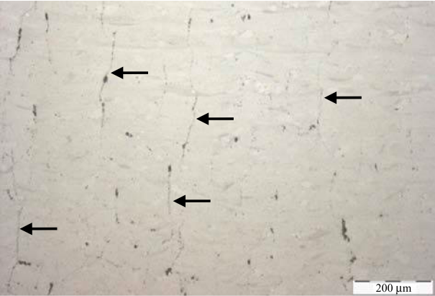
Issues in SLM of ceramics
σ = EαΔT
  Low α material
  Glass-ceramic
  Reduce ΔT
  Support structures
  High temperature preheating
  Low thermal expansion
  LAS glass-ceramic from spodumene mineral
Wilkes, J., et al., Additive manufacturing of ZrO2-Al2O3 ceramic components by selective laser melting. Rapid Prototyping Journal, 2013. 19(1): p. 51-57.

Slide 10
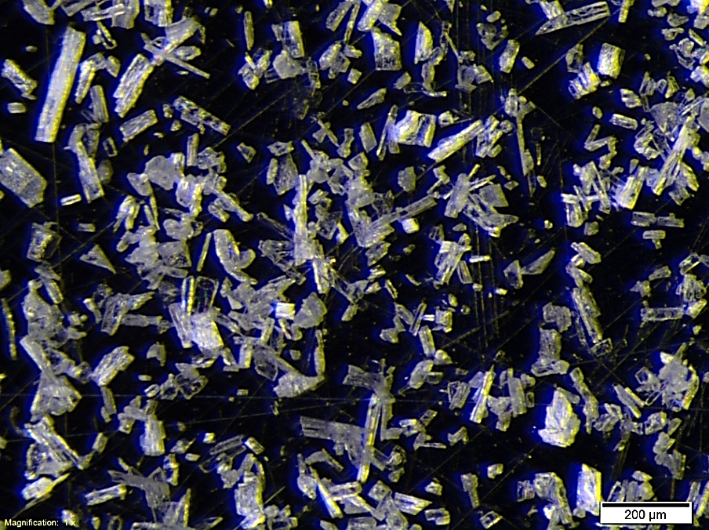
Spodumene
Naturally occurring mineral – α phase
Lithium aluminum silicate – LiAl(Si2O6)
Oxides | wt%
Li₂O | 7.1
Fe₂O₃ | 0.1
K₂O | 0.25
Al₂O₃ | 25.4
SiO₂ | 65.7
P₂O₅ | 0.13
Na₂O | 0.23
LOI | 0.32

Slide 11
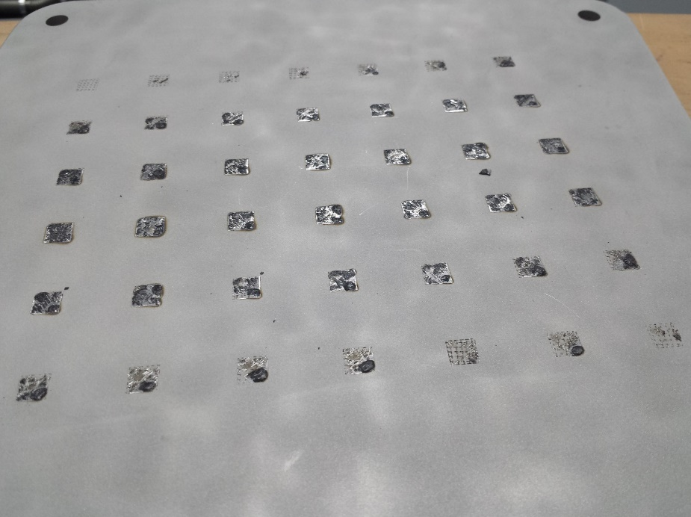
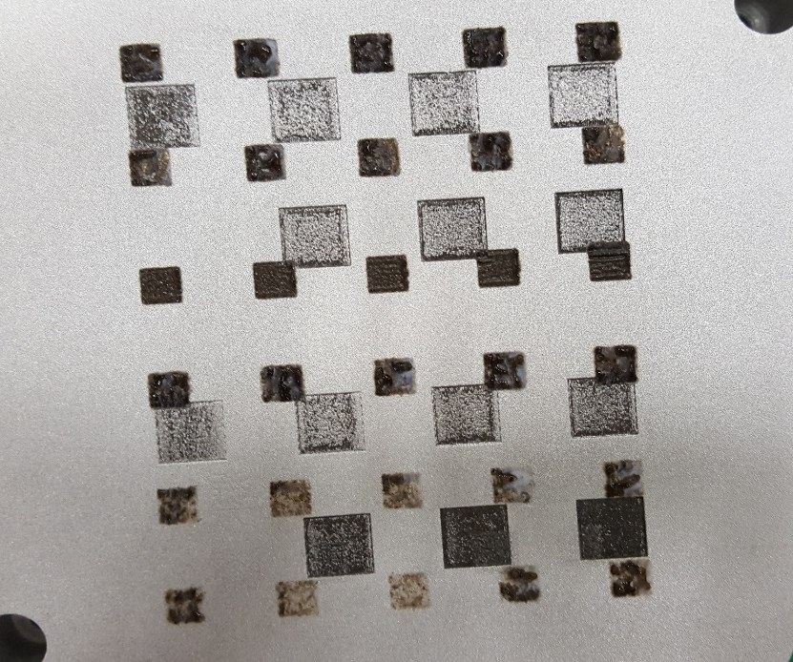
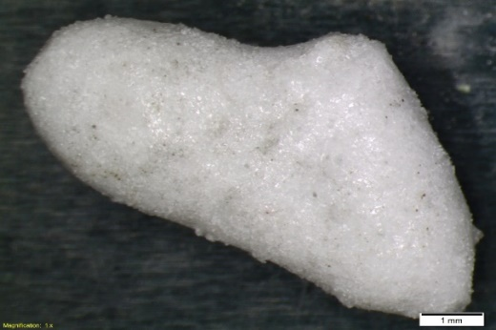
Failure characteristics
Unsuccessful adhesion of first layer
Non-bonded adjacent tracks
Failure to continue printing after the first layer

Slide 12
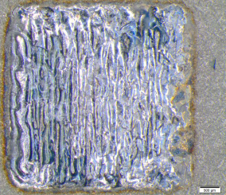
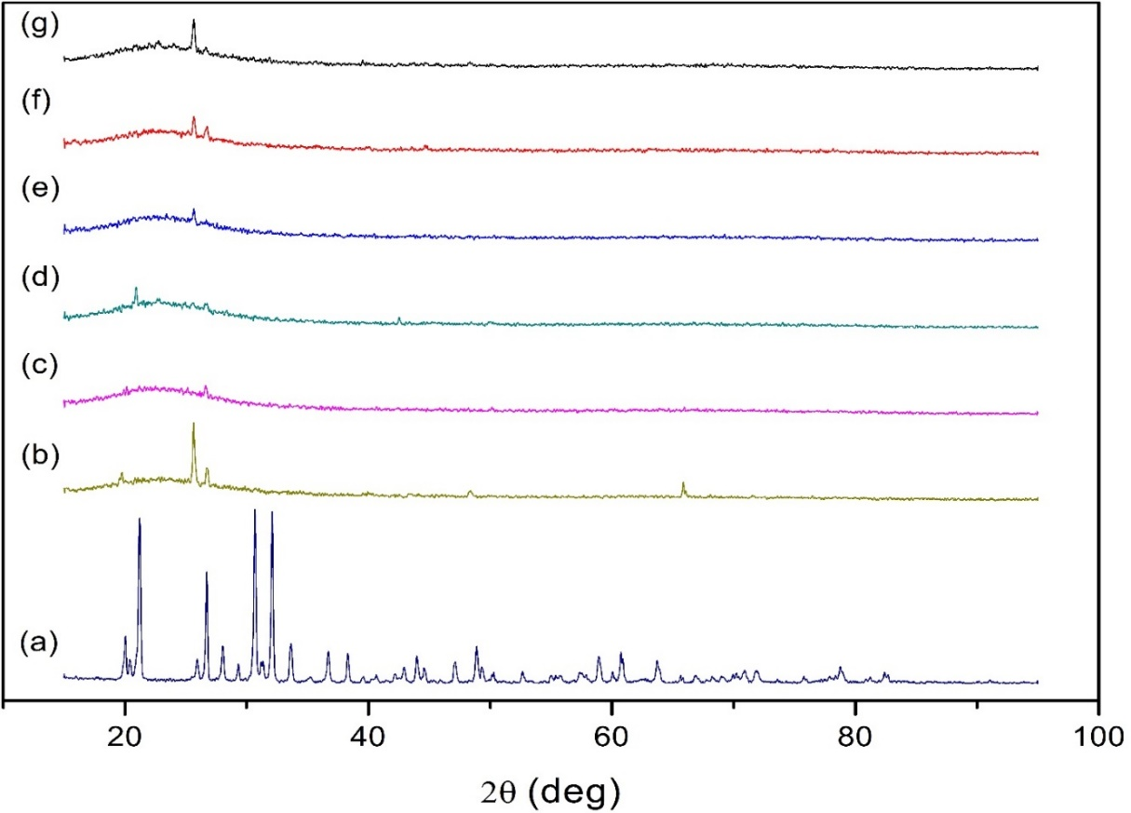
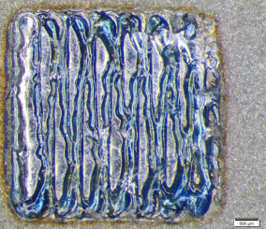
Single layer (2D)
Energy density
(a)
(b)
(c)
M. X. Gan and C. H. Wong, "Selective Laser Melting of Spodumene: An Exploratory Study", paper presented at 2nd International Conference on Progress in Additive Manufacturing, 16 May-19 May, Singapore.(2016).

Slide 13
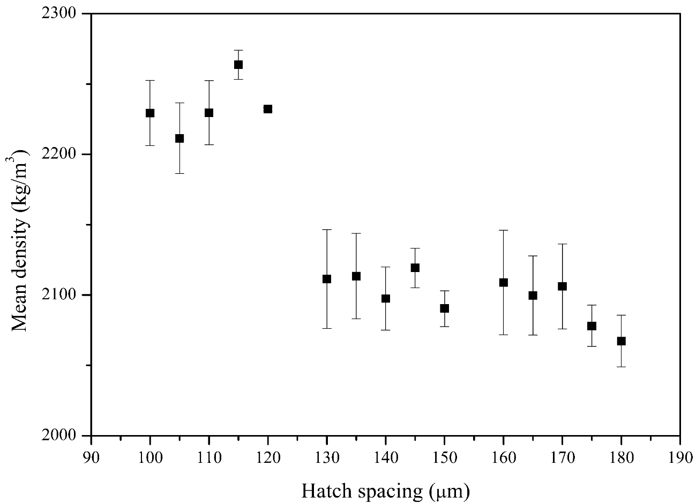
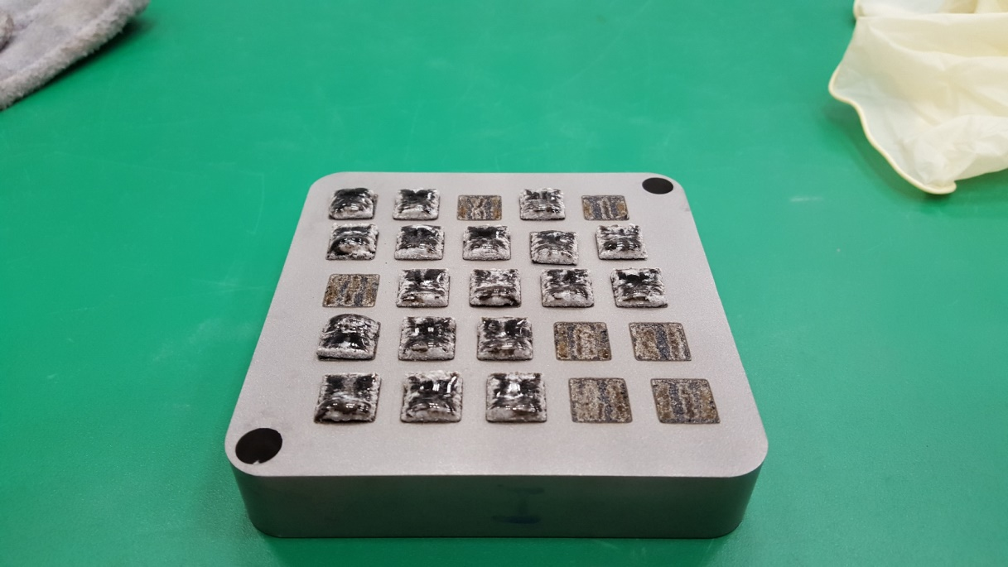
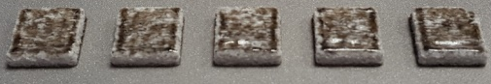
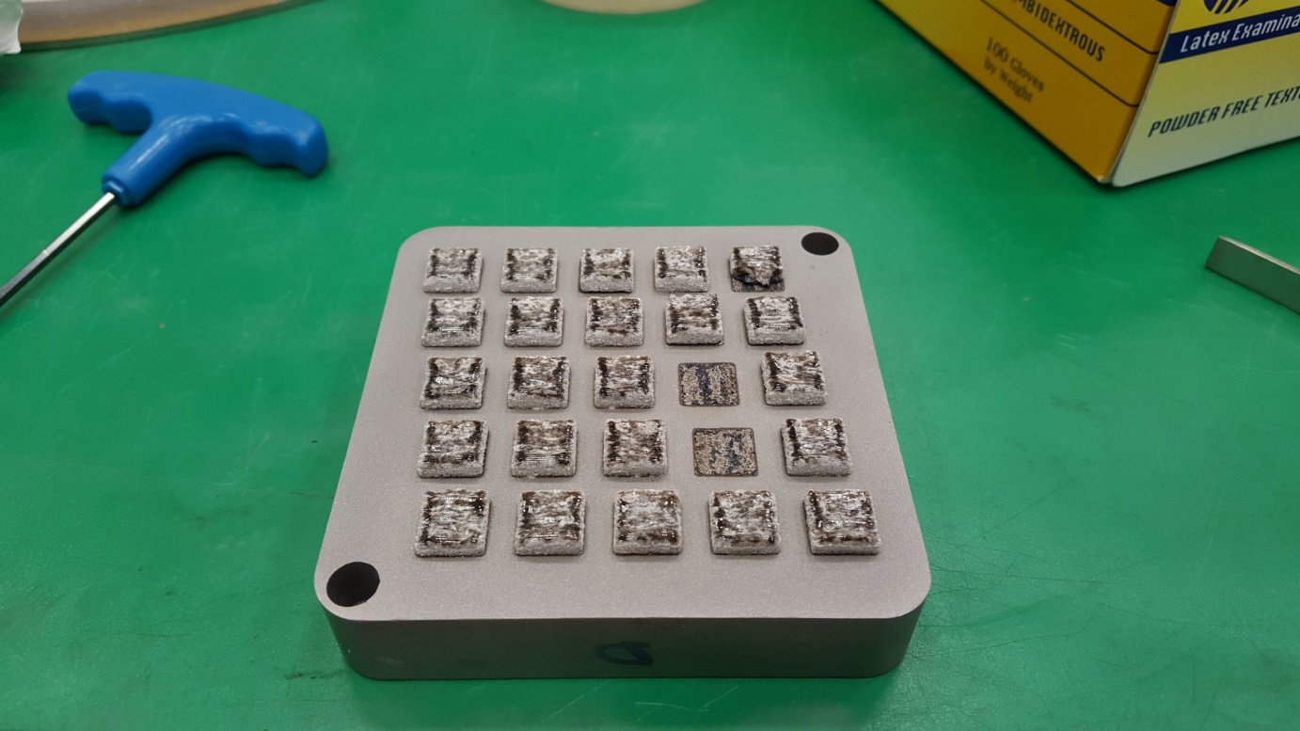
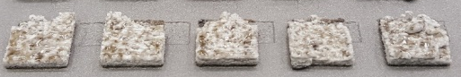
Multilayer (3D)
(a)
(b)
(c)
(d)
M. X. Gan & C. H. Wong, “Effect of hatch spacing on the density of selectively laser melted spoduemene,” 6th International Congress on Ceramics, Dresden, Germany, 21 August 2016 – 25 August 2016.

Slide 14
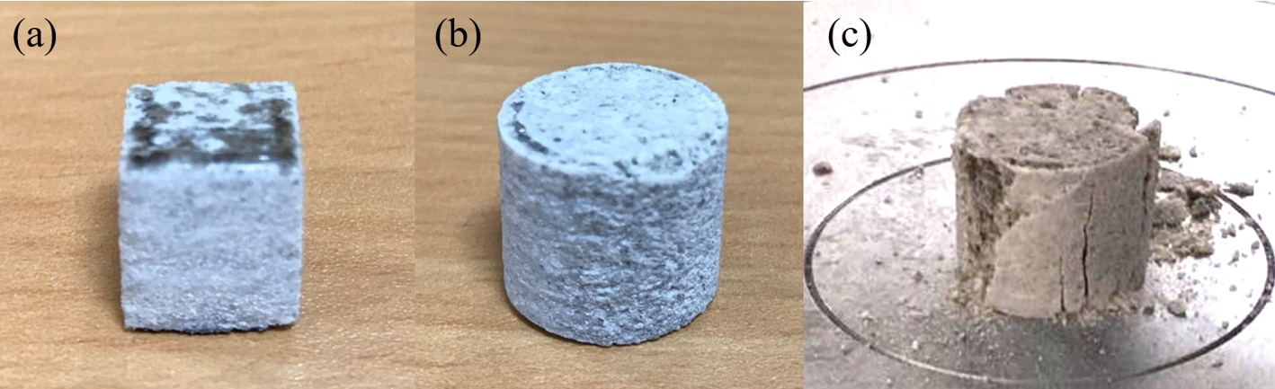
Repeatability
Table 4: Percentage difference with respect to an average of 59.231 %.
Rows |  | Columns
 | 1 | 2 | 3 | 4
1 | -0.051 | -1.021 | 0.599 | 0.599
2 | -0.761 | -0.961 | 0.009 | 0.009
3 | 1.029 | 2.239 | -0.431 | -0.431
4 | 0.019 | -0.221 | 0.849 | 0.849
5 | -0.821 | -0.36 | 0.779 | 0.779

Slide 15
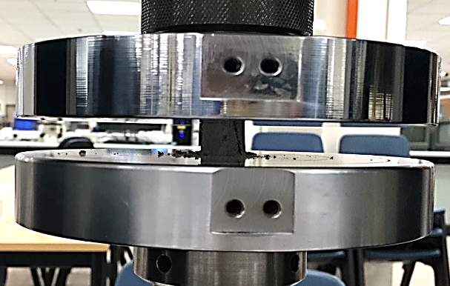
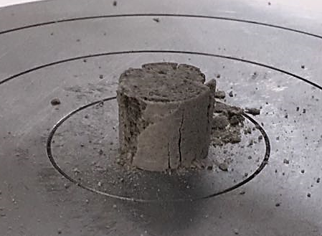
Properties
As-printed
― Sample 1
― Sample 2
― Sample 3
650 °C
950 °C
M.X. Gan, S. Techanithisawat, and C.H. Wong (2017). In submission

Slide 16
Properties
M.X. Gan & C.H. Wong (2017). Properties of selective laser melted spodumene glass-ceramic. Journal of the European Ceramic Society, 37: p. 4147-4154.

Slide 17
Properties
50 µm
100 µm
150 µm
As-printed
850 °C
950 °C
×: β-spodumene
□: hexagonal LAS
○: unidentified
M.X. Gan & C.H. Wong (2017). Properties of selective laser melted spodumene glass-ceramic. Journal of the European Ceramic Society, 37: p. 4147-4154.

Slide 18
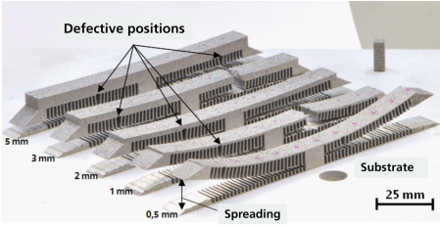
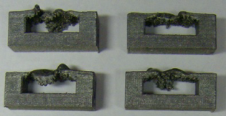
Importance of support structures
Mertens, R., Clijsters, S., Kempen, K., & Kruth, J. P. (2014). Optimization of Scan Strategies in Selective Laser Melting of Aluminum Parts With Downfacing Areas. Journal of Manufacturing Science and Engineering,136(6), 061012.
Gan, M. X., & Wong, C. H. (2016). Practical support structures for selective laser melting. Journal of Materials Processing Technology, 238: p. 474-484.

Slide 19
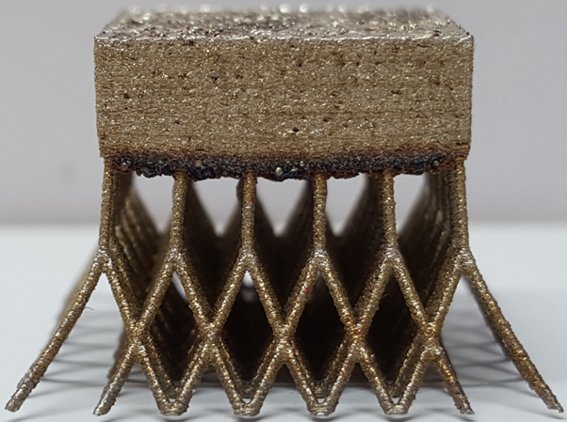
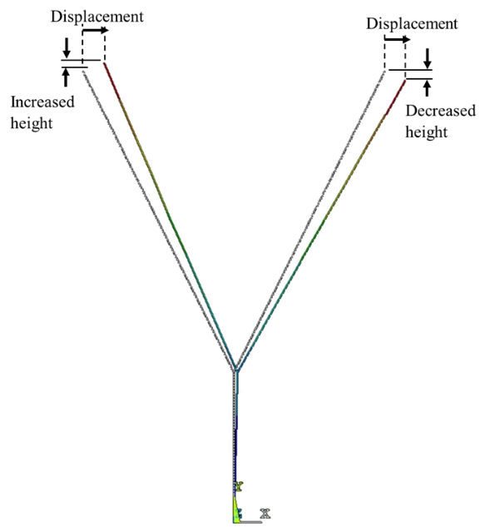
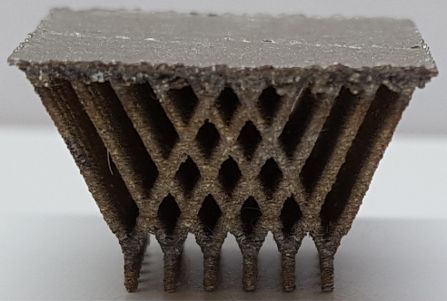
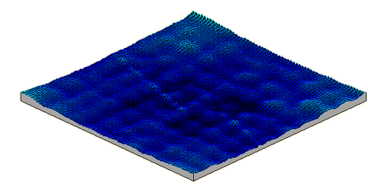
Minimal contact
M.X. Gan & C.H. Wong (2016). Practical support structures for selective laser melting. Journal of Materials Processing Technology, 238: p. 474-484.

Slide 20
Summary
Current work
  Advantages of additive manufacturing
  Potentially useful for ceramics and glass-ceramics
  Properties of laser melted spodumene
    Laser AM of natural mineral
    Very encouraging
    Alumina + LAS
  Importance of support structures

